Slide 1
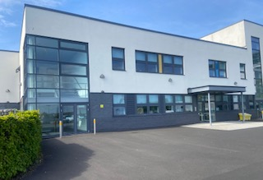


Rosslyn School
Standards and Quality Report 2024 – 25
Achieving Excellence and Equity
Mission Statement
“We have a dream…… that all learners who come to Rosslyn School will have opportunities to continue to learn and grow throughout their life. That they will live in a community that values their contribution and skills, and understands them for who they are, and what they can do.”

Slide 2
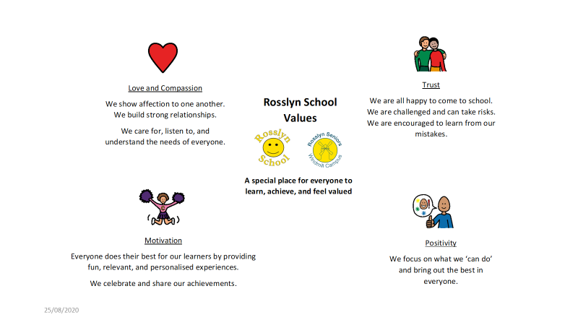
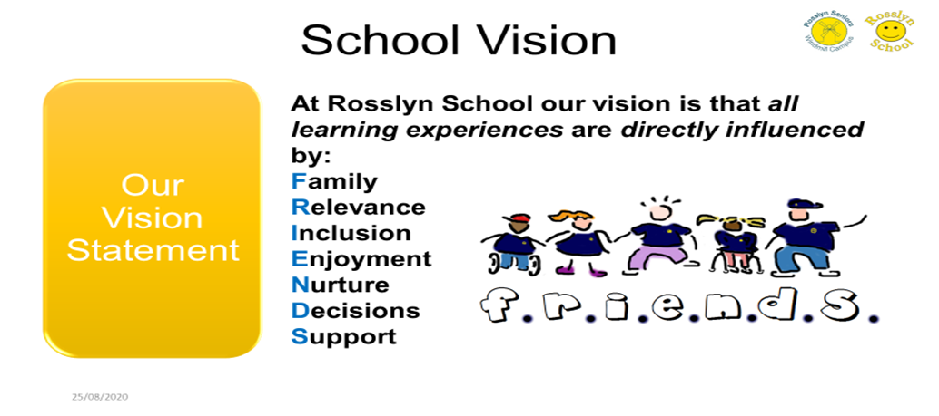

Slide 3
School Context
Rosslyn School provides specialist education to meet the needs of 28 learners aged 5 to 18 with complex additional support needs.
There are 5 classes grouped in age: P1 – P3, P3 – P7, P6 – S1, S1 – S3, S3 – S6 with approximately 6 learners in a class.
Learners in the senior school access SQA National level 1 courses and level 2 units, or Personal achievement awards as appropriate.
The staff: pupil ratio enables learners to follow a bespoke timetable with a balance of personal targets, BGE entitlements or SQA courses, and health needs.
Attendance 2024/25 – 89.5% (Percentages have been impacted by 1 pupil average approx. 26.8%)
Authorised absence 10.3%
£25, 725 PEF allocation with £2,848 carry forward – total £28, 573
All learners have FME (Free School Meal Entitlement) as Rosslyn is one of Fife’s Enhanced Support Provisions.
At Rosslyn school we recognise the need to reduce the cost of the school day. Currently there is no charge for school trips (including the residential trip which is charity funded every 2/3 years); No charge for lunch or snacks; No charge for clubs, activities, or resources; Discounted uniform that is stocked and ordered from school.
SIMD - At Rosslyn we have 12 families in SIMD 1 and 2; 6 families in 3; 6 families in 5 to 7; and 4 families in 9 to 10.
The Promise – At Rosslyn school there are a small number of care experienced pupils. This group all have over 88% attendance and are making good progress within their personal learning plans.

Slide 4

Consultation with Stakeholders
Working with stakeholders is crucial for Rosslyn School. Engaging with families, educators, healthcare professionals, and community members ensures a holistic approach to education. Family contributions are particularly vital; they provide insights into each learner's unique needs, fostering a supportive and inclusive school environment. Families help shape the school's ethos, promoting a culture of understanding, respect, and collaboration. Their involvement in school activities and decision-making processes enhances the sense of community and belonging.
Moreover, stakeholder collaboration drives school improvement. Regular feedback from families and other stakeholders informs the development of tailored educational strategies and interventions. This collaborative approach ensures that the school continuously evolves to meet the diverse needs of its learners. By valuing and integrating stakeholder input, Rosslyn School can create a nurturing and effective learning environment, ultimately leading to better educational outcomes for all learners.
How is SQR, IP and PEF Plan shared with stakeholders?
SQR and SIP including PEF is shared via the school website. A poster that summarises improvement is also sent out to all families and stakeholders via Groupcall and email.
The end of year SWAY newsletter includes the poster and a link to the SQR.
IP and PEF are discussed at parent forum and families were asked for feedback using FORMS.
From the responses, all families said they were aware of school improvement priorities and felt consulted on school improvement.
Pupil Voice
Staff at Rosslyn support learners using the Mosaic Approach. An approach developed from ELC. This approach combines various tools and techniques, such as observations, interactions, and activities, to gather insights from leaners. It is especially effective for learners with complex needs, as it allows them to express their thoughts and opinions over a period of time facilitated by familiar adults.

Slide 5

Summary of progress and impact from last session's Improvement Plan and Next Steps

Slide 6
SCHOOL IMPROVEMENT PRIORITY 1 - Develop child led or interest-based approaches throughout the BGE. Create ‘maps’ to evidence coverage of the curriculum for learners within each class, personalising this with a focus on engagement. Develop understanding of schemas and possible lines of development to plan for provocations within play to enhance our child-led approach.
HGIOS 4 indicators: 1.3 Leadership of change 2.2 Curriculum 2.3 Learning, teaching and assessment; 2.4 Personalised support; 3.2 Raising attainment and achievement UNCRC article 3, 23, 29
Has this priority been: | Fully achieved |  | Partially achieved |  | Continued into the next session
Progress: Staff have explored ways of offering interest-based activities and child led learning. Using the Design Thinking model over the past 2 years we have trialed several different ways to approach and deliver this, creating protypes and reviewing what is working. Teachers have been empowered throughout the year to develop an approach that works for them, focusing on keeping the child at the centre. This has become our new IDL approach in school. IDL is taught through a personalised project where different disciplines are planned and execute as one to learn new concepts. This may be experiential only , however if a learner is working at Early level, for example in music, this becomes part of the PLP. Es and Os are tracked over time to ensure all BGE learners experience their entitlement to the totality of the curriculum as appropriate. Staff have started resourcing projects. Our responsive approach ensures activities change and learning is applied and generalised. Groupings are based on needs, stages of play and other profiling information. Staff have received professional learning on schemas and provocations. Each teacher decides how to use this information when planning both IDL and PLP activities.
Impact: IDL is needs led and personalised – This has impacted learner engagement and participation. LP feedback was that the project-based approach was clear in almost all classes, and the need was relevant to individuals. Activities are motivating and fun – This impacts learners as they are now able to sustain interest for longer. Sessions are 30 minutes, and all learners were observed to be engaged. Success criteria is clear in almost all classes with key words, signing, songs and multi-sensory cues being used to share the purpose. Almost all learners are able to demonstrate an understanding of this key language and apply it in familiar settings and tasks at their level. All learners are exposed to the totality of the curriculum in an experiential way. This impacts learners' ability to cope with new and unfamiliar tasks, resources, and activities. As they become more use to things that are new this is impacting their ability to regulate and try new things.
Next Steps: Quality assure sessions led by PSA staff as learners' projects are personlised and across different environments simultaneously. Track Es and Os to evidence BGE over time. Teacher planning and learner experience will evidence NEW learning within the other curriculum areas used to develop the needs. (Not just Lit, Num and HWB). Continue to resource personlised projects. Continue to embed the IDL approach, moderating planning and learning and teaching.

Slide 7
SCHOOL IMPROVEMENT PRIORITY 2 - Use complex needs milestones and benchmarks for all curriculum areas to measure progress and achievement across the BGE using a range of assessment evidence to inform professional judgement.
HGIOS 4 indicators: 1.2 Leadership of learning 1.3 Leadership of change 2.2 Curriculum 2.3 Learning, teaching and assessment; 2.4 Personalised support; 3.2 Raising attainment and achievement UNCRC article 3, 23, 29
Has this priority been: | Fully achieved |  | Partially achieved |  | Continued into the next session
Progress: The framework continues to be in development. HT is working with the ASL group to create a format that 'designs to the edges'. This should be available by Dec 2025. Staff have agreed that learners' will be tracked through Early level in other curriculum areas where they have shown a particular gift or interest. This is not mandatory and will be in response to achievements. Due to the delay in moving to Progress as a school we decided to pick up moderation this year. The HT has worked as part of a national complex needs subgroup to produce guidance for moderation in ASN schools. This formed the basis of a school moderation guidance document that has been added to our curriculum rationale and strategy guidelines. Within this subgroup we researched the QAMSO training from Education Scotland. All teachers have agreed the expectations and standards for PLP planning, tracking, and reporting. We have used the learning, teaching and assessment cycle to check the national guidance and regional guidance in developing our school standards. HT to share this with Fife ASL as well as reporting back to the NCNN in the new school session.
Impact: Teacher confidence in planning, tracking and assessment has impacted on learner achievements within the milestones. Types of support are clear and significant observations ensure there is pace and challenge. Data analysis has improved as staff use the tracker to provide them with a holistic overview. This has impacted target setting and achievement for all leaners within their PLP. Teacher judgment is strong, and evidence of learning has improved. This has impacted in next steps being set in a timely way. The challenge within learning has improved, and HT learning visits as well as planning and tracking meetings has moderated this across the school. Learners are more accepting of tasks changing and are able to regulate more effectively when it becomes overwhelming. Some learners' have widened their window of tolerance leading to improved participation, and a reduction in incident reporting.
Next Steps: Revisit profiling to ensure barriers to learning are supported in a multi-agency way to improve outcomes for learners. Collaborate more widely across Fife to moderate parts of the learning, teaching and assessment cycle and agree standards. Pilot the new Progress Framework when it is ready – this is a systems change as opposed to a strategic action.

Slide 8
SCHOOL IMPROVEMENT PRIORITY 3 – Develop pathways for individual learners based on likely destinations starting in S4 using the senior phase 3-year planner and PCP. Collaborate across Fife to improve enhanced transitions and positive destination for leavers.
HGIOS 4 indicators: 1.3 Leadership of change; 2.6 Transitions; 2.7 Partnerships; 3.1 Improving wellbeing, equality and inclusion; 3.3 Increasing creativity and employability UNCRC article 3, 23, 29 and 31
Has this priority been: | Fully achieved |  | Partially achieved |  | Continued into the next session
Progress: Staff have produced 2 formats for pathways from SQA to destinations. The first format looks at each course and the destinations it could link to from a range of 5; Family Led, College, Centre Based, Community Based and DYW. The second format has put all the courses relevant to the destination in a single pack for families. For example, all the courses that relate to DYW are in 1 coherent pack. SQA staff in almost all Fife special schools met on the February in-service day to discuss how they deliver the SQA and moderate evidence. We provided an opportunity for parents to come in and discuss the formats and agreed to have the 2 options, as both may be helpful. We added an assessment and outcome section for families to understand the basic requirements of a course to support them in advocating for senior phase choices. Parents suggested S1-3 course choices, narrowing the curriculum earlier and allowing more time for senior phase to impact destinations. This led to the S1-3 teacher providing SQA taster sessions to the group. Our 1 leaver this year has had a summer transition programme with 2 staff in school for the last 3 weeks of term. She has a clear pathway into a community-based programme with elements of centre based working depending on weather etc.
Impact: Positive destination this year for our leaver starting immediately after the school term. SQA taster sessions have been very good. HT quality assurance process' identified strengths in Pupil Voice and UNCRC rights of the child. All SQA learners are able to make informed choices, are supported to create their own context for learning, and generalise their skills, building on prior learning. Families reported that they felt included within the process of curriculum design. As they understand the SQA pathways they are more able to advocate for their young person impacting on a senior phase curriculum that is relevant and meaningful, leading to positive destinations that are realistic.
Next Steps: Develop an S1-3 Course Choice offer that identifies the activities learners' have enjoyed and been successful learning within. This will build on the achievements within the PLP and IDL projects P1-P7. Transition between the BGE and SQA phase will be smoother as staff build on prior learning and identify gifts and abilities. Further develop the format of the pathways to include S1-3 and the transition between BGE and SQA.

Slide 9

Improving Outcomes

Slide 10
PEF Priority 1 - All learners across the BGE should have the opportunity to learn through activities that interest them, and in accordance with their age and stage. Resources must be accessible and inclusive as well as age appropriate as you move through primary to secondary stages.
Progress Progress has been made in resourcing personalised learning projects. Staff have worked collaboratively to assess the unique needs of each learner, ensuring that learning plans are tailored to individual requirements. This collaborative approach involves regular meetings and discussions among teachers, support staff, and specialists to evaluate and refine strategies that best support our learners. In line with the age and stage of our learners, staff are actively engaged in researching and sourcing resources that address complex needs. This includes identifying specialised educational tools, adaptive technologies, and materials that cater to various learning styles and abilities. By staying informed about the latest advancements in special education, staff ensures that the resources we provide are both effective and appropriate. A key consideration in our approach is the incorporation of multi-sensory methods. Recognising that learners benefit from engaging multiple senses, we integrate visual, auditory, tactile, and kinesthetic activities into our curriculum. This multi-sensory approach not only enhances learning experiences but also supports the development of essential skills in a holistic manner.
Impact By assessing individual needs and integrating multi-sensory approaches, our strategies have become more responsive and adaptive. Learners are motivated as the activities are personalised and fun. Engagement in IDL learning projects has been observed to be very good. All learners are interacting with staff and making progress in their ability to use skills across the curriculum to learn new things. This was also observed within the LP and our partners reported both staff and learners were fully engaged. The increase in resources has developed learners' ability to make choices. Many of our resources are perishable and offering choice can be limited due to financial constraints. The PEF has allowed us to keep our resources toped up, ensuring consistency of choice and motivation as learners are able to try things a number of times. This was observed at the LP particularly in the SQA class and our partners commented on the differentiation within choice and the frequency of choice being offered. As staff develop a responsive approach, they are able to offer a variety of resources impacting on learner engagement. Learner preference in selecting a resource ensures the learner is engaged as long as they are able within activities. Groupings are also impacting this as they are adapted to support the learner within the optimum learning environment. Staff have observed that learners who require a more solitary learning environment are far more engaged as the interactions have improved and waiting time in a group has been removed.

Slide 11
PEF Priority 2 - A small target group of approx. 8 learners continue to require de-sensitisation to using a salon, use of equipment, hairstyling/shaving and trimming and cutting. Target group of 4 for transitioning to community hairdresser.
Progress Sharon, the hairdresser, has made remarkable progress through her twice-weekly visits. Her first visit each week focuses on desensitisation to the salon environment, gradually building the learners' tolerance to various experiences associated with getting a haircut. This structured approach has been instrumental in helping learners feel more comfortable and less anxious during their salon visits. The second weekly visit has been particularly impactful for two young people, as Sharon has supported them in identifying and using unfamiliar salons within the local community. This initiative has not only broadened their horizons but also enhanced their confidence in navigating new environments. Sharon diligently tracks the experiences and progress within both sessions, ensuring that achievements are recognised and celebrated. This positive reinforcement has been crucial in maintaining motivation and fostering a sense of accomplishment among the learners.
Impact Sharon's dedicated approach to desensitising learners to the salon environment has significantly reduced anxiety and increased their comfort levels during haircuts. This gradual exposure has been crucial in helping learners build tolerance and confidence in a previously challenging setting. The initiative to support two young people in identifying and using unfamiliar salons in the local community has been transformative. This experience has not only expanded their comfort zones but also enhanced their ability to navigate and adapt to new environments. The skills they have developed in these real-world settings are invaluable. One parent commented on the life changing benefits for her family as she became involved in the visits, with a gradual removal of Sharon. Sharon's meticulous tracking of experiences ensures that every achievement is recognised and celebrated, fostering a positive and motivating atmosphere. This recognition has been instrumental in maintaining the learners' enthusiasm and sense of accomplishment. Furthermore, the significant observations provided by staff have enriched the Personalised Learning Plans (PLPs), highlighting the learners' ability to apply their skills in unfamiliar environments and interact with new people. This feedback underscores the growth and adaptability of the learners, demonstrating the success of Sharon's efforts. Overall, Sharon's contributions have greatly enhanced the learners' confidence, adaptability, and real-world skills, making a lasting positive impact on the development of this target group.

Slide 12
PEF Priority 3 - Access to activities off campus to provide an opportunity for application of learning in exciting and new contexts for learning. D1 Licence
Progress Significant progress has been made in the initiative for staff to obtain their D1 driving licenses. Currently, two staff members have successfully completed their health checks and are now awaiting their theory test. This marks an important milestone in their journey towards becoming licensed drivers, and their dedication to the process is commendable. Additionally, two more staff members have recently begun the process. They are in the initial stages, preparing for their health checks and gathering the necessary documentation. The collective effort of these staff members demonstrates a strong commitment to professional development and enhancing the overall operational efficiency of our school. Overall, the initiative to obtain D1 driving licenses is progressing well, with staff members showing determination and readiness to meet the requirements. This will ultimately benefit our learners by increasing our capacity to provide learning in our community.
Impact With more staff members qualified to drive, we can increase our opportunities to learn in the community. We are due to receive a new minibus in Dec 2025, and this resource will be used to capacity. We have also received a budget to facilitate P.E. and swimming in the community. Drivers will ensure learners have access to pools, sports halls, community clubs etc. The ability to transport learners directly will reduce reliance on external transportation services, leading to cost savings and more streamlined operations. This efficiency will enable us to allocate resources more effectively ultimately increasing the opportunities for learning in the community and generalising skills. Staff members with D1 driving licenses will be able to take on additional responsibilities, contributing to a more versatile and adaptable team. This will improve our overall service delivery and responsiveness to learner needs. Direct transportation by familiar staff members can improve the comfort and trust of our clients, leading to a more positive and personalised experience. This will improve transitions as learners are supported by familiar and skilled staff.

Slide 13

Attainment
Attainment for P1-S3 Pupils 2024-25 ​
​
All BGE pupils are tracked using Fife’s Complex Needs Milestones Tracker that tracks Foundation Milestones through to First Level for Literacy, Numeracy, and parts of HWB. The detail of these individual trackers also informs staff of types of support, continuum of engagement and stages of development. ​
We have developed a responsive approach over this academic year. This ensures 100% success for all pupils as next steps are assessed continually. The pace and challenge is right for all learners and adjustments are made in relation to evidence of achievement.
All learners' reports have evidenced progress and all learners' trackers have evidenced achievement at their level.
Key messages from planning and tracking meetings include;
All learners have the optimum support levels to demonstrate skills
All learners have developed their engagement at an appropriate pace for them
All learners are developing within the stages of development, or have opportunities for this
A few learners are now accessing milestones at a higher level, either starting Pre-Early or Early level within specific organisers
Progress over time is evidenced now over 4 years using our Excel tracker tool
Moderation of PLPs across school has ensured consistency of approach and assessment judgments

Slide 14
Number of National 1 Units Achieved 2024-25
3 Pupils Presenting and Achieved |  |  |  |  |  |  |  | 6 units in total
Skills Area
Communication | Number Skills | Food For Health | Food Preparation | Independent Living Skills | ICT | Life in Another Country | Music |  | Creative Arts | Performance Arts | Personal Development | PE | Practical Craft skills | Science | RME
1 | 1 |  |  | 1 |  |  | 1 |  | 2
Number of National 1 Units/Personal Achievement Awards Each Pupil Passed June 2025
Number of National 1 Units passed | 1 | 2 | 3 | 4 | 5 | 6 | 7 | 8 | 9 | 10 | >10
Number of Pupils | 1 | 1 | 1
Number of Personal Achievement Awards passed | 1 | 2 | 3 | 4 | 5 | 6 | 7 | 8 | 9 | 10 | >10
Number of Pupils |  |  | 1 |  | 1

Slide 15
Post School Destinations June 2025
There is only 1 leavers this session
 | Fife Day Services | Scottish Autism | SSCN – Support and Social Care Network | College | Mixed Services | Bespoke Service supporting from the home | Real Life Options | Other
No of pupils | 0 | 0 | 1 | 0 | 0 | 0 | 0 | 0
Placement Hours/Days |  |  | 60 hours a week – (30 hours with 2 staff) 3-week transition package with 2 staff delivered
100% positive destinations

Slide 16

Achievements

Slide 17
Ethos and Life of the School | This year has seen an improvement in the ethos and life of our school, largely driven by increased family engagement. The active participation of families in school activities has fostered a stronger sense of community and collaboration. Parent forum meetings have enjoyed good attendance, reflecting the commitment of our families to be involved in the school's development. The forum's enthusiasm to pursue charitable status next year is a testament to their dedication and vision for the future. Fundraising efforts have been outstanding, with families raising an impressive £14,000 to replace our fleet of adapted bikes. This achievement has enabled us to acquire 11 new bikes, ensuring that all our learners, regardless of age and ability, have access to these valuable resources. The new bikes will significantly enhance our physical education program and provide inclusive opportunities for all students to participate in cycling activities. Amazon wish list initiative also brought in a stream of resources at Christmas. The collaboration of staff and families resulted in a huge boost to our school resources identified by staff as a need in their room. Families led on this in the community and the wish list was a massive success. Now to be an annual event. Overall, the increased family engagement and successful fundraising initiatives have greatly enriched the ethos and life of our school. The collaborative spirit and shared commitment to improving our school environment have created a more supportive and vibrant community for our learners. HT has taken part in an Education Scotland event redesigning the contexts for learning as part of the CfE refresh. Working nationally ensures Rosslyn school is at the frontline of improvement and that the development of curriculum is inclusive of leaners with complex needs.
Wider Achievement | The annual school reports have highlighted the impressive wider achievements of all learners, showcasing their progress both within the school and at home. Feedback from families has provided valuable insights into how learners are generalising their skills to their home environments. This positive impact is evident in several key areas: Learners are demonstrating a better understanding of boundaries, which helps them navigate social interactions and maintain respectful relationships at home. Improved ability to follow instructions has been noted, contributing to smoother daily routines and increased independence. Learners are showing a willingness to try new activities and experiences, fostering curiosity and resilience. Enhanced coping skills are helping learners manage transitions and adapt to changes more effectively. The ability to make informed choices at home is empowering learners, promoting autonomy and confidence. These achievements reflect the holistic development of our learners and the strong partnership between the school and families. The collaborative efforts have created a supportive environment that nurtures growth and enables learners to thrive.

Slide 18
IDL | The shift to project-based learning in our Interdisciplinary Learning (IDL) program has yielded significant progress for our learners. This approach has enabled learners to acquire new skills and abilities that are directly relevant to their current needs. Personalised projects have included: Learning to 'Wait' and Understanding 'Now': Learners are developing patience and a clearer understanding of time concepts, which are essential for daily routines and interactions. Driving a Power Chair: A few learners are gaining independence by learning to navigate their environment using power chairs. This skill not only enhances mobility but also encourages purposeful use of technology. Coping with Medical Appointments: Learners are being equipped with strategies to manage medical appointments, reducing anxiety and improving their ability to handle these situations. Being a Good Friend and Cooperating in Groups: Social skills are being nurtured, with learners understanding the importance of friendship and teamwork. This fosters a sense of community and cooperation. Overall, the project-based IDL learning approach is proving to be highly effective in meeting the diverse needs of our learners, promoting their holistic development and preparing them for life and work.
Curriculum | The curriculum at our school is now clearly defined for learners aged 3 to 18 years, with a structured focus that transitions from Early Learning and Childcare (ELC) to the Broad General Education (BGE) phase, and then to the Scottish Qualifications Authority (SQA) and post-school destinations. This clarity ensures that each stage of education is tailored to the developmental needs and future aspirations of our learners. Pathways have been created to support families in making informed choices during the senior phase for their young person, enhancing the transition to adult services. This has strengthened our ability to provide comprehensive guidance and support, ensuring smooth transitions for our learners. We have also developed a GLOW Blog page that outlines our curriculum rationale and strategy guidelines. This resource includes a new section on moderation, which has significantly improved teacher judgment, planning, and the overall quality of learning and teaching. The inclusion of moderation practices has empowered teachers to make more accurate assessments and improved overall consistency and equity across the school. Teachers have felt particularly empowered this year as they have taken the lead in driving curriculum changes. Supported by the Senior Leadership Team (SLT), they have ensured that the learner remains at the center of all improvements. This collaborative approach has fostered a sense of ownership and professional growth among the teaching staff, ultimately benefiting our learners. Overall, these developments have not only clarified our educational pathways but also enhanced the quality of education and support we provide, ensuring that every learner can achieve their full potential.

Slide 19
NIF Quality Indicators (HGIOS 4) School Self- Evaluation
Quality Indicator | 2022 -2023 | 2023- 2024 | 2024-2025 | Inspection Evaluation (since August 2022)
1.3 Leadership of change | 4 Good | 4 Good | 4 Good
2.3 Learning, teaching and assessment | 4 Good | 4 Good | 4 Good
3.1 Ensuring wellbeing, equity and inclusion | 5 Very Good | 5 Very Good | 5 Very Good
3.2 Raising attainment and achievement | 4 Good | 4 Good | 5 Very Good

