Slide 1
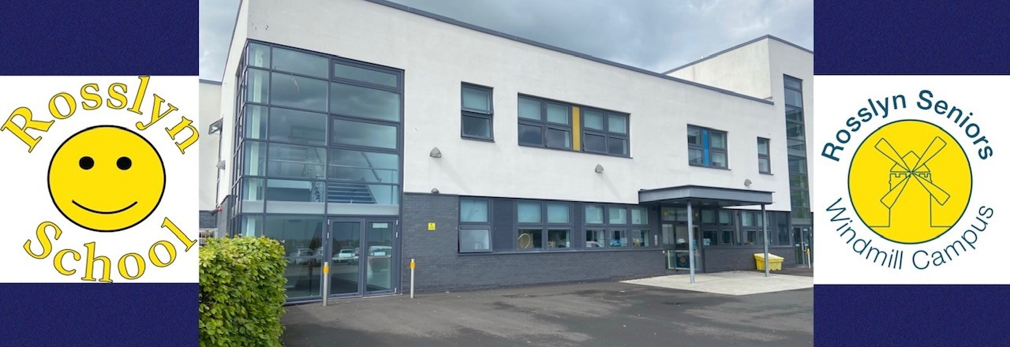
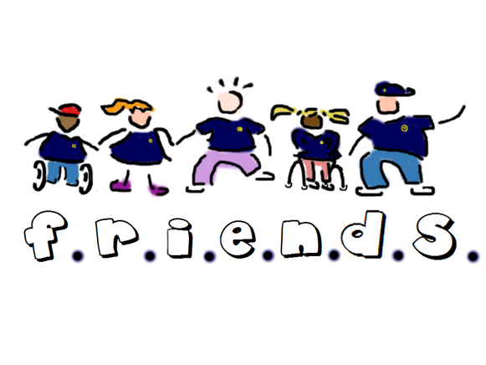
Through our self-evaluation we have identified 3 key priorities for improvement 2025-26
We aim to strengthen our partnership working and pupil profiles to develop a more collaborative approach to outcomes.
We will create S1-3 curriculum choices to support transition from BGE to SQA.
Transforming Learning – We will develop not only our use of iPads in school but our access and use of technology to support learning.
School Improvement Plan 2025-26
Focus Priority 1 – All our learner profiles need to work in synergy to support learning. We aim to develop a new digital profile book, summarised by our Learning Mat. We will work in collaboration with all our partners to strengthen our unified approach. This will impact learner readiness and ensure there is the optimum environment, resources, equipment, groupings, access etc.
PEF Spend:
Music Therapy – This will focus primarily on interaction and communication. Target group will be created based on tracking information. (1 morning a week)
Rebound Therapy – Resources and training to create a full-time resource in school. This will be a motivating and fun activity to deliver PLP or IDL activities in school impacting on pupil progress and achievement.
Hairdresser – Target group – SQA Personal Presentation/Exploring a local area/ Interacting in the workplace and Overcoming a personal situation. (1 morning a week)
Digital Technology – Use of Book Creator to enhance learner engagement with social and sensory stories. Book Creator will also be used to display new learner profiles.
Focus Priority 2 – As we develop our IDL approach through the BGE this will give us the information we require to advocate for SQA tasters and choices from S1-S3. This will strengthen the transition to S4 and impact on attainment within the SQA courses based on needs and interests.
Focus Priority 3 – All P6-S6 learners will have their own iPad device in school. We aim to develop our use of technology and improve access for all learners to impact progress towards the Milestones.
Move to 'Progress' for tracking – systems change
Rights Respecting School – Silver Award

