Slide 1
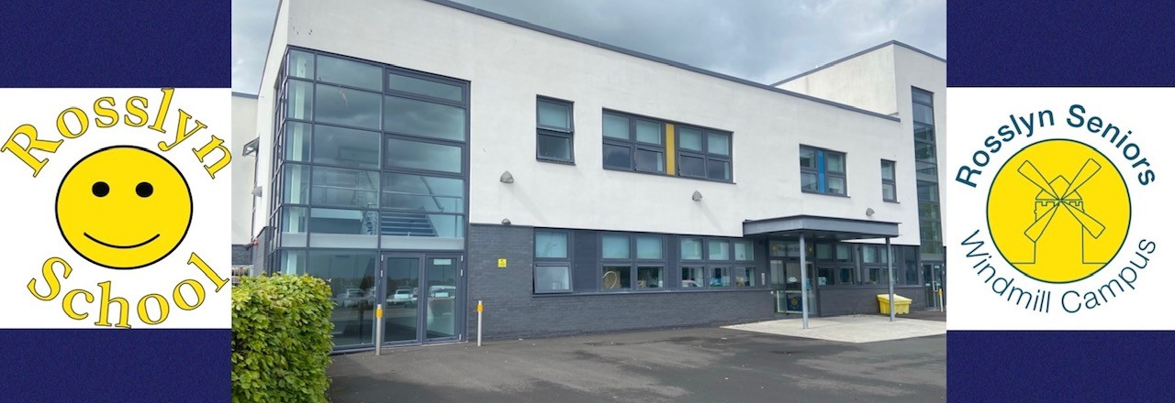
Rosslyn School Improvement plan 2025 – 26

Slide 2


Contents
Background Information
Mission Statement
School Vision
School Values
School Improvement priorities; Transforming Learning, Learner Profiling, Curriculum choices S1-S3
RRS Silver Award – progress and next steps
Cost of the school day
Stakeholders Engagement
PEF Plans; Music Therapy, Rebound Therapy, Hairdresser SQA only
Project Spend

Slide 3
Rosslyn School
Background Information
Rosslyn School provides specialist education to meet the needs of learners aged 3 to 18 with complex additional support needs.
The school is part of Windmill Community Campus and has access to campus facilities including the library, café (The Street), and Viewforth classrooms including the P.E. department.
We have 5 classrooms all with the highest quality facilities built in.
Class groupings are in age; P1 – P3, P3 – P5, P6 – S2, S2 – S4, S4 – S6 with approximately 6 pupils in a class.
Teachers plan in line with our curriculum rationale ensuring that learning experiences are relevant, motivating, and engaging.
Our location gives us good access to the surrounding community to develop learning opportunities including; supermarkets, shops, café’s, community swimming pool, woodland walks, parks and play facilities.
Planning for all our pupils in Rosslyn is personalised and differentiated to meet the needs of learners. Progress is tracked and reported in line with Education Scotland Milestones for Complex Learners and the Benchmarks.
Pupils in the senior school access SQA National level 1courses and level 2 units, or Personal Achievement Awards as appropriate.
The staff : pupil ratio enables pupils to follow a bespoke timetable with a balance of personal targets, BGE entitlements or SQA courses, and health needs.
SIMD profile - At Rosslyn we have 14 families in SIMD 1 and 2; 6 families in 3; 6 families in 5 to 7; and 4 families in 9 to 10.

Slide 4
Mission Statement
“We have a dream…… that all learners who come to Rosslyn School will have opportunities to continue to learn and grow throughout their life. That they will live in a community that values their contribution and skills, and understands them for who they are, and what they can do.”

Slide 5

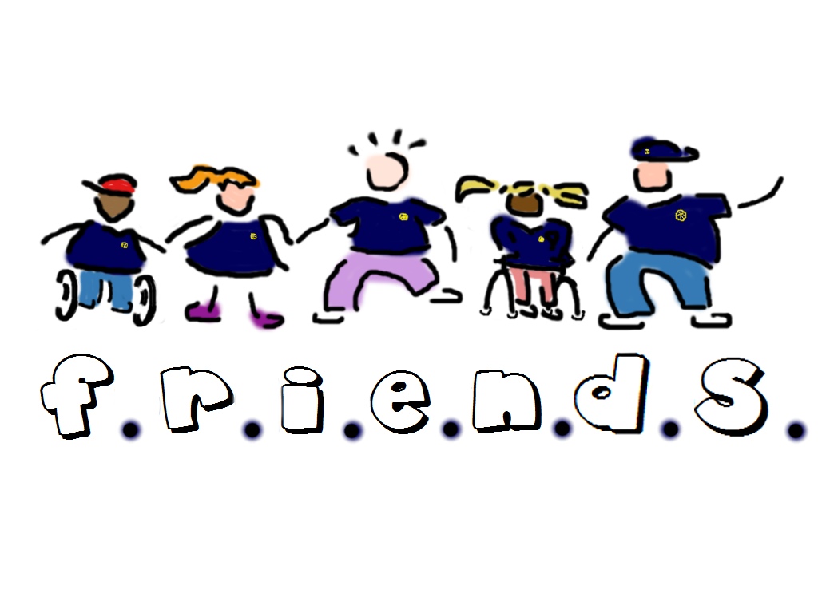
School Vision
At Rosslyn School, our vision is that all learning experiences are directly influenced by:
Family
Relevance
Inclusion
Enjoyment
Nurture
Decisions
Support

Slide 7
Education Directorate Improvement Plan: Equality and Equity and Achievement
Focused Priority – Transforming Learning – All P6-S6 pupils will have their own device for learning. All learners within this target group will use the device to develop skills within digital literacy by exploring, playing and communicating using digital technology.
HGIOS4 1.3 Leadership of change 2.2 Curriculum 2.3 Learning, teaching and assessment; 2.4 Personalised support; 3.2 Raising attainment and achievement
Expected Impact | Strategic Actions Planned | Responsibilities | Measures of Success | Timescale
Enhanced Digital Literacy: Pupils will develop critical digital literacy skills through hands-on exploration, interactive play, and effective communication using digital technology. Increased Engagement and Motivation: The use of technology is expected to increase learner engagement and motivation by making learning more interactive and enjoyable. Learners will have access to a variety of educational apps and resources that cater to their interests and learning preferences. Independence: Types of support will be scaffolded to ensure that the use of technology promotes independent learning within the PLP targets. | Professional Learning Conduct comprehensive training sessions for teachers and support staff on using iPads and integrating them into the curriculum - Delivered by the transforming learning team (5 hours) Offer ongoing professional development opportunities to keep staff updated on the latest educational apps and digital teaching strategies. Looking Outward/Collaboration Teachers to link across Fife special schools as well as collaborating with a special school in Glasgow that already uses the devices to share what is working well. This will be facilitated by the additionality within the special schools (shared resource). Link with CALL Scotland - attending conference events and using online resources. Planning Teachers will identify PLP targets where the use of technology could enhance outcomes for learners, focussing on literacy, numeracy and HWB. Parental Involvement: Engage parents and guardians by informing them about the initiative and its benefits. Provide resources and training for parents to support their children's use of iPads at home. | Megan Davidson – Lead role Danielle McKinnon – switching and access using the iPads. Class teachers PSA staff | Observations – Staff record significant observations that feed back into the PLP in a personalised way. This will include the use of digital skills that impact on achievement. Data – Data will be gathered in relation to the current number of milestones that have technology support. This will be gathered again in Jan 2026 and finally May 2026 to evidence if technology is supporting progress. Feedback and Improvement: Gather feedback from all stakeholders to continuously improve the implementation process. Use feedback from LP to refine strategies, address challenges, and enhance the overall effectiveness of the initiative. | iPads due to arrive Aug 2025 Training will be completed by Dec 2025 Data – Sept 25, Jan 26, May 26 Visits and partnerships will be created by Feb 2026

Slide 8
Education Directorate Improvement Plan: Equality and Equity, Achievement and HWB
Focused Priority – All learner profiles will be reviewed and updated developing a multi-agency profile book for each learner focussed on outcomes. This collaborative approach will impact learner readiness and achievement.
HGIOS4 1.2 Leadership of learning 1.3 Leadership of change 2.2 Curriculum 2.3 Learning, teaching and assessment; 2.4 Personalised support; 3.2 Raising attainment and achievement
Expected Impact | Strategic Actions Planned | Responsibilities | Measures of Success | Timescales
Holistic Understanding of Learners: The multi-agency profile book will provide a detailed and holistic understanding of each learner, incorporating insights from various professionals and stakeholders. This comprehensive profile will ensure that all aspects of a learner's development are considered, leading to more effective support and interventions. Improved Learner Readiness: By regularly reviewing and updating learner profiles, we can identify and address any barriers to learning promptly. This proactive approach will enhance learner readiness, ensuring that pupils are well-prepared to engage with their educational activities. Increased Engagement and Motivation: With a clear understanding of their goals and the support available, learners will be more engaged and motivated to succeed. This increased engagement is expected to lead to higher levels of participation and enthusiasm for learning. | Professional Learning/Collaboration Establish regular meetings and communication channels among educators, specialists, healthcare providers, and other relevant stakeholders. Develop a standardised template for the multi-agency profile book that includes sections for social, emotional, and physical development. Offer regular professional development opportunities to keep staff updated on best practices and new strategies for supporting learners to maintain a high level of expertise and adaptability among staff to meet the evolving needs of learners. Looking Outwards Staff will explore a variety of frameworks and assessment tools that support identifying needs. HT will work collaboratively with the NCNN to ask for samples of what is used nationally. This is an extension of the Moderation Group 2024/25. | HT Lead Class staff Physiotherapy Occupational Therapy Speech and Language Therapy VI Education Team Deaf Service FaacT | Observations Significant observations will be recorded in learner diaries and feed into PLP reviews. People's Views Comments from all stakeholders will evidence a more collaborative approach with clear roles and responsibilities in targeting barriers and planning around outcomes. Data Surveys will evidence a more effective collaborative model where all partners feel that their input impacts outcomes. | Identify needs and develop story book profile by Oct 2025. Nov 2025 in-service training delivery by 3 groups of partners. Jan 2026 – Pilot a story book for 1 learner in each class. Feb in-service – feedback and agree universal model for Rosslyn learners.

Slide 9
Education Directorate Improvement Plan: Equality and Equity, Achievement and Positive Destinations
Focused Priority – Develop a choice-based curriculum S1-3 building on PLP and IDL achievements throughout the BGE. Choices will be personalised and aligned with activities where learners have shown a particular interest, gift or skill level.
HGIOS4 1.3 Leadership of change; 2.6 Transitions; 3.1 Improving wellbeing, equality and inclusion; 3.3 Increasing creativity and employability
Expected Impact | Strategic Actions Planned | Responsibilities | Measures of Success | Timescale
The implementation of a choice-based curriculum for S1-S3 learners is expected to significantly enhance the educational experience, promote personalised learning, and prepare our pupils for a positive destination. By building on PLP and IDL achievements throughout the BGE, we aim to create a coherent and engaging learning pathway that supports the diverse needs of our learners and prepares them for senior phase. | Curriculum Design and Development: Collaborate with educators, specialists, and stakeholders to design a flexible and inclusive choice-based curriculum. Ensure the curriculum builds on PLP and IDL achievements throughout the BGE, providing continuity and coherence in learning. Parental and Community Engagement: Engage parents and guardians by informing them about the choice-based curriculum and its benefits. Create opportunities for parents to participate in the curriculum planning process and support their children's learning at home. Resource Allocation and Infrastructure: Ensure that adequate resources, including digital tools, learning materials, and classroom infrastructure, are available to support the choice-based curriculum. Allocate budget and resources to develop and maintain a diverse range of learning activities and subjects. Feedback and Continuous Improvement: Gather feedback from students, teachers, and parents to continuously improve the choice-based curriculum. Use feedback to refine strategies, address challenges, and enhance the overall effectiveness of the initiative. | S1-S3 teaching staff PSA staff Families | Active participation and contributions from all stakeholders in the curriculum design process. Positive feedback and high ratings on the inclusivity and flexibility of the curriculum. Smooth transition and coherence in learning as evidenced by learner progress and achievements. Increased parental support and involvement in their children's learning as reported in surveys and feedback forms. Observations from staff in significant observations diaries. Data in relation to the number of skills within the milestones now support via technology. | Consultation Oct 2025 Planning Nov in-service day Nov 2025 Pilot new planning from Jan 2026 Review June 2026

Slide 10
UNCRC – Progress towards Silver Award
Bronze RRS Achieved 2024-2025
Developed the staffs understanding of the RRSA, ABCDE of Rights and how we can incorporate this in our daily school life. October 24
Each class decided on a right or aspects of rights that they will focus on in their classroom. – Ongoing Oct 2024
Updated self-esteem guidelines and school values format to link to the UNCRC in a more cohesive format. This has help to embed RRS into our school ethos. The RRSA Co-ordinator developed a choice of formats, and the school staff voted on the chosen format. This will be completed in term 2. – Completed Feb 2024
Development of across school clubs during the school day on a Friday afternoon. Learners can experience all clubs, leading to them being able to select which club they would like to attend using a range of communication methods, suitable for each learner. – Ongoing Jan 2024
Paired work with other learners in class and across school. For example, bringing classes together for PE, outdoor learning, School Clubs, swimming – Ongoing Jan 2024
A RRS Steering staff group has been developed. This group discuss how RRS can be developed and promoted in Rosslyn. Achieved March 25
A RRS Steering parent group has been developed. This group discuss how RRS can be developed and promoted in Rosslyn. Achieved April 25
Whole school charter has been developed. Staff and pupils have signed the charter using their handprints. School charter links to our self-esteem guidelines and the rights which we feel are most relevant and important to us as a school. Achieved February/March 25
Curriculum Rationale has been adapted to incorporate how RRS and the UNCRC is embedded throughout our school and the curriculum.
Fundraising for Pamis – Sponsored Walk with families and staff. June 25
Started a voting system for staff on whole school decisions.
Added a RRS section into the staff handbook.
We are updating parents on the RRS development work through termly newsletters
Updated school website with information on our RRSA journey. Completed March 25

Slide 11
Next Steps
Use of school communication – Sharing article of the term, RRS updates. The RRSA Coordinator and HT will share this relevant information on a termly basis and when needed (steering group and HT to discuss)
Displays – linked to current termly rights. The RRSA Coordinator will develop the displays in conjunction with class teachers termly. To also include a display about how learners and school community have brought about change or development to the school through a voting system. Where possible displays will be multi-sensory and be interactive (use of QR codes)
We will develop a system so learners can vote on what happens in the school. For example, a choice of equipment/resources to buy (steering group to discuss)
Organise a fundraiser for global charity (steering group to discuss)
Develop how to further inform parents with information about the UNCRC, helping to develop their understanding. (steering group and HT to discuss)
Discuss how we can further embed UNCRC into lessons

Slide 12
Pupil Equity Fund 2025 – 2026
Cost of the school day
Stakeholders Engagement
PEF Plans;
Music Therapy
Rebound Therapy
Hairdresser – SQA only
Project Spend

Slide 13
Cost of the school day
At Rosslyn school, we are committed to ensuring that every learner has equal access to educational opportunities without the burden of additional costs. We have implemented several measures to mitigate the cost of the school day, making education more accessible and inclusive for all families.
Key Measures:
Stocking School Uniforms:
  We stock school uniforms and remove VAT costs, making them more affordable for families. Uniform is not mandatory.
Free Lunches and Snacks:
  All learners receive free lunches and snacks, ensuring that no child goes hungry during the school day.
Free Resources for School Activities:
  We provide free resources for all school activities, including shopping and cooking. This allows students to fully participate in educational experiences without worrying about additional costs.
Free Travel:
  Fife council offer free travel to and from school, removing transportation barriers and ensuring that all learners can attend school regularly and on time.
Free Trips and Residential Trips:
  All school trips, including regular residential trips, are provided free of charge. This ensures that every learner can benefit from these enriching experiences, regardless of their financial situation.
Resource Bank for Families:
  We maintain a resource bank with a variety of everyday goods available to families. This support helps alleviate financial pressures and ensures that learners have what they need at home.
Free Use of Personal Care Resources:
  Personal care resources are provided free of charge, ensuring that all their hygiene and personal care needs are met.
Pre-Loved Clothing and Uniforms:
  We offer free use of pre-loved clothing and school uniforms, promoting sustainability and ensuring that all learners have access to uniform.
By implementing these measures, we aim to create an equitable learning environment where all learners can thrive without the worry of financial barriers. Our commitment to supporting families and reducing the cost of the school day reflects our dedication to fostering an inclusive and supportive educational community.

Slide 14
At Rosslyn School, we believe that meaningful stakeholder engagement is crucial to the success of our initiatives and the well-being of our learners. We are committed to fostering strong partnerships and open communication with all stakeholders, including staff, families, partners, advocacy groups and local business
Consultation with Staff: We actively involve our dedicated staff in the decision-making process, ensuring their valuable insights and expertise shape our policies and practices. Regular meetings provide opportunities for staff to contribute their perspectives and feedback, helping us create a supportive and effective learning environment.
Engagement with Families: Families are integral to our school community, and we priorities' their involvement in the education of their young people. We hold regular consultation sessions with families to discuss their needs, concerns, and aspirations. By maintaining open lines of communication, we ensure that families feel heard and supported, fostering a collaborative approach to their young person's development.
Parent Council Sessions: Our parent council sessions serve as a vital platform for parents to engage with school leadership and participate in the governance of the school. These sessions provide a forum for parents to share their views, offer suggestions, and collaborate on initiatives that enhance the educational experience for all learners. We value the contributions of our parent council and strive to incorporate their feedback into our decision-making processes.
Partnerships: We work closely with all partners to ensure that our learners receive comprehensive support for all aspects of their well-being and education. Regular consultations with healthcare professionals allow us to integrate medical insights into our educational strategies, providing holistic care for our students. This collaboration ensures that we address the diverse needs of our learners and promote their overall development.
By engaging with these key stakeholders, Rosslyn School is committed to creating a collaborative and inclusive environment that supports the success and well-being of all our learners. We believe that strong partnerships and open communication are essential to achieving our goals and providing the best possible education for our learners.
Stakeholder Engagement

Slide 15
Attainment Fund Rationale Rebound therapy |  | Amount of Fund £10,000 approx.
Introducing rebound therapy daily in school as it can significantly enhance the physical, emotional, and cognitive development of our learners, providing a holistic approach to their education and well-being.
Expected Impact | Interventions Planned | Measures of Success (Triangulation of Evidence/QI Methodology) | Measures of Success (Triangulation of Evidence/QI Methodology) | Impact on learners Ongoing evaluation
Develop gross motor skills, coordination, and balance. The controlled movements on the trampoline can enhance muscle tone and strength, contributing to overall physical development. Improved flexibility and range of motion, making daily living activities easier and more manageable. Reduced anxiety and stress. Improved focus and attention and enhanced cognitive skills. Learners process sensory information more effectively, which is crucial for their overall development. The physical activity involved in rebound therapy can stimulate brain function, leading to improved cognitive abilities. This can translate to better outcomes for learners at school and at home. | Equipment Procurement: Purchase high-quality trampolines and necessary accessories, such as safety mats, physio balls, sensory resources etc. Staff Training and Professional Development: Provide comprehensive training for staff on the principles and practices of rebound therapy, including safety protocols and therapeutic techniques. Individualised Therapy Plans: Develop personalised rebound therapy plans for each learner, based on their specific needs, abilities, and goals. Collaboration with Healthcare Professionals: Work closely with physiotherapists, occupational therapists, and other healthcare professionals to integrate rebound therapy into the overall planning for each learner. Safety Protocols: Establish and enforce strict safety protocols, including risk assessments, regular equipment inspections, supervision during sessions, and emergency procedures. Looking Outwards: Visit schools in other authorities who already have rebound set up in a small space. Work with PAMIS and BounceOT to collaborate on meeting the needs of Rosslyn learners with the spaces we have. |  | Observations and Reporting: Observable and measurable improvements in gross motor skills, coordination, and balance, as documented in progress reports and physical evaluations. Decreased levels of anxiety and stress, as indicated by calmer behaviour, improved mood, and positive feedback from stakeholders. Increased ability to focus and follow instructions, leading to better concentration and engagement in both therapy and classroom settings. Improved sensory processing abilities, as evidenced by better responses to sensory input and reduced sensory-related behaviours. Enhanced cognitive abilities, leading to improved performance in school tasks and daily life activities, as documented in PLPs and school reports.

Slide 16
Attainment Fund Rationale Music Therapy |  | Amount of Fund £7,000 approx.
Introduce music therapy sessions in school with a focus on PLP and IDL learning personalised to individuals. Many learners in Rosslyn are motivated and engaged using music and this is a perfect context for learning in which to deliver a variety of targeted skills. These skills are then tracked and impact next steps within the PLP.
Expected Impact | Interventions Planned | Measures of Success (Triangulation of Evidence/QI Methodology) | Measures of Success (Triangulation of Evidence/QI Methodology) | Impact on learners Ongoing evaluation
Improved memory and recall abilities. Enhanced memory supports better retention of skills. Develop attention and focus, which are crucial for learning. Singing and musical storytelling enhance vocabulary, sentence structure, and language comprehension, leading to better communication and interaction skills. Develop social communication skills, such as turn-taking and listening. Develop emotional expression and regulation, reducing anxiety and stress. A calmer emotional state supports better concentration and learning. Improve fine and gross motor skills, coordination, and balance. Enhanced motor skills support better participation in physical education and other activities. Develop sensory integration, helping learners process sensory information more effectively, which is crucial for overall development. | Collaboration Work closely with Drake music therapist to integrate PLP learning into music sessions for individuals. Staff to work closely alongside the therapist to build capacity in their skills in understanding the activities and outcomes. Staff training In-service delivery of progress to inform all staff of interventions and outcomes. Resources Research resources to improve outcomes and procure these for individual projects. |  | Observations and Reporting: DRAKE music therapist will provide detailed progress reports for individuals using comments, photographic and media evidence. Staff will record any significant observations in learner diaries to feedback into the PLP impacting on Next Steps. Tracking: Trackers will evidence progress within the milestones for Literacy, Numeracy and HWB.

Slide 17
Attainment Fund Rationale Hairdresser for SQA only |  | Amount of Fund £10,000 approx.
This initiative aims to enhance the educational experience within specific SQA courses by providing practical, hands-on learning that supports personal development, vocational skills, and self-esteem. This is a priority as it leads to creating opportunities for learning, life and work, relevant to the young people at Rosslyn.
Expected Impact | Interventions Planned | Measures of Success (Triangulation of Evidence/QI Methodology) | Measures of Success (Triangulation of Evidence/QI Methodology) | Impact on learners Ongoing evaluation
Development of fine motor skills and hand-eye coordination through hairdressing activities will support learners in various daily tasks and vocational activities. Boost self-esteem and confidence. Understanding and cooperating with personal grooming will enhance learners' ability to care for themselves and present themselves confidently, which is particularly important for social interactions and self-image. Develop interactions with the hairdresser and peers, fostering social skills and communication. These interactions will help build relationships and improve conversational abilities. The hairdresser will serve as a positive role model, demonstrating professionalism, empathy, and patience, encouraging learners to develop similar qualities. Integrating hairdressing into SQA courses will allow learners to achieve recognised qualifications that validate their skills and efforts. These awards will provide formal recognition of their achievements and can enhance their educational and life prospects. Regularly celebrating learners' progress and achievements in hairdressing will foster a positive learning environment and motivate continued effort and improvement. | Collaboration Staff will work closely with a professional hairdresser to ensure that the outcomes of the SQA courses are delivered in a fun, motivating and relevant way for each learner. Staff will share judgement statements for SQA and ensure Sharon is aware of how to deliver these. Sharing good practice SQA staff will share the planning, learning, teaching and assessment, and evidence of this intervention with all staff. CLPL opportunities. |  | Observations Achievements will be recorded through evidence packs for each course. Evidence will include comments, photographs and media clips. Staff comments and feedback will impact course delivery in a responsive way ensuring there is new learning that may enhance the judgement statements. Data The hairdresser will use a tracker for experiences in the salon and use data to evidence success within specific skills and activities. People's Views The views of SQA staff will evidence the positive impact of the relationship with the hairdresser and the self-esteem of learners.

Slide 18
Attainment Fund Rationale Staff allocation a day a week to develop the use of Book Creator for learning and teaching |  | Amount of Fund £6,000 approx.
This initiative aims to enhance the use of digital technology in school. Staff allocation of a day a week to develop sensory stories, social stories and learning profiles using Book Creator on the iPads.
Expected Impact | Interventions Planned | Measures of Success (Triangulation of Evidence/QI Methodology) | Measures of Success (Triangulation of Evidence/QI Methodology) | Impact on learners Ongoing evaluation
Through the creation of sensory and social stories, learners will explore key concepts in a format that is interactive, multi-sensory, and tailored to their individual needs. This approach is designed to: Increase engagement by making abstract concepts more accessible and relatable. Support literacy development through immersive storytelling. Enhance communication skills by encouraging expressive and receptive language within a structured digital environment. In addition, Book Creator will be used to develop learner profiles that are: Easily shared and accessible to all staff. Rich in detail about each learner’s preferred learning environment, effective teaching approaches, behavioural support strategies, and health and medical needs. Designed to ensure that every learner receives the most appropriate and responsive support across all aspects of their education. This digital approach empowers staff with the information they need to create inclusive, responsive, and engaging learning experiences, ensuring that every learners needs are met to the fullest. | Resources and Looking Outwards PSA Level 3 Amanda Hunter – A day a week to research the use of Book Creator to create more engaging sensory stories by developing the use of digital technology alongside the story. Link with Frozen Lights drama company who produced a visual story book and resources for cinema nights during Covid. Collaboration Link with Fiona Turner to develop sensory resources for stories. Sharing good practice and staff training Book Creator will also be used to share the new learner profiles. Amanda will support developing the prototype for this and create an example book for staff to use. |  | Observations Learner engagement - Using the Continuum of engagement staff will track learners using the Foundation, Pre-Early and Early Milestones – particularly the skills that focus on Attention Skills and interest in books/stories. People's views Staff will discuss the resource and feedback to Amanda and Fiona. Media clips will evidence learner engagement and their views about the stories created, and how the story is enhanced by using digital technology. Feedback from families Stories can be shared with home – FORMS questionnaire will capture the views of families and partners.

Slide 19

Pupil Equity Funding Projected Spend
School: Rosslyn School
PEF Allocation 2025/26: £ 25,725 Carry Forward - £ 1, 394 Total £ 27, 119
 | Music Therapy
Category | Brief Description | Cost
DRAKE music | Music therapist to enhance delivery of IDL for personalised projects and PLP targets. | £7,000
Total |  | £7,000
 | HWB - Hairdresser
Category | Brief Description | Cost
SQA | Salon sessions Professional hairdresser 1 half day – Personalised outcome based on SQA course. | £3,000
Total |  | £3,000
 | HWB – Rebound
Category | Brief Description | Cost
Rebound | Develop Rebound area in school as a permanent resource | £6,000
 | Staff training | £2,000
Total |  | £8,000
 | Transforming Learning
Category | Brief Description | Cost
Digital Learning | Focus on use of Book Creator on the iPads to create sensory stories for all learners | £6,000
Total |  | £6,000
Amount of spend planned : £24,000
Unallocated Spend : Staffing costs to carry to Aug 2026 Approx. None

