Slide 1
Fife Parent Forum
Building Home and School Partnerships:
How we can work together
to support your children and young people's journey through school in Fife

Slide 2
In Fife Education we are committed to building our Parental Partnerships
We recognise the benefits of parental partnerships for children and young people ​
The notion of partnership with parents is not a new thing for us in education
Notes:
EM

Slide 3

What you told us through the last Fife Parentwise survey
Safe and Healthy Environment | Almost all Parents/Carers feel that their child is safe in school and know who to contact if they are upset or worried about something that is affecting their child and that the school encourages their child to be healthy and take part in physical activity.
Parental Engagement | Parents report that they are kept informed about their child’s progress through report cards, parents’ nights and that their child is making progress. Parents feel suitably informed about the life of the school through information letters, newsletters, email and websites.
Healthy Life Choices | Need more about how the school/nursery promotes learning about healthy life choices appropriate to age and stage, for a) relationships, sexual health and parenthood, and b) substance misuse.
Communication, Relationships and Behaviour | Need to think about how to improve communication, parental awareness and confidence in nurseries/schools’ approaches to managing behaviour and building positive relationships (to include reflection on communication and handling of bullying concerns).
Parental Involvement & Family Learning: | Need to think more about approaches to engaging with parents, how to promote opportunities for family learning that focus on children and parents learning together and how to improve parental engagement
Notes:
PC

Slide 4
From what we've learned from feedback we saw a need for something which visually pulled together the things we need to think more about.
We wanted to create something which gives a focus to talking together about the different aspects which parents told us we need to think more about
Notes:
PC

Slide 5
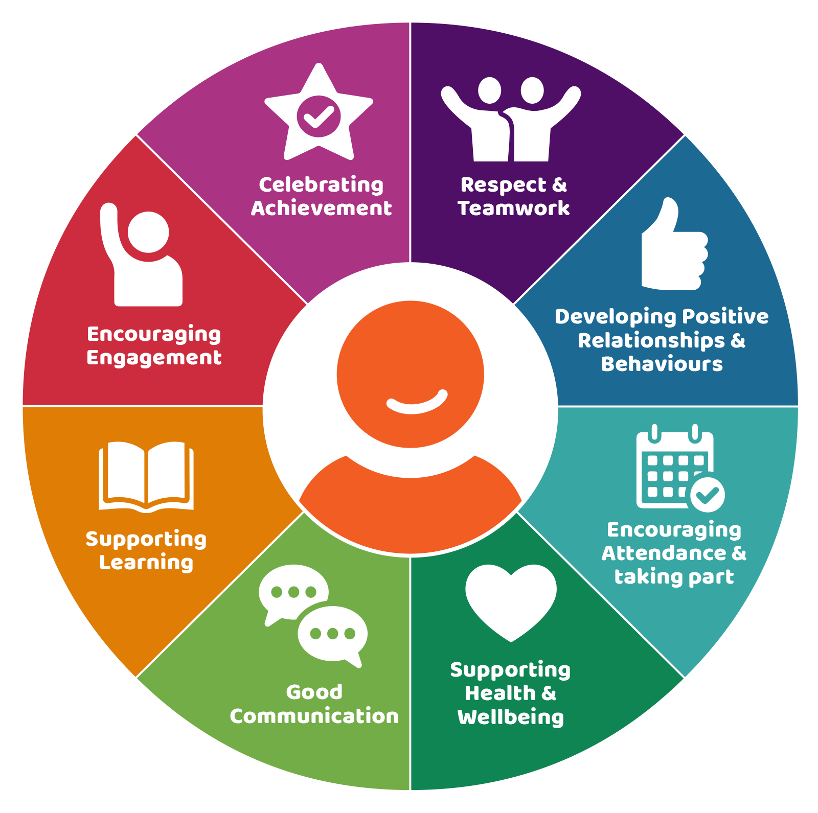
From what we've learned from feedback we saw a need for something which visually pulled together the things we need to think more about.
We wanted to create something which gives a focus to talking together about the different aspects which parents told us we need to think more about
Home/School
Partnership Wheel
Notes:
PC

Slide 6
Next Steps
We'd propose that as we keep coming together through our Fife Parent Forum meetings we keep in mind the different aspects of the partnership wheel and 'roll through' different aspects as we go along
Notes:
EM

Slide 7

Alongside this we need to keep checking that we understand people's views – so we're going to run the "-Wise" surveys again.
Pupilwise Survey
Nursery, primary and secondary sectors
19th Jan – 27th Feb 2026
Parentwise Survey
All parents and carers
19th Jan – 27th Feb 2026
Staffwise
All Education staff
19th Jan – 27th Feb 2026
Fife Young People Health & Wellbeing Survey
P5 – S6 pupils
2nd – 27th March 2026
https://forms.office.com/e/61gZGT7u53
Notes:
PC

Slide 8
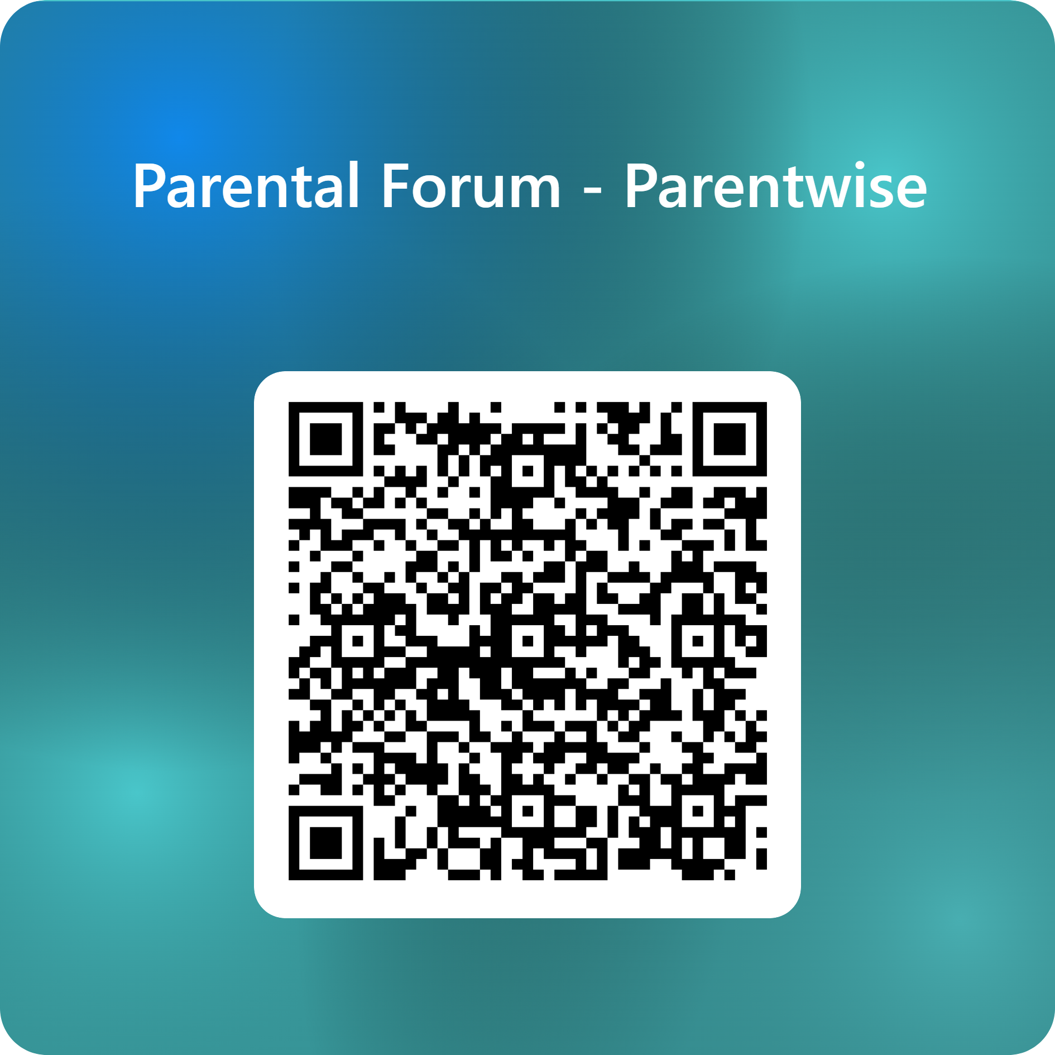
We're working to review the next round of "-Wise Survey" questions just now, and we'd like your thoughts on these.
https://forms.office.com/e/61gZGT7u53
Notes:
PC

Slide 9
We hope you'll join again to find out more about what we’ve been working on and next steps!
Overview of Fife Parent Forum Meetings - Session 25/26
Focus | Dates (6-7 pm on TEAMS)
Engagement and Attendance | Cowdenbeath and Glenrothes: Wednesday 12th November 2025
Developing Positive Relationships and Behaviour (to include our work on Anti-Bullying) | Last week in January/beginning of February
Children’s Learning: Transforming Learning | Last week in March/beginning of April
CONNECT: Support and advice for Parent Councils | Last week in May/beginning of June
Notes:
EM

Slide 10

And finally, some information from
The wait is over – you can now Register for MyConnect today!
Connect members are invited to explore MyConnect, - exclusive online library full of practical tools, templates, short films, and expert guidance
Whether you’re running a parent group, contributing to school policies, volunteering, or working to build a more inclusive school community, MyConnect gives you easy access to resources and on-demand content that support stronger parental involvement and better outcomes for children and young people across Scotland.
Co-created with input from parents, carers, education partners, and local authorities, MyConnect is regularly updated based on real needs and feedback.
👉 Join MyConnect today!
Just complete your details at the link above, then check your inbox (and Junk folder) for your confirmation email. If you don’t get a response within 3 days, contact us at info@connect.scot.
You'll also find a short helpful reel to guide Connect members through using MyConnect – If you have any suggestions or features you'd like to see added, please contact feedback@connect.scot
Notes:
EM

