Slide 1


Meeting Learners Needs in Park Road Primary School
Supporting all our neurodivergent and neurotypical children at home and at school.

Slide 2
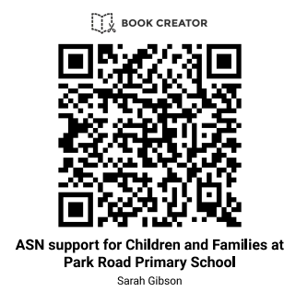

For an audio version use this QR code or link
https://read.bookcreator.com/NQhBRtgRMMSRaXtAzqEAESeki8V2/SbRhuNUDQQG1K3i91gbgcA

Slide 3
What should you do if you have a worry or a wee niggle about your child
Who can help?
Get in contact with us, we can work together to look at supports for your child. 01592602426 or email: parkroadps.enquiries@fife.gov.uk
Sometimes, we can have worries or niggles in one environment but not the other e.g. your child is managing at school but is dysregulated at home. This is called masking and is frustrating and upsetting. We can work together to support you and your child.
You can contact the Children's Services Phoneline 01592 226699 Tuesdays 10am–12 noon and Wednesdays 2pm–4pm

Slide 4
Who can help in Park Road
Mrs Anderson (Headteacher)
Mrs Gibson or Mrs Heath (Learning Support Teachers)
Mrs Forbes or Mrs Hanton (Principal Teachers)
Of course you can always speak to your child's class teacher.

Slide 5
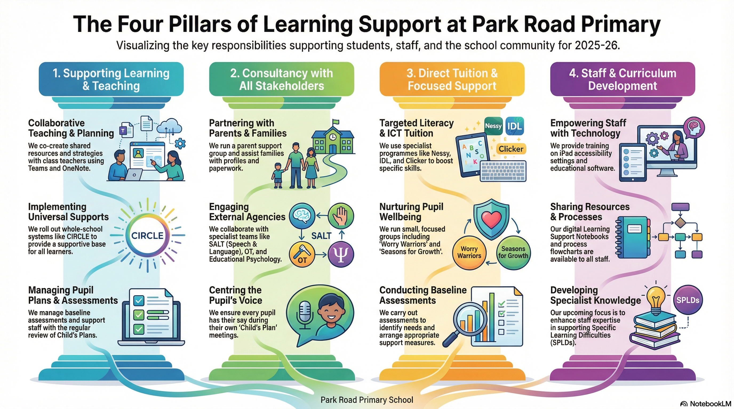

Slide 6
Children’s Services phone line is there to support parents, carers and professionals
01592226699

Slide 7
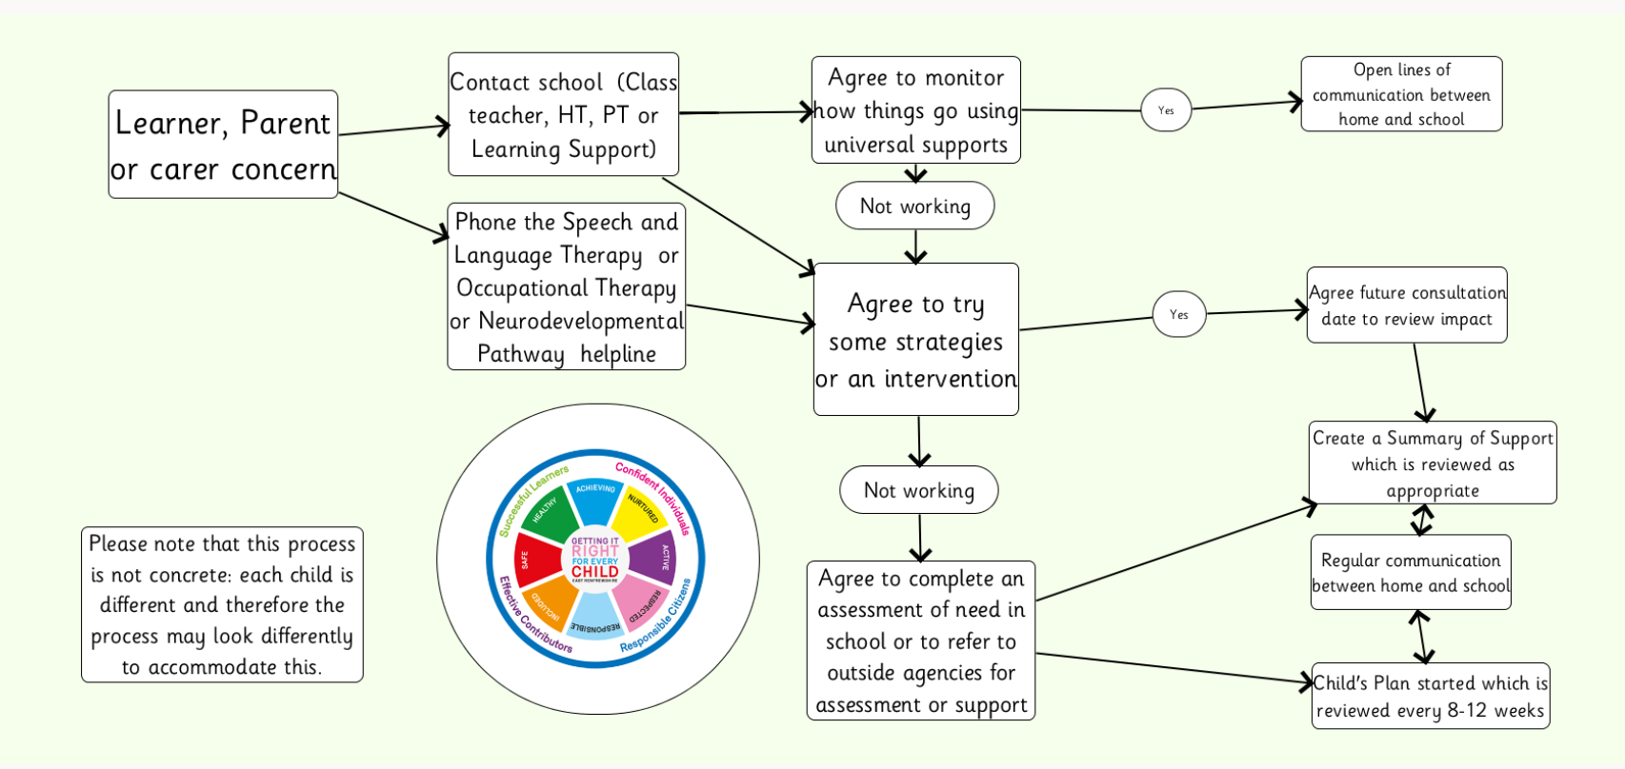
What happens if you have a concern:

Slide 8
Universal Supports (all Children)
Neurodivergent Friendly School Support Systems
We have a number of things in place in consideration of having a neurodiverse setting:
-Soft start to the day
- Quiet / calm time after break times
-Snack after break time for self-regulation
-Brain / Movement breaks
--Active Assemblies/regular movement breaks throughout assemblies
-Movement breaks an accepted part of the day as and when
-Calm Corner in every class
-Free access to concentration aids in every classroom
-Symbolised environment
Clutter free tidy environment
Concrete materials available e.g. numbersquares, times, table squares, numicon
Children are able to present their learning in a variety of ways
- Access to technology in every classroom
-Neurodiversity awareness across P1-7 through assemblies, targeted learning (LEANS) for P4-7 TBA

Slide 9
Health and Wellbeing Support Systems
We have a number of things in place, across the school to support our pupils wellbeing, including:
Kitbag
Emotion Works
Seasons for Growth
Normalising Anxiety (Worry Warriors)
Lego therapy
Nurture Support
Fidgit toys for anyone who needs
Support teddies
Emotional check ins
Social stories

Slide 10

Strategies Agreed
When the school and family consult one another over the concerns raised, some actions may be agreed. These usually involve putting strategies in place designed to support your child.
The school may use The Circle Document as a tool for identifying and tracking strategies/supports
All agreed strategies should be reviewed. A date to discuss the impact of the strategies in place should be arranged between school and the caregivers.
If specific strategies are put in place for your child this may be recorded in a Summary of Support so they can be communicated with anyone who works with them
It is not uncommon for the school, children and parents to need to update strategies regularly to support learners. Children change and as a result strategies need to change with them.

Slide 11
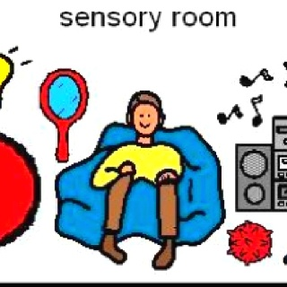
Individualised/Targeted Support Systems
Some children need additional supports in place to help them manage the school day. For some of our children this can look like:
Individual work space within classroom
Flexibility within learning and adjustments to timetable to accommodate pupil’s needs/interests
Now and Next Boards / Individual timetable
Reduced instructions/demands
Basket of high interest items/Brain Break tray – selected by pupil
Flexible seating – wobble cushions/wobble chairs/bean bags
Specific access to digital technology/apps
Use of Clicker for writing
Time out of assemblies
Regular movement breaks/Brain Breaks
Timers/visuals
Lunch club
Soothing/sensory supports e.g. weighted blankets/shoulder wraps
5 point scale to help understand and regulate emotions
These will be recorded and shared with all those working with them in a Summary of Support

Slide 12

Agency Support
In some cases, we may suggest referring to outside agencies for further support.
Agency support is invaluable for supporting children and families across Fife.
Sometimes a referral will be made for advice and consultation for school staff, sometimes it is for family support or direct support for the child e.g. counselling, sometimes it is for assessment if, for example, neurodiverse behaviours have been identified.
No referrals are made without parent/carer consent.
Some Fife Supports
Educational Psychology
Community Paediatrician
CAMHS
Supporting Learners Service
Family Support Service
Speech and Language Therapy
Occupational Therapy
Neurodevelopmental Pathway
Children’s Services phone line is there to support parents, carers and professionals 01592226699

Slide 13
Childs Plan
This is a plan that is reviewed every 8 -12 weeks by the Team around the child.
There may be other agencies involved or the Educational Psychologist involved in this process.
A Child’s Plan will remain in place while we work out how best to support your child and what strategies are the ones for them.

Slide 14
What happens if I want my child assessed?
The most important thing is to think about needs and to take time to get the right supports in place first. It can take time for the assessment process to be completed so we do not wait for a ‘label’ to support a child, we look at need. If despite support your child is still finding things difficult then:
We can assess your child for dyslexia, dyscalculia and dysgraphia
Occupational Therapy assess children for Developmental Coordination Disorder
Children need to be referred to the Neurodevelopmental Pathway to be assessed for Autism, ADHD, or a Learning Disability

Slide 15
Help for home
There are lots of supports for children and families, here are some:
Sunflower badge – you do not need a diagnosis to use this A symbol for non-visible disabilities
Access Card: Making access easy Once given a diagnosis you can apply for one. It is recognised internationally
Cinema Card – Home - CEA Card
VoiceAbility | In Scotland - provide benefits advocacy
Fife Carers Centre
Square start- family support projects Square Start / Families - BRAG Enterprises Limited
Fife One Stop Shop - Scottish Autism - The One Stop Shop provides information, advice and support to autistic people, their families, friends and other professionals

