Slide 1
WW1 LIFE IN THE TRENCHES AND ANIMALS
BY KELSEA REYNOLDS

Slide 2
CONTENTS
ANIMALS
DIFFRENT ANIMALS
HORSES
DOGS
PIGENS
PICTURE PAGE
LIFE IN THE TRENCH
PARAGHRAPH OF DIARY ENTRY
DESCRIBE TRENCH
WHAT THEY DID

Slide 3
Different animals
In ww1 they had horses , pigeons, dogs and more.
Animals in ww1 were used for all sorts of things and reasons.
If you want to find more you can read all about the different animals on there page.

Slide 4
Horses in the war
horses were very popular in ww1 because there were no cars so they were used for travel as well as the war.
In the war horses were used for carrying supply's like food, water and equipment.
Because of there strength they were also used to carry injured men .
They ate hay ,grass and possibly hay ledge as well.
Horses now a days are used differently now that war is over they don't carry injured men and now we have cars they are not used for transport as much.

Slide 5
Dogs in the war
Dogs in the war were used as medical emergency when men got injured.
some were also used for messenger dogs.
They were used as guard dogs.
the most popular were the medium sized intelligent and ok to train.
two in particular were popular as well because of their strenghth.

Slide 6
Pigeons in the war
pigeon's were used as messenger birds but that's really all they were used for.

Slide 7
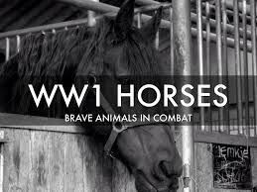
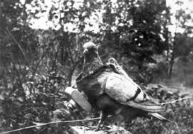
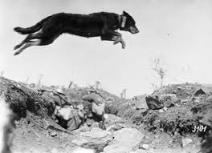
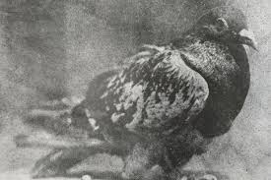
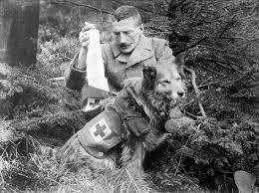
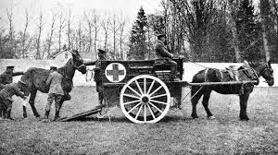
pictures

Slide 8
Diary entry
I am sitting in my trench its about 5 to 12 and I'm shaking with fear and the fact that I am freezing. my trench is filthy so it is however its something.yesterday was amazing despite the fact that the German leader sent his army to attack us at about noon. we played games and told each other stories of all kinds. I was to meant to stop at 12'o clock but its 12:05 so I'm gong to stop now ....

Slide 9
trenches
Trenches are like your home when your not fighting.
You have trench buddies witch is just people who share a trench with you.
A trench is basically under ground so its all muddy especially when it rains.
Men and dogs protected trenches at night nto make sure they were not attacked.

Slide 10
what they did
They played games and told stories.
one of the games they played was called ludo and you have counters and you have to move around the board and try to get all your counters home to win.
They wrote diary entry's when they were bored.

Slide 11
remembrance day
remembrance day is on the eleventh day of the eleventh minute of the eleventh hour. remembrance day is represented by a poppie.

Slide 12
hope you enjoyed
Thank you for listening and watching this power point presentation !!!!

