Slide 1
All About WW1
BY LEONEI

Slide 2
Introduction
I am writing this PowerPoint because I would like to talk to you about world war one.
Please read the following pages.

Slide 3
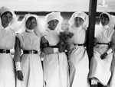
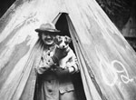
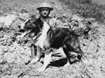
WW1 Dogs
Dogs were used for guarding there trench's and fighting with the soldiers. They were also used for sniffing out enemies for the war.

Slide 4
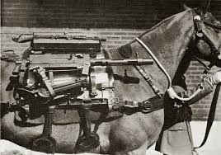
Horses
Horses were used carrying for stuff to the soldiers or carrying guns.

Slide 5
HOPE YOU ENJOYED
THANK TOU FOR WATCHING

