Slide 1
Conceptual Development in Number
Fife Documentation

Slide 2
Conceptual Understanding in Fife
The majority of Fife schools have been involved in Professional Learning Team led professional learning.
Within each cluster, there will be Numeracy leaders who have engaged in Train the Trainer or Universal +.
There exists comprehensive guidance to support teachers.
Notes:
Add key elements of the position paper

Slide 4
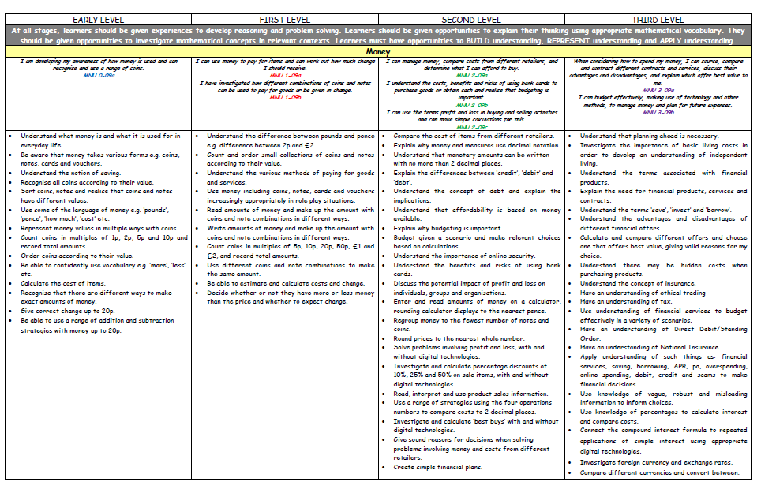
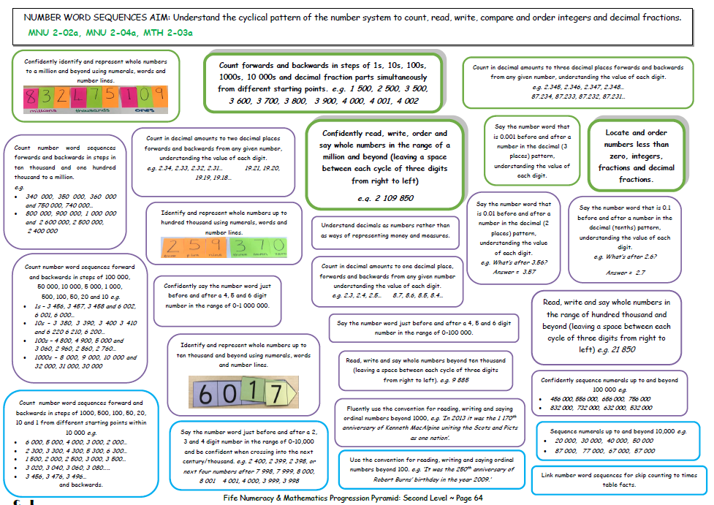
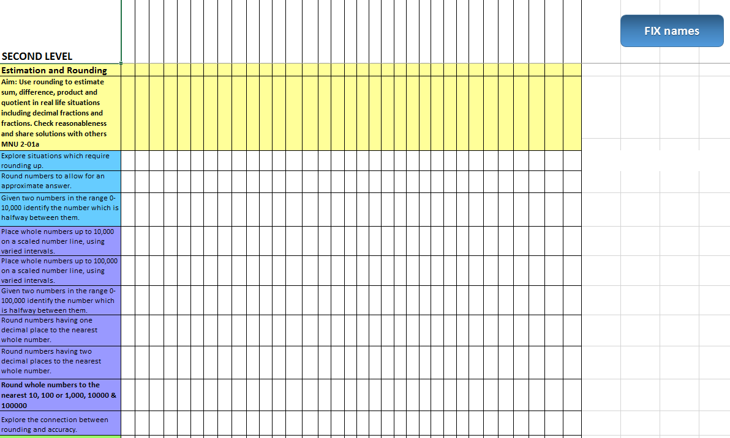
Fife Documentation – Three Documents
There are three documents to the Fife Documentation:
Overviews – Pace, Coverage, What has been taught
Pathways – Informs daily, weekly and termly planning, bundling of outcomes.
Records of Understanding – Tracking, evidence, transition
Overviews
Pathways
RUs
Pace / Coverage / What has been taught
Informs Planning
Tracking / Fluid Groupings / Pupil Progress
Over the following slides we are going to look at the purpose of each of the three documents in more detail.
Notes:
Point :Triangulation of the 3 documents Overviews – Pace, Coverage, What has been taught
Pathways – Informs daily, weekly and termly planning, bundling of outcomes.
Records of Understanding – Tracking, evidence, transition,

Slide 5
Overviews

Slide 6
Overviews
The overview is a document that shows the development of skills and understanding across Early to Third or First to Fourth Levels.
There are two Overview documents – Early to Third Level and First to Fourth Level.
The Overviews offer staff a clear outline of key aspects within and across both curriculum organisers and levels.
This document allows practitioners to look ahead and look behind at a glance. Curriculum for Excellence Experiences and Outcomes are clearly referenced with those Numeracy Experiences and Outcomes which are the responsibility of all teachers shown in bold italics throughout.
By using the overviews, practitioners are able to easily identify where learners have been and where they are currently, while planning next steps in learning.

Slide 7
Overviews
The Overviews have colour coded E’s and O’s throughout that match those in the Pathways
The following overview example is from the Early to Third Level Document.
Early Level
Blue
First Level
Red
Second Level
Green
Third Level
Purple

Slide 8
Overviews
The Overviews have colour coded E’s and O’s throughout that match those in the Pathways
The following overview example is from the First to Fourth Level Document.
First Level
Red
Second Level
Green
Third Level
Purple
Fourth Level
Orange

Slide 9
Overviews
The Overviews have colour coded Areas of the Curriculum throughout that match those in the Pathways
Number, Money and Measure (Yellow)
Shape Position & Movement (Purple)
Information (Tan)

Slide 10
Progression Pathways

Slide 11
Progression Pathways
The Fife Numeracy and Mathematics Progression Pathways determine a clear set of learning experiences and outcomes from each of the three curriculum organisers within Numeracy and Mathematics, namely:
Number, Money and Measure
Shape, Position and Movement
Information Handling
The Pathways assist practitioners in their planning of effective pedagogy in conceptual understanding of Mathematics and Numeracy to meet individual learners’ needs.

Slide 12
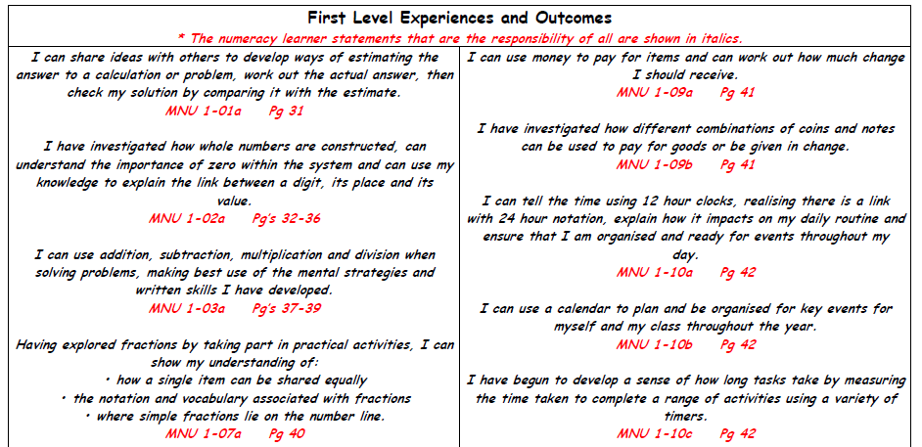
Progression Pathways
The structure of the Fife Mathematics and Numeracy Progression Pathways:
E’s & O’s are outlined at the start of the pathway sections of each level. If the E&O is numeracy based it will appear bold and in italics. If it is maths based it will present in standard font.

Slide 13
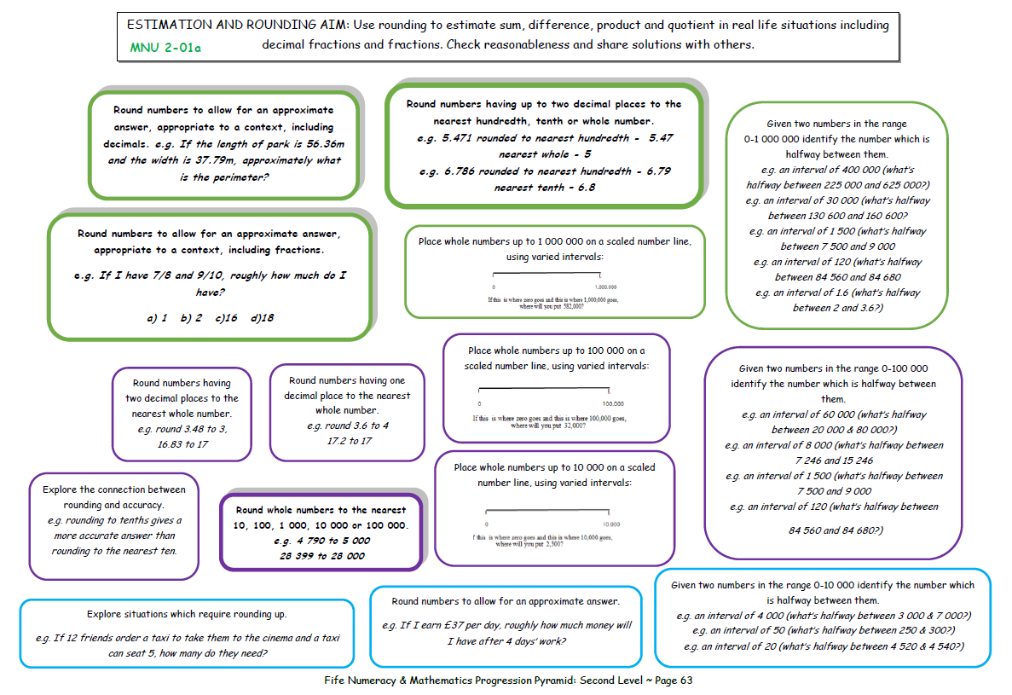
Progression Pathways
The Progression Pathways informs planning
Each pathway contains the learning required for a level.
The pathway clearly show the learning that underpins the ultimate aim displayed at the top of the page.

Slide 14
Progression Pathways
The Progression Pathways informs planning
The boxes are not linear or represent ‘common order’, although learning contained within blue boxes will be necessary to allow access to purple boxes and green boxes.
The three colours within each pathway do not equate to any particular year group but instead are best considered as Building, Representing and Applying – Skill based progression

Slide 15
Progression Pathways
The Progression Pathways informs planning
The boxes which are shadowed and in bold show statements relating to the National Benchmarks.

Slide 16
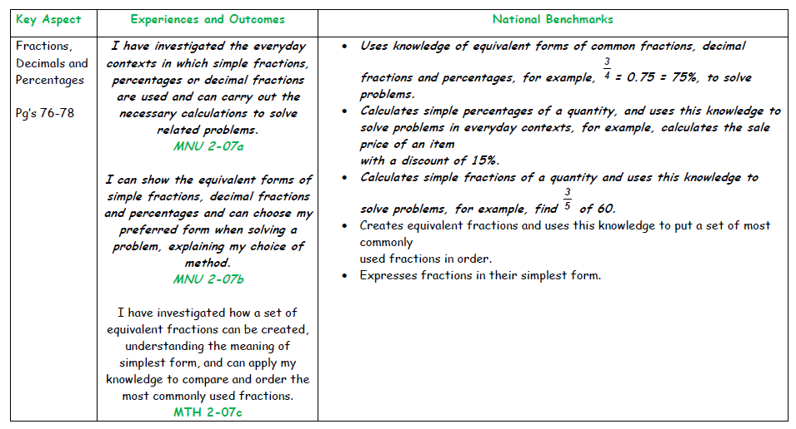
Progression Pathways
The structure of the Fife Numeracy and Mathematics Progression Pathways:
Benchmarks are outlined at the end of the pathway sections of each level.

Slide 17
Progression Pathways
The Number, Money and Measure Pathway also contain Points to Consider
The ‘Points to Consider’ provide detailed descriptions of the key ideas or concepts and provide clear and concise guidance for teachers.
Common learner misconceptions are also highlighted within this section.
Notes:
Points to Consider
The ‘Points to Consider’ provide detailed descriptions of the key ideas or concepts and provide clear and concise guidance for teachers.
Common learner misconceptions are also highlighted within this section.
Emphasise these – if printing print these too!!!

Slide 18
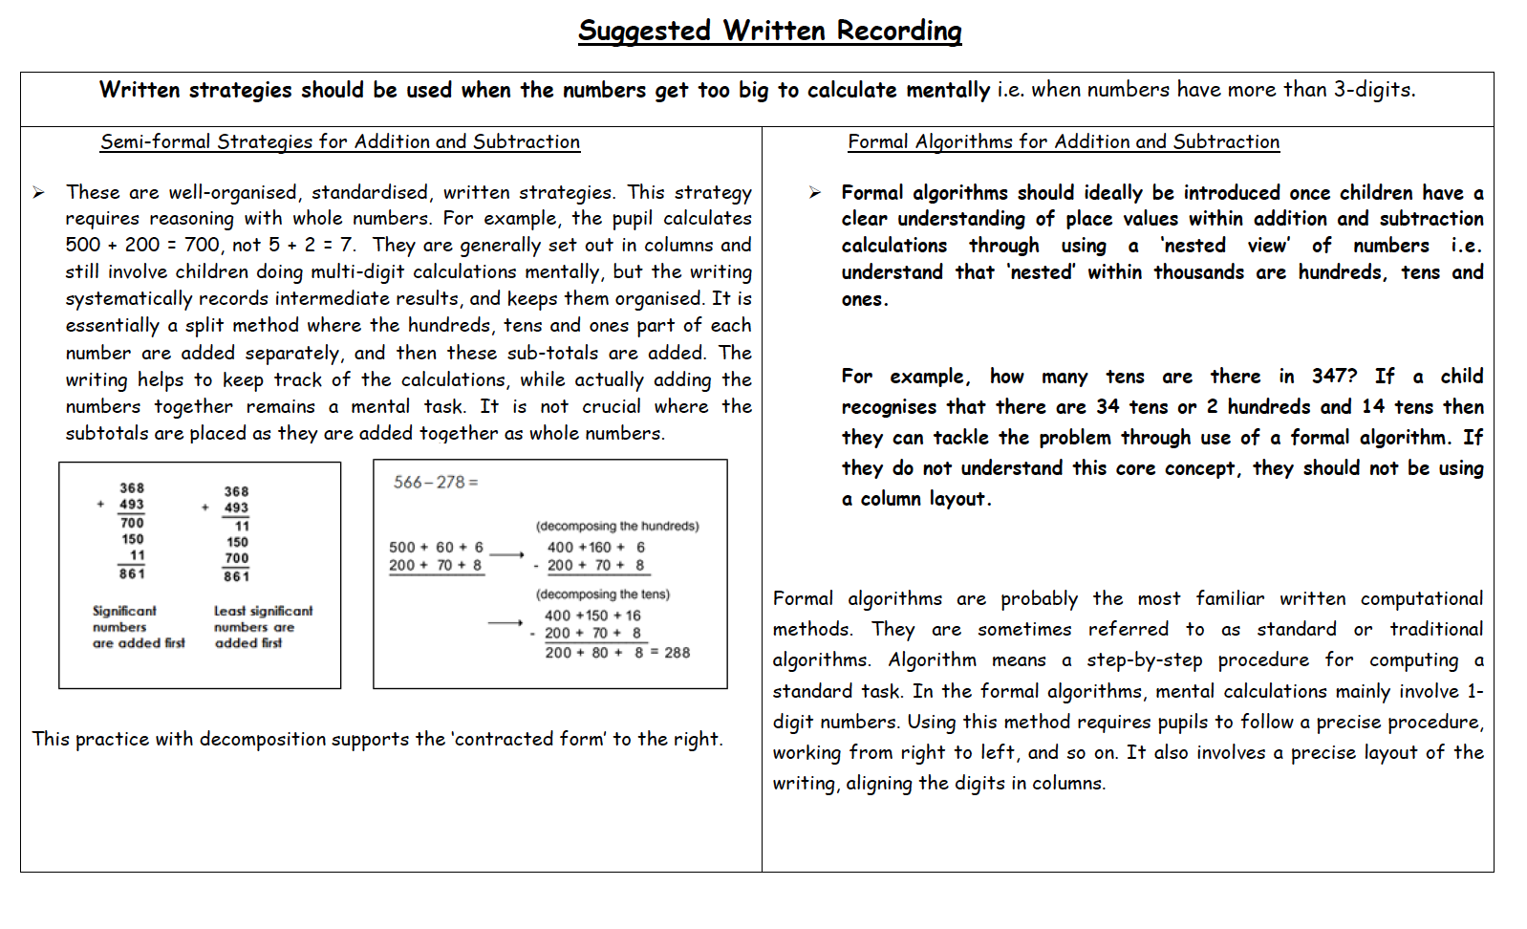
Progression Pathways
The Number, Money and Measure Pathway also contain Suggested Written Recording:
The ‘Suggested Written Recording’ section explores ways in which learners might record and represent their mathematical thinking. (They highlight the importance of allowing learners to build links between their mental and written methods, allowing for greater opportunities for them to use and apply their strategies. Once conceptual understanding is embedded this leads to more formal methods of recording.)
The Suggested Written Recording sections make suggestions on developmentally appropriate methods of recording.
Supports consistency across the school.

Slide 19
Records of Understanding (RU)

Slide 20
Records of Understanding (RU)
The Records of Understanding (RU) are linked directly to the Progression Pathways where each statement tile within the Progression Pathways is replicated within the Record of Understanding.
A consistent approach across schools (or even clusters) is recommended to:
Ensure effective tracking of the developmental progression of individual learners.
identify of any gaps in learning or misconceptions that exist.
justify declarations of achievement for their learners.

Slide 21
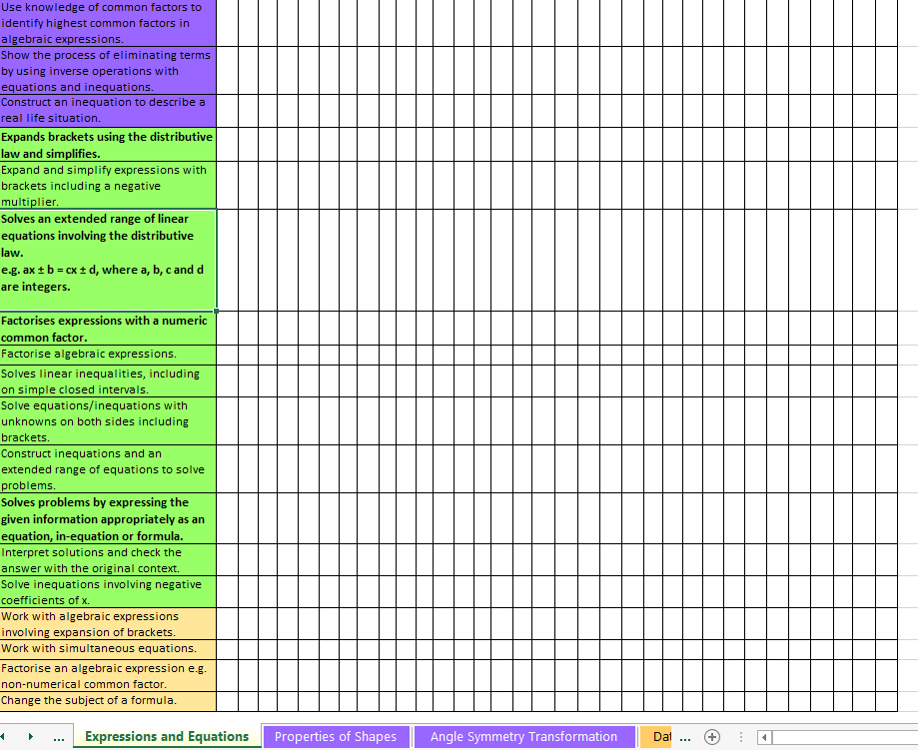
Records of Understanding (RU)
Each statement tile within the Progression Pathways is replicated within the RU
Note: The only tab you need to put the names in are the estimation tab.
The coloured tabs along the bottom match the colours in the Overviews

Slide 22
Records of Understanding (RU)
The Records of Understanding (RU) are in two formats:
Original format with pupils names along the top
Reformatted format with pupils names along the side that allow to filter by groups of children when supporting learning

Slide 23
Leigh.Graham@fife.gov.uk Fife ESO Numeracy professional.learning@fife.gov.uk @fifepedagogy
Notes:
Numeracy Support Videos (office.com)
Maths Talk (office.com)

