Slide 1
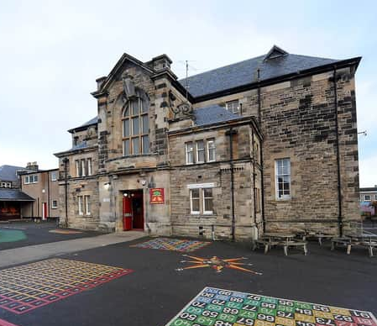
Kirkcaldy North Primary School Term 4 2023-2024 Newsletter

Slide 2
In this newsletter….
Staffing update
Helpful reminders – READY TO LEARN
Mobile Phones
Pokemon Cards and Helmets
Celebrating Success
Updates to our building
Pupil Voice
Anti Bullying Policy
Dates for your diary
Learning Partnership Visit
School and Nursery Improvement Plan
Contact Us

Slide 3
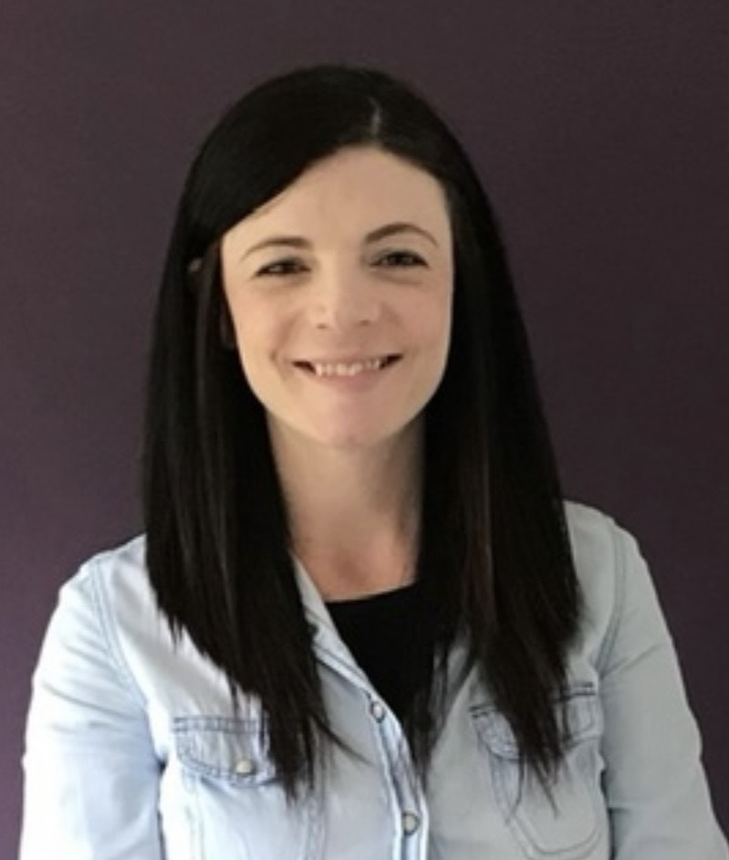
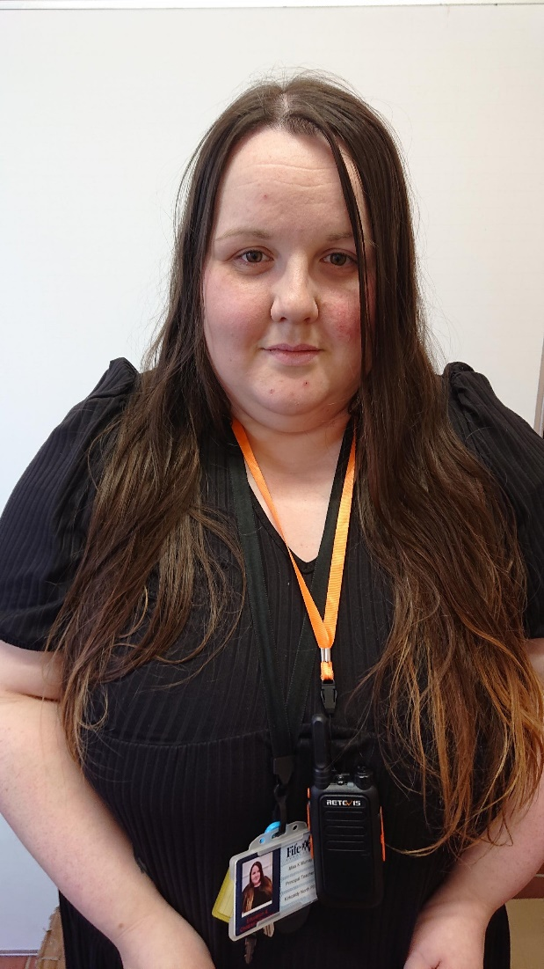
Staffing Update
Senior Leadership Team
Mrs Emma Clunie (Headteacher)
Miss Kayla Murray (Principal Teacher)
Mrs Clunie has a departmental remit
of Nursery – Primary 3/4
Miss Murray has a departmental remit
of Primary 5 – Primary 7

Slide 4
Staffing Update continued…
Our Teaching staff this session are:
Primary 1 - Miss A McDonald
Primary 1/2 – Mrs M McQuillan
Primary 3 – Mrs R O’Keefe
Primary 3/4 – Miss E Marley
Primary 5 – Mrs K Duncan
Primary 6 – Mrs J Campbell
Primary 7 – Miss R Wilson
Non Class Contact Time – Miss Murray/Mrs B Clunie
EAL Support – Mrs B Clunie
Support for Learning Teacher – Mrs C Murray
Mr Thomason continues to be absent from work. At the moment, we do not have a date for his return. Mrs O’Keefe will continue to teach Primary 3 until Mr Thomason returns.
We are delighted to have Miss Turner, a teaching student, with us in Primary 5 this term. Miss Turner is also an Active Schools Netball coach, and we are delighted that she will be delivering some out of school netball sessions for upper school children this term.

Slide 5
Nursery Staffing…
Our Nursery staff team this session includes:
Mrs Y Miller – Early Years Lead Officer
Mrs H Stowe – Early Years Officer
Mrs K Wight - Early Years Officer
Miss N Benitez - Early Years Officer
Miss Z Winton (Early Years Officer)
Miss E Snaddon (Early Years Officer)
Mrs Elaine Walker – Nursery Teacher (Every 3rd Week)

Slide 6
Office and PSA Staff
Mrs L Glasgow (Admin Assistant)
Miss L Plimer (School Support Assistant and Clerical Assistant)
Mrs T McGregor (Clerical Assistant) Mrs McGregor works with us every Thursday from 10am – 2pm
Mrs J Frame (PSA)
Mrs G Shaw (PSA)
Miss R McMullen (PSA)
Mrs C Melia (PSA)
Ms K McFarlane (PSA)
Mrs K Kinloch (PSA)
Mrs M Londra (PSA)
Mrs F Coleman (PSA, Nurture, 2 days per week)

Slide 7
The Child Protection Coordinator is:
Mrs Clunie

Slide 8
The Depute Child Protection Coordinator is:
Miss Murray

Slide 9
How can you ensure your child is READY to learn?
We are encouraging children to ATTEND school every day. Regular attendance at school is absolutely crucial for learning. We will be rigorously monitoring pupil attendance this session and we will call you, or pop out to visit you, if we have any concerns.
Attend school ON TIME at 9am. Children will miss out on crucial learning time if they are late to school in the morning. Please support us by ensuring children are in the line with their class at 9am each day.
Wear SCHOOL UNIFORM. We are encouraging all children to take pride in KNPS by wearing their smart school uniform every day. Wearing school uniform also helps our children feel ready to learn. Children should not wear hoodies or tops with bright logos or writing on.
HEALTHY EATING. Did you know that we have a free Breakfast Café in our dinner hall each day? This opens at 8am daily and is free for all to attend, including adults. Encourage your child to start the day in the best way with a healthy, delicious breakfast (this will also help to make sure your child arrives at school on time). This is also open to nursery families.

Slide 10
How can you ensure your child is READY to learn?
HEALTHY EATING – Snack… Children are only required to bring one piece of healthy snack to school each day. Children should not bring giant sharing bags of sweets and/or crisps.
Drink WATER. Children should bring a water bottle to school each day. Please fill this up at home in the morning. Children will have the opportunity to fill this up in school throughout the day. Bottles should contain water only.
Change of clothes – If your child is prone to accidents, please ensure there is a spare change of clothes in their bag. Thank you.

Slide 11
Mobile Phones
We would like to remind all children and adults that mobile phones are not permitted in school.
We are aware that some children may use a phone on the journey to and from school. However, mobile phones are not permitted in the classroom or public spaces in school.
Mobile phones must be handed to the class teacher on arrival at school, or to the school office for safe keeping.
Children can collect these at 3pm.
Staff will remind children that mobile phones must be handed in each morning. If a child refuses to give their mobile phone to their class teacher, or to the office, a member of school staff will call parents and ask for them to attend school to collect their child’s phone.
We appreciate your support with this as we endeavour to ensure that phones are not used inappropriately in school.

Slide 12
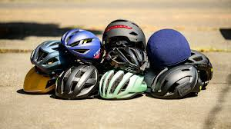
Pokemon Cards
This is a polite reminder to leave all Pokemon Cards at home. These are causing some issues and impacting on friendships ☺
Helmets
We are aware that many children are riding their bikes to school without helmets. Please ensure your child always wears a helmet when cycling to school. This is to ensure their safety at all times.

Slide 13
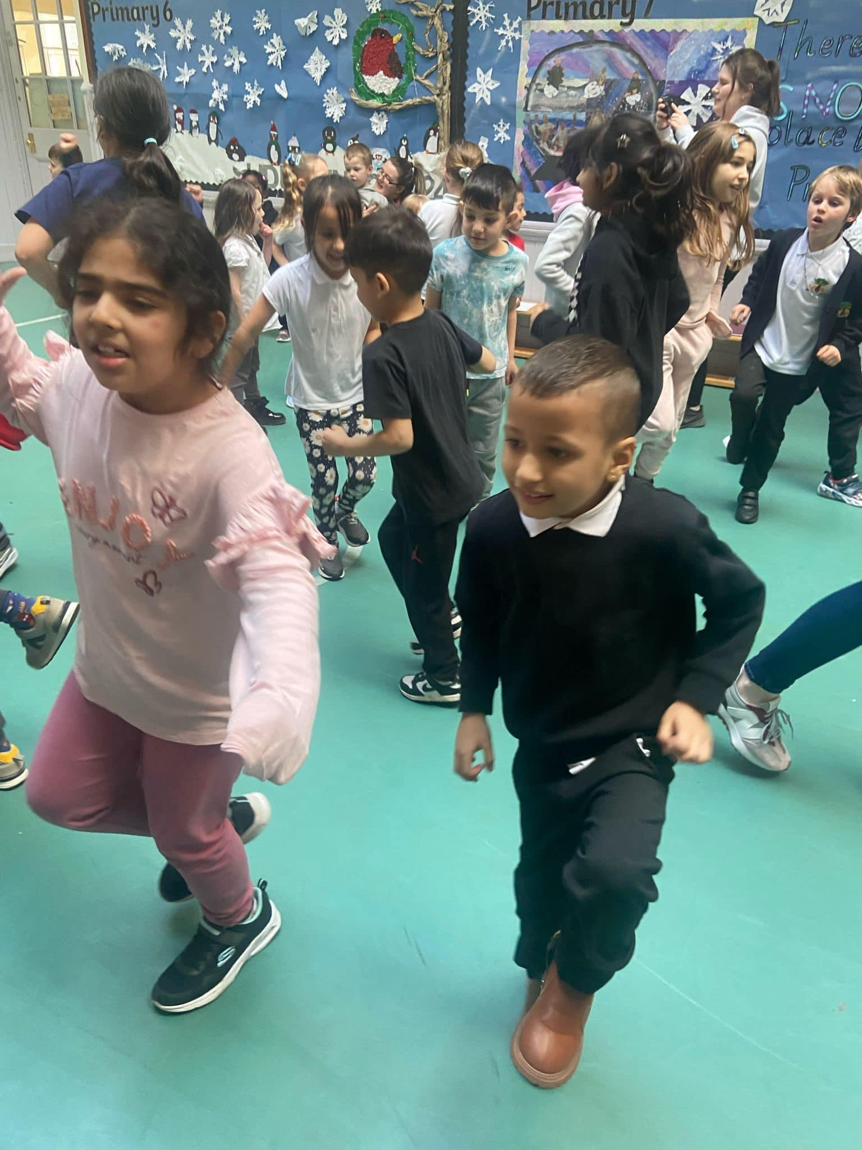
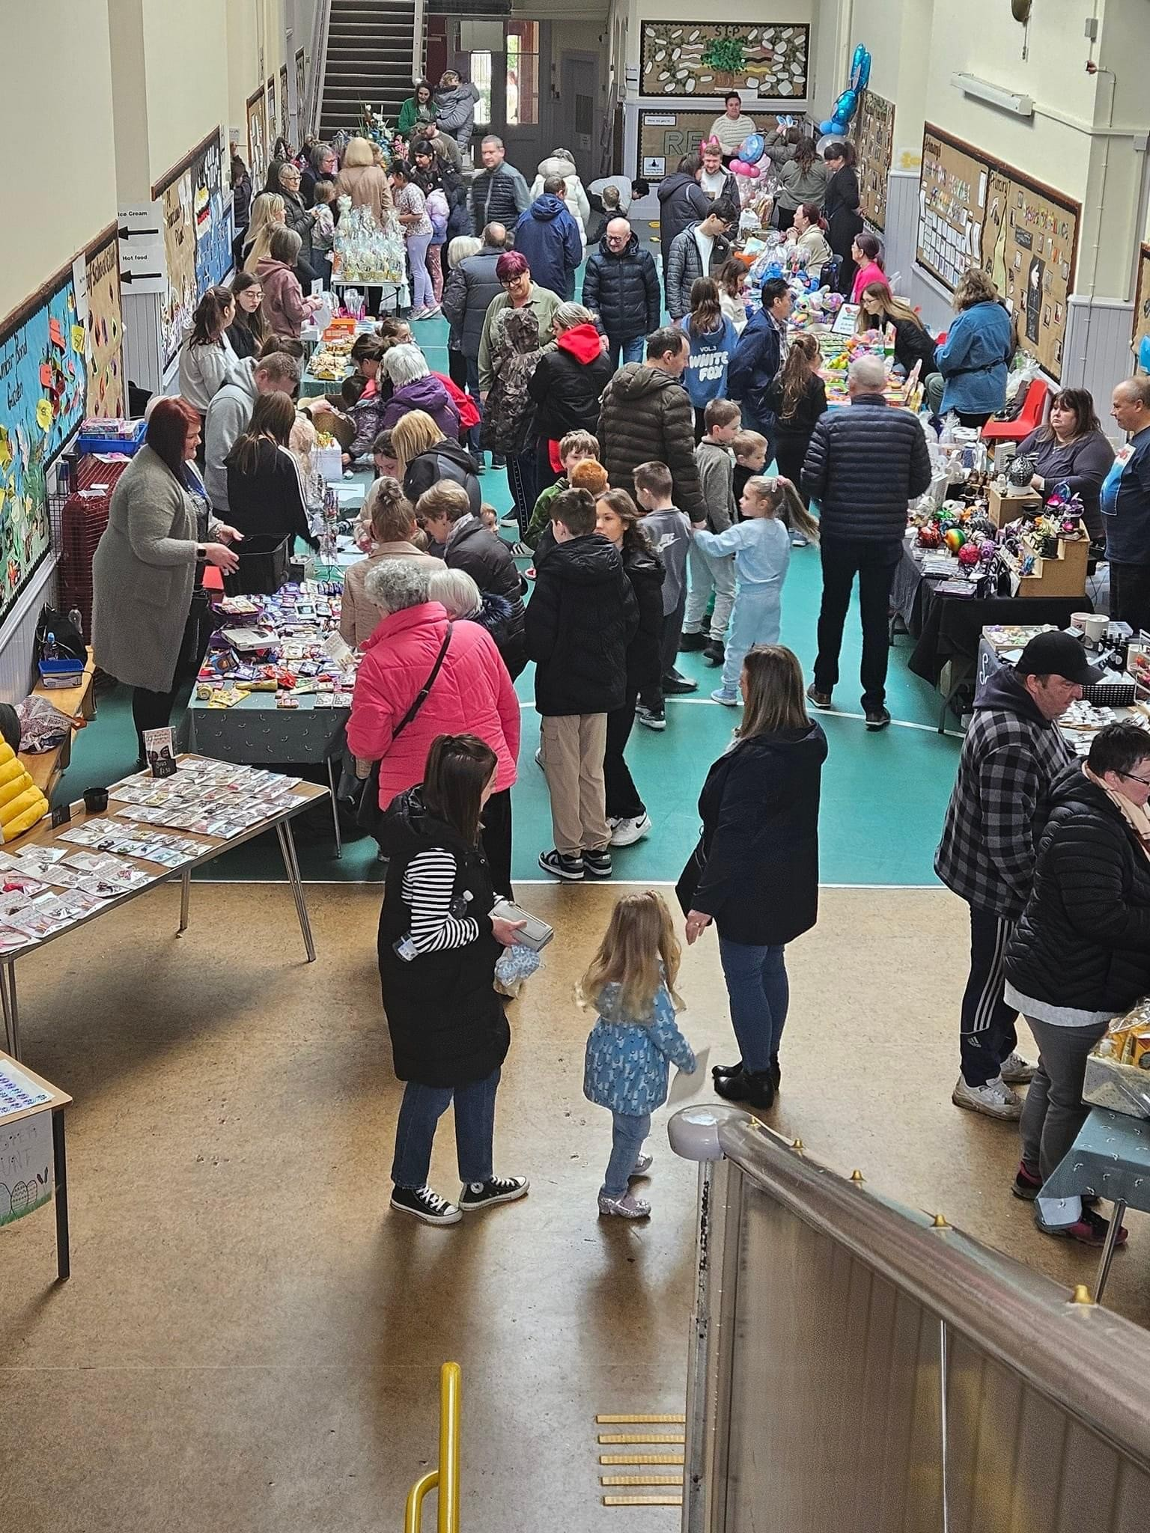
Celebrating Success
Our Leap Year ‘Hopathon’ was a wonderful success, with an incredible £1855.50 raised for school funds. It was a fantastic day, with lots of fun had by all. We will continue to ask the children for their views on how the money should be spent. So far, resources for the playground has been identified as a priority from children.
Spring Family Fun Day
What a wonderful day we had celebrating our Spring Family Fun Day in March. Thank you once again to our incredible Parent Council for organising this event, and to everyone who attended for their generosity and support. A total of £1291.55 was raised! Amazing!

Slide 14
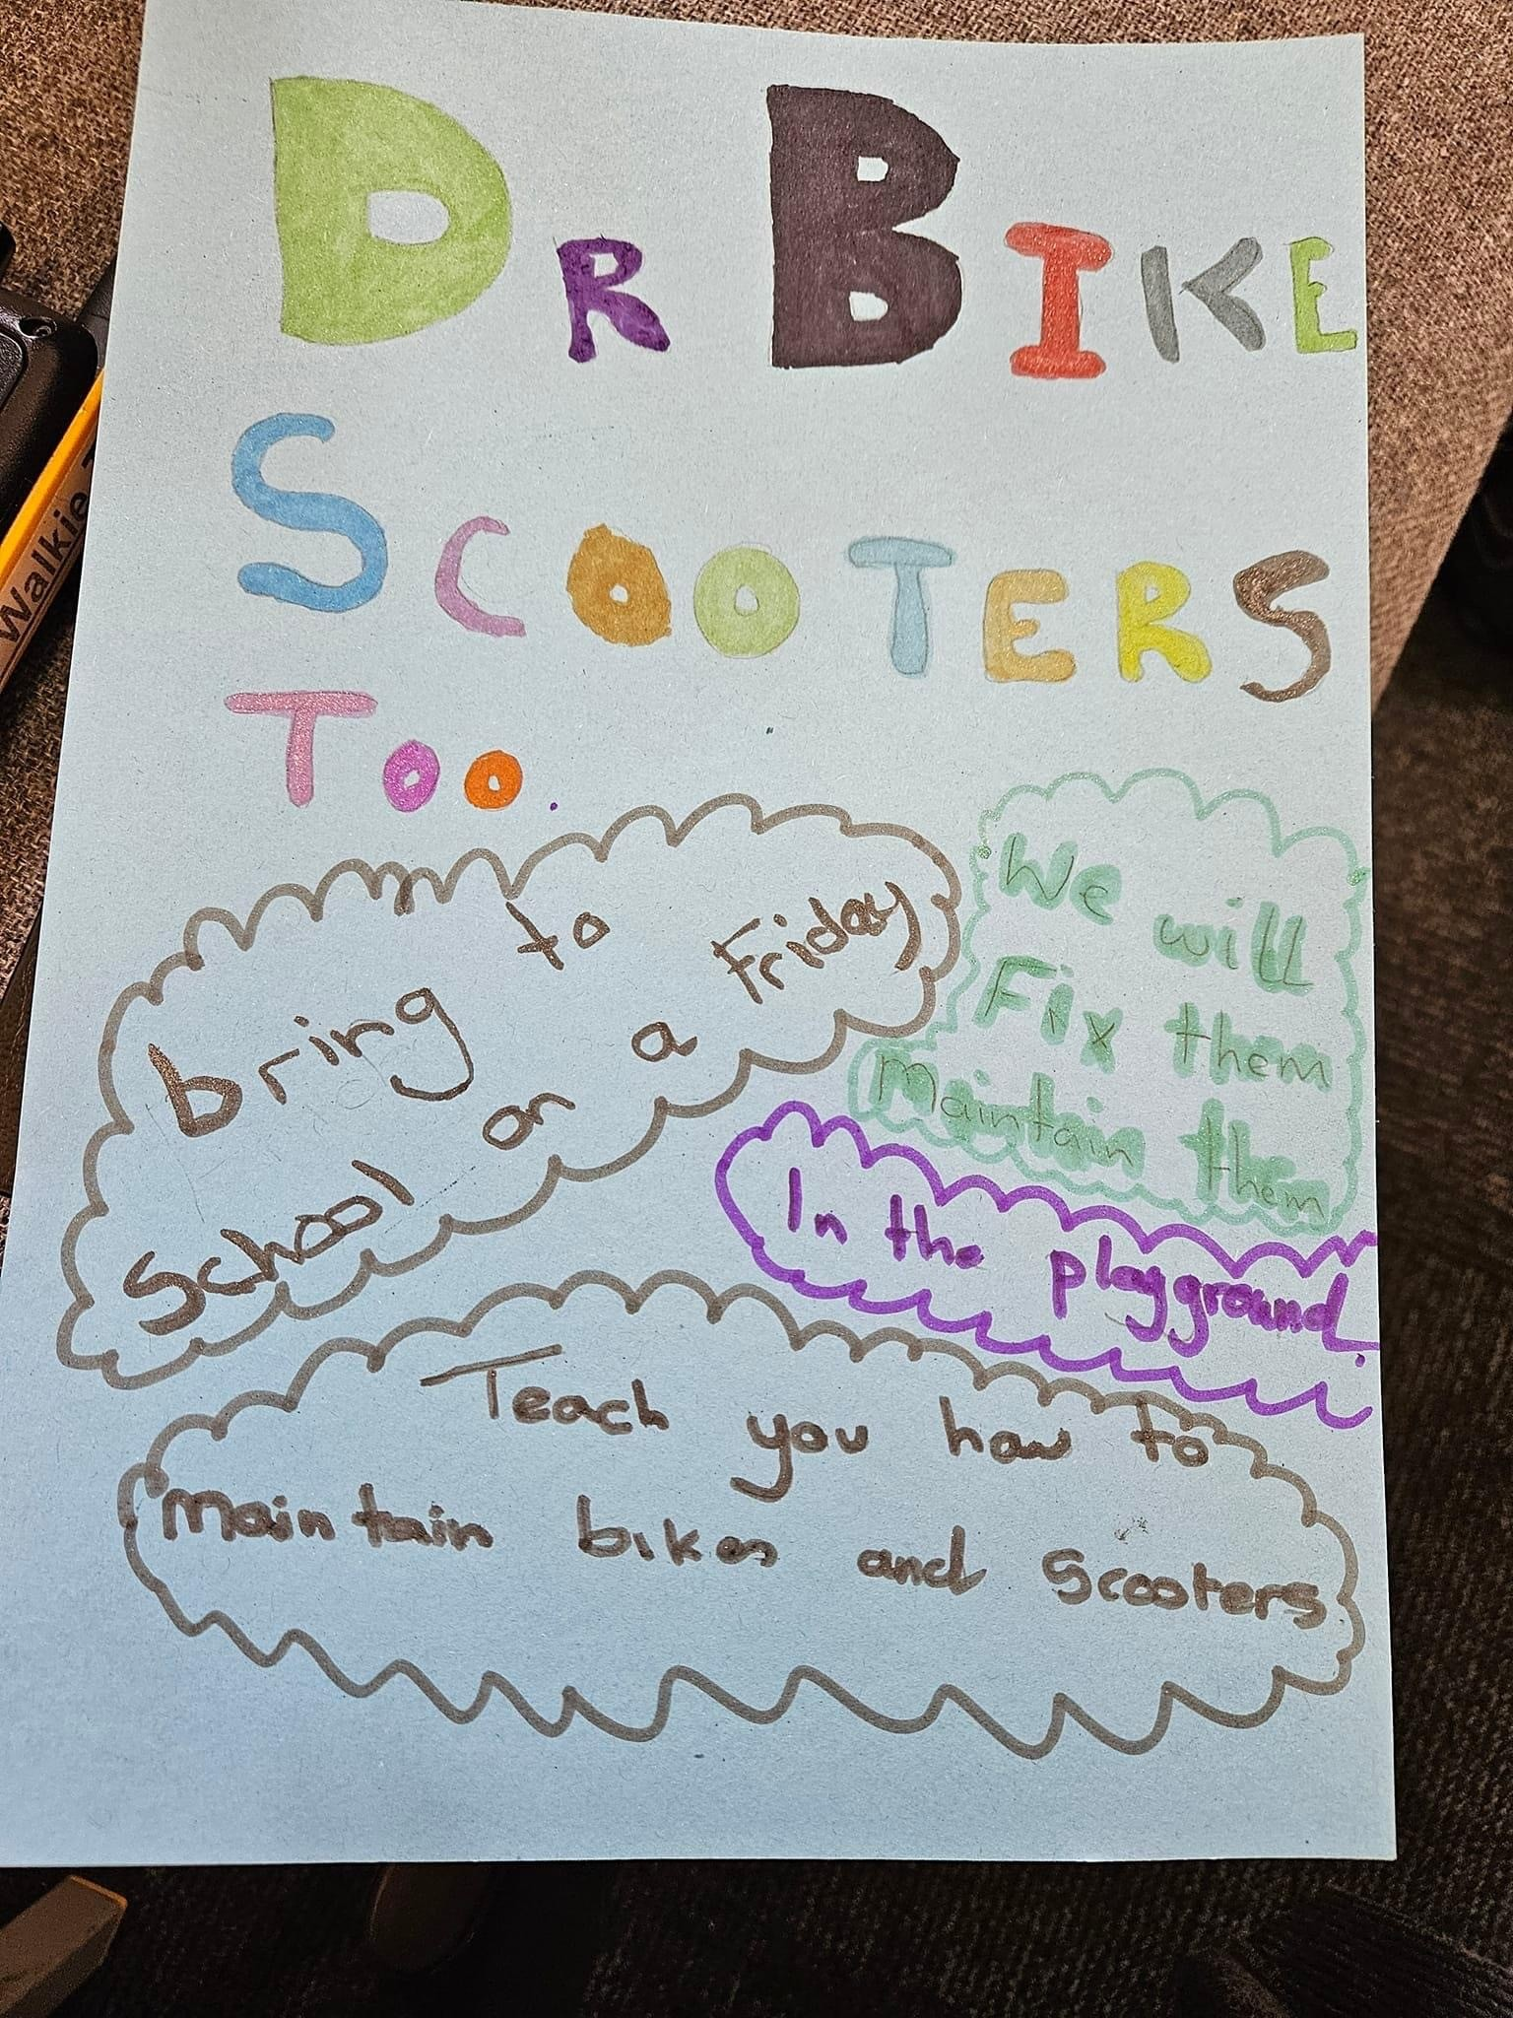
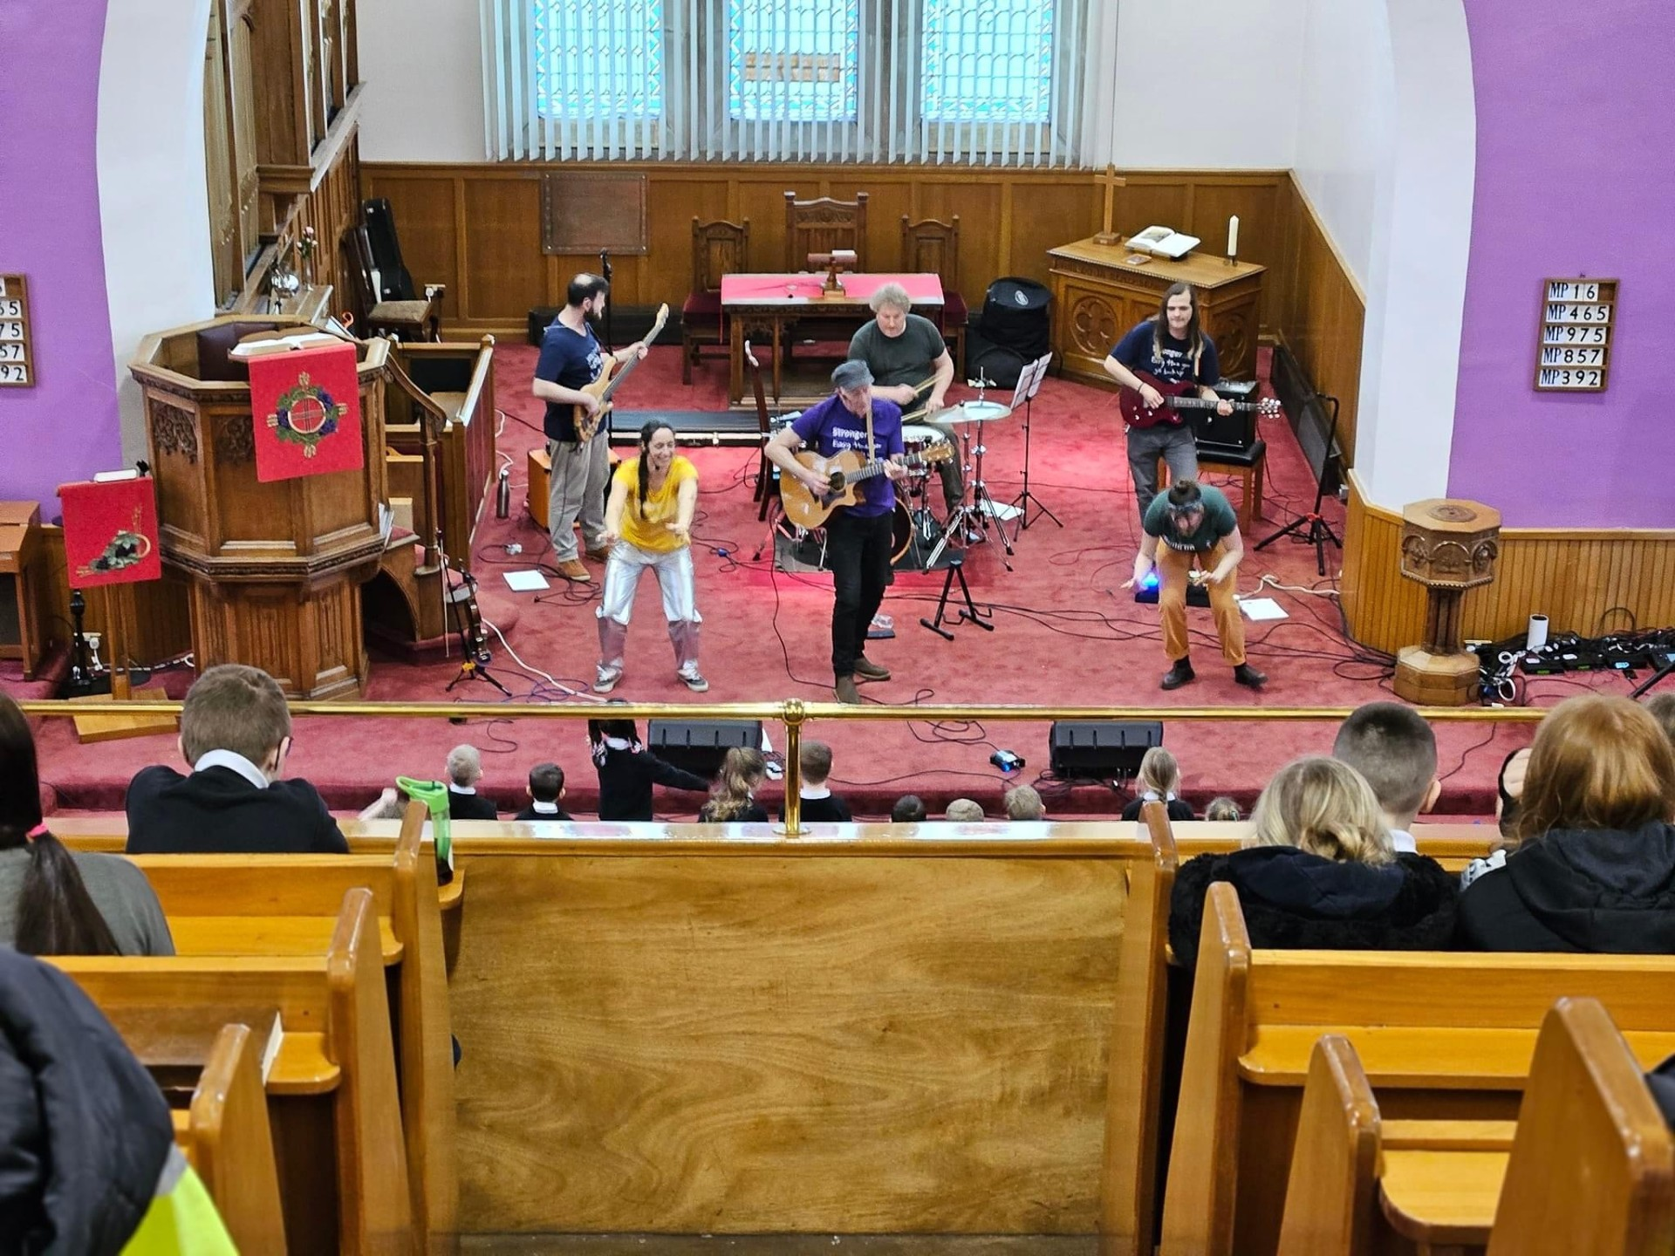
Celebrating Success
Dr Bike – Every Friday afternoon, some of upper school pupils are running ‘Dr Bike’ sessions. Children can bring bikes and scooters to school on Fridays and have these bikes serviced and fixed free of charge. Our upper school pupils are learning skills and building experience which will help them to achieve a Hi 5 Award (an SQA accreditation). We are so very proud of them!
Fischy Music Concert
Last term, we had a wonderful time participating in the Fischy Music YMI Programme. Children in Primary 5 wrote a fantastic song in partnership with children from Dysart Primary School and the whole school had a chance to perform this at Pathhead Church. It was a fab afternoon!

Slide 15
Updates to our building
You may have spotted that we are currently having new windows installed in our school. This is very exciting!
The work started in the Easter holidays and is expected to be completed by the end of the Summer holidays.
As a result of the school being a listed building, each window is being individually hand made in the workshop. We are therefore working at the pace of the workshop and updating as each window is ready.
We are working in partnership with building services to have each window replaced. There will be some minimal impact in the playground and nursery garden during this time as scaffolding is erected, but this should only last a couple of days at a time.
We may need to temporarily move children from their classroom to another classroom for 2 days to allow classroom windows to be installed, but there are no firm plans for this as yet.
If this is the case, we will ensure learning continues for all during this time.

Slide 16
Pupil Voice
On Wednesday 24th April, two of our Primary 6 children visited Dysart Primary School to share their opinions on school dinners. They met with school catering representatives from Fife Council, alongside children from Dysart and Sinclairtown Primary School.
They confidently shared their thoughts on the current meals on offer, including what children in our school like and dislike. They also learned some of the restrictions that are in place when planning the menus to meet nutritional guidelines.
The children had the opportunity to sample and give their opinions on new menu items that are planned to be introduced from August 2024.
On return to school, the children then spoke to the full school during assembly to share their experience. They represented the school so well and we are so proud of them!

Slide 17
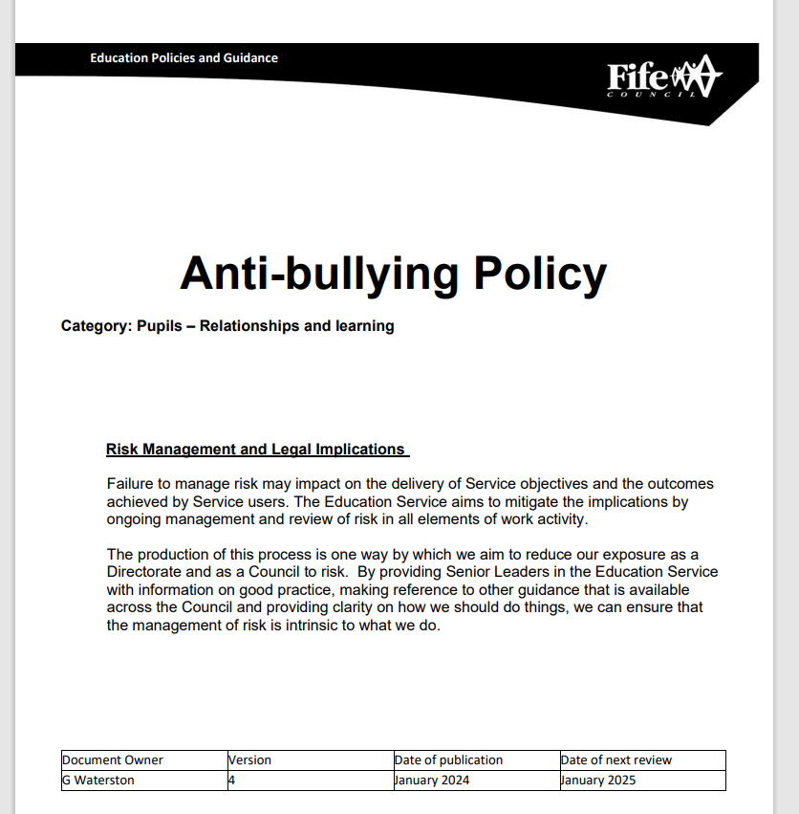
Anti-Bullying Policy
As a school, we are working to refresh our Anti-Bullying Policy.
We have set up a short life working group to develop this. The group is made up of parents and staff.
One meeting has taken place so far, with another planned for 15th May at 2pm.
We are always looking for more parents to join us. Please contact us at the office if you would be interested in joining us.

Slide 18
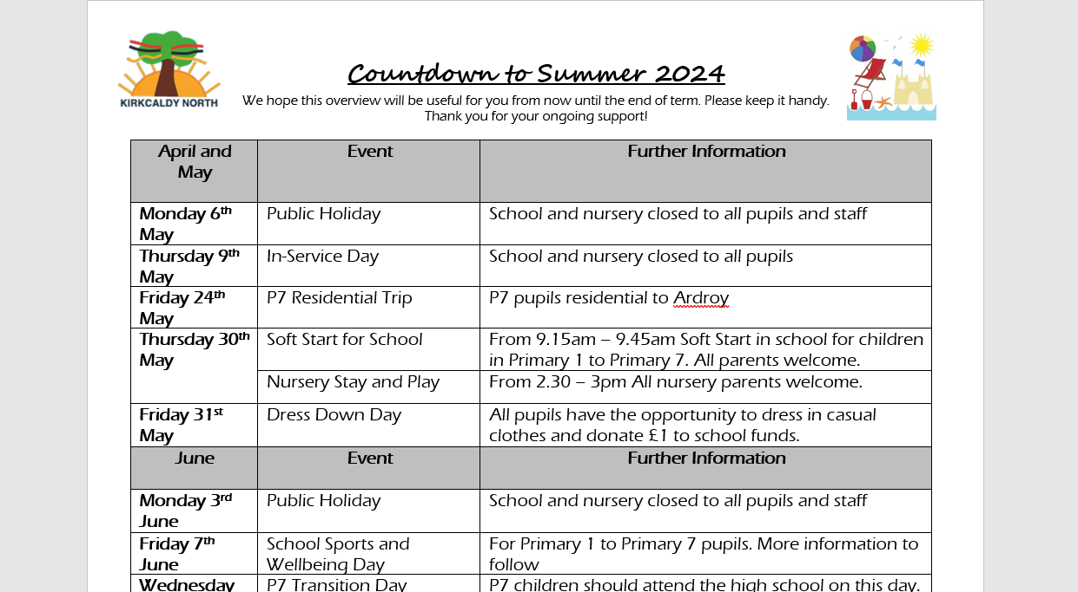
Dates for your diary
Please check your emails. Our “Countdown to Summer” was shared with all parents at the start of Term 4. Please refer to this for key dates for the remainder of this term.

Slide 19
Learning Partnership Visit
Learning Partnership Visit – Term 4
On Wednesday 24th April, we welcomed headteachers from Fair Isle Primary School and Denbeath Primary School, along with our Education Manager and the Quality Improvement Officer for Early Years for our Learning Partnership Visit. During this time, our visitors spent time in classes and talked to children and staff as part of our ongoing Quality Assurance processes. The following strengths and areas for improvement were identified:
Strengths:
Happy, confident children who were proud of their school
Children engaged in learning
Use of Support Staff to support learning
A range of interventions to raise attainment in Literacy and Numeracy
Warm, caring interactions in Nursery
Use of indoor and outdoor space in Nursery
Areas for Improvement:
Development of an Assessment Strategy across P1 to P7
Children learning about skills for life, learning and work
Standards and Expectations in jotters
Use of Feedback to support learning
Processes for tracking of attainment and self-evaluation in Nursery

Slide 20
School and Nursery Improvement Plan
The school and nursery improvement priorities for this session are:

Slide 21
School and Nursery Improvement Planning Session 2024 – 2025
We are always looking for feedback from our parents and carers to include in our School and Nursery Improvement Plans. If you have any feedback or any ideas you would like us to include in next session’s improvement planning – please do let us know.
We would welcome an email to: kirkcaldynorthps.enquiries@fife.gov.uk
Let us know your thoughts on what we could improve on ☺

Slide 22
KNPS CARES
Compassion
Ambition
Respect
Equity
Success
Values
We’d love to hear from you! If your child displays the school values out of school – please drop us an email at kirkcaldynorthps.enquiries@fife.gov.uk
We would love to celebrate this at assembly and share the news with everyone!

Slide 23
We show compassion through kindness
We have ambition to achieve
We show respect through our behaviour and attitude
We value equity through fairness
We celebrate success

Slide 24
Please always feel free to contact us with comments and queries. Telephone: 01592 583431 Email: kirkcaldynorthps.enquiries@fife.gov.uk Follow us on Facebook too

