Slide 1
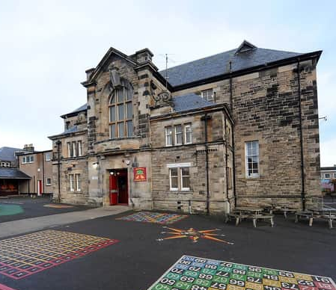
Kirkcaldy North Primary School Term 3 2023-2024 Newsletter

Slide 2
In this newsletter….
Staffing update
Helpful reminders – READY TO LEARN
Education Scotland Inspection
PE
Mobile Phones
Valuables and Toys
School and Nursery Improvement Plan
Dates for your diary

Slide 3
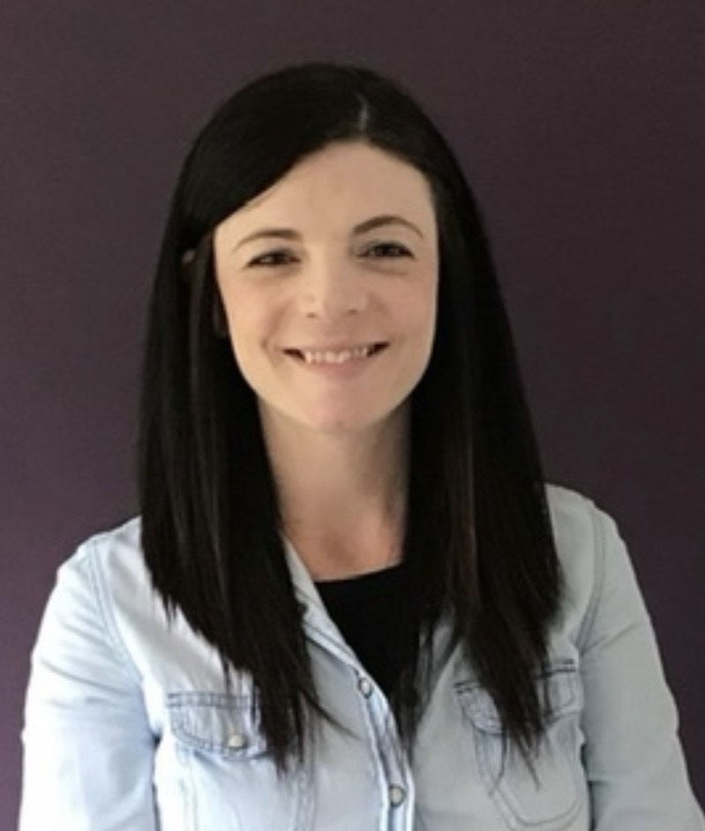
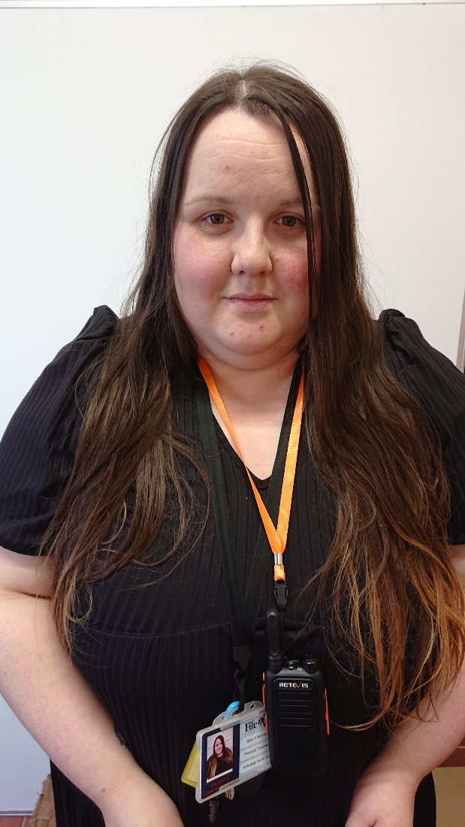
Staffing Update
Senior Leadership Team
Mrs Emma Clunie (Headteacher)
Miss Kayla Murray (Principal Teacher)
Mrs Clunie has a departmental remit
of Nursery – Primary 3/4
Miss Murray has a departmental remit
of Primary 5 – Primary 7

Slide 4
Staffing Update continued…
Our Teaching staff this session are:
Primary 1 - Miss A McDonald
Primary 1/2 – Mrs M McQuillan
Primary 3 - Mr R Thomason
Primary 3/4 – Miss E Marley
Primary 5 – Mrs K Duncan
Primary 6 – Mrs J Campbell
Primary 7 – Miss R Wilson
Non Class Contact Time – Miss Murray/Mrs B Clunie
EAL Support – Mrs B Clunie
Support for Learning Teacher – Mrs C Murray

Slide 5
Nursery Staffing…
Our Nursery staff team this session includes:
Mrs Y Miller – Early Years Lead Officer
Mrs H Stowe – Early Years Officer
Mrs K Wight - Early Years Officer
Miss N Benitez - Early Years Officer
Miss Z Winton (Early Years Officer)
Miss E Snaddon (Early Years Officer)
Mrs Elaine Walker – Nursery Teacher (Every 3rd Week)
Miss Stephanie Bryson (Early Years Development Officer) Stephanie visits us for a few days each month to support with Nursery development.

Slide 6
Office and PSA Staff
Mrs L Glasgow (Admin Assistant)
Miss L Plimer (School Support Assistant and Clerical Assistant)
Mrs T McGregor (Clerical Assistant) We recently welcomed Mrs McGregor to our Office. Mrs McGregor works with us every Thursday from 10 – 2pm
Mrs J Frame (PSA)
Mrs G Shaw (PSA)
Mrs C Melia (PSA)
Mrs R Dewar (PSA)
Ms K McFarlane (PSA)
Mrs K Kinloch (PSA)
Mrs M Londra (PSA)
Mrs F Coleman (PSA, Nurture, 2 days per week)
We are very sad to share that Mrs Dewar will be leaving us at the Easter Holidays to begin a new adventure. We know that you will join us in wishing Mrs Dewar all the best. We hope that she won’t be stranger! I am delighted to share that we will be welcoming Miss Rachel McMullen to the KNPS PSA team. Miss McMullen will start after the Easter holidays. She will also visit us before then to meet children, staff and families.

Slide 7
The Child Protection Coordinator is:
Mrs Clunie

Slide 8
The Depute Child Protection Coordinator is:
Miss Murray

Slide 9
How can you ensure your child is READY to learn?
We are encouraging children to ATTEND school every day. Regular attendance at school is absolutely crucial for learning. We will be rigorously monitoring pupil attendance this session and we will call you, or pop out to visit you, if we have any concerns.
Attend school ON TIME at 9am. Children will miss out on crucial learning time if they are late to school in the morning. Please support us by ensuring children are in the line with their class at 9am each day.
Wear SCHOOL UNIFORM. We are encouraging all children to take pride in KNPS by wearing their smart school uniform every day. Wearing school uniform also helps our children feel ready to learn. Children should not wear hoodies or tops with bright logos or writing on.
HEALTHY EATING. Did you know that we have a free Breakfast Café in our dinner hall each day? This opens at 8.15am daily and is free for all to attend, including adults. Encourage your child to start the day in the best way with a healthy, delicious breakfast (this will also help to make sure your child arrives at school on time).

Slide 10
How can you ensure your child is READY to learn?
HEALTHY EATING – Snack… Children are only required to bring one piece of healthy snack to school each day. Children should not bring giant sharing bags of sweets and/or crisps.
Drink WATER. Children should bring a water bottle to school each day. Please fill this up at home in the morning. Children will have the opportunity to fill this up in school throughout the day. Bottles should contain water only.
Change of clothes – If your child is prone to accidents, please ensure there is a spare change of clothes in their bag. Thank you.

Slide 11
Education Scotland Inspection October 2023
Follow this link to the full inspection report:
Details | Find an inspection report | Find an inspection report | Inspection and review | Education Scotland
In October 2023, we welcomed visitors from Education Scotland to carry out an inspection of our school. We are absolutely delighted to share that the inspection found the following strengths:
The highly-effective leadership of the headteacher.
The very effective teamwork of all staff.
The robust processes used by staff to monitor children’s progress in learning.
The very effective partnership work with a range of agencies and the Parent Council.
The following areas for improvement were identified:
Teachers should provide children with more opportunities to learn through a range of motivating contexts.
• Senior leaders and staff should provide children with increased opportunities to reflect on and improve their wellbeing.
• Senior leaders and staff should raise attainment in literacy and numeracy, ensuring all children make the best possible progress.

Slide 12
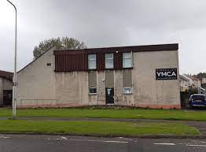
PE at the YMCA
A reminder that children from Primary 3 to Primary 7 will attend the YMCA on Hendry Crescent each week for PE.
In order to make best use of this facility and ensure that children receive their entitlement to PE each week, classes will go to the YMCA in all weathers.
Please check the weather forecast and ensure your child is dressed appropriately to walk to the YMCA each week.
Thank you for your support with this.
Monday – P3/4
Tuesday – P3
Wednesday – P7
Thursday – P5
Friday – P6

Slide 13
Mobile Phones
We would like to remind all children and adults that mobile phones are not permitted in school.
We are aware that some children may use a phone on the journey to and from school. However, mobile phones are not permitted in the classroom or public spaces in school.
Mobile phones must be handed to the class teacher on arrival at school, or to the school office for safe keeping.
Children can collect these at 3pm.
Staff will remind children that mobile phones must be handed in each morning. If a child refuses to give their mobile phone to their class teacher, or to the office, a member of school staff will call parents and ask for them to attend school to collect their child’s phone.
We appreciate your support with this as we endeavour to ensure that phones are not used inappropriately in school.

Slide 14
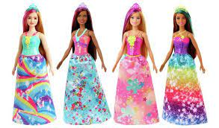
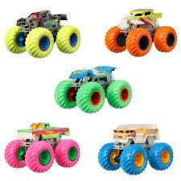
Valuables and Toys
This is a polite reminder to leave all valuables at home. We cannot guarantee that valuables will be safe in school as these items are often left unattended in trays or cloakrooms. If it is precious – please keep it safe at home. Thank you ☺
Please also leave toys at home. Many children are bringing in numerous toys to play with and these cannot fit in classroom trays, which means they are often left in cloakrooms or public areas. We have lots of fun things to play with in school, so toys are not needed. Thank you ☺

Slide 15
Dates for your diary
Parents Nights
We will be holding Parents Nights on Tuesday 19th March from 3.30-6.30pm and Thursday 21st March from 3.30-6pm.
This is a chance to speak with your child’s class teacher and learn about their progress this session.
Further information regarding appointments will be sent in due course.
Spring Family Fun Day – 23rd March 2024
Please join us on Saturday 23rd March from 10 – 12noon for some fabulous Spring fun for all the family! Our amazing Parent Council are organising this wonderful event. All funds raised will go towards supporting the whole school trip in Term 4. Bring along family and friends – all welcome! We can’t wait to see you there!
KNPS Larder
A wee reminder that our Larder is open during all of our open events. Our Larder is very well stocked with a variety of food, clothing and toiletries. Please contact us at school if your family would benefit from any of these items.

Slide 16
Dates for your diary
Sharing Learning (Primary 1 to Primary 7)
We continue to hold Soft Starts and Soft Finishes on the last Thursday of every month. Soft Start will take place between 9.15 and 9.45am and a Soft Finish takes place between 2.15 and 2.45pm. We will alternate these each month. The next opportunity to join your child in their learning will be a Soft Start on Thursday 29th February at 9.15am.
Learning Partnership Visit – Term 4
On Wednesday 24th April, we will be welcoming headteachers from Hyndhead School and Denbeath Primary School, alongside other visitors including our Education Manager. During this time, our visitors will be visiting classes and talking to children as part of our ongoing quality assurance processes. We look forward to sharing the feedback from this visit next term.
EASTER HOLIDAYS
School and Nursery will close on Thursday 28th March at 3pm for 2 weeks and will reopen to pupils on Monday 15th April 2024
Easter Service
Pupils from Primary 6 will be hosting an Easter Service on Wednesday 27th March at 9.30am. This will take place at Bennochy Church and all parents are invited to attend. We look forward to seeing you all there!

Slide 17
School and Nursery Improvement Plan
The school and nursery improvement priorities for this session are:

Slide 18
KNPS CARES
Compassion
Ambition
Respect
Equity
Success
Values
We’d love to hear from you! If your child displays the school values out of school – please drop us an email at kirkcaldynorthps.enquiries@fife.gov.uk
We would love to celebrate this at assembly and share the news with everyone!

Slide 19
We show compassion through kindness
We have ambition to achieve
We show respect through our behaviour and attitude
We value equity through fairness
We celebrate success

Slide 20
Please always feel free to contact us with comments and queries. Telephone: 01592 583431 Email: kirkcaldynorthps.enquiries@fife.gov.uk Follow us on Facebook too

