Slide 1
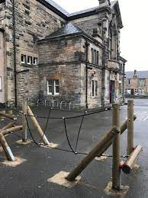
Kirkcaldy North Primary School Term 1 2023-2024 Newsletter

Slide 2
In this newsletter….
Staffing update
Helpful reminders – READY TO LEARN
PE Arrangements
Dates for your diary

Slide 3
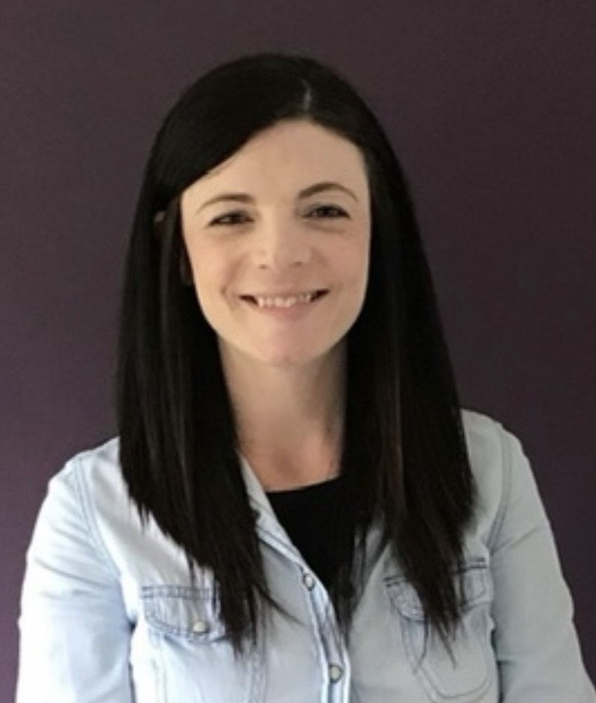
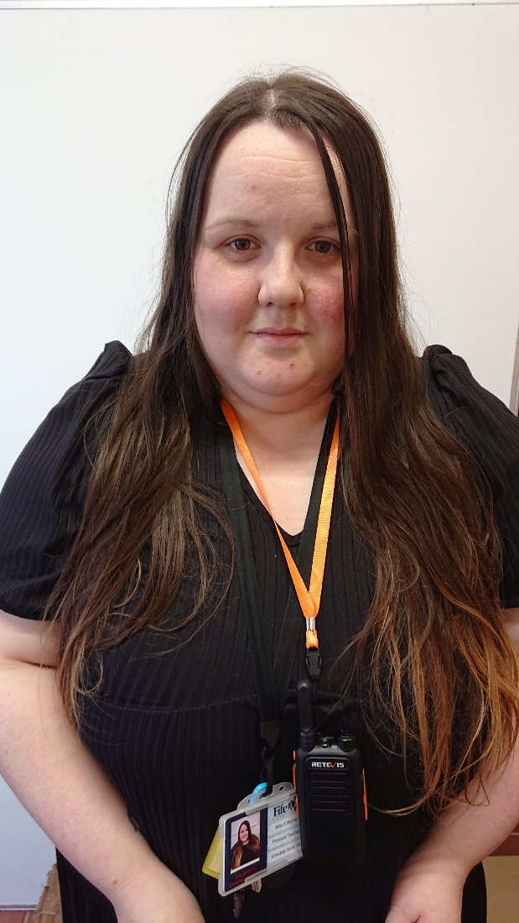
Staffing Update
Senior Leadership Team
Mrs Emma Clunie (Acting Headteacher)
Mrs Emma Clunie
Miss Kayla Murray (Principal Teacher)
Miss Kayla Murray
Mrs Clunie has a departmental remit
of Nursery – Primary 3/4
Miss Murray has a departmental remit
of Primary 5 – Primary 7

Slide 4
Staffing Update continued…
Our Teaching staff this session are:
Primary 1 - Miss A McDonald
Primary 1/2 – Mrs M McQuillan
Primary 3 - Mr R Thomason
Primary 3/4 – Miss E Marley
Primary 5 – Mrs K Duncan (Currently shared with Mrs R O’Keefe)
Primary 6 – Mrs J Campbell
Primary 7 – Miss R Wilson
Non Class Contact Time – Miss Murray
Support for Learning Teacher – Mrs Chloe Murray– We are delighted to welcome Mrs Murray to our school in the role of Support for Learning Teacher. Mrs Murray has already been working hard to get to know our children and school community. We are delighted to have her as part of the KNPS family. Mrs Murray will work with us from Monday to Thursday each week, and she also has responsibility for developing our whole school nurture provision.
Mrs B Clunie continues to work with us every Tuesday, supporting our learners who have English as an Additional Language. Mrs Clunie will also deliver Non class contact time to Primary 6 this session.

Slide 5
Nursery Staffing…
Our Nursery staff team this session includes:
Miss S McClymont – Early Years Lead Officer
Mrs H Stowe – Early Years Officer
Mrs K Wight - Early Years Officer
Miss N Benitez - Early Years Officer
Mrs Elaine Walker – Nursery Teacher (Every 3rd Week)
Miss Stephanie Bryson (Early Years Development Officer) Stephanie visits us for a few days each month to support with Nursery development.
We are delighted to welcome Miss Zoe Winton and Miss Emma Snaddon to our Nursery team this session. Zoe and Emma are Early Years Officers and they have settled well into our team and are already doing a super job of supporting our children!
EYLO POST – In bittersweet news…Stacey has secured a brand new job within Fife Council Out of School Club Service. This means that Stacey will sadly be leaving our nursery and will have her last day with us on Friday 1st September. This is fantastic news for Stacey as we know she will be wonderful in her new role, but of course we will be very sad to see her leave our nursery. I am sure you will join me in wishing Stacey all the very best in her new post.

Slide 6
Office and PSA Staff
Mrs L Glasgow (Admin Assistant)
Miss L Plimer (School Support Assistant and Clerical Assistant)
Mrs M Allan (Clerical Assistant) Mrs Allan works with us every Wednesday from 10 – 2pm
Mrs J Frame (PSA)
Mrs G Shaw (PSA)
Mrs C Melia (PSA)
Mrs R Dewar (PSA)
Ms K McFarlane (PSA) is currently on Maternity Leave and is due to return to work in January
Mrs K Kinloch (PSA)
Mrs M Londra (PSA)
Mrs L Birrell (PSA)
Mrs F Coleman (PSA) Every Wednesday and Friday
We are delighted to welcome Mrs Birrell and Mrs Londra to our PSA Team. Mrs Birrell is currently supporting children in Primary 1 and Mrs Londra is working closely with children in Primary 5. They have been wonderful additions to our KNPS family!

Slide 7
Timetabling
Teachers are contracted to have children in class for 22.5 hours per week. This means that they are entitled to 2.5 hours per week of non-class contact time (NCCT)
The Senior Leadership Team lead assemblies every Monday morning which ensures that 50 minutes of this time is allocated to this.
For the remainder of a teacher’s NCCT, please see the timetable below. Your child’s class will be taught by either Miss Murray or Mrs B Clunie at the times detailed below. This rotates throughout the year and can be flexible, depending on staffing.
 | 9 – 10.40am | 10.55 – 12.35 | 1.20 – 3pm
Tuesday | P7 Miss Murray | P1 Miss Murray | P1/2 Miss Murray P6 Mrs B Clunie
Thursday | P3 Miss Murray | P5 Miss Murray | P3/4 Miss Murray

Slide 8
The Child Protection Coordinator is:
Mrs Clunie

Slide 9
The Depute Child Protection Coordinator is:
Miss Murray

Slide 10
How can you ensure your child is READY to learn?
We encourage children to ATTEND school every day. Regular attendance at school is absolutely crucial for learning. We will be rigorously monitoring pupil attendance again this session and we will call you, or pop out to visit you, if we have any concerns.
Attend school ON TIME at 9am. Children will miss out on crucial learning time if they are late to school in the morning. Please support us by ensuring children are in the line with their class at 9am each day.
Wear SCHOOL UNIFORM. We encourage all children to take pride in KNPS by wearing their smart school uniform every day. Wearing school uniform also helps our children feel ready to learn. Children should not wear hoodies or tops with bright logos or writing on.
HEALTHY EATING. Did you know that we have a free Breakfast Café in our dinner hall each day? This opens at 8.15am daily and is free for all to attend, including adults. Encourage your child to start the day in the best way with a healthy, delicious breakfast (this will also help to make sure your child arrives at school on time).

Slide 11
How can you ensure your child is READY to learn?
HEALTHY EATING – Snack… Children are only required to bring one piece of healthy snack to school each day. Children should not bring giant sharing bags of sweets and/or crisps.
Drink WATER. Children should bring a water bottle to school each day. Please fill this up at home in the morning. Children will have the opportunity to fill this up in school throughout the day. Bottles should contain water only.
Change of clothes – If your child is prone to accidents, please ensure there is a spare change of clothes in their bag. Thank you.

Slide 12
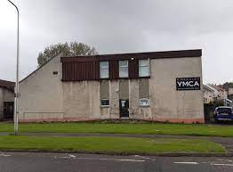
PE
From Monday 28th August, children from our P3 to P7 classes will participate in PE lessons at the YMCA building at Hendry Crescent.
This was hugely successful last session, with very positive feedback from both children and staff.
Using the YMCA allows children to participate in PE in a larger, purpose-built sports hall, whilst also developing a partnership with our partners in the community.
There is also benefit to the whole school, as a reduction in the number of PE lessons taking place in the central hall throughout the school day results in calmer and more purposeful learning environments for all.

Slide 13
Timetable for PE at the YMCA
Monday – Primary 3/4
Tuesday – Primary 3
Wednesday – Primary 7
Thursday – Primary 5
Friday – Primary 6
We are always looking for parent volunteers to support our classes with walking to the YMCA and back each week.
We are looking for grown ups to commit to walking with a class every week please if possible.
If this is something you can help with, please contact us at the school. Thank you!

Slide 14
PE Reminders
PE Kit – Children in Primary 1 and Primary 1/2 should bring a PE kit to school, with a change of indoor shoes. This should go home regularly to be washed and returned to school again. Children in Primary 3 to Primary 7 can come dressed to school in their PE kit on their allocated YMCA PE day.
Jewellery - Jewellery should not be worn on PE days. Please remove all jewellery before attending school on PE days.
Earrings - Children cannot participate in PE if they are wearing earrings. Children will be asked to remove earrings. If earrings cannot be removed then your child should bring a roll of micropore tape in their school bag and will be asked to tape over their own earrings (please note: staff cannot do this, so children will be asked to tape their own ears. Please practise this with your child if necessary) The easiest thing to do is to remove all jewellery before attending school.
Football strips of any kind are not permitted in school.

Slide 15
Dates for your diary
Parents Evenings
We will be holding Parents Nights on Tuesday 26th September from 3.30-6.30pm and Thursday 5th October from 3.30 – 6pm
This is a chance to speak with your child’s class teacher and learn about their progress so far.
Further information regarding appointments will be sent to you in due course.
School Photos
These will take place on Thursday 7th September and Friday 8th September. Further information will follow.
Judo Tasters
Children in school will have the opportunity to experience Judo Taster Sessions on Thursday 31st August
Soft Starts and Soft Finishes
You are welcome to join your child in class for a Soft Start or Soft Finish on the last Thursday of every month. This is an opportunity to learn a bit more about your child’s learning and share in their success. Dates for this term are:
Thursday 31st August – Soft Start – 9.15 – 9.45am
Thursday 28th September – Soft Finish – 2.15 – 2.45pm
Parent Council AGM
Our Parent Council AGM will take place on Wednesday 6th September at 9.10am in school. All parents welcome!

Slide 16
Dates for your diary
KNPS Larder
Our Larder is very well stocked with a variety of food, clothing and toiletries. If you require any specific items, please do not hesitate to contact us at school and we will do our best to source these for you. This term, our Larder will be open to all parents on the following dates:
Thursday 31st August 9am-9.30am
Thursday 14th September 9am-9.30am
Thursday 28th September 2.15 – 3.00pm
Thursday 5th October 9am-9.30am
Please respect the 1 item rule so we can ensure there is enough for everyone.
Please also remember to bring your own bag as we do not have any spares. Thank you!
OCTOBER HOLIDAYS
School and Nursery will close on Friday 6th October at 3pm for 2 weeks and will reopen to pupils on Monday 23rd October at 9am.
Dress Down Fridays
We will continue with Dress Down Fridays this session. These take place on the last Friday of every month. Children are asked to donate £1 to dress down, with money going directly to school funds. Last year we used the funds to purchase snack items for children, to help pay for the buses for our whole school trip and to purchase cosy cushions and furnishings for our library. It makes a huge difference – thank you!

Slide 17
Nursery
NURSERY STAY AND PLAY and BOOKBUG
All Nursery parents and carers are invited to join us for Stay and Play Sessions on Thursday 31st August from 2.30 – 3pm and Thursday 28th September from 9 – 9.30am
Bookbug sessions will take place weekly, in our beautiful library, on Wednesdays from 9.15 – 9.45am. Sessions will take place on the following dates:
30th August
6th September
13th September
20th September
27th September
4th October

Slide 18
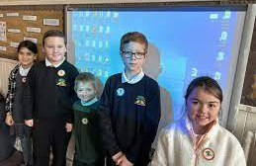
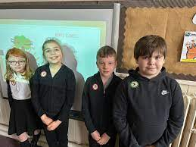
We continue to celebrate our school Values by recognising when children are displaying these in school.
KNPS CARES
Compassion
Ambition
Respect
Equity
Success

Slide 19
KNPS CARES
Compassion
Ambition
Respect
Equity
Success
Values
We’d love to hear from you! If your child displays the school values out of school – please drop us an email at kirkcaldynorthps.enquiries@fife.gov.uk
We would love to celebrate this at assembly and share the news with everyone!

Slide 20
We show compassion through kindness
We have ambition to achieve
We show respect through our behaviour and attitude
We value equity through fairness
We celebrate success

Slide 21
Please always feel free to contact us with comments and queries. Telephone: 01592 583431 Email: kirkcaldynorthps.enquiries@fife.gov.uk Follow us on Facebook too

