Slide 1



Parental Information Slides

Slide 2

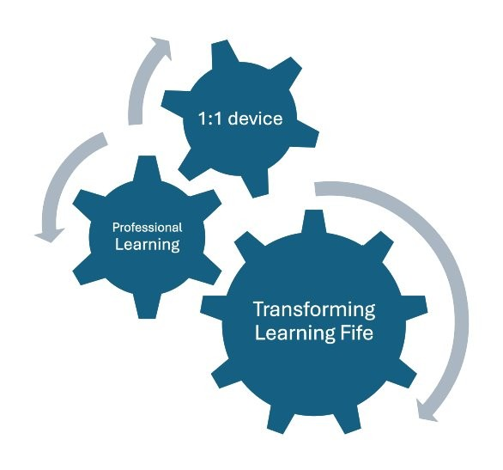
Our Aim
To provide your child with the tools needed to transform the ways we engage with learning and teaching.
This is an investment in young people to develop their confidence as well as the digital skills they will need throughout their educational journey and beyond.

Slide 3
Our Vision
In 5 years time, teachers in Fife will have transformed learning by:
integrating digital skills throughout the learning process to engage and motivate learners
using technology for effective explanations and modelling to learners
providing personalised learning experiences and facilitating learners to lead their own learning
improving assessment and feedback with digital tools

Slide 4



Jamf Parent - setting iPad restrictions at home
Using the Jamf Parent app you can:
allow and restrict apps to choose which apps your child can use
enable App Lock to set a timer for app restrictions
create locations to see the approximate location of your child’s device
create a Device Rule to schedule app restrictions
https://read.bookcreator.com/ets9ByGBmOa3zYFDTgg4GgES0Ra2/YRCP3NDmTgeTg4FGunRxYQ

Slide 5


Showbie - viewing your child’s schoolwork at home
By creating a Showbie parent account you can:
see your child’s assignments, feedback, and grades
receive email or push notifications about new assignments, deadlines, and feedback
Notes:
Optional – depending on if your school is using Showbie this academic year

Slide 6

Parental Agreement
Fife Council provides P6-S6 pupils with an iPad to support their learning in and out of school. By your child using this iPad, you, as a parent/carer, agree to the following terms:
Responsibility for Parents
You are responsible for the safe storage and use of the iPad at home | Your child must bring their iPad to school fully charged every day
The iPad should be stored securely when not in use | No stickers or markings should be placed on the iPad or case
If the iPad is lost, stolen, or damaged, report it to the school immediately | If your child leaves Fife Council Education, the iPad must be returned to their school

Slide 7

Damage - Repair/Replacement Costs
These are estimated costs and are to be confirmed. Discussions are ongoing with the local contractor.
Item | Contribution 1st Repair | Contribution 2nd Repair
Damage to screen | £70 | £150
Damaged charge port | £65 | £140
Lost or device beyond repair | £150 | £200
https://blogs.glowscotland.org.uk/fi/transforminglearning/repair-replacement-costs/

Slide 8

School Expectations
In line with our school values, we expect children to be
Ready: coming daily with your iPad, charged up and ready to use. We’re ready with our ‘can-do’ attitude, thinking about new ways to learn using technology. Ready to listen to our teacher’s instructions.
Respectful: Treat the technology with respect, this includes the device and the work and apps you use. We communicate with others through our iPad respectfully.
Safe: We follow online safety approaches. We don’t share confidential information.

Slide 9
School Expectations
We’re exited for the learning adventure ahead!
We expect we’ll be using our iPads daily but not all the time.
We expect to use our iPads for core learning like numeracy or literacy tasks but also being innovative and exploring new ways of learning and adaptive tools too.
We expect it will take time to learn about the variety of ways we can use our iPad and its apps.
We expect pupils and staff to only use their iPad for educational purposes.
We expect pupils and staff to take care of their device. Damages should be reported to Mrs Gardiner

Slide 10

Questions?
Please scan the QR code to visit the Transforming Learning programme’s FAQs.
https://blogs.glowscotland.org.uk/fi/transforminglearning/frequently-asked-questions/

