Slide 1

Inverkeithing Primary School
Welcome to Primary 1 ~ August 2024

Slide 2

Promote close co-operation and communication between parents and teachers
Identify and represent the views of parents on the education provided by the school
Study and discuss matters affecting the education and welfare of pupils; and engage in activities which support the education and welfare of pupils

Slide 3

How can you get involved?
Become a member of the Parent Council and year group rep and attend 4-6 meetings a year
Volunteer at school events
Let us know ideas/suggestion to discuss at Parent Council meetings
Become a member of the PTA
Take on the role of Chair or Secretary of the Parent Council
Become a Parent Council Facebook group admin

Slide 4
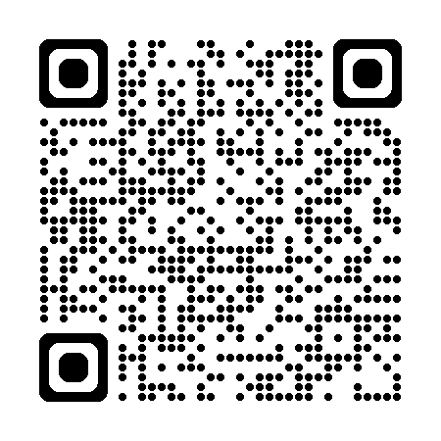
Have a look at our ‘Welcome to P1’ Sway!
Introducing our school…
our school day
uniform
sharing &
supporting learning
celebrating
success
child protection
school dinners
& milk
term dates
attendance
Out of School Club

Slide 5

Essential School kit…
We are very proud of our school uniform and visitors often comment how smart the children look.
Our school uniform is:
Black or grey trousers or skirt
White (or yellow) polo shirt or white school shirt
Blue school sweater or cardigan (with school badge)
School tie
Every day you child needs:
School uniform ~ labelled please!
Gym kit (shorts, gym shoes, T-shirt)
School bag
Snack
Packed lunch/school meal organised
Waterproof jacket
Water bottle
Things to leave at home:
Toys
Jewellery
At school we stock:
Ties
We actively discourage:
Sports branded clothing
Hoodie tops (with the exception of our Leavers’ tops)
Coloured clothing different to our school colours (blue/black)

Slide 6

Names, names, names!
You will be amazed how much school uniform, lunchboxes, shoes and jackets we collect in our lost property pile!
Please help us to help your child get all their belongings back by writing their name on a label!

Slide 7
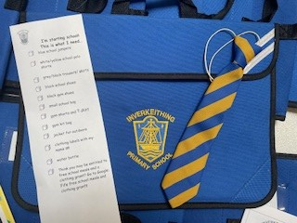
School uniform

Slide 8
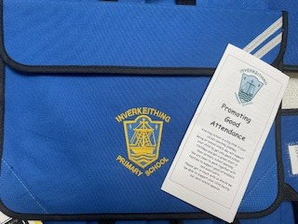
Great
Attendance!

Slide 9
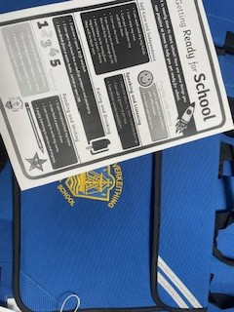
Getting ready for school!

Slide 10
Preparations for P1
(outdoors)
When your child gets ready to go outside, they will have a number of jobs to do again! Changing shoes, putting on and fastening their coat, organising their snack, water bottle or bag.
We’ll help anyone who is struggling but here’s practical ways you can help…
  Practise putting on and taking off shoes – make it a game, how fast can they do it?
  Putting on their coat and fastening it every time they leave the house
  Packing their bag

Slide 11
Preparations for P1 (indoors)
When your child comes to school, they have a number of jobs to do even before they enter the classroom. Hanging up their coat, changing shoes, putting their water bottle on the trolley, putting their snack in their tray.
At home try helping you child to be independent to:
  taking off their coat
  changing shoes
  taking their water bottle and snack out of a bag

Slide 12
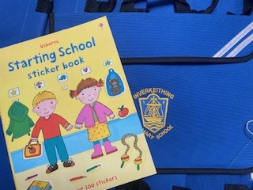
Getting excited!

