Slide 1

Inverkeithing Primary School
Welcome to Primary 1 ~ August 2024

Slide 2

Welcome to our school!
In this presentation you can find information that will help you to familiarise yourself with Inverkeithing Primary School.

Slide 3
Welcome to Inverkeithing Primary School!
Our school has a positive ethos and is committed to celebrating success and encouraging high self-esteem in all its pupils.
The staff have high expectations of all the children and work hard to provide an appropriate and stimulating education for all the children.
We are an inclusive school in which staff and pupils alike aim to be:
  Responsible Citizens
  Effective Contributors
  Successful Learners
  Confident individuals

Slide 4
All about Inverkeithing Primary.
More about our building…
16 classrooms arranged in 5 ‘pods’
Community lounge,
Dining / Assembly hall with toilet facilities,
Gym hall with changing rooms,
Tutorial rooms,
Resource rooms,
Storage rooms,
Library with access to ICT
Medical / first aid room
Laundry;
Staffroom,
Offices for SMT, Admin and Support staff
Reception area;
Sensory Room,
Tarmac and grass playgrounds
Developing garden areas

Slide 5
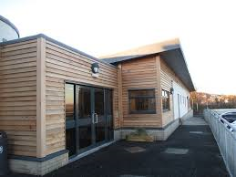

Nursery to Primary… moving on!
Moving from Nursery to Primary School is a big deal. Staff at both our nursery and school aim to make this a smooth process by…
Sharing information so staff at school get to know your child quickly
Nursery staff bring the children to visit our P1 classrooms
Staff share your child's PLJ
We work with our partner agencies to ensure the best possible support is available for all our children
Parent and carers can help us by…
Keeping us up to date with information about your child
Regular attendance at nursery to help us prepare your child for school.

Slide 6
Nursery to Primary…moving on!
This session our transition work includes
P1 / N4 joint transition working where the children will explore and learn together.
Visits from our staff to the Nursery playrooms
Visits from the N4 pupils to see the P1 classroom, spending time sharing stories and doing activities.
Transition activities have already started with our nursery children joining in with assemblies, using the dinner and gym halls and library.
Parent and carers can help us by…
Regular attendance at nursery to help us prepare your child for school and to make sure they attend all their P1 visits.

Slide 7
Inverkeithing Primary School
Our vision…
Learning Together,
Achieving Together!

Slide 8
Inverkeithing Primary School
Our values…
Ready,
Respectful,
Safe.

Slide 9
First days in Primary 1
School starts Wednesday 21st August 2019
Children attend full time from the start of term.
Our school day:
Starts at 9:00am ~ pupils' line up outside the cloakroom corridor
Break is at 10:40am
Lunchtime is at 12:40pm – younger children come down around 12:20pm. We would encourage your child to have dinner at school. All P1-3 children receive free school meals.
Home time is at 3:00pm ~ pupils are collected at the classroom doors.
Help us by:
  Coming to school on time
  Making sure your child is prepared (enough sleep, school uniform, snack)
  Talk about and treasure everything your child brings home
  Keep in touch with school staff ~ let us know of any worries, questions or home updates

Slide 10

We have a proactive group of parents who form our Parent Council and separate PTA fundraising group.
Promote close co-operation and communication between parents and teachers
Identify and represent the views of parents on the education provided by the school
Study and discuss matters affecting the education and welfare of pupils; and engage in activities which support the education and welfare of pupils

Slide 11

How can you get involved?
Become a member of the Parent Council and year group rep and attend 4-6 meetings a year
Volunteer at school events
Let us know ideas/suggestion to discuss at Parent Council meetings
Become a member of the PTA
Take on the role of Chair or Secretary of the Parent Council
Become a Parent Council Facebook group admin

Slide 12
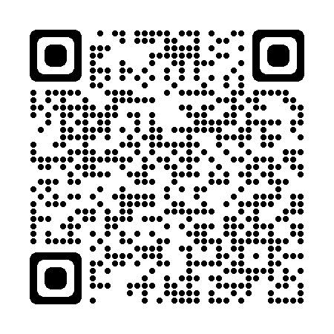
Have a look at our ‘Welcome to P1’ Sway!
Introducing our school…
our school day
uniform
sharing &
supporting learning
celebrating
success
child protection
school dinners
& milk
term dates
attendance
Out of School Club

Slide 13
Preparations for P1 (indoors)
When your child comes to school, they have a number of jobs to do even before they enter the classroom. Hanging up their coat, changing shoes, putting their water bottle on the trolley, putting their snack in their tray.
At home try helping you child to be independent to:
  taking off their coat
  changing shoes
  taking their water bottle and snack out of a bag

Slide 14
Preparations for P1
(outdoors)
When your child gets ready to go outside, they will have a number of jobs to do again! Changing shoes, putting on and fastening their coat, organising their snack, water bottle or bag.
We’ll help anyone who is struggling but here’s practical ways you can help…
  Practise putting on and taking off shoes – make it a game, how fast can they do it?
  Putting on their coat and fastening it every time they leave the house
  Packing their bag

Slide 15

Essential School kit…
We are very proud of our school uniform and visitors often comment how smart the children look.
Our school uniform is:
Black or grey trousers or skirt
White (or yellow) polo shirt or white school shirt
Blue school sweater or cardigan (with school badge)
School tie
Every day you child needs:
School uniform ~ labelled please!
Gym kit (shorts, gym shoes, T-shirt)
School bag
Snack
Packed lunch/school meal organised
Waterproof jacket
Water bottle
Things to leave at home:
Toys
Jewellery
At school we stock:
Ties
We actively discourage:
Sports branded clothing (no football club clothing please)
Hoodie tops (with the exception of our Leavers’ tops)
Coloured clothing different to our school colours (blue/black)

Slide 16
School Uniform
Our 2 school uniform suppliers are:
My Clothing
and
www.border-embroideries.co.uk/schools/inverkeithing-primary-school
In school we have a selection of good quality second hand school uniform which families can request. Contact the school office if this would be helpful to have for your child.

Slide 17

Names, names, names!
You will be amazed how much school uniform, lunchboxes, shoes and jackets we collect in our lost property pile!
Please help us to help your child get all their belongings back by writing their name on a label!

Slide 18
Attend to Achieve!
We have a duty to record attendance. Children who attend school regularly will do better academically.
Please let us know, by phoning the school office, as soon as possible if your child is off school.
If you are running late, please let the office know so we can update our records.
We will phone or write to you if we have concerns about your child’s attendance.

Slide 19





I look for good attendance at school when taking on new apprentices.
When young people attend school they are safe & not in harm’s way in the community .
At nursery I learn how to make friends & to make sense of my world.
Mr Hill, Fife Council Housing Maintenance Manager
PC Bobby, Fife Constabulary
Sophie, Caterpillar Nursery
Attend to Achieve!
95% attendance means you are missing half a day of learning every week
When I’m late I always miss the first part of the maths lesson
I find it hard to catch up
Miss Honey, Sunshine School
Liam, Rainbow School

Slide 20
Sharing our Learning at school
We have many opportunities throughout the year for parents to come into school and see how their child is getting on and the classroom environment. We share the dates for these through our monthly newsletters.
On a monthly basis we currently run Shared Finishes for all classes. Family members can come in and share activities and games. This is a great opportunity to share with your child their school successes and see what is going on in class.
Termly we hold ‘sharing our learning’ events when we show case learning in the form of a ‘show’, special assembly or class. Stage group specific event.
We also use our Seesaw app to share regular photos and updates from your child’s teacher.

Slide 21
School Dinners!
We use a cashless system (iPay) for parents to purchase school dinners.
This is an online system.
We will provide a link for families to get set up during the first week of school in August.
Families can pre-order school meals through this system.
If you already have an iPay account, your new P1 child can be added, or their account transferred from their nursery to school.

