Slide 1
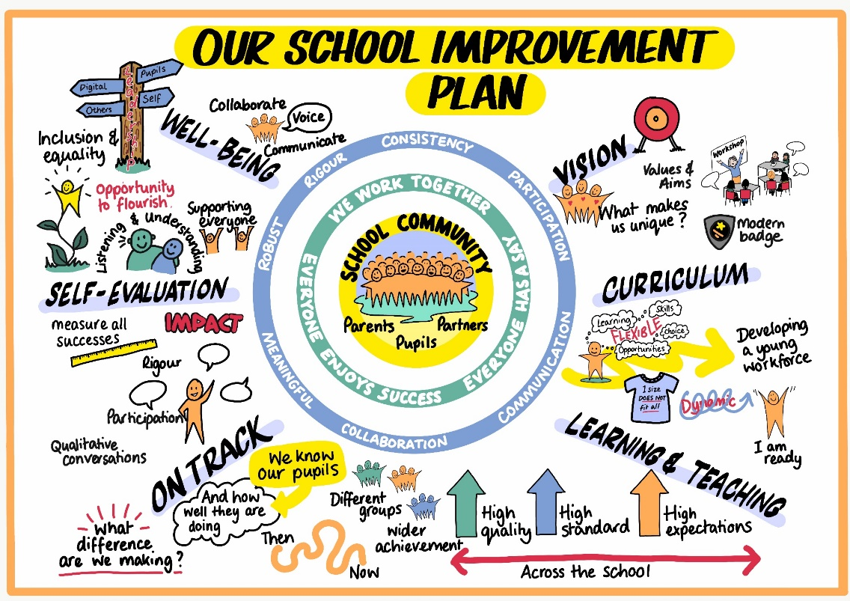

Slide 2
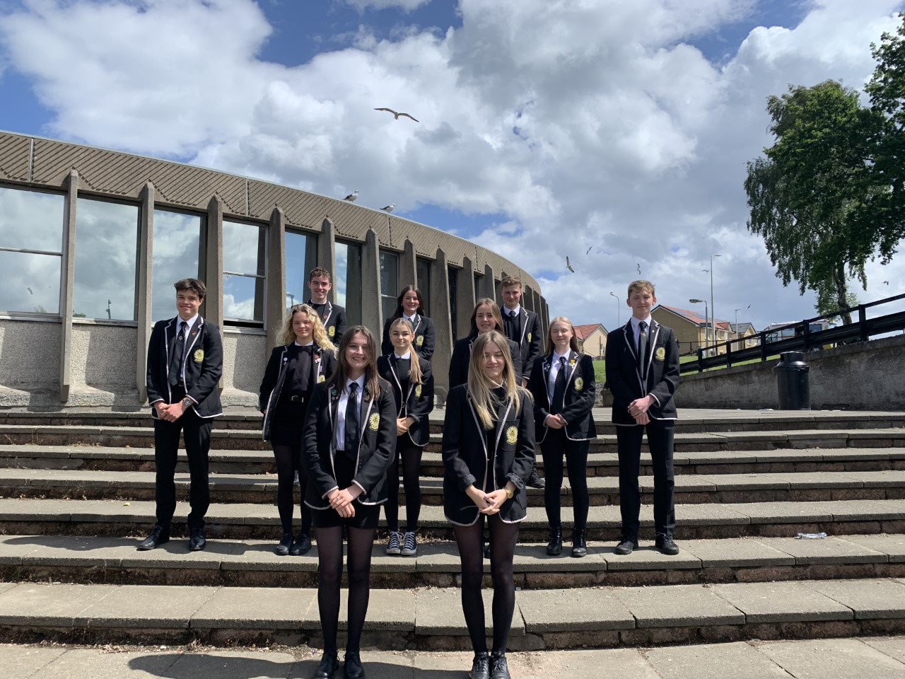
P7 Parent/Carer Evening 2023
Grow by Choice

Slide 3
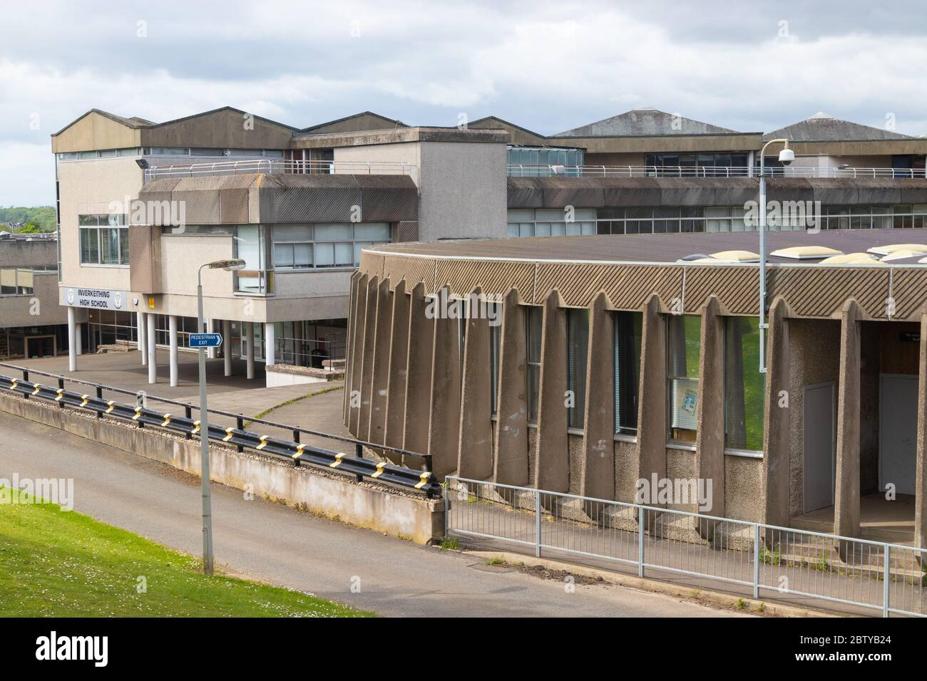
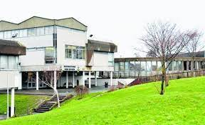
Purpose of Meeting
Facilities in school
Secondary – Differences
and continuity
Daily Schedule
School policies and charter
Opportunities
S1 Views
Pupil Support
Question time
Notes:
Overview of the evening, discuss house keeping – mute mics, questions in chat panel

Slide 4
Our school

Slide 5
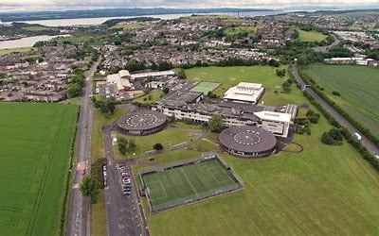
Our Building
What do you think
It looks like?
Notes:
Ask first what they know about the shape of the school, perhaps guesses within the chat function, then click the button

Slide 6
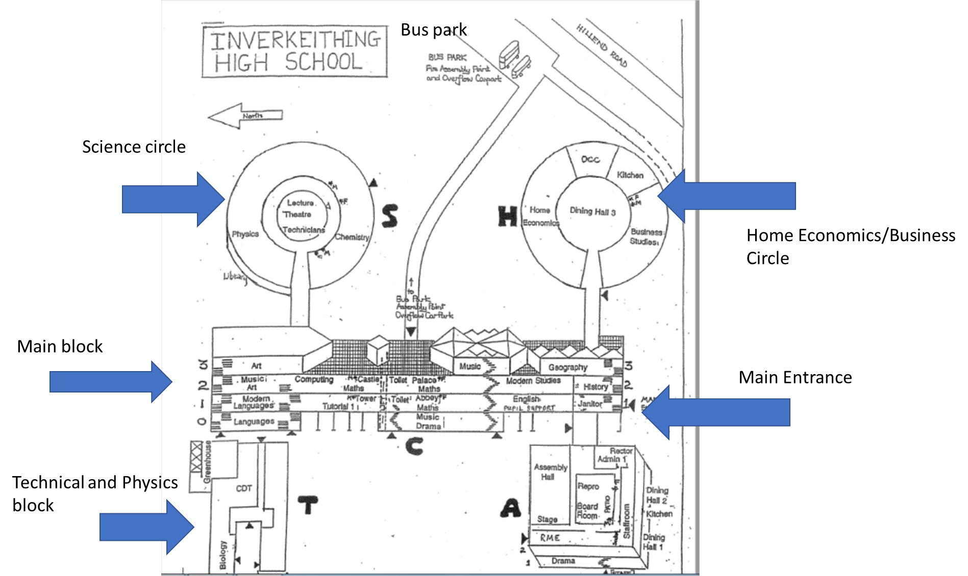
Map
ASTRO
PE WING
PE Block includes:
Large Games Hall, small gym,
fitness Suite, swimming pool
and tennis courts
Notes:
Talk through the various facilities on the map, talk about the 3 floors and room numbers etc, also the T,S,H block

Slide 7
Differences

Slide 8
Differences
Size of year group and classes
Subjects
Structure of the day
Breaks and lunches and Dining Halls
Notes:
Talk about two types of class practical and non practical, number of teachers potentially 15 per week, in total 90 approx.
Subjects up to 12 in a week. Next slide for timetable

Slide 9
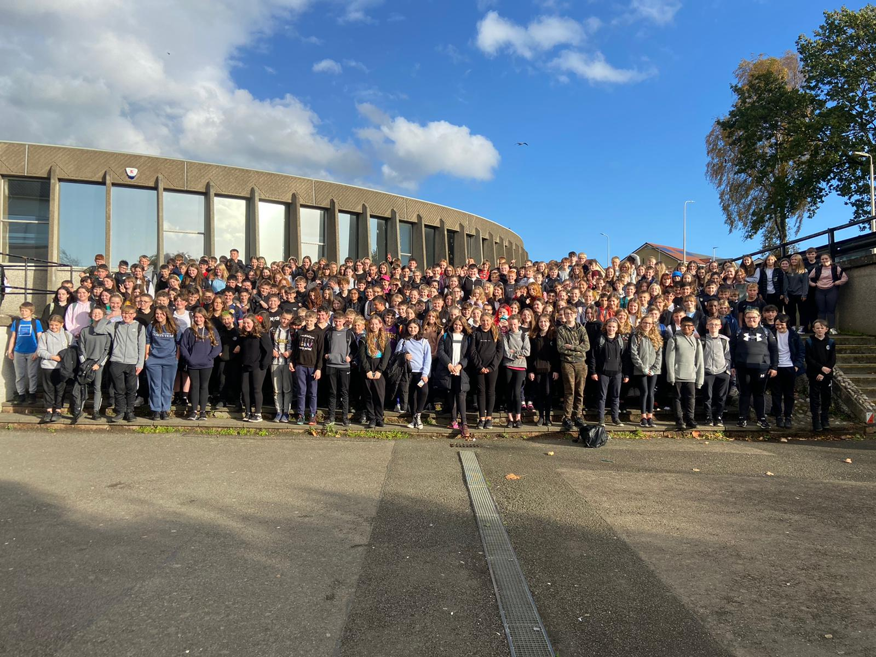
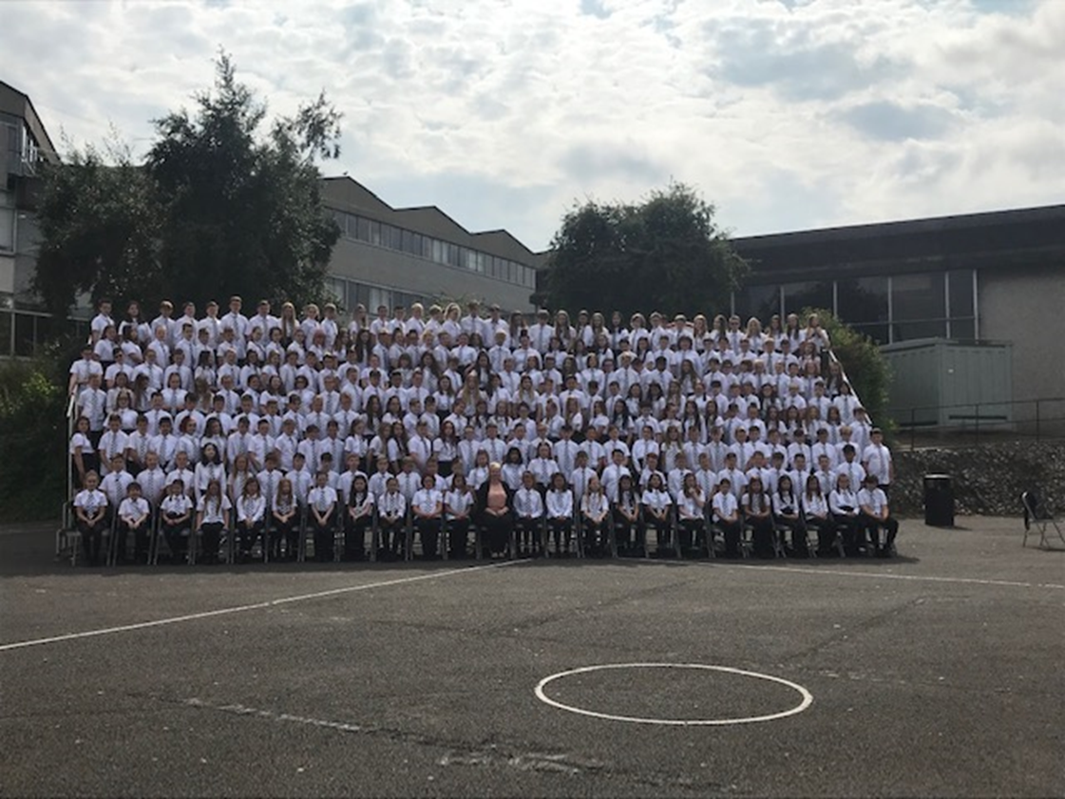
Class of 2022
Class of 2020
Notes:
This is last year’s S1 264, this year’s S1 326, next year around the same 330. School size 1400

Slide 10
Class sizes –
Throughout S1 and S2
Non Practical sets – up to 33 young people
e.g. Social subjects (History/modern Studies/Geography) English, Maths
Practical sets – Up to 20 people
e.g. Science (Biology/Chemistry/Physics), Home Economics

Slide 11
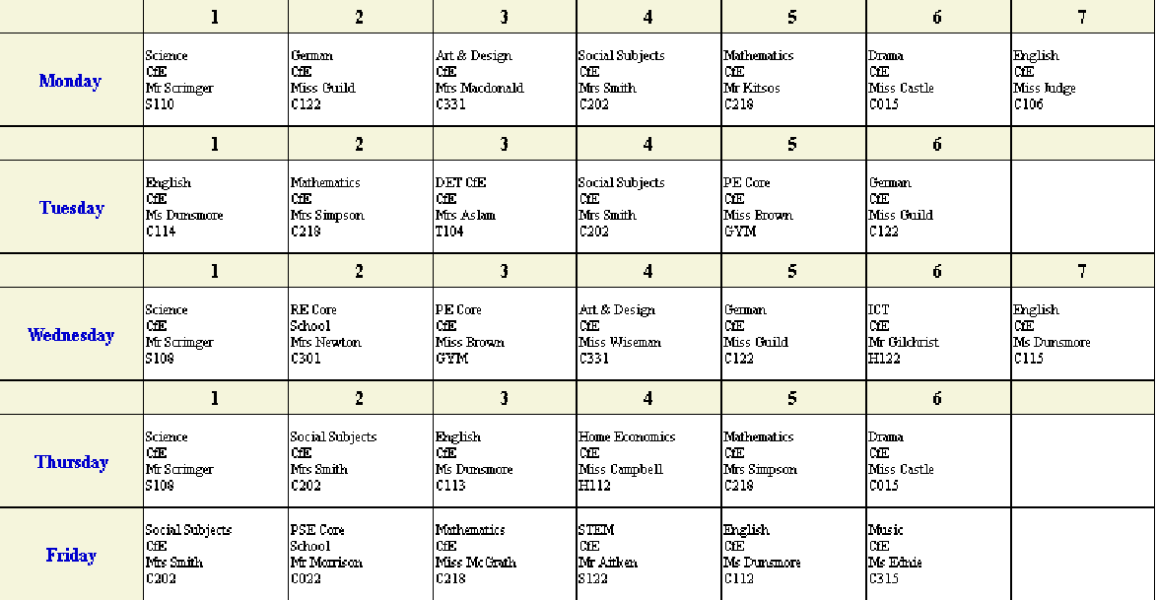
Subjects - Typical Timetable
Notes:
Talk over the number of subjects per day, types of subjects, when break comes. Then onto day structure

Slide 12
Our School Day Structure
Monday & Wednesday
Period 1 | Period 2 | Interval
08:40 | 09:30 | 10:20
09:30 | 10:20 | 10:35
Period 3 | Period 4 | Period 5
10:35 | 11:25 | 12:15
11:25 | 12:15 | 13:00
Lunch | Period 6 | Period 7
13:00 | 13:45 | 14:35
13:45 | 14:35 | 15:25
2 minute warning bell at : 08:38, 10:33 & 13:43
Tuesday, Thursday & Friday
Registration | Period 1 | Period 2
08:45 | 09:00 | 09:55
09:00 | 09:55 | 10:45
Interval | Period 3 | Period 4
10:45 | 11:05 | 11:55
11:05 | 11:55 | 12:45
Lunch | Period 5 | Period 6
12:45 | 13:35 | 14:25
13:35 | 14:25 | 15:15
2 minute warning bell at : 08:43, 11:03 & 13:33
School bells ring throughout the day
Notes:
Talk through the times, now the lack of bells with warning bells that are staggered, probably will keep these

Slide 13
Breaks and Lunches
Breaktime – Entire school remains on campus
Lunchtime - Until October the recommendation is on campus during break and lunch
School clubs

Slide 14


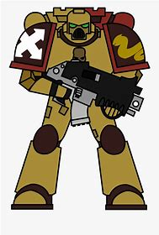



School clubs include:
Volleyball,
Pride club,
Fitness Club,
Warhammer,
Music,
Netball,
Drama,
Amnesty international,
Film club,
Football,
Basketball,
Rounders.

Slide 15
Policies and the IHS Charter

Slide 16
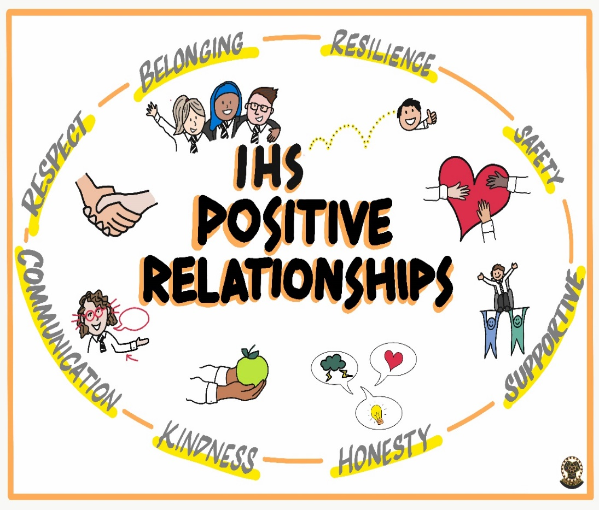
Our Collective Vision for Positive Relationships
We aim for a safe, happy and positive learning environment for all members of our school community built on strong communication, honesty and respect.
We promote relationships which are fair, supportive and kind to ensure that our school is a place where we all belong.

Slide 17
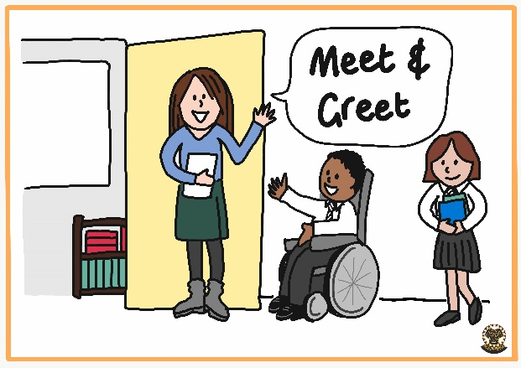
Visible consistencies: Meet and Greet
We want our school to be a welcoming place!

Slide 18

Visible consistencies: Positive Recognition
We want to make sure that all good conduct is recognised and celebrated!

Slide 19

Visible consistencies: Unbelievable Uniform
We want our learners to feel they belong as part of our school and demonstrate this by observing the school dress code!

Slide 20


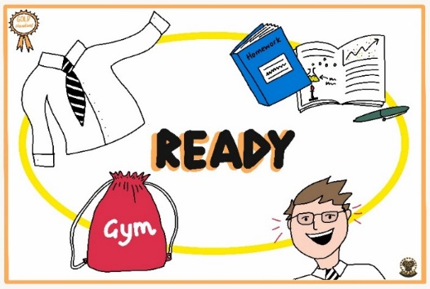
Our School Charter: Respectful, Responsible and Ready
We are respectful of ourselves, each other and our school through Restorative Practice and a kind and calm environment.
Our learners take responsibility for their actions, learning, choices and our community. We are all committed to being the best version of ourselves.
Our learners are smartly presented (unbelievable uniform) with the right attitude (jackets off, headphones out and phones away) and resources to learn.

Slide 21
Uniform
School tie
White shirt
Plain black jumper/hoody (no logos)
Black skirt, trousers, shorts, no branding
Black shoes, boots (Preferably Black)

Slide 22
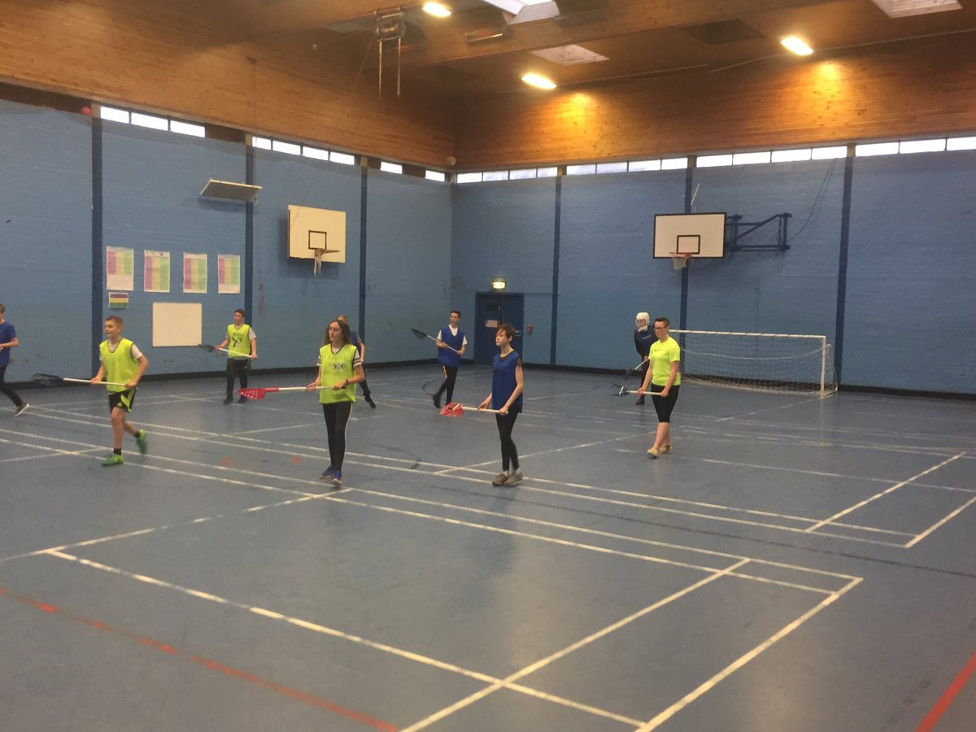
PE Kit
Top (no short/crop tops or football strips)
Shorts/trousers/sports leggings
Hoody/water proof
Trainers
No note policy

Slide 23
Kit Bag for IHS
Essential
- Uniform
- A water bottle
- Pencil case (pencil, pen, ruler, sharpener, eraser)
- PE kit (when required)
- A tub for HE (when required)
- An apron (when required DET/HE)
Even better if…
- A mobile device
- A calculator
- Lockers for storage
- A note of your user names and passwords
Notes:
These are a suggested list of things that S1s will need, and some that would be good but not essential

Slide 24
Opportunities

Slide 25
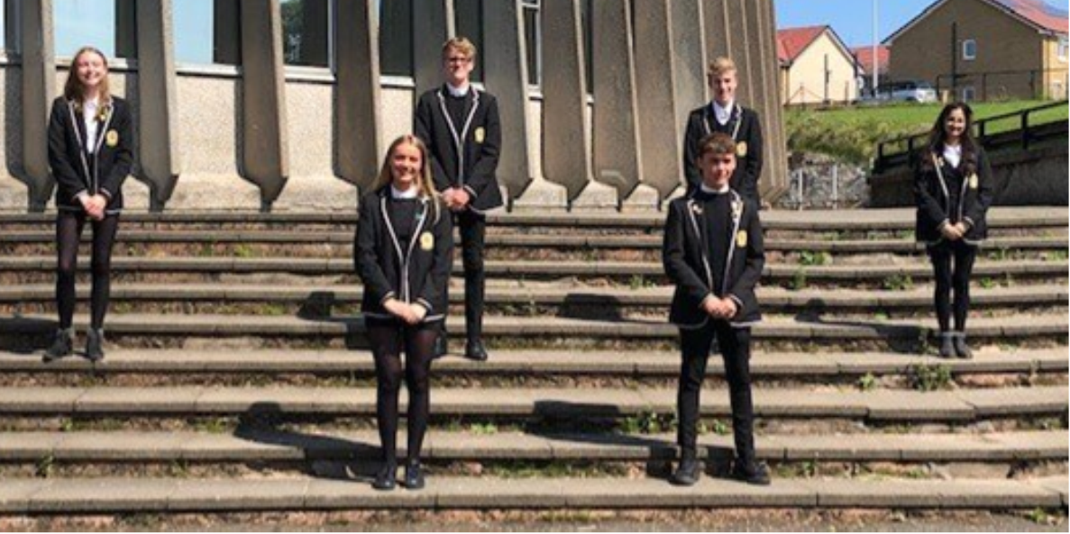
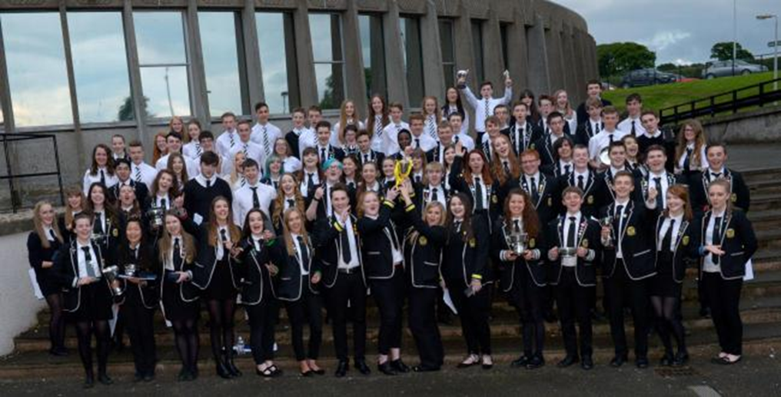
Leadership Programmes
Student
Leadership
team
S4-6
Prefects
Notes:
Discuss progression from prefect into leadership team

Slide 26
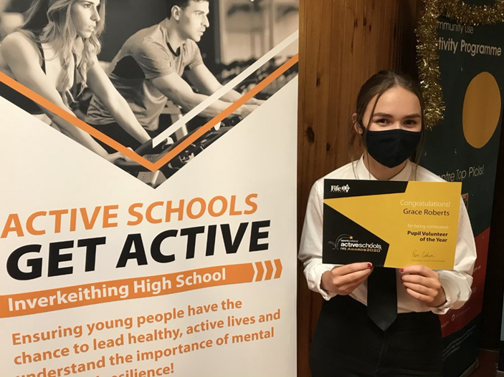
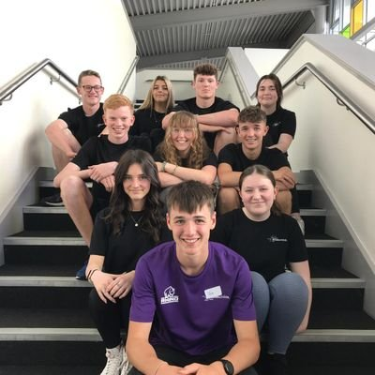
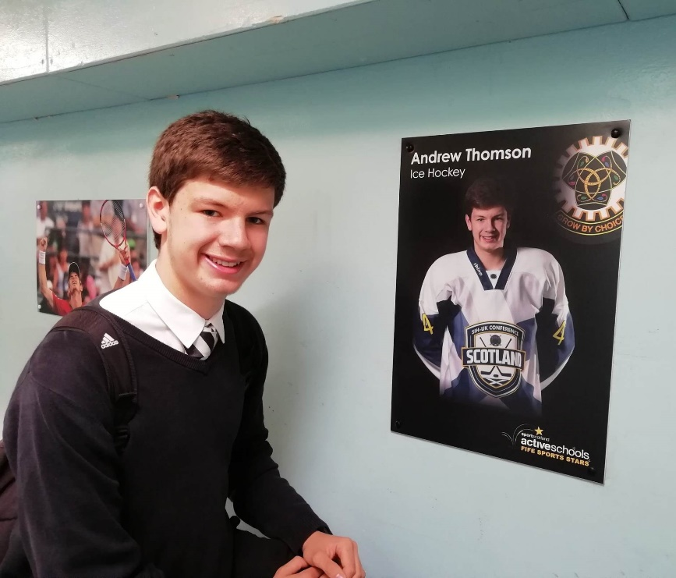
Sports Ambassadors
Notes:
Discuss Sports stars and ambassadors, pupils give back and support in school clubs as well as at cluster level during term time and holidays

Slide 27
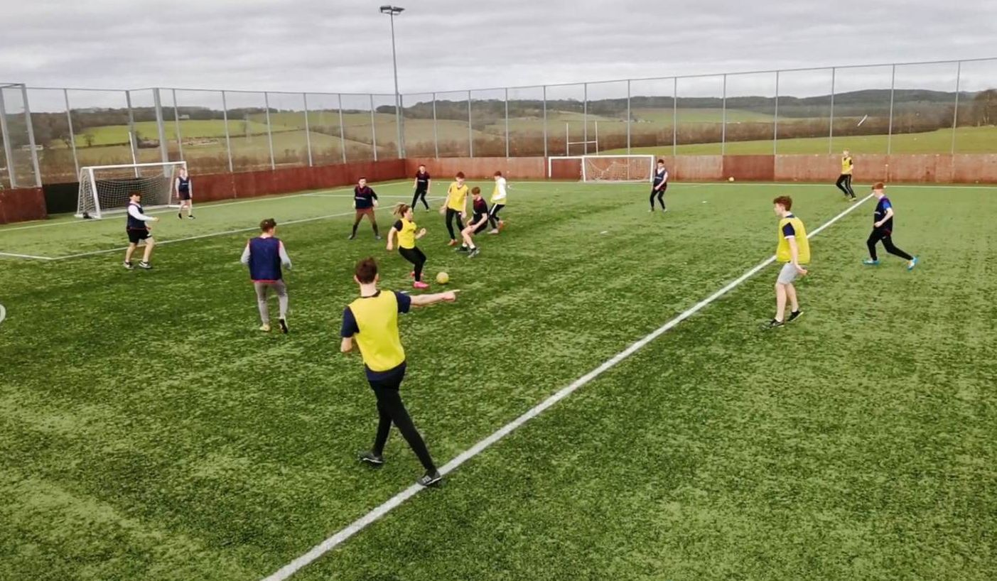
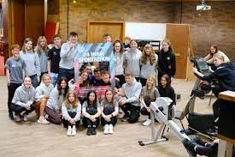
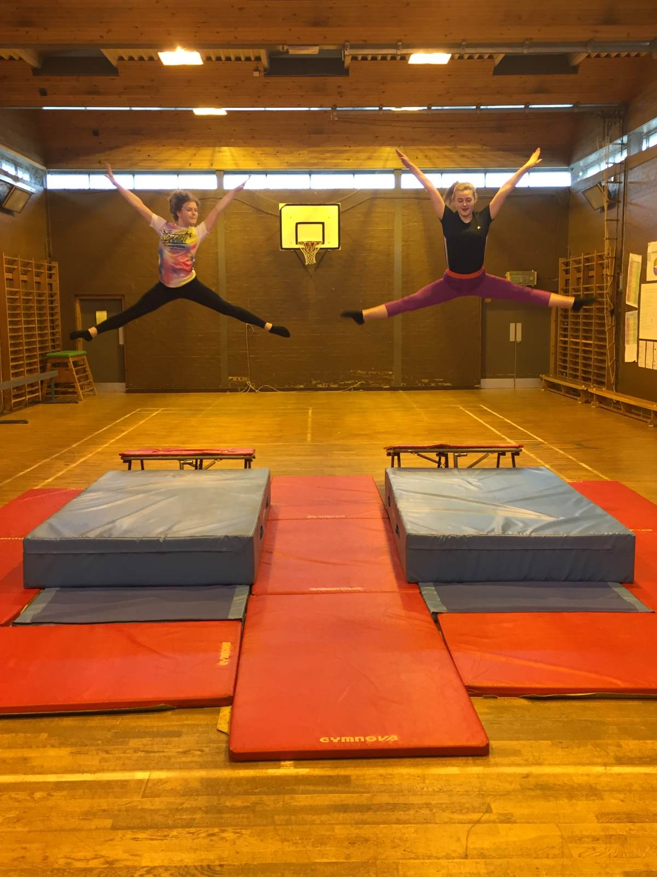
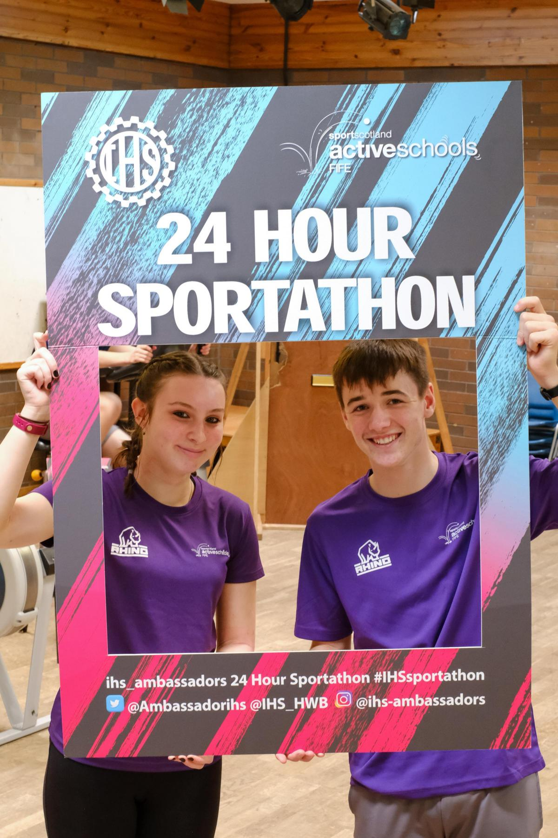
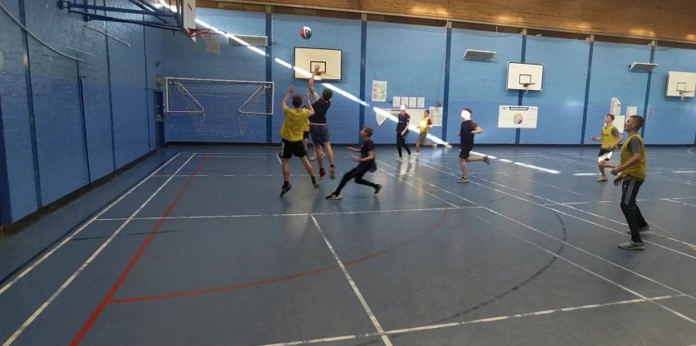
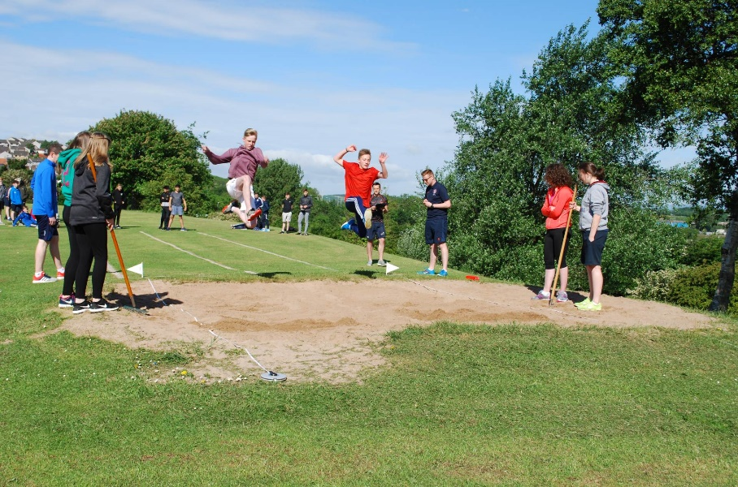
Sports Opportunities
Notes:
All year groups, very proud of their successes

Slide 28
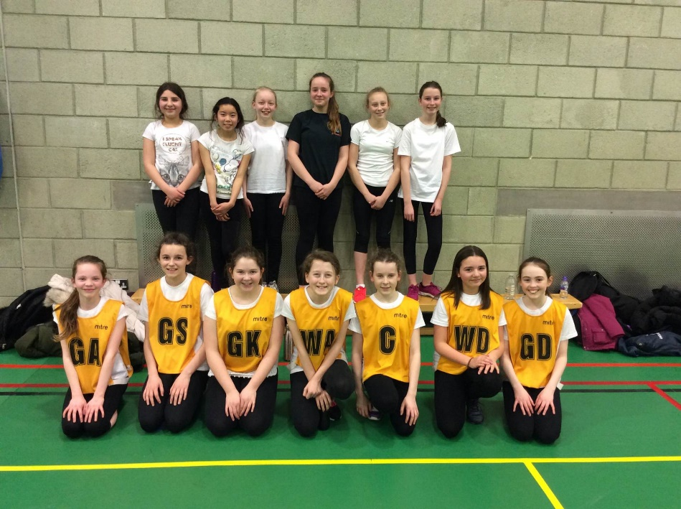
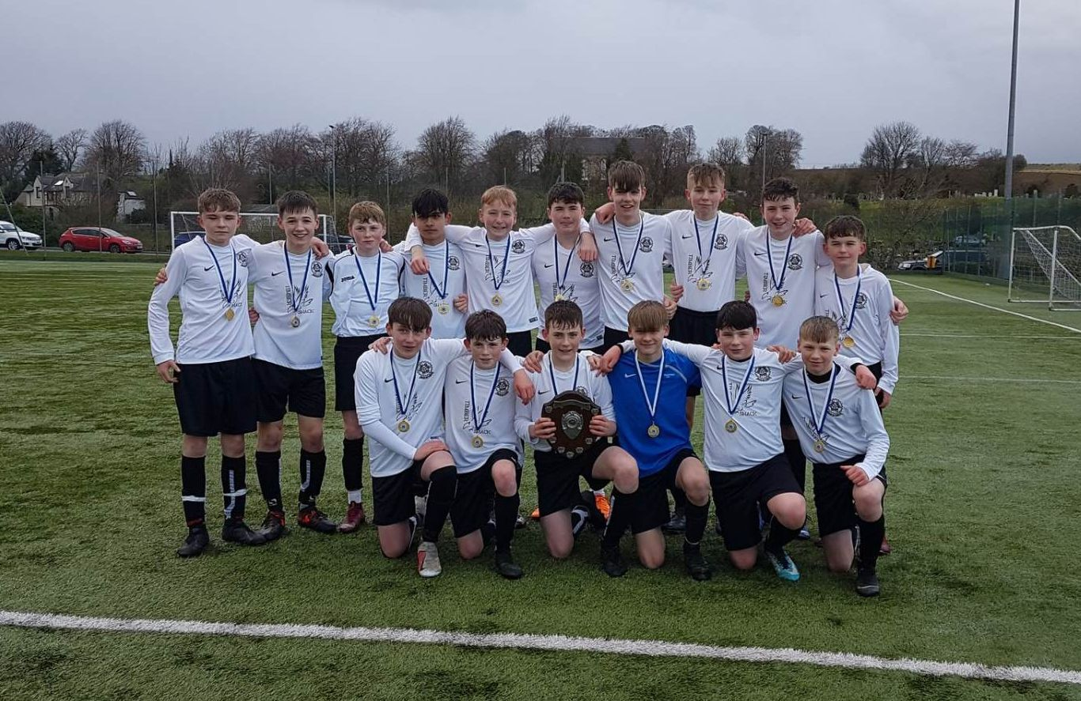
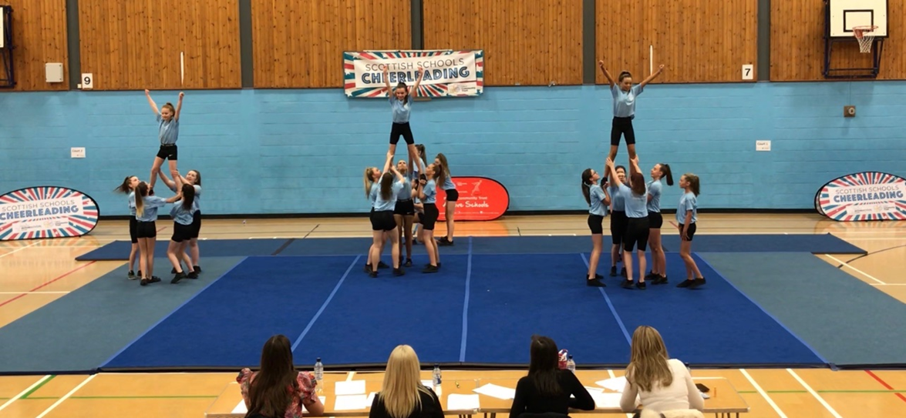
Notes:
Netball, cheerleading, football

Slide 29
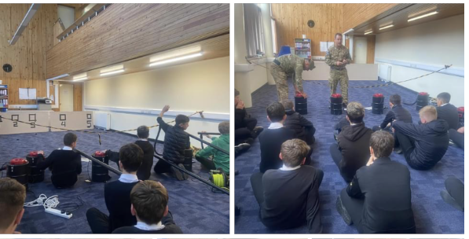
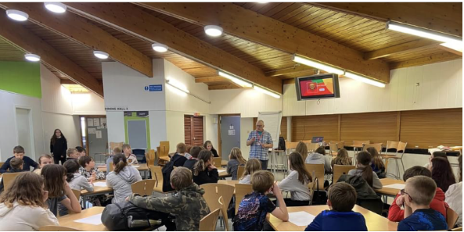
Developing Young Workforce
Notes:
DoE, Hospitality, first aid, business innovation, writing comps

Slide 30
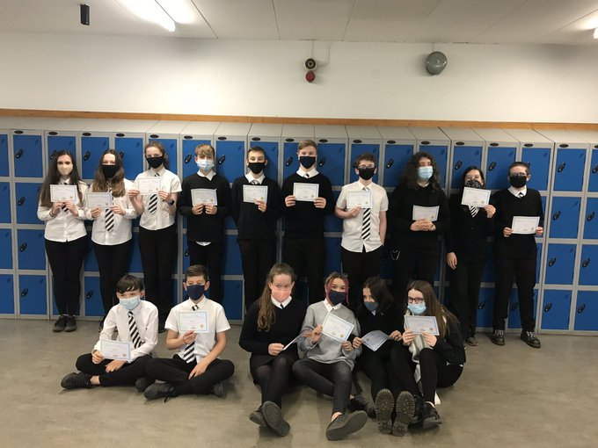
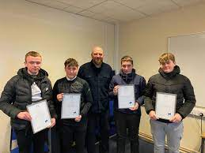
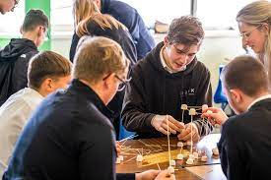
Employers working with our young people
Notes:
DoE, Hospitality, first aid, business innovation, writing comps

Slide 31
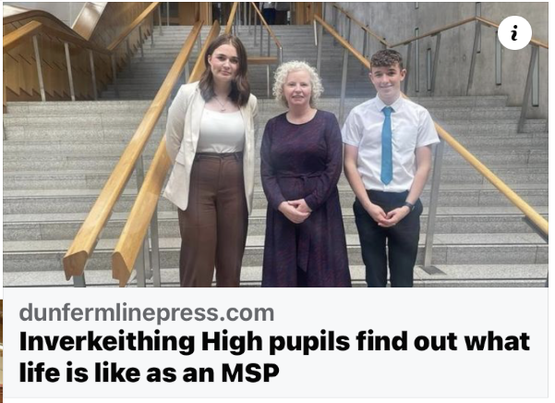
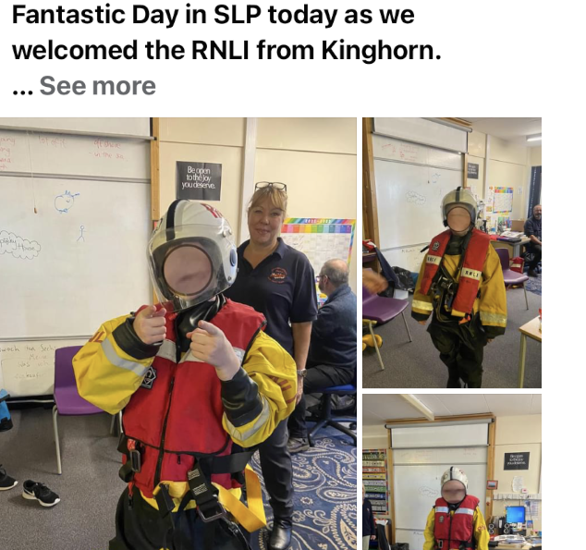

Slide 32
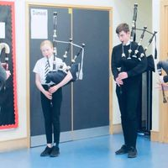
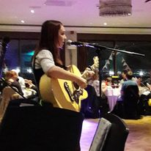
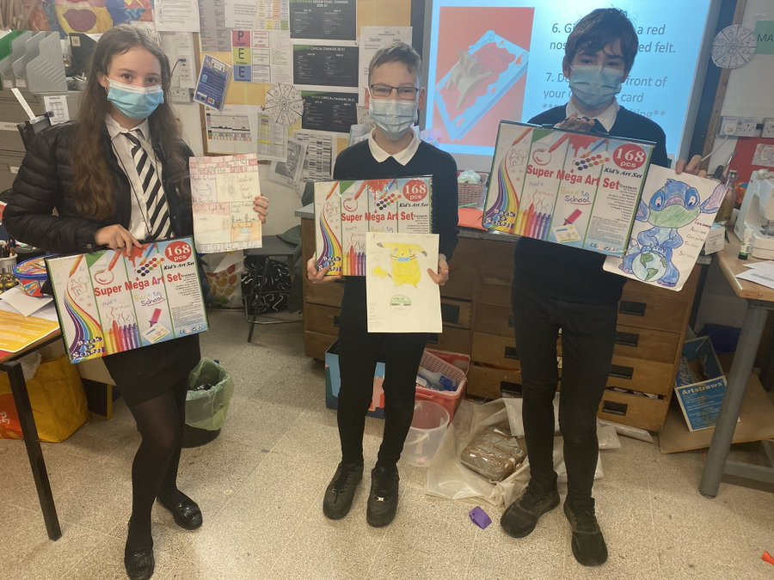
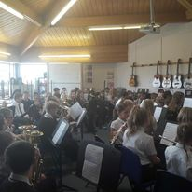
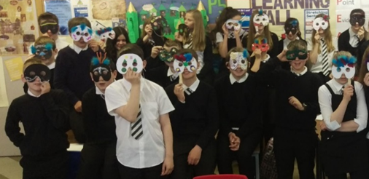
Expressive Arts Opportunities
Notes:
Very active departments, regular Art/Design comps IDL with DET, regular Drama performance, 3 annual concerts

Slide 33
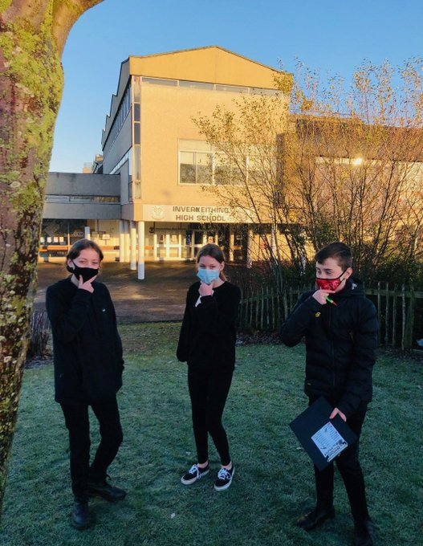
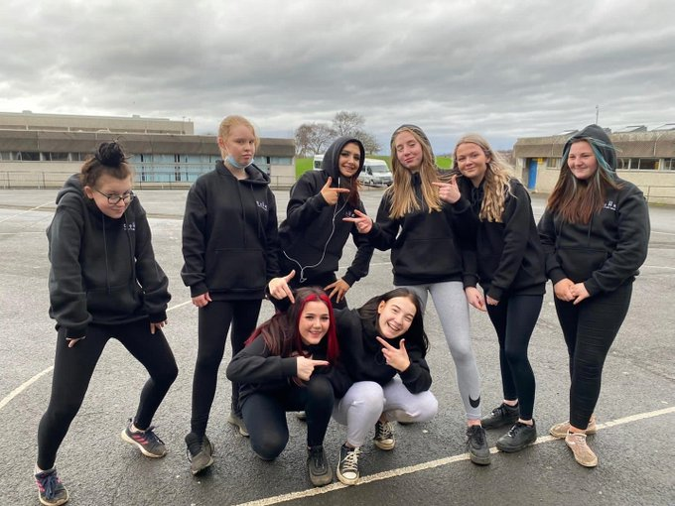
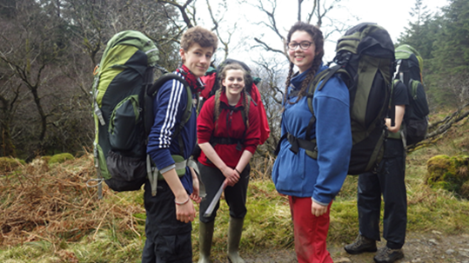
Notes:
S1 SOHK, S2/3 Girls SOHK, John Muir, D of E

Slide 34
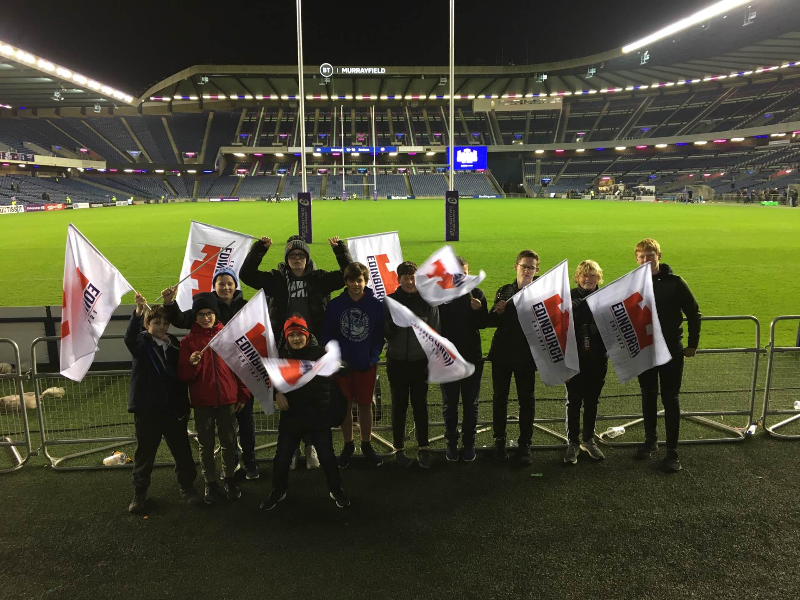
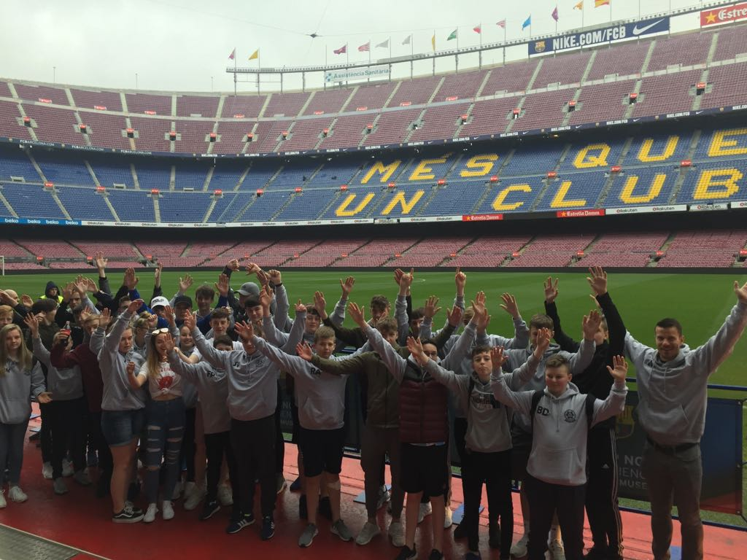
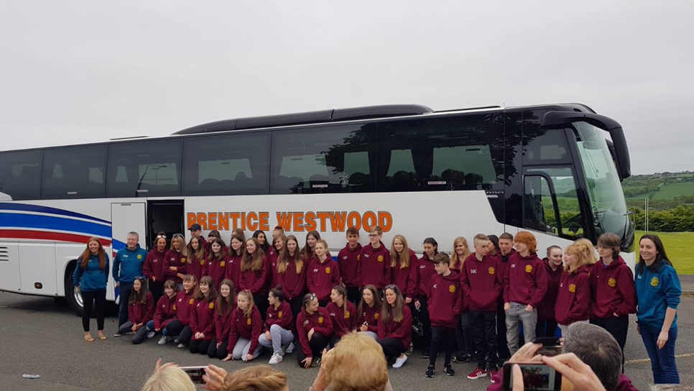
Trips
Notes:
PE trips regularly, all year groups, raffle style basis if too many wish to attend, History annual trip to Belgium, regular London trips, Camp international Cambodia

Slide 35
House Structure
Bramble House
Mr Morrison and Mr McNinch (Guidance Teachers)
Miss Abbott (Pupil Support Officer)
Mrs Snoddy (Pupil Support Assistant)
Mrs Appleton (Teacher of Learning Support)
Mrs Allan (DHT – Head of House)
Mrs Ferns (Family Support Worker)
Miss Clark – DHT Support

Slide 36
House Structure
Fern House
Miss Darling and Mrs Smith (Guidance Teachers)
Mr Fotheringham (Pupil Support Officer)
Mrs Crannage (Pupil Support Assistant)
Mrs Sutton (Teacher of Learning Support)
Mrs Cumming (DHT – Head of House)
Mrs Ferns (Family Support Worker)
Miss Clark – DHT Support

Slide 37
House Structure
Thistle House
Mr Marshall and Ms Squair (Guidance Teachers)
Mr Nicol (Pupil Support Officer)
Mrs Simpson (Pupil Support Assistant)
Miss Windle (Teacher of Learning Support)
Miss Gilmour (DHT – Head of House)
Mrs Ferns (Family Support Worker)
Miss Clark – DHT Support

Slide 38
S1 Views
We welcome some of our current S1s to offer views on their experiences

Slide 39
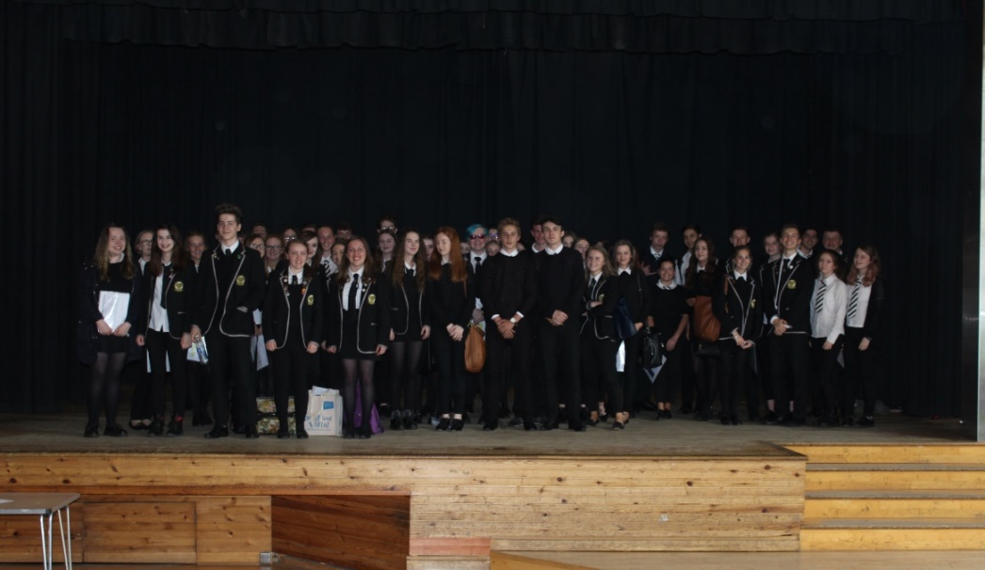
Transition Week overview
P7 Induction Week
(Mon 19th – Frid 23rd June)
Activity Night
P7 Numeracy/Literacy/STEM Day
Health & Wellbeing Day
19/20/21 JUNE 2023 | Inverkeithing High School | 08:40 – 15:30 (Mon & Wed) 08:44 – 15:20 (Tues)
Pupils follow their School Timetable
Mon-Wed
Wed 21 JUNE 2023 | Inverkeithing High School | 18:00 – 20:00
Thurs 22 JUNE 2023 | Inverkeithing High School | 08:44 – 15:20
Friday 23 JUNE 2023 | Inverkeithing High School | 08:40 – 15:30
Notes:
Support from prefects for transition, still working on this news to come once update and back to school (hopefully!)

Slide 40
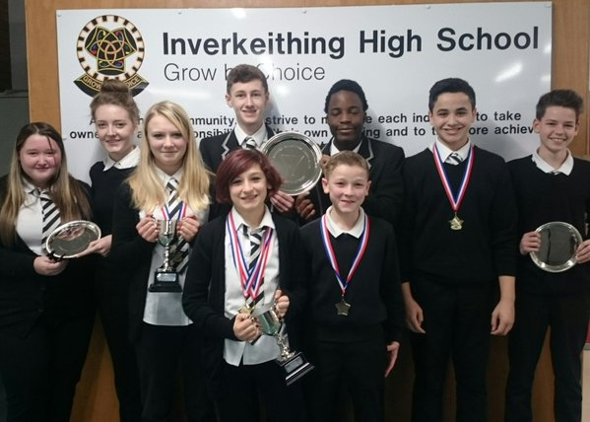
External Pupil Support
Skills Development Scotland
Family Support Service
Drug and Alcohol Project Ltd
Educational Psychologists
Visiting Therapies – Therapet, Lego
Notes:
Discuss in school supports, then external agencies

Slide 41
Online Systems
Teams
Online Lunch app
Didbook – Progress Tracking and Monitoring system
Didbook – Pupil profiling system
Online Parents evening booking page
Ipay impact – lunches/payments
School Twitter page
Notes:
Discuss main systems in use

Slide 42
IHS SQA Results
2012-2022

Slide 43
Key Measure | 2012 | 2013 | 2014 | 2015 | 2016 | 2017 | 2018 | 2019 | 2020 | 2021 | 5-YR ave. | 3-YR ave. | 2022
5 @ Level 3 by S4 | 97.6 | 97 | 92.7 | 90.1 | 93.5 | 95.2 | 84.2 | 75.4 | 87.7 | 93.6 | 87.2 | 85.6 | 87.8
5 @ Level 4 by S4 | 87.3 | 87.3 | 86.2 | 87.9 | 89.4 | 92.8 | 79.3 | 70.4 | 82.7 | 83.4 | 81.7 | 78.8 | 83.9
5 @ Level 5 by S4 | 38.8 | 43.9 | 42.7 | 45.7 | 46.1 | 50.5 | 47.8 | 43.8 | 47.3 | 51.2 | 48.1 | 47.4 | 45.5
5 @ Level 6 by S5 | 12.4 | 15.5 | 15.6 | 20.6 | 21.1 | 24.9 | 27.3 | 19.6 | 21.2 | 19.6 | 22.5 | 20.1 | 21.2
3 @ Level 6 by S5 | 34.7 | 36.3 | 36.3 | 44 | 42.6 | 45.2 | 46.9 | 37.7 | 48.8 | 41.4 | 44 | 42.6 | 45.2
1 @ Level 6 by S5 | 57 | 51 | 56.1 | 62.9 | 60.8 | 66.8 | 67.5 | 61.3 | 68.5 | 61.4 | 65.1 | 63.7 | 62.7
5 @ Level 6 by S6 | 27.1 | 31.1 | 33.2 | 32.8 | 37.1 | 36.2 | 38.4 | 38 | 37 | 43.8 | 38.7 | 39.6 | 33.6
3 @ Level 6 by S6 | 42.1 | 47.5 | 44.5 | 46.8 | 55.1 | 50.4 | 55.1 | 53.9 | 44.8 | 59.6 | 52.8 | 52.8 | 46.4
1 @ Level 6 by S6 | - | - | - | - | - | - | 70 | 70.2 | 62.6 | 73.9 | - | 68.9 | 66.4

Slide 44
School | S4 5@N5 - 2018 | S4 5@N5 - 2019 | S4 5@N5 - 2020 | S4 5@N5 - 2021 | S4 5@N5 - 2022
Auchmuty | 31.2 | 31.2 | 34.3 | 37.1 | 31.4
Balwearie | 45.7 | 40.5 | 49.5 | 42.9 | 46.5
Beath | 20.1 | 18.6 | 26.5 | 34.9 | 26.9
Bell Baxter | 37.2 | 45.5 | 55.7 | 45.2 | 43.2
Dunfermline | 39.1 | 44.8 | 54 | 46.8 | 49.2
Fife | 34 | 34 | 42.6 | 39.5 | 36.3
Glenrothes | 28.8 | 35.2 | 41.6 | 30.7 | 41.8
Glenwood | 22.2 | 26.6 | 34.4 | 29.5 | 30.6
Inverkeithing | 47.8 | 43.4 | 47.3 | 51.2 | 45.5
Kirkcaldy | 20.2 | 24.2 | 44.7 | 27 | 24.7
Levenmouth | 12.7 | 10.8 | 15.8 | 23 | 16.1
Lochgelly | 20.9 | 28 | 34.3 | 28.6 | 19.7
Madras | 52.5 | 54.9 | 61.9 | 54.5 | 47.6
Queen Anne | 40.6 | 35.2 | 47 | 31.6 | 36.4
St Andrew's | 24.5 | 27.2 | 31.9 | 33.1 | 34.2
St Columba's | 32.3 | 24.7 | 44.4 | 50.3 | 35.7
Viewforth | 18.3 | 20.4 | 33.3 | 30.2 | 22.5
Waid | 49.6 | 44.4 | 50.1 | 61.7 | 60.5
Woodmill | 43.9 | 40.1 | 49.7 | 49.2 | 38.7

Slide 45
School | S5 5@H - 2018 | S5 5@H - 2019 | S5 5@H - 2020 | S5 5@H - 2021 | S5 5@H - 2022
Auchmuty | 6.8 | 10.7 | 11.8 | 13.1 | 7.9
Balwearie | 18.9 | 20.1 | 20 | 15.8 | 15.2
Beath | 9.9 | 6.9 | 6.2 | 6.9 | 3.4
Bell Baxter | 15.9 | 13.7 | 22.2 | 16.1 | 16.9
Dunfermline | 13.9 | 14.3 | 18.6 | 24.1 | 19.8
Fife | 14 | 13 | 16.2 | 15.3 | 13.6
Glenrothes | 14.2 | 9.5 | 15.9 | 8.1 | 10.2
Glenwood | 2.3 | 7.2 | 15.4 | 16.4 | 5
Inverkeithing | 27.3 | 19.6 | 21.2 | 19.6 | 21.2
Kirkcaldy | 10.2 | 4.9 | 11.6 | 12.8 | 4.4
Levenmouth | 4.9 | 2.2 | 5.9 | 3.3 | 4.3
Lochgelly | 3.4 | 6.5 | 8.4 | 11.7 | 3.1
Madras | 26.2 | 28.4 | 37.1 | 33.7 | 26.6
Queen Anne | 18.7 | 15.1 | 16.1 | 16.8 | 9.8
St Andrew's | 12.2 | 5.9 | 11 | 11.6 | 7.5
St Columba's | 8.8 | 9.9 | 13 | 10.6 | 17.8
Viewforth | 12.3 | 6.6 | 2.2 | 5.9 | 9.3
Waid | 17.8 | 21.2 | 19.7 | 27.6 | 26.1
Woodmill | 19.4 | 18 | 21.8 | 14 | 29.2

Slide 46
School | S5 3@H - 2018 | S5 3@H - 2019 | S5 3@H - 2020 | S5 3@H - 2021 | S5 3@H - 2022
Auchmuty | 25.4 | 25.7 | 29.1 | 34.3 | 24.2
Balwearie | 40.4 | 37.2 | 41.2 | 38.5 | 33.8
Beath | 22.4 | 17.7 | 14.8 | 23.3 | 18.7
Bell Baxter | 34.1 | 31.4 | 43.6 | 41.1 | 36.4
Dunfermline | 34.5 | 30.1 | 41.6 | 43.9 | 36.2
Fife | 30.6 | 28.3 | 34.9 | 35.7 | 31.1
Glenrothes | 29.7 | 18.1 | 31 | 30.2 | 22.8
Glenwood | 12.8 | 21.6 | 32.9 | 32.8 | 15
Inverkeithing | 46.9 | 37.7 | 48.8 | 41.4 | 45.2
Kirkcaldy | 29.8 | 18 | 27.1 | 31.9 | 13.7
Levenmouth | 12.7 | 11.1 | 13.1 | 18.2 | 15.7
Lochgelly | 16.4 | 20.1 | 22.4 | 29.2 | 18.1
Madras | 46.3 | 48.2 | 62 | 59.4 | 46.4
Queen Anne | 37 | 32.4 | 41.6 | 40.1 | 29.2
St Andrew's | 26.9 | 23 | 36 | 31.9 | 27
St Columba's | 20 | 25.7 | 22.1 | 25.6 | 36.2
Viewforth | 31.5 | 13.1 | 23.7 | 20.6 | 25.6
Waid | 31.4 | 40.2 | 42.8 | 44.8 | 49.6
Woodmill | 37.1 | 35.2 | 40.1 | 38.8 | 54.2

Slide 47
School | S5 1@H - 2018 | S5 1@H - 2019 | S5 1@H - 2020 | S5 1@H - 2021 | S5 1@H - 2022
Auchmuty | 50 | 50 | 51.9 | 56 | 47.9
Balwearie | 64.4 | 56.2 | 61.3 | 58.6 | 53.4
Beath | 46.2 | 36.5 | 37.1 | 48 | 49.3
Bell Baxter | 53.8 | 56.5 | 61.1 | 59.7 | 59.8
Dunfermline | 55.4 | 54.6 | 59.9 | 61.9 | 52.9
Fife | 51.6 | 49.1 | 54.3 | 55.9 | 50.3
Glenrothes | 51 | 45.7 | 55.2 | 53.7 | 40.1
Glenwood | 35.3 | 46.4 | 51.1 | 50 | 41
Inverkeithing | 67.5 | 61.3 | 68.5 | 61.4 | 62.7
Kirkcaldy | 47.8 | 34.5 | 44 | 55.3 | 35.8
Levenmouth | 31.9 | 28.2 | 30.2 | 37.4 | 32.8
Lochgelly | 31.5 | 43.2 | 40.6 | 49.6 | 37.6
Madras | 64.3 | 61.5 | 72.2 | 76.7 | 64
Queen Anne | 57.8 | 53.2 | 61.9 | 60.7 | 45.8
St Andrew's | 59.6 | 43.4 | 58.8 | 52.2 | 48.1
St Columba's | 38.8 | 45.4 | 44.2 | 48.8 | 48.5
Viewforth | 48 | 32.8 | 47.3 | 45.1 | 43.4
Waid | 57.6 | 61.4 | 67.5 | 62.7 | 68.7
Woodmill | 53.9 | 56.1 | 59 | 56.9 | 66

Slide 48

Questions?
Notes:
Perhaps easiest to place into chat box, difficult to see hands up

