Slide 1
Fife Reading Assessment Resource
High Frequency Words Progression
they
about
from
I
did
it
them
get
and
a
if
that
in
was
for
as
there
he
after
you
to
had
the
her
on
does
of
but
along

Slide 2
High Frequency Words
High frequency words are those that appear most often in text. They make up a significant amount of the words learners need to read and write, with around 300 accounting for approximately 75% of any text.
Being able to recognise these words automatically by sight is critical to developing greater reading fluency. Many high frequency words are decodable and can be read using regular phonics concepts whereas others have irregular parts and may be ‘tricky’ for learners.
This High Frequency Word Progression has been developed to provide a framework for systematic and explicit instruction. Informed by research and the National Benchmarks, words have been grouped to align with a relevant phonics concept. This is intended to inform more effective learning and teaching, helping learners to develop their sight vocabulary of the words required to read a text more efficiently.

Slide 3
Early Level
Notes:
This High Frequency Words Progression has been developed to provide a framework which outlines the common words learners should be able to recognise in texts they engage with. Informed by research and the National Benchmarks, high frequency words have been grouped to align with an appropriate phonics concept to support more effective learning and teaching, helping learners to recognise these through a variety of modelled, guided and independent reading activities.
Note that, as in the Fife Progression Pathways and Writing Assessment Resource Pack, National Benchmarks have been emboldened for ease of identification to support professional judgement about achievement of a level.
Note that some high frequency words may fit into more than one grouping. Practitioners should use professional judgement and maximise opportunities for learners to be introduced to, revisit or consolidate words where appropriate.

Slide 4
High Frequency Words
Pre-Reading
a | and | for | I | is
of | the | to | was | you
Notes:
It is recommended to teach these pre‐reading high-frequency words only after learners know all the letter names, but before they start phonics instruction.
These words can be used to help learners read and write decodable sentences when phonics instruction begins. This will support their fluency and confidence.

Slide 5
High Frequency Words
s a t i p n
a | an | as | at | in
is | it | its
Notes:
These high frequency words should be focused on for reading/spelling as learners develop their knowledge and understanding of the following:
s a t i p n

Slide 6
High Frequency Words
c k h e r m d
am | and | can | car | did
end | had | hand | hard | has
him | his | man | men | part
America | set
Notes:
These high frequency words should be focused on for reading/spelling as learners develop their knowledge and understanding of the following:
c k h e r m d

Slide 7
High Frequency Words
g o u l f b
animal | big | but | cut | far
farm | for | from | get | got
help | if | land | last | left
let | list | must | not | of
often | on | or | plant | run
second | stop | turn | until | up
us
Notes:
These high frequency words should be focused on for reading/spelling as learners develop their knowledge and understanding of the following:
g o u l f b

Slide 8
High Frequency Words
ai j oa ie ee or
air | been | feet | just | keep
need | see | seem | tree
Notes:
These high frequency words should be focused on for reading/spelling as learners develop their knowledge and understanding of the following:
ai j oa ie ee or

Slide 9
High Frequency Words
z w ng v oo
along | book | food | good | long
look | song | soon | thing | took
went | will
Notes:
These high frequency words should be focused on for reading/spelling as learners develop their knowledge and understanding of the following:
z w ng v oo

Slide 10
High Frequency Words
y x ch sh th
children | next | much | than | that
the | their | them | then | there
they | think | this | three | with
Notes:
These high frequency words should be focused on for reading/spelling as learners develop their knowledge and understanding of the following:
y x ch sh th

Slide 11
High Frequency Words
qu ou oi ue er ar wh
about | after | around | father | found
her | house | never | number | our
out | over | point | river | sound
start | under | which | without
Notes:
These high frequency words should be focused on for reading/spelling as learners develop their knowledge and understanding of the following:
qu ou oi ue er ar wh

Slide 12
First Level
Notes:
This High Frequency Words Progression has been developed to provide a framework which outlines the common words learners should be able to recognise in texts they engage with. Informed by research and the National Benchmarks, high frequency words have been grouped to align with an appropriate phonics concept to support more effective learning and teaching, helping learners to recognise these through a variety of modelled, guided and independent reading activities.
Note that, as in the Fife Progression Pathways and Writing Assessment Resource Pack, National Benchmarks have been emboldened for ease of identification to support professional judgement about achievement of a level.
Note that some high frequency words may fit into more than one grouping. Practitioners should use professional judgement and maximise opportunities for learners to be introduced to, revisit or consolidate words where appropriate.

Slide 13
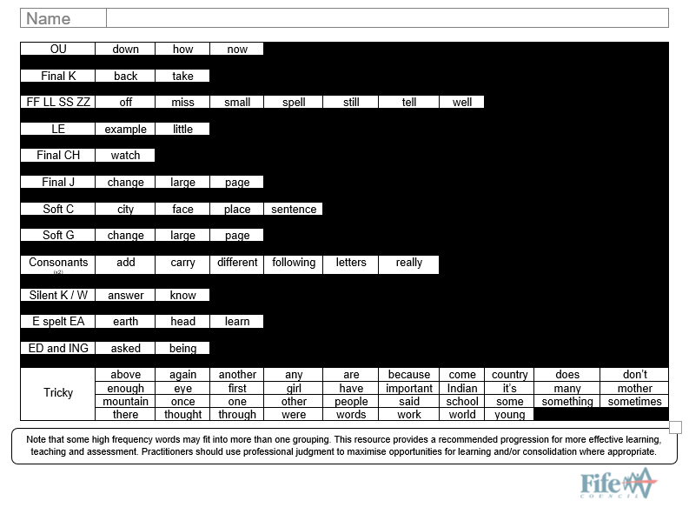
Notes:
Tricky words have also been grouped together. They can be focused on as and when required, in addition to other high frequency words. They will be ‘tricky’ for learners at this stage of development, as many contain irregular sound/letter correspondences or those which haven’t been taught yet.
Practitioners should use professional judgement and maximise opportunities for learners to be introduced to, revisit or consolidate words where appropriate.

Slide 14
High Frequency Words
Long A
away | came | day | great | late
made | make | may | name | paper
play | same | say | state | take
way | where
Notes:
These high frequency words should be focused on for reading/spelling as learners develop their knowledge and understanding of the following:
Long A

Slide 15
High Frequency Words
Long E
be | began | begin | being | between
each | eat | even | he | hear
here | leave | me | means | near
read | sea | she | these | we
years
Notes:
These high frequency words should be focused on for reading/spelling as learners develop their knowledge and understanding of the following:
Long E

Slide 16
High Frequency Words
Long I
by | find | high | I | idea
kind | life | light | like | line
might | mile | my | night | right
side | time | try | while | white
why | write
Notes:
These high frequency words should be focused on for reading/spelling as learners develop their knowledge and understanding of the following:
Long I

Slide 17
High Frequency Words
Long O
before | below | both | close | four
go | grow | home | more | most
no | old | open | show | so
those
Notes:
These high frequency words should be focused on for reading/spelling as learners develop their knowledge and understanding of the following:
Long O

Slide 18
High Frequency Words
Long U
picture | use
Notes:
These high frequency words should be focused on for reading/spelling as learners develop their knowledge and understanding of the following:
Long U

Slide 19
High Frequency Words
Long OO
could | do | few | group | into
move | new | put | should | to
together | too | two | who | would
you | your
Notes:
These high frequency words should be focused on for reading/spelling as learners develop their knowledge and understanding of the following:
Long OO

Slide 20
High Frequency Words
O spelt A
all | almost | also | always | called
saw | talk | walk | want | was
water | what
Notes:
These high frequency words should be focused on for reading/spelling as learners develop their knowledge and understanding of the following:
O spelt A

Slide 21
High Frequency Words
OI
boy
Notes:
These high frequency words should be focused on for reading/spelling as learners develop their knowledge and understanding of the following:
OI/OY

Slide 22
High Frequency Words
OU
down | how | now
Notes:
These high frequency words should be focused on for reading/spelling as learners develop their knowledge and understanding of the following:
OU/OW

Slide 23
High Frequency Words
Final K
back | take
Notes:
These high frequency words should be focused on for reading/spelling as learners develop their knowledge and understanding of the following:
Final K

Slide 24
High Frequency Words
Final FF LL SS ZZ
off | miss | small | spell | still
tell | well
Notes:
These high frequency words should be focused on for reading/spelling as learners develop their knowledge and understanding of the following:
Final FF LL SS ZZ

Slide 25
High Frequency Words
LE
example | little
Notes:
These high frequency words should be focused on for reading/spelling as learners develop their knowledge and understanding of the following:
LE endings

Slide 26
High Frequency Words
Final CH
watch
Notes:
These high frequency words should be focused on for reading/spelling as learners develop their knowledge and understanding of the following:
Final CH

Slide 27
High Frequency Words
Final J
change | large | page
Notes:
These high frequency words should be focused on for reading/spelling as learners develop their knowledge and understanding of the following:
Final J

Slide 28
High Frequency Words
Soft C
city | face | place | sentence
Notes:
These high frequency words should be focused on for reading/spelling as learners develop their knowledge and understanding of the following:
Soft C

Slide 29
High Frequency Words
Soft G
change | large | page
Notes:
These high frequency words should be focused on for reading/spelling as learners develop their knowledge and understanding of the following:
Soft G

Slide 30
High Frequency Words
Double Consonants
add | carry | different | following | letters
really
Notes:
These high frequency words should be focused on for reading/spelling as learners develop their knowledge and understanding of the following:
Double Consonants

Slide 31
High Frequency Words
Silent K / W
answer | know
Notes:
These high frequency words should be focused on for reading/spelling as learners develop their knowledge and understanding of the following:
Silent K and W

Slide 32
High Frequency Words
E spelt EA
earth | head | learn
Notes:
These high frequency words should be focused on for reading/spelling as learners develop their knowledge and understanding of the following:
E spelt EA

Slide 33
High Frequency Words
ED / ING endings
asked | being
Notes:
These high frequency words should be focused on for reading/spelling as learners develop their knowledge and understanding of the following:
Ed/ing endings

Slide 34
High Frequency Words
Tricky Words
above | again | another | any | are
because | come | country | does | don’t
enough | eye | first | girl | have
important | Indian | it’s | many | mother
mountain | once | one | other | people
said | school | some | something | sometimes
there | thought | through | were | words
work | world | young
Notes:
Tricky words have been grouped together. They can be focused on as and when required, in addition to other high frequency words. These words will be ‘tricky’ for learners at this stage of development because many contain irregular sound/letter correspondences or those which haven’t been taught yet.
Practitioners should use professional judgement and maximise opportunities for learners to be introduced to, revisit or consolidate words where appropriate.

Slide 35
This has been created to support professional learning and school improvement.
This resource is intended for use in accordance with professional learning programmes provided by Fife Council.
© Fife Council is the owner of the copyright in this work and all rights are reserved.
Notes:
Acknowledgements
Benchmarks for Literacy and English, Education Scotland

