Slide 1
Fife Reading Assessment Resource
Fluency and Expression Progression

Slide 2
Fluency and Expression
Reading with fluency is the ability to read text with a high level of accuracy, at a suitable rate, using expression as appropriate for the text type and context.
Reading with fluency and expression relies on knowledge of the English language system including sound-letter correspondences, punctuation, text structures and grammar that support an understanding of how to read meaningful phrases and intonate in appropriate places within the text.
This Reading Fluency and Expression Progression has been developed to provide a framework for systematic and explicit instruction. Informed by research and the National Benchmarks, key indicators of progress are outlined as appropriate to developmental stage. This is intended to inform more effective learning and teaching, helping learners to develop and demonstrate fluency and expression when engaging with a wide variety of texts across the curriculum.

Slide 3
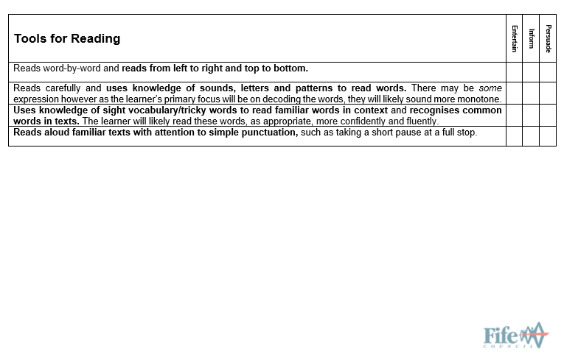
Early Level
Notes:
This Fluency and Expression Progression has been developed to provide a framework for identifying the opportunities, experiences and support required to help learners read more effectively. Informed by research and the National Benchmarks, the different skills are outlined. This is intended to inform more effective learning and teaching, helping learners to develop their abilities through a variety of modelled, guided and independent reading activities.
This has also been designed to support the assessment of learners when reading texts that entertain, inform or persuade.
Note that, as in the Fife Progression Pathways and Writing Assessment Resource Pack, National Benchmarks have been emboldened for ease of identification to support professional judgement about achievement of a level.

Slide 4
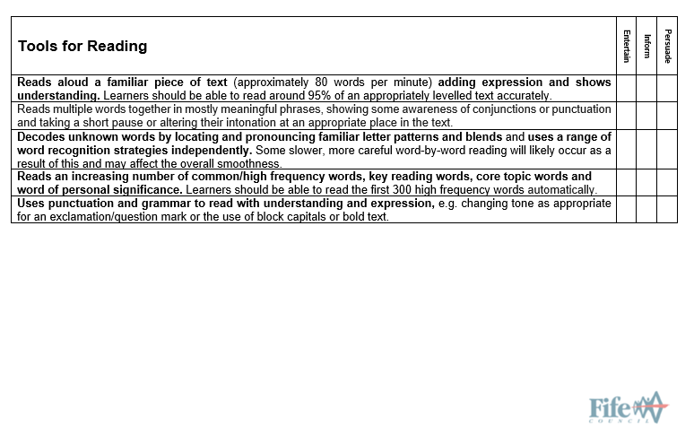
First Level
Notes:
This Fluency and Expression Progression has been developed to provide a framework for identifying the opportunities, experiences and support required to help learners read more effectively. Informed by research and the National Benchmarks, the different skills are outlined. This is intended to inform more effective learning and teaching, helping learners to develop their abilities through a variety of modelled, guided and independent reading activities.
This has also been designed to support the assessment of learners when reading texts that entertain, inform or persuade.
Note that, as in the Fife Progression Pathways and Writing Assessment Resource Pack, National Benchmarks have been emboldened for ease of identification to support professional judgement about achievement of a level.

Slide 5
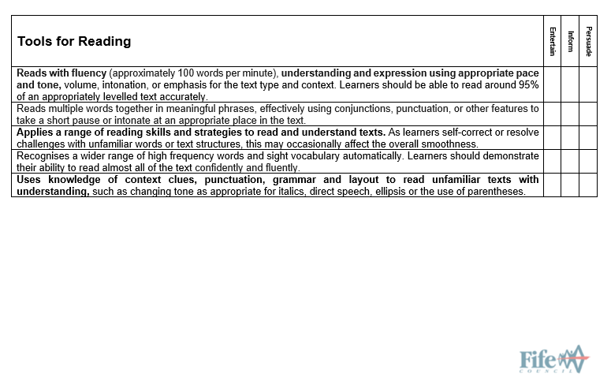
Second Level
Notes:
This Fluency and Expression Progression has been developed to provide a framework for identifying the opportunities, experiences and support required to help learners read more effectively. Informed by research and the National Benchmarks, the different skills are outlined. This is intended to inform more effective learning and teaching, helping learners to develop their abilities through a variety of modelled, guided and independent reading activities.
This has also been designed to support the assessment of learners when reading texts that entertain, inform or persuade.
Note that, as in the Fife Progression Pathways and Writing Assessment Resource Pack, National Benchmarks have been emboldened for ease of identification to support professional judgement about achievement of a level.

Slide 6
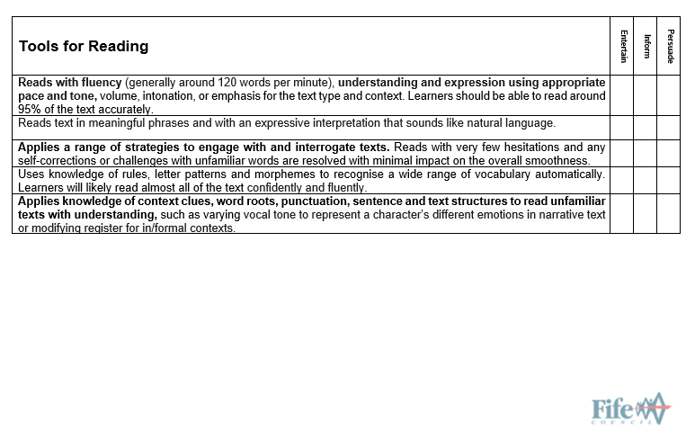
Third Level
Notes:
This Fluency and Expression Progression has been developed to provide a framework for identifying the opportunities, experiences and support required to help learners read more effectively. Informed by research and the National Benchmarks, the different skills are outlined. This is intended to inform more effective learning and teaching, helping learners to develop their abilities through a variety of modelled, guided and independent reading activities.
This has also been designed to support the assessment of learners when reading texts that entertain, inform or persuade.
Note that, as in the Fife Progression Pathways and Writing Assessment Resource Pack, National Benchmarks have been emboldened for ease of identification to support professional judgement about achievement of a level.

Slide 7
This has been created to support professional learning and school improvement.
This resource is intended for use in accordance with professional learning programmes provided by Fife Council.
© Fife Council is the owner of the copyright in this work and all rights are reserved.

