Slide 1
Fife Reading Assessment Resource
Understanding, Analysing and Evaluating Progression

Slide 2
Understanding, Analysing and Evaluating
Understanding, Analysing and Evaluating is the ability to read text, process it and draw meaning from ideas or information. It relies on two interconnected abilities: decoding and language comprehension.
Being able to apply a range of comprehension skills and strategies is critical to developing greater understanding. To engage with a variety of texts effectively, learners need to be able to understand, analyse and evaluate the different ways in which language can be used to convey information, the usefulness or reliability of sources, as well use critical literacy skills to inform judgement and decisions.
This Understanding, Analysing and Evaluating Progression has been developed to provide a framework for identifying the opportunities, experiences and support required to help learners develop their use of key comprehension strategies. Informed by research and the National Benchmarks, key Understanding, Analysing and Evaluating skills are outlined as appropriate to developmental stage. This is intended to inform more effective learning and teaching, helping learners to develop the skills necessary to draw meaning from the ideas and information in different texts more effectively.

Slide 3
Notes:
Studies have identified these key comprehension strategies to be highly useful in supporting learners to more effectively understand texts they engage with.
Making Connections
Identify the text type, purpose, audience and make connections to their personal experiences, other texts or wider knowledge of the world.
Predicting
Use inference and deduction to predict what might happen next in a text.
Asking Questions
Ask and answer a range of questions to develop understanding about a text.
Visualising
Visualise ideas and information in meaningful ways to help make sense of a text.
Summarising
Identify the main ideas to develop knowledge and understanding of a text.
Evaluating
Discuss different aspects to develop critical literacy skills when reading a text.

Slide 4
Early Level
Notes:
This Understanding, Analysing and Evaluating Progression has been developed to provide a framework for identifying the opportunities, experiences and support required to help learners develop their use of key comprehension strategies. Informed by research and the National Benchmarks, the different strategies and skills are outlined. This is intended to inform more effective learning and teaching, helping learners to develop these through a variety of modelled, guided and independent reading activities.
This has also been designed to support the assessment of learners when reading texts that entertain, inform or persuade.
Note that, as in the Fife Progression Pathways and Writing Assessment Resource Pack, National Benchmarks have been emboldened for ease of identification to support professional judgement about achievement of a level.

Slide 5
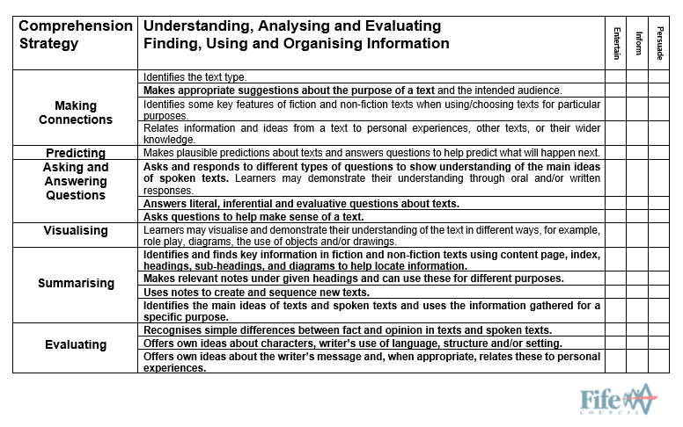
First Level
Notes:
This Understanding, Analysing and Evaluating Progression has been developed to provide a framework for identifying the opportunities, experiences and support required to help learners develop their use of key comprehension strategies. Informed by research and the National Benchmarks, the different strategies and skills are outlined. This is intended to inform more effective learning and teaching, helping learners to develop these through a variety of modelled, guided and independent reading activities.
This has also been designed to support the assessment of learners when reading texts that entertain, inform or persuade.
Note that, as in the Fife Progression Pathways and Writing Assessment Resource Pack, National Benchmarks have been emboldened for ease of identification to support professional judgement about achievement of a level.

Slide 6
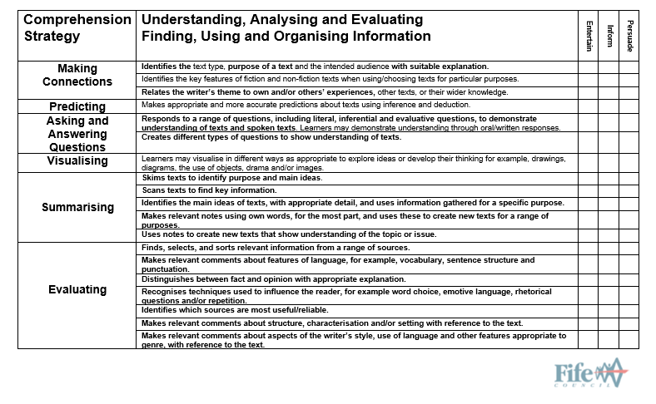
Second Level
Notes:
This Understanding, Analysing and Evaluating Progression has been developed to provide a framework for identifying the opportunities, experiences and support required to help learners develop their use of key comprehension strategies. Informed by research and the National Benchmarks, the different strategies and skills are outlined. This is intended to inform more effective learning and teaching, helping learners to develop these through a variety of modelled, guided and independent reading activities.
This has also been designed to support the assessment of learners when reading texts that entertain, inform or persuade.
Note that, as in the Fife Progression Pathways and Writing Assessment Resource Pack, National Benchmarks have been emboldened for ease of identification to support professional judgement about achievement of a level.

Slide 7
Third Level
Notes:
This Understanding, Analysing and Evaluating Progression has been developed to provide a framework for identifying the opportunities, experiences and support required to help learners develop their use of key comprehension strategies. Informed by research and the National Benchmarks, the different strategies and skills are outlined. This is intended to inform more effective learning and teaching, helping learners to develop these through a variety of modelled, guided and independent reading activities.
This has also been designed to support the assessment of learners when reading texts that entertain, inform or persuade.
Note that, as in the Fife Progression Pathways and Writing Assessment Resource Pack, National Benchmarks have been emboldened for ease of identification to support professional judgement about achievement of a level.

Slide 8
This has been created to support professional learning and school improvement.
This resource is intended for use in accordance with professional learning programmes provided by Fife Council.
© Fife Council is the owner of the copyright in this work and all rights are reserved.

