Slide 1
Fife Reading Assessment Resource
Morphological Awareness Progression
mis
ment
ly
anti
ed
ful
ible
in
ant
dis
de
under
in
est
al
sion
ist
ing
inter
ive
less
cian
er
ous
ness
tion
ance
ent
un

Slide 2
Morphological Awareness
Morphological Awareness is an understanding of how words are constructed of units of meaning, such as roots, prefixes and suffixes.
Being able to recognise these units within words automatically by sight is critical to developing greater reading fluency and understanding. Words can be broken down into units to support effective decoding and this can also support learners to construct meanings of new words.
This Morphological Awareness Progression has been developed to provide a framework for systematic and explicit instruction. Informed by research and the National Benchmarks, the most common roots, suffixes and prefixes have been outlined. This is intended to inform more effective learning and teaching, helping learners to develop their sight vocabulary of a range of morphemes to read and understand words.

Slide 3
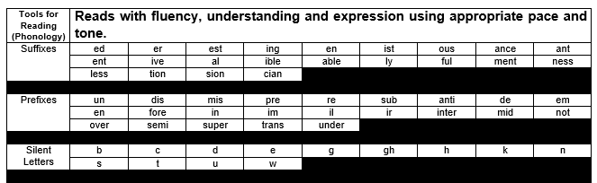
Second Level
Notes:
This Morphological Awareness Progression has been developed to provide a framework which outlines the suffixes, prefixes and silent letters learners should be able to recognise in texts they engage with. Informed by research and the National Benchmarks, these have been grouped to support more effective learning and teaching, helping learners to recognise these through a variety of modelled, guided and independent reading activities.
See Appendix 1 ‘Spelling Patterns and Rules’ of the Workshop for Literacy Progression Pathways for the recommended sequence and examples of words that could be considered for learning, teaching and assessment purposes.
Note that, as in the Fife Progression Pathways and Writing Assessment Resource Pack, National Benchmarks have been emboldened for ease of identification to support professional judgement about achievement of a level.

Slide 4
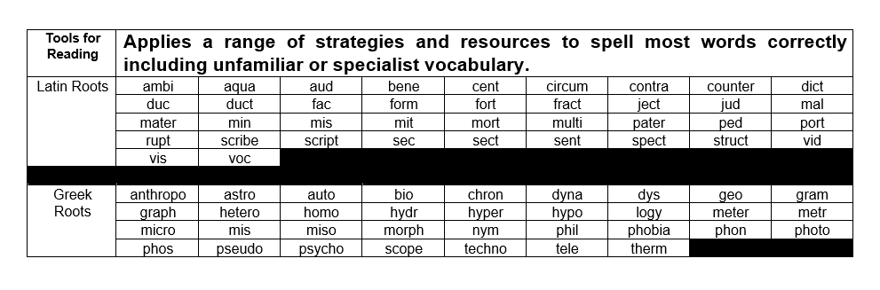
Third Level
Notes:
This Morphological Awareness Progression has been developed to provide a framework which outlines the Latin and Greek roots learners should be able to recognise in texts they engage with. Informed by research and the National Benchmarks, these have been grouped to support more effective learning and teaching, helping learners to recognise these through a variety of modelled, guided and independent reading activities.
See Appendix 1 ‘Spelling Patterns and Rules’ of the Workshop for Literacy Progression Pathways for the recommended sequence and examples of words that could be considered for learning, teaching and assessment purposes.
Note that, as in the Fife Progression Pathways and Writing Assessment Resource Pack, National Benchmarks have been emboldened for ease of identification to support professional judgement about achievement of a level.

Slide 5
This has been created to support professional learning and school improvement.
This resource is intended for use in accordance with professional learning programmes provided by Fife Council.
© Fife Council is the owner of the copyright in this work and all rights are reserved.
Notes:
Acknowledgements
Benchmarks for Literacy and English, Education Scotland

