Slide 1
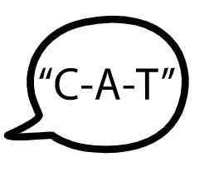
Fife Reading Assessment Resource
Sounds and Letters Progression

Slide 2
Sounds and Letters
As the English language system has evolved over time, the sounds we hear in spoken words can be represented by a vast range of letters with many different patterns, rules and irregularities.
Being able to decode text is an essential skill in life, learning and work. Nearly 50% of English words are predictable based on regular sound-letter correspondences, with an additional 37% almost predictable except for one sound. A smaller percentage of words have irregular parts and may be ‘tricky’ for learners. To decode words accurately, learners need to be able to apply their knowledge and understanding of the variety of sound-letter correspondences used in our English language system.
This Sounds and Letters Progression has been developed to provide a framework for systematic and explicit instruction. Informed by research and the National Benchmarks, various letters or patterns that can be used to represent sounds are outlined as appropriate to developmental stages. This is intended to inform more effective learning and teaching, helping learners to develop their knowledge and understanding of the English language system to decode text more confidently.

Slide 3
MORPHEMES
ment
de
mis
ness
ly
anti
ible
sion
in
SYLLABLES
ba / sic
u / nit
com / plex
ro / bot
un / wind / ing
dis / hon / est
LETTER PATTERNS
i_e
ow
th
ch
ng
ough
dge
ai
SOUNDS AND LETTERS
b
h
m
w
a
t
e
r
f
Notes:
Dr. Louisa Moats describes English is a ‘layer-cake’ language. It has evolved over hundreds of years with a vast range of letter patterns and rules organised to represent spoken sounds.
We make sense of English spelling by exploring the “layer cake” of language our writing system represents – its sounds, sound-symbol correspondences, letter patterns, syllable patterns, principles for adding suffixes, morpheme structures, and history. Experienced readers combine all of these elements simultaneously, so it is important to support learners as appropriate to effectively acquire these skills.

Slide 4
Early Level
Notes:
This Sounds and Letters Progression has been developed to provide a framework to support systematic and explicit instruction. Informed by research and the National Benchmarks, various letters or patterns that can be used to represent sounds are outlined as appropriate to developmental stages. This is intended to inform more effective learning and teaching, helping learners to develop their knowledge and understanding of the English language system to decode text more confidently.
See Appendix 1 ‘Spelling Patterns and Rules’ of the Workshop for Literacy Progression Pathways for the recommended sequence for learning, teaching and assessment.
As in the Fife Progression Pathways and Writing Assessment Resource Pack, National Benchmarks have been emboldened for ease of identification to support professional judgement about achievement of a level.

Slide 5
First Level
Notes:
This Sounds and Letters Progression has been developed to provide a framework to support systematic and explicit instruction. Informed by research and the National Benchmarks, various letters or patterns that can be used to represent sounds are outlined as appropriate to developmental stages. This is intended to inform more effective learning and teaching, helping learners to develop their knowledge and understanding of the English language system to decode text more confidently.
See Appendix 1 ‘Spelling Patterns and Rules’ of the Workshop for Literacy Progression Pathways for the recommended sequence for learning, teaching and assessment.
As in the Fife Progression Pathways and Writing Assessment Resource Pack, National Benchmarks have been emboldened for ease of identification to support professional judgement about achievement of a level.

Slide 6
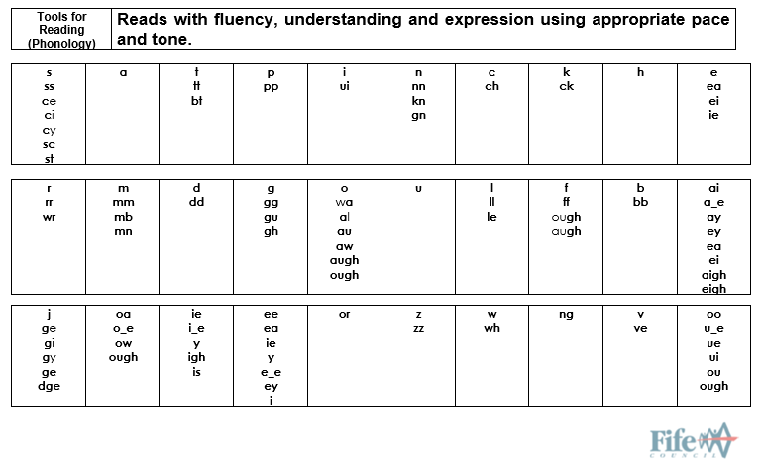
Second/Third Level
Notes:
This Sounds and Letters Progression has been developed to provide a framework to support systematic and explicit instruction. Informed by research and the National Benchmarks, various letters or patterns that can be used to represent sounds are outlined as appropriate to developmental stages. This is intended to inform more effective learning and teaching, helping learners to develop their knowledge and understanding of the English language system to decode text more confidently.
See Appendix 1 ‘Spelling Patterns and Rules’ of the Workshop for Literacy Progression Pathways for the recommended sequence for learning, teaching and assessment.
As in the Fife Progression Pathways and Writing Assessment Resource Pack, National Benchmarks have been emboldened for ease of identification to support professional judgement about achievement of a level.

Slide 7
This has been created to support professional learning and school improvement.
This resource is intended for use in accordance with professional learning programmes provided by Fife Council.
© Fife Council is the owner of the copyright in this work and all rights are reserved.

