Slide 1
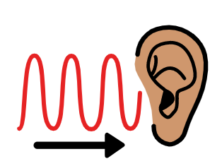
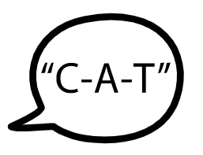
Fife Reading Assessment Resource
Phonological Awareness Progression

Slide 2
Phonological Awareness
Phonological Awareness is critical for learning to read any alphabetic writing system and research shows that difficulties with these skills is a predictor of poor reading and spelling development.
Being able to recognise and manipulate sounds in spoken language is crucial for effective reading. English uses an alphabetic writing system in which letters represent single speech sounds. To read and spell words effectively, learners first need to develop a range of Phonological Awareness skills which help them to recognise and manipulate the sounds they hear in different ways.
This Phonological Awareness Progression has been developed to provide a framework for identifying the opportunities, experiences and support required to help learners acquire these fundamental skills. Informed by research and the National Benchmarks, the different Phonological Awareness skills are outlined. This is intended to inform more effective learning and teaching, helping learners to acquire abilities and skills that will more effectively support their reading development.

Slide 3
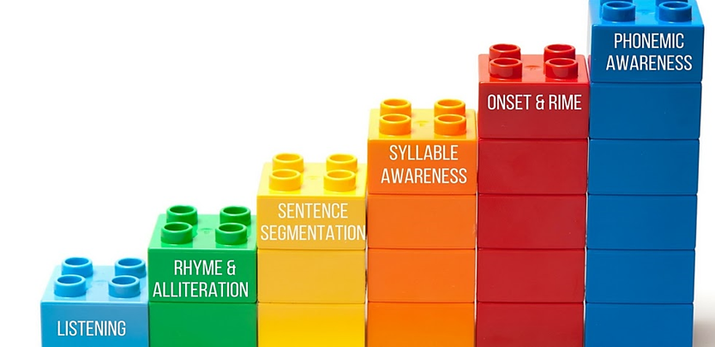
Notes:
Phonological Awareness skills can be conceptualised within a continuum of increasing complexity.

Slide 4
Early Level
Notes:
This Phonological Awareness Progression has been developed to provide a framework for identifying the opportunities, experiences and support required to help learners acquire these fundamental skills. Informed by research and the National Benchmarks, the different Phonological Awareness skills are outlined. This is intended to inform more effective learning and teaching, helping learners to develop their abilities through a variety of play and instructional activities.
Note that phonological awareness learning, teaching and assessment activities will involve oral discrimination using pictures and/or real objects.
As in the Fife Progression Pathways and Writing Assessment Resource Pack, National Benchmarks have been emboldened for ease of identification to support professional judgement about achievement of a level.

Slide 5
First Level
Notes:
While there are no Benchmarks at First Level, important phonological awareness skills are outlined as appropriate to the age studies have shown learners should develop their abilities to blend, segment and manipulate sounds.
Note that phonemic awareness is more effective when learners are taught to use letters as they manipulate phonemes as this helps them with both reading and spelling.
This Phonological Awareness Progression has been developed to support learning, teaching and assessment through First Level. It may also be useful to consider if older learners are experiencing reading difficulties. This will inform the opportunities, experiences and support required to help learners acquire these early reading skills that may be causing barriers to reading success.

Slide 6
This has been created to support professional learning and school improvement.
This resource is intended for use in accordance with professional learning programmes provided by Fife Council.
© Fife Council is the owner of the copyright in this work and all rights are reserved.

