Slide 1

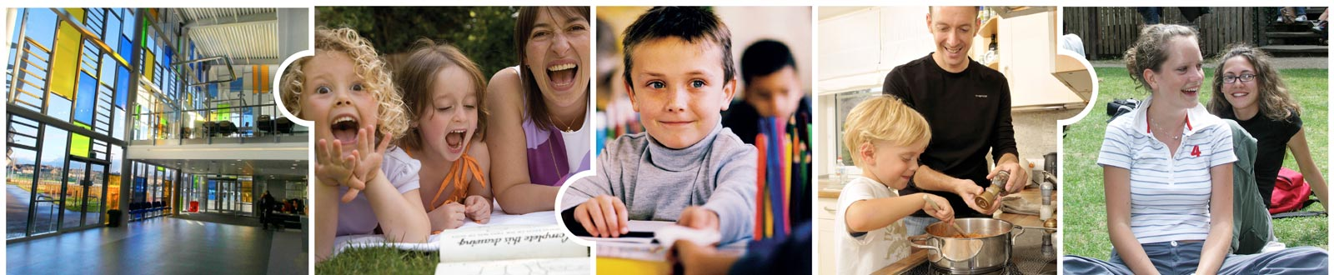
FIFE COUNCIL
Education Service
August 2025

Slide 2
Food Hygiene ELC Annual Update
Introduction
Training House Rules
Personal Hygiene House Rules
Cleaning House Rules
Temperature Control House Rules
Cross Contamination- high risk foods
Pest House Rules
Waste House Rules
Maintenance House Rules
Stock Control House Rules
Suspected Food Poisoning
Record keeping
Snack
Allergies

Slide 3
Introduction
Food Handling Legislation/Environmental Health Agency
Allergen Legislation
HACCP System
4. Fife House Rules
Fife Guidance
5. Best practice Snack
This presentation should be read in conjunction with the House Rules and Guidance
Notes:
1. It’s our responsibility as practitioners to provide healthy, nutritious snacks while complying with the legal requirements of all Food Handlers. As food handlers, we have a duty under Food Safety Act of 1990 (and following updates in 2002 and 2004)
This is supported by the Environmental Health Agency who will visit regularly to assess procedures and make recommendations and requirements which must be complied with.
2. It is also now law (2014)to provide details of allergens which are in the food served by practitioners and handle and manage food allergens effectively in food preparation. (Natasha’s Law in Oct 2021 now requires food businesses in Scotland to include detailed ingredient and allergen info on labels for ‘prepacked for direct sale’ foods. (This would not normally include ELC as we are not preparing and selling food for consumption off premises)
3. HACCP – Hazard Analysis Critical Control Points – This is used in all food businesses and looks at the critical points for ensuring food is safe to eat during storage, preparation and serving of food and what measures are in place to reduce risks of food poisoning. It is like the risk assessments we have elsewhere in ELC settings.
4. Fife have detailed House Rules and accompanying Guidance to support practitioners to comply with legal requirements. These are based on standard industry guidance. Fife House Rules must be followed by all practitioners . Guidance explains the House Rules in more detail More info is available at foodstandards.gov.scotland
5. We want our children and families to have rich, quality learning experiences around Health and Wellbeing which includes food and nutrition.
Current guidance is provided within ‘Setting the Table’ which was published in 2015 by nhs.healthscotland. and ‘Food Matters’ published in 2018 by Care Inspectorate. (Be aware that the recipes included in ‘Setting the Table’ are for full day meal provision, not nursery snack and therefore should not be used as a snack option.)

Slide 4
Introduction
1. Food Handlers -
Anyone who stores, prepares, serves and handles food for public consumption
need to ensure food is safe to eat and cross contamination does not occur
2. Food legislation (1990, 2006) Allergen legislation (2014)
3. Legal requirements -
following the correct legal requirements and recording systems and procedures.
4. Food safety guidelines
training, awareness of current documentation, record keeping
Notes:
1. A Food Handler is anyone who stores, prepares, serves and handles food for public consumption. Therefore all practitioners who work in ELC settings can be classed as Food Handlers, as part of their job may be to provide food for children in their care. This may be snack or light meals.
2. Food Legislation has been in effect since at least 1990 Food Safety Act. Allergen legislation came into effect in December 2014. Information on 14 common allergens, when used as ingredients, must be provided on loose foods, in an obvious place, for example on a: menu, chalkboard, recipe card or allergy folder. If it is not provided upfront, the staff need to be able to signpost where it can be obtained, either in writing or orally. There are templates of paperwork which will help settings comply with this, within the Food Hygiene pack provided by Fife council.
3. Environmental Health will check on procedures relating to food handlers and all types of legislation relating to training of food handlers, food storage, prep, serving and informing around food products.
4. Record keeping must be in place and kept for a minimum of 3 months. Environmental Health will ask to see this when they visit. Details of paperwork to be kept are detailed within the Food Hygiene House Rules and The Food Hygiene Guidance pack provided by Fife council.

Slide 5

Training House Rules
Training should be undertaken
Elementary Food Hygiene Certificate
Annual read of House Rules
Annual refresh of current policy
This Photo by Unknown Author is licensed under CC BY-SA
Notes:
Accredited training to elementary standard of food hygiene by REHIS (Royal Environmental Health Institute of Scotland) or equivalent, is needed. This is available by booking through Oracle. Other on line accredited training is available to the same standard and is acceptable. Best practice would be that all staff are trained to Elementary Food Hygiene Level 2 and updated every 5 years
In house training can be done using the House Rules and House Guidance documents. Staff who have not had accredited training must be supervised within food handling area by someone who has the accredited training.
In house training should be documented and signed off before starting to work in the snack area for the first time. It is essential that all food handling staff should have received either written or verbal instruction on the House Rules to make them aware of food hygiene and are supervised.
Documentation should be signed and kept up-to-date for all staff. Environmental Health Officers may ask to see this.

Slide 6
Training
-Play spaces need at least 1 staff with elementary food hygiene training –) if a staff who is preparing or supervising snack does not have training, they need to be supervised – albeit from a distance - by someone who has been trained..
-Accredited training does not date but best practice would be to update certificate every 5 years
Notes:
To account for different shift patterns there must always be at least one staff member present in each setting who is trained to level 2 in food safety or above.
REHIS (Royal Environmental Health Institute of Scotland) training is available through usual training procedures.
Other online training is available, such as High Speed Training,

Slide 7

Personal Hygiene House Rules
Personal cleanliness is an important part of food hygiene and applies to everyone who comes into contact with food.
hand washing is vital, disposable gloves are not recommended as an alternative (provides a false sense of security), any staff wearing nail polish must wear gloves when preparing snack
Antibacterial soap / hand wipes and gel
Not to be used routinely for children
Handwipes and gel does not replace handwashing
Aprons
Must be worn while preparing snack, -must be removed if leaving food area
Notes:
Personal hygiene is an important part of food hygiene and applies to everybody who comes into contact with food. All must have high level of personal hygiene.
Gloves – not recommended as may give a false sense of security, can be worn but still need to follow the hand washing procedure and must be changed after handling raw root veg. Any staff wearing nail polish must wear gloves when preparing snack.
Anti-bacterial soaps should not be used routinely for the children – use if an outbreak occurs and then return to ordinary soap. If staff wish to use anti-bac soap, label clearly for their use only.
Use of hand wipes and gels. This does not replace hand washing where water and soap are available. Children should always wash their hands in line with current guidance ie after playing outdoors, after playing in the sand or water tray, before they brush their teeth, after brushing teeth etc.
Aprons must be worn while preparing snack. Disposable is best practice – however if you wish to use fabric; you must have a clear washing regime procedure

Slide 8
Cleaning House Rules
Cleaning the process of physical removal of food debris, visible dirt and food particles from surfaces, equipment and fittings using hot water and detergent. Cleaning on its own will not remove all bacteria.
Disinfecting Disinfection is the of killing bacteria and viruses following general cleaning
BS EN 1276 or BS EN 13697
Dishwasher
Two stage clean in house rules page 8
Cleaning Schedule in house rules page 9
Notes:
Please ensure all staff have read and fully understand this House Rule and the two stage cleaning procedure. Cleaning and disinfecting is key getting rid of harmful bacteria and spreading to food
Cleaning is the process of physical removal of food debris, visible dirt and food particles from surfaces, equipment and fittings using hot water and detergent. Cleaning on its own will not remove all bacteria.
Disinfection is the process of killing bacteria and viruses following general cleaning . Food safety coaching (Part 6): Cleaning effectively - YouTube
Separate materials and equipment must be used for cleaning and disinfecting raw food handling areas, from cleaning materials and equipment used in the rest of the kitchen.
Products used for cleaning and disinfecting MUST adhere to British Standards BS EN 1276 or BS EN 13697. They must be food safe.
Products can be ordered from what ever company Fife have a contract with, through procurement.
Staff should not dilute cleaning materials. Riska assessments for cleaning products should be shared with staff and compliance regularly monitored.
Recommend that if you have a dishwasher you use it – at correct temperature! (over 80C )
Two stage clean – in House Rules page 8
Cleaning schedule – in house rules page 9

Slide 9
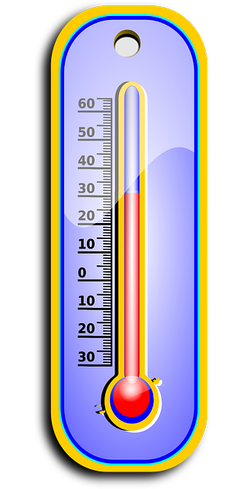
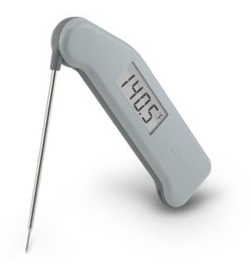
Temperature Control House Rules
. Bacterial Growth
multiplies rapidly between temp of 8°C and 63°C
Critical / Target Limits
Legal requirements
  raw food should reach a core temp of 80°C (critical limit is 75°C), reheated food should reach 85°C (critical limit is 82°C)
This must be recorded
Temperature monitoring using a thermometer
-probes should be cleaned and disinfected after use - A monthly calibration needs to be undertaken and recorded.
Notes:
1. Bacteria tend to multiply rapidly between temperatures of 8°C and 63°C . It is best to keep food out of this zone as much as possible. Ie chilling or heating to over that.
2. Target limit / temperature is what your setting has agreed to strive for. Critical Limit is the legally required limit.
For example – Fridge –The target temperature is between 1 °C and 5°C . The critical limit of the fridge temperature is 8. °C If the temperature reaches 8°C or above, food should be discarded. Between 5 – 8°C , action needs to be taken to lower the fridge temperature.
Any food which is made to be eaten later e.g. soup should be cooled as quickly as possible. Target time is 60 minutes -critical limit is 90 minutes
3. Foods cooked from raw should reach a temperature of 80 °C or above to destroy almost all types of bacteria. Critical limit of 75°C . Reheated food should reach over 85°C . Critical limit is 82 °C.
4. You need to have a temperature probe to check these limits. These temperatures should be recorded on the weekly record sheet. Probes should be cleaned and disinfected after use. A monthly calibration needs to be undertaken and recorded. Record sheets and details of how to do this are within the Food Hygiene guidance pack. However, if the probe has not been used – note that down on the sheet.

Slide 10
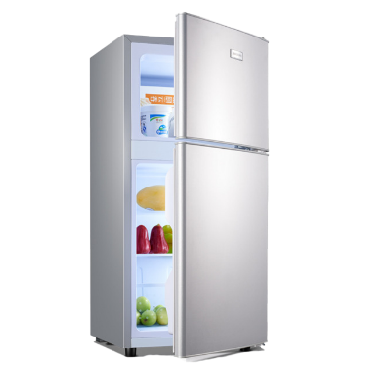
Temperature Control House rules
Cold temperature monitoring - The target temperature for fridges is between 1°C and 5°C. The critical limit of the fridge temperature is 8°C. If the temperature reaches 8 °C or above, food should be discarded. Between 5 – 8°C , action needs to be taken to lower the fridge temperature.
– This should be recorded, am and pm for fridge and daily for freezer
Delivered Goods
Storage of food products
eggs, raw root veg, soft fruits, other unwashed fruit’
raw and ready to eat food, food awaiting preparation
timings for temperature controlled food
Notes:
Fridges and freezers should have temperatures recorded – am and pm for fridge and daily for freezer – record on record sheet provided. Always check the temperature of the warmest part of the fridge. Built in thermometers are useful but should be checked regularly. Best practice would be to check and record fridge temperatures at the start of each session to avoid periods when the door has been open for any significant period of time.
2. Check temperatures of delivered goods – those using a delivery service –this is provided for you. If you do need to check, only one fridge item, one freezer item is needed to be tested for the temperature. (not each item) and the probe can be placed between items so they do not need to be opened.
Think about how you get your snack. Best practice would be to have a delivery service. Next would be to buy and bring straight to the setting where it can be stored and recorded in line with the House Rules.
3. Storage of foods –
eggs do not necessarily need to be stored in the fridge, but they do need to be taken out of their packet and placed in a sealed container,
Raw root veg need to be stored in a specific separate, sealed, labelled container. Treat them separately as they could have soil and earth particles on them which can be a risk.
Soft fruits in fridge but out of their packet and in a suitable container,
Other unwashed fruit in suitable containers stored off the floor (not needed to be covered as long as they are washed before eating.)
Raw and ready-to-eat foods will be separated in the fridge with raw foods stored below ready to eat/cooked foods.
Food awaiting preparation will remain covered at all times
All temperature controlled food will be put into storage within 4 hours of receipt
More details at Food Standard Scotland website.

Slide 11
Cross contamination House Rules
Cross Contamination
avoid transferring harmful bacteria from contaminated foods / surfaces to non- contaminated foods
Risk of E. coli 0157.
Foods which provide the main risk of cross contamination.
Raw meat such as beef, pork, lamb, chicken, turkey and game
Other raw foods such as fish, shellfish and eggs
Vegetables and fruit that have not been labelled as ready-to-eat and especially vegetables that are visibly dirty.
The main deterrents of cross contaminations are good handwashing, strict cleaning and disinfecting procedures after preparation of individual foods and correct storage
Notes:
1. Cross contamination occurs when harmful bacteria are transferred from contaminated food to uncontaminated food. Cross contamination has frequently been found to be the cause of food poisoning outbreaks.
Cross Contamination occurs
• By Direct Cross Contamination – contact between raw food and ready-to-eat food during transport, storage or preparation
• By Indirect Cross Contamination - spread of bacteria from raw food to ready-to-eat food via food handlers, equipment or surfaces. For example, indirect cross contamination can occur via refrigerator door handles, knives, chopping boards, work surfaces, chefs’ cloths or cleaning cloths.
2. E. coli O157 is a particularly dangerous organism because: • it can lead to serious untreatable illness and even death • it is reported to have a very low infective dose (less than 100 bacteria can cause illness) • it has the ability to survive refrigeration, freezing and environments which have a low pH or reduced water activity
3 The following raw foods or ingredients present a potential source of cross contamination and should be handled with care:
• Raw meat such as beef, pork, lamb, chicken, turkey and game
• Other raw foods such as fish, shellfish and eggs
• Vegetables and fruit that have not been labelled as ready-to-eat and especially vegetables that are visibly dirty. More details are on the following slide.
The main deterrents of cross contaminations are good handwashing, strict cleaning and disinfecting procedures after preparation of individual foods, correct storage, You should also clean and disinfect sinks, washbasins, taps and any other items that are liable to come in contact with food either directly or indirectly

Slide 12

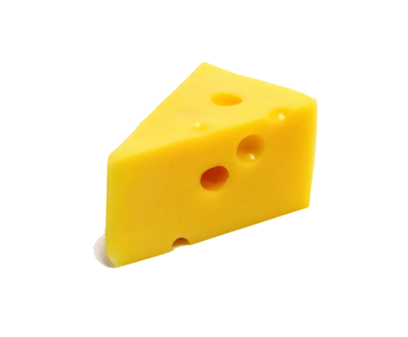
High Risk Foods
Raw meats such as beef, pork, chicken, lamb, turkey and game.
Other raw foods such as eggs, fish, shellfish
Vegetables and fruits that are not labelled ready-to-eat and especially vegetables which are visibly dirty.
All cooked meat and poultry
Cooked Meat products including gravy and stock
Milk, cream, artificial cream, cheese, custard and dairy products
Cooked eggs and egg products i.e. mayonnaise
Shellfish and other sea food
Cooked rice
Notes:
The following are considered High Risk Foods.
Raw meat such as beef, pork, lamb, chicken, turkey and game
• Other raw foods such as fish, shellfish and eggs
• Vegetables and fruit that have not been labelled as ready-to-eat and especially vegetables that are visibly dirty.
All unwashed root vegetables must be stored in a sealed, labelled container along with any utensils to be used i.e. peelers, chopping boards and knives. The boards and knives need to be colour coordinated, kept specifically for this purpose and stored within the box. Notices relating to colour boards and coordinated knives, should be displayed within the food preparation area.
Raw meats should not be used within ELC settings – if you wish to use, then the setting needs to re-write the house rules and comply with legislation and HACCP.
All cooked meat and poultry
Cooked Meat products including gravy and stock
Milk, cream, artificial cream, cheese, custard and dairy products
Cooked eggs and egg products i.e. mayonnaise
Shellfish and other sea food
Cooked rice
These need to be stored separately and UBD / BBD adhered to.
Staff must follow manufacturers guidance e.g. use within 3 days of opening – this must be stated on the container the food has been decanted into as well as the date the product was opened

Slide 13
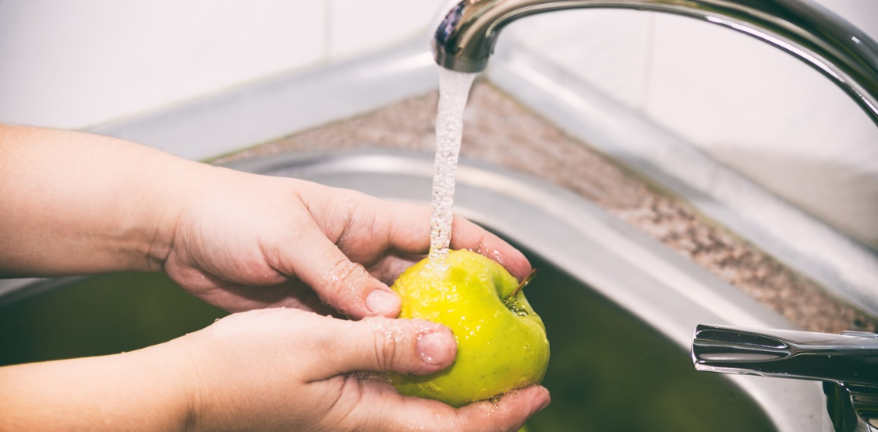
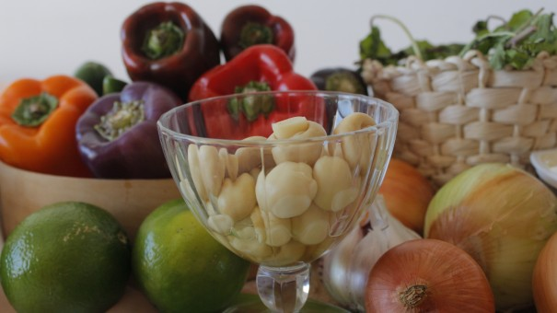
Preparation of foods
Food preparation area
Chopping boards, knives and utensils are colour coded
Washing of raw food, including fruit and vegetables,
Use of sinks
Labelling of sinks
Spillages and waste food
Notes:
Food preparation area is given a two stage clean before use and after preparing raw or unwashed foods
Colour coded chopping boards, knives and utensils are used as designated
Raw food, including fruit and vegetables, will be washed in a separate sink, which is not used for washing dishes etc.
If only one sink is available, this sink will be given a ‘Two Stage Clean’ before and after each use.
Where there is more than one sink, all sinks should be clearly labelled for their designated purpose (e.g. hand washing) to avoid cross contamination
Spillages and waste food should be cleared away promptly.

Slide 14
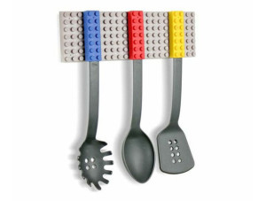
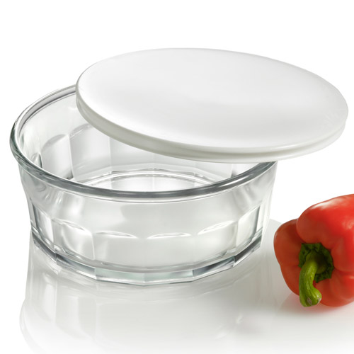
Food surfaces
Utensils
Chopping boards, knives, cloths and mops
Storage of Chopping Boards,
Cloths
Unpeeled fruits and vegetables
Tongs and serving spoons
Storage of Food
Foods awaiting preparation.
This Photo by Unknown Author is licensed under CC BY-SA-NC
Notes:
Food surfaces should be kept clean and tidy and free from unnecessary items
All utensils used for food are kept exclusively for food use
Chopping boards, knives, cloths and mops are colour coded for different uses. Signage is clear for the different colours and uses.
Chopping Boards, once cleaned, will be stored on their edge so that both surfaces remain dry
Single use cloths will be used whenever possible and always after root vegetable preparation. Where this is not possible a cleaning and disinfecting procedure will be followed to ensure cloths are scrupulously clean
All fruits and vegetables that are not going to be peeled will be washed before use
Specific different tongs and serving spoons are used for raw or unwashed food and ready-to-eat foods
Food will be stored off the floor and away from walls
Foods which are awaiting preparation or are being defrosted or cooled will remain covered

Slide 15
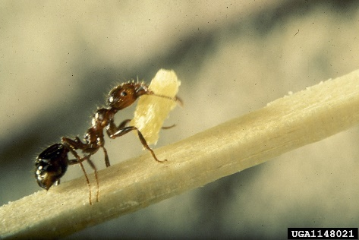
Pest House Rules
Pests may carry harmful bacteria which can contaminate food
Pests –rodents, insects, birds
Visibly check buildings for signs of pest access
Visibly check food preparation area for signs of pests
Visibly check food items for pest damage
Notes:
Any signs of pests should be noted on weekly overview but reported immediately to line manager and/or janitorial staff to be dealt with as soon as possible. These visual checks should be done every time the snack area is used.

Slide 16
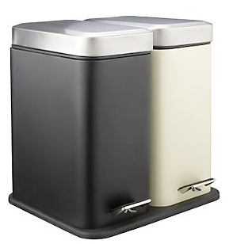
Waste House Rules
To prevent risk of physical contamination and avoid attracting pests
Waste –any item of food, ingredients, packaging materials, soiled cloths
Removal of waste
Notes:
It would be good practice to recycle as much food waste as possible. This may need separate bins/containers etc. You may have a garden compost bin. Compost bins need specific raw vegetable matter, not cooked matter i.e. bread, crackers, cereal etc. Think about how this will be managed and used.
What other items of waste can be recycled? Ie glass, plastic
Think about how often waste is removed and the procedures around this. Waste bins should never be overflowing and/or left for long periods of time ie over a weekend etc

Slide 17

Maintenance House Rules
Visual checks on structure of the building and equipment.
Replacing/updating worn, scratched, stained and broken equipment
Replacing/updating equipment which cannot be effectively cleaned and disinfected.
Follow correct 2 stage cleaning programme.
This Photo by Unknown Author is licensed under CC BY-SA
Notes:
Report any changes to the building to your line manager or janitor, this should also be noted on the weekly sheet.
Visually check equipment including fridges, dishwashers, chopping boards etc. – replace as necessary

Slide 18
Stock Control House Rules
Use by date - This date mark is required on microbiologically perishable pre-packed foods. It is an offence to sell food after UBD has expired. Food eaten after the UBD has expired could cause food poisoning.
Best before date - This date mark is required on longer life foods that are NOT subjected to microbiological spoilage i.e. canned / dried / frozen foods. This date relates to food quality rather than food safety.
It is important to note that when purchasing foods with a “Use by Date” the product should have at least three days shelf life. Foods with a “Best Before Date” should have at least a three month shelf life.
Notes:
UBD – date mark required on microbiologically perishable pre-packed foods, it is an offence to sell food after UBD has expired. Food eaten after the UBD has expired could cause food poisoning
BBD – date marked required on longer life foods that are NOT subjected to microbiological spoilage i.e. canned / dried / frozen foods. This date relates to food quality rather than food safety.
When food is opened, the manufacturers guidance must be followed i.e. use within 3 days, this supersedes the UBD / BBD - this must be noted on the container with the date opened ie soft cheese once opened must be consumed 3-5 days after opening though use by date will be longer.

Slide 19
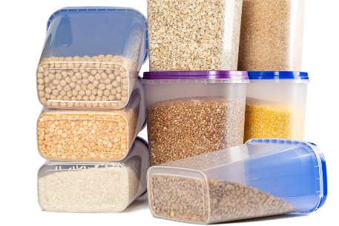
Stock Control House Rules
Storage of dried goods -
-Once opened, dry goods e.g. flour, sugar, cereals must be taken out of the original packaging and put into sealed, labelled containers, with date opened and the original use by / best before date clearly marked on the container. To adhere to allergen advice the ingredients list should be attached to the new container. Old stock MUST NOT be topped up with new stock.
-All manufacturer’s storage instructions should be always followed i.e. keep always refrigerated or use within 3 days of opening
-Opened tinned goods should never be left in their tin but decanted to a container with a lid. Date opened UBD / BBD or manufacturers guidance should be listed along with the ingredients list
Remember root vegetables must be stored in a sealed container with the chopping board and knives designated for their use etc.
This Photo by Unknown Author is licensed under CC BY
Notes:
.Dried goods once opened should be put into a sealable container with the UBD / BBD and date opened clearly marked and manufacturer’s guidance (as above). The ingredients list should also be attached for allergen information
Remember root vegetables must be stored in a sealed container with the chopping board and knives designated for their use etc.

Slide 20
Suspected food poisoning
Two or more cases is considered an outbreak.
Inform Care Inspectorate 0345 600 9527
Fife Health Protection Team 0300 790 62 64
Review cleaning procedures and implement infection control products
Consider contacting the local Environmental Health Officer for advice
An email must be sent to Environmental Health Department Food.Advice@fife.gov.uk
Notes:
An outbreak is TWO or more cases i.e. within a Nursery setting. However, food poisoning can only be identified by a doctor.
Two or more cases are considered an outbreak. Inform Care Inspectorate on 0345 600 9527 Fife Health Board on 01592 226447 Review cleaning procedures and implement infection control products Consider contacting the local Environmental Health Officer In the event of an outbreak, an email must be sent to Environmental Health Department Food.Advice@fife.gov.uk

Slide 21
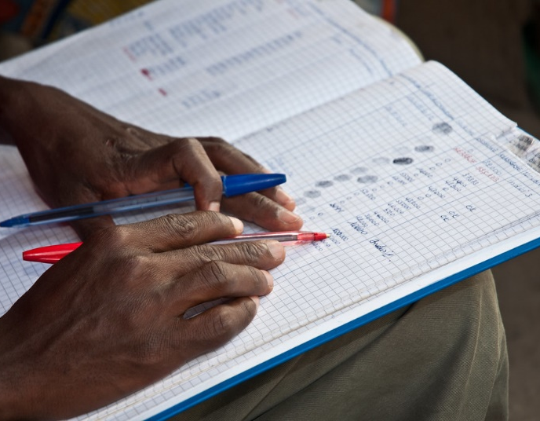
Record Keeping
Legal requirements
All in one record
Weekly overview
Monthly probe calibration
Yearly refresh training with all staff
Notes:
There is a legal requirement to keep record with the details of foods stored, prepared and served by food handlers within your setting. A weekly All-in-one page is included within the Fife Food Hygiene pack. This can detail the daily temperature of fridge and freezer, the food being served that day with the UBD and BBD details, and probe temperatures if required
You do not need to note down all the food purchased on the day – you need to note down the food being served on each day with the relevant information (as above). This should be noted on the record sheet “food being served”.
It would be best practice to double side this sheet with the “Weekly All-in One” sheet
Weekly overview by management – verify the records are being kept and spot any patterns. Signed by SLT.
Yearly refresh training should be undertaken with all staff to ensure skills, knowledge and procedures are up to date and correct. A record should be kept of staff completing this.

Slide 22
Allergies
Legal responsibility from December 2014 – to share information with users as to the ingredients that are in the food made and served within your setting
You must have a notice displayed asking users to share any allergy concerns they may have
14 common allergens (but there are many others)
Best Practice – products all children can use, allocate specific chopping boards, knives, utensils for child with allergy (store separately in a sealed container) refer to allergens within ingredients EVERY TIME,
Allergen Menu folders -to record up to date info, product specific sheets, recipes, allergen templates
Notes:
Legislation states you must provide the user with the correct allergen information about the ingredients that are in the food you make or serve. This can be done verbally but staff need to be able to reference this. You must have a notice on display asking service users to share any allergy concerns with you.
There are more than 14 allergens but the ones listed below are the common ones legally required to be identified within the whole EU. You may have children within your setting who have different allergies and you need to accommodate them. (you may need a specific Health Care Plan)
• Celery,
• Cereals containing gluten, Crustaceans(lobster, crab, prawns, shrimp paste etc.)
• Eggs,
• Fish (sauces, dressings, stock cubes, Worcester sauce),
• Lupin (lupin seeds, flour, types of breads and pasta),
• Milk,
• Molluscs(mussels, squid, oyster sauce), Mustard (found in breads, marinades, dressings, soups etc),
• Nuts, Peanuts,
• Sesame seeds,
• Soya (can be in some ice creams, sauces, vegetarian products),
• Sulphur dioxide (found in dried products such as raisins, and beer and wine – and stock cubes)
(reminder-the information within the allergen section of Setting the Table is different. Legally you must inform on the ABOVE 14 allergens.)
Staff need to be extra vigilant for cross-contamination with regards to food handling, storage and preparation. Where possible, best practice would be to allocate specific chopping boards, knives, utensils for the child with the specific allergy, and store these separately in a sealed container.
Best practice would also be to look at products which could be used by all children.
Allergen template is provided to use with common snack items and regular recipes. This can be completed annually but checked regularly to ensure the info is current and correct. i.e. if you have written down Asda’s crackers, but change to Tesco’s crackers, you MUST update the paperwork with the new allergen information. This info does not need to be on display, but staff must be able to access it if a service user asks for it.
Best practice would be for staff to regularly check ingredients lists within all the products they use. Allergens are normally noted in bold. Manufacturers can and do change the ingredients to products, so referring to the allergens every time staff provide them, should allow for any changes to be noted.
Child(ren) with a food allergy should be clearly identified, so all staff are fully aware of this. However, be aware of the child’s right to privacy i.e. display clearly but only so staff can access this.
There are recipes available within the appendix with allergen information detailed on them.

Slide 23
Allergies – what to do in an emergency
A clear visual display of the children with known allergies is accessible for all staff including supply staff. (with child’s privacy maintained)
Allergens are clearly listed, with symptoms which might occur if the child has been exposed to an allergen.
All staff know the correct procedure and protocol for children with known allergies and where medication is held, if needed. ·
All staff know who the trained person is, who can administer emergency medication if needed. The agreed protocol is followed if a reaction occurs. · If in ANY doubt, the emergency services (999) will be called immediately if a child is suspected of having an allergic reaction. Send someone to meet the ambulance crew and someone to remain with the child in the meantime.

Slide 24

Snack Provision
Menu planning-variety of sensory qualities, variety of types, textures, flavours, colours and temperatures.
Ensure children are actively involved in all aspects of snack – planning, choosing, preparing, baking etc
Nutritious and low in sugar
Food for special occasion
Choking Hazards
‘Setting the Table’ and ‘Food Matters’
This Photo by Unknown Author is licensed under CC BY-SA
Notes:
We need to provide a balanced, healthy snack for children, taking into account their needs and the length of time they are in the setting i.e. most children may attend for a full day and thought should be given to what is available for snack across the full day. Snack needs to compliment lunches. Give thought to timings of snack in relation to lunches/light meals which are offered. We want children to experience and consume nutritionally rich foods to allow for appropriate growth. Timings for snacks, lunches and other meals need to be thought about. Ie responding to children’s needs but also allowing time between snack and a lunch or light meal.
Also, it is very important to know your children – some children may be hungry when they come in. We need to think about this and how we meet their needs. Children can be involved in helping to plan what they would like to eat i.e. helping to order the fruit and vegetables for that week. (see Board maker appendix for a template)
Children can be involved in cooking and baking for others to consume as these foods will be brought up to the correct cooking temperature before eating.
Food should be nutritious and low in sugar i.e. natural yoghurt.
Thought needs to be given on how Birthdays and festivals are celebrated. Do you always provide a cake? What happens if you have 80 children in the setting?
Snack can provide a rich learning experience with opportunities for independence. Children can be involved in setting the table for themselves, preparing their own snack and tidying away their own dishes etc. Neither children nor staff should be preparing platters of cut fruit, sandwiches etc. for lots of children to choose from.
Think about the size and shape of food being offered and the possibility of any choking Hazards – i.e. cut grapes in half. Guidance is available from the Care Inspectorate (Good practice guidance: prevention and management of choking episodes in babies and children December 2019 )
‘Setting the table’ and ‘Food matters’ guidance is available for ELC settings, where you should be following the snack procedure not the full day menu.
‘Better eating, Better Learning’ is also available in schools to support healthy eating.
Care Inspectorate and SEIC Practice notes discuss lunches, and are useful reminders in relation to portion sizes, sitting with children, not 'forcing' children to finish all that is on their plate etc

Slide 25
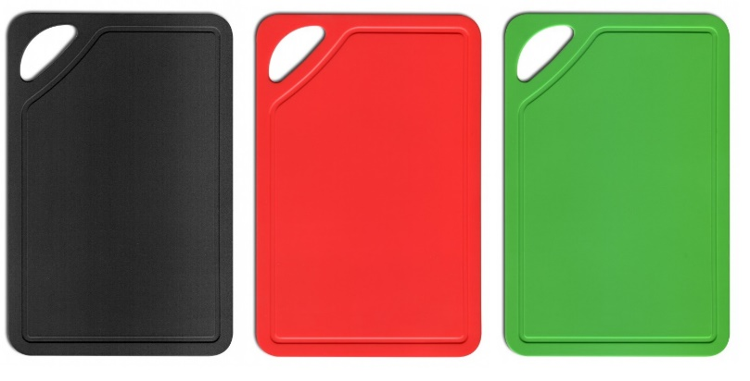
Colour Coded Resources
Cloths/Brushes/Dustpans and Mops
– Green – food handling areas
Blue – Other areas within playroom
Red – toilet and nappy change areas
Chopping Boards and Knives
-Green – salad, fruit and clean vegetables
-Yellow –cooked meats
-Brown – unwashed root vegetables
White – dairy
Blue - bread
This Photo by Unknown Author is licensed under CC BY-NC-ND
Notes:
These are recommended colour codes for items within ELC.
However, other colours can be used.
Ie if you cannot get a brown chopping board for unwashed raw root vegetable, you can use any other colour, ie purple, but you must indicate this within your policy and signs.

Slide 26

Food Standards Scotlandwebsite offers lots of advice and practical support to ensure you are complying with legislation.
This Photo by Unknown Author is licensed under CC BY-SA
Notes:
Visit the Food Standards Scotland website for advice, support and guidance to ensure you are complying with current legislation around Food Hygiene.

