Slide 1


Parental Engagement Evening

Slide 2
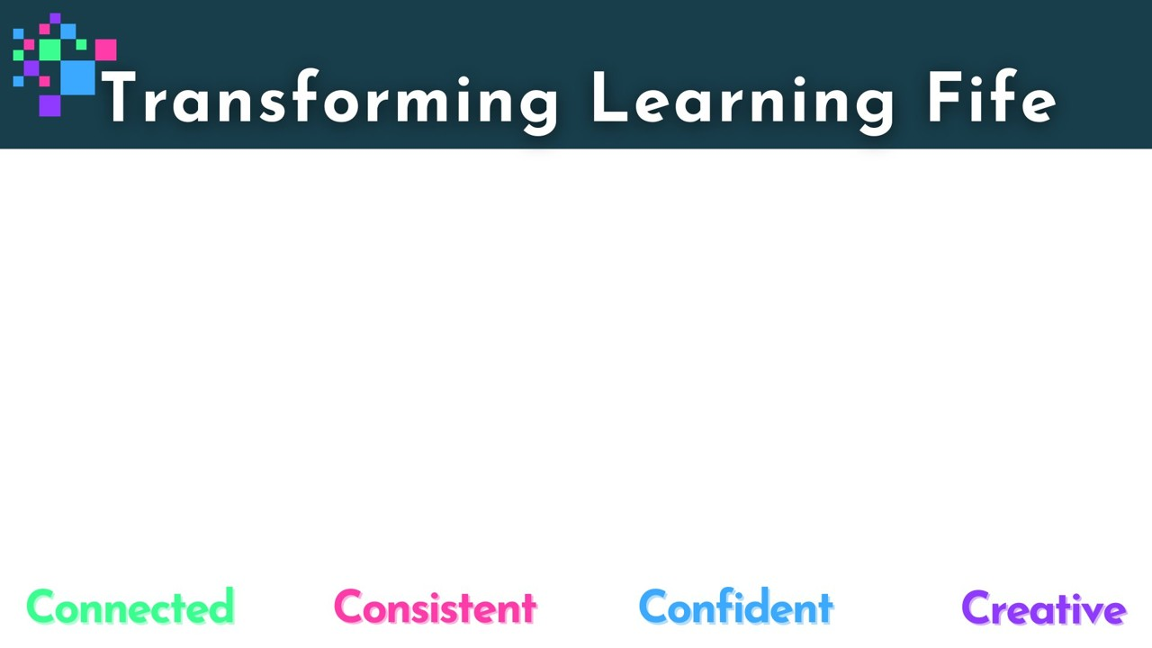
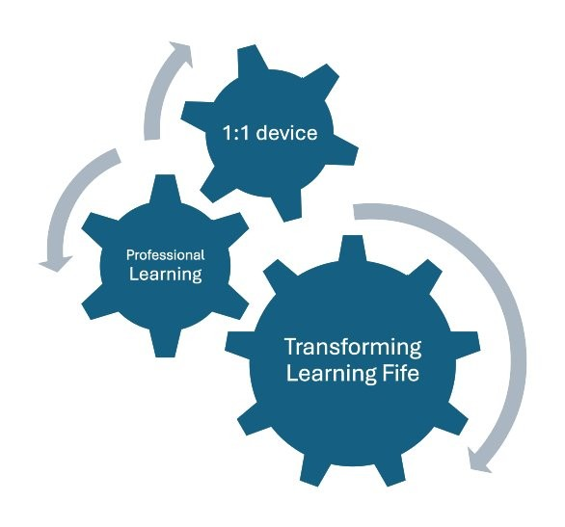
Our Aim
To provide your child with the tools needed to transform the ways we engage with learning and teaching.
This is an investment in young people to develop their confidence as well as the digital skills they will need throughout their educational journey and beyond.

Slide 3
Our Vision
In 5 years time, teachers in Fife will have transformed learning by:
integrating digital skills throughout the learning process to engage and motivate learners
using technology for effective explanations and modelling to learners
providing personalised learning experiences and facilitating learners to lead their own learning
improving assessment and feedback with digital tools

Slide 4



Jamf Parent - setting iPad restrictions at home
Using the Jamf Parent app you can:
allow and restrict apps to choose which apps your child can use
enable App Lock to set a timer for app restrictions
create locations to see the approximate location of your child’s device
create a Device Rule to schedule app restrictions
https://read.bookcreator.com/ets9ByGBmOa3zYFDTgg4GgES0Ra2/YRCP3NDmTgeTg4FGunRxYQ

Slide 5


Showbie - viewing your child’s schoolwork at home
By creating a Showbie parent account you can:
see your child’s assignments, feedback, and grades
receive email or push notifications about new assignments, deadlines, and feedback

Slide 6

Parental Agreement
Fife Council provides P6-S6 pupils with an iPad to support their learning in and out of school. By your child using this iPad, you, as a parent/carer, agree to the following terms:
Responsibility for Parents
You are responsible for the safe storage and use of the iPad at home | Your child must bring their iPad to school fully charged every day
The iPad should be stored securely when not in use | No stickers or markings should be placed on the iPad or case
If the iPad is lost, stolen, or damaged, report it to the school immediately | If your child leaves Fife Council Education, the iPad must be returned to their school

Slide 7
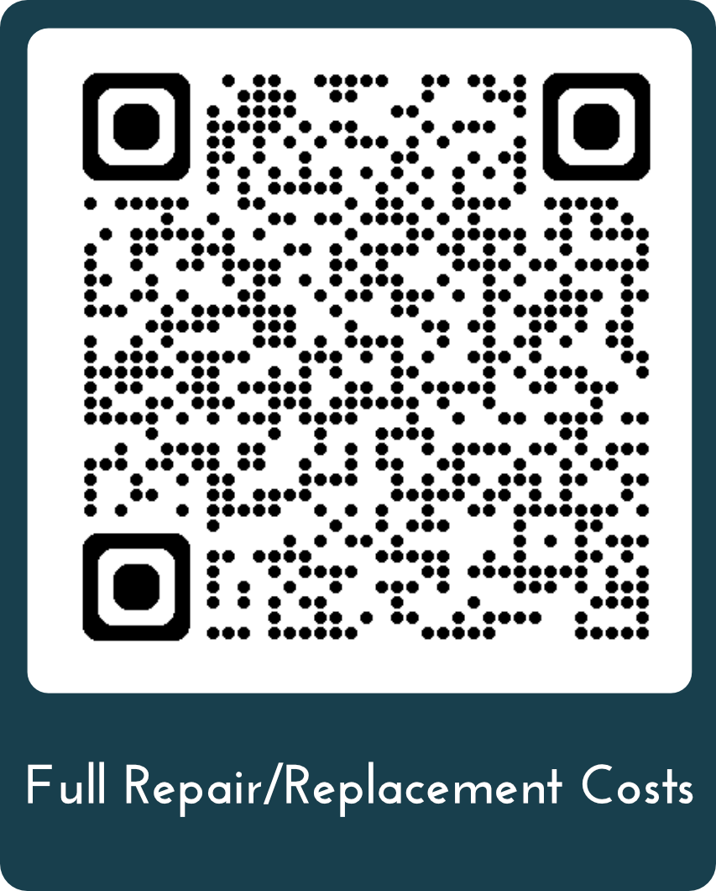
Damage - Repair/Replacement Costs
These are estimated costs and are to be confirmed. Discussions are ongoing with the local contractor.
Item | Contribution 1st Repair | Contribution 2nd Repair
Damage to screen | £70 | £150
Damaged charge port | £65 | £140
Lost or device beyond repair | £150 | £200
https://blogs.glowscotland.org.uk/fi/transforminglearning/repair-replacement-costs/

Slide 8
School Expectations
Present to Oct
Continuing to develop transferrable skills e.g. making connections to using netbooks and iPad
Staff modelling use of iPad when appropriate, raising awareness of devices and applications
Making links to existing knowledge and skills
Responding to leaners questions ahead of the roll out
Build learners awareness of the expectations of them as responsible digital citizens

Slide 9
School Expectations
Oct onwards
How to look after the device – responsibilities
Familiarisation with the device – using Apps, logging in, sharing documents etc
Accessibility tools – to empower learners to use the devices creatively to learn e.g. audio feedback/dictate
Introduction to apple apps, making connections to known applications, such as, Microsoft 365
Use of devices in class to access, record and feedback on learning as teacher and learners' skills develop over the course of the year e.g. annotating, audio feedback, accessing learner specific resources and support materials.
Issues with devices to be reported to Class Teacher, Depute Headteacher as soon as possible.

Slide 10

Supporting each other
This is a new landscape for all of us….
Dedicated section on our website for
parents / carers
Share ongoing learning in school
Provide support for home
Talk to each other

Slide 11

Questions?
Please scan the QR code to visit the Transforming Learning programme’s FAQs.
https://blogs.glowscotland.org.uk/fi/transforminglearning/frequently-asked-questions/

