Slide 1


Denbeath primary

Slide 2

Events
For our events we do sports day. we do Halloween party and Christmas party

Slide 3
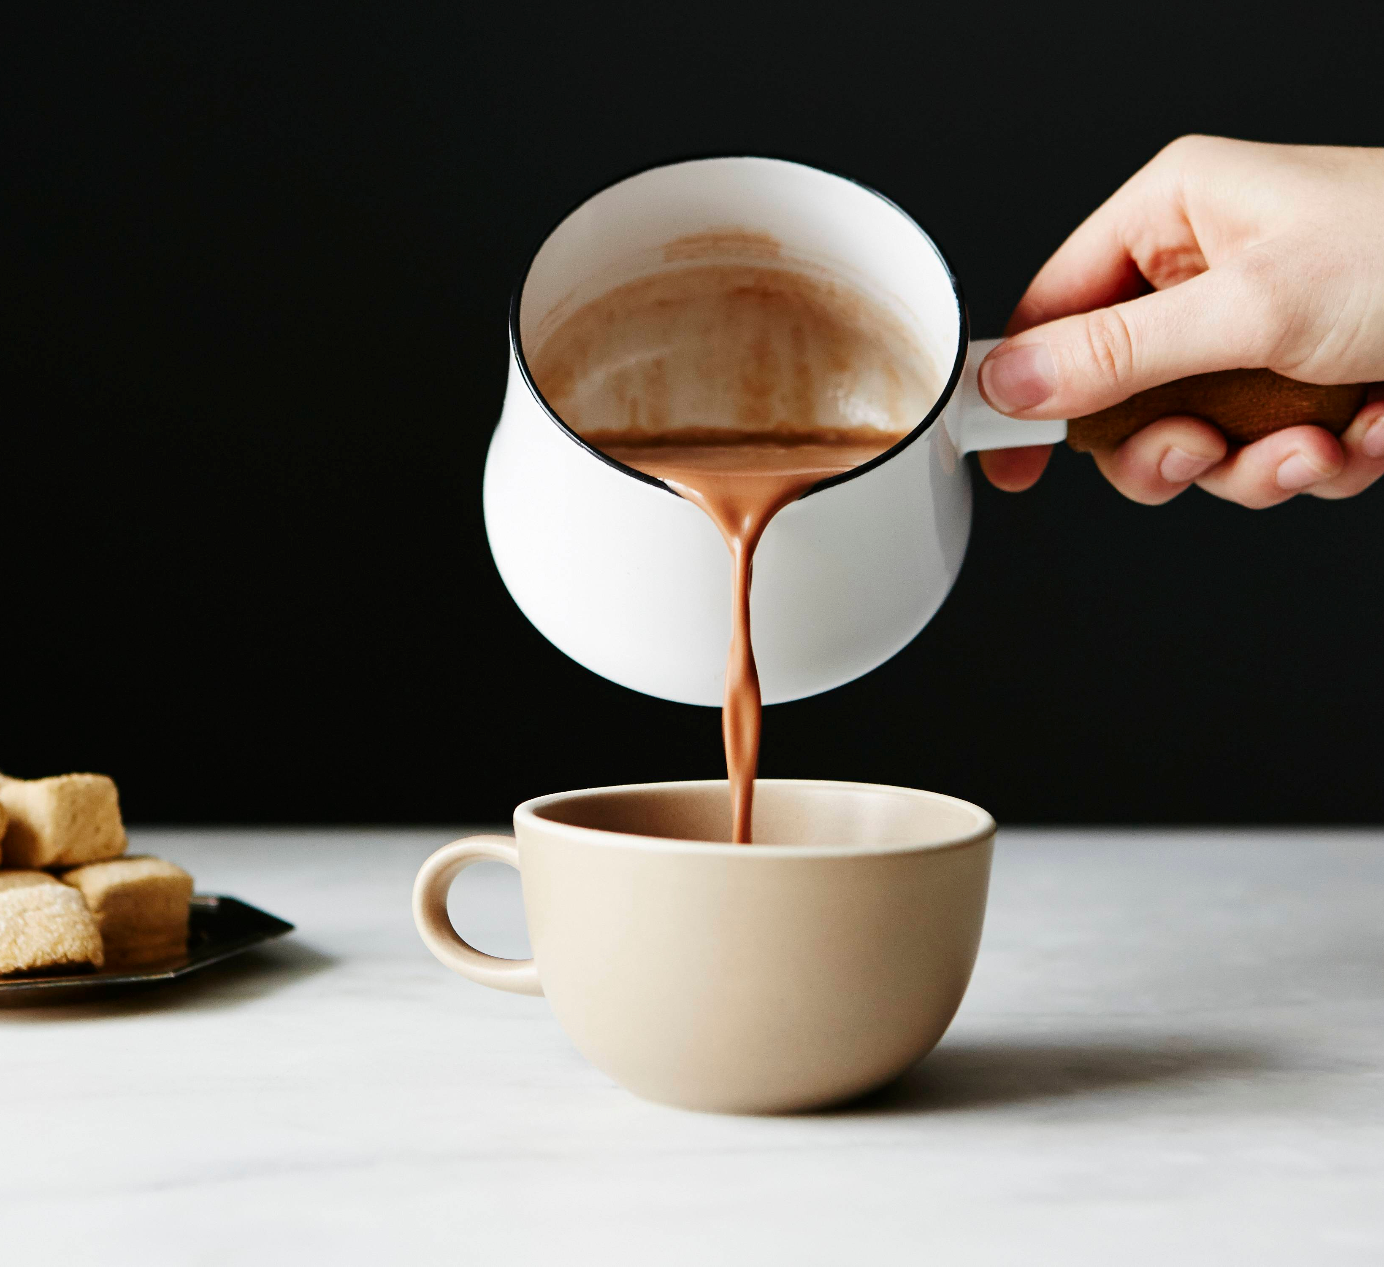
Hot choc Friday
Hot chocolate Friday is a time when you are ready respectful and safe you can go to miss Miss Manton and have a hot chocolate ☕️

Slide 4
Denbeath facts
Denbeath was founded in 1908 also Denbeath was first founded as a secondary school
Denbeath primary’s head teacher is miss manton

Slide 5
Denbeath
Denbeath values are ready respectful and safe
Our aim is to be a duck - dilegent unique caring and kind

Slide 6

After school club
After school football is on Wednesday three till four
.extra time club three till five football on Tuesday Thursday .basketball is Friday three till four.

