Slide 1


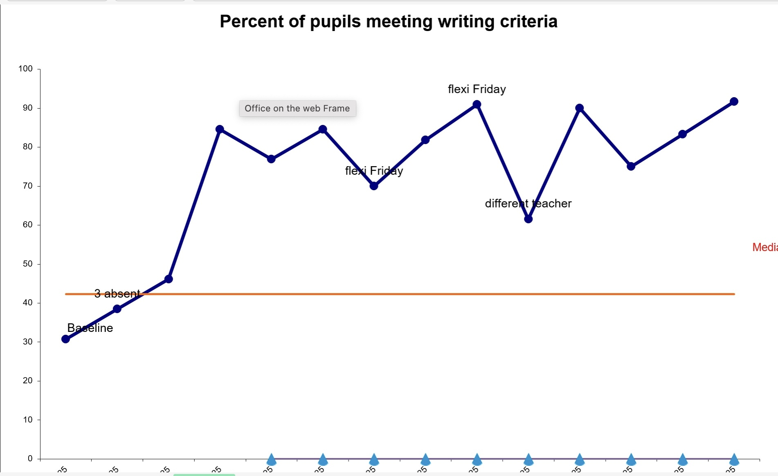
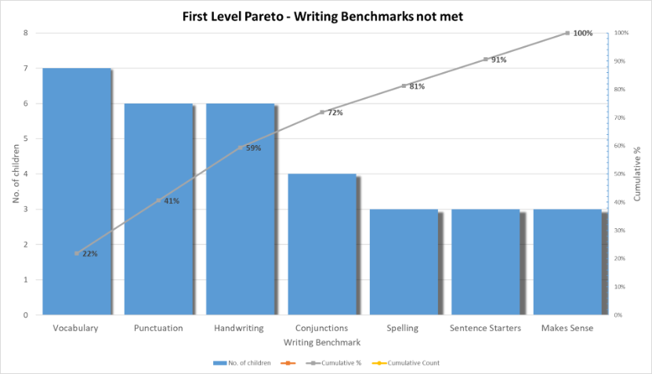
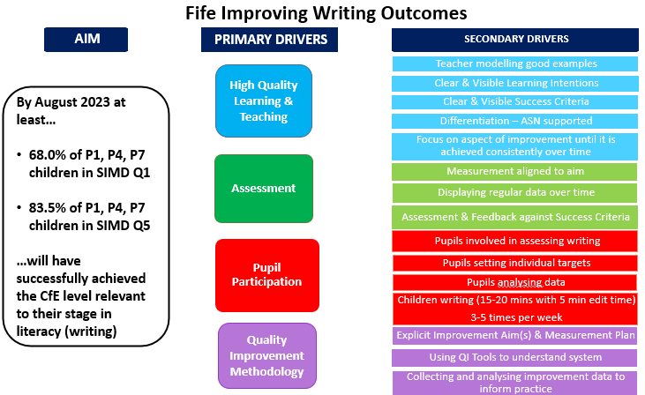

Improving Writing Outcomes for P2/3 Learners
Holly Birse, Class Teacher, Kingsbarns Primary School
Stretch Aims: By December 2025 85% of P2 will be on expected CfE level (baseline 0%, projected 29%)
By December 2025 87% of P3 will be on expected CfE level (baseline 0%, projected 50%)
Teaching Aims: By 24th February 84% of P2/3 will be able to punctuate* sentences at First Level (baseline 13%).
using capital letters, full stops and finger spaces in at least 2 sentences (p2)
using capital letters, full stops and finger spaces in at least 3 sentences (p3)
Results
Method
Established an Improvement Team.
Attended Fife QI Improving Writing Programme (Wave 12).
Carried out a baseline assessment against CfE benchmarks.
The baseline assessment was used to create a pareto chart.
The biggest challenge for the majority of the children was punctuation and vocabulary.
The pareto chart informed teaching aims and where to start.
Worked with others on the QI course to feedback, discuss and reflect.
As shown, our results dipped for various reasons such as a different teacher’s input or absence.
I found that when 1 or 2 children were absent, it impacted results significantly because I was working
with small numbers. When the median was established and we had 7+ points above this, we moved
on to our next aim. The children were extremely motivated to get 100% and achieved this by
24th February.
Conclusions
”I can write so much more than I used to”
”I always try my best now because of our chart”
“I love seeing our chart go up”.
Process Change
Parent:
I can’t believe how much ___ is writing at home, he asked for a jotter at the shops!
PSA:
“It’s amazing to see those who struggled to write without support, realising their capabilities”
Implement
Key Learning Points
Using clicker was a barrier to some children – typing and
technology skills slowed them down (further keyboard skills)
Self assessing their own writing is tricker – easy for young children to miss punctuation etc. however, I can see with practice, how this can improve
In general, the children are very imaginative, so picture/object stimuli worked well.
Short clips served as a great hook for writers who struggled more to use their imagination.
Having a yes/no pile helped make assessing quick, effective, and manageable for me.
Children writing 3-5 times per week.
Write for 15 mins, 5 mins to self-check.
Teacher input aligned to aim (stimulus, dialogue, model)
Share Learning Intention and make Success Criteria explicit.
Assess and feedback against Success Criteria.
Involve Children in the process
Whole class reflect and discuss results the following day – what went well? How can we make it even better?
Achievements
Next steps/Evaluation
By 24th February 2025, 100% of children achieved stretch aim (baseline 13%). - punctuation
We then moved onto our next focus, which was vocabulary.
By 9th April 2025, 84% of children achieved stretch aim (baseline 13%) - vocabulary
Continue to implement the QI writing bundle to continue to help me target my teaching to meet the needs of all learners.
Ensure writing sessions are short, sharp bursts to really focus on the specific skill.
Encourage pupil voice and use this to motivate and engage – creating a sense of excitement around writing.
Use data to make informed decisions about learners for tracking/attainment/reports etc.
Increased my enjoyment and confidence in teaching writing – positive impact on childrens attitudes towards writing.
Further information contact: holly.birse@fife.gov.uk

