Slide 1
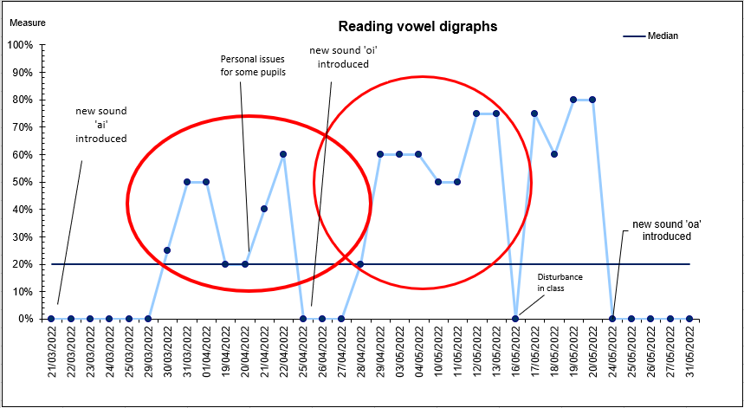
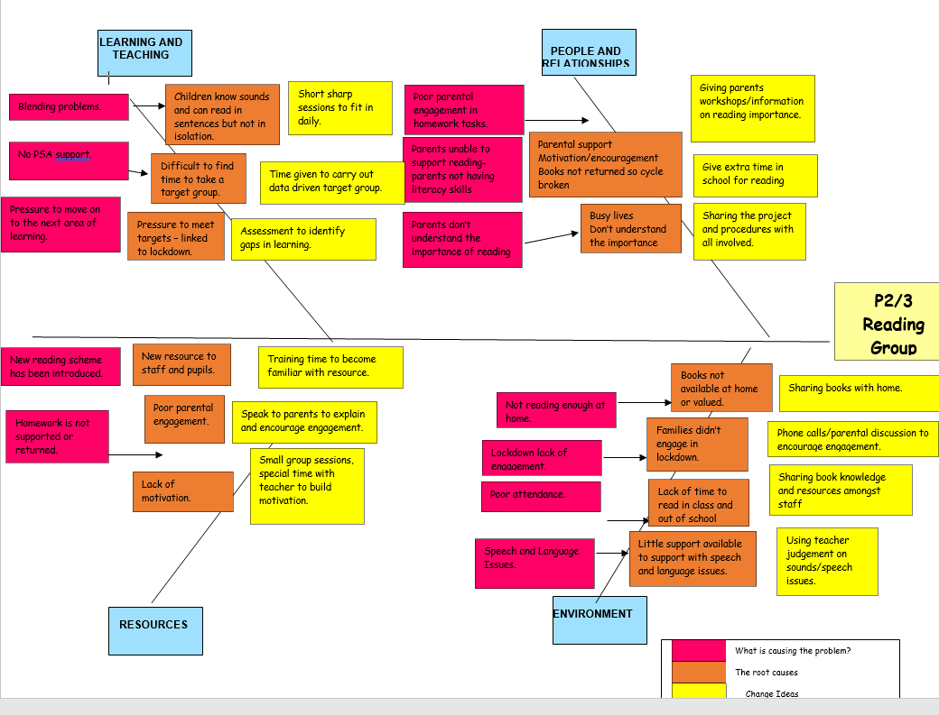
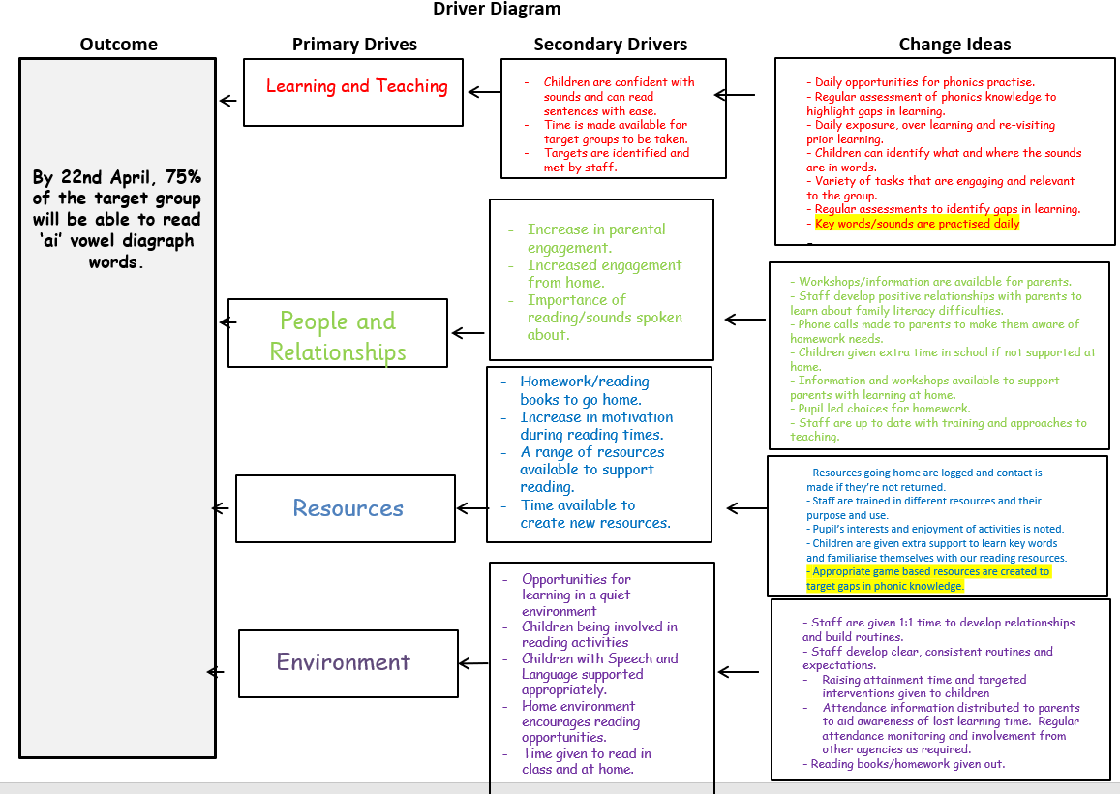
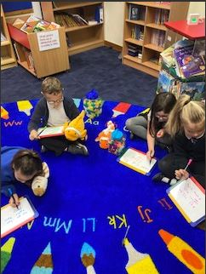
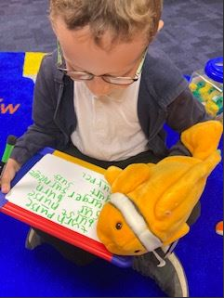
Improving Reading
Jacqueline Kyme- Class Teacher (Pathhead Primary School)
Kirsty Wilson/Vanessa Anderson - Coaching Support (St Joseph’s RC Primary School)
A group of P2 learners were identified as not meeting the benchmarks for achieving first level reading.
Stretch Aim: By the end of June, 60% (3/5) of the children in target group will achieve the benchmarks for first level reading
Aim 1: By 22nd April 2022 60% (3/5) of the target group will be able to read the ‘ai’ vowel digraph in words (baseline *).
Aim 2: By 27th May 2022 60% (3/5) of the target group will be able to read the ‘oi’ vowel digraph in words.
Aim 3: By 15th June 2022 60% (3/5) of the target group will be able to read the ‘oa’ vowel digraph in words.
Conclusions
Shifts in data – demonstrating improvement!
Dips in data are attributed to challenging circumstances at home and in school for some pupils.
Method
Results
Pathhead participated in coaching sessions to support them through the Quality Improvement journey.
We used a range of resources to gather baseline data and identify the issues within reading and decoding.
Vowel diagraphs was identified as the first target and a process was created to assess these daily.
We decided we needed to create a tool to gather the baseline data which identified how many words the children knew out of nonsense words daily.
Key Learning Points
Time to focus on group with no class support has been difficult for the class teacher.
It is challenging in the afternoon sessions to keep children focused on the task.
First vowel digraph took a long time to grasp but the second one was grasped more quickly.
Attendance issues had an impact on the learning.
It was hard to build a regular routine with so many holidays, in-service days and other school commitments.
Good to work in partnership with colleagues from another school to support QI process. However, communication is key to maintaining momentum.
The driver diagram helped us to identify which change ideas to test first.
The main issue was the children not being able to recognise vowel diagraphs within words.
The first change idea was to implement a morning activity using magnetic letters and sound cubes to create words using the target vowel digraph.
In the afternoon the children were assessed using nonsense words to test their knowledge of the target digraph.
Next steps
Continue to use QI process in daily classroom practice.
Look at how to incorporate the time better into the day (use PSA support).
Share successes with other school staff so QI can become more widespread.
“It’s easy to remember because we do them everyday.” (Child A)
I like to play with the sound cubes.” (Child B)
Achievements
Learners are able to recognise and read words out of context.
Learner confidence and self-esteem is growing.
Aim 1 and 2 achieved.
Worked well in partnership with QI Lead school.
Further information contact: jacqueline.kyme@fife.gov.uk kirsty.wilson-wd@fife.gov.uk vanessa.anderson@fife.gov.uk

