Slide 1

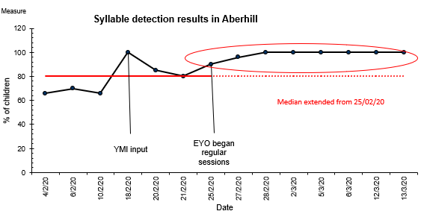
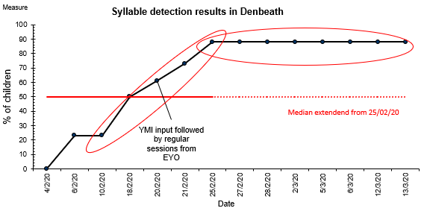
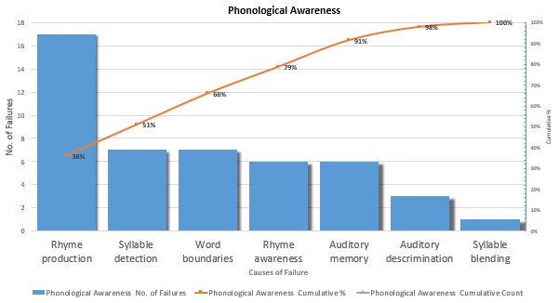
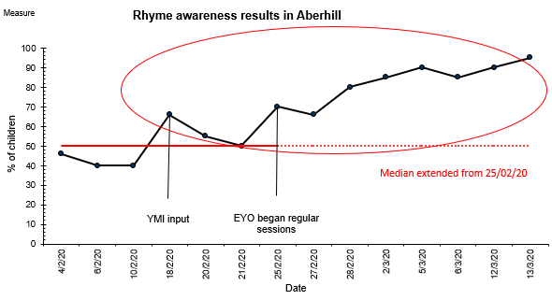
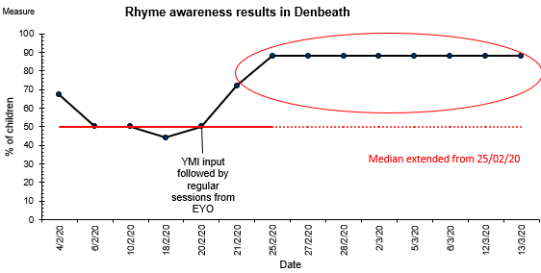
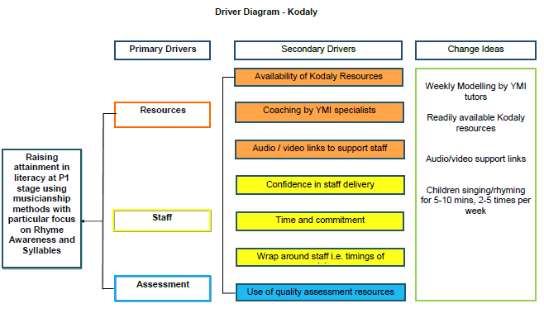
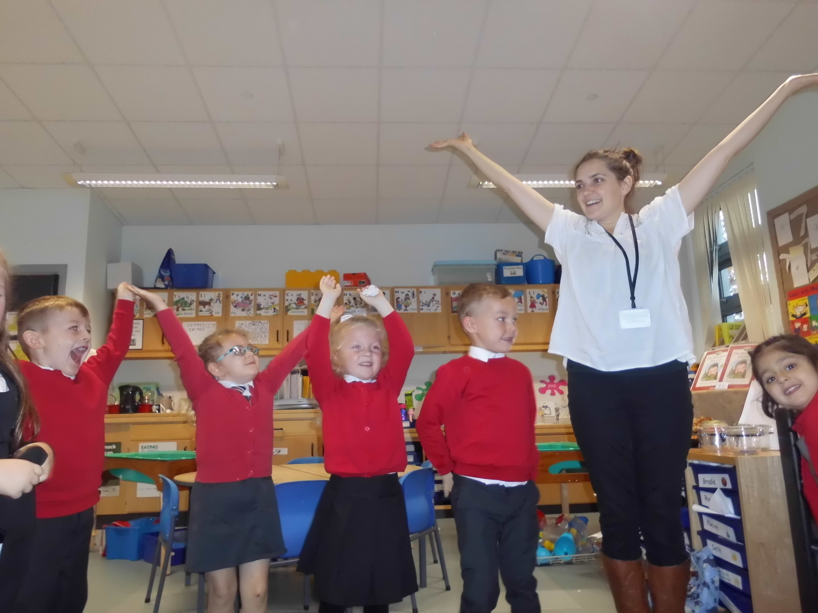
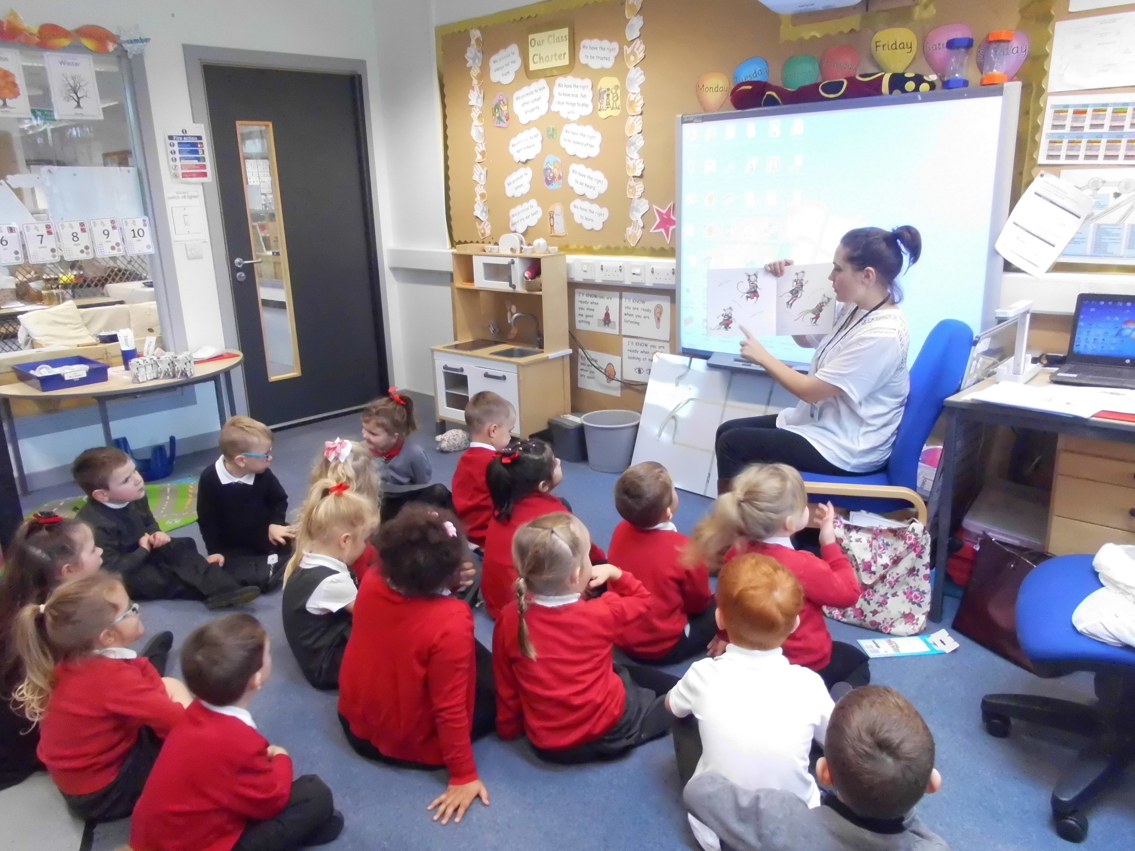
Raising Attainment in Literacy at P1 stage using Kodaly musicianship methods
Ruth Craib - Assistant Music Coordinator ( YMI)
Catherine Baker – YMI Project Leader
Fiona Howe – YMI Project Leader
Claire Reekie – EYO, Denbeath PS
Luisa McDougald – EYO, Aberhill PS
Aim: By the end of the Summer term 2020 that 80% of P1 pupils will be able to identify syllables and have rhyme awareness.
Rationale
Syllable recognition and rhyme awareness is critical to reading acquisition. This improvement project focused on schools within areas of high deprivation (SIMD) where baseline assessment showed low results in both syllable recognition and rhyme awareness in P1 classes. The YMI team had a strong belief that regular music input, specifically Kodaly rhymes and songs, would improve children’s literacy.
Method
Results
A baseline assessment was carried out across P1 classes in Aberhill PS and Denbeath PS. Quality improvement tools supported us to refine our improvement aims, measures and change ideas.
A pareto chart helped us to understand what aspects of phonological awareness our cohort of children found most challenging.
Our Driver Diagram is a visual display of our theory of change. This process enabled us to agree High Impact/ low effort change ideas.
Conclusions
With regular 5/10 minute practice of the Kodaly rhymes/songs several times per week (2-5 times), both syllable recognition and rhyme awareness scores improved greatly over a 2 week period. Improvement gains were mirrored across both settings.
Process Change
“Children who struggled with literacy via traditional methods were able to improve their skills through the Kodaly rhymes and songs” (Class Teacher).
EYOs received weekly coaching from YMI specialists.
Provision of readily available resources including audio/video links.
Kodaly rhymes/songs were practised (5-10mins) with the groups of children as regularly as possible with their EYO (between 2-4 times per week).
Data was collected from a new assessment after each Kodaly session.
“Children were motivated and engaged in all sessions. Staff found the resources easy to use” (Class Teacher).
Key Learning Points
The aim of the project was achieved in a shorter timescale than anticipated.
Keeping Kodaly resources simple and making audio/video material available for staff delivering daily in schools was seen as vital.
Helping to raise classroom staff confidence in delivery by YMI specialists was very important.
Regular practice (2-5times per week of 5-10 min sessions) demonstrated improvements.
This process provided key learning around the usefulness of modelling and is transferrable to a range of work/teaching settings.
Achievements
Improvements happened in a very short times scale!
Over 2 weeks:
Syllable recognition increased from 65-100% (Aberhill) and 0-88% (Denbeath).
Rhyme awareness increased from 45-95% (Aberhill) and 45-88% (Denbeath).
Early Years staff confidence in facilitating Kodaly sessions grew.
Next steps
To deliver to other groups of pupils in the current and other schools.
Test the same methods to see whether our change ideas replicate similar improvements in different contexts.
Apply our learning to other aspects of literacy.
Further information contact: ruth.craib@fife.gov.uk

