Slide 1
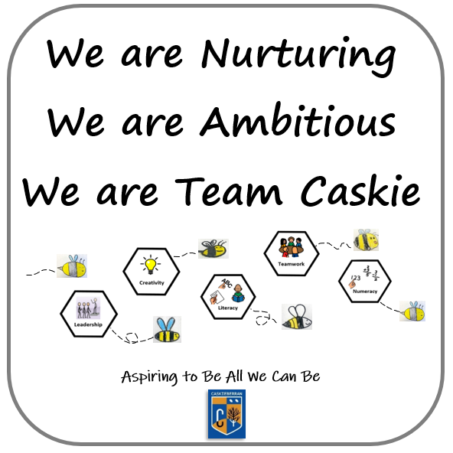
ScHOOL IMPROVEMENT PLAN 2023-2024

Slide 2
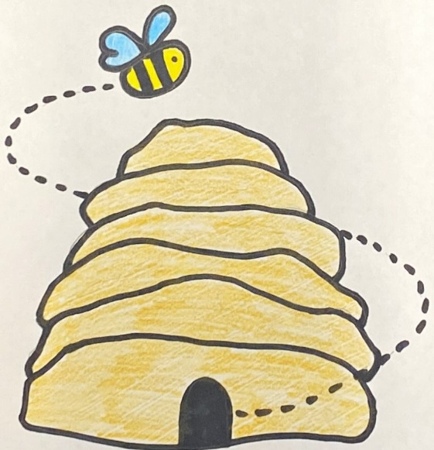
Priority 1 Raising Attainment AMBITIOUS
We will improve our writing and become a school of writers.

Slide 3
We will improve our writing and become a school of writers.
How will we achieve this?
All classes will have a writing area to encourage us to write.
Our writing will be celebrated.
We will write for a variety of purposes and audiences.
We will have the opportunity to take part in writing competitions.
We will be encouraged to ‘have a go’ and be independent in our writing.
We will be supported in our writing by e.g., technology, spellcheckers etc.
Mrs Smith, Mrs Cloy and Miss Deas will take weekly writing groups.
Staff will be reviewing the way we are taught writing and encourage us to be independent.
We will feel good about writing, enjoy it and work hard to improve.
Staff will take part in learning activities to help us improve. This will be shared with our school community.

Slide 4
Priority 2 Culture and Ethos NURTURING
We will feel safe, secure and included and enjoy positive relationships with others.

Slide 5
We will feel safe, secure and included and enjoy positive relationships with others.
How will we achieve this?
Staff will continue to be calm and nurturing and we will ensure we are nurturing and caring towards others.
We will have a variety of supports to help us if we become dysregulated and recognise what helps us as individuals.
We will set up a Playground Action Group to make a radical new playground plan so everyone feels happy, safe and included.
Regulation Buddies and Peer Mediators will help us regulate in the playground by using the 3 Rs and PACE.
We will develop a new House System, so we feel included and belong to a team that supports each other.
We will encourage leadership opportunities within the school and nursery.
We will review our ‘Respect Me (Anti-Bullying) policy and share with our school community.
We will create the BeeHive to support us in our learning, sensory needs and emotional wellbeing.
We will participate in exciting learning opportunities, life skills and enterprising learning to develop our skills and help us feel ambitious.

