Slide 1
NURSERY IMPROVEMENT PLAN 2023-2024

Slide 2
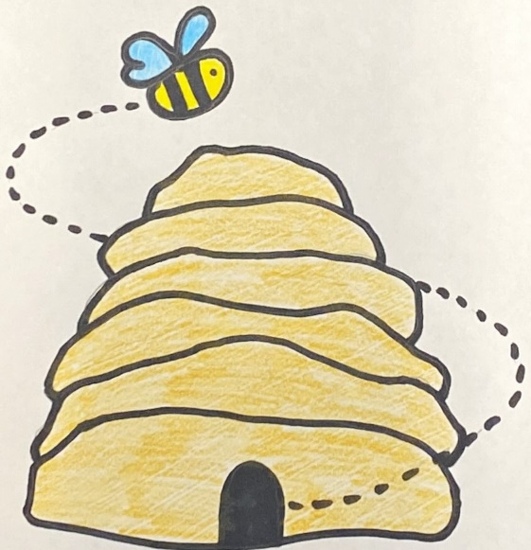
Priority 1 Our Professional Learning AMBITIOUS
Staff feel empowered to implement change

Slide 3
How will we achieve this?
Staff will learn about quality improvement methodology.
Staff will identify an area of responsibility which they will lead on and develop across the nursery.
Staff will share their areas of responsibility.
Staff will regularly discuss and share progress to ensure changes are having positive outcomes for our children and families.
Staff feel empowered to implement changes that lead to positive outcomes for children and families

Slide 4
Priority 2 Our Environment NURTURING
The nursery environment will be refreshed regularly to meet our interests and learning needs

Slide 5
The nursery environment will be refreshed regularly to meet our interests and learning needs
How will we achieve this?
All staff working within the nursery will receive training on the CIRCLES framework (inclusive learning and collaborative working)
Core provision audits to take place with pupil voice at the centre
Regular updates through seesaw to show what is changing in our nursery
Area standards to be developed with children

