Slide 1


Parental Engagement Evening
Wednesday 26th November 2025 – 6pm

Slide 2
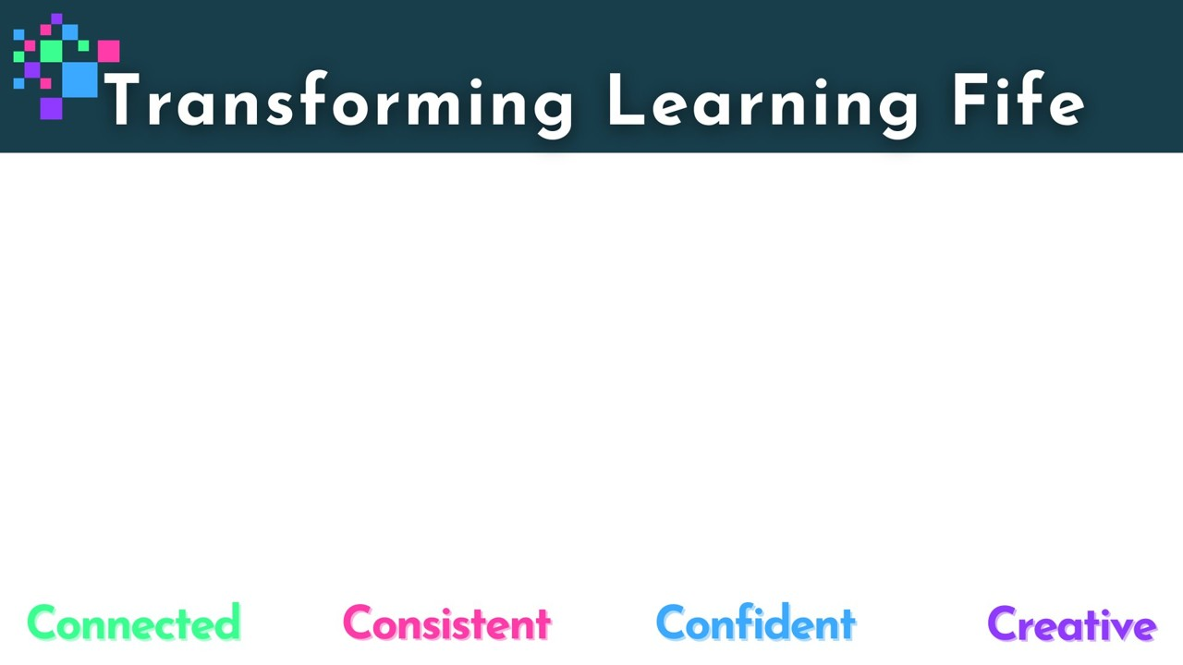

Welcome and Introductions:
Craig Martin – Quality Improvement Officer
Donna Bain – Headteacher – Lawhead and Largoward
Patricia Shafren – Headteacher – Canongate and Kingsbarns
Collette Crompton – Headteacher – Greyfriars
Gemma Friel – Headteacher – Leuchars
Kate Balsillie – Headteacher – Guardbridge and Strathkinness

Slide 3
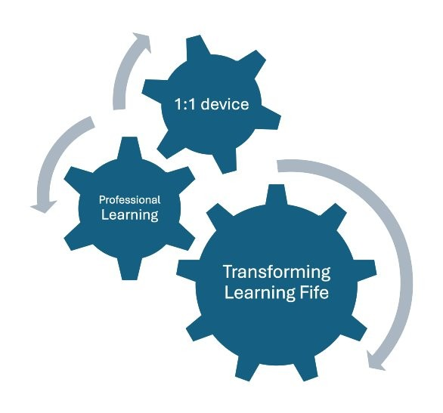
Our Aim
To provide your child with the tools needed to transform the ways we engage with learning and teaching.
This is an investment in young people to develop their confidence as well as the digital skills they will need throughout their educational journey and beyond.

Slide 4
Our Vision
In 5 years time, teachers in Fife will have transformed learning by:
integrating digital skills throughout the learning process to engage and motivate learners
using technology for effective explanations and modelling to learners
providing personalised learning experiences and facilitating learners to lead their own learning
improving assessment and feedback with digital tools

Slide 5



Jamf Parent - setting iPad restrictions at home
Using the Jamf Parent app you can:
allow and restrict apps to choose which apps your child can use
enable App Lock to set a timer for app restrictions
create locations to see the approximate location of your child’s device
create a Device Rule to schedule app restrictions
https://read.bookcreator.com/ets9ByGBmOa3zYFDTgg4GgES0Ra2/YRCP3NDmTgeTg4FGunRxYQ

Slide 6


Showbie - viewing your child’s schoolwork at home
By creating a Showbie parent account you can:
see your child’s assignments, feedback, and grades
receive email or push notifications about new assignments, deadlines, and feedback
Notes:
Optional – depending on if your school is using Showbie this academic year

Slide 7

Parental Agreement
Fife Council provides P6-S6 pupils with an iPad to support their learning in and out of school. By your child using this iPad, you, as a parent/carer, agree to the following terms:
Responsibility for Parents
You are responsible for the safe storage and use of the iPad at home | Your child must bring their iPad to school fully charged every day
The iPad should be stored securely when not in use | No stickers or markings should be placed on the iPad or case
If the iPad is lost, stolen, or damaged, report it to the school immediately | If your child leaves Fife Council Education, the iPad must be returned to their school

Slide 8
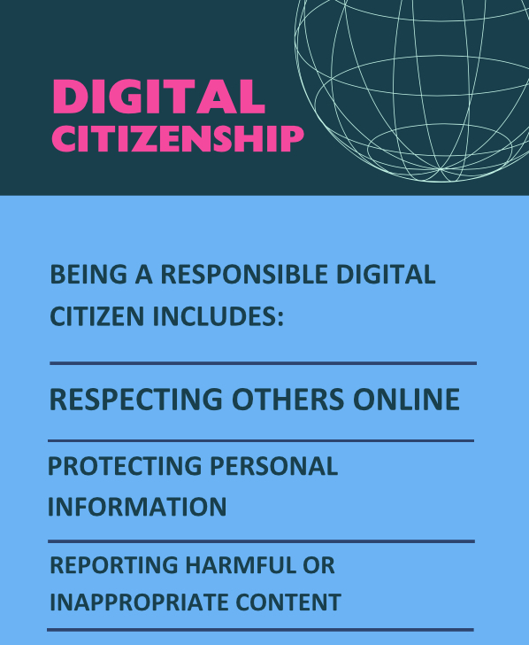
Safeguarding and iPad use at home
The device will support young people’s education and creativity – but it also comes with responsibilities around online safety and wellbeing.
How you can support at home
Talk regularly with your child about their online experiences – what they enjoy, what worries them, and who they interact with. Set boundaries for screen time and device use, especially around bedtime and social media. | Encourage responsible behaviour- remind them what they post online can have lasting consequences. Know where to go for help – you can also use CEOP and Fearless to learn more about online risks and how to respond.

Slide 9


Helpful websites to support online safety.
CEOP (Child Exploitation and Online Protection)
A trusted site where children can report concerns about online behaviour, including inappropriate contact or content.
https://www.ceop.police.uk/Safety-Centre/
Fearless by Crimestoppers
A youth-friendly platform offering advice on crime and safety, and a way to report concerns anonymously.
https://crimestoppers-uk.org/fearless
CEOP (Child Exploitation and Online Protection)
Fearless

Slide 10

Damage - Repair/Replacement Costs
These are estimated costs and are to be confirmed. Discussions are ongoing with the local contractor.
Item | Contribution 1st Repair | Contribution 2nd Repair
Damage to screen | £70 | £150
Damaged charge port | £65 | £140
Lost or device beyond repair | £150 | £200
https://blogs.glowscotland.org.uk/fi/transforminglearning/repair-replacement-costs/

Slide 11
Cluster Expectations
Devices are used and cared for in line with our school values
Devices are brought to school each day and charged
Used responsibly as directed by their class teacher to enhance learning and teaching
Prompt communication from home if there are any issues with the device

Slide 12
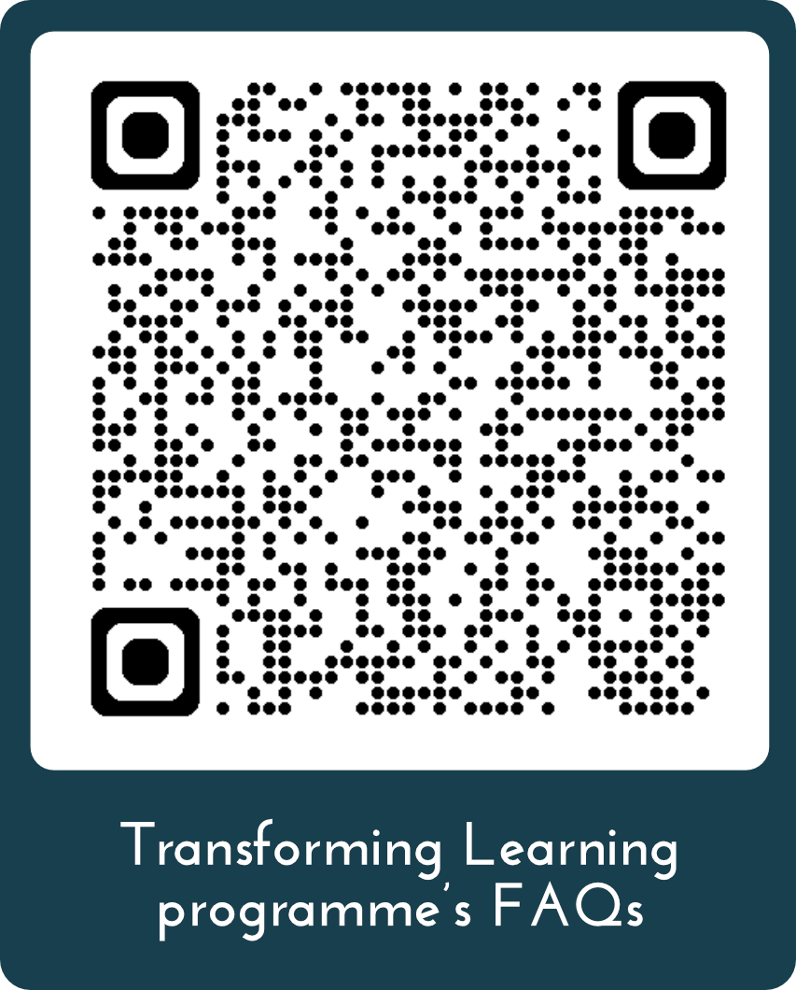
Questions?
Please scan the QR code to visit the Transforming Learning programme’s FAQs.
https://blogs.glowscotland.org.uk/fi/transforminglearning/frequently-asked-questions/

Slide 13
Demonstration

