Slide 1

RRSA: Achieving Silver Award
Implementing UNCRC for Children with Complex Additional Needs at Calaiswood School

Slide 2
Strand A: Teaching and learning about rights
The United Nations Convention on the Rights of the Child (CRC) is made known to children, young people and adults who use this shared understanding to work for improved child well-being, school improvement, global justice and sustainable living.

Slide 3
Embedding Children's Rights in Calaiswood School
• We ensure children’s rights are upheld in ways accessible to all learners – staff have a great knowledge of our pupils, their individual needs and can advocate for them in every aspect of the learning
• We adapt communication to suit individual needs (e.g., symbols, visuals, AAC) to enable pupils' voice for choice and decision making
• We have created an environment where every child feels safe, respected, and valued – our classrooms areas are designed to meet individual needs; there are class corners with soft furnishing or dark room spaces to allow pupils a rest, and we also have soft room spaces to allow for self- regulation

Slide 4
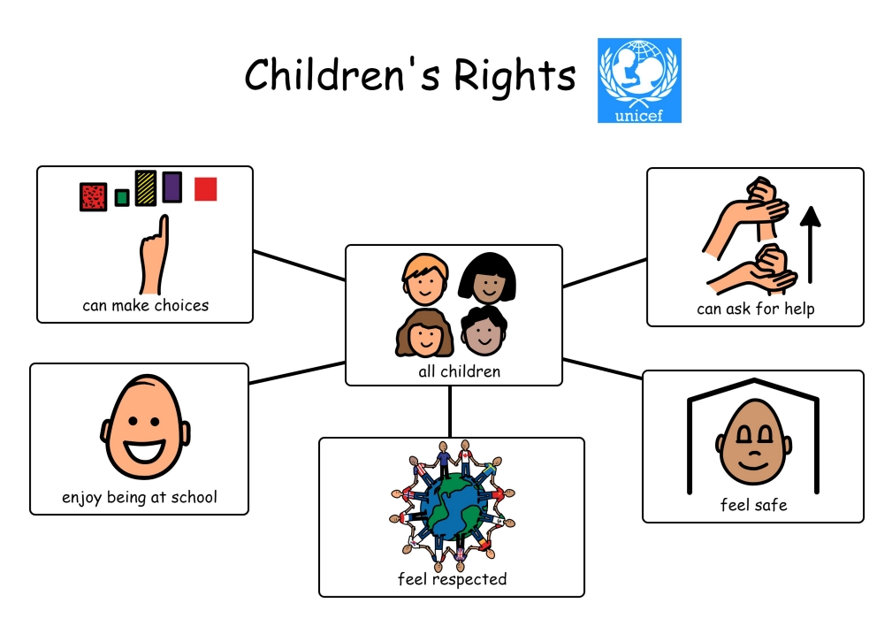
Our adapted Children's Rights chapter

Slide 5
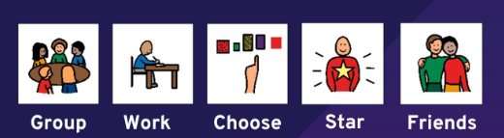
Our adapted/symbolised school vision
At Calaiswood we work together to provide our pupils with enjoyable experiences, celebrating their successes in an environment where everyone belongs.

Slide 6
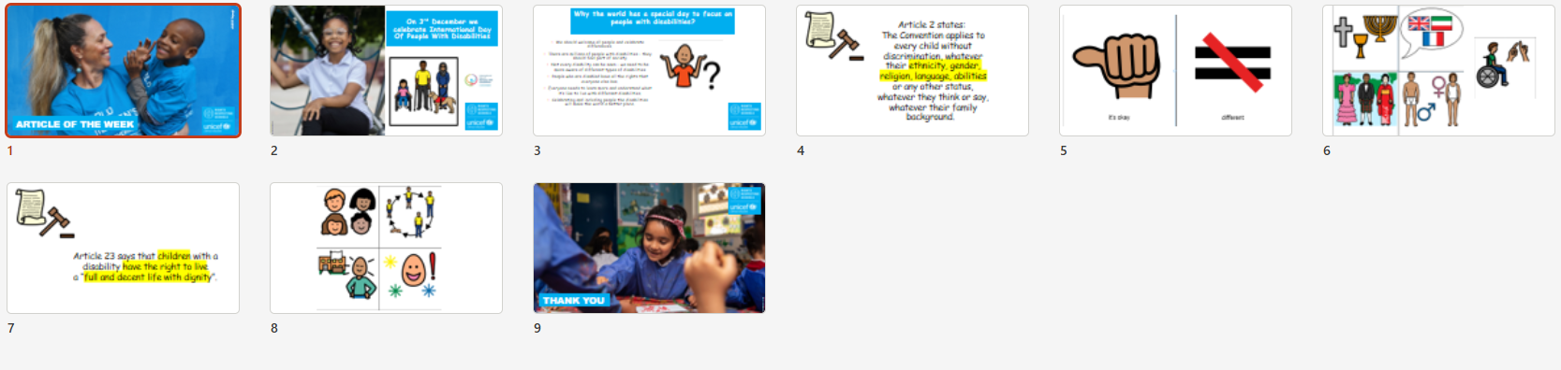
Learning about Children's Rights – example of the adapted resource
Article of the week – adapted pupil version

Slide 7

Staff and parental information leaflet

Slide 8
Strand B: Teaching and learning through rights – ethos and relationships
Actions and decisions affecting children are rooted, reviewed and resolved through rights. Children, young people and adults collaborate to develop and maintain a school community based on equality, dignity, respect, non-discrimination and participation; this includes learning and teaching in a way that respects the rights of both educators and learners and promotes well-being.

Slide 9
Silver Award: Rights-Aware
Calaiswood school has implemented the specific steps listed below:
We have created our own adapted Children’s Rights Charter (see slide 4)
We have tied in our school vision and values with these Rights and embedded them in our daily routines and interactions (see the slides throughout the presentation)
We ensure of breadth and depth in educational opportunities which are adapted and accessible for all learners
Adults are modelling rights-respecting behaviours
All pupils are included in decision-making at their level of communication through class-based choice making activities and Pupil Council group sessions
Throughut the school year we celebrate the important events and festivals in relation to children's rights

Slide 10
Approaches used for Calaiswood pupils to implement the UNCR
Holistic approach to communication: key verbal cues,use of AAC devices, switches, PECS, photographs, signing (Signalong or On Body Signing), use of high-tech devices (talkers, Eye Gaze or iPads), tactile objects (OOR) to aid the understanding of children’s rights
Consistent routines promoting emotional safety and predictability.
Adults interpreting children’s cues to support their participation.
Inclusive/real life opportunities like visits to local community centres/care homes, participating in bigger sport or musical events to represent the school and raise the awareness, organising UN Day events or fundraisers

Slide 11
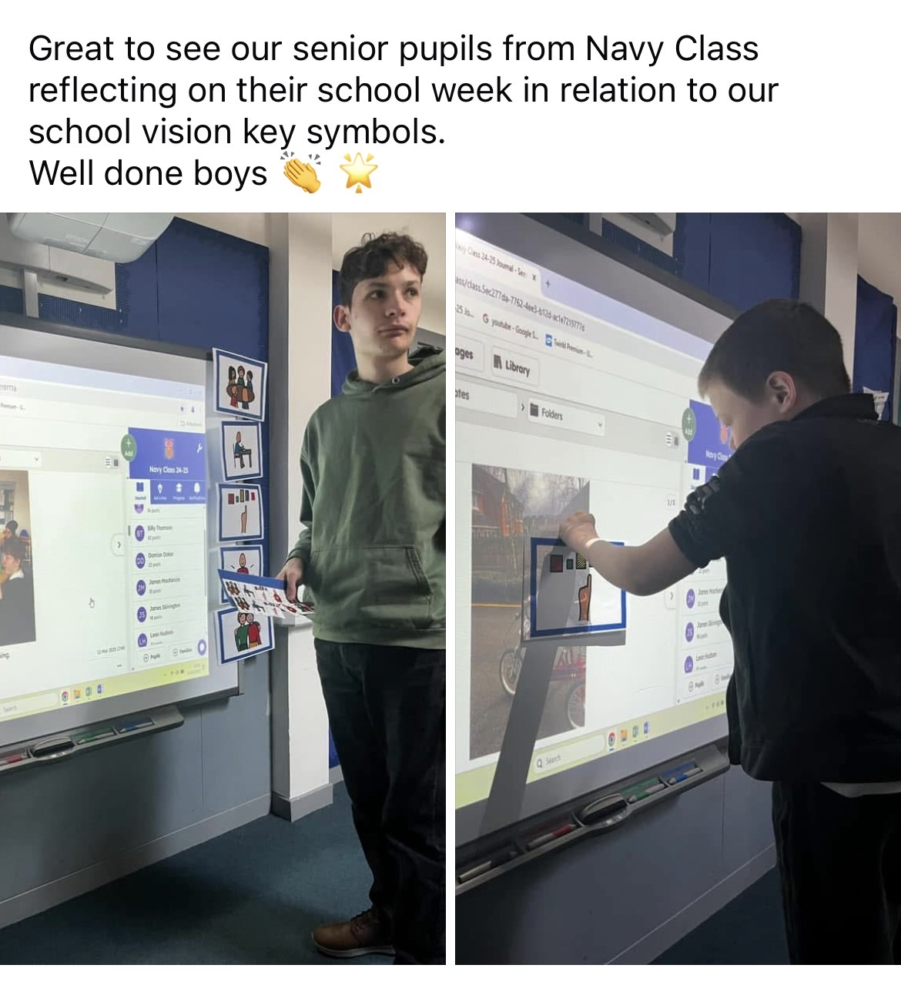
Embedding our school vision in daily opportunities

Slide 12
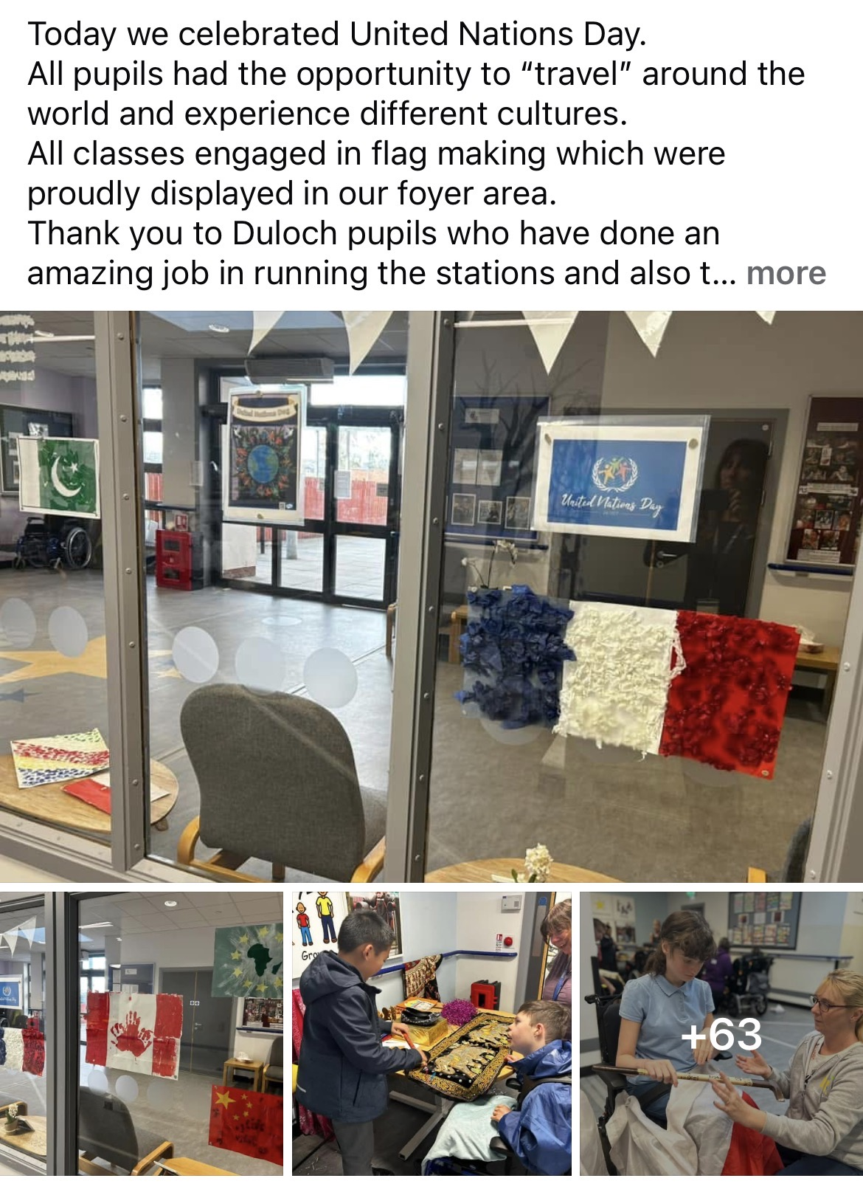
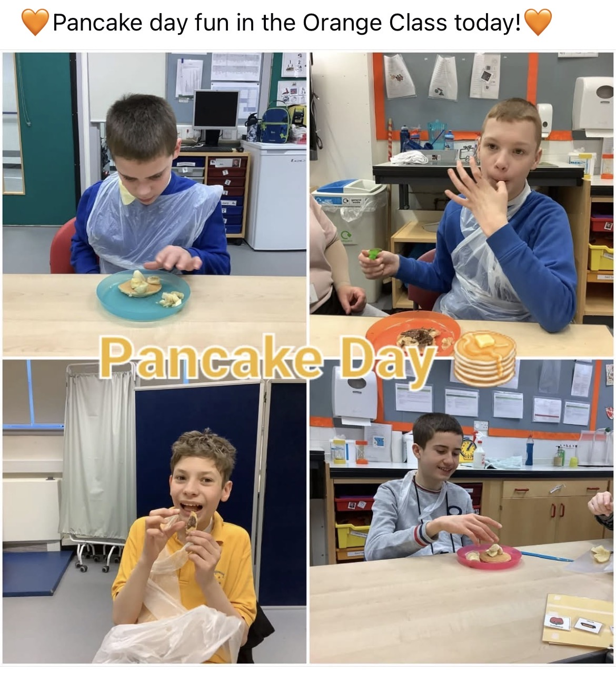
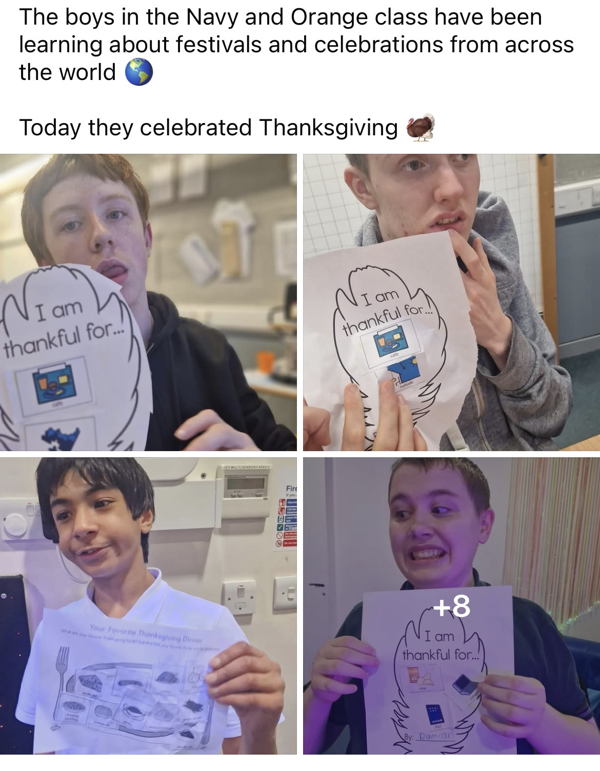
Celebrating different events

Slide 13
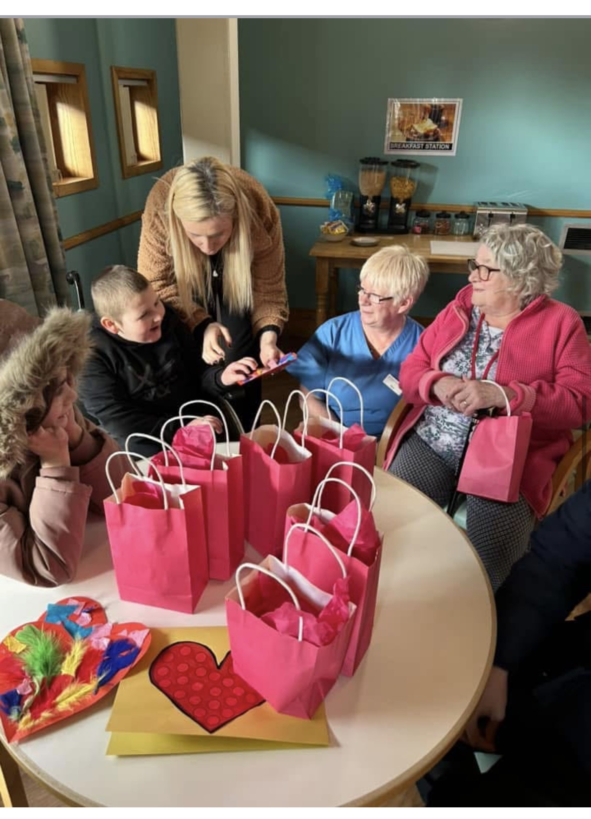
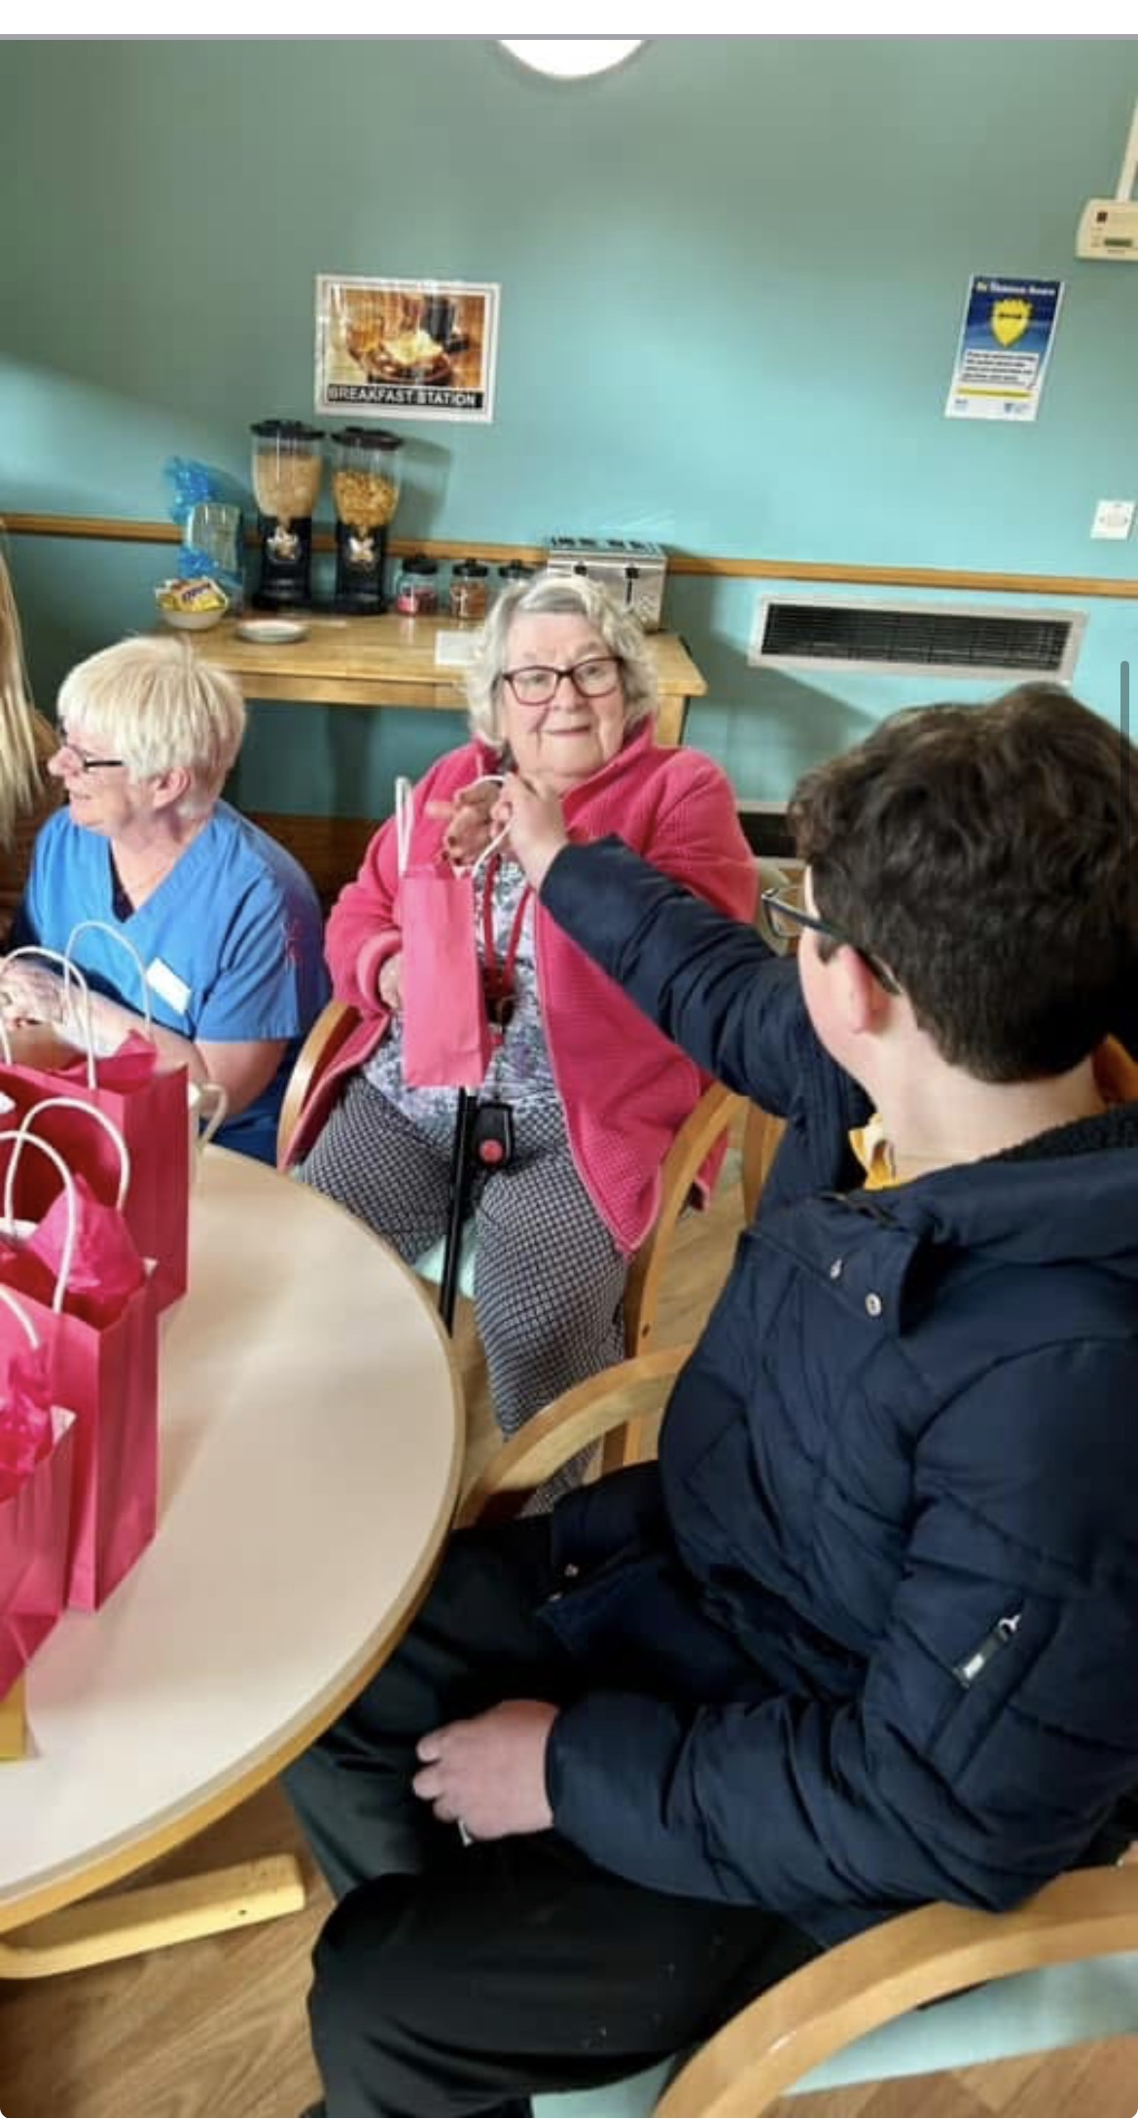
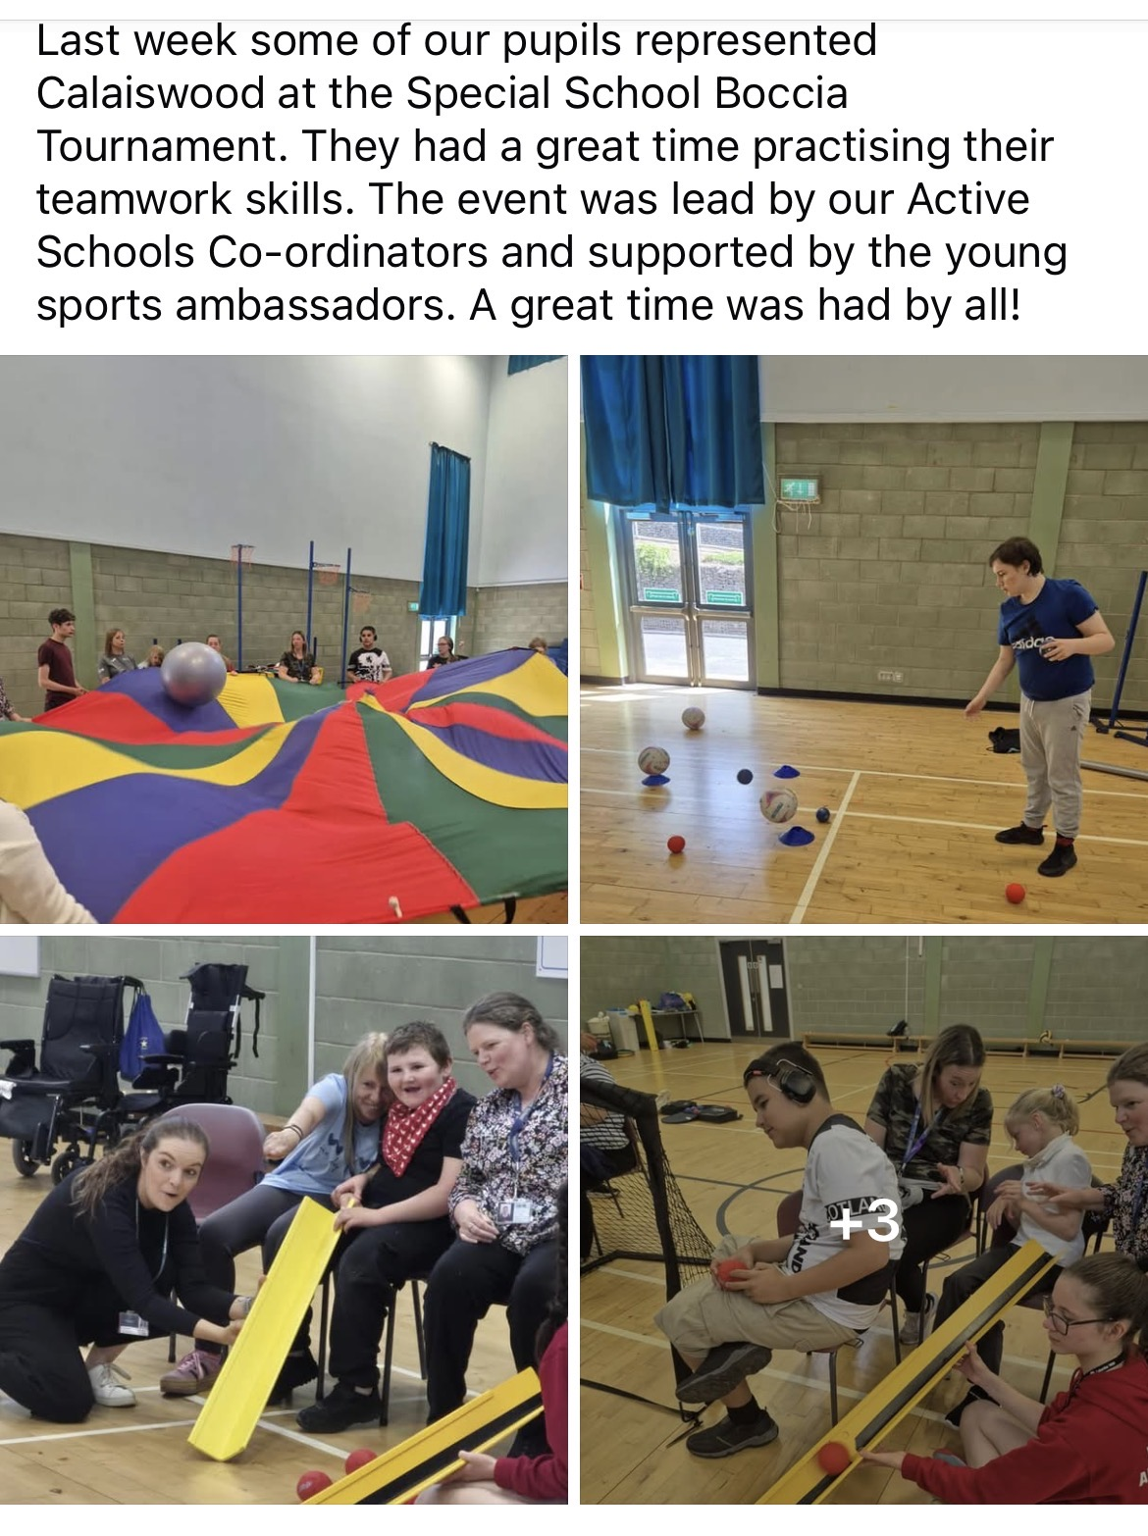
Representing school in the local community

Slide 14
Strand C: Teaching and learning for rights – participation, empowerment and action
Children are empowered to enjoy and exercise their rights and to promote the rights of others locally and globally. Duty bearers are accountable for ensuring that children experience their rights.

Slide 15
Children’s Rights in an accessible form for Calaiswood pupils
The right to communicate in their own way.
The right to enjoy school through sensory and experiential learning.
The right to make choices with support.
The right to be safe physically and emotionally.
The right to be heard through behaviour, gestures, or AAC.
Embed child voice through accessible tools (e.g., choosing boards, switches).
Ensure all policies reflect the needs of pupils with complex care requirements (Best Practice Model, School Vision, School Values).
Model self-regulation strategies, nurture, and relationship-based practice.
Continue developing a Rights Steering Group including pupils and using varied communication

Slide 16
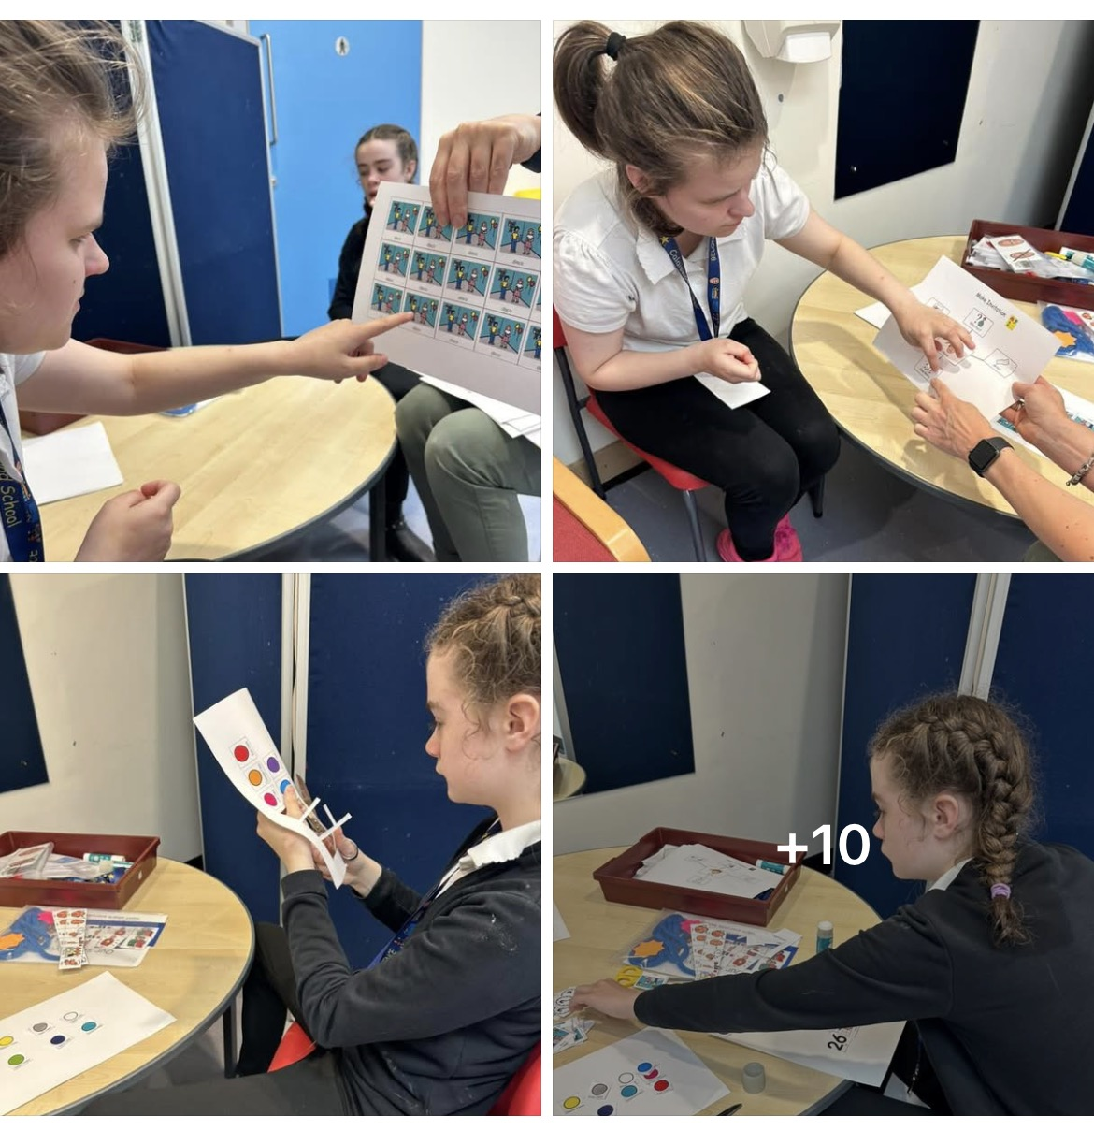
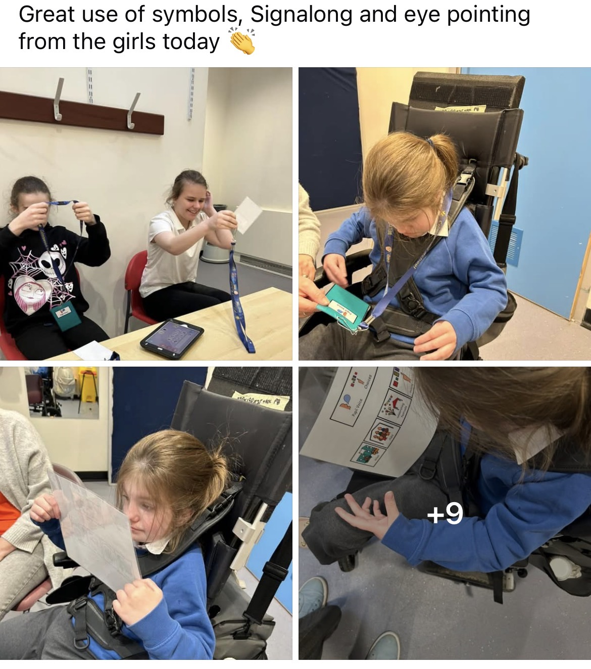
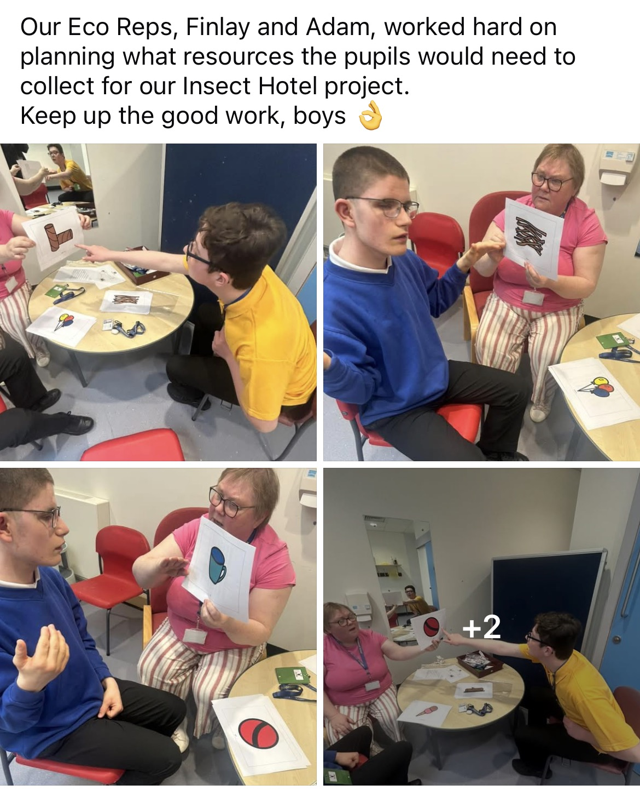
Some of our pupil council groups sessions

Slide 17
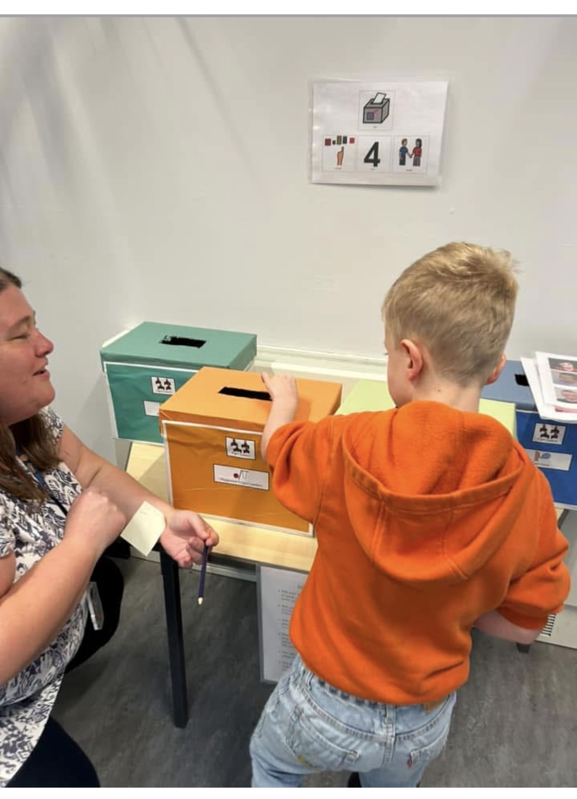
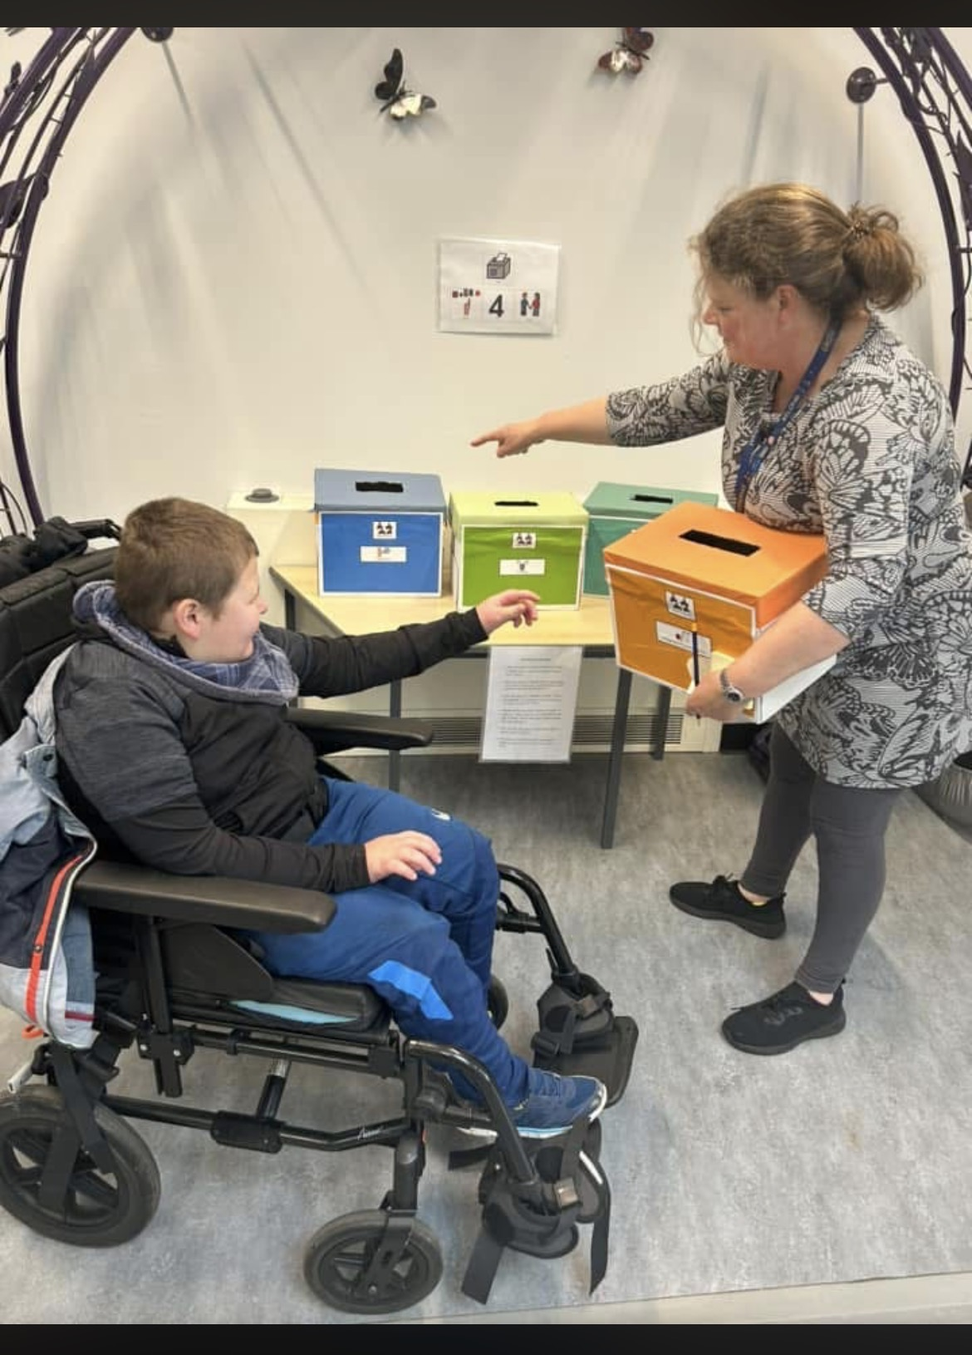
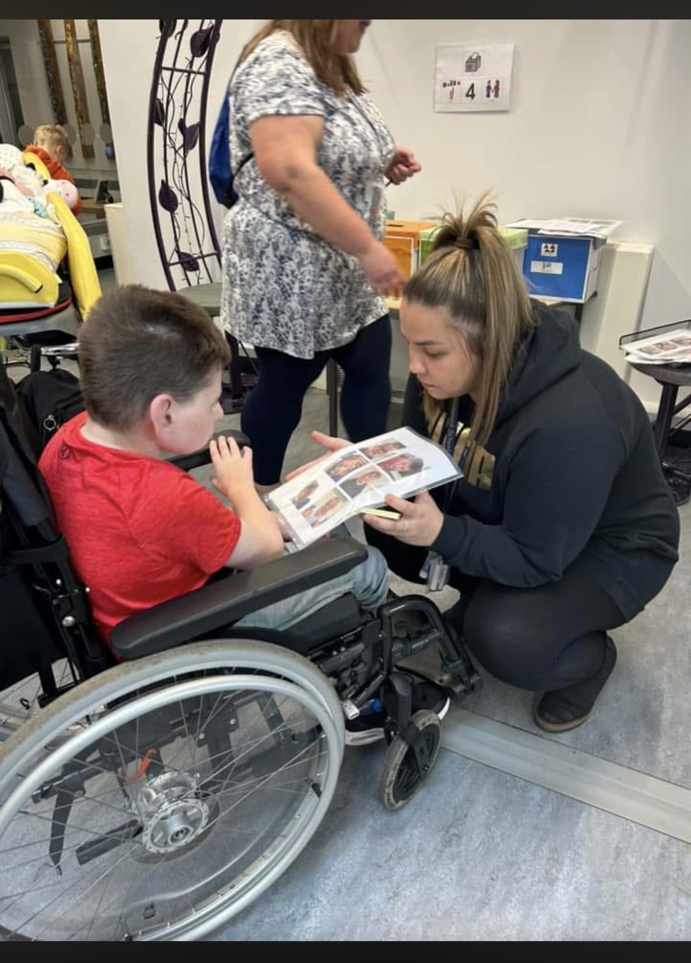
Pupil Voice opportunities - Pupil Council Voting Station

Slide 18
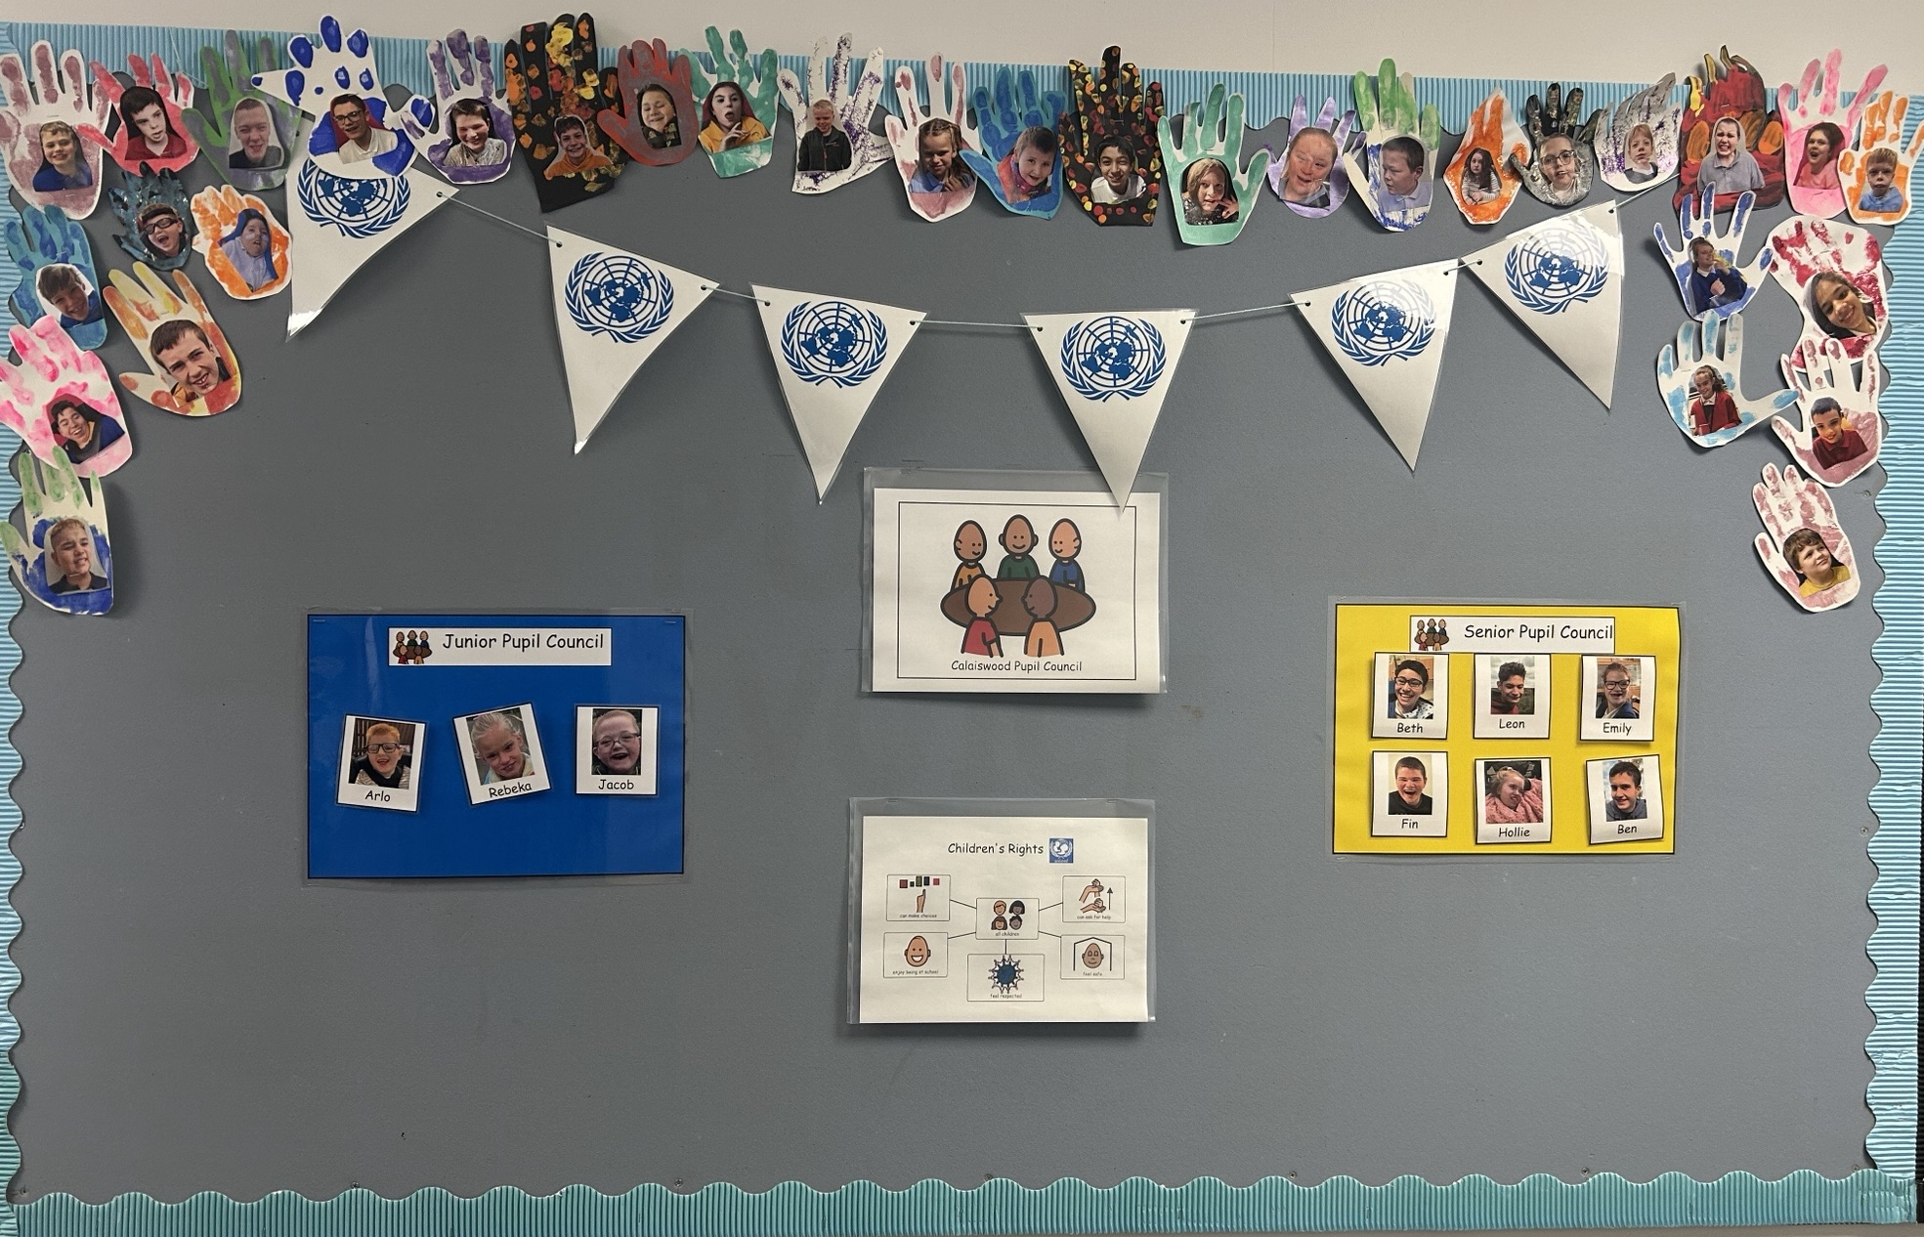

Slide 19
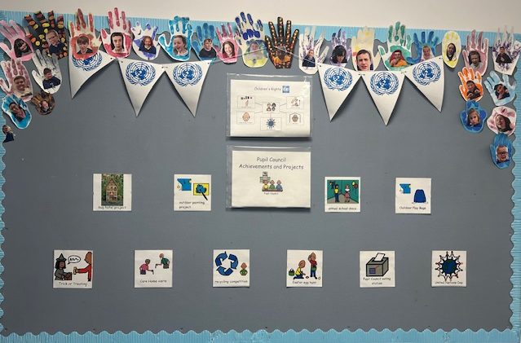

Slide 20

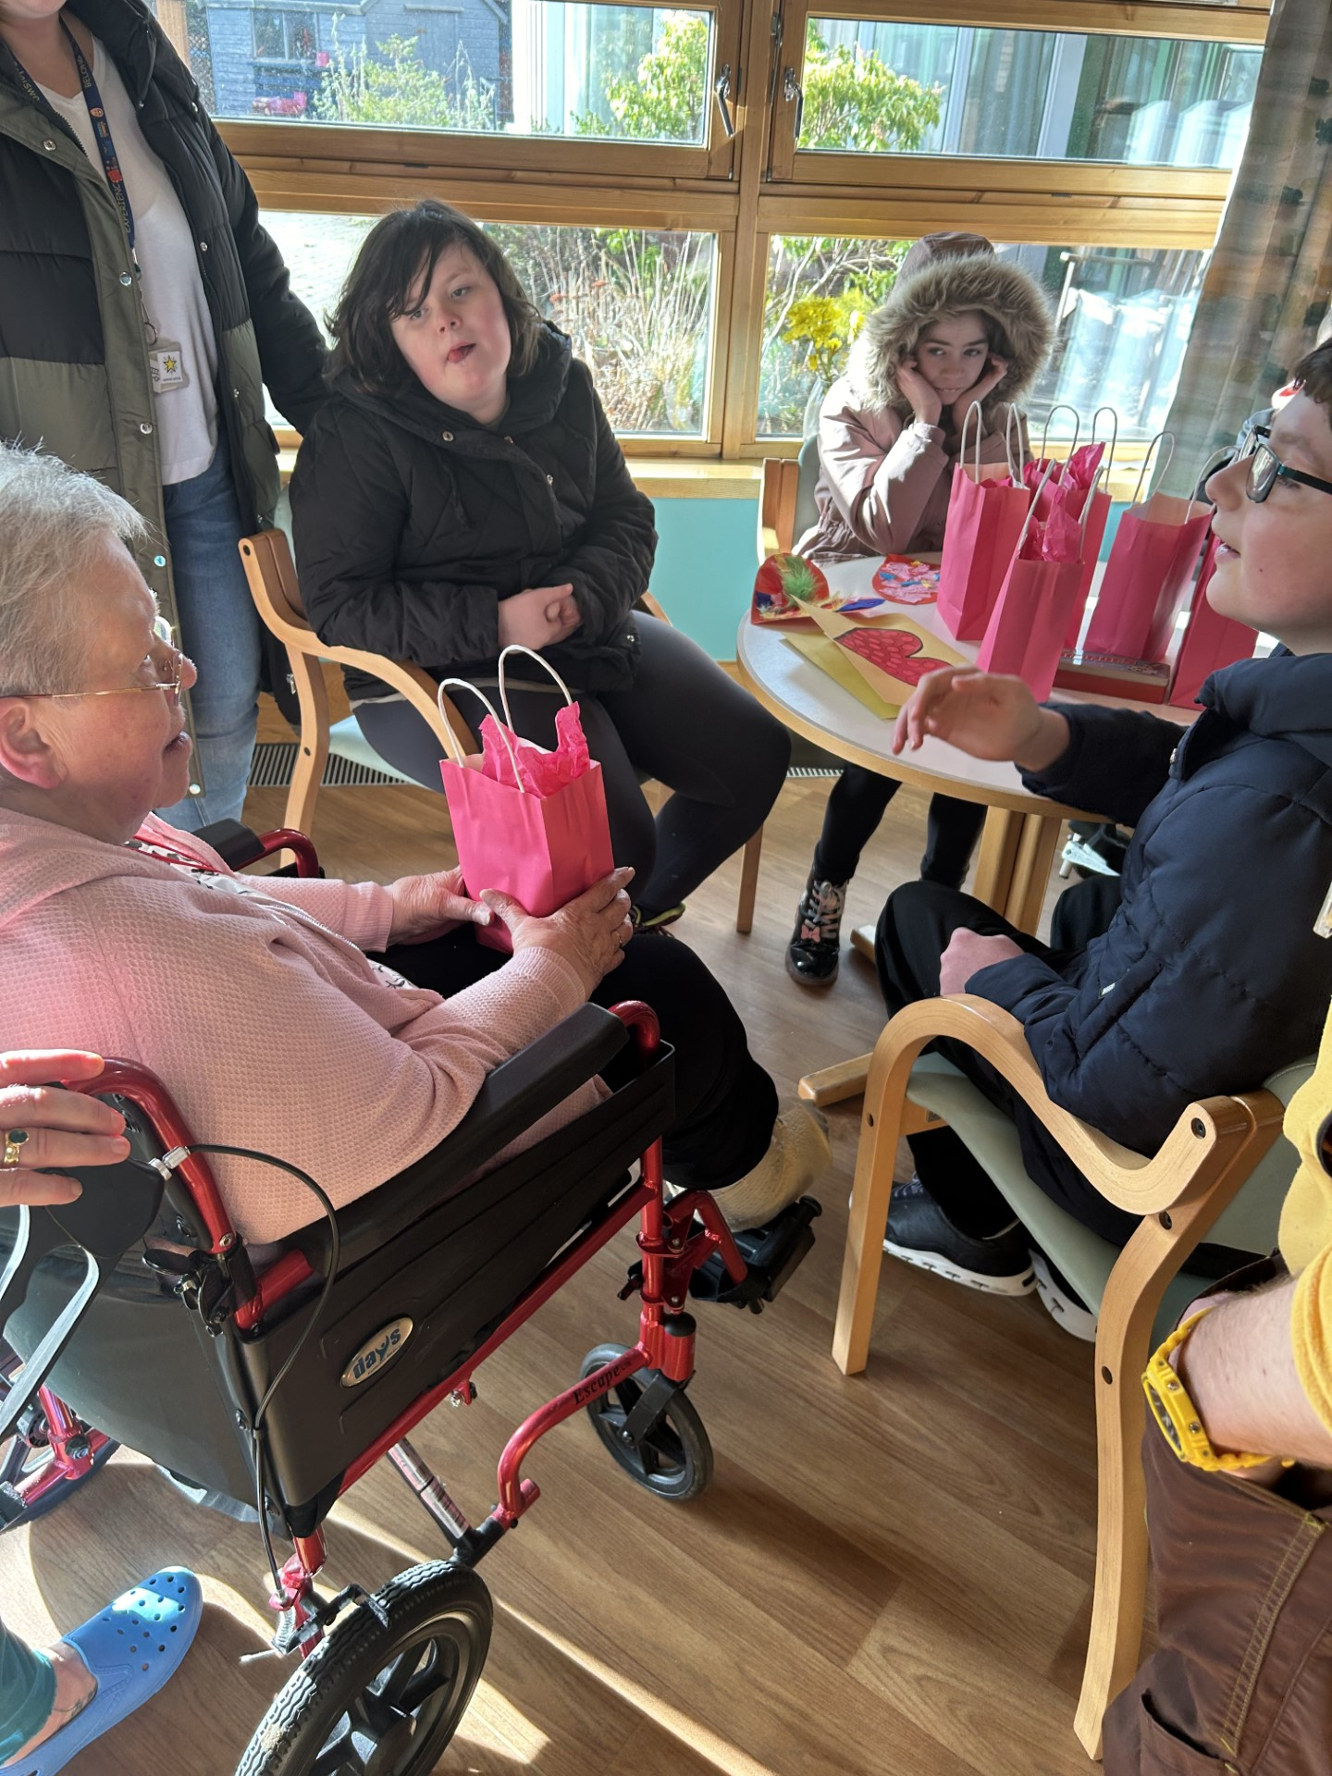
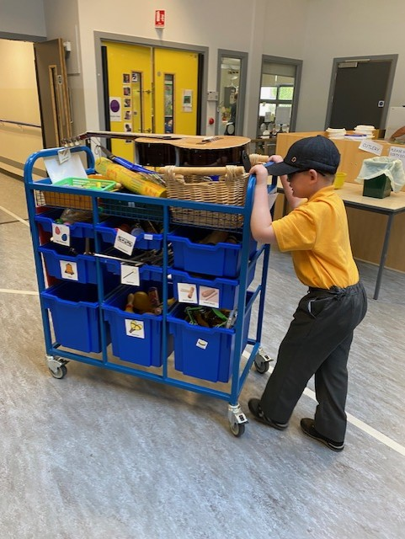
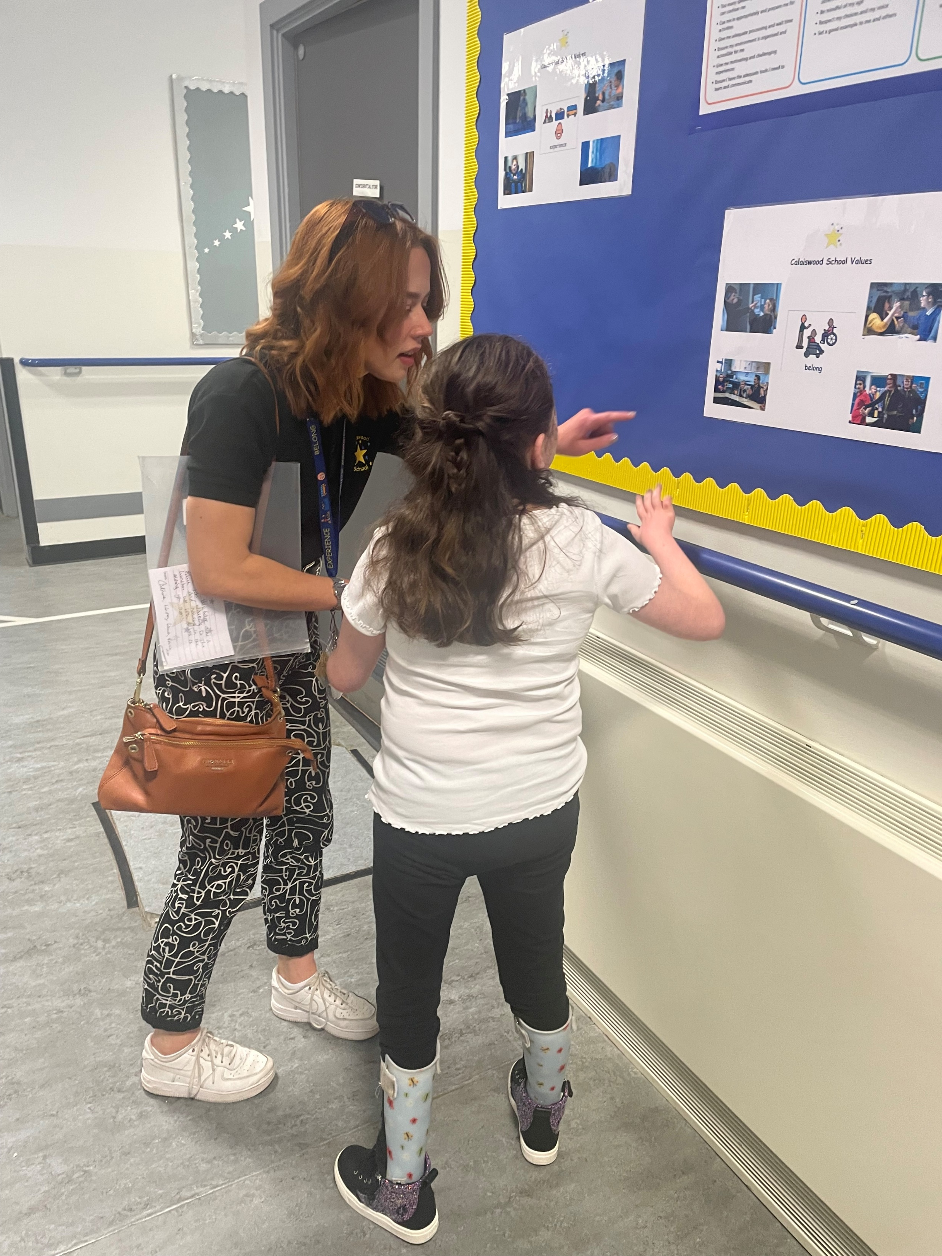

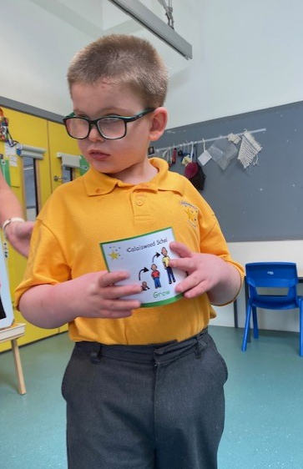
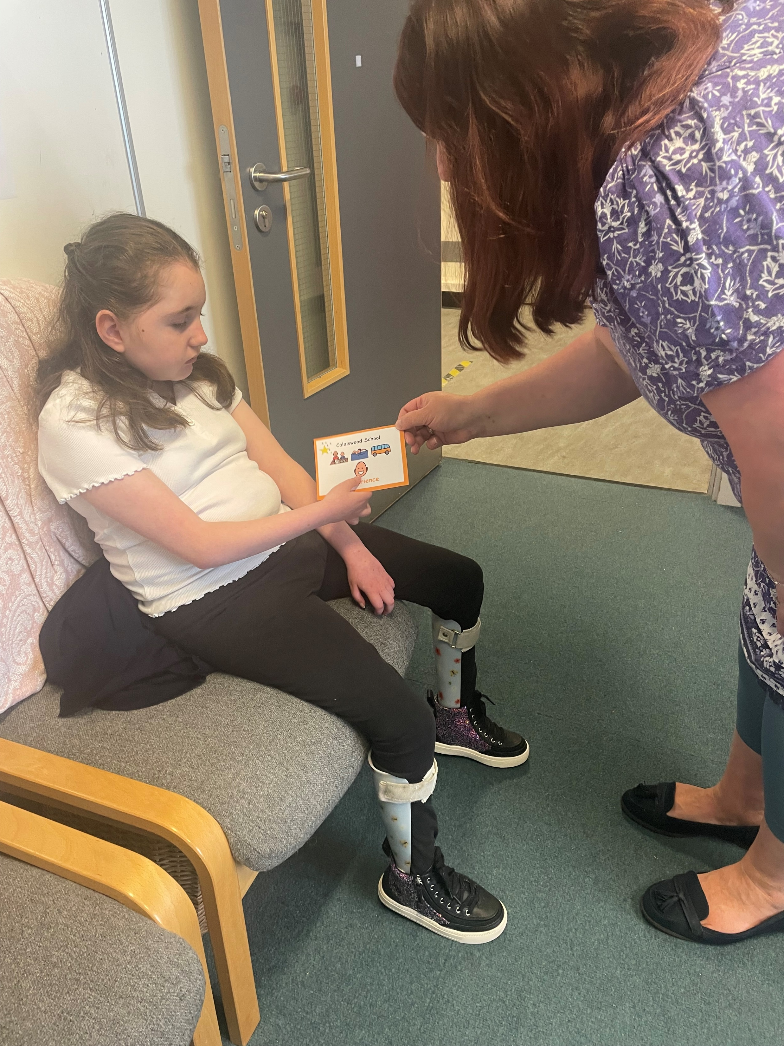
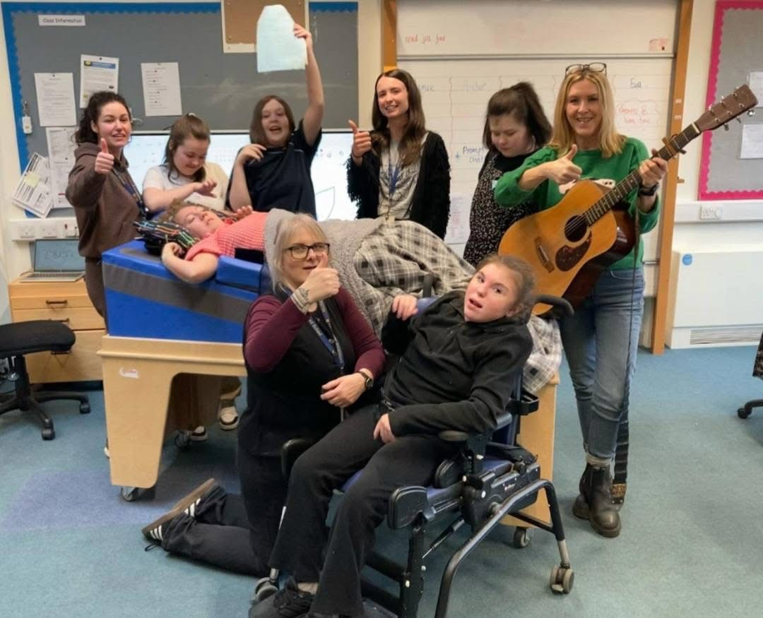
Calaiswood School Values

Slide 21
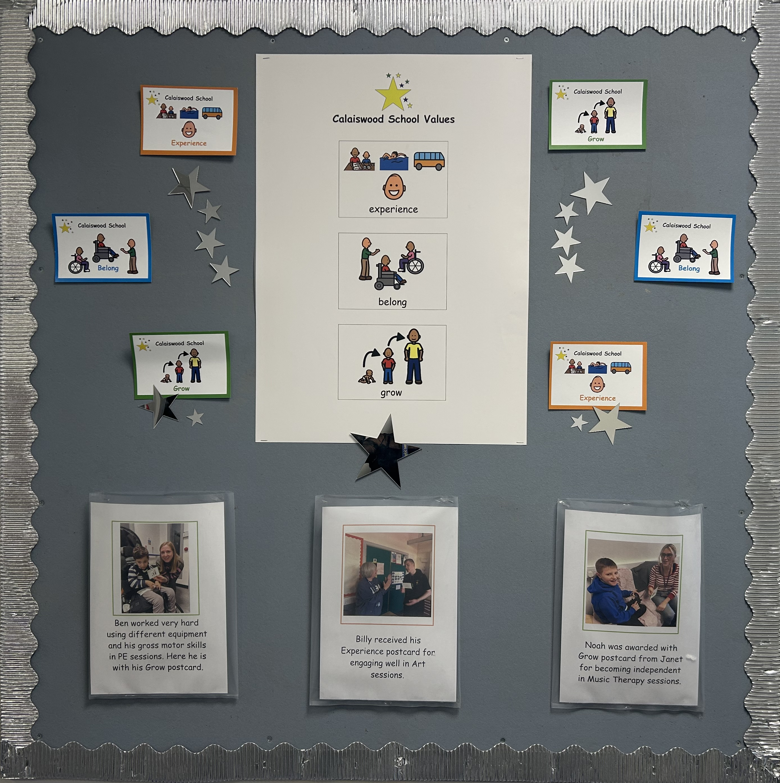

Slide 22
Silver Award: Rights-Aware
Evidence and findings
Staff Awareness session on UNCRC and Rights Respecting School Awards
Staff Questionnaire
Pupil Voice groups with adapted questionnaires about school in relation to Children's Rights
Individual work with a couple of pupils on Article of the week
Celebration of school values and embedment of school vision daily and during school assemblies
Parental engagement through information shared during Parent Evening

Slide 23

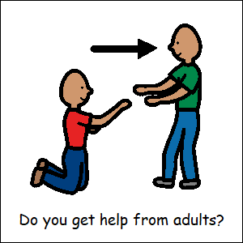



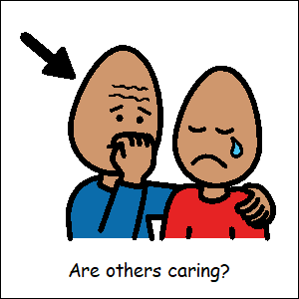



Adapted Pupils’ Questionnaire

Slide 24
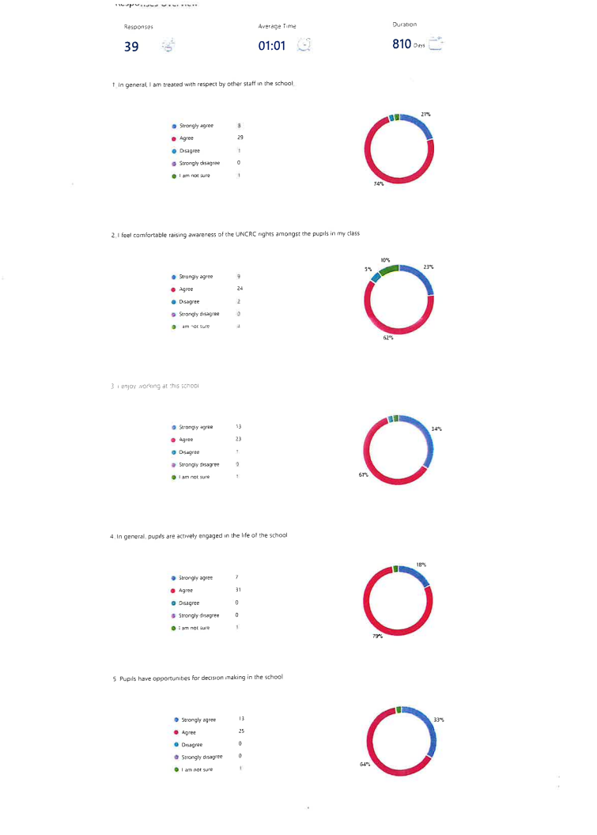
Staff Questionnaire
Out of 64 staff , 39 staff took the questionnaire with most answer to be positive
(follow the link below for more detailed findings)
Rights Respecting School- Staff Questionare – Results

