Slide 1
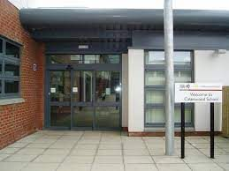
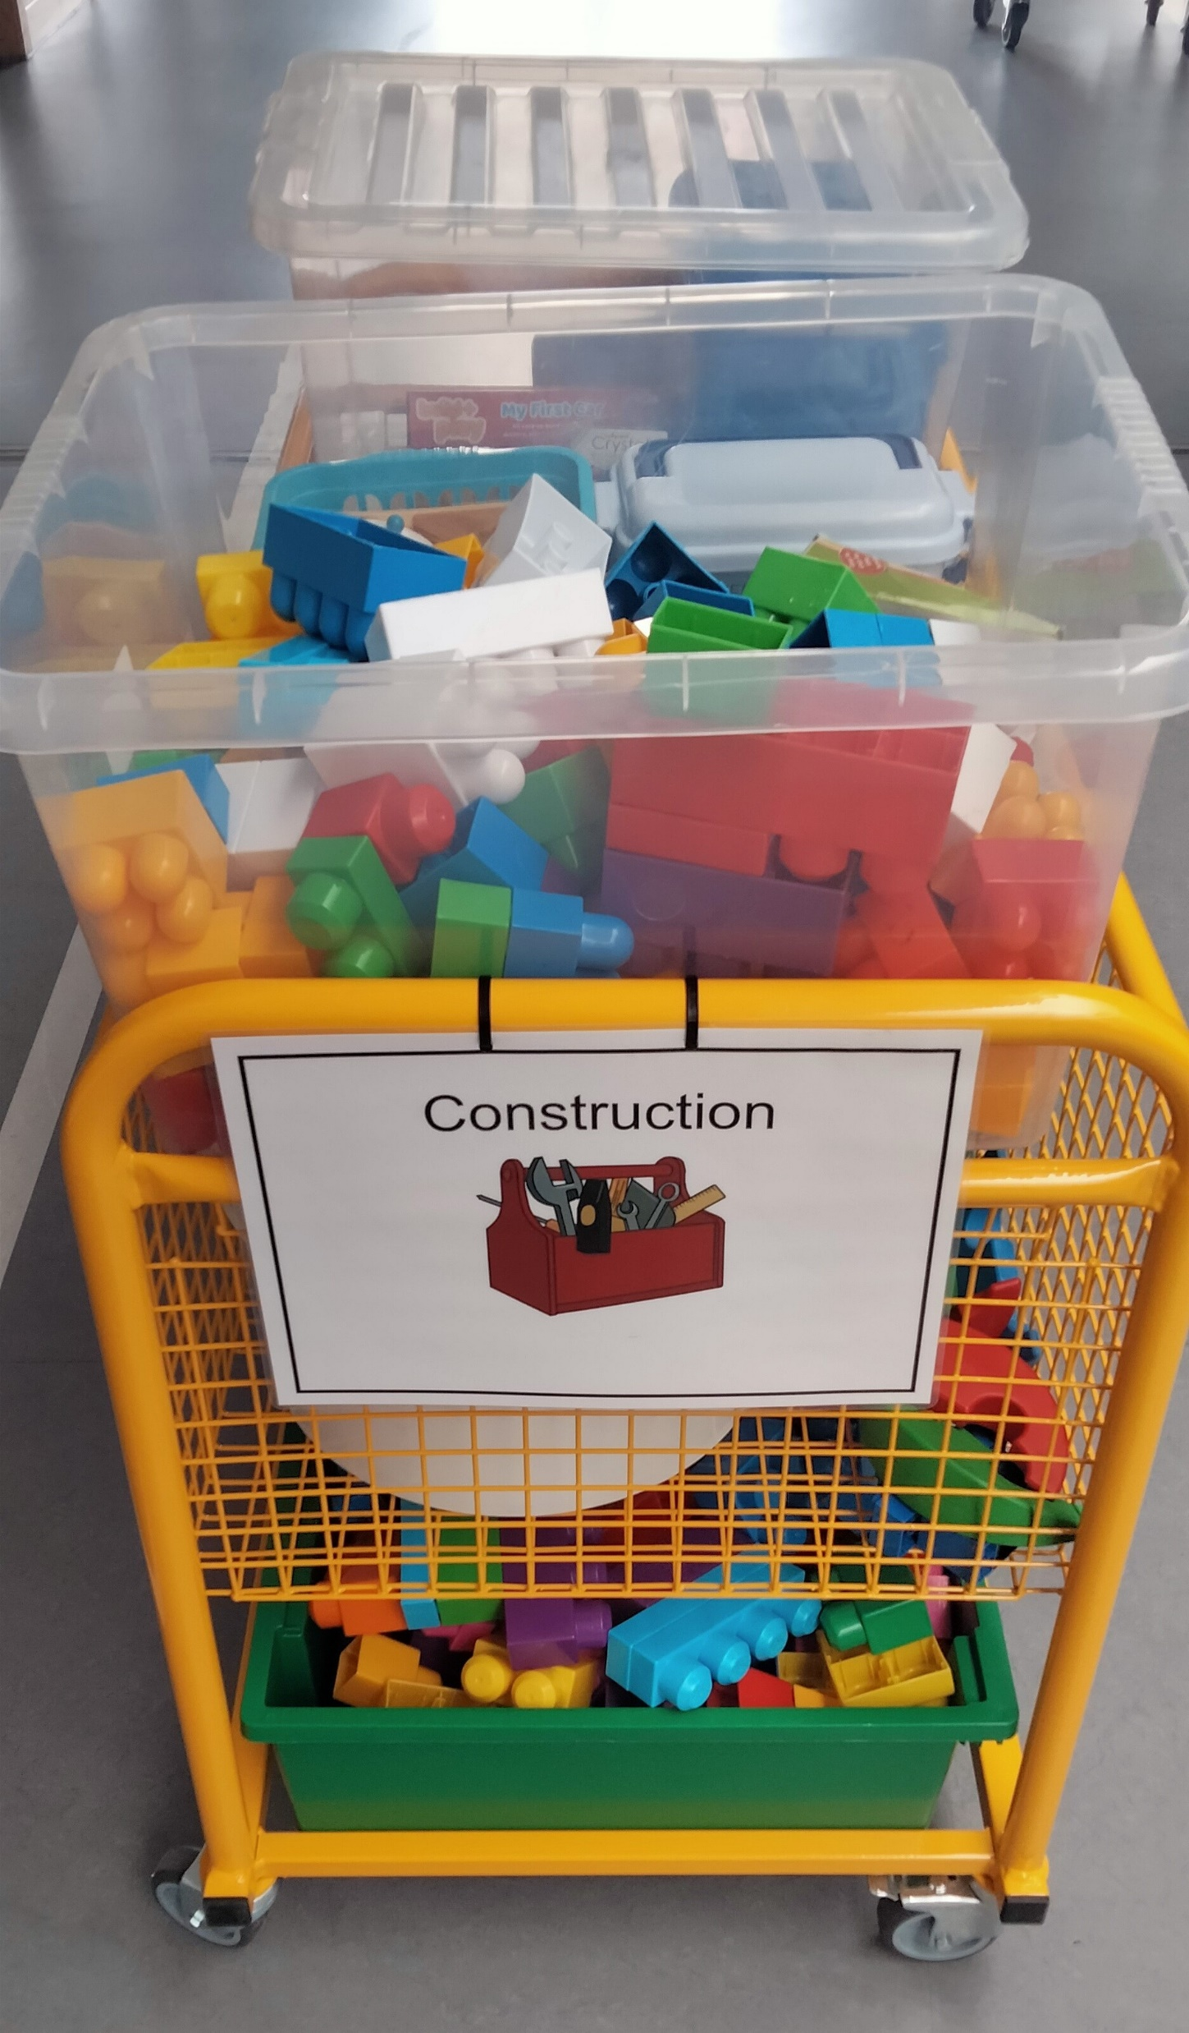
Through our self-evaluation we have identified 3 key priorities for improvement 2024-2025:
We will focus on supporting staff to promote increased levels of engagement, active participation and focus across planned group activities.
Develop robust approaches to planning across the Broad General Education
By the end of 2025, 4 (29%) teachers will have experience in leading a Quality Improvement Methodology project (baseline 0%) to improve outcomes for Calaiswood learners.
Focus Priority 2 – Planning across the curriculum
We will use curriculum documents to ensure relevant planning across all areas of the curriculum. We will develop further our approaches to ensure pupils experience progressive learning across all curriculum areas.
Focus Priority 1 – Wave of Engagement
We will develop our approaches to pupil engagement. We will undertake training relating to different types of learning styles. We will develop our understanding of the best ways to cue pupils in to support and maintain focus during group sessions.
School Improvement Plan 2024-25
PEF Spend:
Music Therapy Sessions
Purchase of new equipment for sensory integration
Support from Ian Bean, AAC Specialist
Other spend TBC over the school year
Focus Priority 3 – Quality Improvement
We will use quality improvement methodology across classes to review and to improve pupil engagement.

