Slide 1

Congratulations!
Benarty Primary School

Slide 2
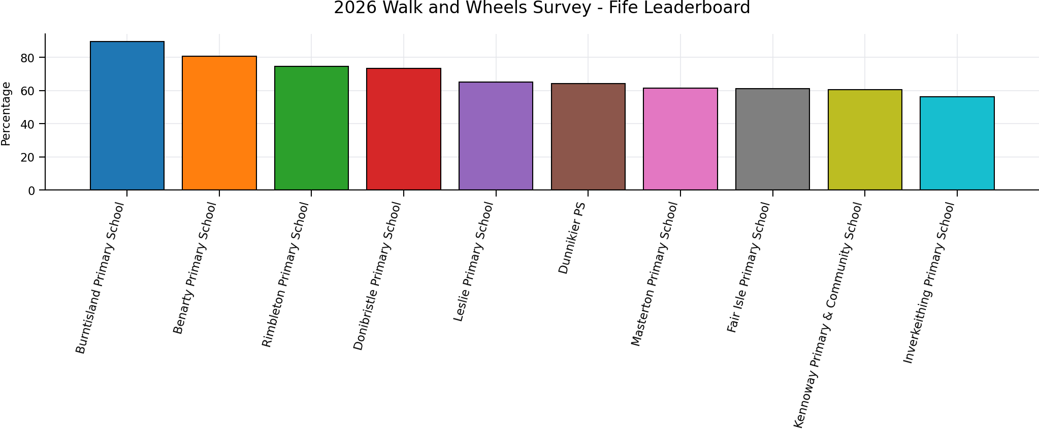
Fife Leaderboard

Slide 3
