Slide 1
Conceptual Numeracy
Place Value
Calculations

Slide 2
Theory
“Being a successful learner in mathematics involves constructing understanding through exploration, problem solving, discussion and practical experience – and also through interaction with a teacher who has a clear grasp of the underlying structure of the mathematics being learnt.”
(Haylock D, 2014, p3)

Slide 3
Why is place value important?
Counting
Calculating
Place Value

Slide 4
Mental maths
https://mathsbot.com/manipulativeMenu

Slide 5
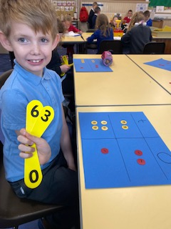
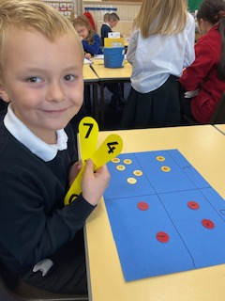
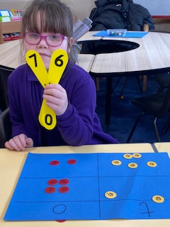
Calculations

Slide 6
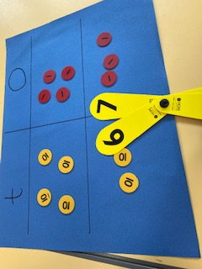
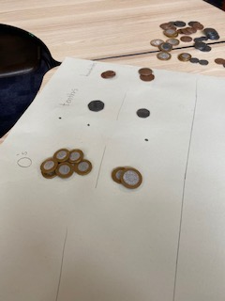
Education Scotland PLR Number and number processes.pdf

Slide 7
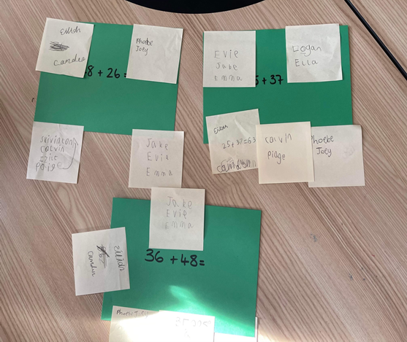
Calculations (with carrying)

Slide 8
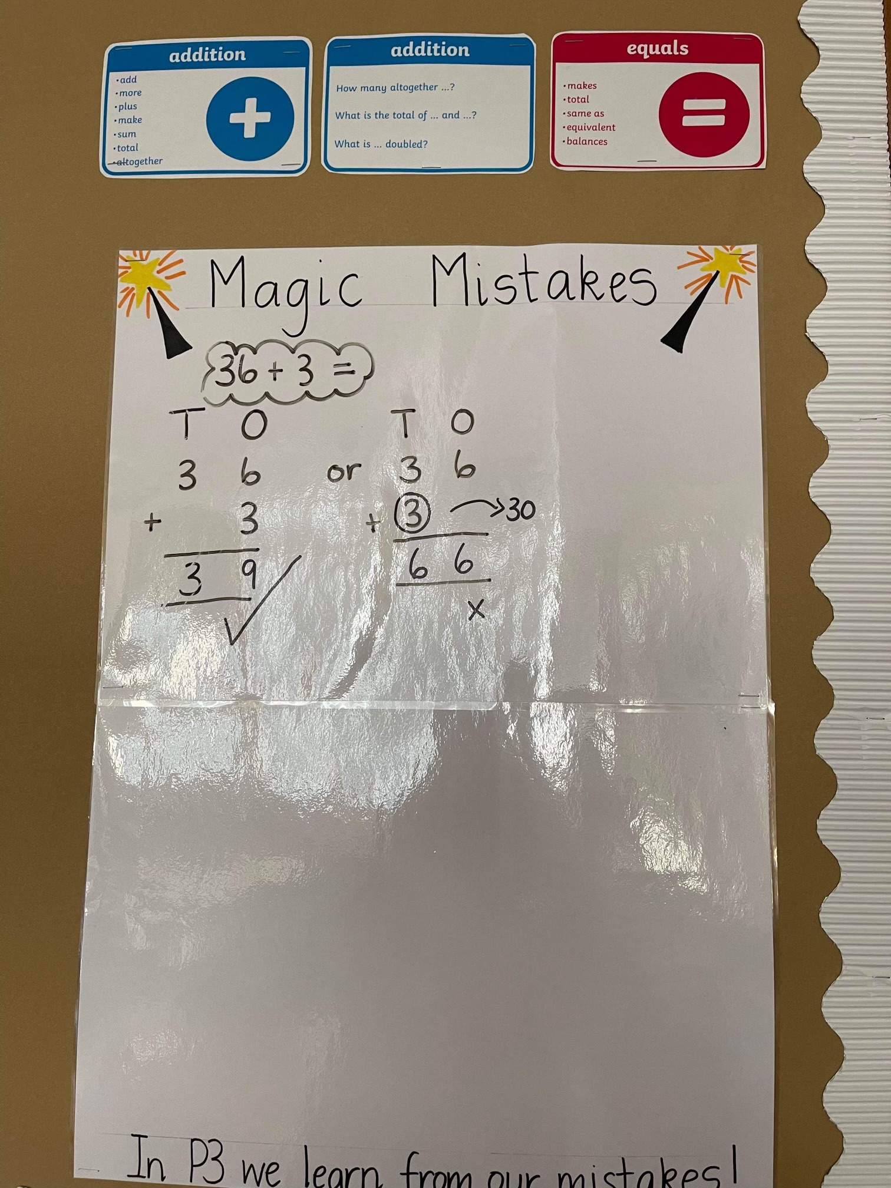
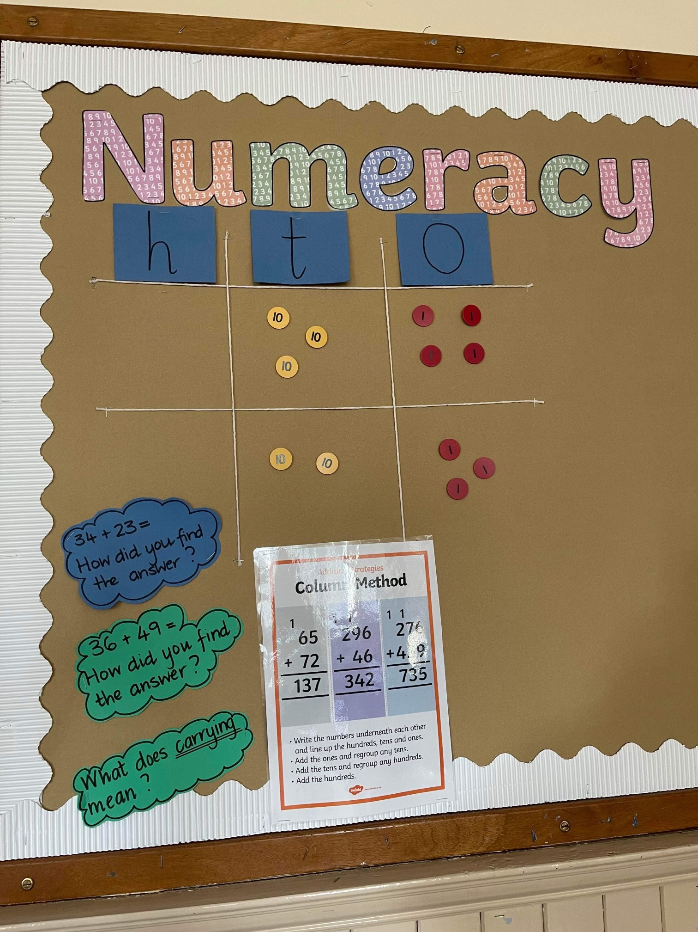
Numeracy Working Walls

