Slide 1




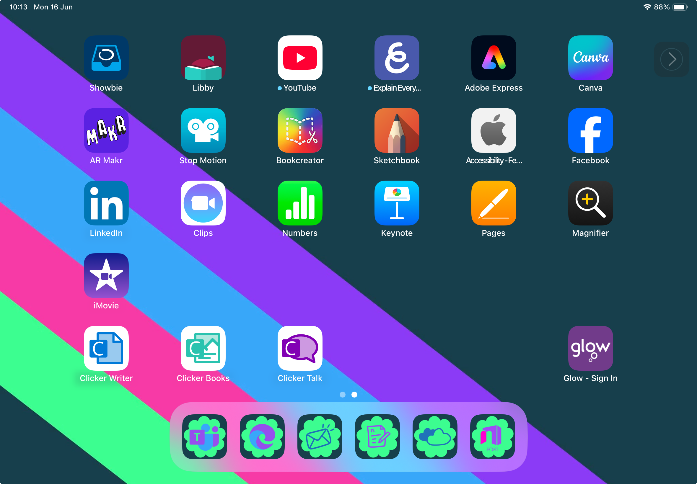
Accessibility is for Everyone
We are learning about some screen reading tools.
I can find and use:
-Safari Reader
-Live Text
-Magnifier
-Ambient Sounds
-Scanning

Slide 2
Accessibility tools are built into the iPad, and whilst they are essential for learners with additional support needs, they can be useful for every single child in your class… and you as well!
The following unit contains lessons to use with your whole class, that support reading texts.
You may find that it is particularly useful for any learners who, for example, struggle with aspects of reading, such as a print disability like dyslexia.

Slide 3
Reading Digital Texts

Slide 4

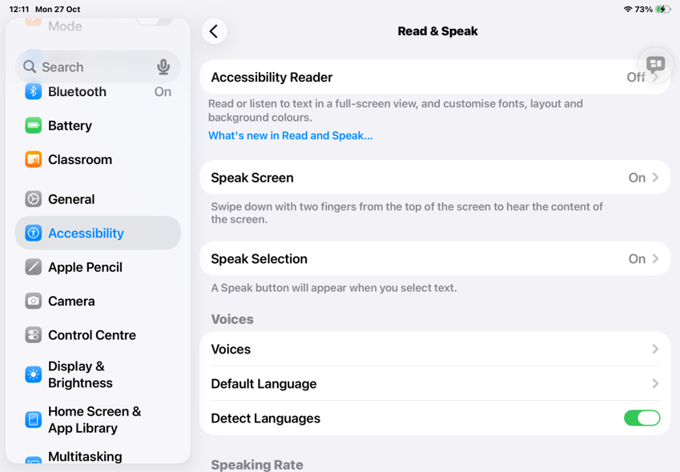

Speak Screen
We already looked at Speak Screen and the Speech Controller in Lesson 1.
But your iPad has lots of other features to help make reading a bit easier!

Slide 5

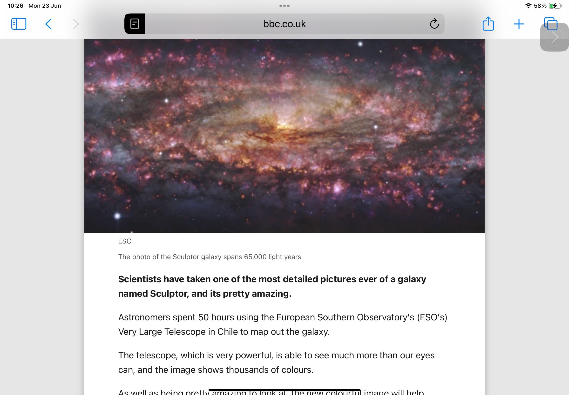

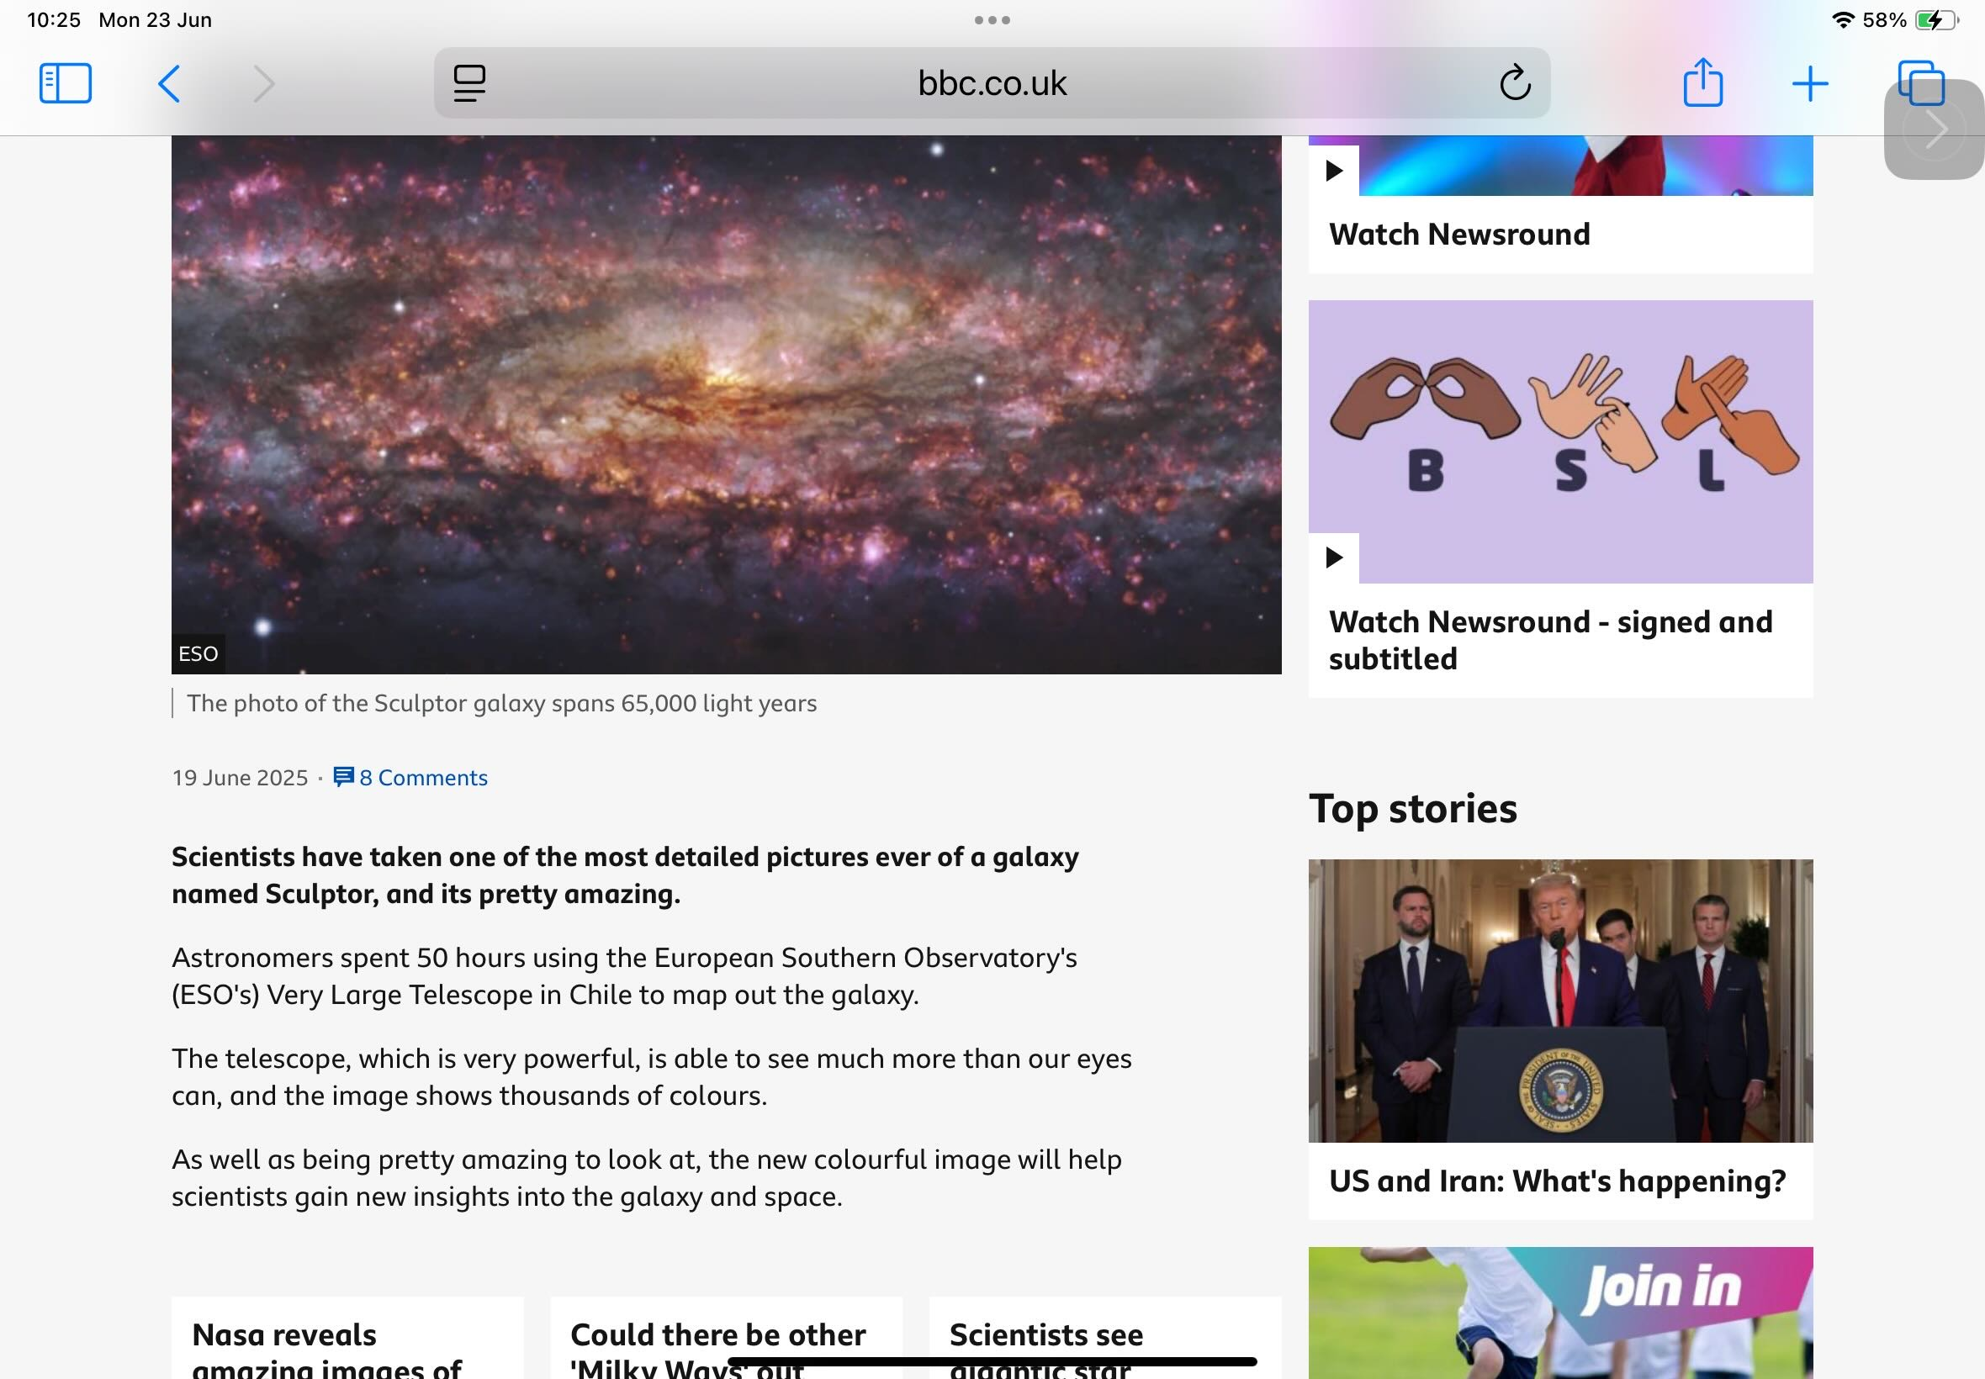
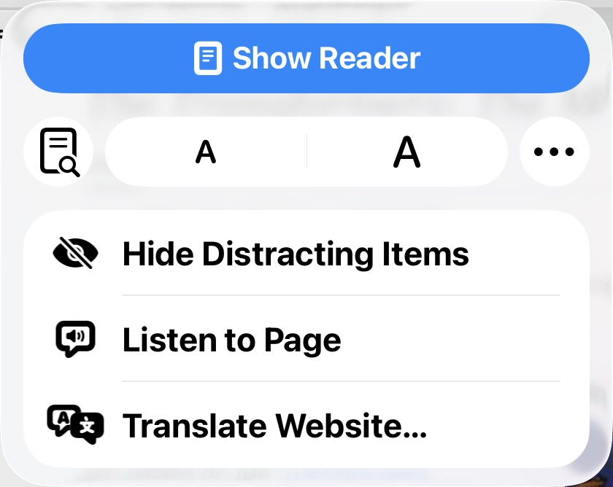
Safari Reader
In Safari, by tapping the Reader icon
in the address
bar, then
choosing Show Reader you can get rid of distractions.
You can change the background colour and the font size and style by tapping on the Reader icon again. You can even listen to the page if you want to- just select the text and choose Speak.

Slide 6
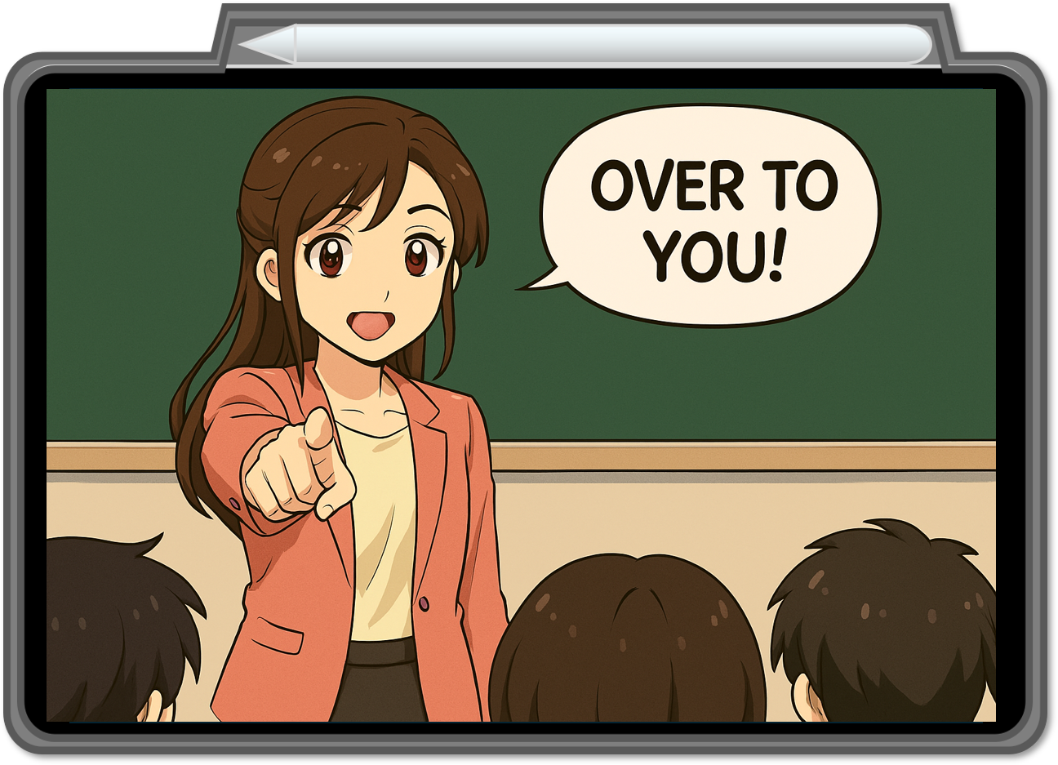
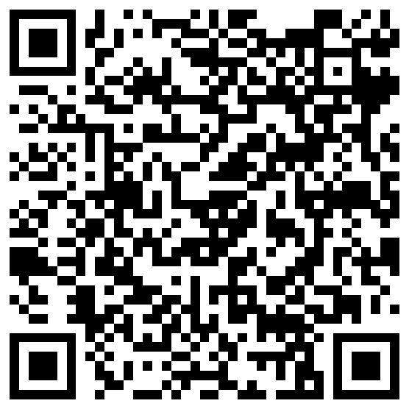
Have a go!
Scan the QR code above to visit Newsround.
Turn on Reader. Feel free to change the colour and font if you want to.

Slide 7
Reading Physical Texts

Slide 8


Physical texts
But what if it’s not a digital text you want to read?
What if it’s a poster, or a book, or a menu?
Your iPad can do that too- using just the camera!

Slide 9
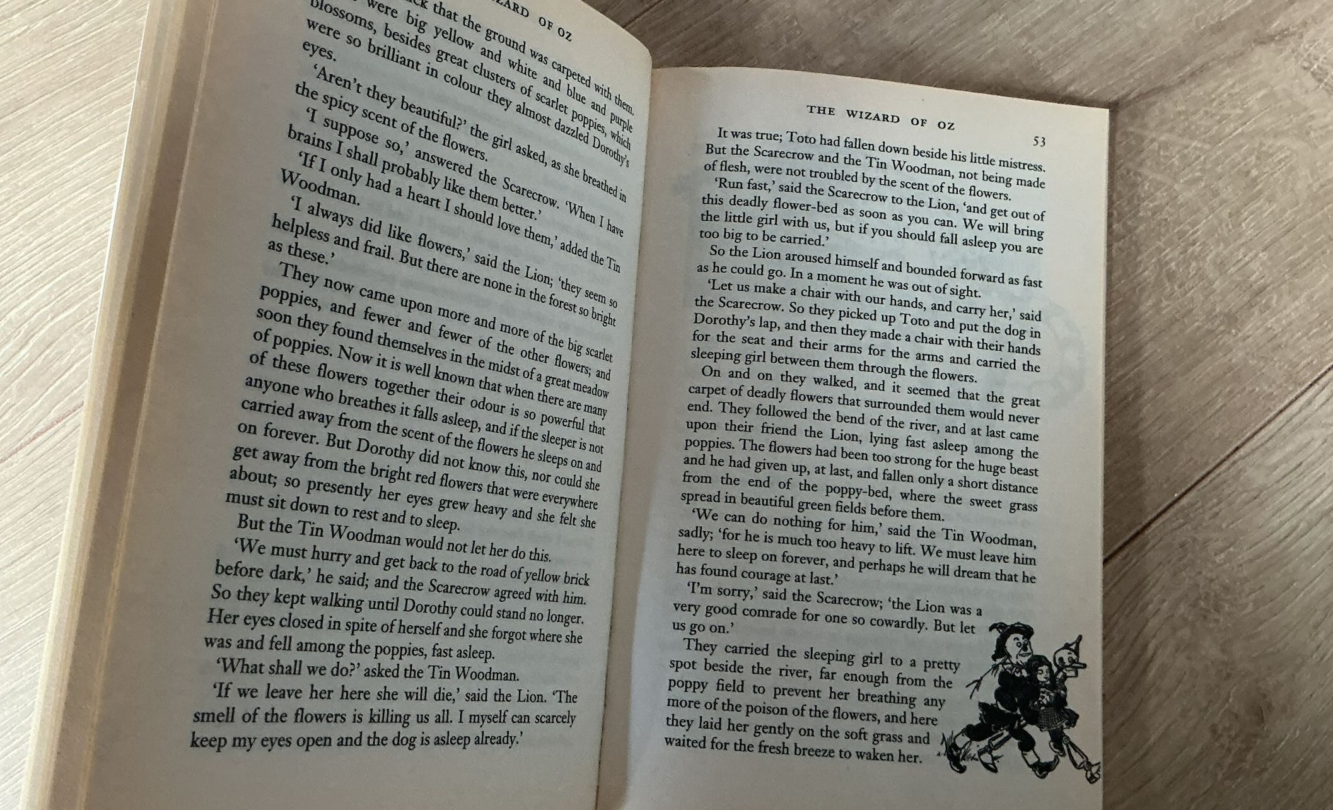
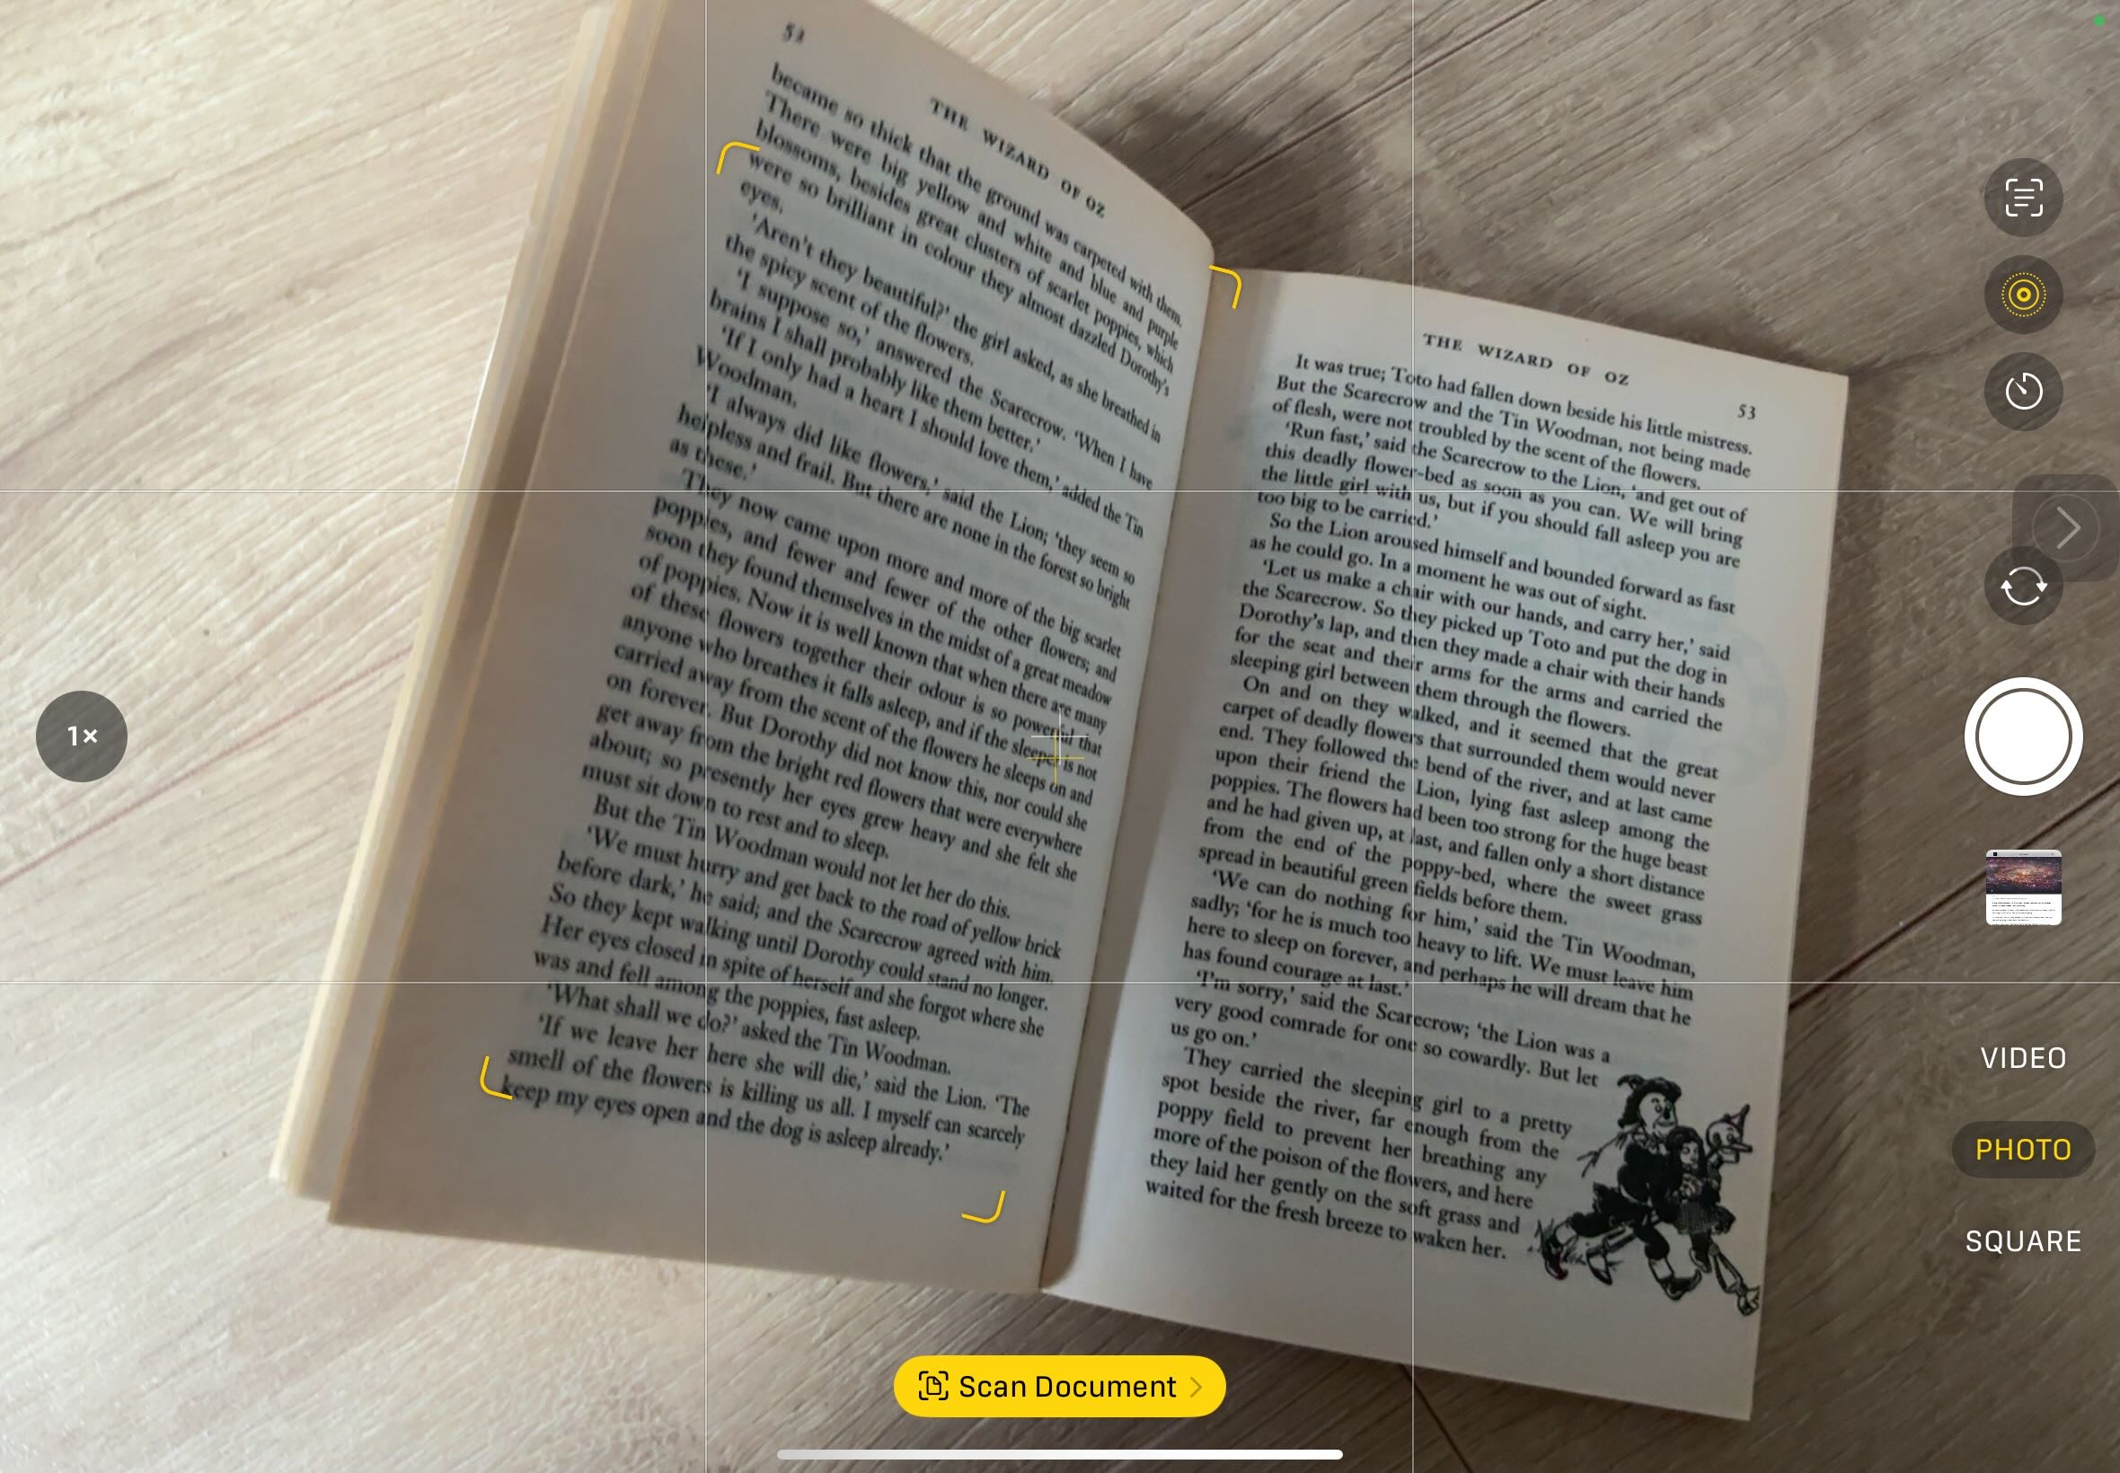
Live Text
Open your camera
and point it at
some text. This works on handwriting too… if it’s neat enough!
You are waiting for the Live Text icon to appear…
Tap the Live Text icon, then select what you want it to read and choose Speak!
(you turned Speak on in lesson 1)
If you don’t have the steadiest of hands, take a photo first, then use the Live Text icon… whatever works best for you!

Slide 10
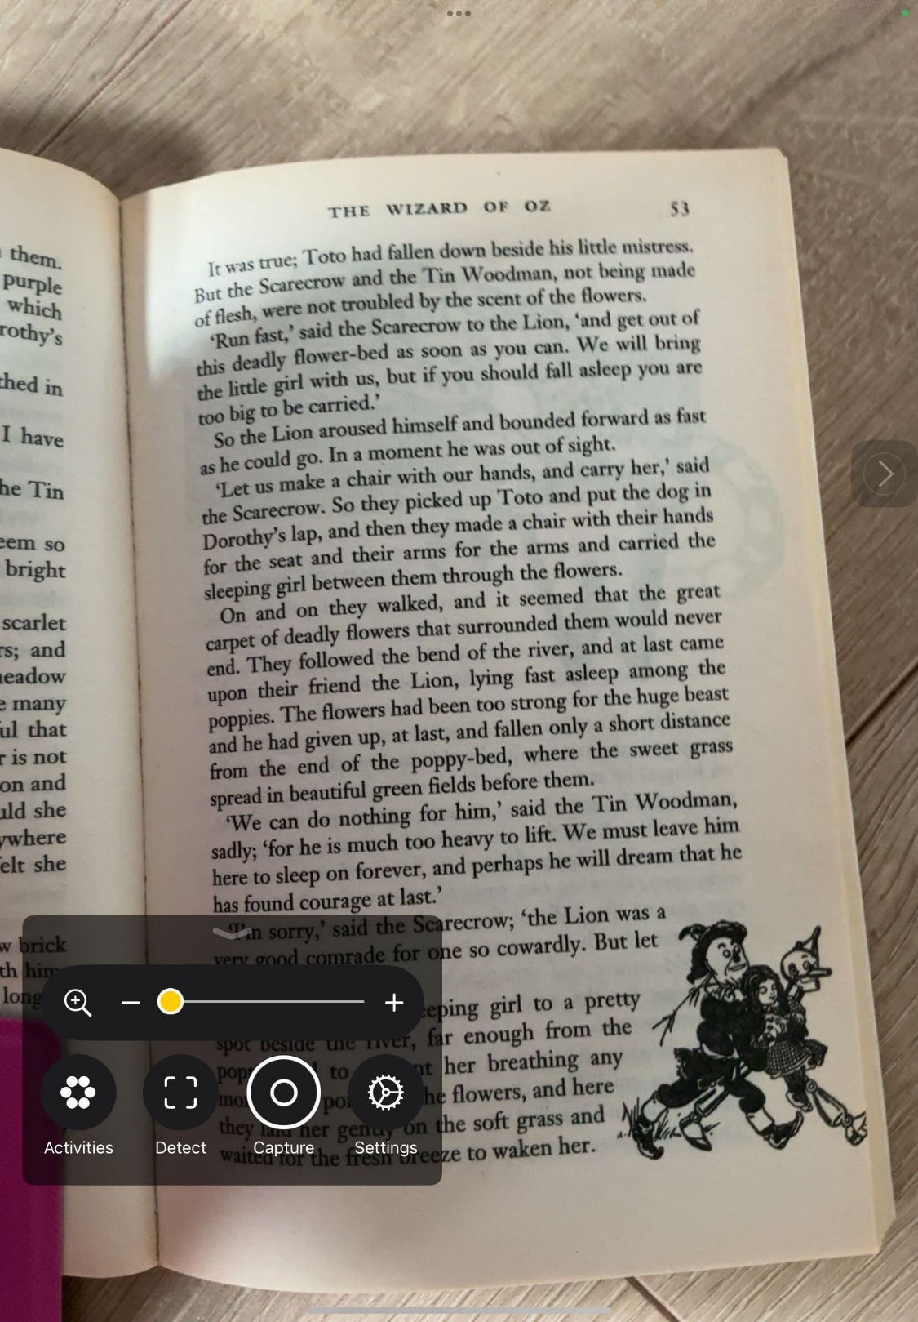
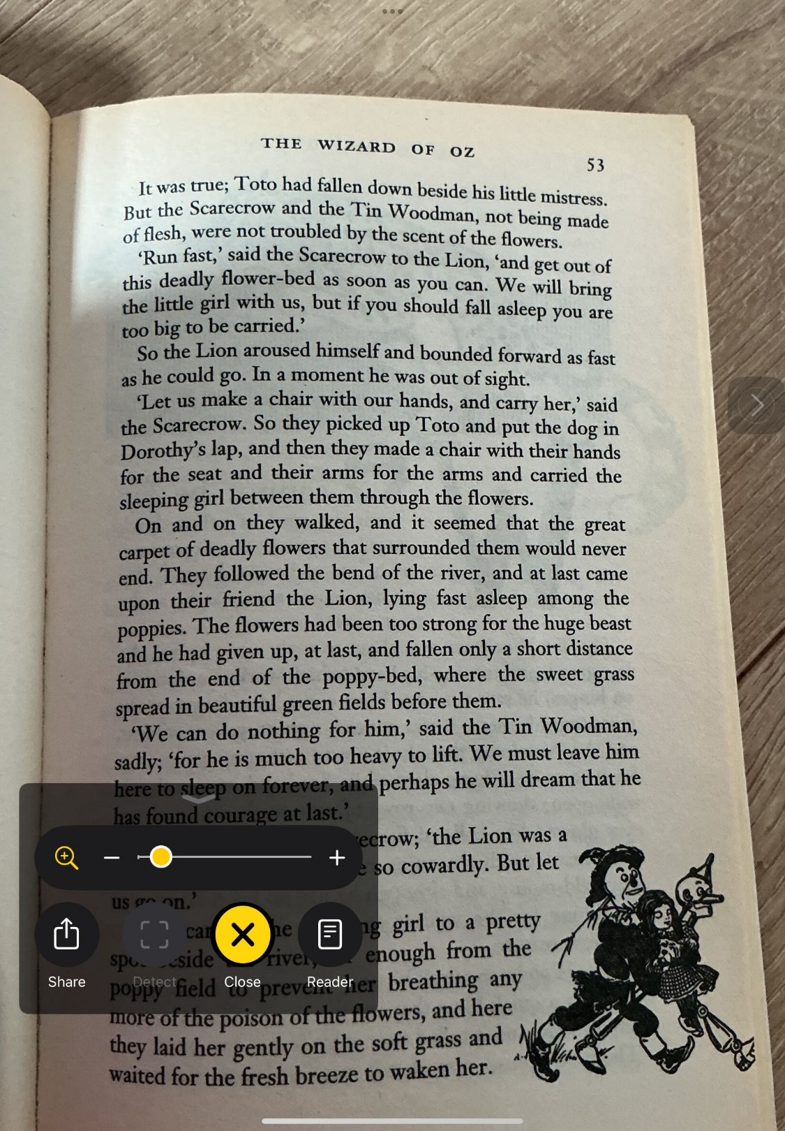


Another way to read a physical text is to use the Magnifier app.
Open Magnifier, hover over the text you want read and tap Capture.
You are waiting for the Reader icon to turn white… then tap it!

Slide 11
Now is your chance… find something really long and really boring to read!
Use Live Text or the Magnifier to read it!

Slide 12



Reading for Enjoyment
Sometimes we just want to sit in the story corner with a good book… the tools built into your iPad can help with that too! But where do you get the books?
Libby
If you are a member of a library, you have access to digital books through this app.
Apple Books
This is the built in book app on your iPad. It can read .epub, .iBooks, and .pdf files.
Easy Reader
Has some nice dyslexia friendly fonts and can read most file formats.
Notes:
Teachers- For children with a print disability, including visual impairment, dyslexia, ADHD and ASD, you can access the RNIB Bookshare website. This has many up to date books that you can download for print disabled learners in your class. There is a requirement that a physical copy of the book exists in your school. For textbooks and some reading books, there is the CALL Scotland Books for All database.

Slide 13
Ambient Sounds

Slide 14

Some people like background noise while they read. It can help them focus!
You can access built in background sounds using Control Centre.
To open Control Centre swipe down from the top right corner.
Libby
If you are a member of a library, you have access to digital books through this app.

Slide 15
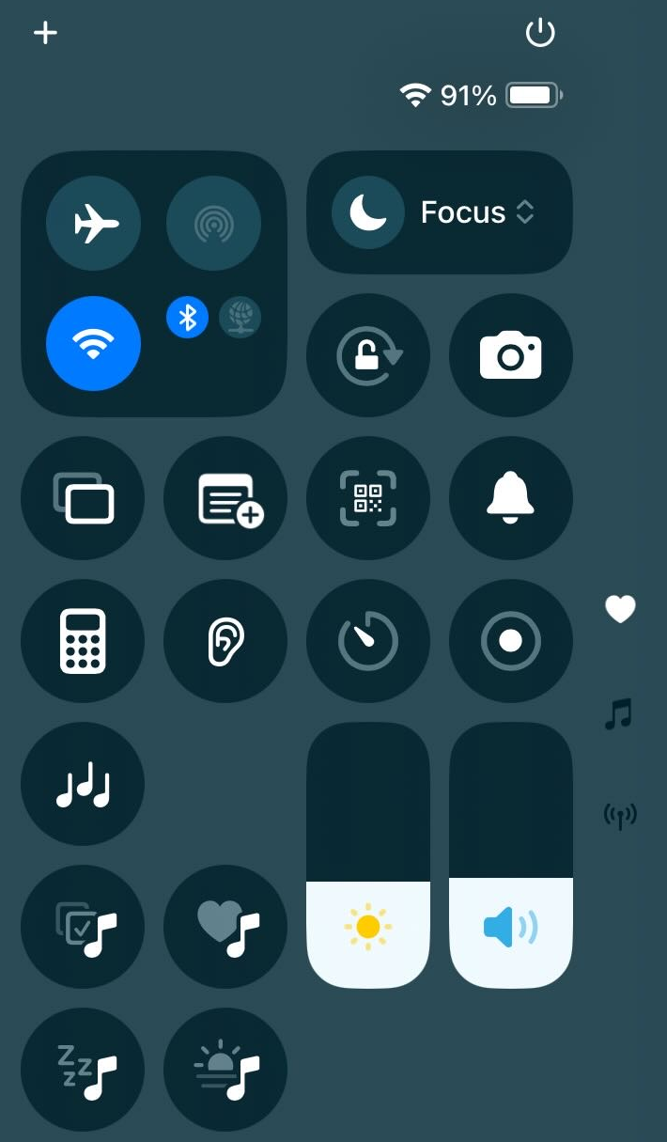
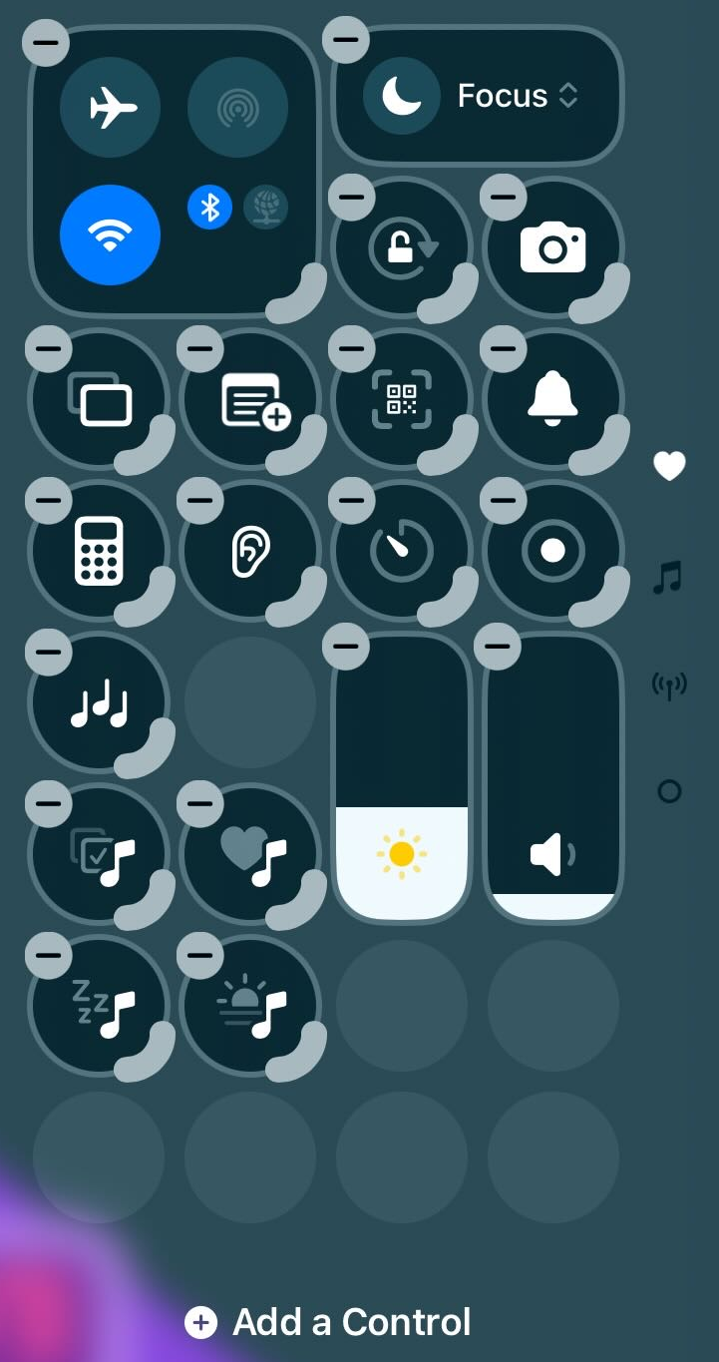
This menu will appear
(make sure you’ve not swiped too far. You want to be on the heart icon). This is the Control Centre.
If you tap on the + in the top left, you can choose Add a Control.
(you can also delete controls here if you don’t think you’ll use them)
Libby
If you are a member of a library, you have access to digital books through this app.

Slide 16
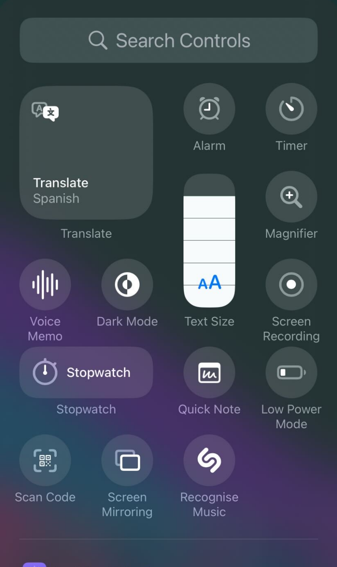
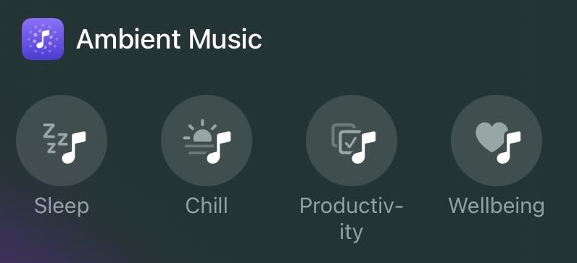
These are all the Controls you can add. There’s loads!
What we are looking for first is
Add all 4 if you want… Although I don’t think your teacher wants you falling asleep!
Libby
If you are a member of a library, you have access to digital books through this app.

Slide 17
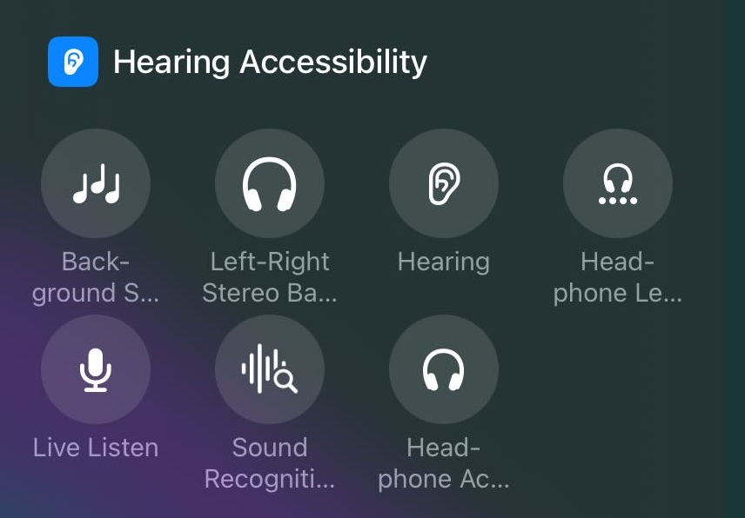
Next have a look for Background Sounds
It’s really far down the list in Hearing Accessibility.
Libby
If you are a member of a library, you have access to digital books through this app.

Slide 18
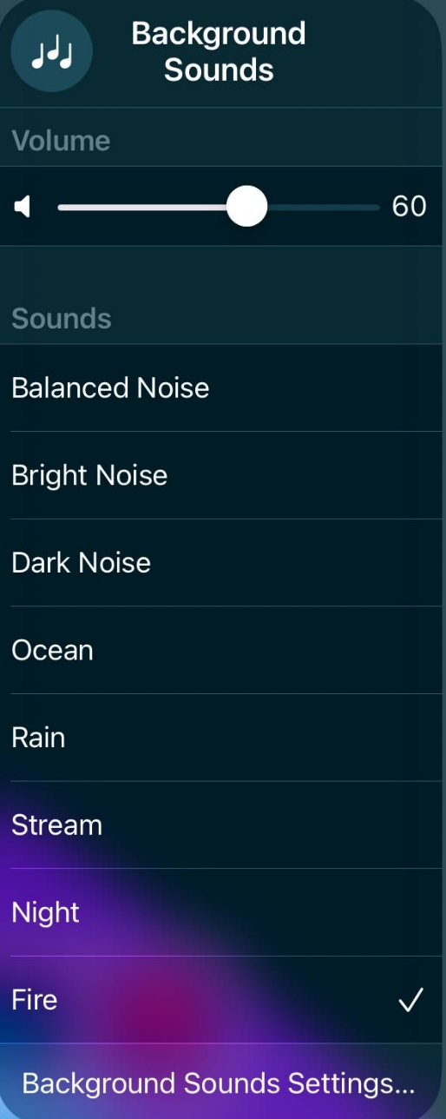
Once they are in your controls, if you tap and hold Background Sounds, you can choose what kind of sound suits you best!
Libby
If you are a member of a library, you have access to digital books through this app.
Switch on both Ambient Music and Background Sounds from your control centre… and switch them back off from here too!

Slide 19
Add both Ambient Music and Background sounds into your Control Centre.
See if you like any of them!
(sorry teachers- this may be a bit noisy…)

Slide 20
Scanning

Slide 21
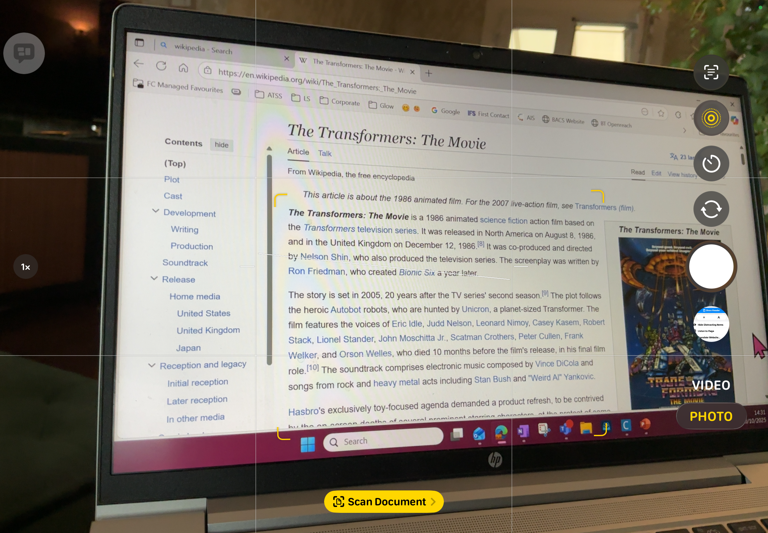
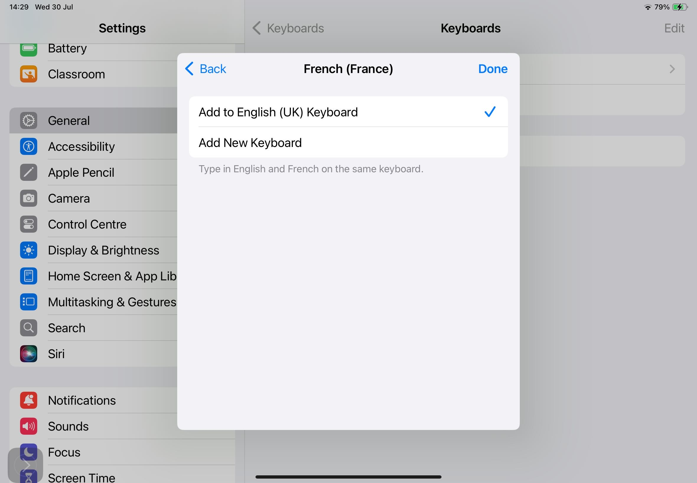
Sometimes you will want to take a picture of something like a whiteboard or a textbook page to help take notes or to work something out.
When you do this, it helps to scan rather than just take a photo.

Slide 22
One way to easily scan a whiteboard or a document is using the camera app.
Notice how you don’t even need to be straight in front of the screen for this to work…
Just point it at what you want to scan. Your iPad will give you the Scan Document option…

Slide 23
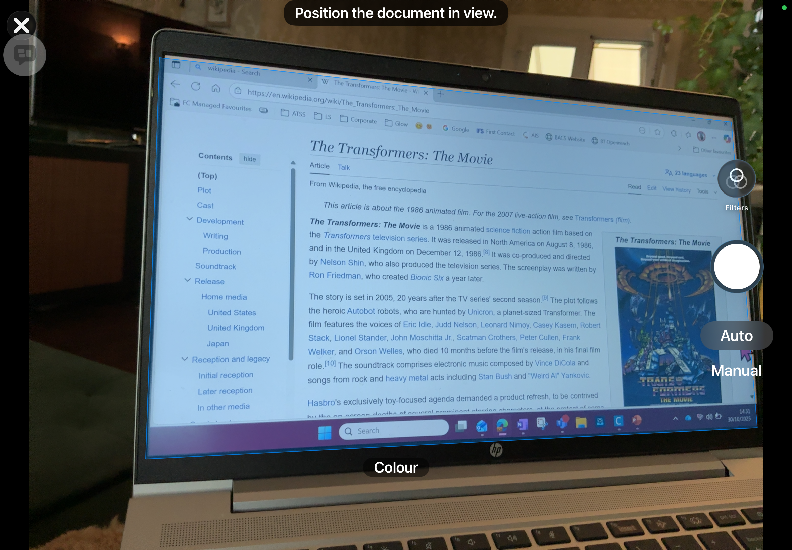
Your iPad will try to auto scan the screen or page. (That’s what the blue overlay is.)
Sometimes if your hand is a bit too shaky, it’s easier to just tap the button.

Slide 24
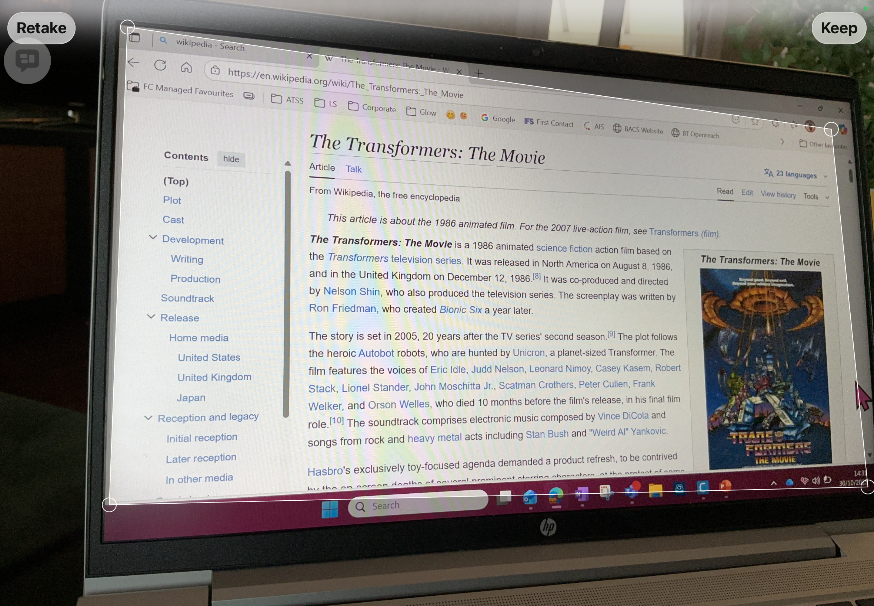
If you tapped the button, you then get to choose what is in your scan by dragging the corner circles.
If your image isn’t great, you can always Retake.
If you like what you got, tap Keep.

Slide 25
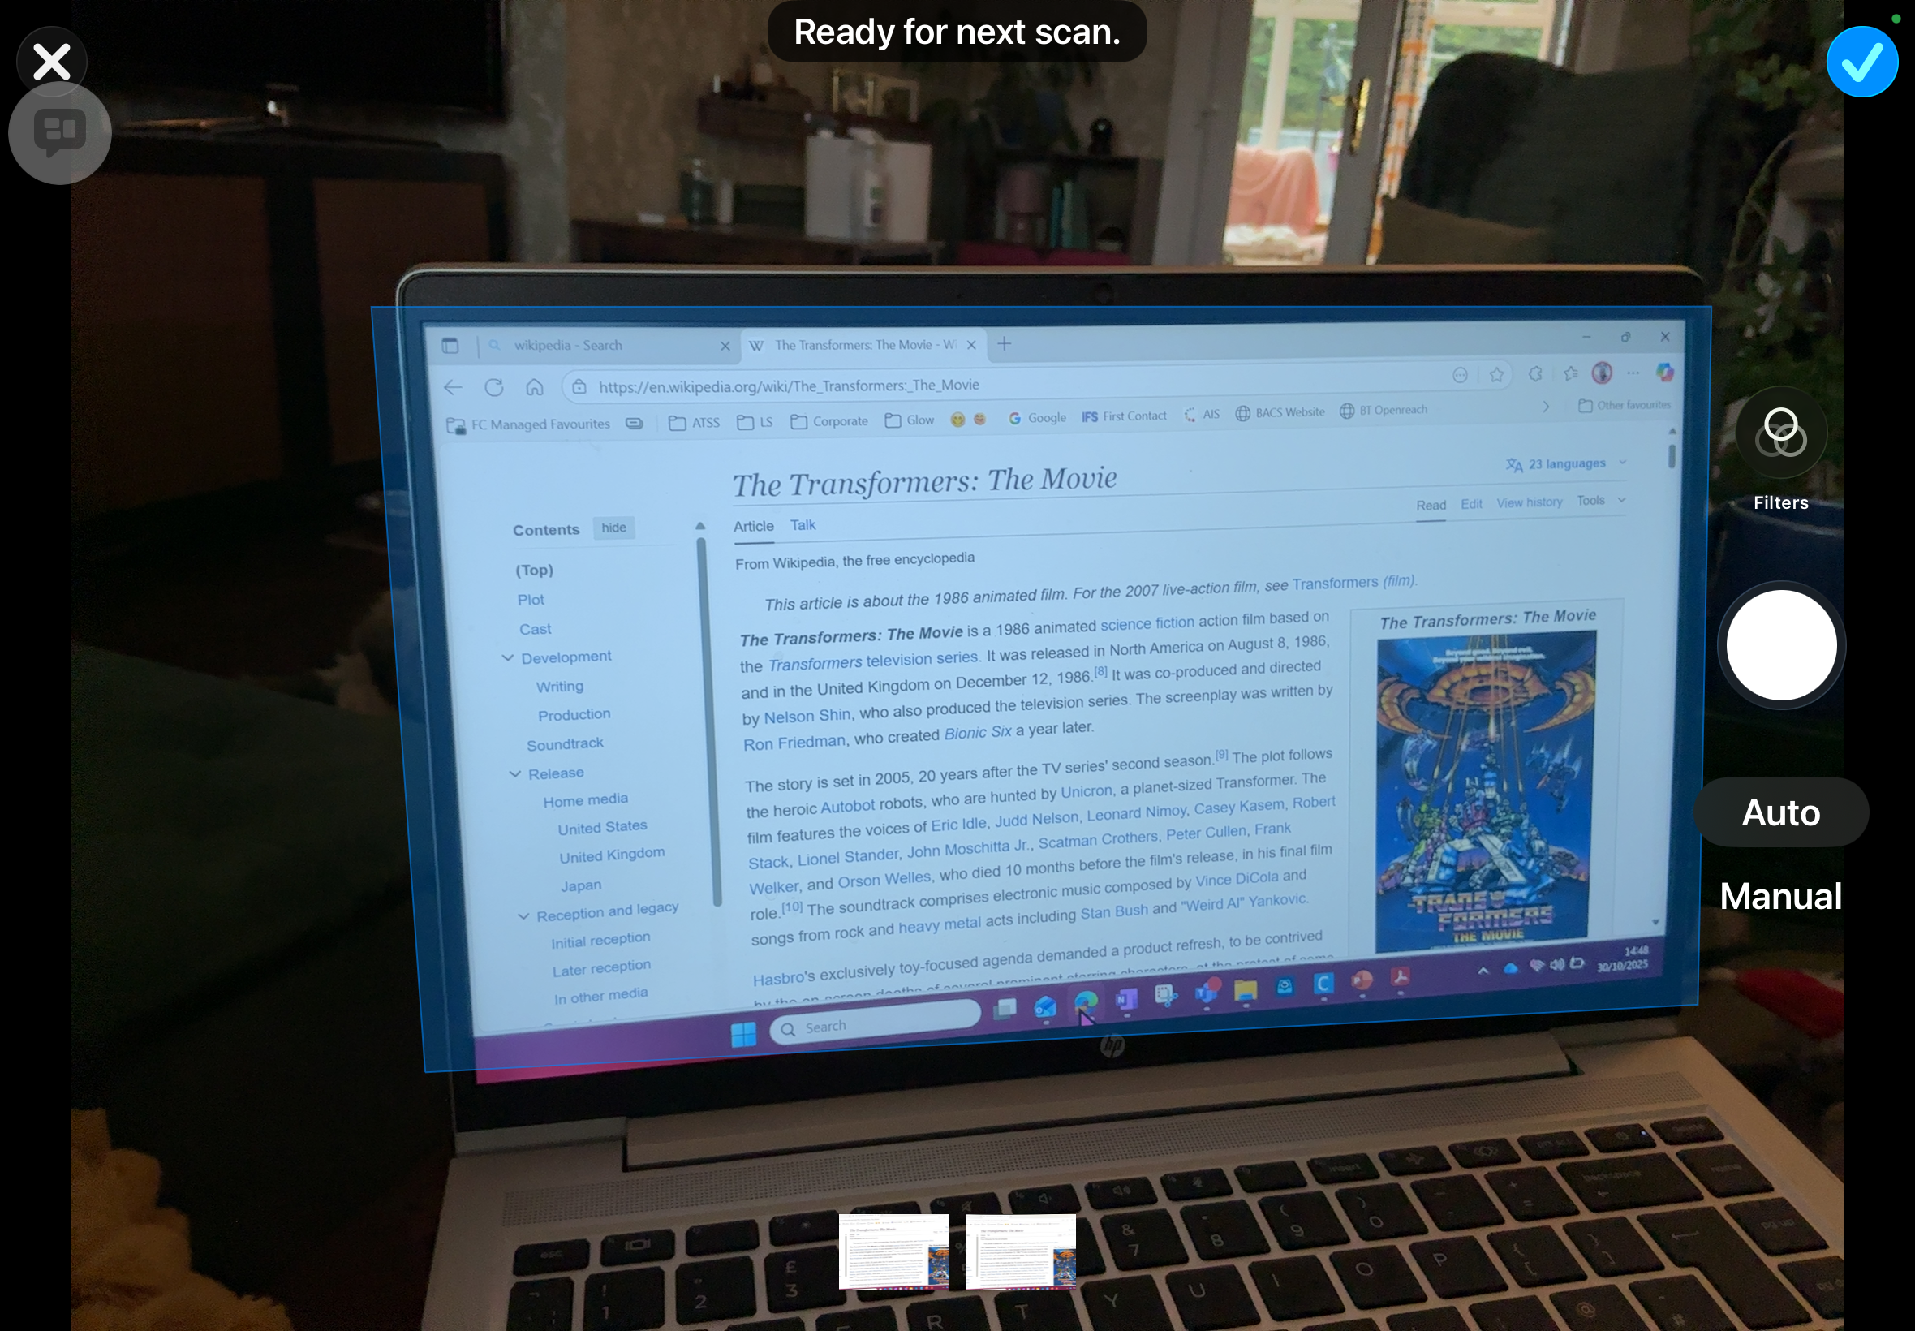
If your iPad automatically took the scan, then you’ll jump straight to this screen. There’s a little preview down here.
You can now choose to save this scan, by tapping the tick in the top right.

Slide 26
You can also keep adding more scans, by repeating the process. They will just be added to the previews along the bottom.

Slide 27
If there’s something not quite right, like you don’t want the whole screen in your scan, or you just want to check what the scan looks like, tap the preview.

Slide 28
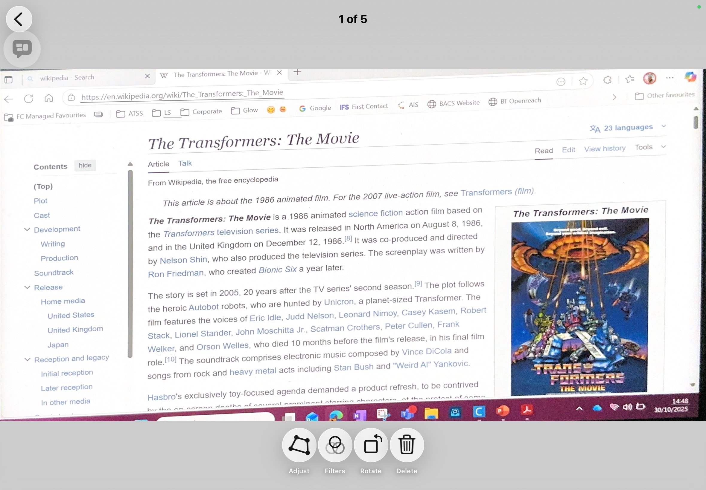
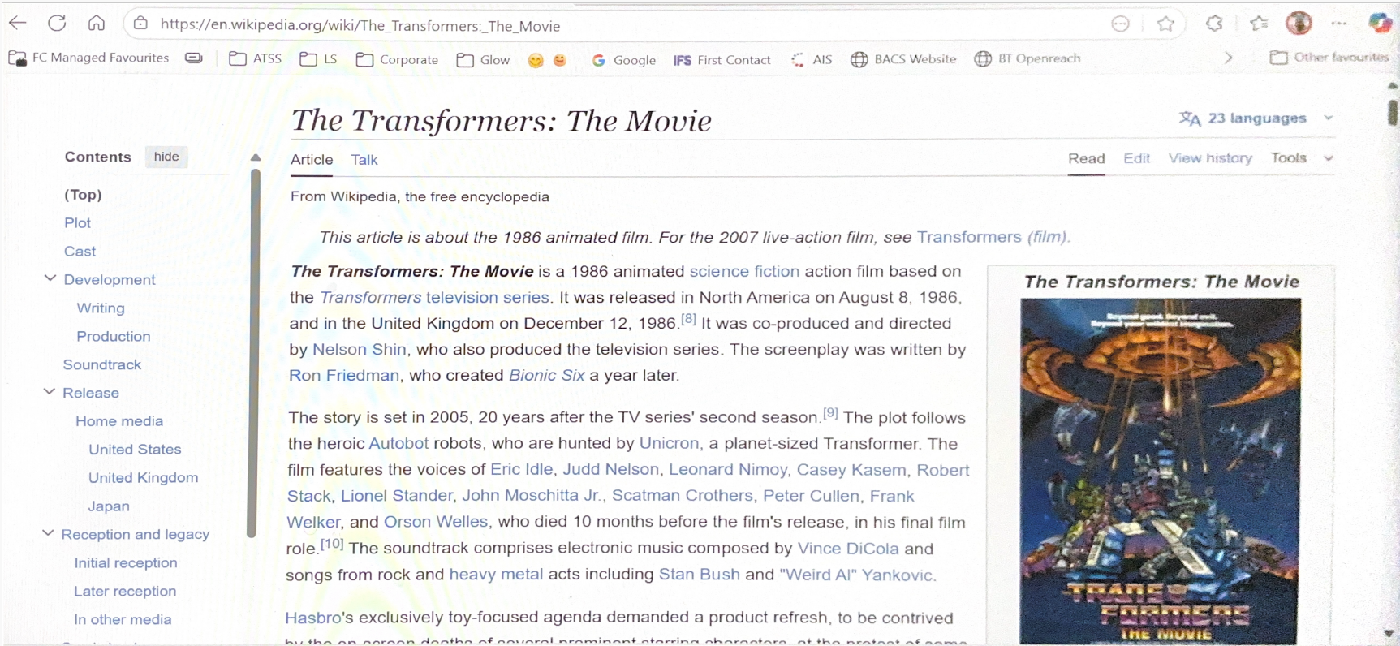
Your iPad will have straightened up the image for you… look how neat it is!
You can edit the image by tapping up here.

Slide 29
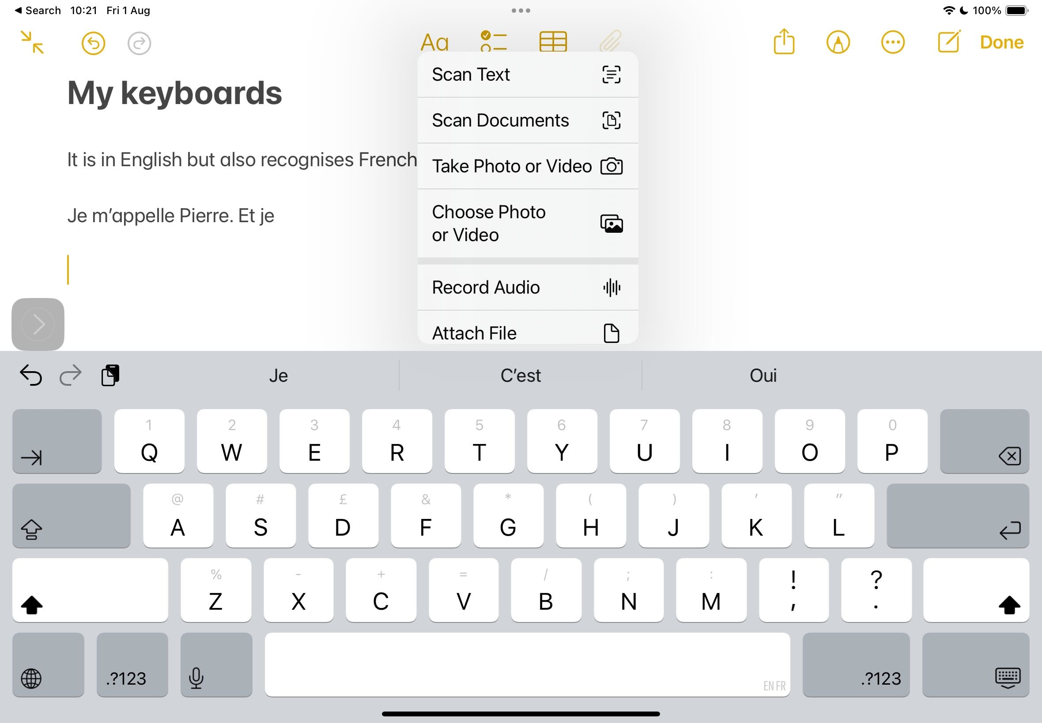
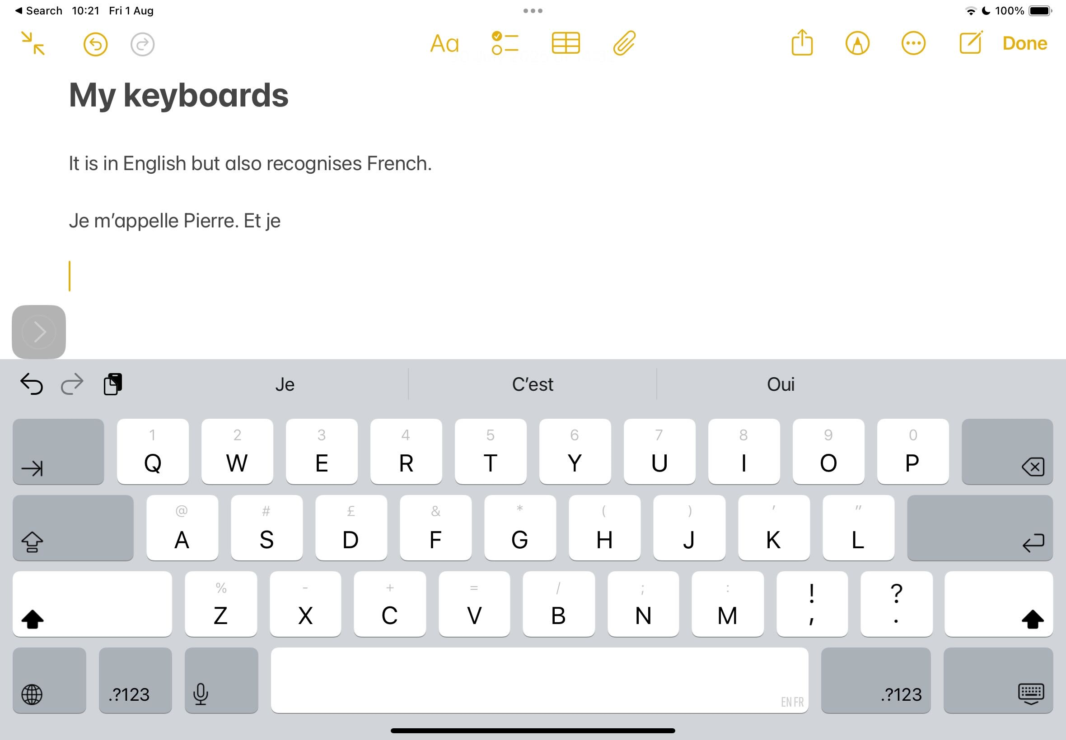

Scanning also works from within the Notes app.
To access scanning, just tap the paperclip up here…

Slide 30
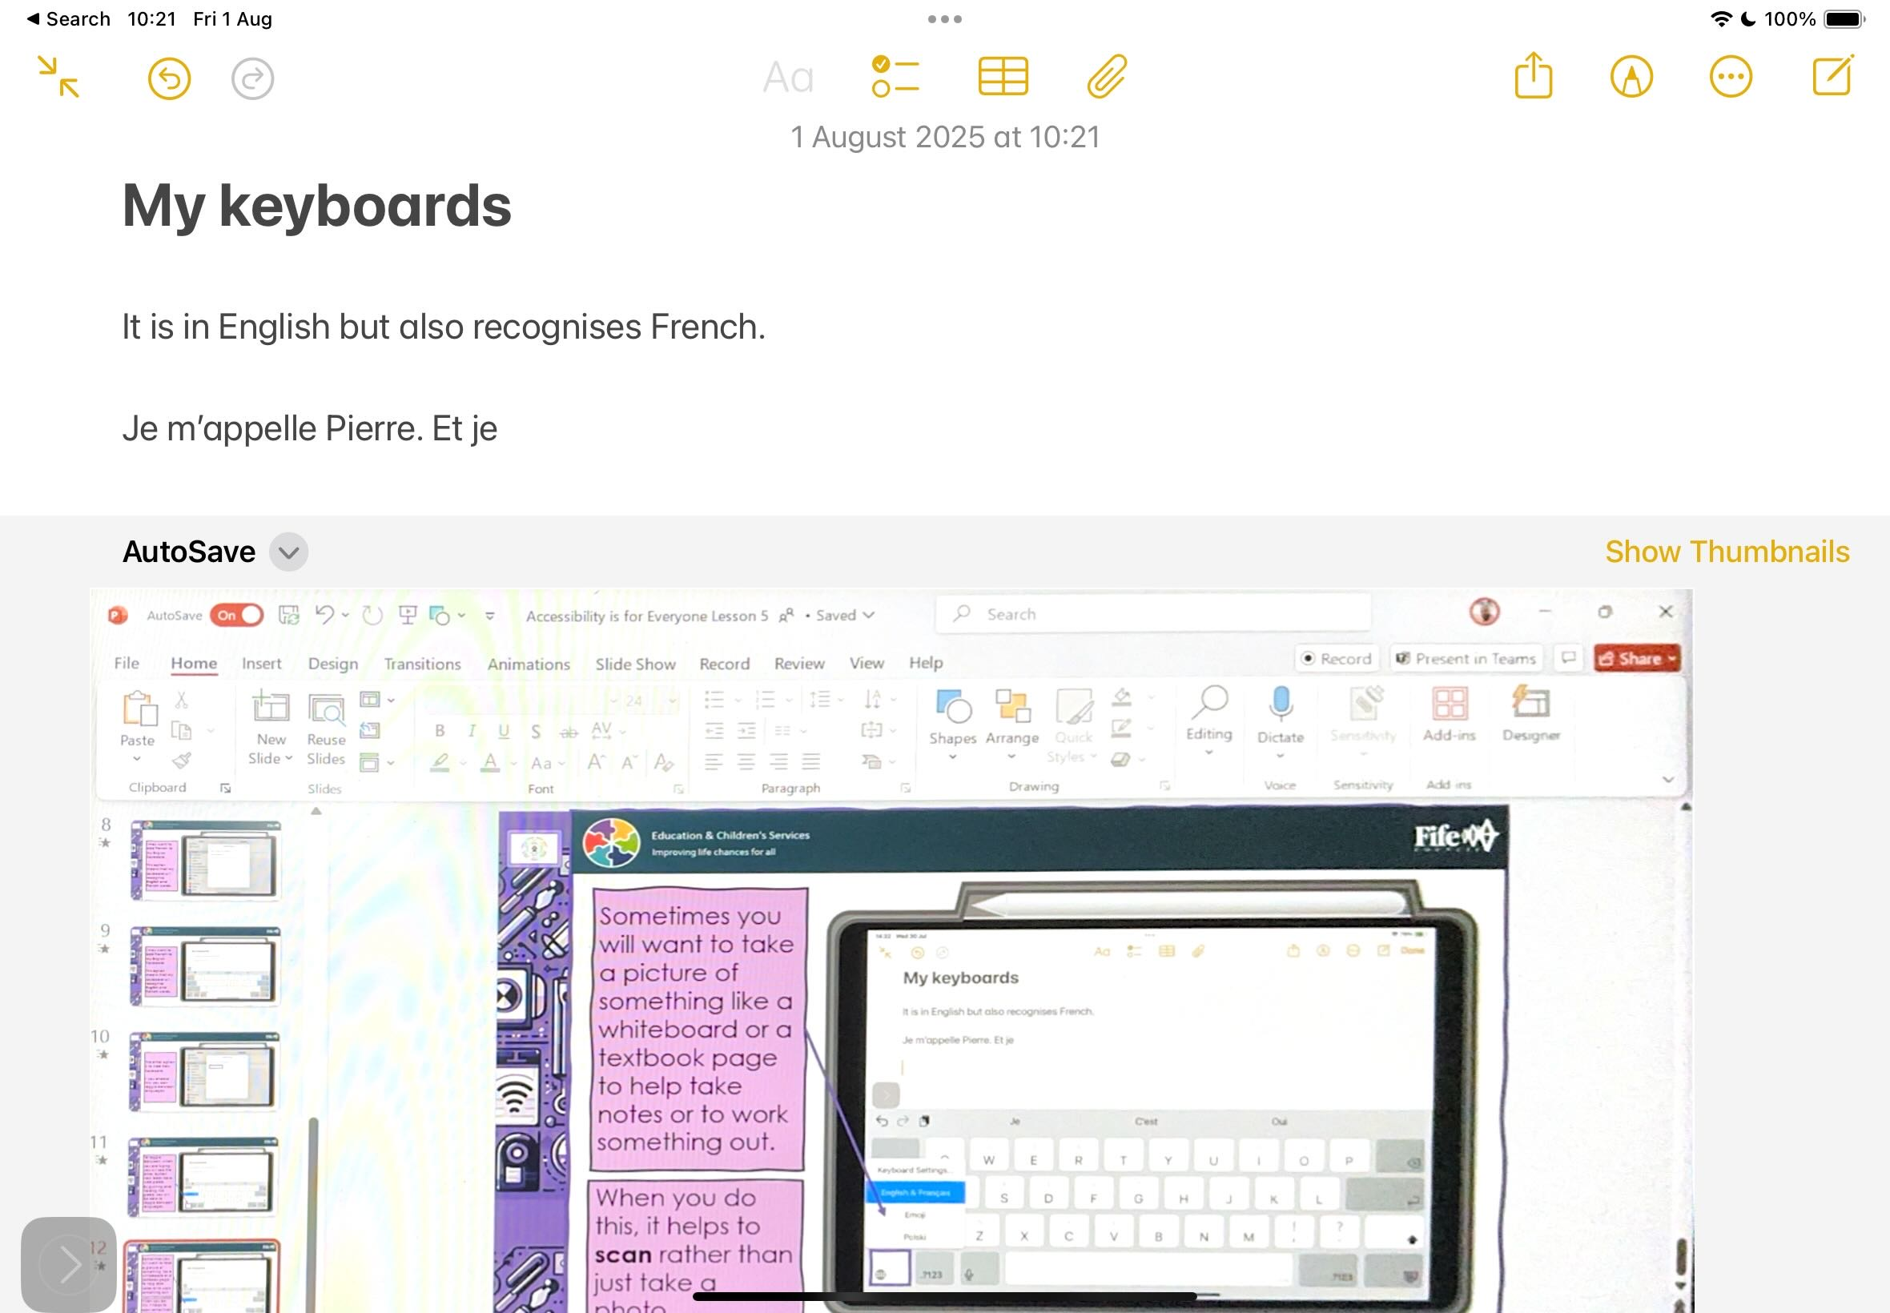
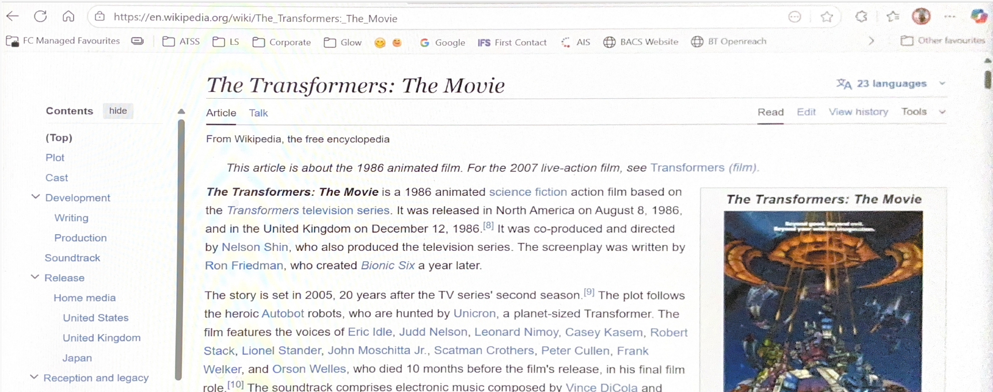
You can scan just text and insert it into your Note.
Look how it just slots neatly into your note!
Or scan the whole document.
The benefit here is you can add notes, voice memos, pictures, annotations…

Slide 31


Scan this screen!
Either use the camera app or Notes.
Once you have it scanned… what can you do with it? Can you crop it to just contain this purple box? Can you access any of the text on it? Can you use Mark Up to add notes?
Can you add it to a different app?

Slide 32
What did we cover?
Screen Reading tools
-Safari Reader
-Live Text
-Magnifier
-Ambient Sounds
-Scanning

Slide 33

This series of lessons was created by the Fife ATSS Team and is based on lessons created by Ms Linsey Miller (Sacred Heart Primary School ASC, Falkirk, linsey.miller@education.falkirk.sch.uk) and research carried out by Mrs Nicola Denholm (Larbert Village Primary School, Falkirk).
All content is protected by copyright. You may use the contents of these lessons and adjust them to suit your own context and practise; however you are strictly prohibited from reselling this series of lessons or any derivative created from it, either in part or in its entirety.

