Slide 1

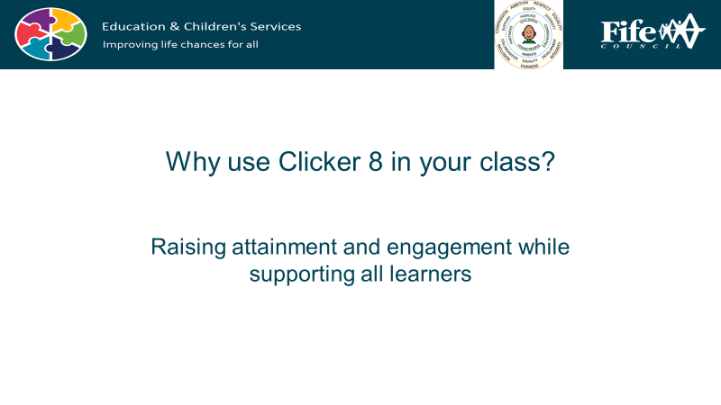

Accessibility tools are built into the iPad, and whilst they are essential for learners with additional support needs, they can be useful for every single child in your class… and you as well!
The following unit contains lessons to use with your whole class, that support organisation and planning.
You may find that it is particularly useful for any learners who, for example, struggle with aspects of executive function, as many of our neurodivergent learners do.

Slide 2
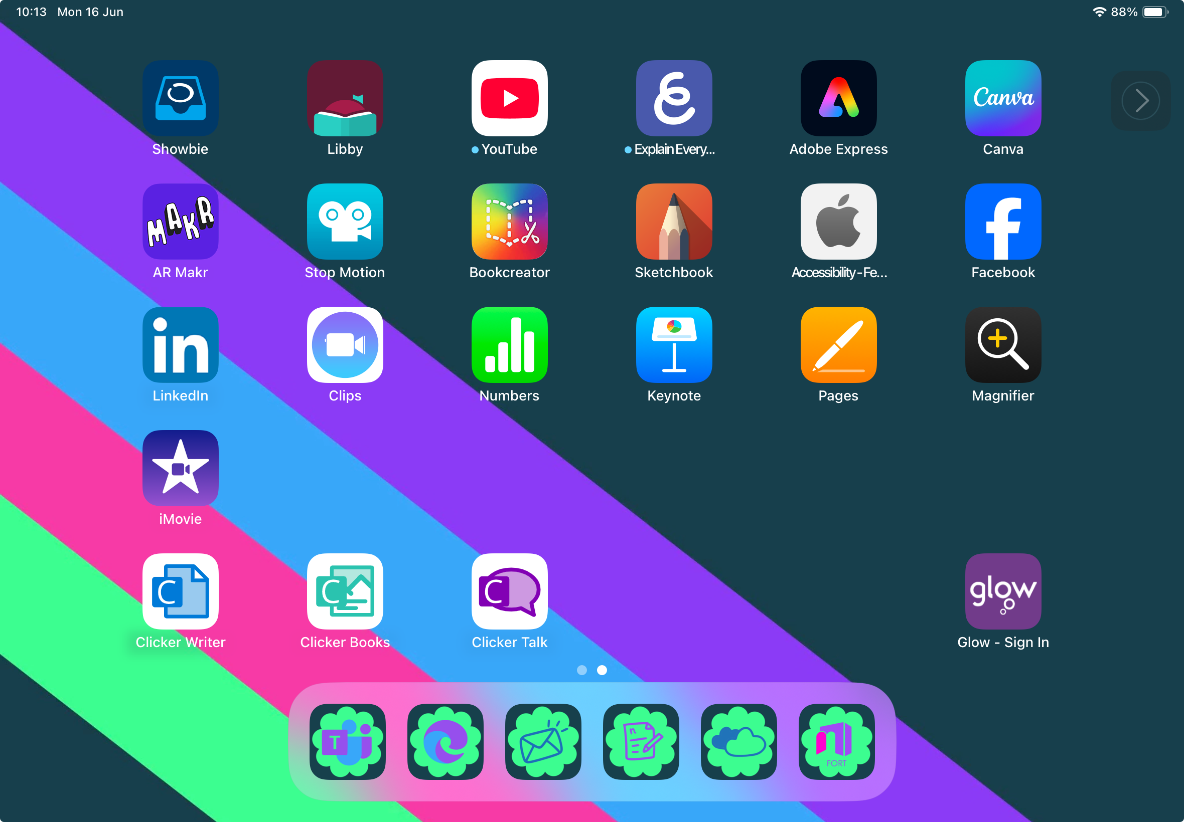
Accessibility is for Everyone
Unit 4: Planning and Organising Tools
-Mind Maps
-Calendar
-Reminders
-Widgets

Slide 3
Mind Maps

Slide 4
A mind map is a way to show ideas using pictures, words and lines.
What do you do when you have lots of ideas and want to remember them?
It can help your brain remember things.
It might also make information easier to understand and display.

Slide 5
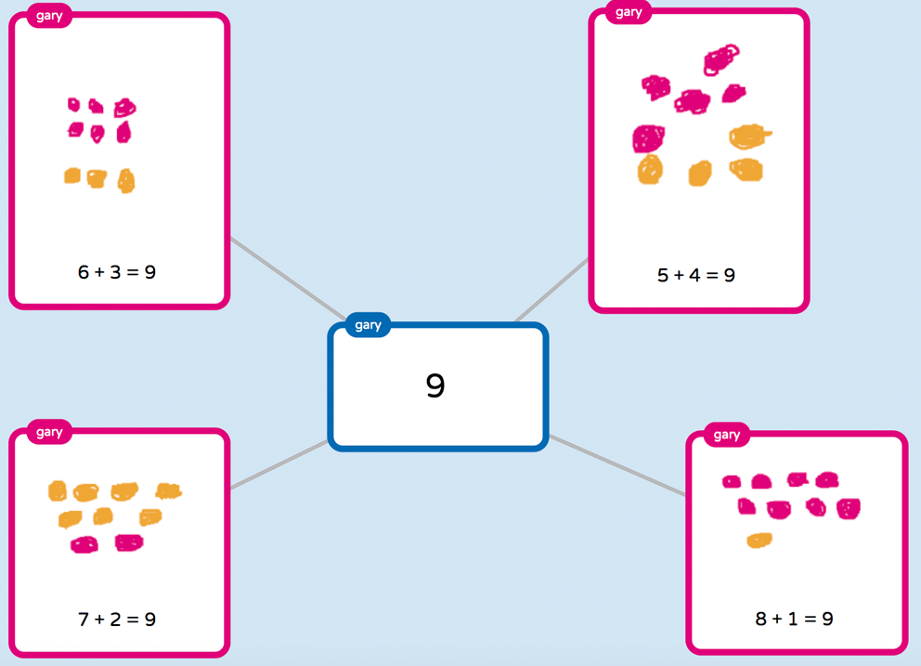
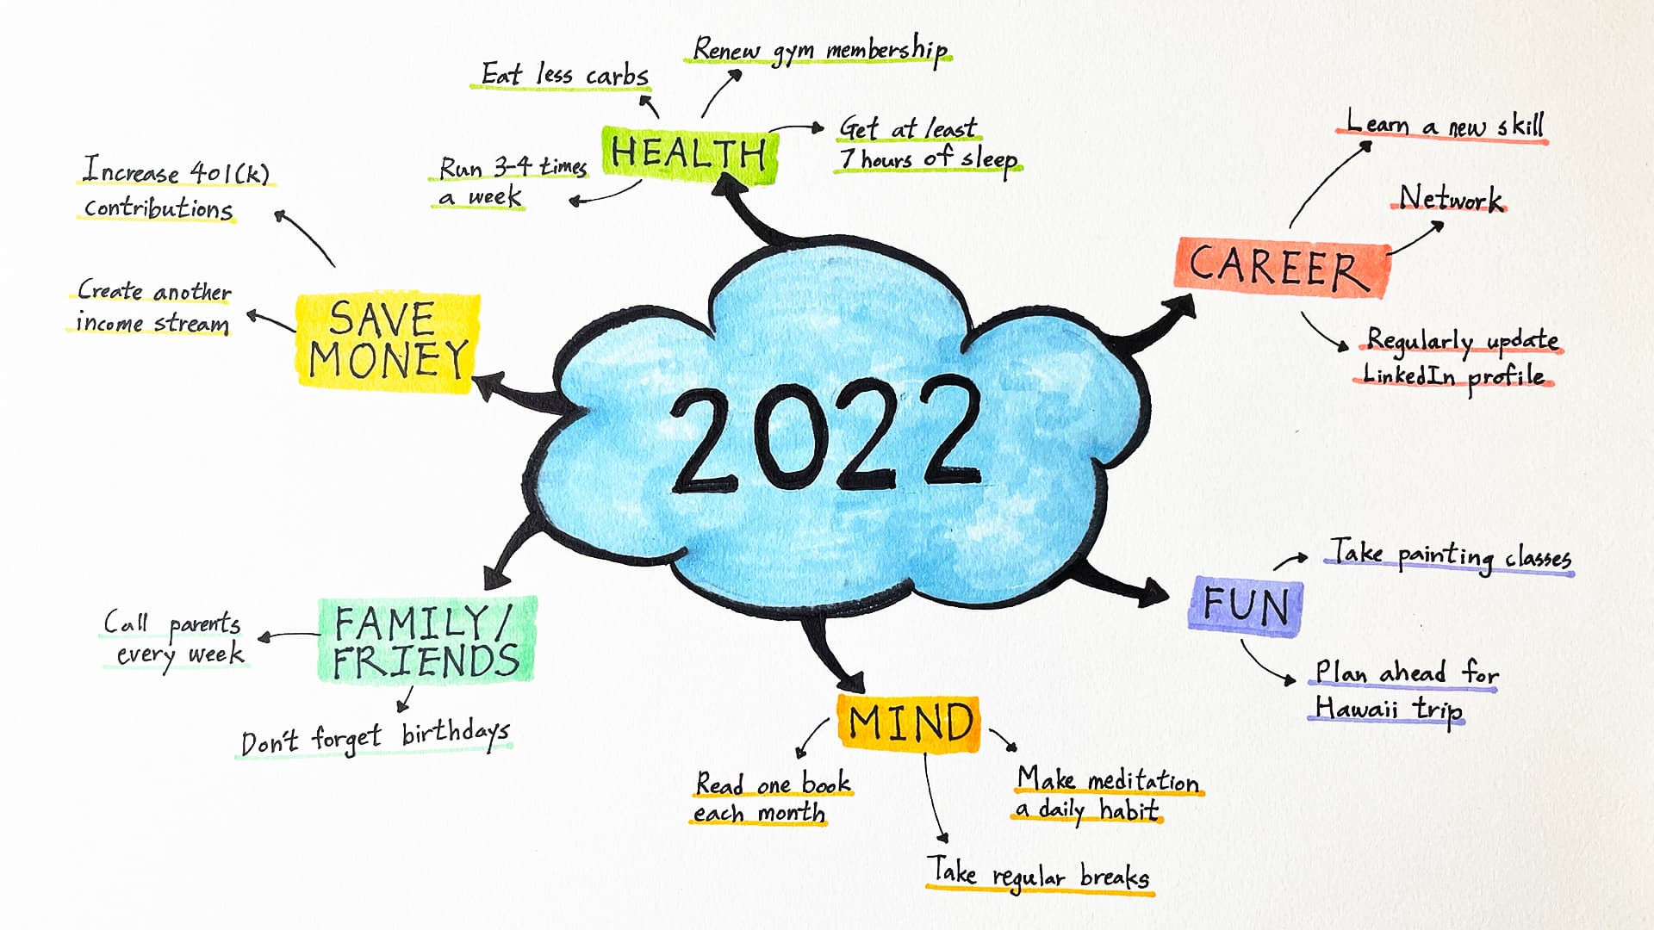
Mind Maps can be created on paper or digitally…
… and your iPad has a few apps you can use!

Slide 6



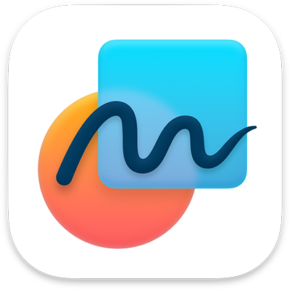
Canva
Sign in with your Glow
login. There are lots of templates for Mind Maps. Just search mind map on the home screen.
Explain Everything
There are lots of templates
here as well.
Freeform
This is Apple’s built in tool and is really easy to use. In fact- we’re going to have a go right now!
Clicker Boards
Your school may have a
Clicker licence and Clicker Boards are found in the Clicker Writer app.

Slide 7
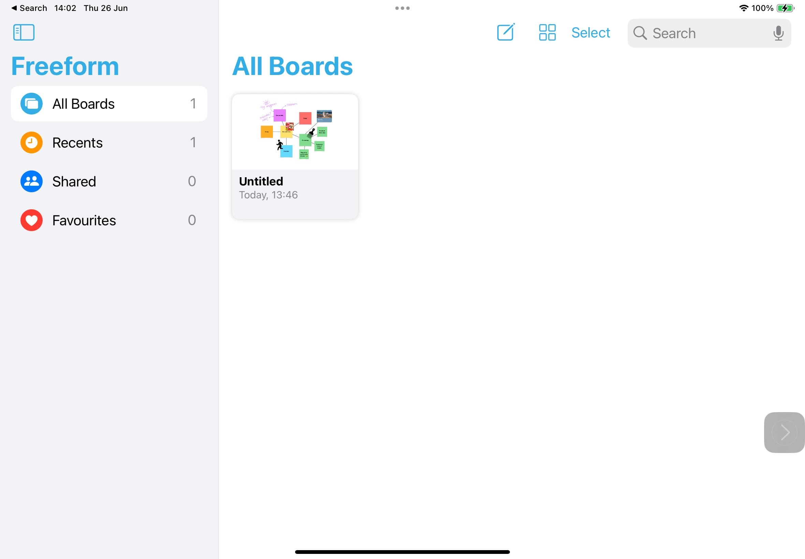
Open your
Freeform app.
To create a new board you want to tap this icon…

Slide 8
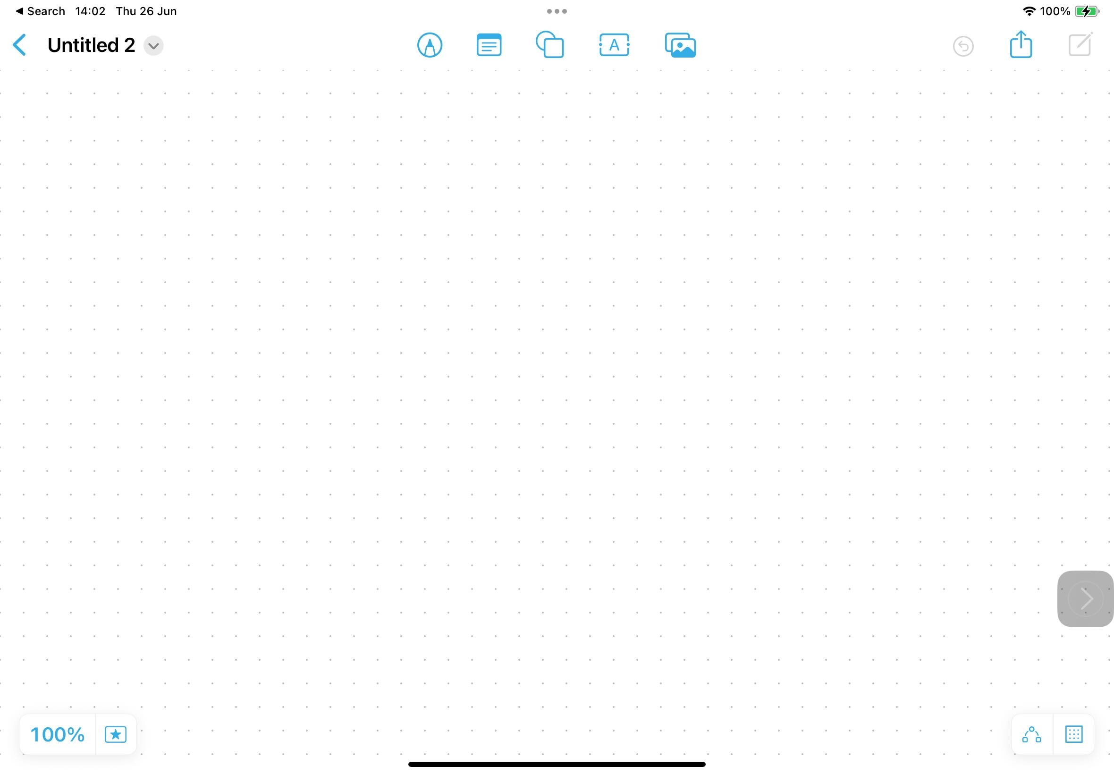
This is your board.
All your tools sit in a nice row along the top.

Slide 9
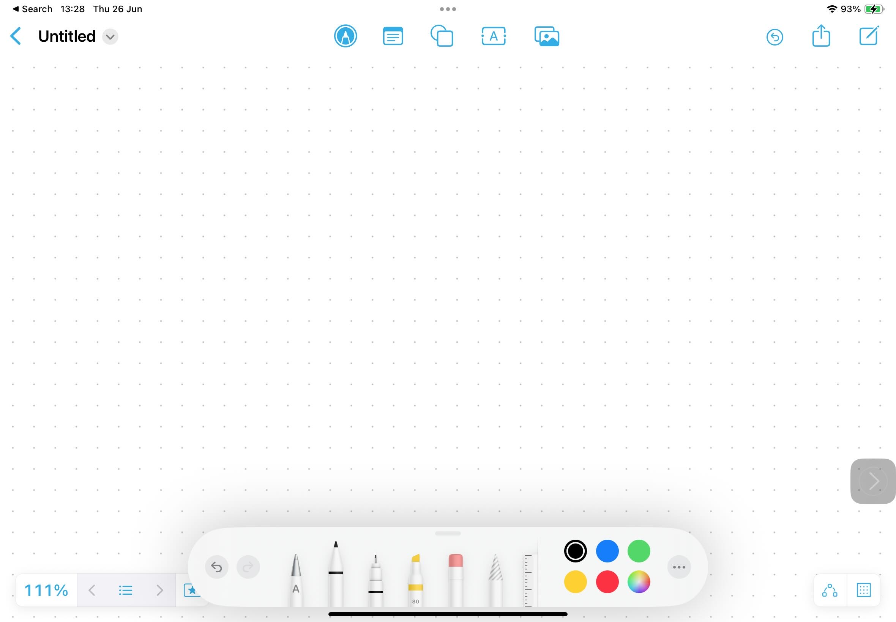
This icon opens the draw menu. This works best if you have an Apple Pencil.

Slide 10
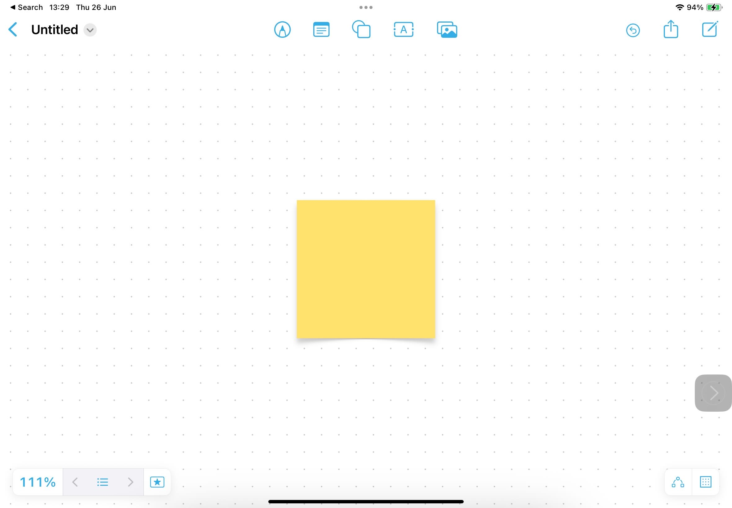
This icon adds Post-It notes.
I’m going to add the title of my mind map here.
I’m going to do a mind map about how to care for my favourite type of dog.

Slide 11
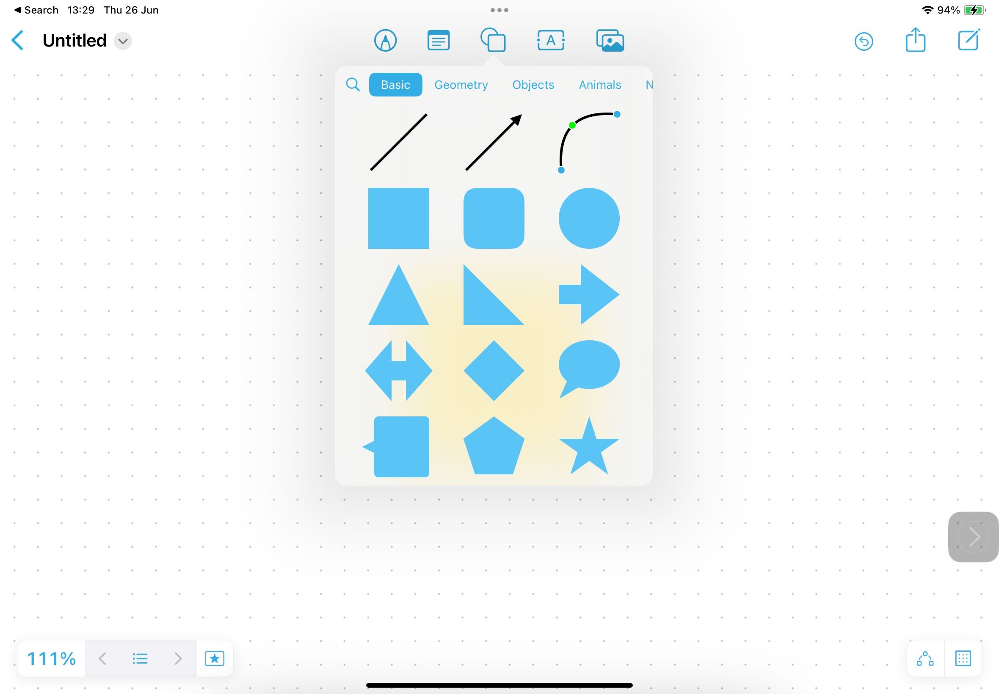
With this icon you can add different shapes. Swipe to see more shapes.

Slide 12
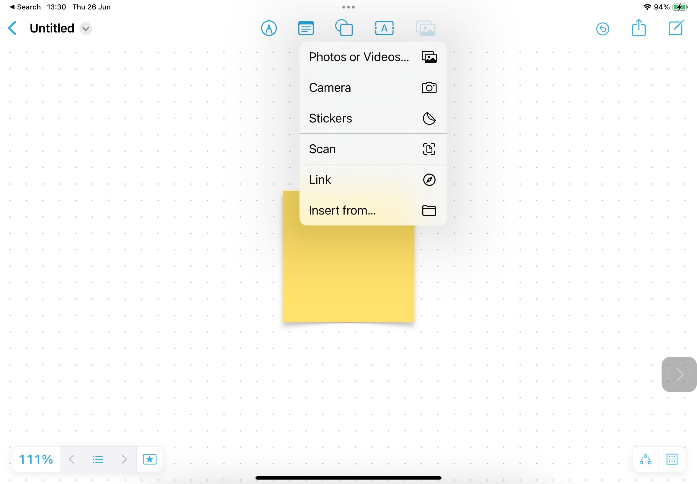
With this icon you can add lots of different types of media.
I have a nice picture of my dog saved on my iPad already. I might add that.

Slide 13
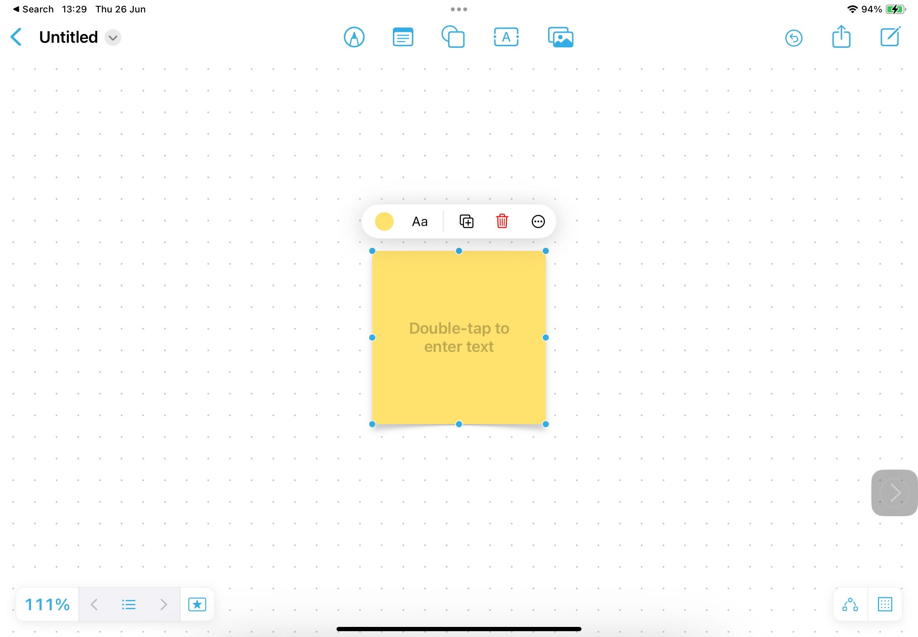
By tapping on an object once, you get a menu.
For Post-It Notes you can, for example-
Change the colour
Change the font
Duplicate it
Delete
Remember, you can type the text or use dictate!
Double tapping lets you add text.

Slide 14
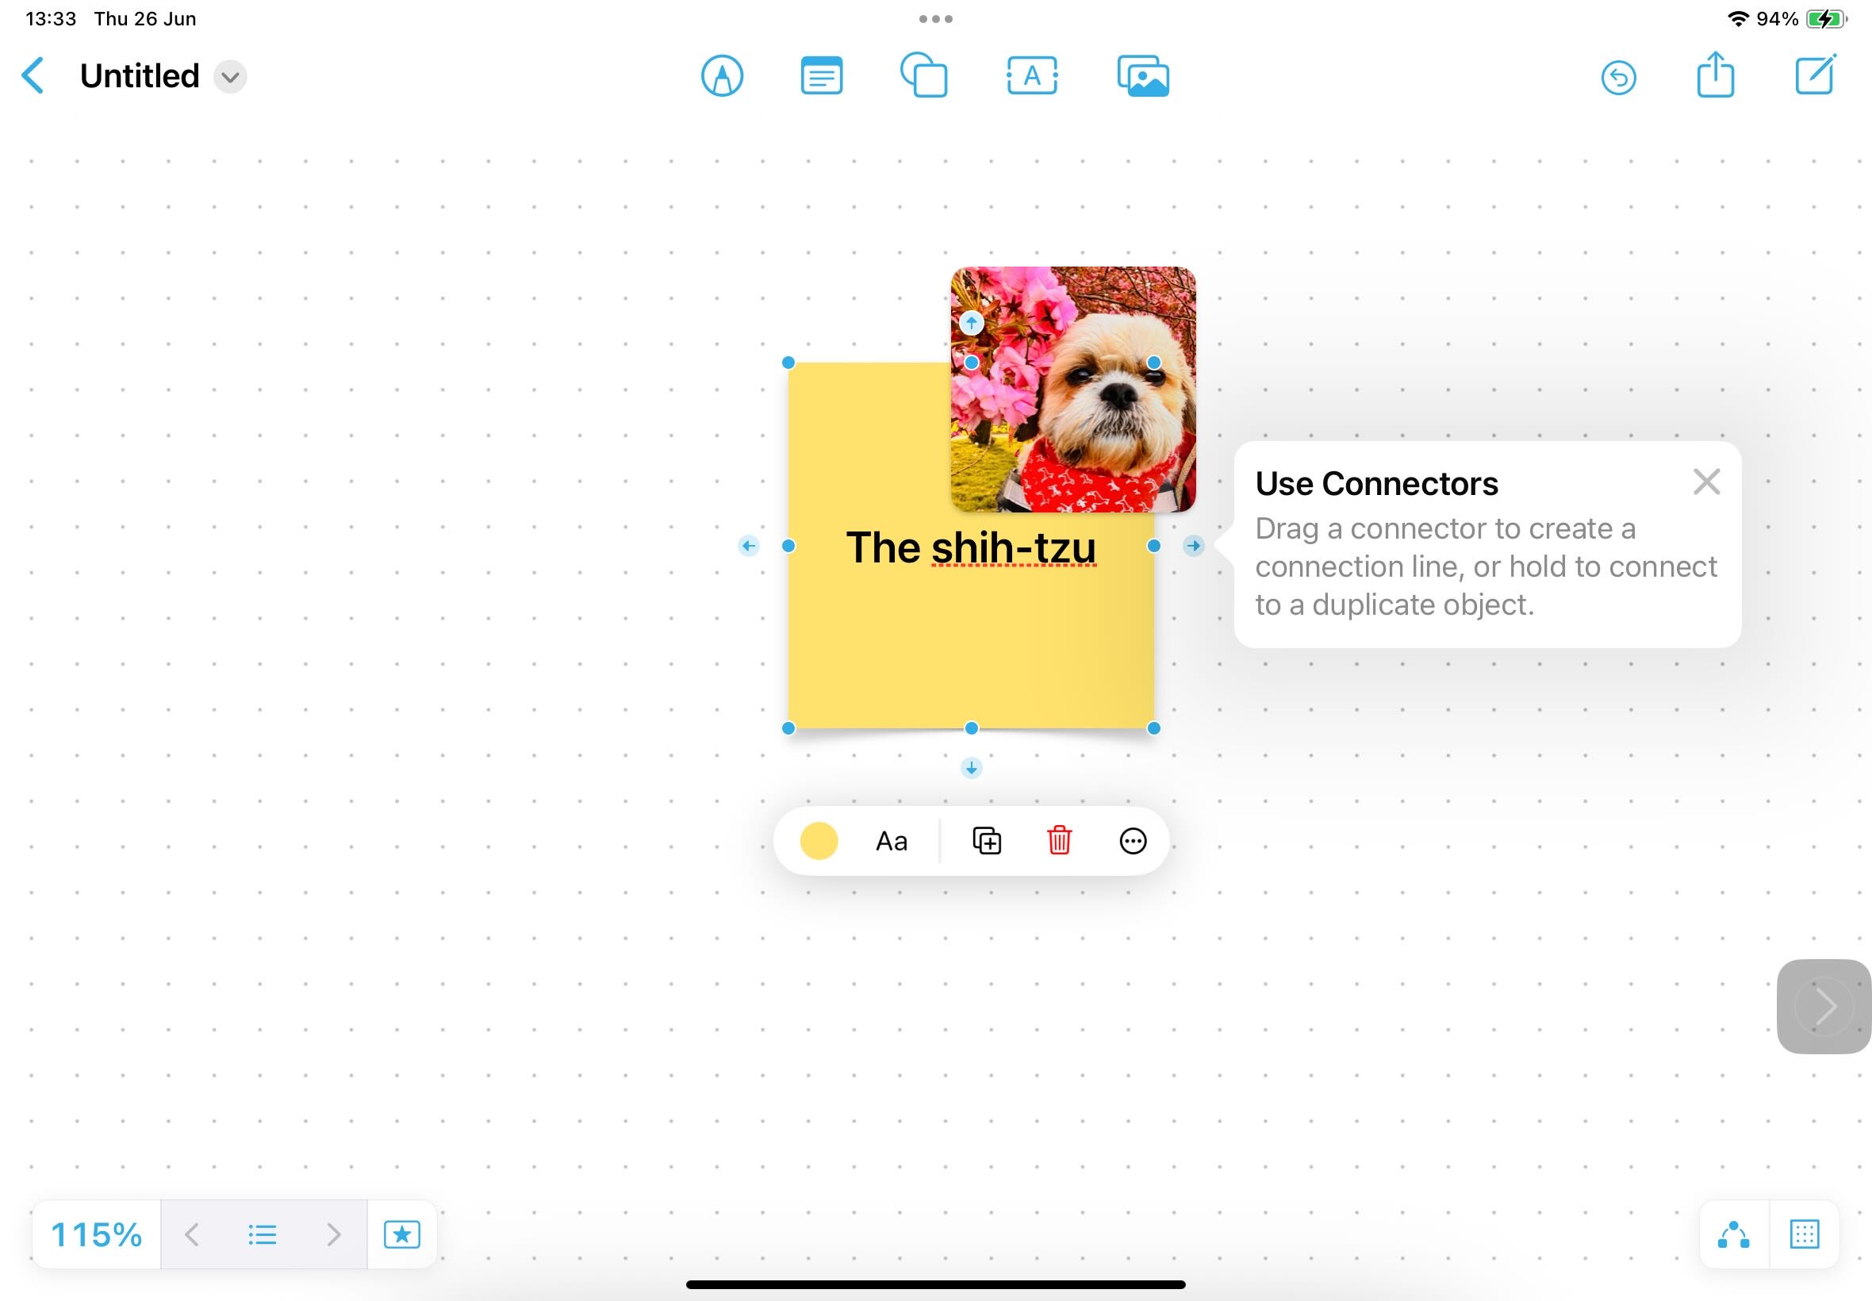
Here we go, a title (my iPad doesn’t like the spelling) and a picture.
I like to use connectors on my mind maps to join the boxes together. Turn them on here.

Slide 15
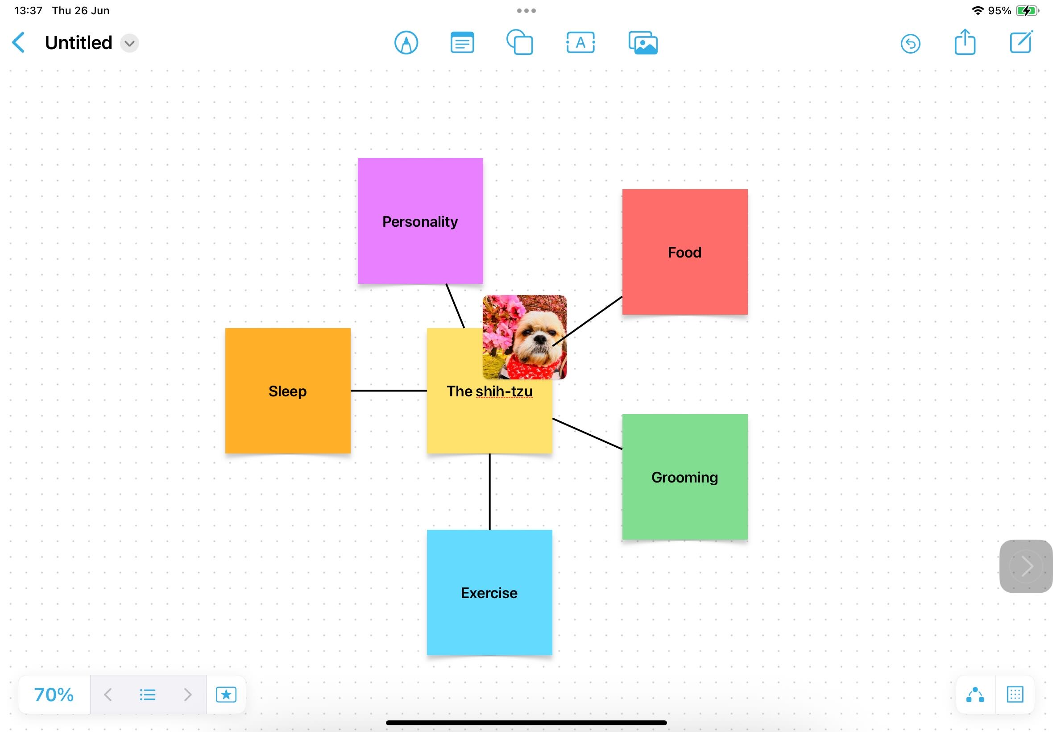
So now I’m thinking about all the things you need to know to look after a shih-tzu. I now add them all around my title.
Tap and hold one of the connector icons around the edge of your object to duplicate, or you can drag one to connect to another object.

Slide 16
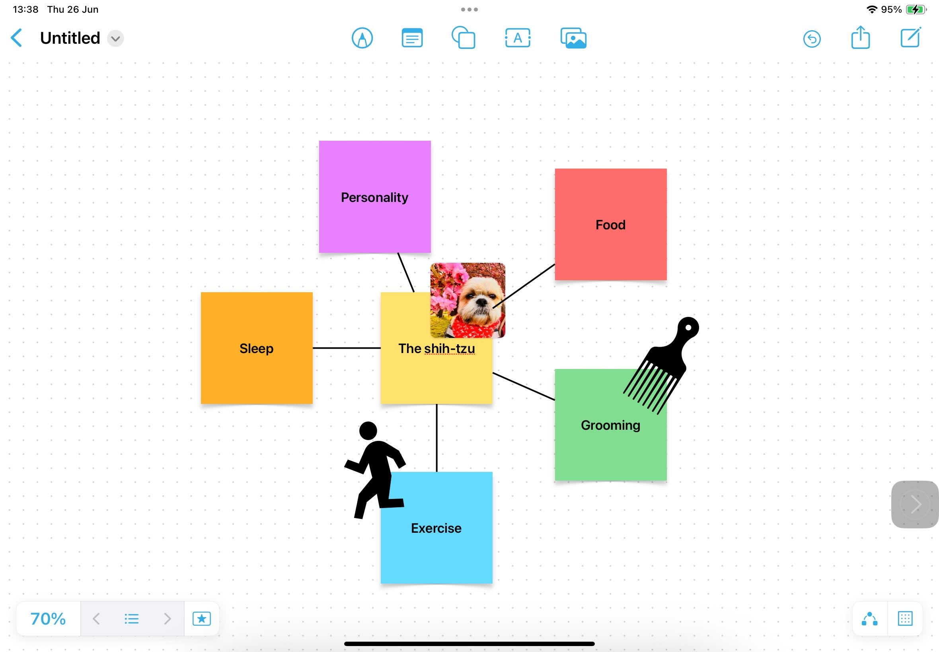
I’m going to add a few shapes to remind me what the new topics are.
Remember, you can use your screen reader and the pointy finger to read anything on the mind map…

Slide 17
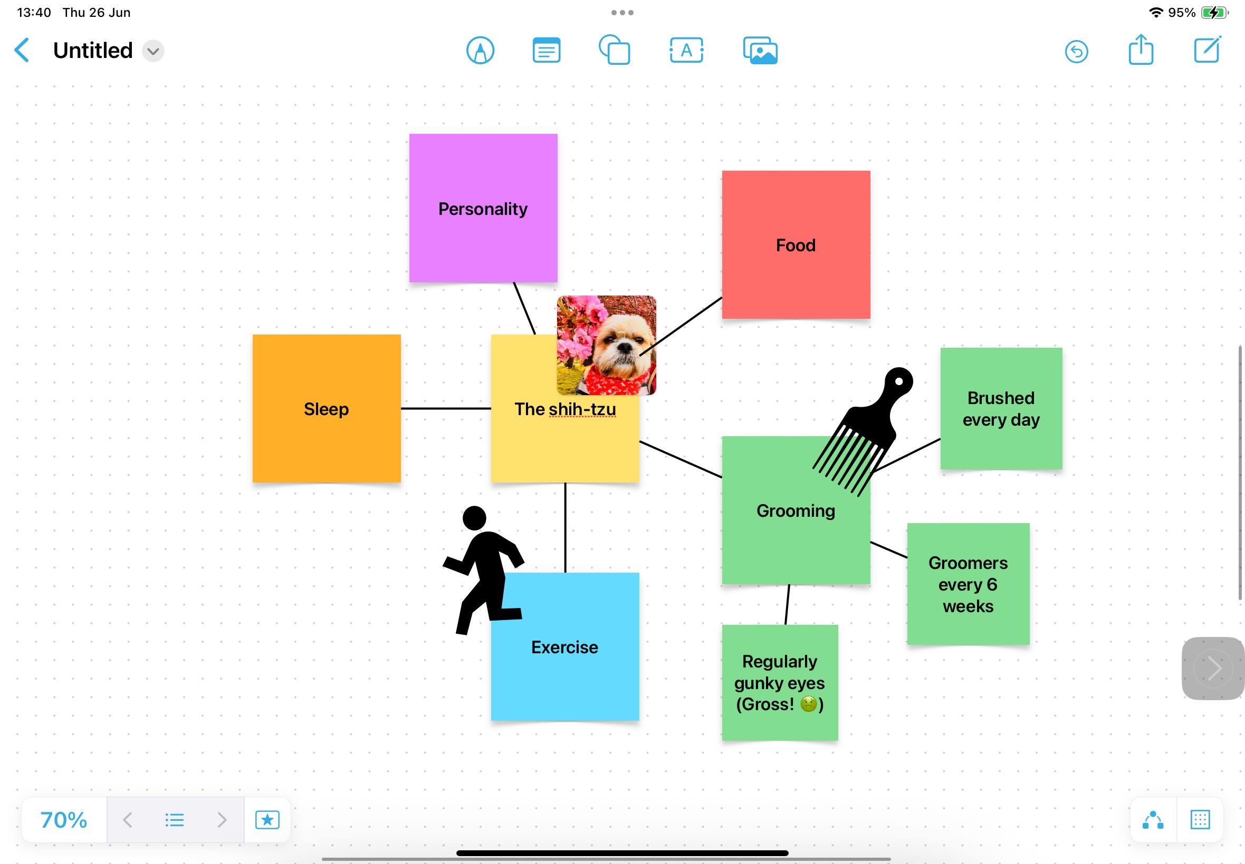
For each of the new Post-Its I need to think of all the things you need to know about that topic.
Don’t worry about running out of space… your board is an INFINITE canvas!

Slide 18
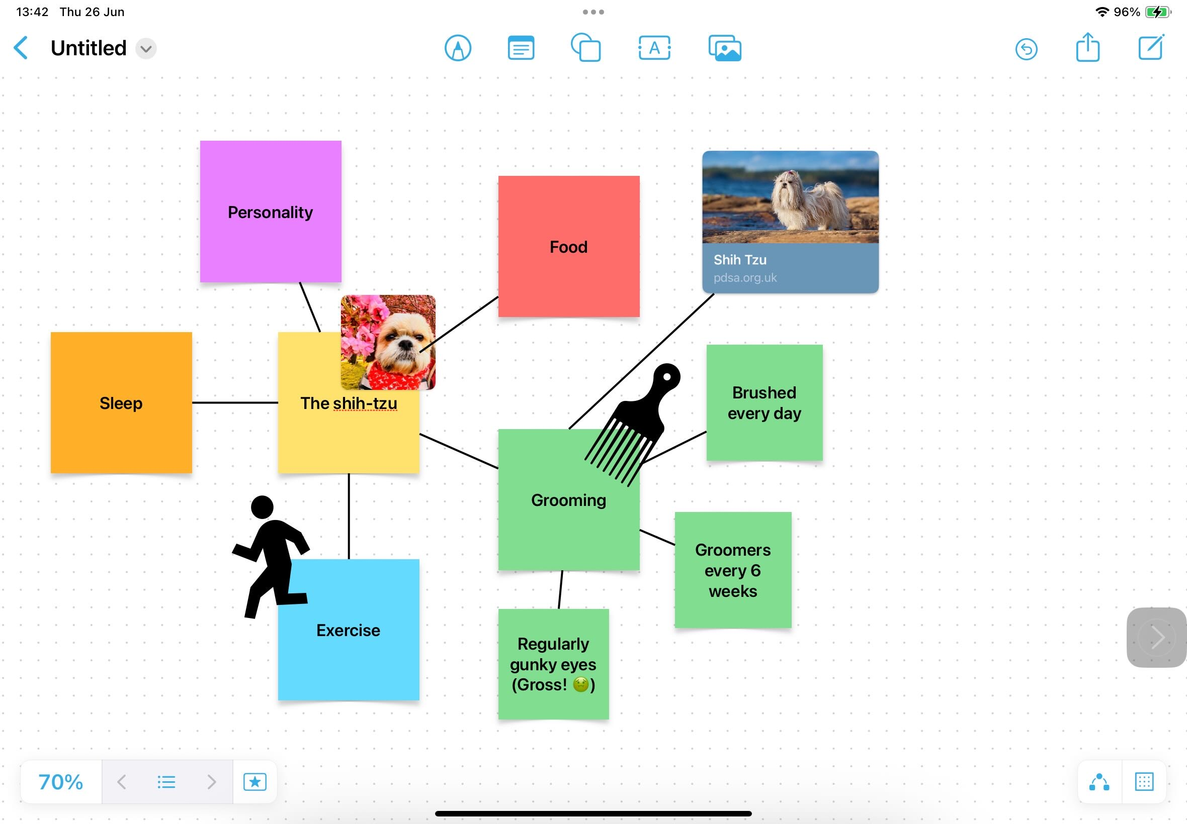
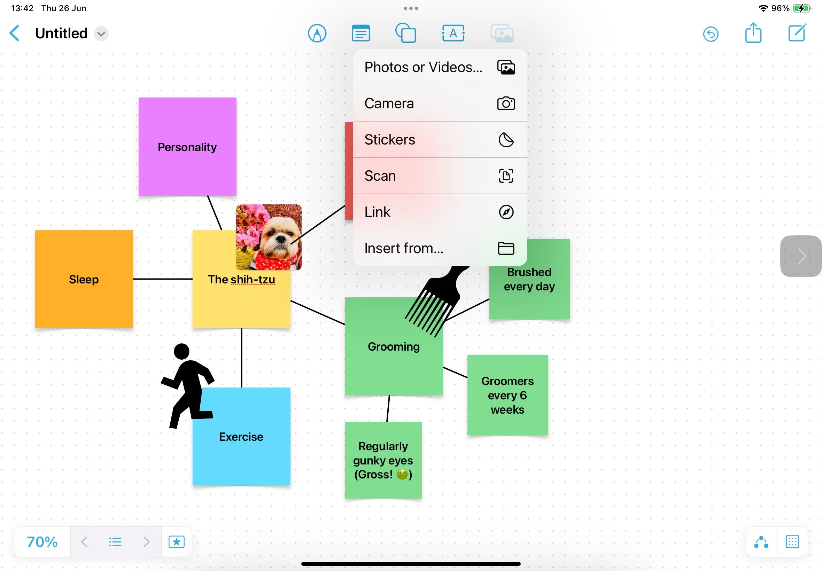
I remember I have a good website that tells you how to look after shih-tzus…
Tap the insert media button choose link and paste the URL… It even puts a little preview of the website on your mind-map!

Slide 19
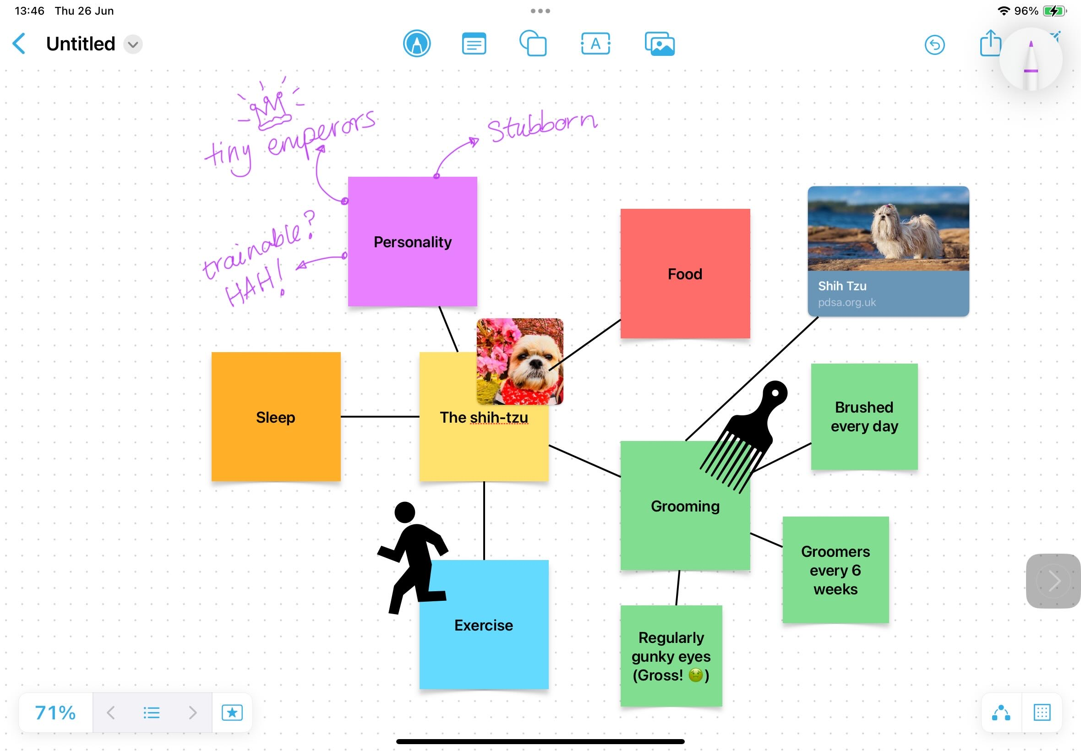
I used my Apple Pencil to add notes about personality.
What can I say? I like to doodle!
Top Tip!
Your screen reader can read your handwriting too… if it’s neat enough!

Slide 20
Calendar

Slide 21
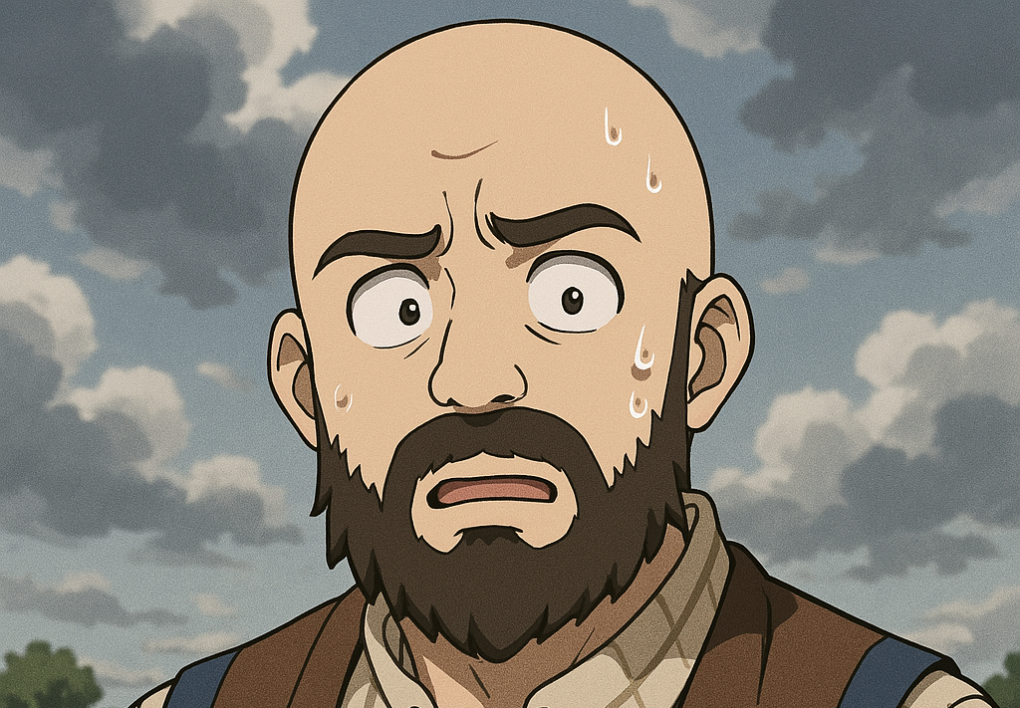
Water the plants!
After school club!
Homework!
As we get older, we have to get good at remembering lots of things!
Dentist!
Feed the cat!
Dinner duty!
Buy carrots!
Luckily, our iPads have lots of tools to help us organise these things so we don’t have to!

Slide 22

Calendar
Find your calendar app.
What do you notice about your calendar app, that’s different to the one on my iPad here?

Slide 23
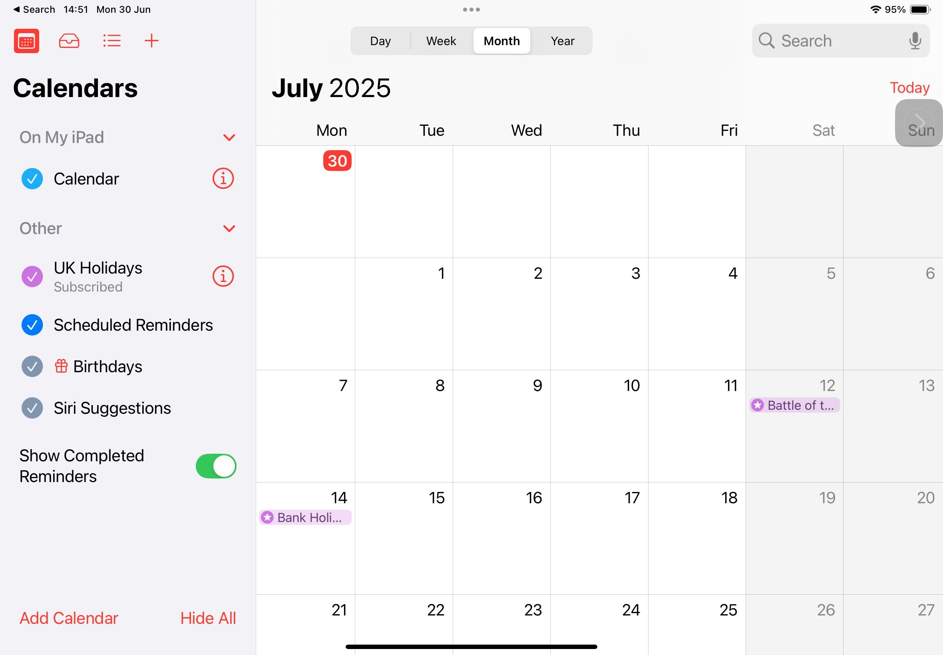
When you open the Calendar it may already have some things in it. Apple adds some events for you, like Christmas or bank holidays.
Today will be marked in red.

Slide 24
You can create a new event up here.
Lets do that now!
You can view a day, week, month or even the whole year!
You can search for events here.
Wherever you are in the calendar, Today jumps you back to today.

Slide 25
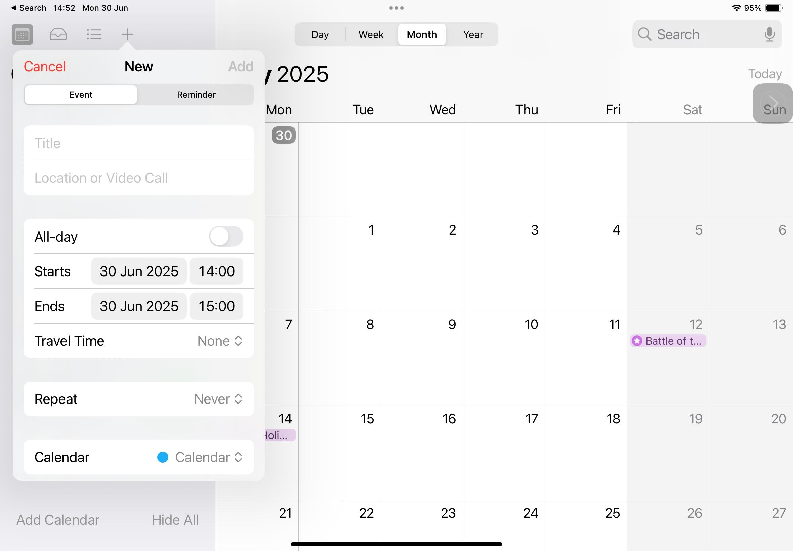
A pop up box appears.
You can add the details of the event here.
You don’t have to fill in all the boxes, but make sure you add a title,
date and time at the very least!
The Repeat button is good if the event happens more than once.

Slide 26
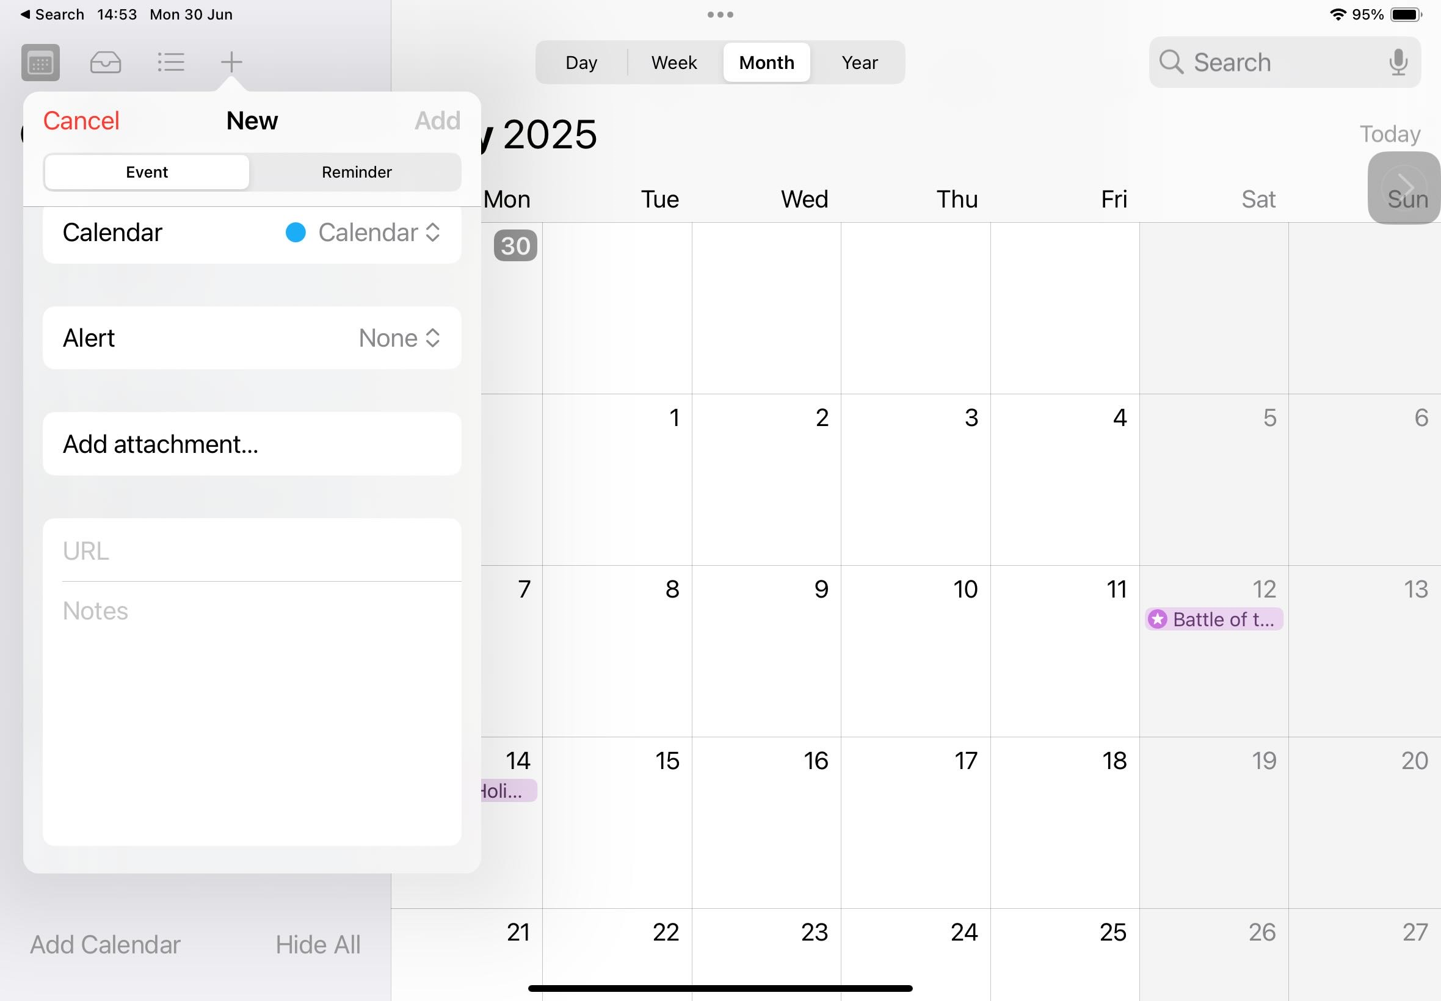
If you scroll down in this box, you will find Alert.
You can use this to set a reminder before the event!
When you’ve added all your details, tap Add in the top right!

Slide 27
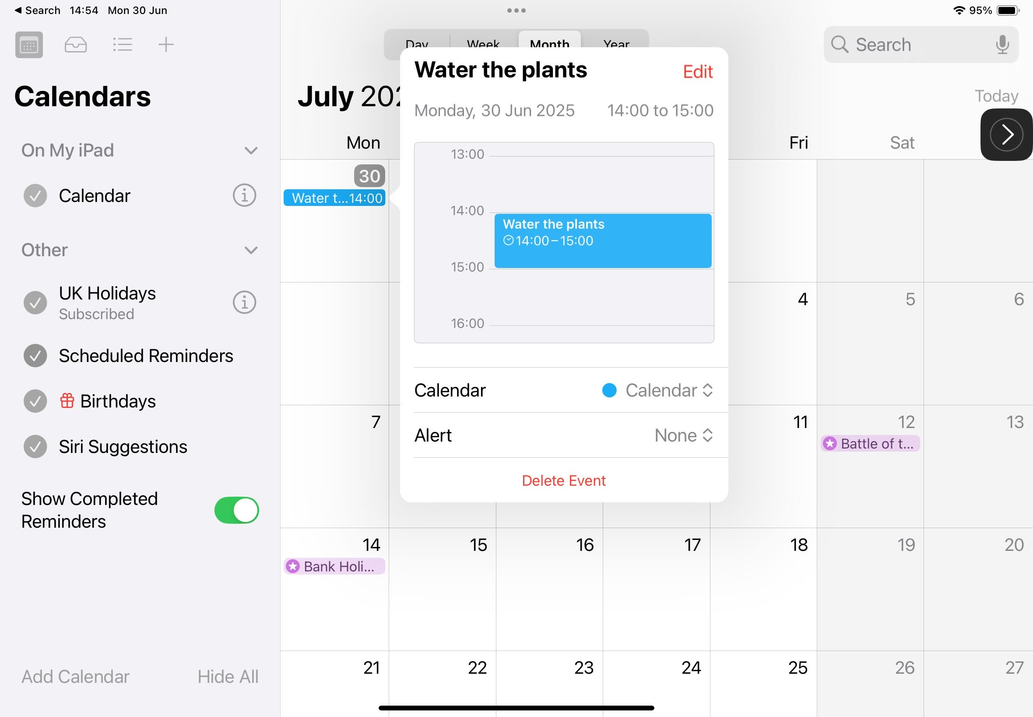
Over to you!
Add your birthday to the calendar, making sure you choose to repeat it every year!
What else would be good to add?
School holidays?
After school clubs?
Your friend’s birthday?
Homework due day...?
The event will now be in your calendar. You can tap on it to see more details or edit it!

Slide 28
Reminders

Slide 29
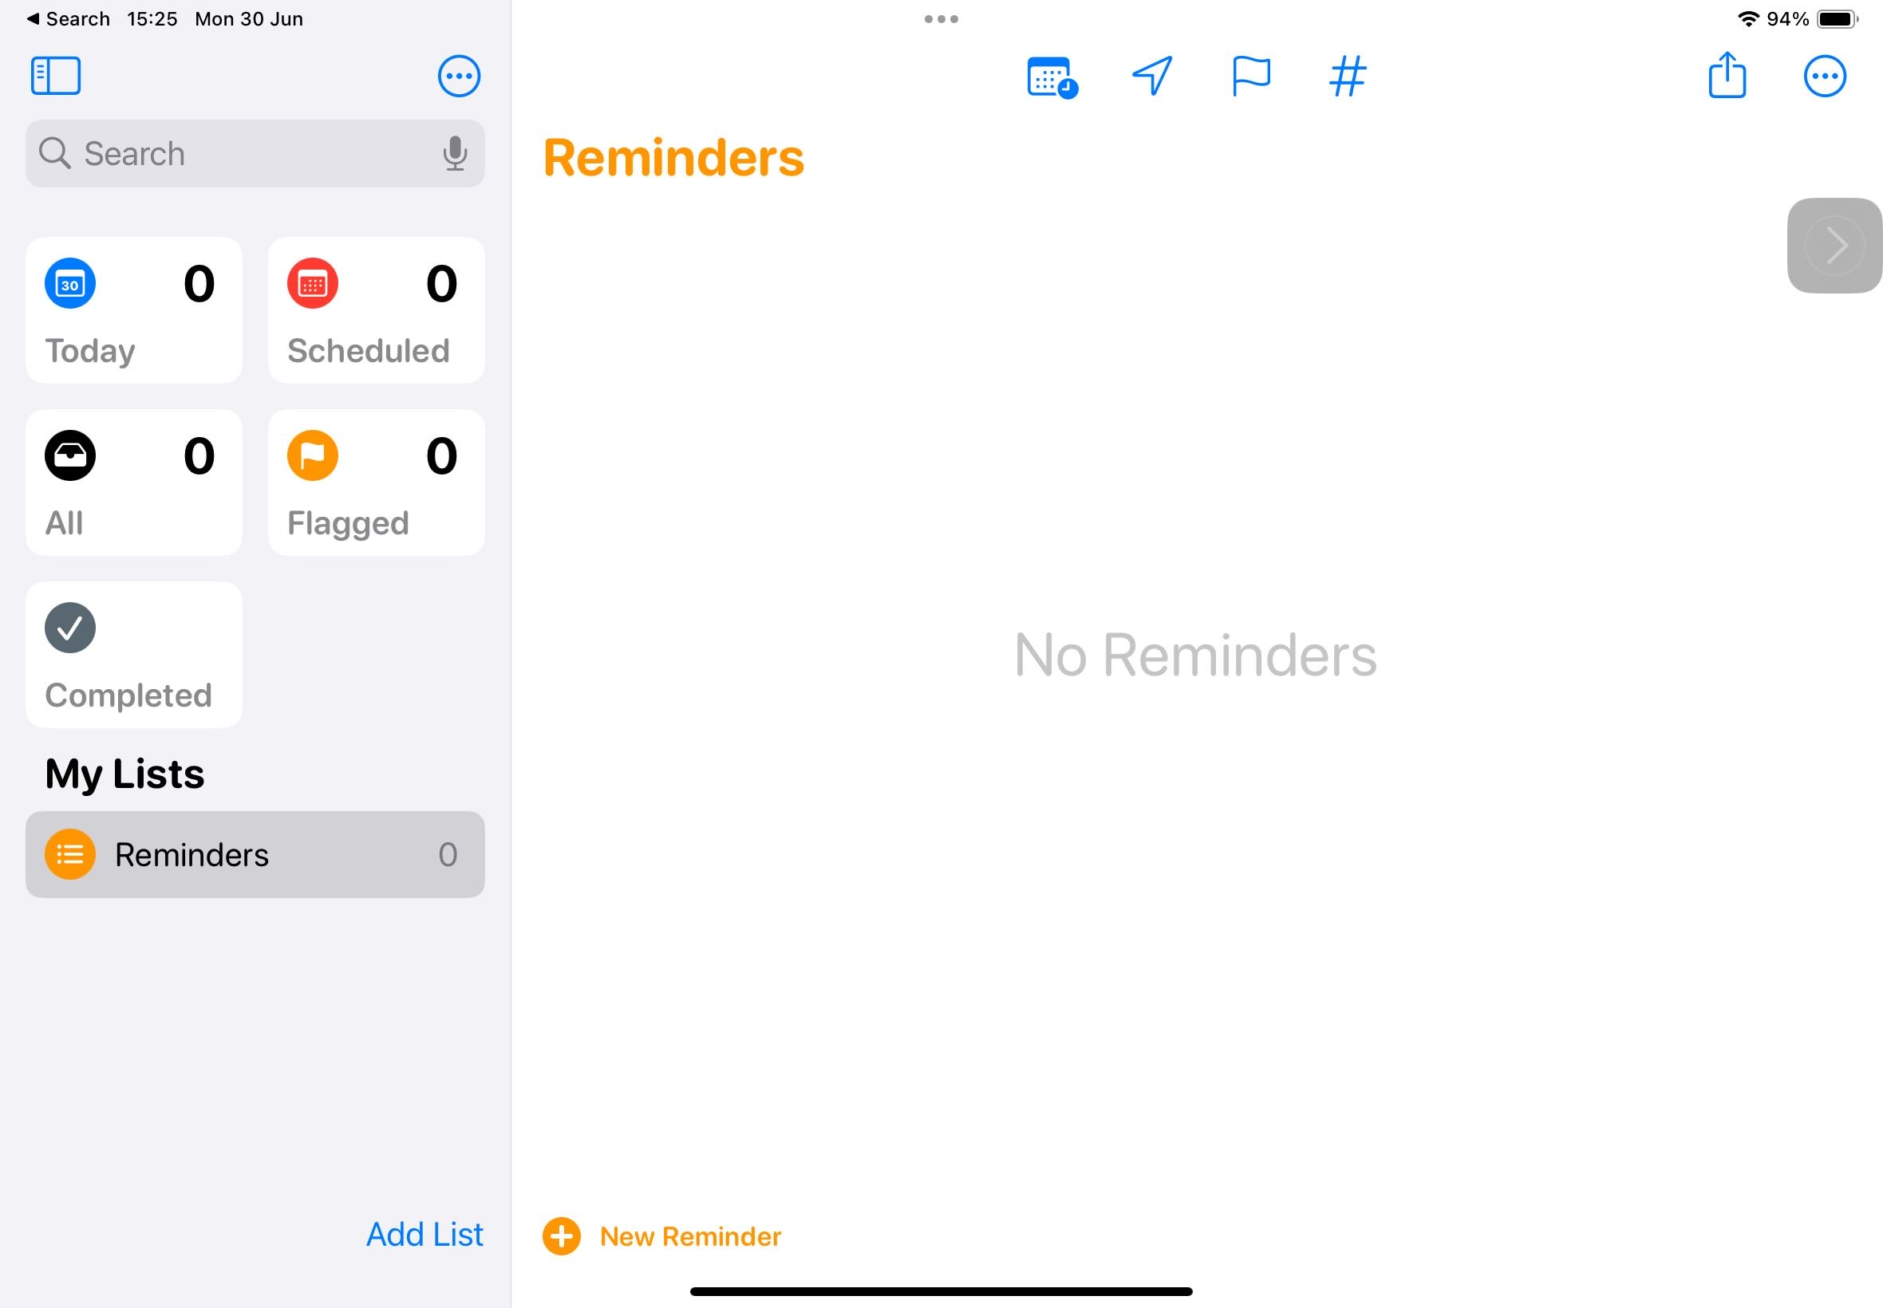
Your Reminders are organised in Lists.
To begin with you may just want to add reminders into the default List called Reminders.
That’s handy!
To add a Reminder, tap here.

Slide 30
Sometimes you may have a lot of reminders about one thing… for example homework!
So, you may want to add a new List.

Slide 31
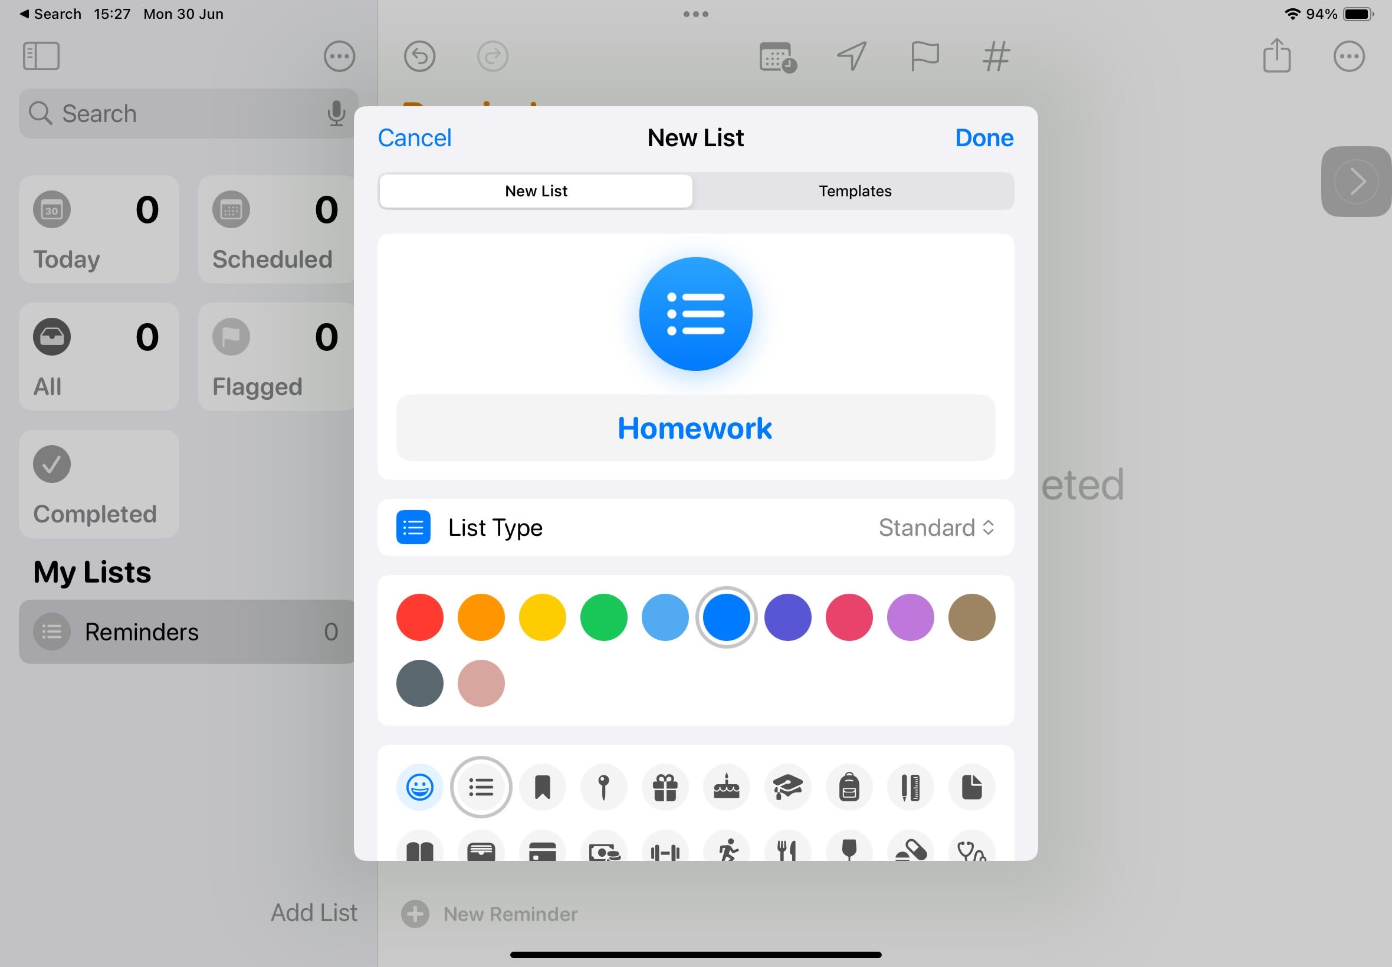
Give it a name, a colour and icon… and then tap Done.
Feel free to play around with the buttons in here. Remember, your screen reader finger will help you read anything that is tricky!

Slide 32

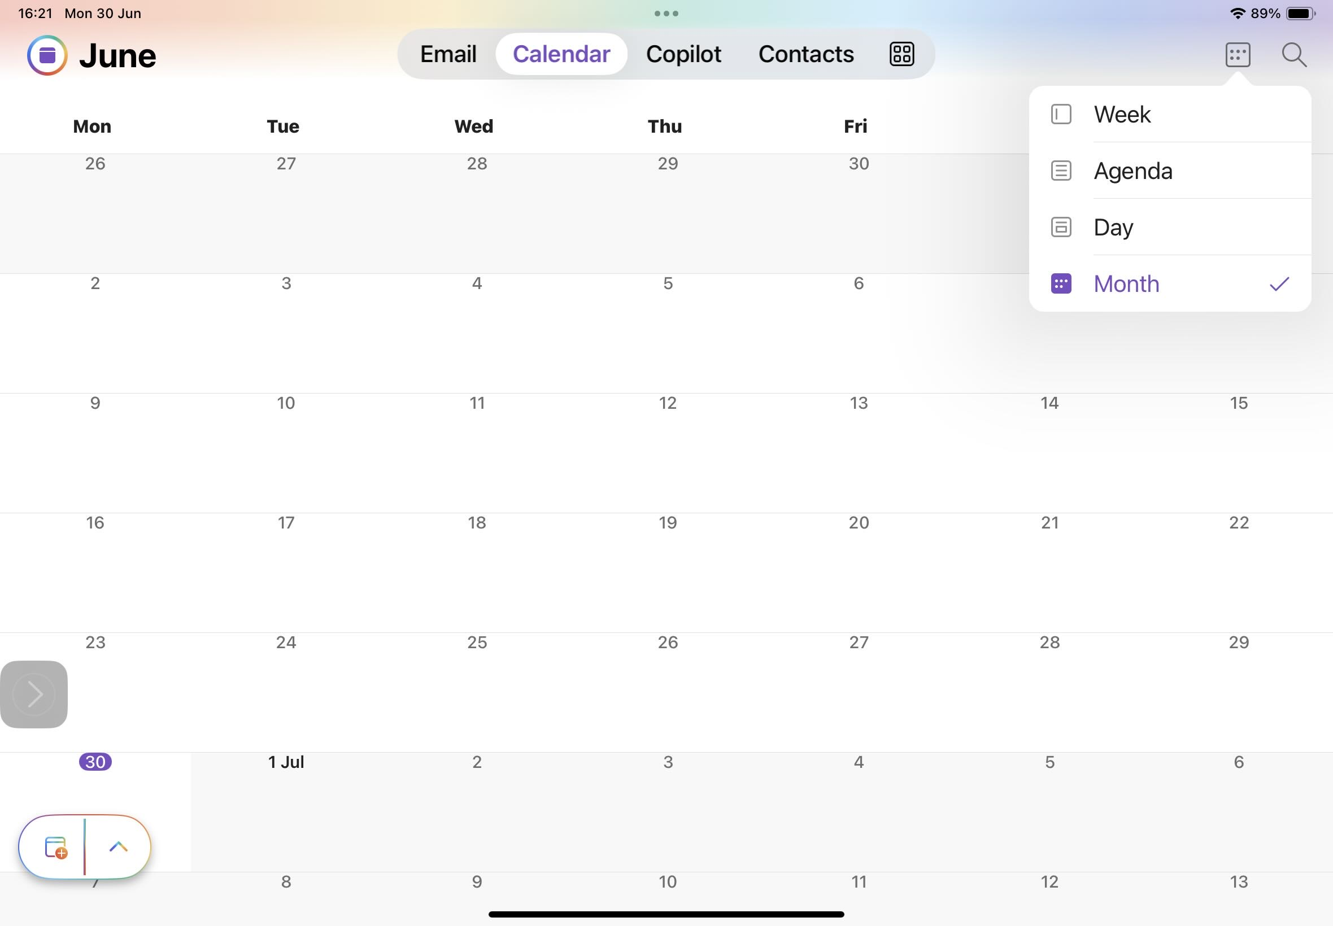

You also have a calendar in Outlook (log in using your Glow login)…
…and To Do is the Microsoft version of Reminders.

Slide 33
Widgets

Slide 34
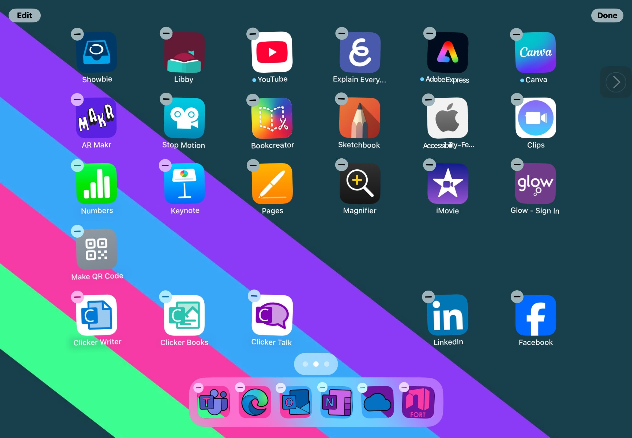
Widgets are a great way to help get organised.
They give you a wee preview window into apps so you can see what’s coming up without having to open the app!
To get started tap and hold on an app or an empty bit of screen until they start jiggling.
Now tap Edit…

Slide 35
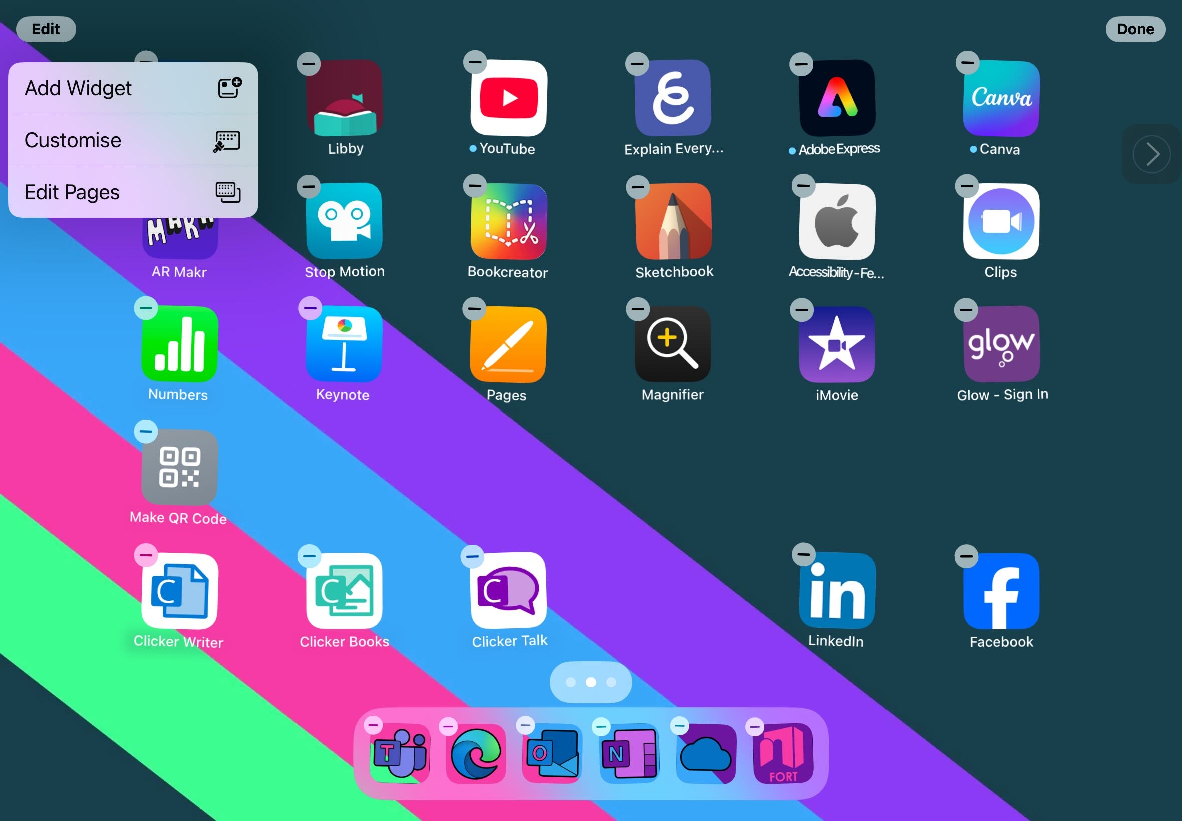
Choose Add Widget.

Slide 36
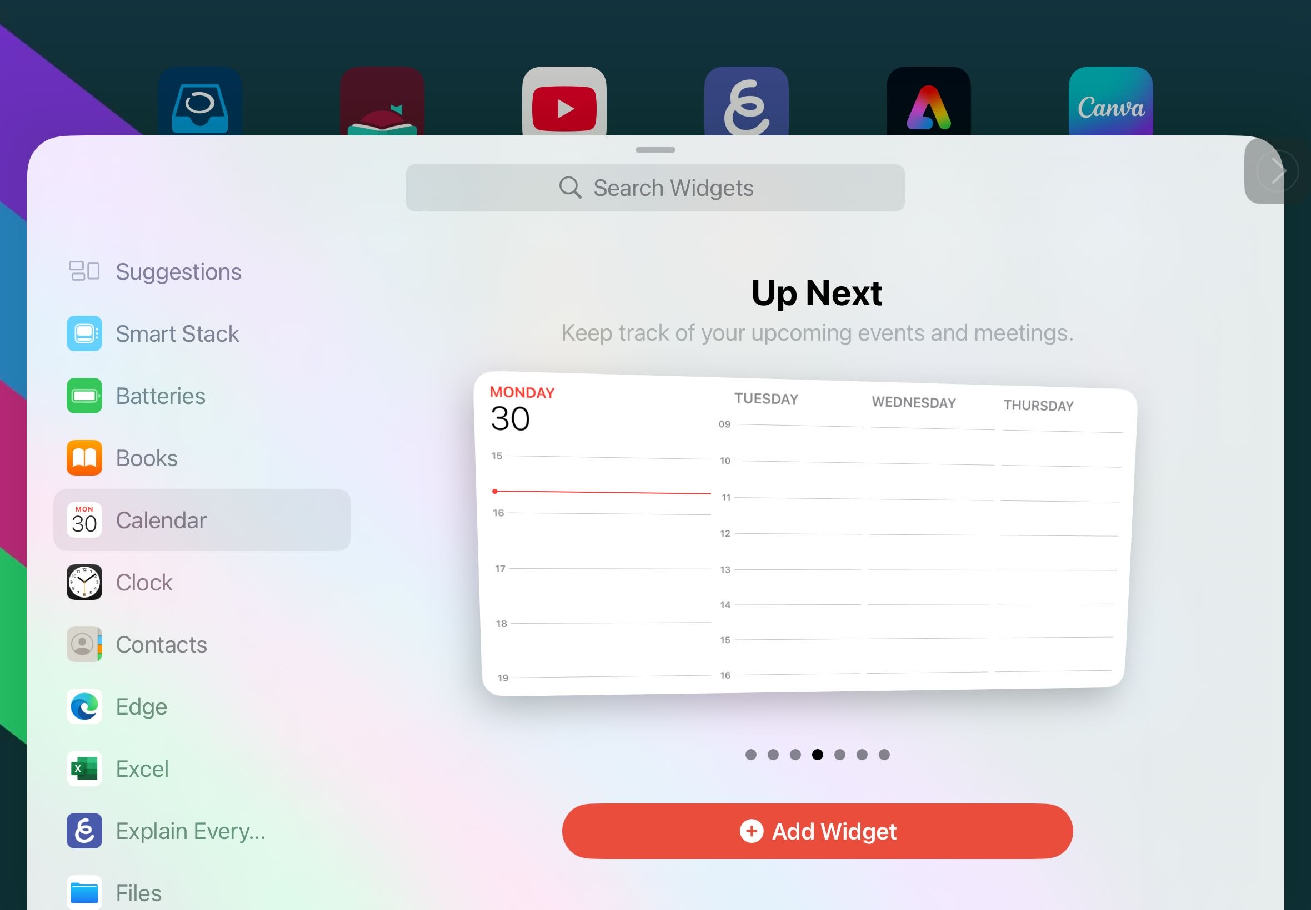
Lets look at the Calendar Widgets.
Scroll down on the left-hand side to find Calendar.
By swiping here, you can see all of the different Calendar Widgets.
When you find one you would like, Tap Add Widget.

Slide 37
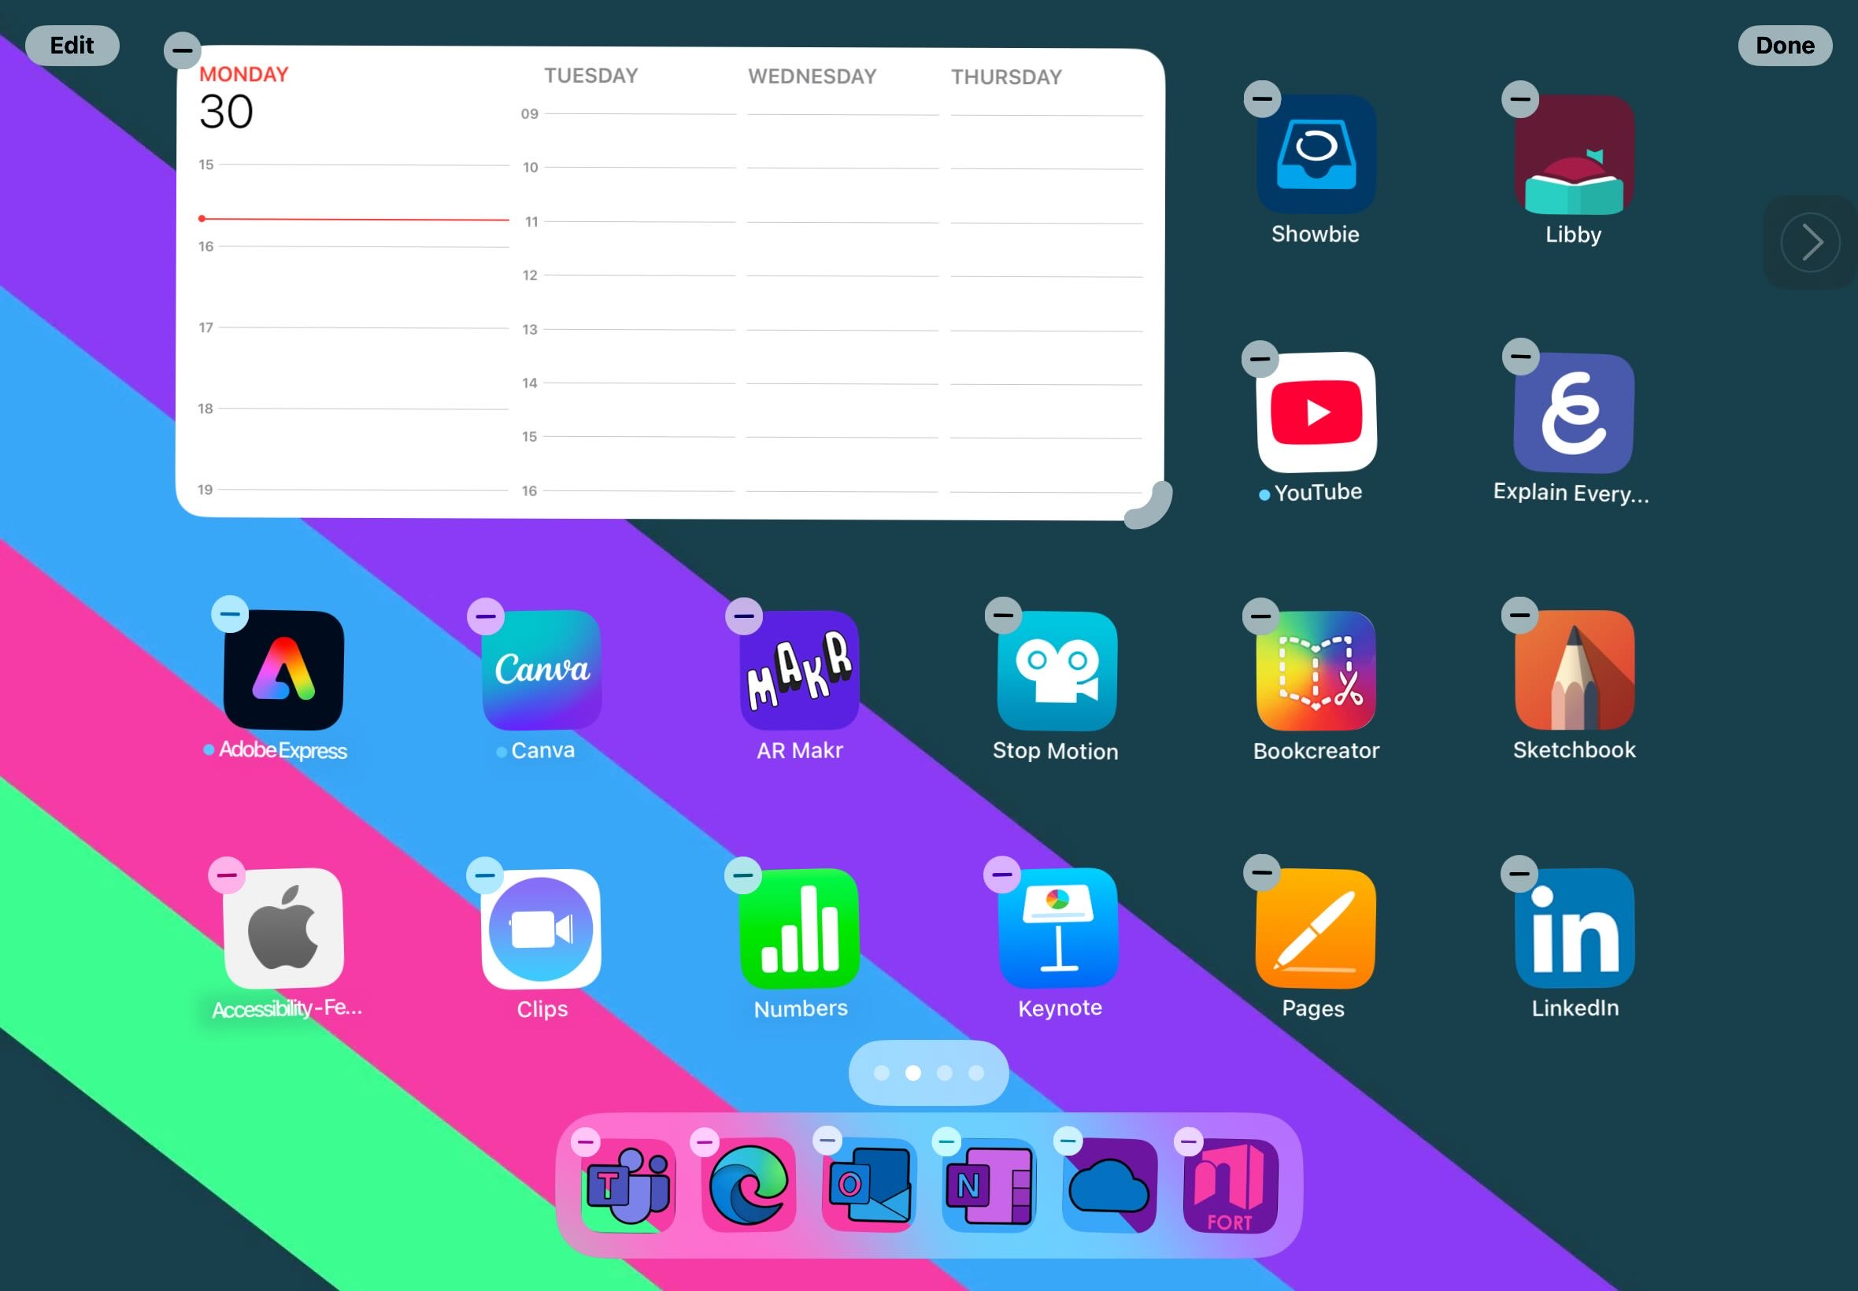
Then your Widget just sits on your home screen like an app does, but it gives you a preview of what’s in the app.
In the case of the Calendar, it’ll show you what’s coming up.
What other widgets do you think will be useful?

Slide 38
What did we cover?
Tools to help me plan and organise.
-Mind Maps
-Calendar
-Reminders
-Widgets

Slide 39
This series of lessons was created by the Fife ATSS Team and is based on lessons created by Ms Linsey Miller (Sacred Heart Primary School ASC, Falkirk, linsey.miller@education.falkirk.sch.uk) and research carried out by Mrs Nicola Denholm (Larbert Village Primary School, Falkirk).
All content is protected by copyright. You may use the contents of these lessons and adjust them to suit your own context and practise; however you are strictly prohibited from reselling this series of lessons or any derivative created from it, either in part or in its entirety.

