Slide 1
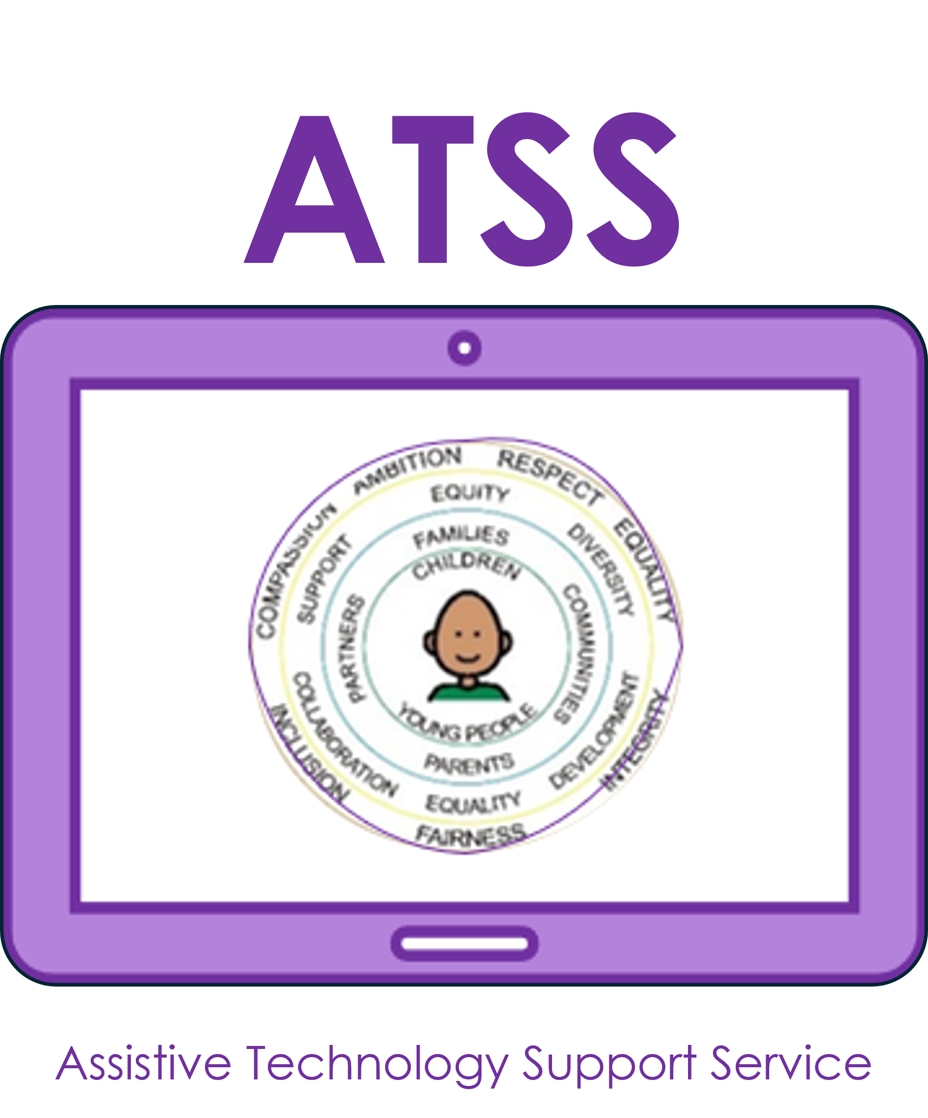
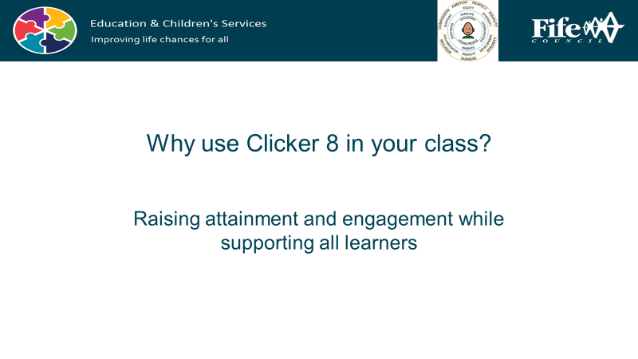

Accessibility tools are built into the iPad, and whilst they are essential for learners with additional support needs, they can be useful for every single child in your class… and you as well!
The following unit contains lessons to use with your whole class, that support creating text.
You may find that it is particularly useful for any learners who, for example, struggle with aspects of writing, such as a physical disability, or a print disability such as dyslexia.

Slide 2
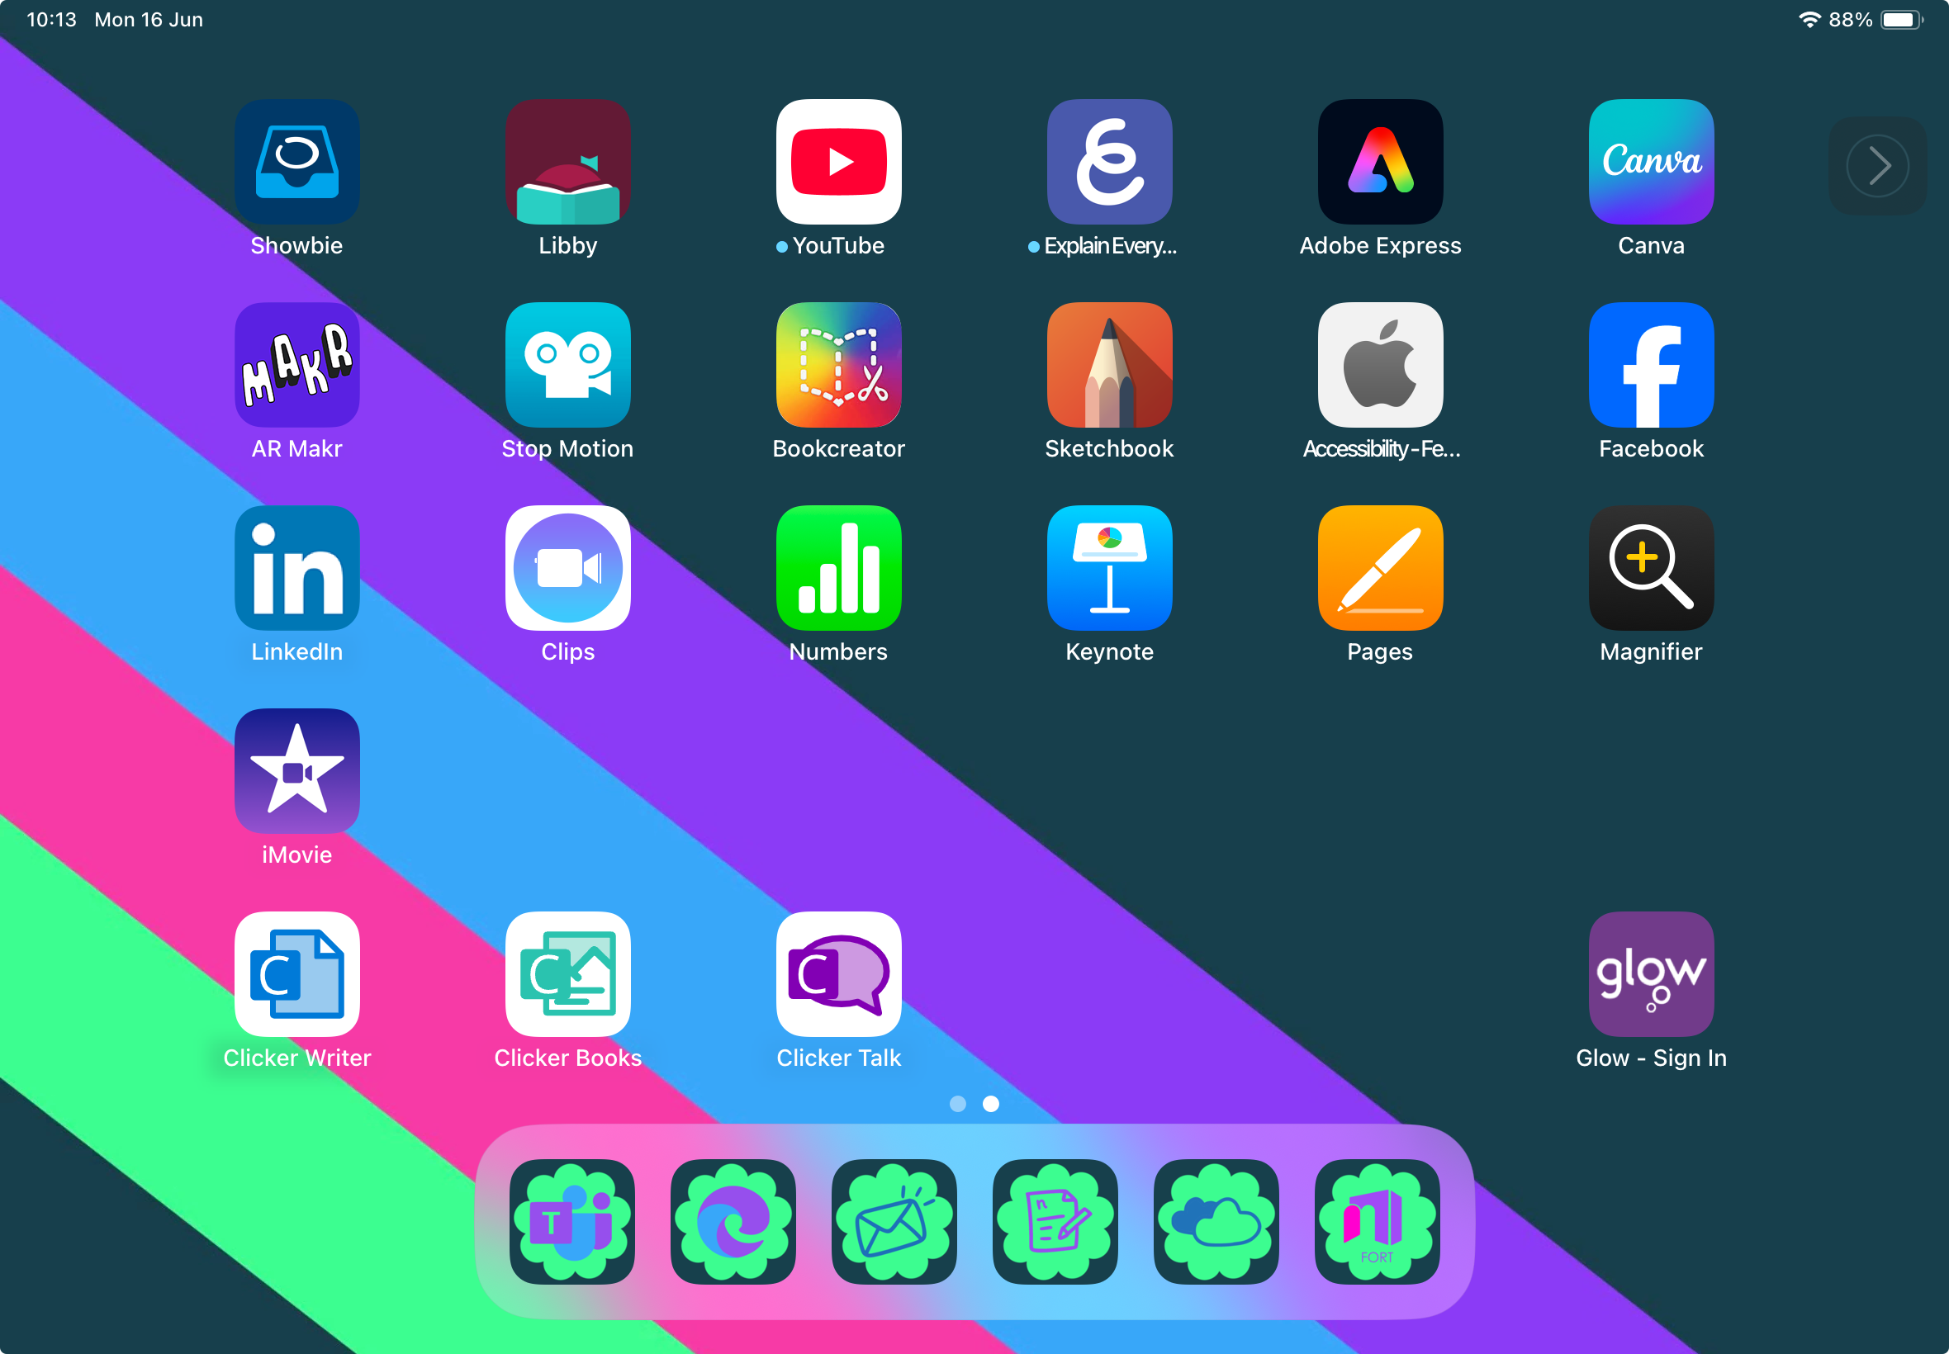
Accessibility is for Everyone
Unit 2: Creating Text
I can…
…use predictive text
…use spellcheck and autocorrect
…use speech to text
…add languages to the keyboard
…use Voice Memos and Transcribe
…access Touch Typing practice*
Notes:
*You may not wish to cover touch typing, but it is worthwhile remembering that some people prefer physical keyboard and if that’s the case, should practise keyboard skills.

Slide 3
Predictive Text

Slide 4
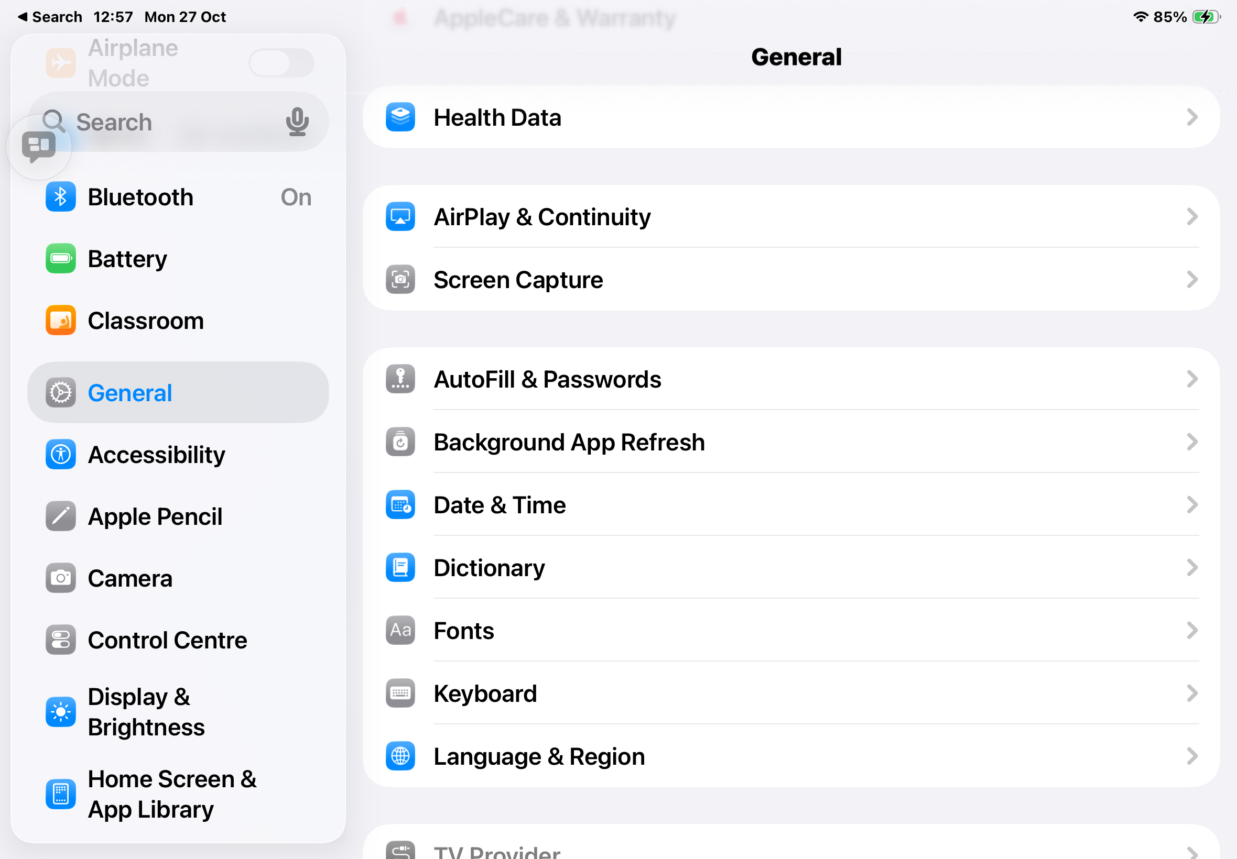

Predictive Text options are usually switched on as a default, but if they are not, head to
Settings
⬇️
General
⬇️
Keyboard
⬇️
Toggle on Predictive Text

Slide 5
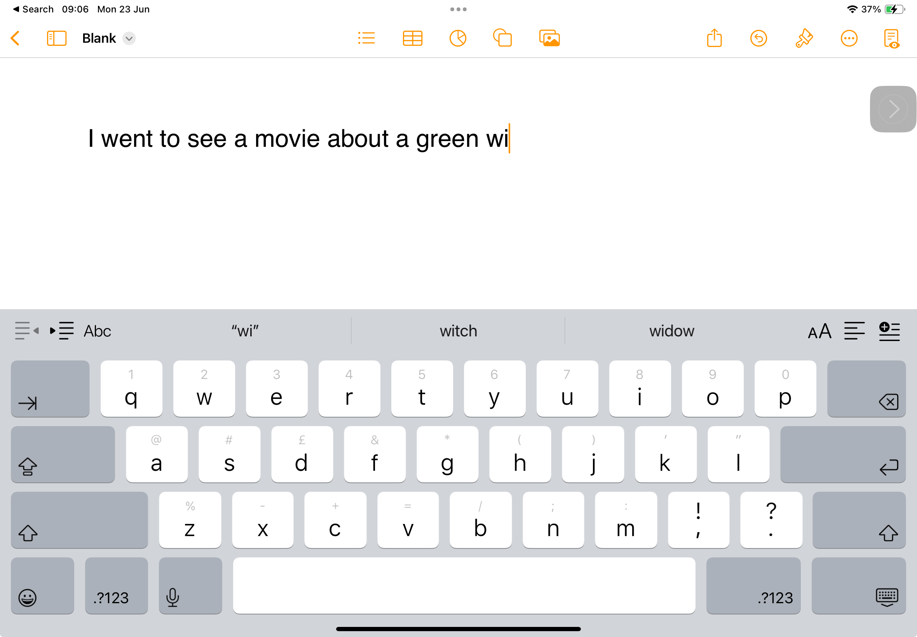

As you type, suggestions for your next word appear along the top of the keyboard.
The more you use your iPad the better the suggestions get.
The predictor appears whenever you type, in every app!

Slide 6
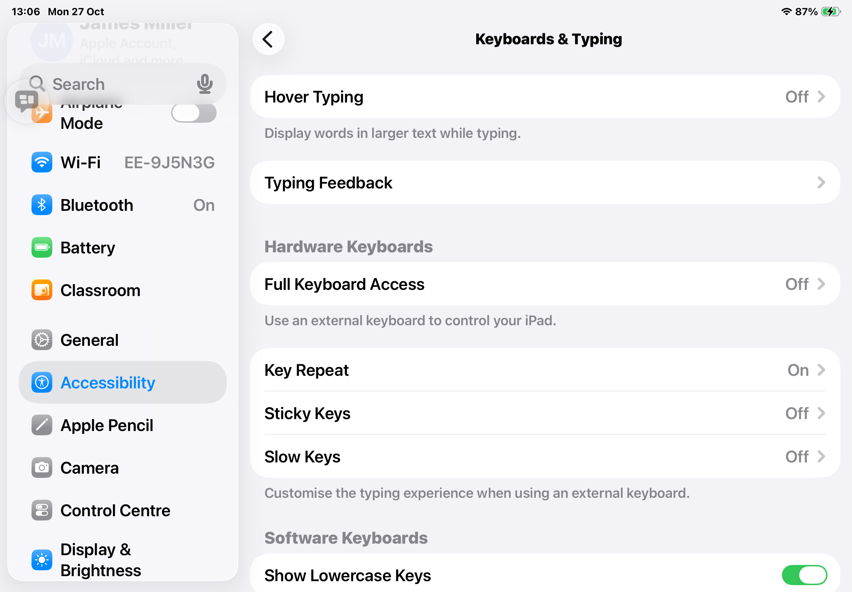

Typing Feedback
Step 1:
Tap on the Settings icon on your iPad.
Step 2:
Tap Accessibility
Step 3:
Choose Keyboards & Typing
Step 4
Choose Typing Feedback

Slide 7
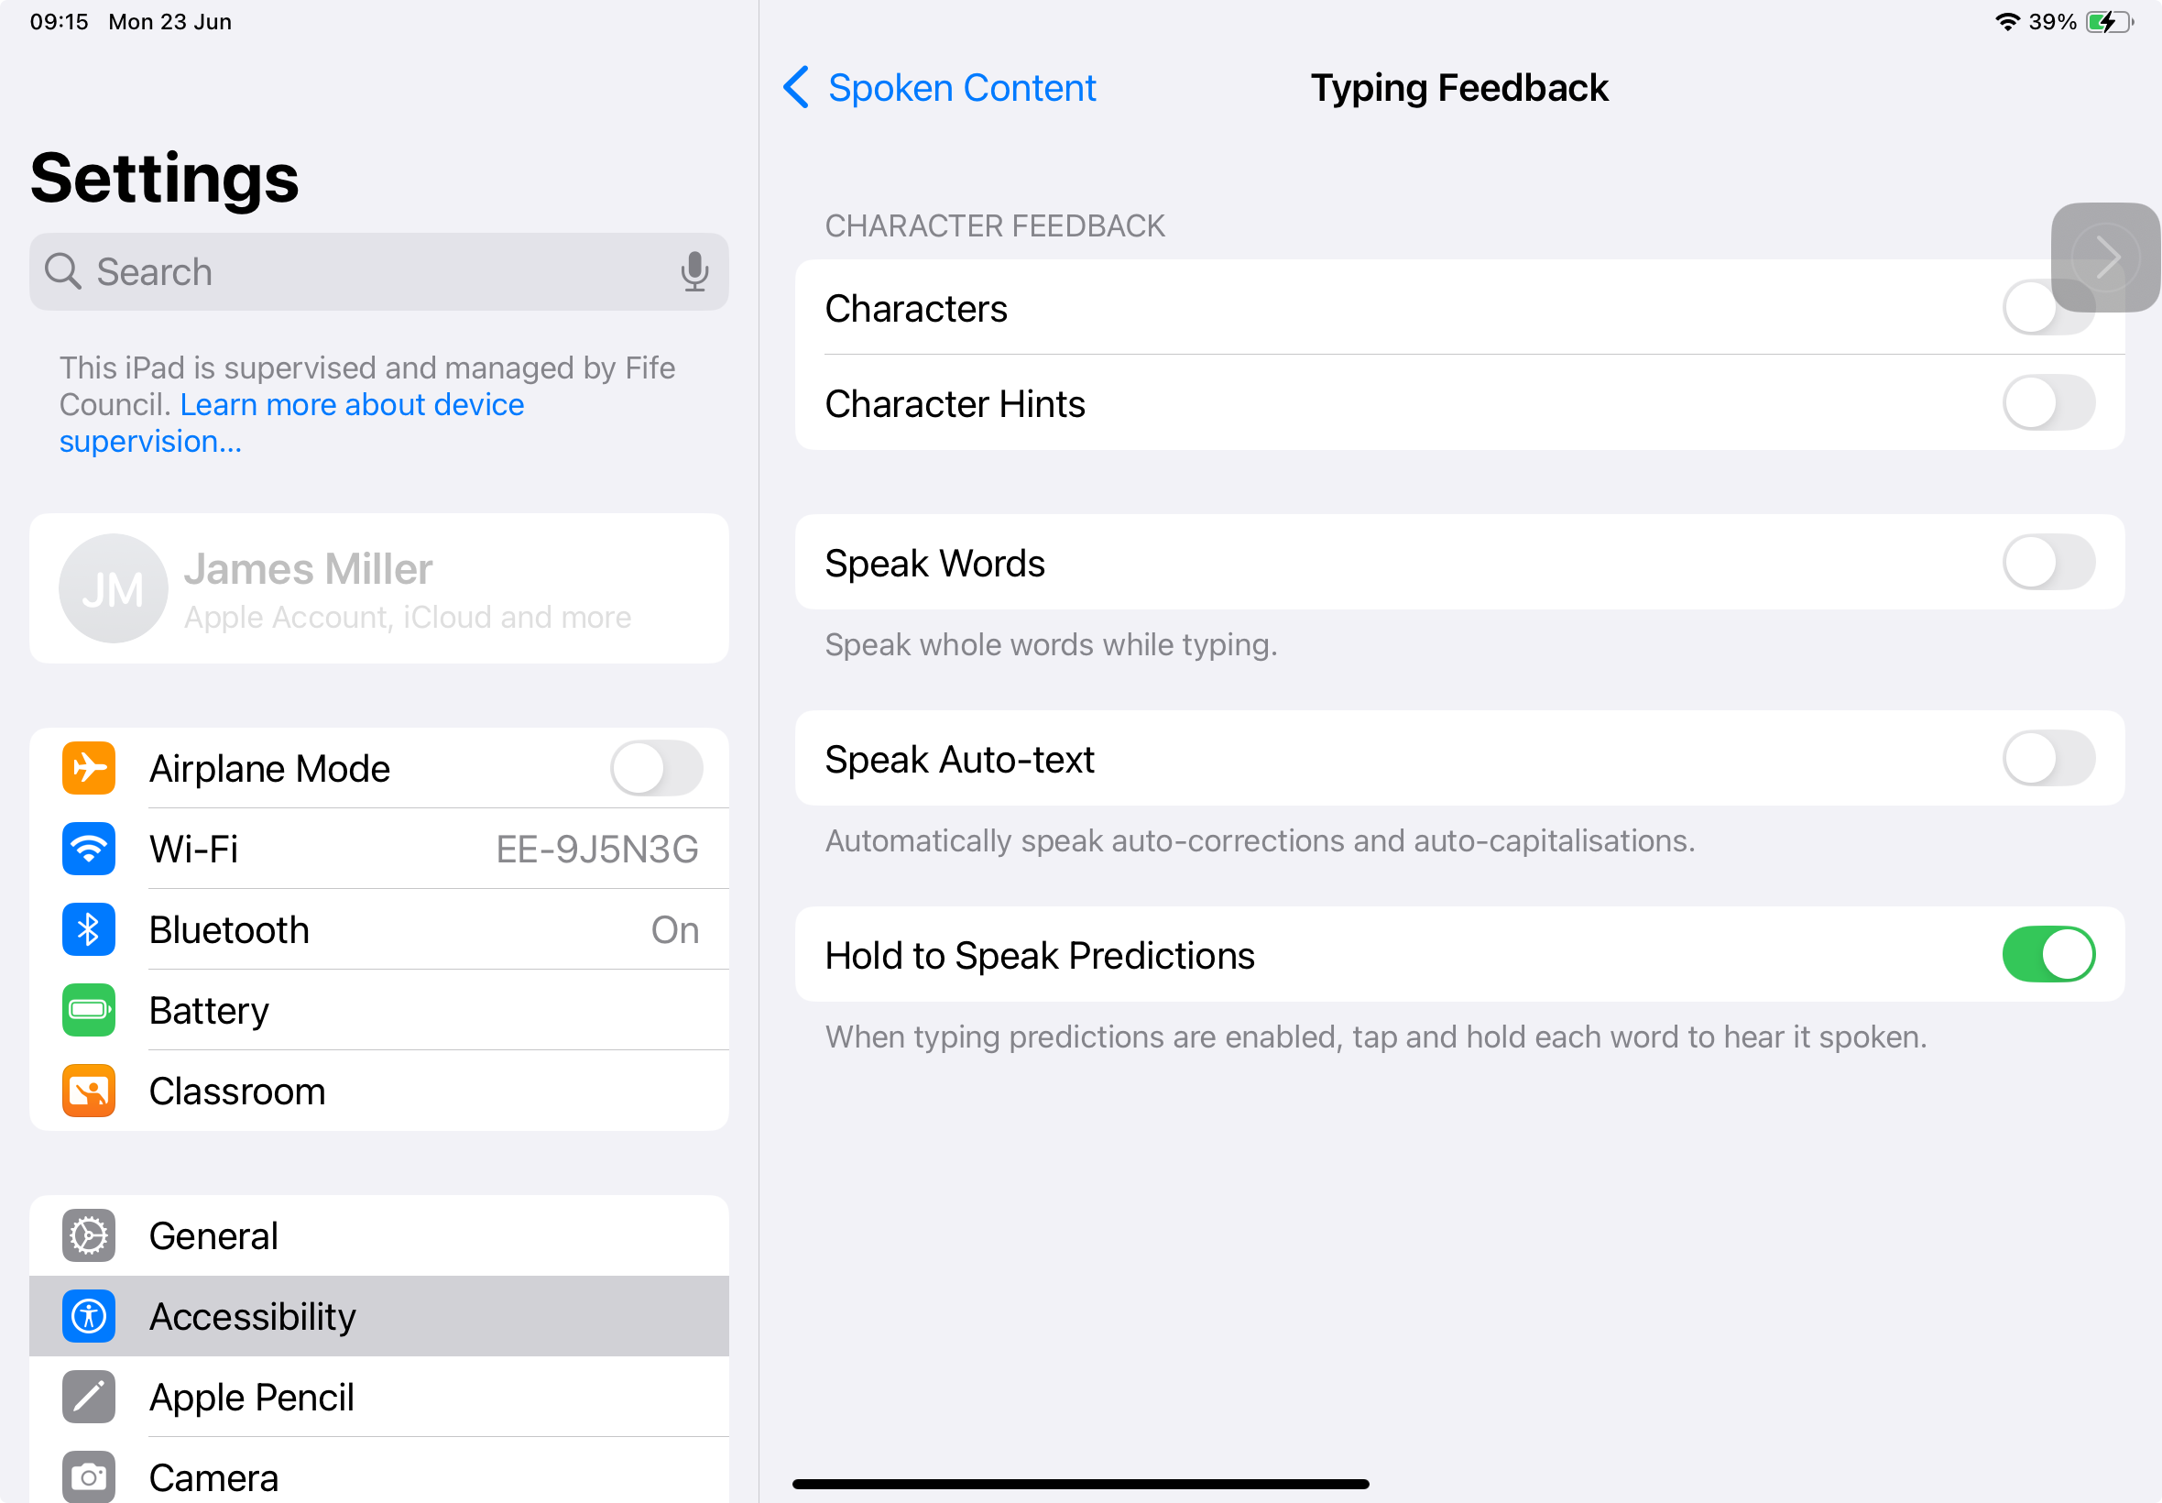


Toggle on Hold to Speak Predictions
Now in the Predictor, if you tap and hold the prediction, it will read it out loud to you. Just make sure you have chosen the right word!
If you choose Speak Words, it will read out every word as you type.
Alternatively, you can use the Controller finger to check the predictions!

Slide 8
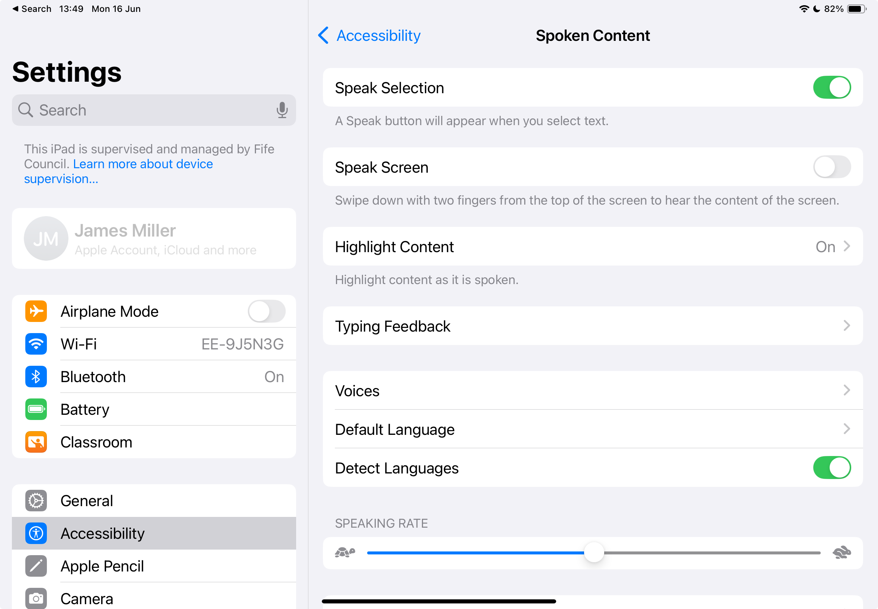
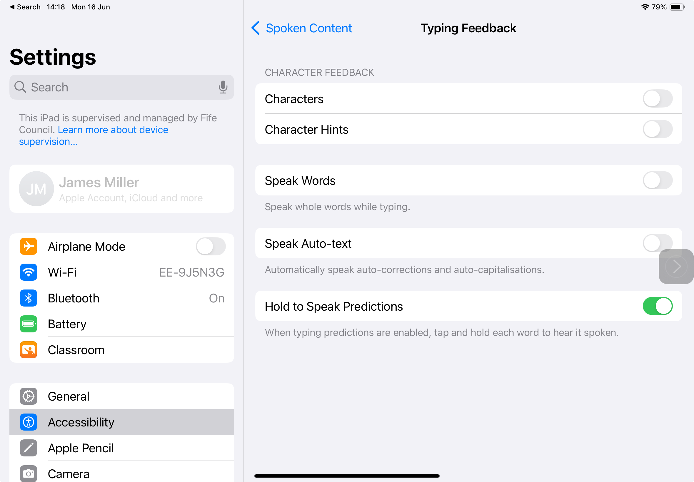
Typing Feedback
This one can get a bit noisy whilst you try to get things sorted!
Characters reads out letter names as you type them.
Character Hints reads out the letter sound.
Speak Words reads each word as you type.
Speak Auto-text lets you know if the iPad has had to autocorrect anything.
Hold to speak Predictions lets you hear what the predictor is suggesting.
You may want to skip this slide… it can get a bit noisy and confusing.

Slide 9
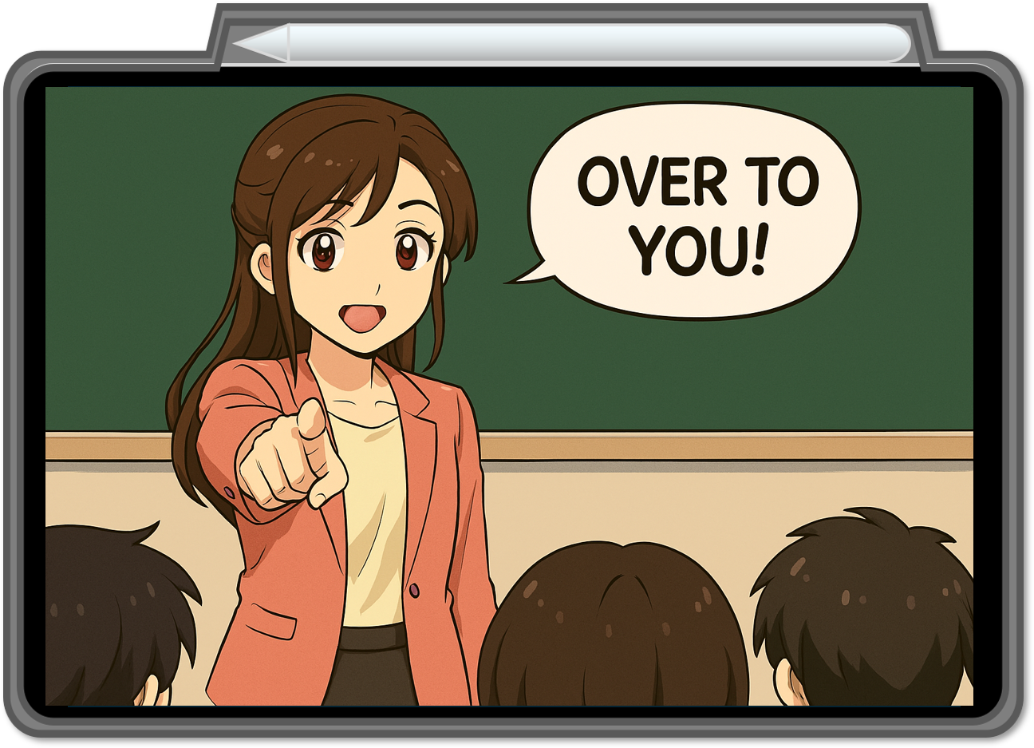




Open an app you can type in and see how well the iPad can predict you!
Can you get the iPad to write a sentence that makes sense just by using predictive text?
Share what you wrote with the class!

Slide 10
Autocorrect
Spellcheck
and

Slide 11
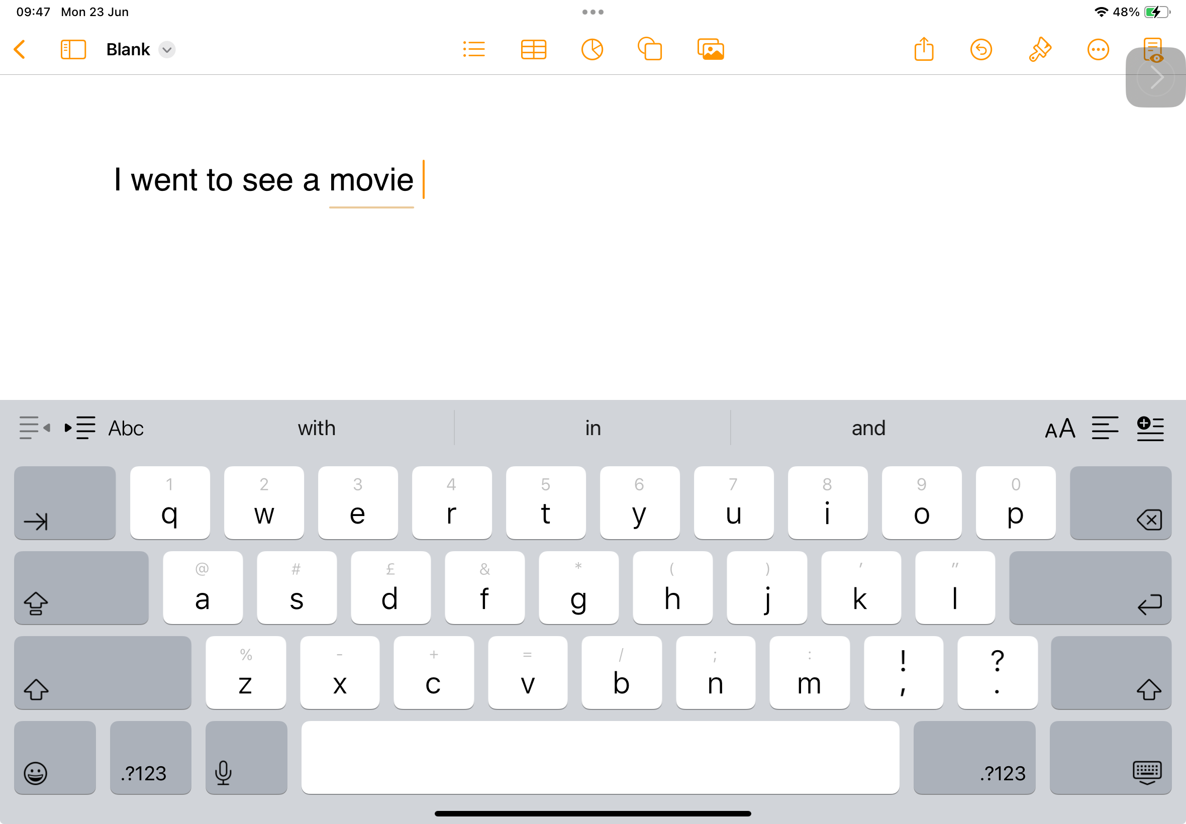
What is autocorrect?
Your iPad is very clever and will sometimes ‘autocorrect’ a word for you. When it does this, a line will appear beneath the word for a short time. You can tap on the word to revert it back if you want to.

Slide 12
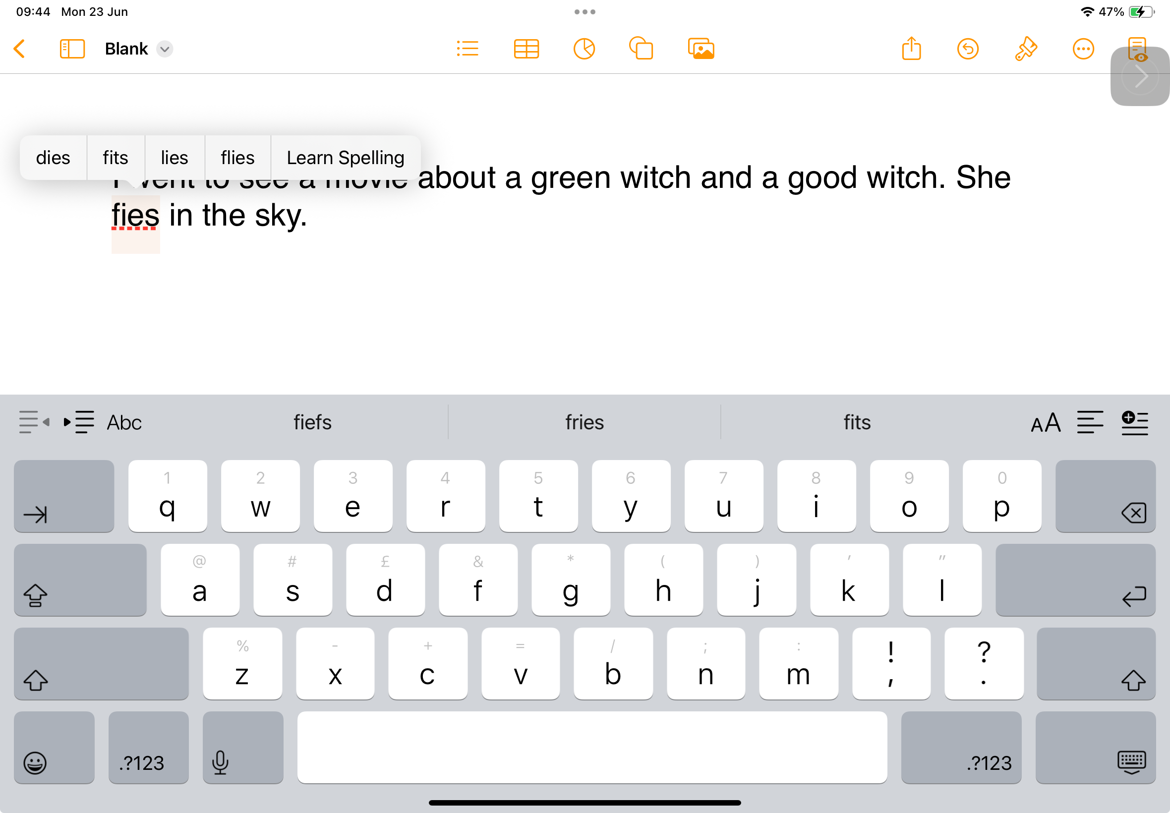
What is spellcheck?
If the iPad can’t figure out what you meant, it will underline the misspelled word in red. Just tap on the word to see some choices for your correction.
Remember, you can always listen back to what you’ve typed to make sure it makes sense!

Slide 13
Speech to Text
(dictate)

Slide 14
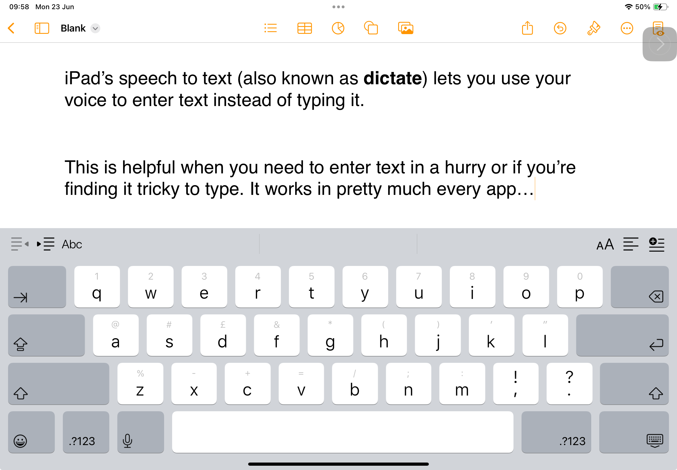

Slide 15
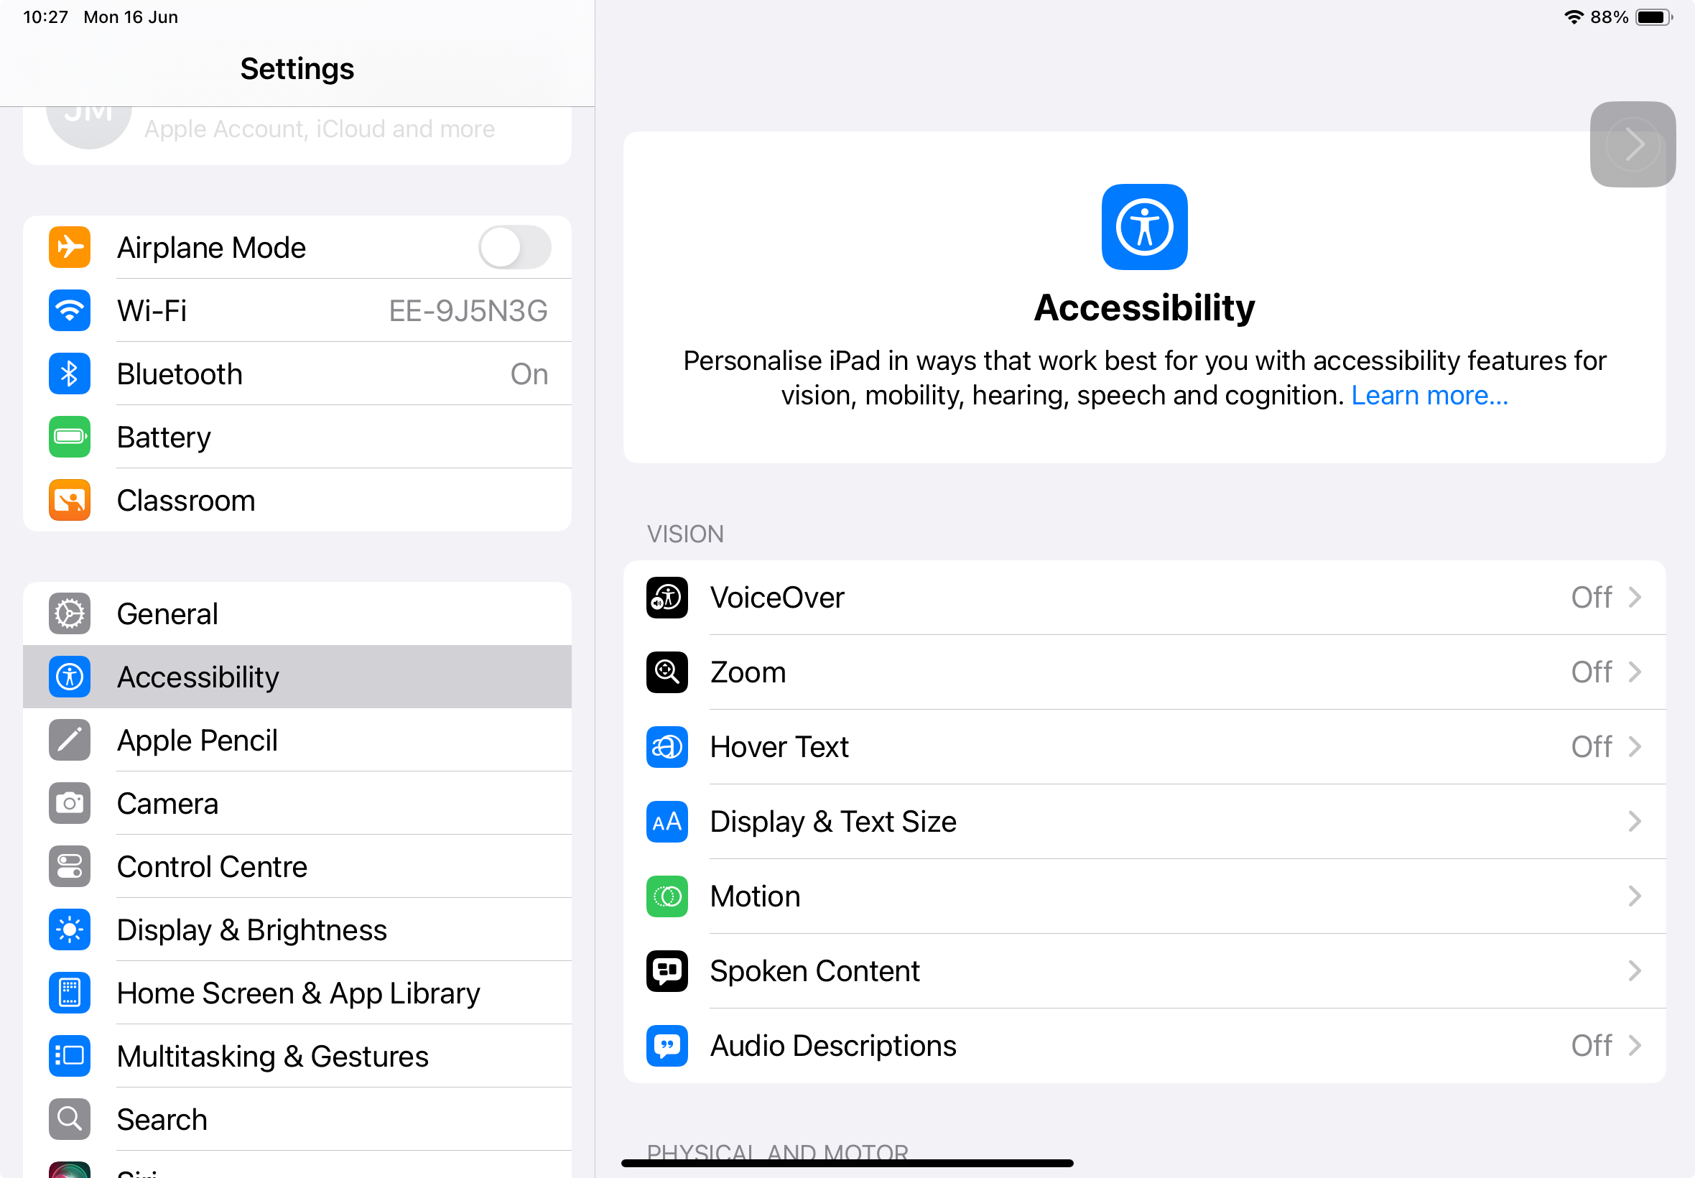
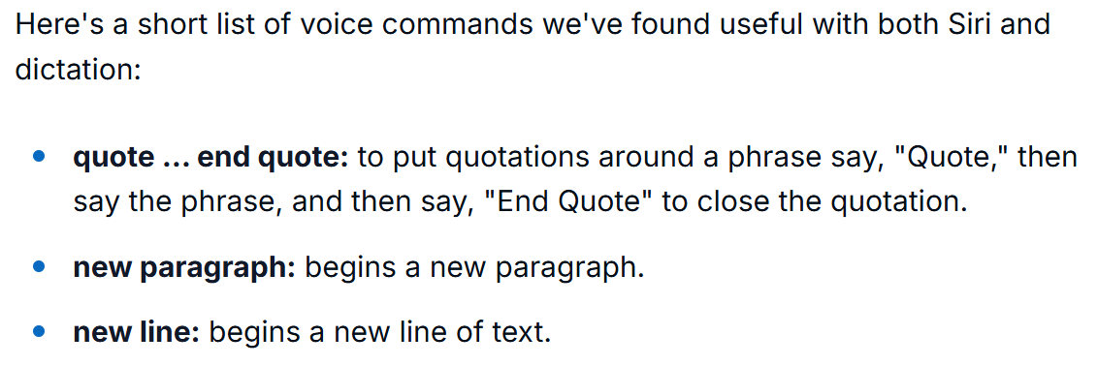
Have a go!
Using dictate is a skill, you will need to practise to get good at it.
You need to think about what you want to dictate before you hit the button as your iPad won’t know what to do with lots of ‘emming’ and pauses!
You can also give the iPad instructions like ‘new line’ when using dictation! What other instructions can you find?

Slide 16
Open an app you can type in and use speech to text (dictate) to write a short paragraph about your favourite TV show, film or book.
See if your iPad recognises character or place names- it can find this tricky!
Try a few orders like: ‘new paragraph’ or ‘new line’. Are there any other orders you can find?

Slide 17
Other Keyboard Languages

Slide 18

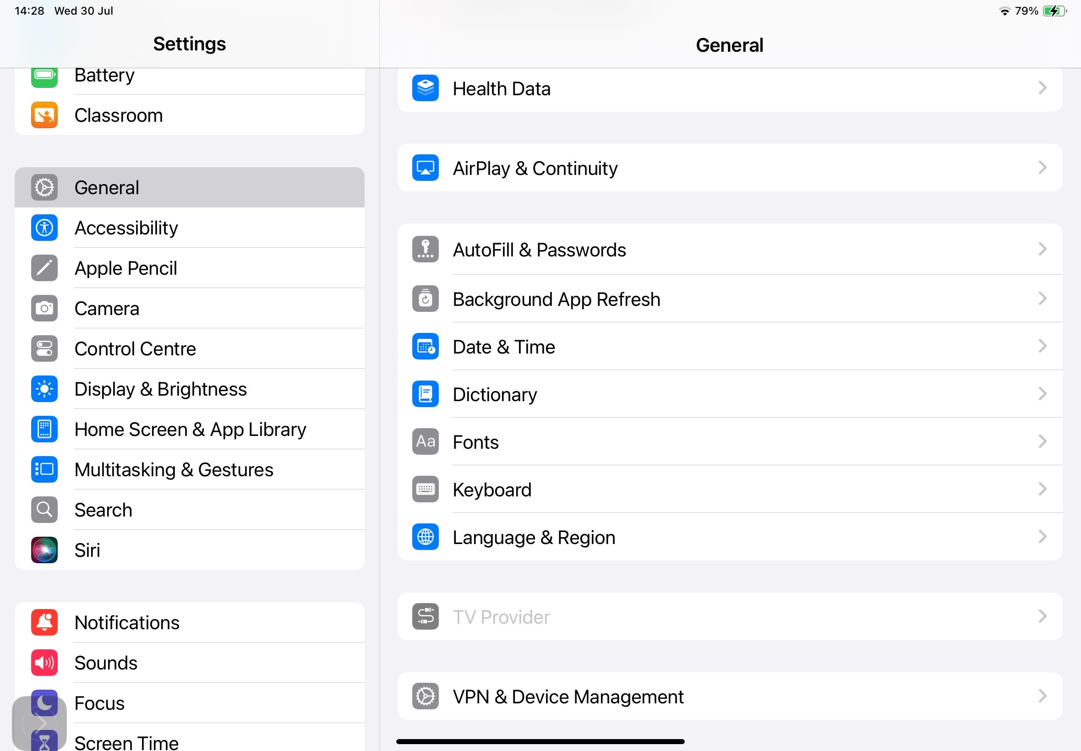
You can add virtual keyboards for other languages to your iPad.
This will be useful in Modern Languages lessons, or if English isn’t your first language.
Head to settings…

Slide 19
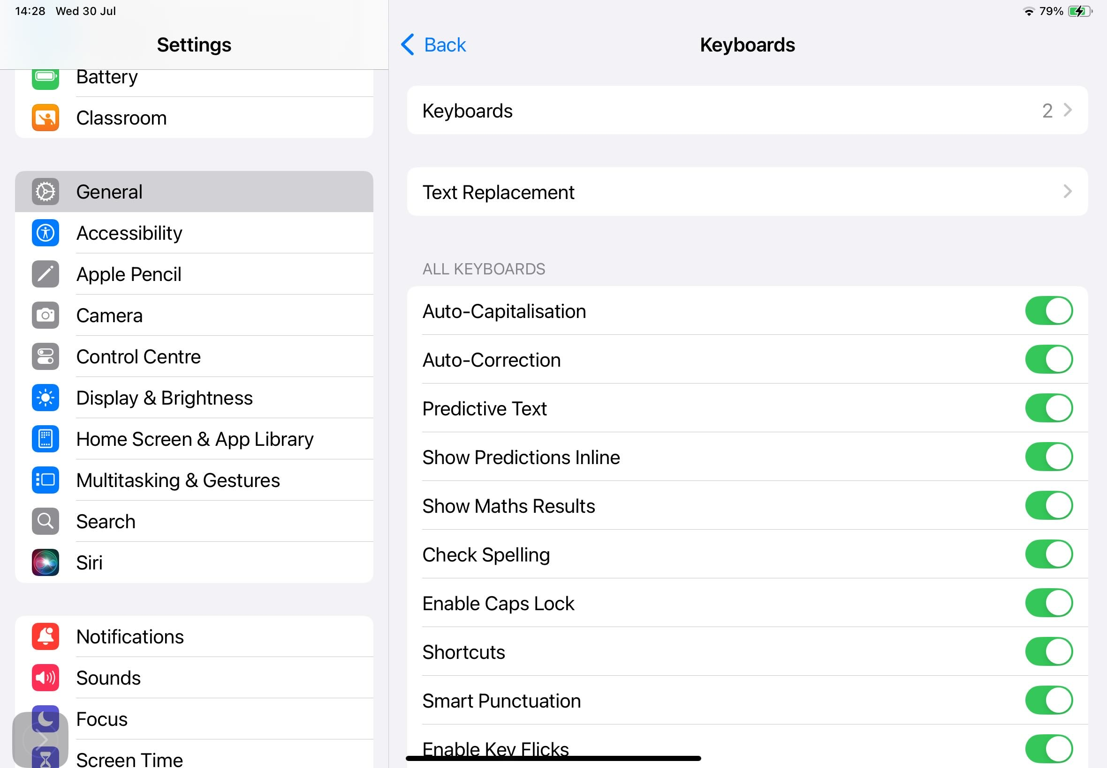
Choose keyboards…

Slide 20
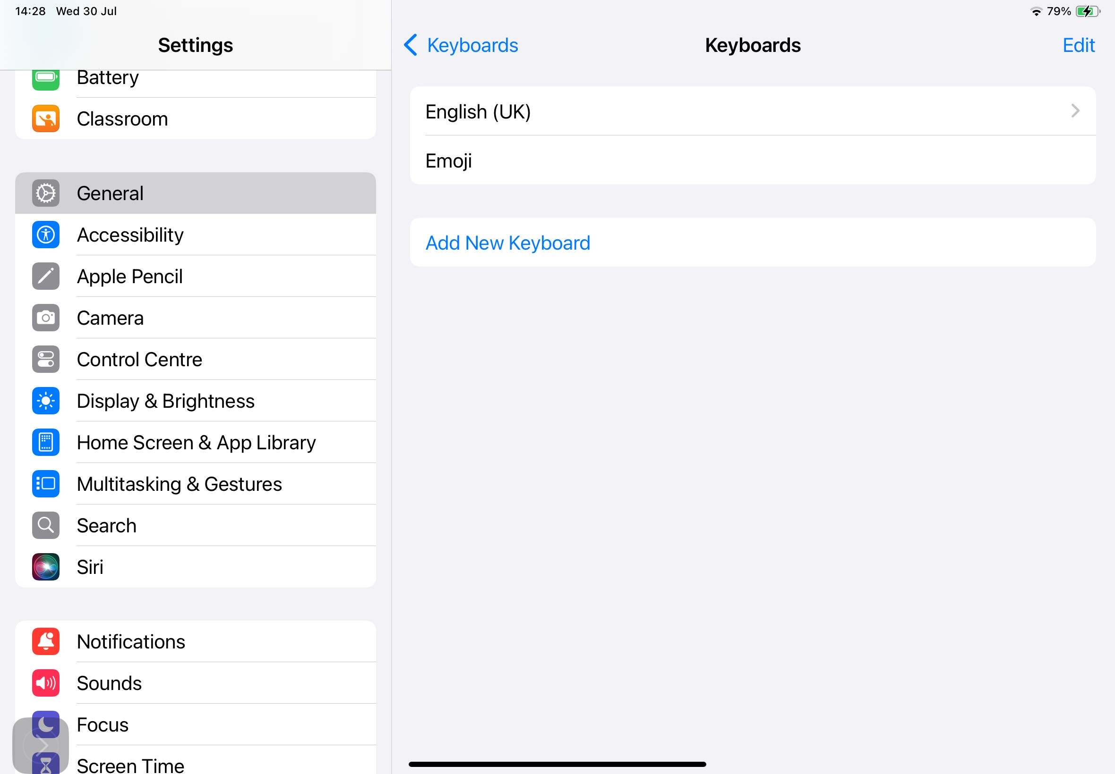
…and Add New Keyboard.

Slide 21
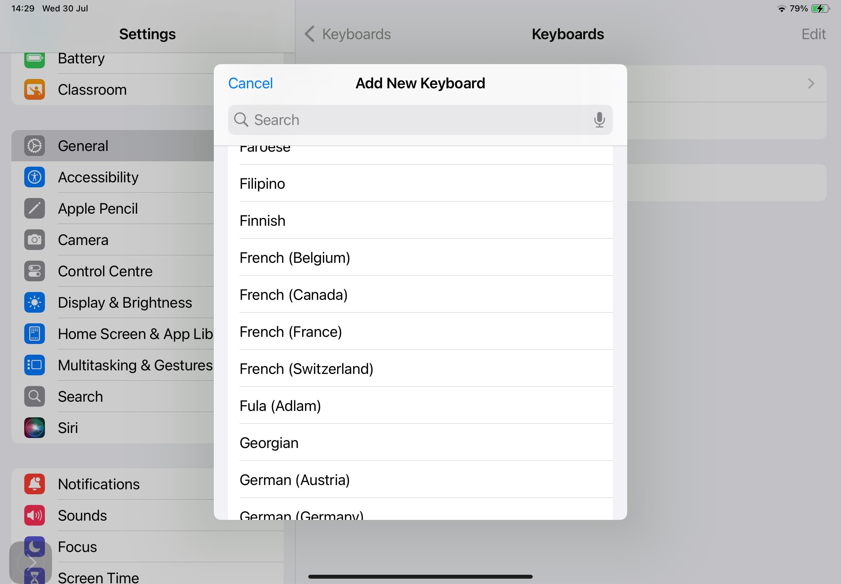
I’m going to choose French because that’s a Modern Language I learn.

Slide 22
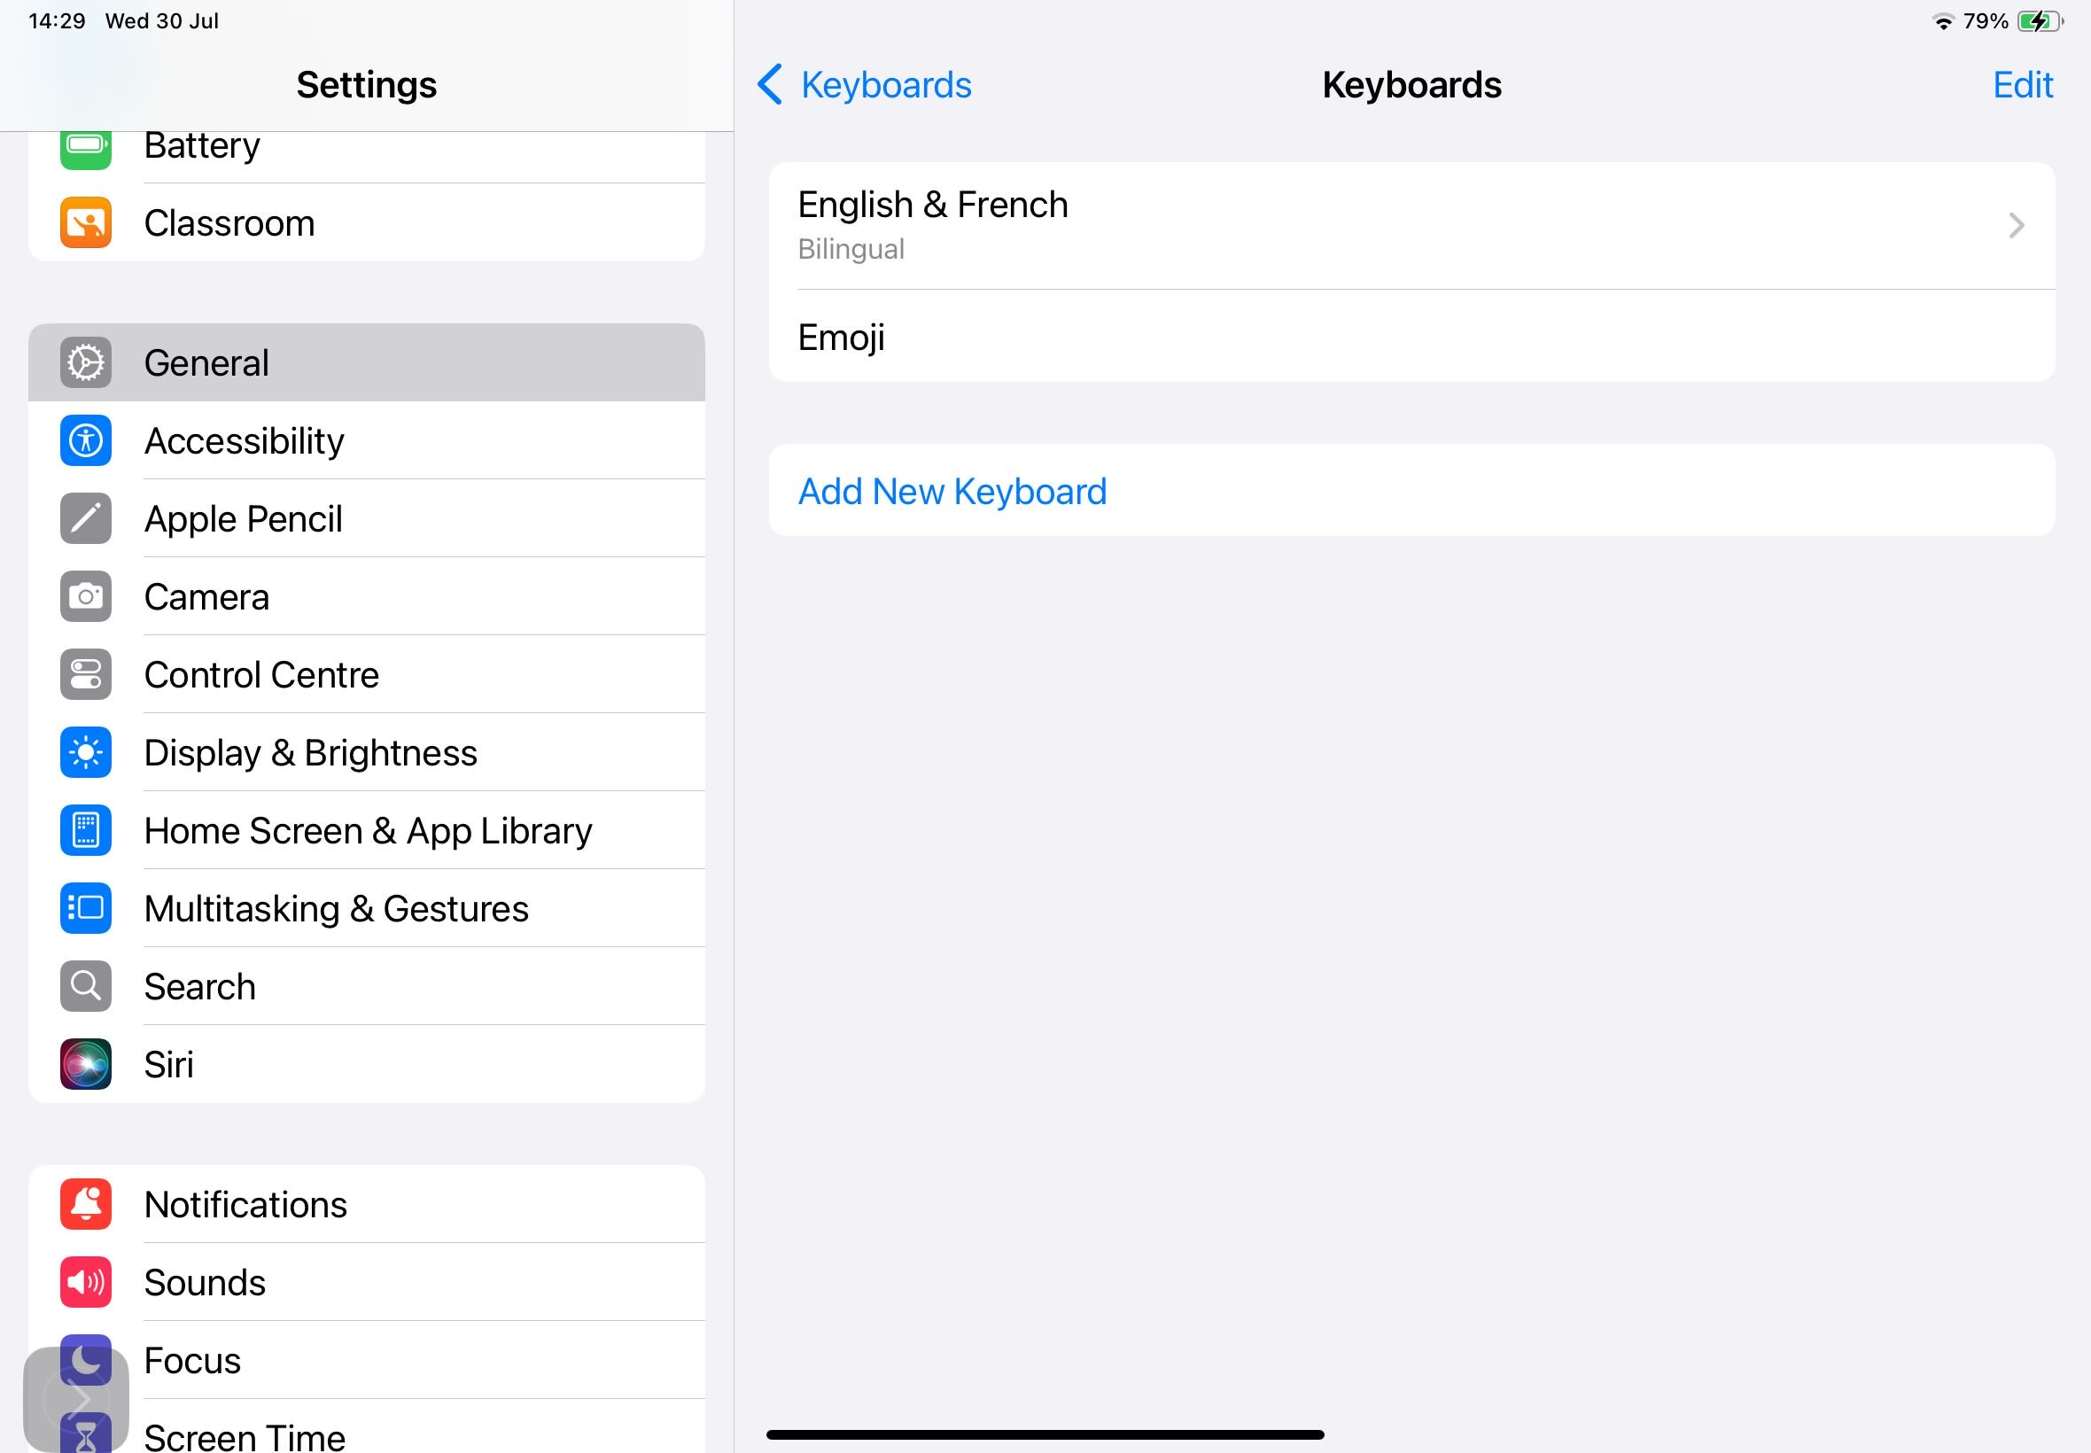
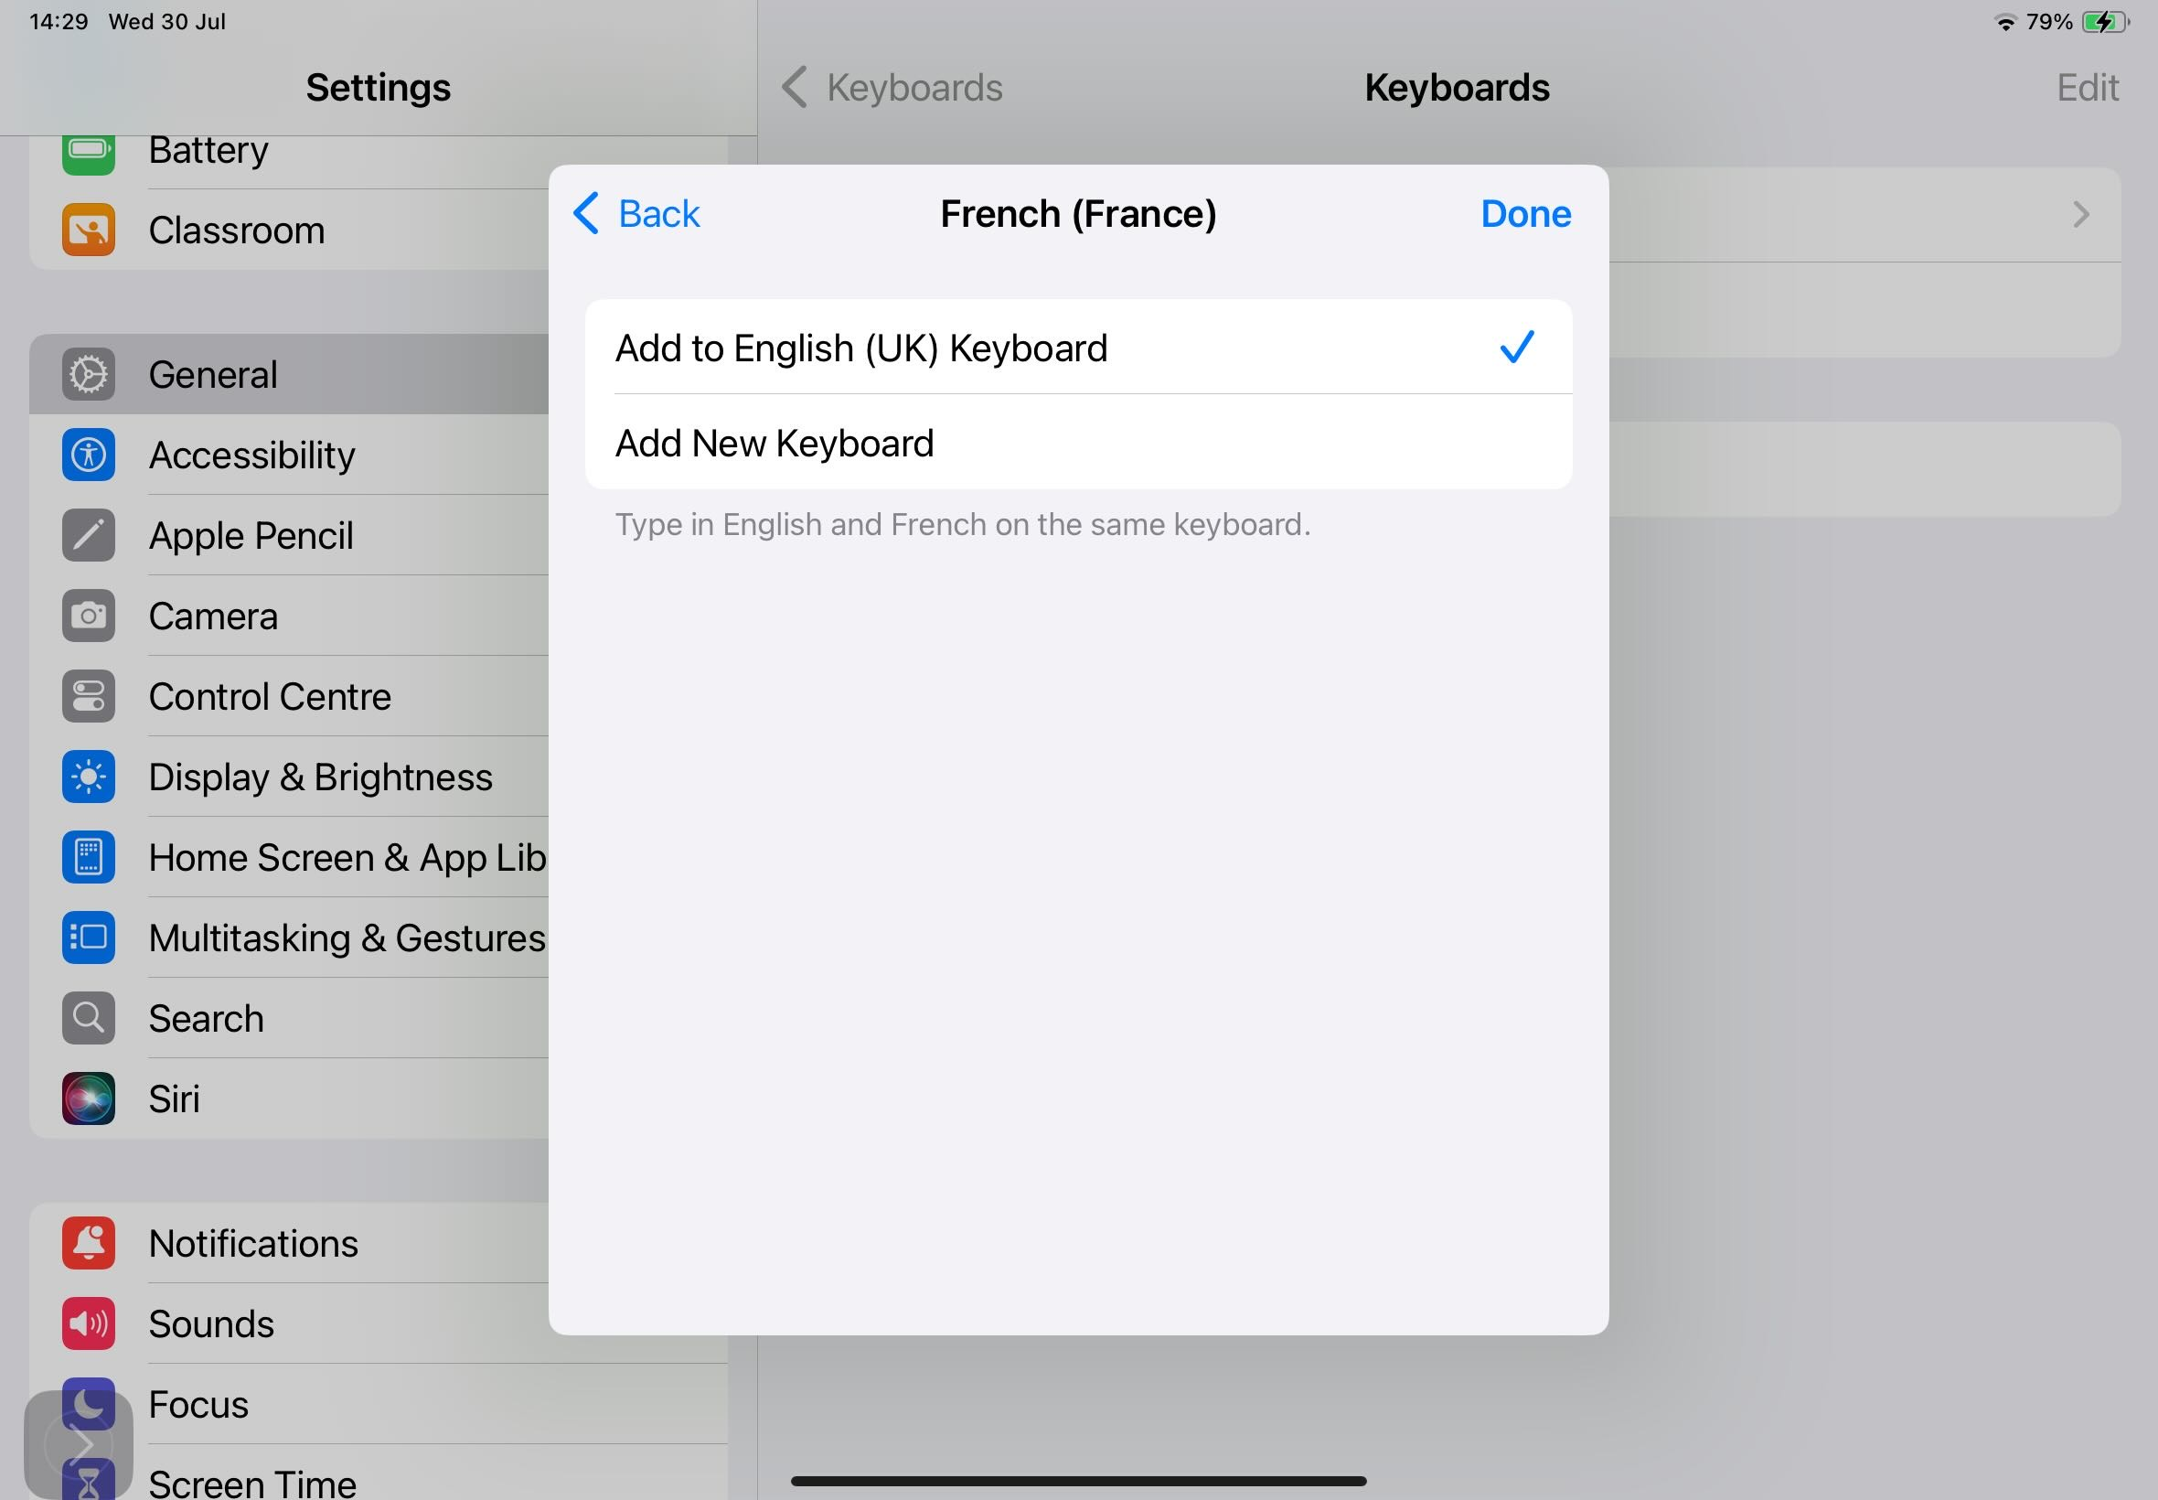
I may want to add French to my English Keyboard.
This option means that my keyboard will recognise English and French words.

Slide 23
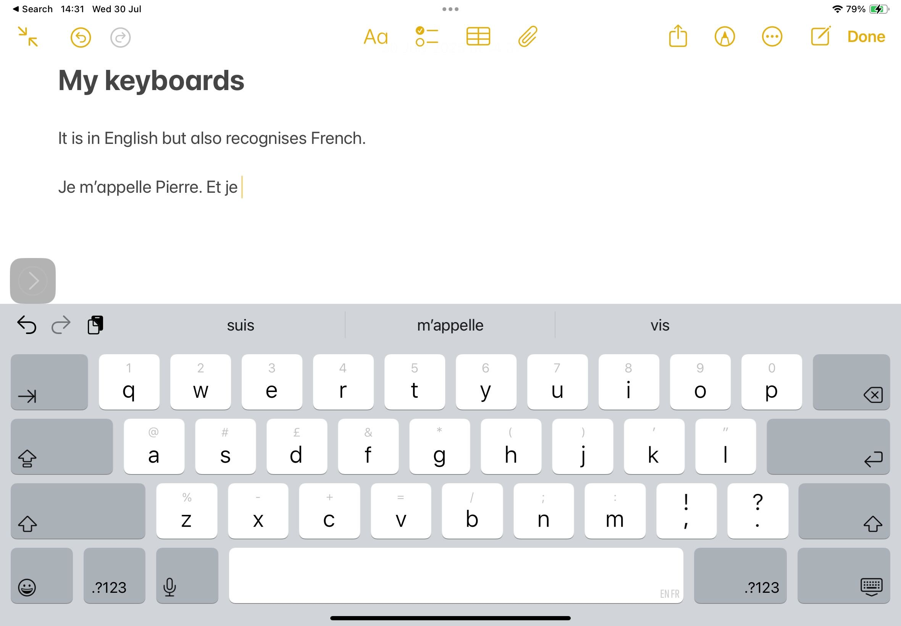
I may want to add French to my English Keyboard.
This option means that my keyboard will recognise English and French words.

Slide 24
The other option is to Add New Keyboard.
If you choose this, you can toggle between languages.

Slide 25
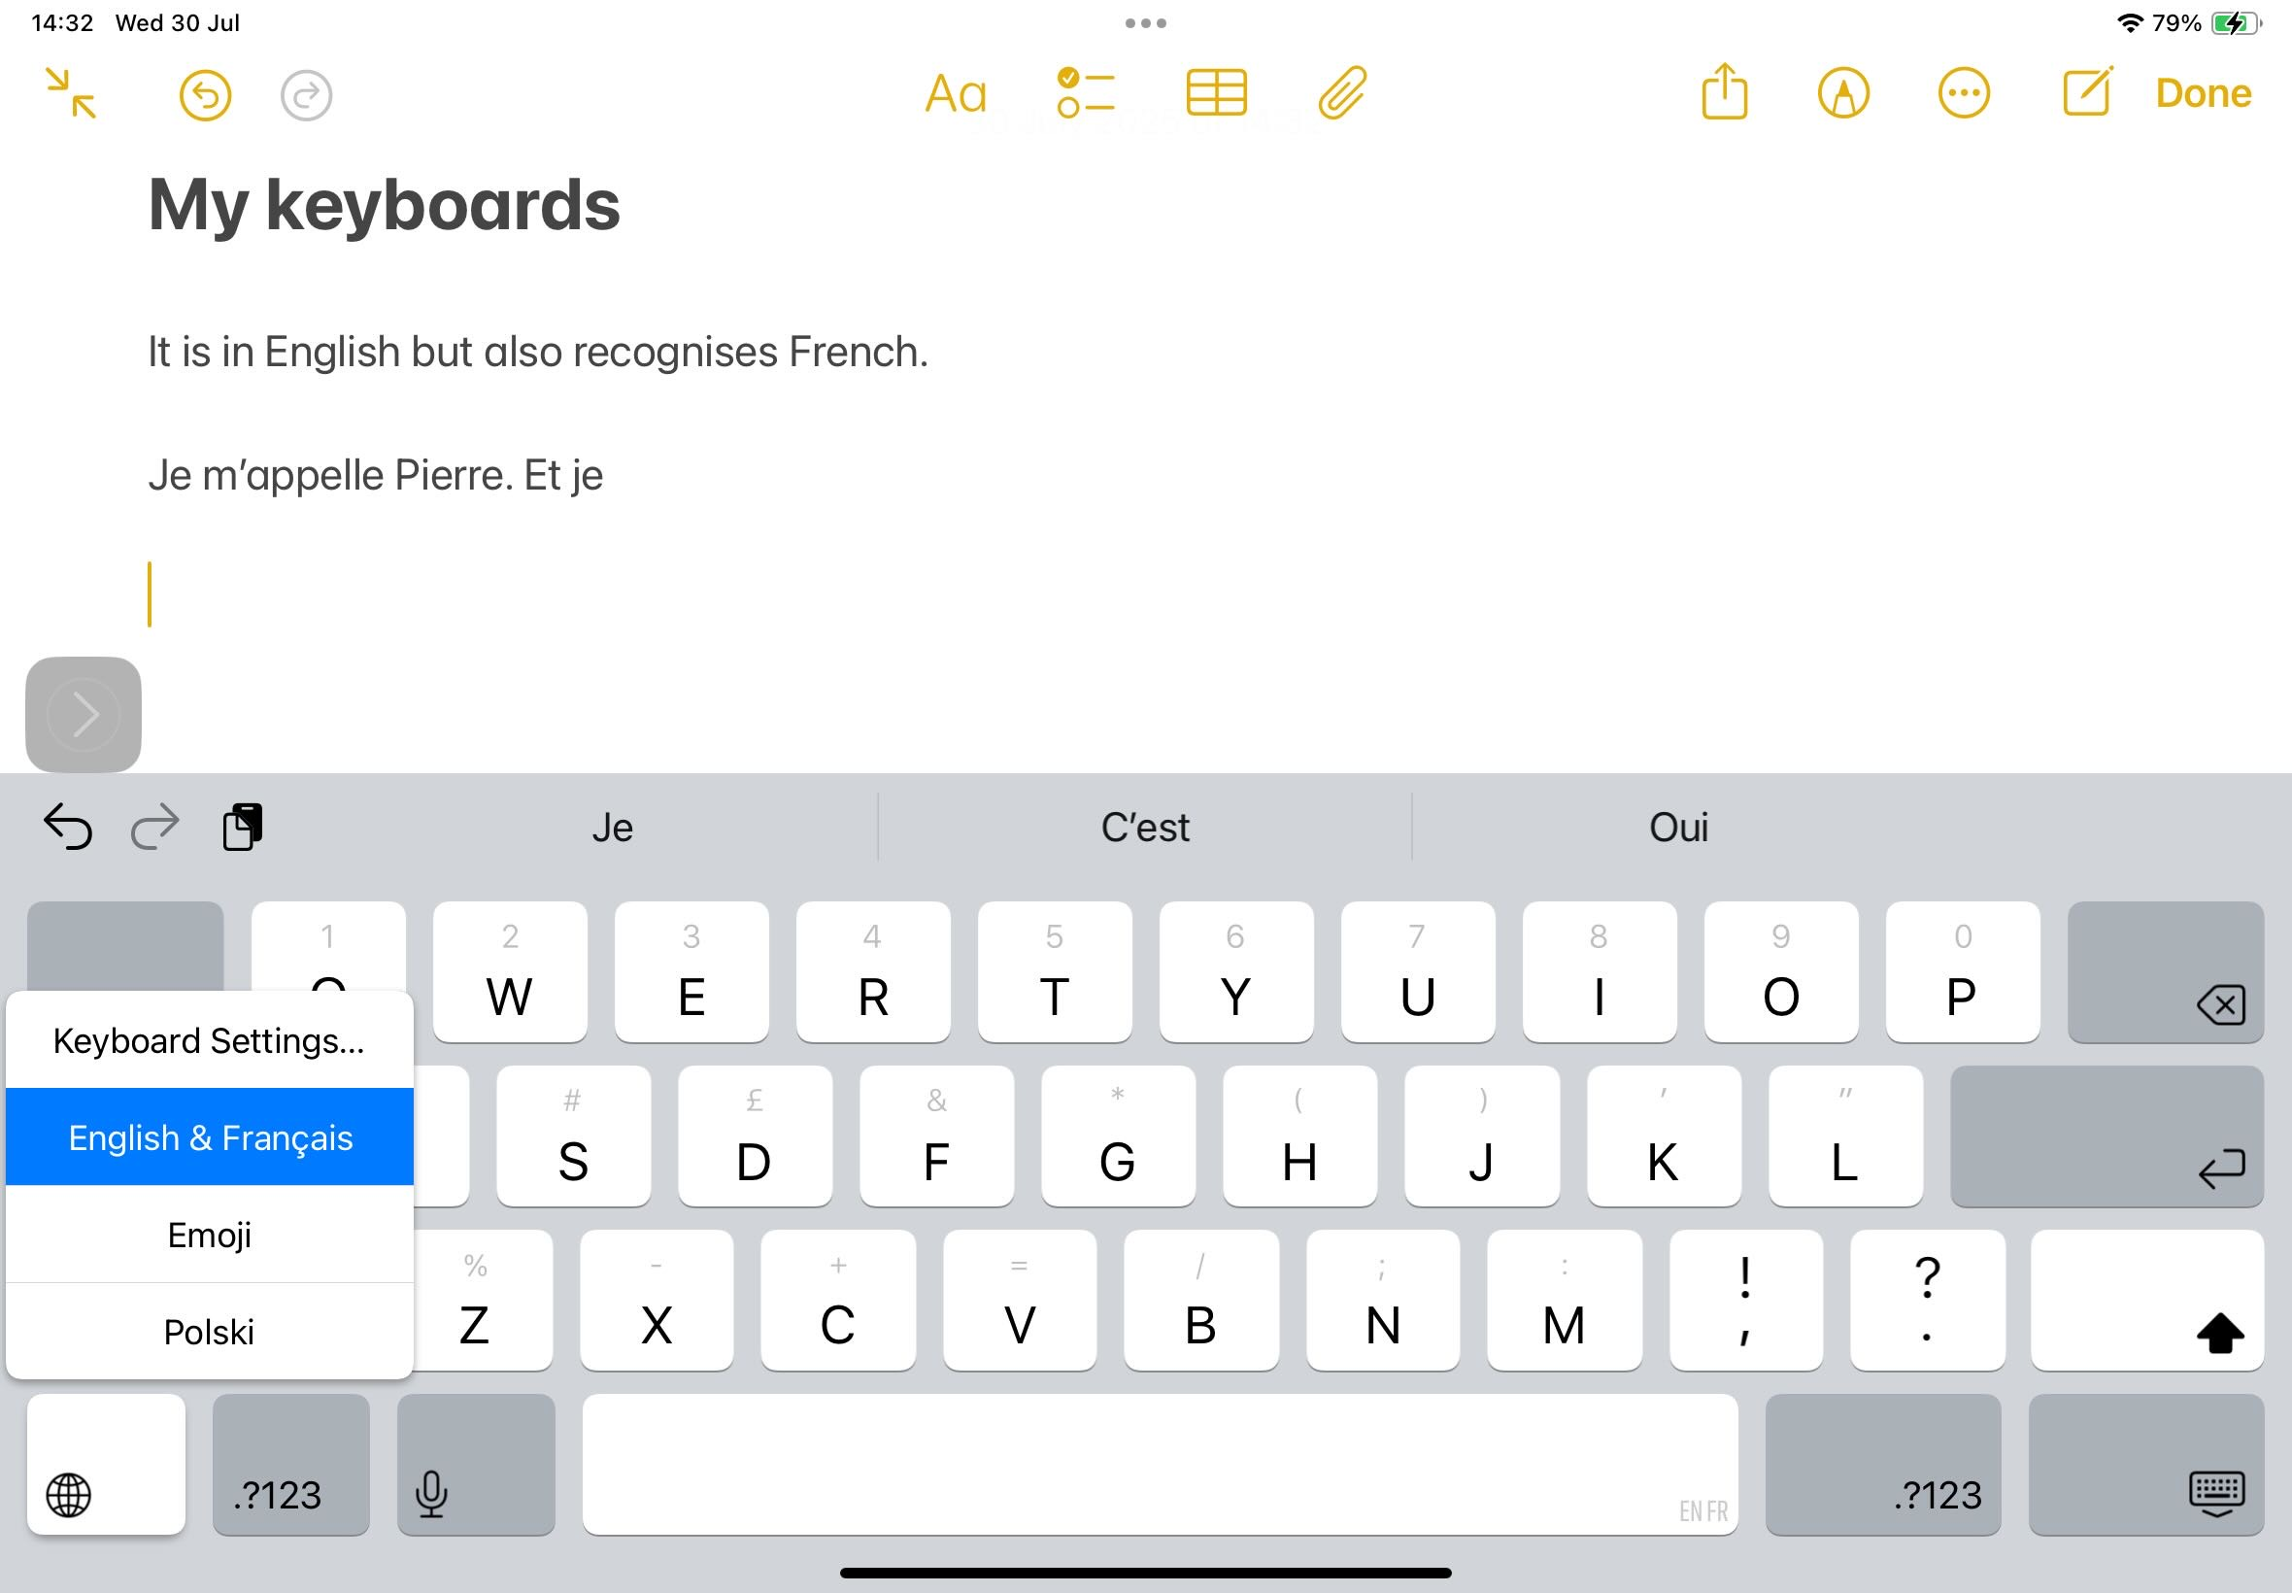
To toggle between, when you are typing, you will see the emoji button now looks like a wee globe.
By pushing and holding the globe, you will be able to toggle between languages.

Slide 26
Add in any modern languages you use at school.
Remember you can add them to you your English keyboard or keep them separate- it’s up to you!
Now try typing something that’s not English!

Slide 27
Voice Memos and Transcribe

Slide 28
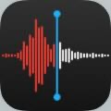
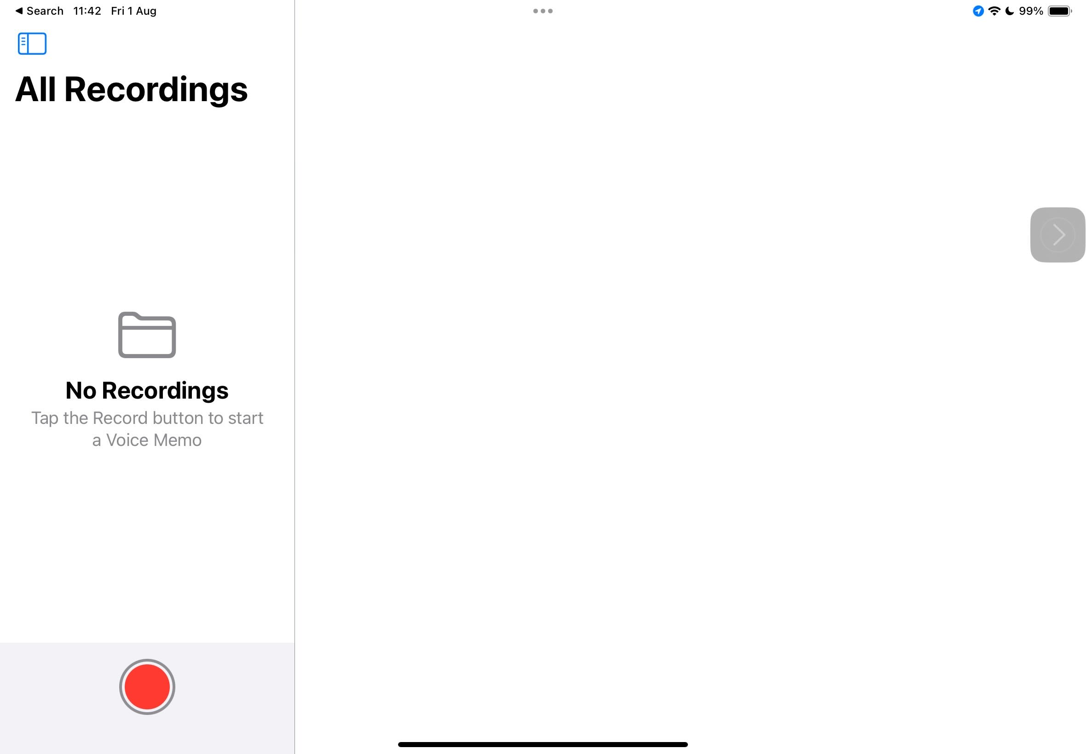
One way to take a voice note on an iPad is using the Voice Memos app.
Just hit the record button to get going!

Slide 29
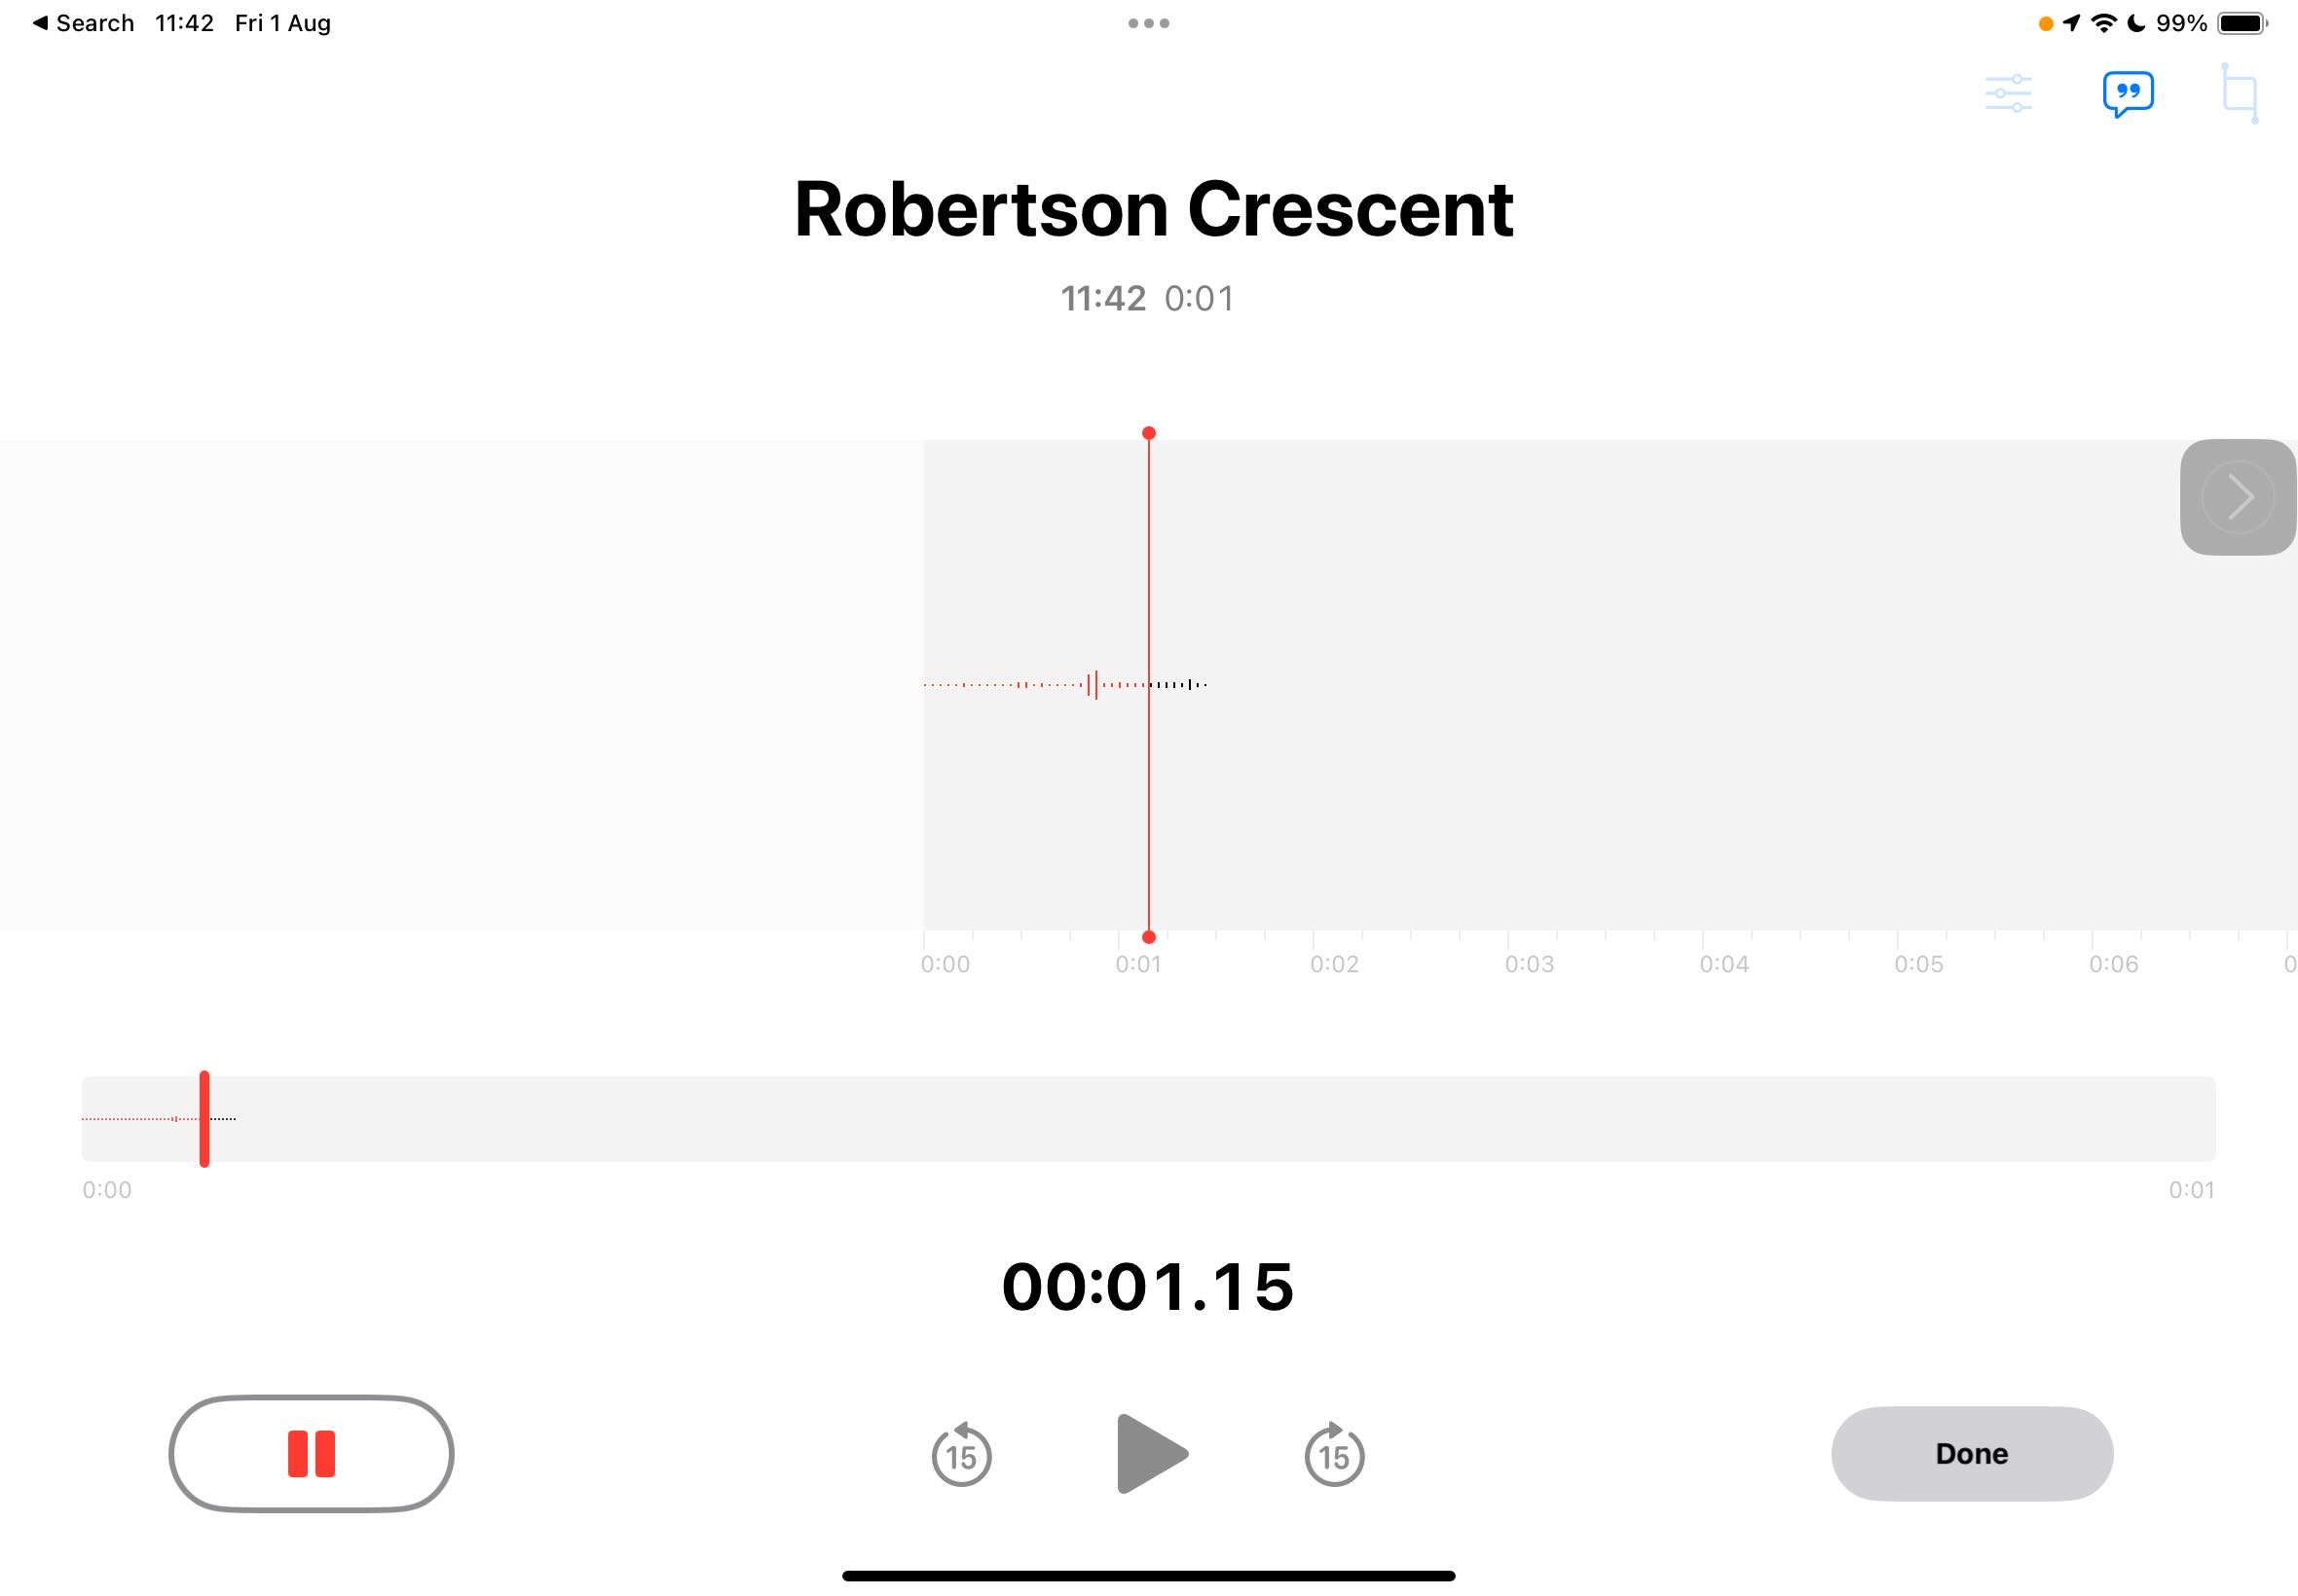
This is where you will find the transcribe button.

Slide 30
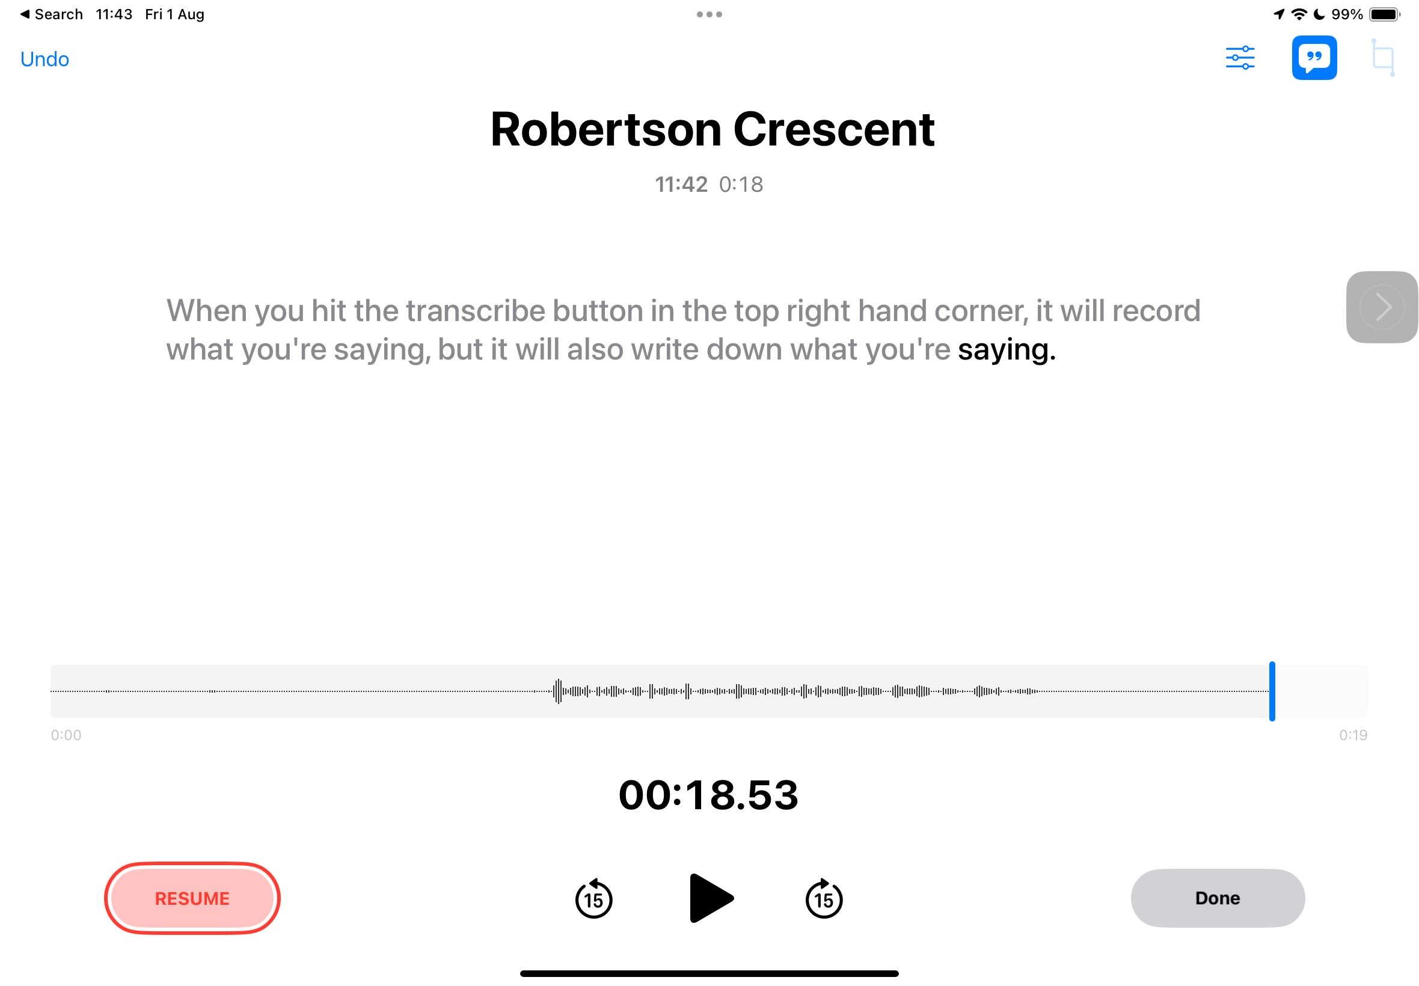
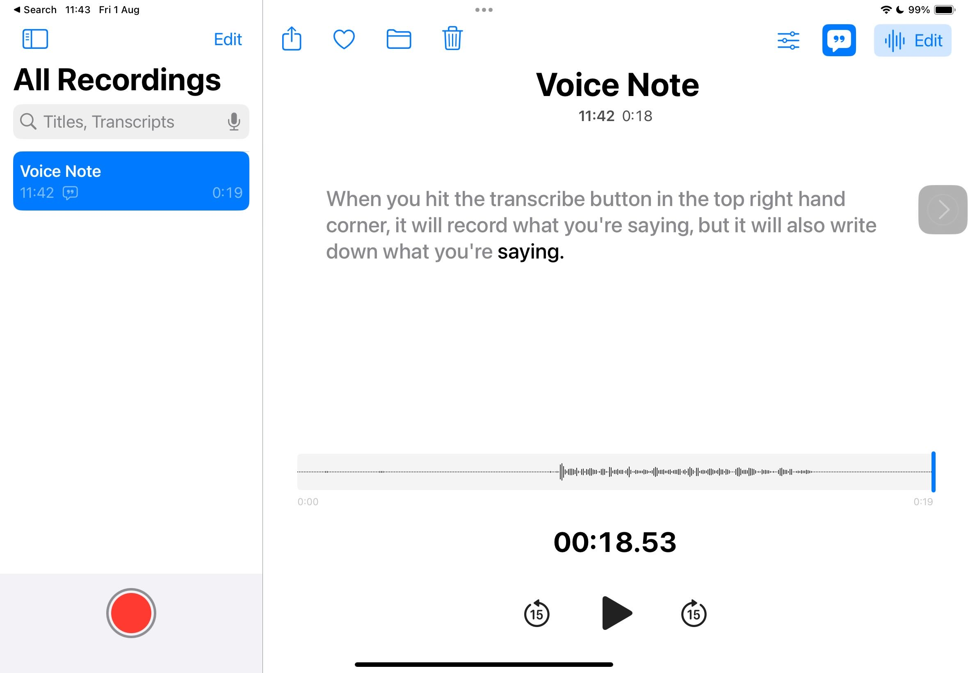
Once you hit done, your voice memo and the transcription are saved.
Your iPad even tries to work out different voices! It will label them Speaker 1, Speaker 2 etc.

Slide 31
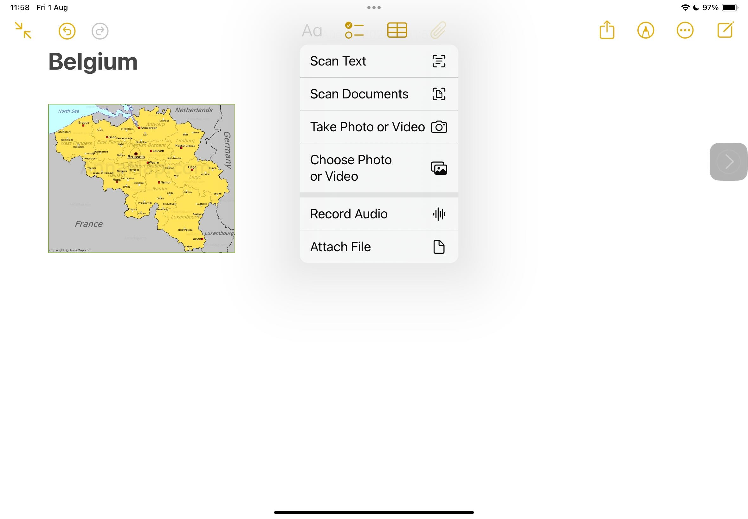
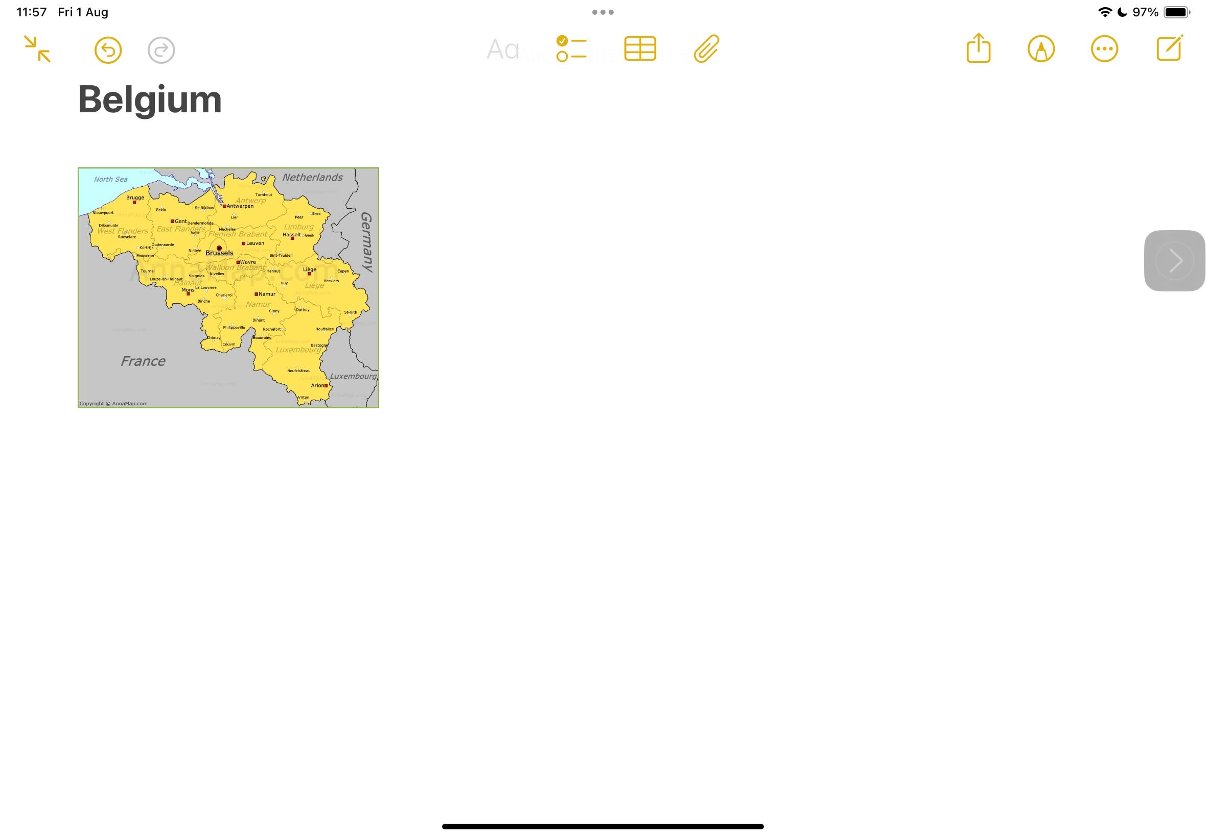
If you are using an app like Notes, you can even add the Voice memo right into the note by tapping the paperclip…

Slide 32
…and choosing Record Audio.

Slide 33
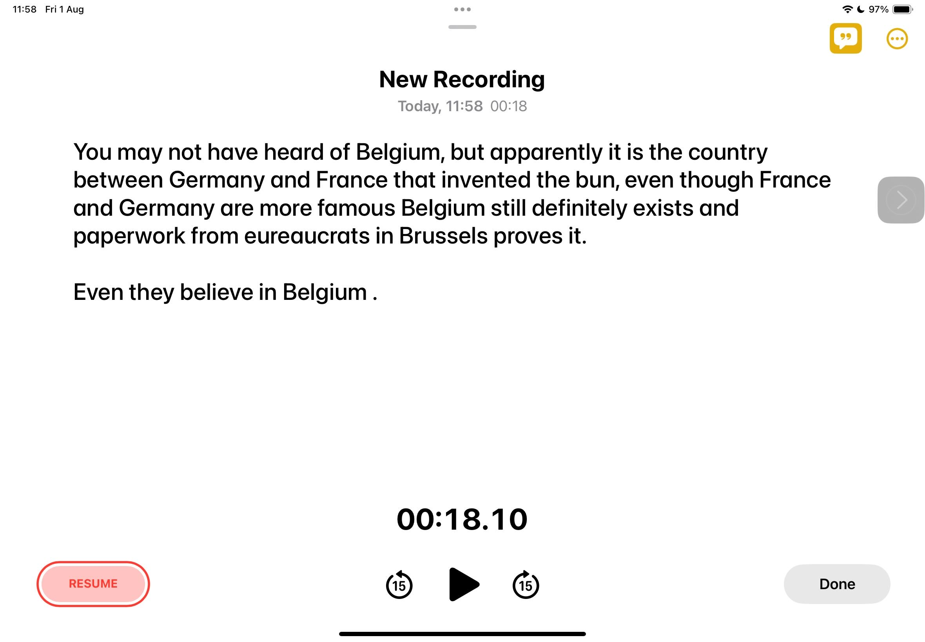
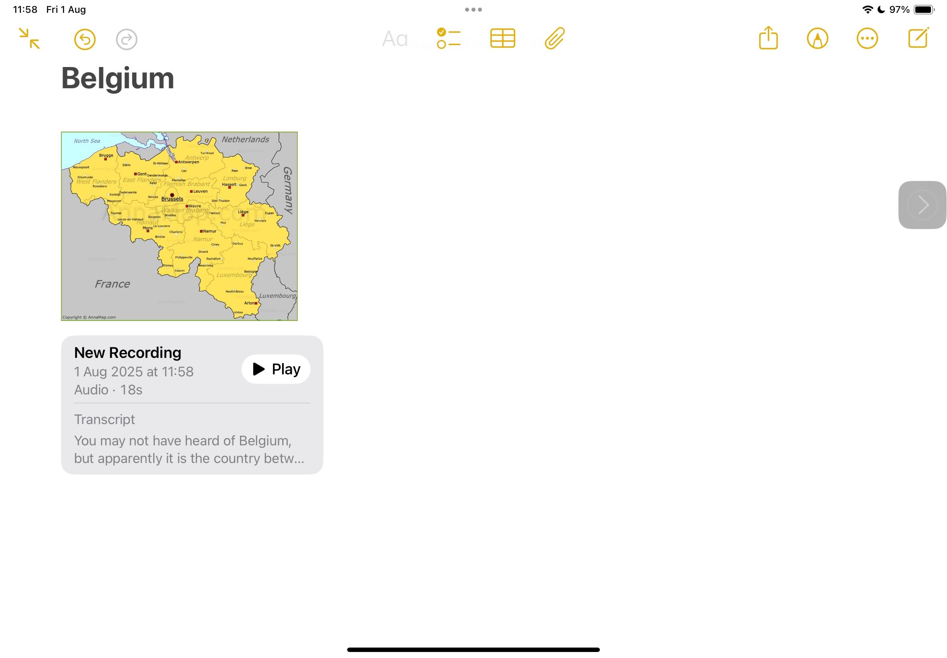
Record and Transcribe as you normally would. Tap done…
…and it slots right into your note!

Slide 34
Try opening Notes and adding a voice memo on a subject of your choice. Make sure you switch on the transcribe function so you have a transcription as well!

Slide 35
Touch Typing

Slide 36
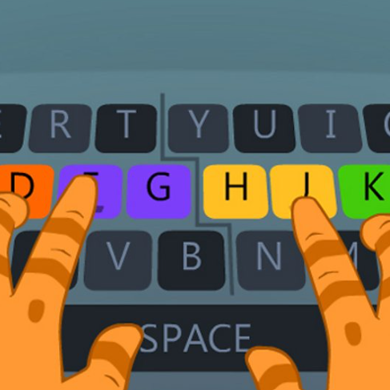

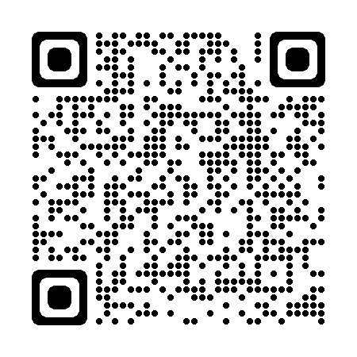
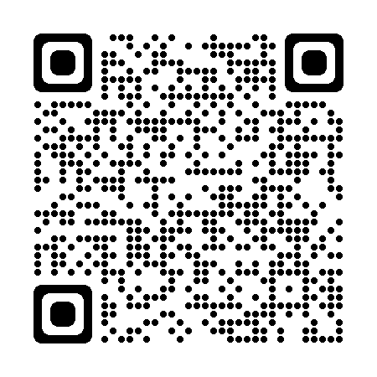
If you find typing on a touchscreen tricky, you can attach a keyboard to your iPad.
Here are some online tutors to help with your keyboard skills.
Notes:
BBC Dance Mat
Dance Mat is a fun way to learn touch typing. There are four levels to play, each divided into three stages. https://www.bbc.co.uk/bitesize/topics/zf2f9j6/articles/z3c6tfr
Doorway Online Text Type
A highly accessible typing tutor designed for all learners including visually impaired pupils. https://www.doorwayonline.org.uk/activities/text-type/

Slide 37
What did we cover?
Tools to help create text
-Predictive text
-Speech to text
-Spellcheck
-adding languages to the keyboard
-Voice Memos and Transcribe
-Touch Typing practice*

Slide 38
This series of lessons was created by the Fife ATSS Team and is based on lessons created by Ms Linsey Miller (Sacred Heart Primary School ASC, Falkirk, linsey.miller@education.falkirk.sch.uk) and research carried out by Mrs Nicola Denholm (Larbert Village Primary School, Falkirk).
All content is protected by copyright. You may use the contents of these lessons and adjust them to suit your own context and practise; however you are strictly prohibited from reselling this series of lessons or any derivative created from it, either in part or in its entirety.

