Slide 1

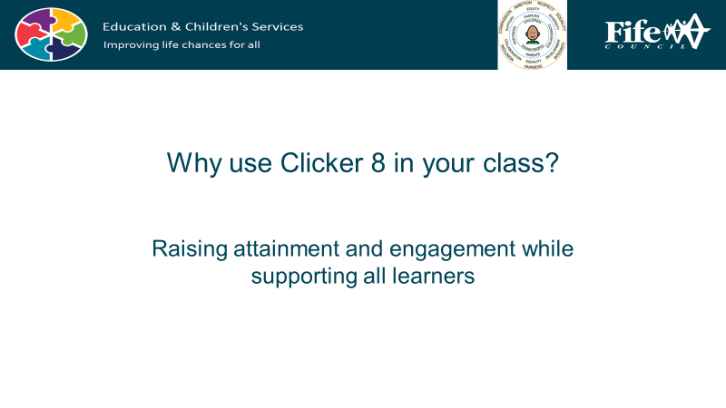

Accessibility tools are built into the iPad, and whilst they are essential for learners with additional support needs, they can be useful for every single child in your class… and you as well!
The following unit contains lessons to use with your whole class, that support personalising the screen and activating Text to Speech.
You may find that it is particularly useful for any learners who, for example, have a form of print disability, such as a visual impairment or dyslexia.

Slide 2
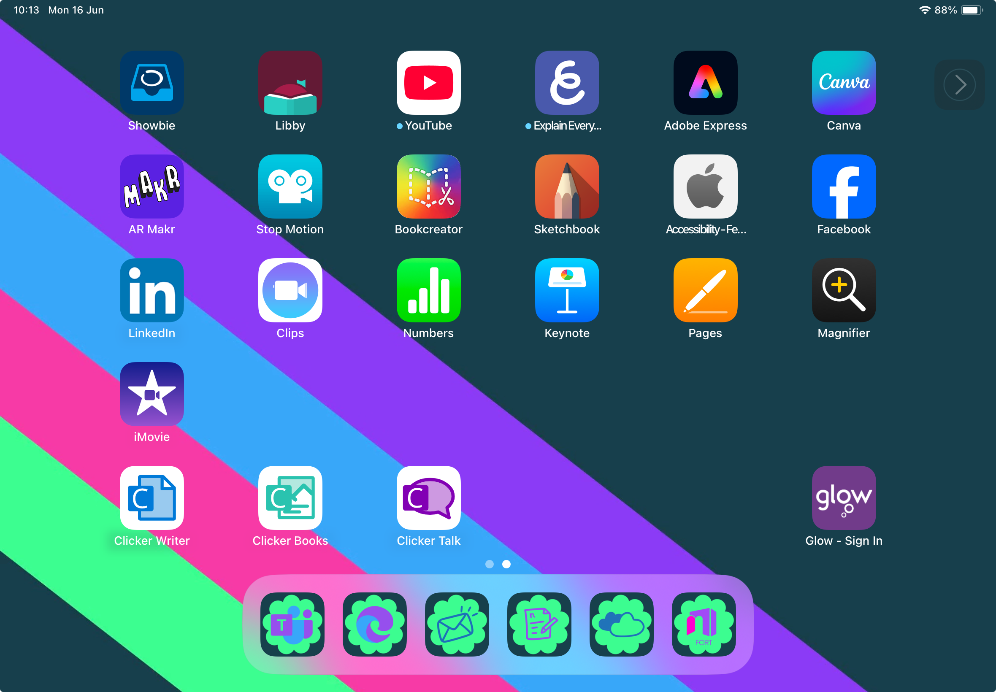
Accessibility is for Everyone
Unit 1: Display and Speech
I can change the display Settings and use Text to Speech

Slide 3
Display Settings

Slide 4
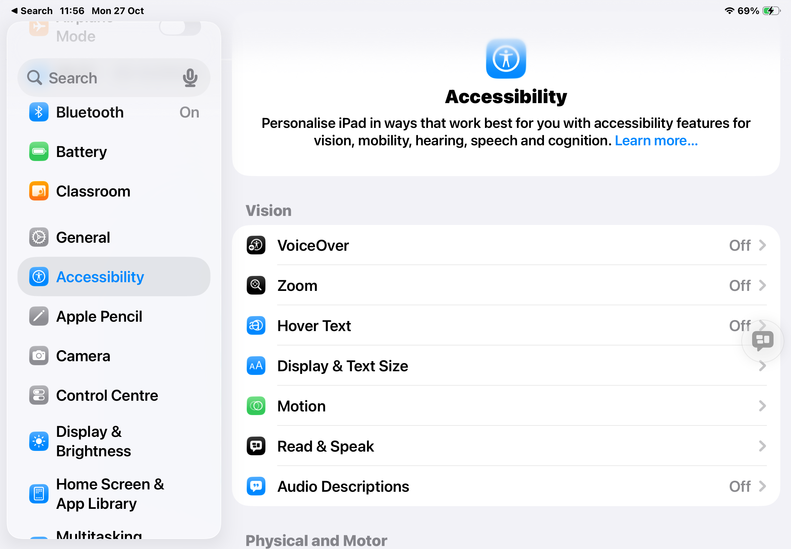


Step 1:
Tap on the Settings icon on your iPad.
It looks like this…
Step 2:
Scroll down the settings menu until you find Accessibility and
tap it.

Slide 5


Step 3:
Now tap
Display & Text
Size

Slide 6
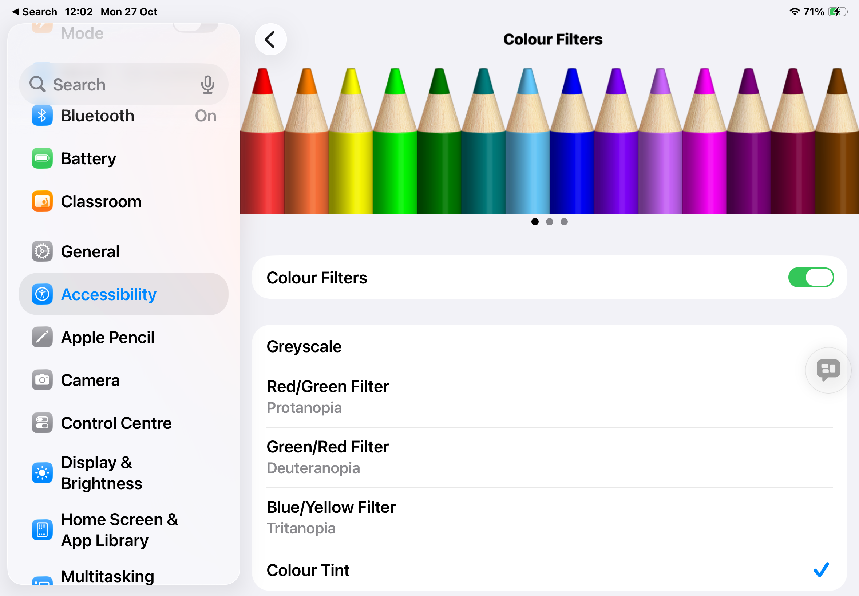
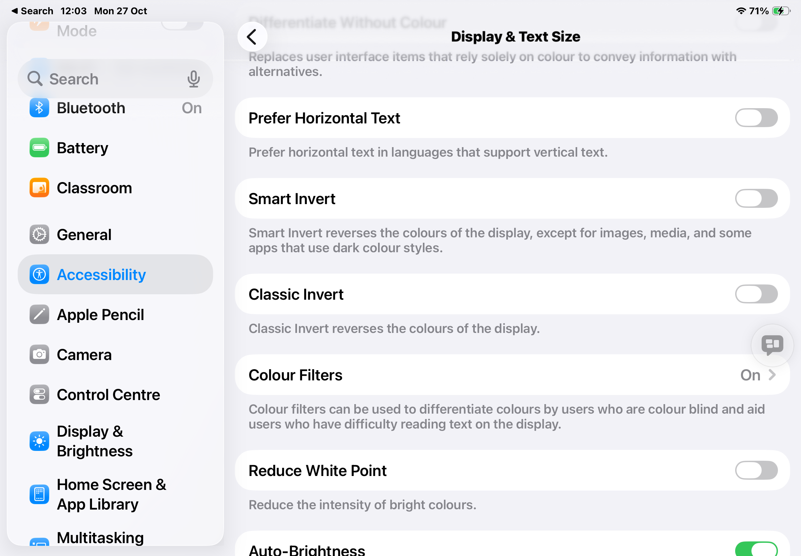
There’s lots to adapt in here, a good bit is the Colour Filters if you like a coloured overlay, or if you are colour blind.
If you turn on Colour Tint, beneath that you can change the Intensity (how transparent the filter is) or Hue (what colour it is.

Slide 7
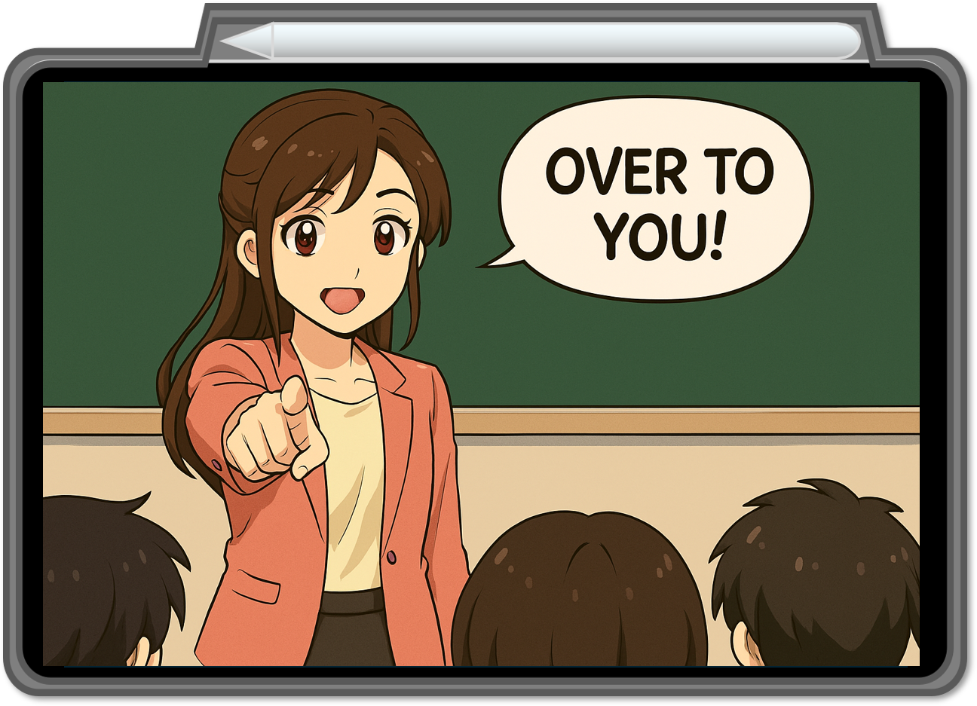

Display & Text Size
There are a few things to try here…
Bold Text
Larger Text
Increase Contrast
Smart/Classic Invert
Colour Filters (scroll right to the bottom and choose hue to change the colour- the pencils do nothing except look pretty!)

Slide 8
Text to Speech

Slide 9
Step 1:
Tap on the Settings icon on your iPad.
It looks like this…
Step 2:
Scroll down the settings menu until you find Accessibility and
tap it.

Slide 10

Step 3:
Now tap
Read and Speak

Slide 11
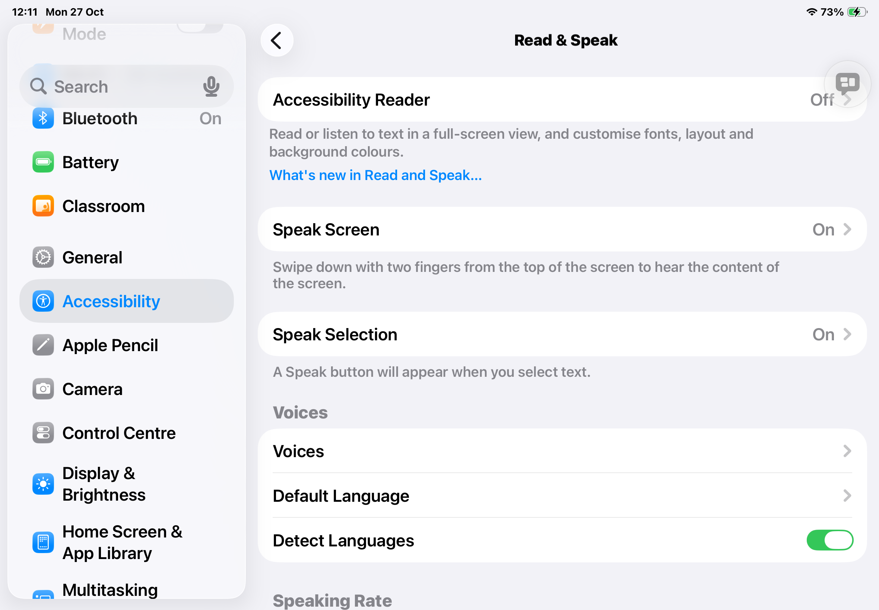
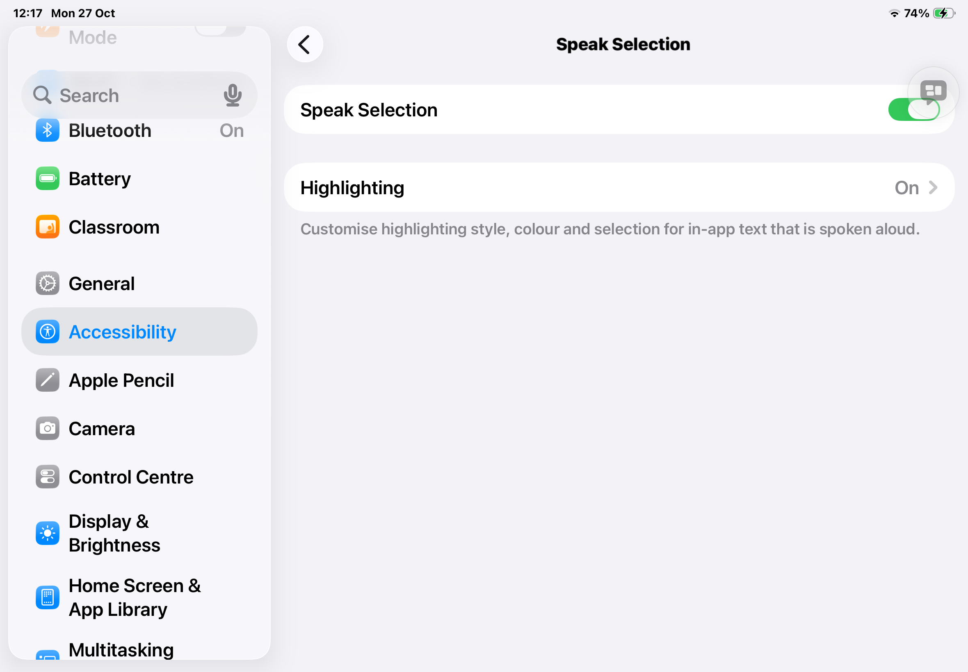
Speak Selection
Tap here to toggle it on.
I also like to turn on Highlighting, so I don’t lose my place!

Slide 12
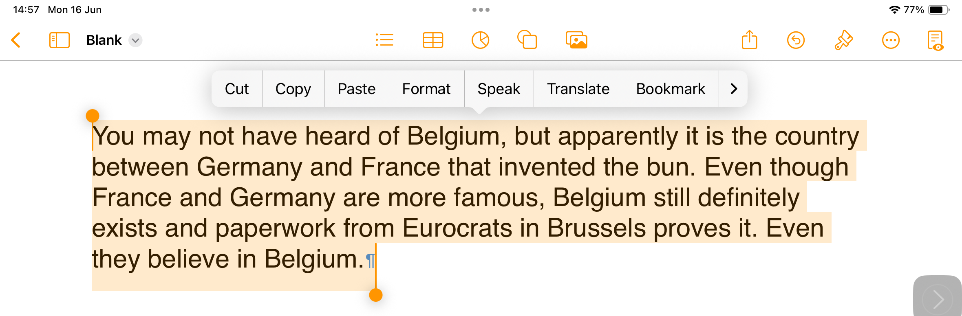
Speak Selection
Select any text from a document or website
Tap ‘speak’ from the menu that appears above.

Slide 13
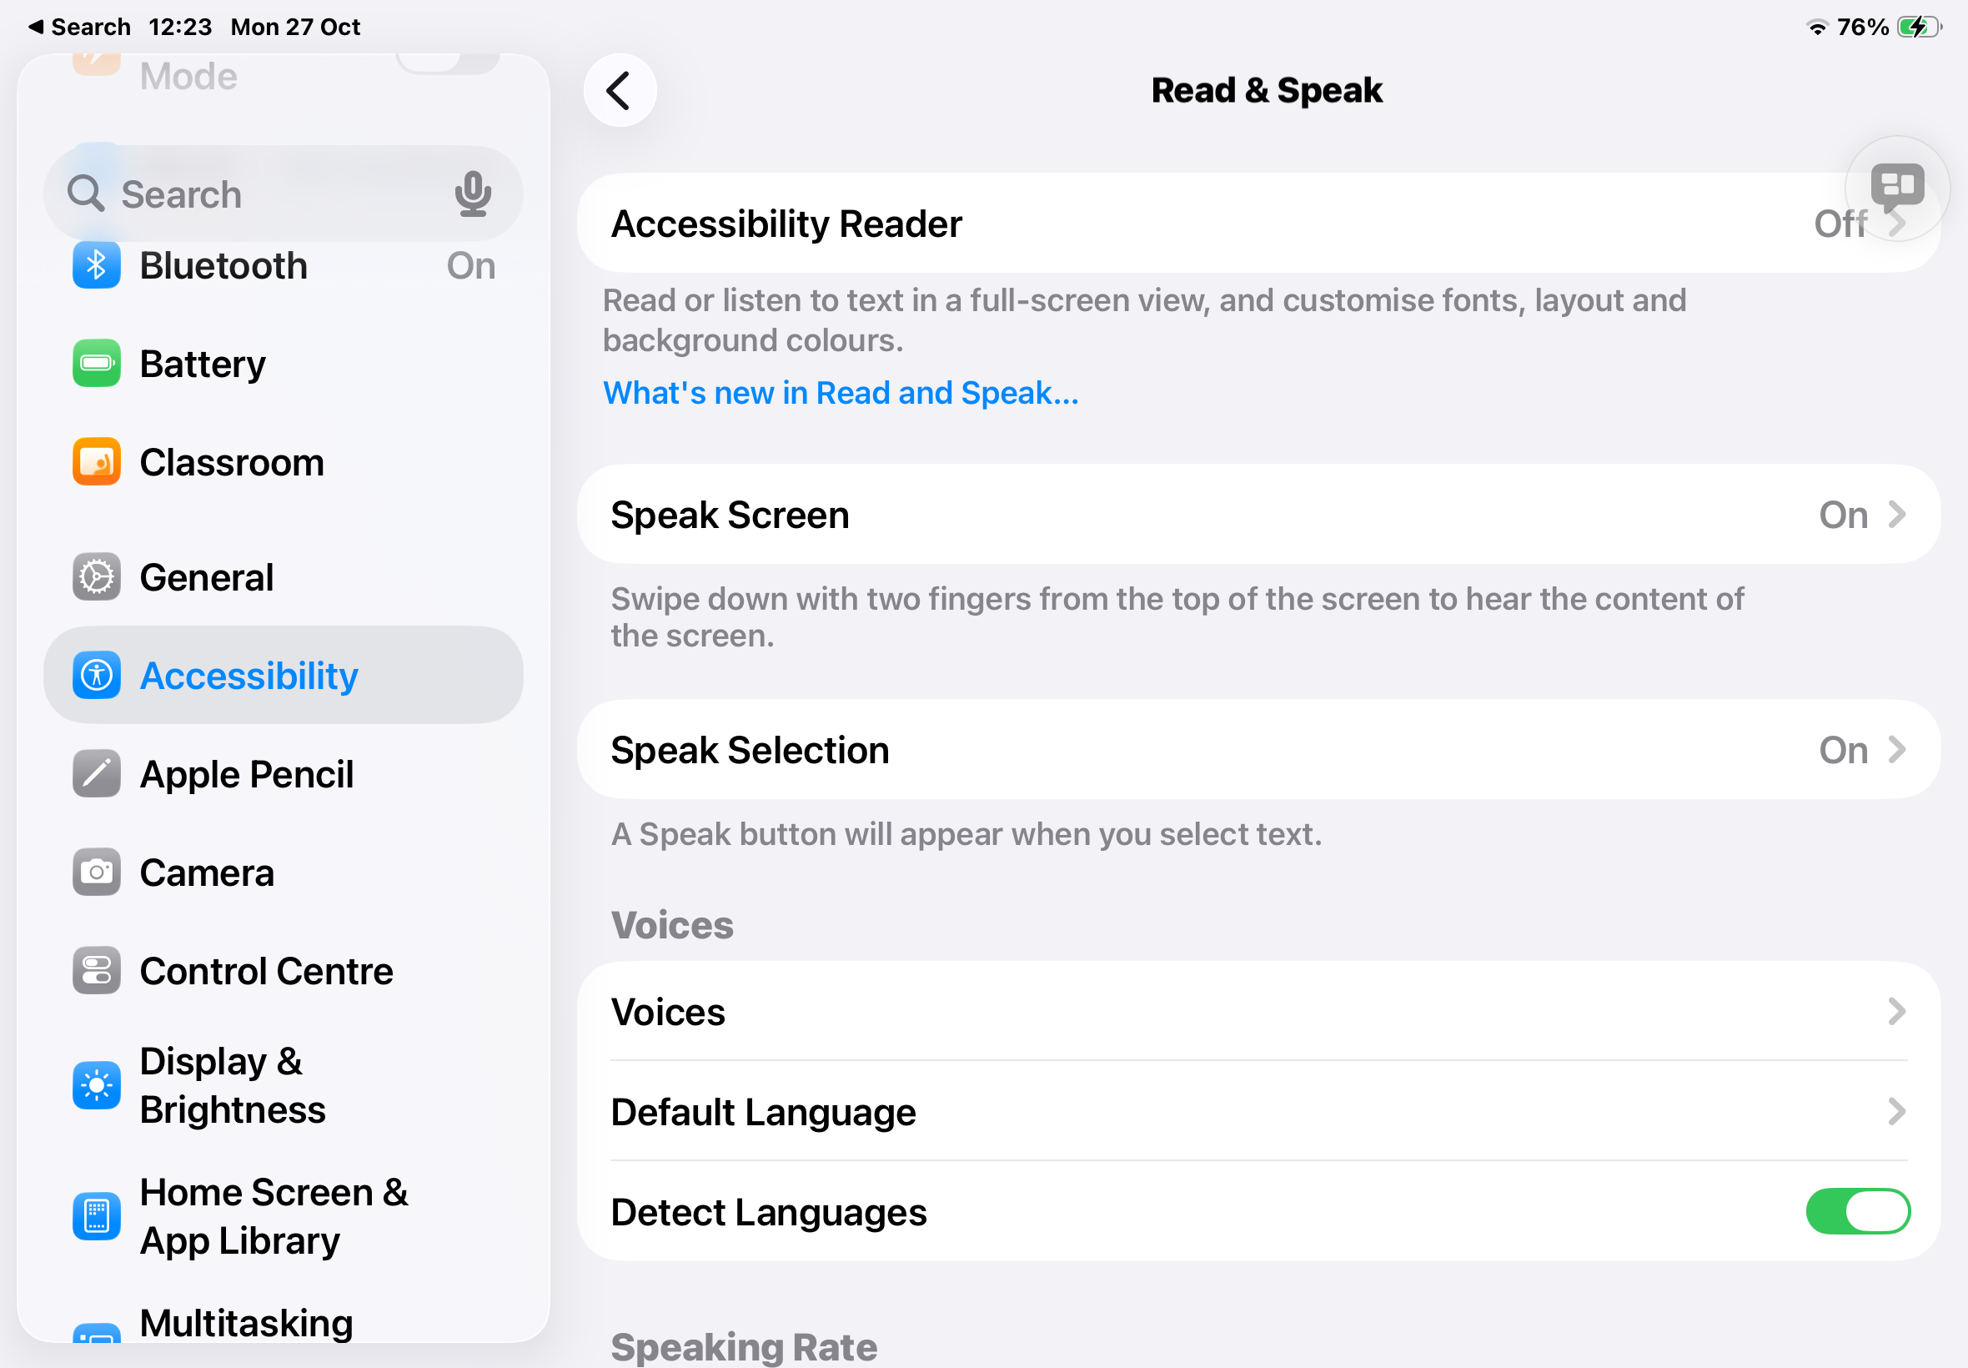
Voices
This lets you choose the voice that the iPad reads in.
If you tap: Voices then English you’ll get a few options like Rate and Voice options- I like Fiona because she is Scottish!

Slide 14
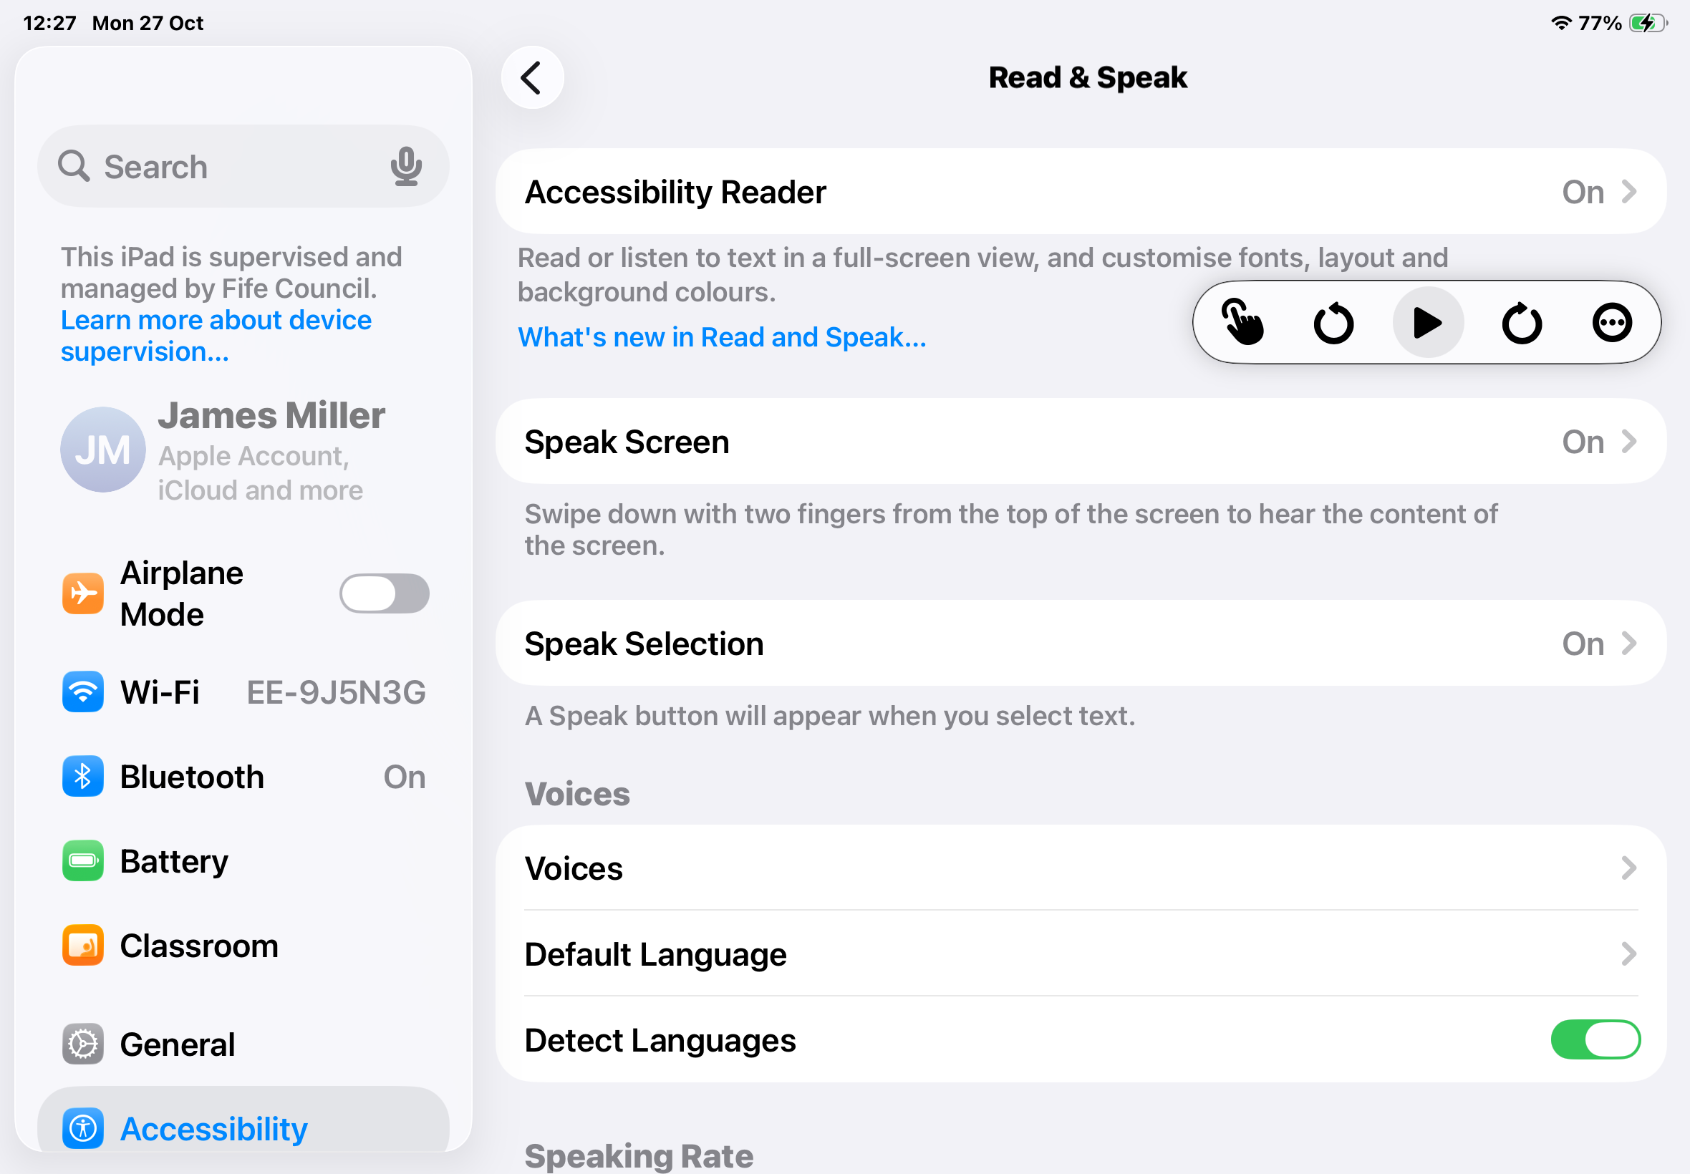
Speak Screen
Still within the Read and Speak menu, turn on Speak Screen.
Turn speech controller on, then a floating button appears that can be expanded.
Tapping the play button will read the whole screen.
By tapping the pointing finger then tapping any text on screen, it will read that aloud.
The controller can be tucked away again by tapping the 3 dots.

Slide 15


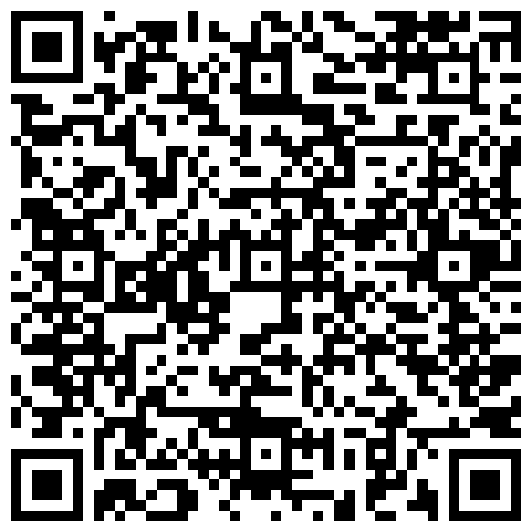
Head over to the BBC Bitesize website by following the QR code.
Try using the controller to listen to the whole page.
Try using the finger to select text.
Try highlighting a sentence and using the Speak option.
Notes:
Any website will do the job, but this one should take you to a BBC Bitesize article about the artist, Banksy

Slide 16
What did we cover?
Display and Speech
-changing the display on my iPad to suit my preferences.
-text to speech settings

Slide 17
This series of lessons was created by the Fife ATSS Team and is based on lessons created by Ms Linsey Miller (Sacred Heart Primary School ASC, Falkirk, linsey.miller@education.falkirk.sch.uk) and research carried out by Mrs Nicola Denholm (Larbert Village Primary School, Falkirk).
All content is protected by copyright. You may use the contents of these lessons and adjust them to suit your own context and practise; however you are strictly prohibited from reselling this series of lessons or any derivative created from it, either in part or in its entirety.

