Slide 1
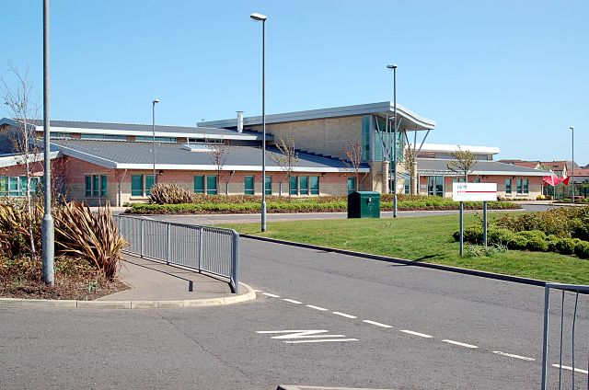
Welcome to our team at Anstruther Primary & Nursery

Slide 2
We would like to introduce the adults who support our children in learning and wellbeing.

Slide 3
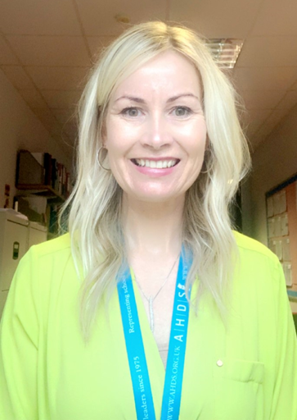
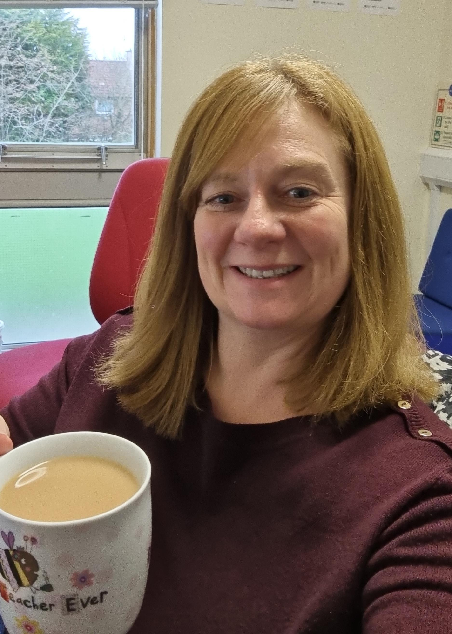
Our Senior Leadership Team
Mrs Easton - DHT
Miss Manton - HT
Mrs Hamilton - DHT
Mrs Todd - DHT

Slide 4
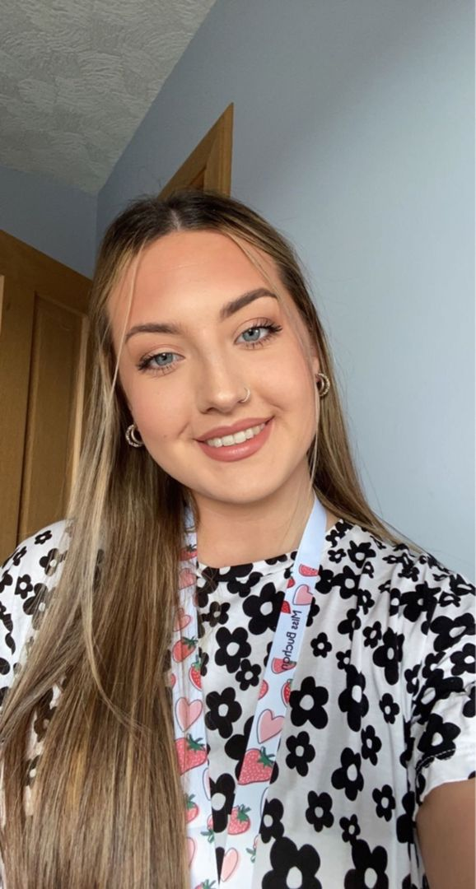
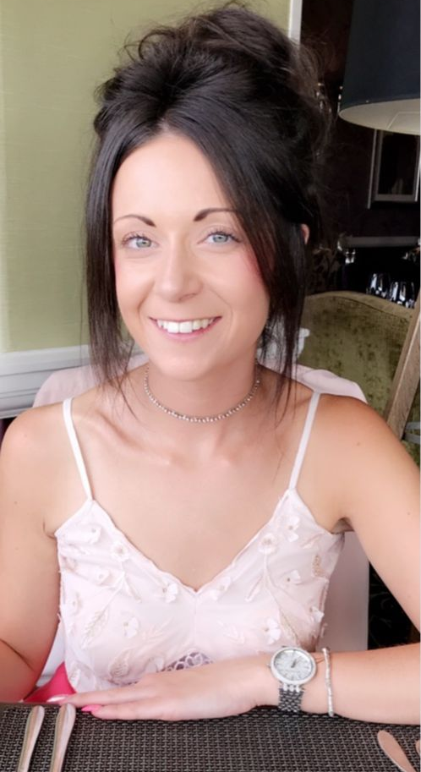
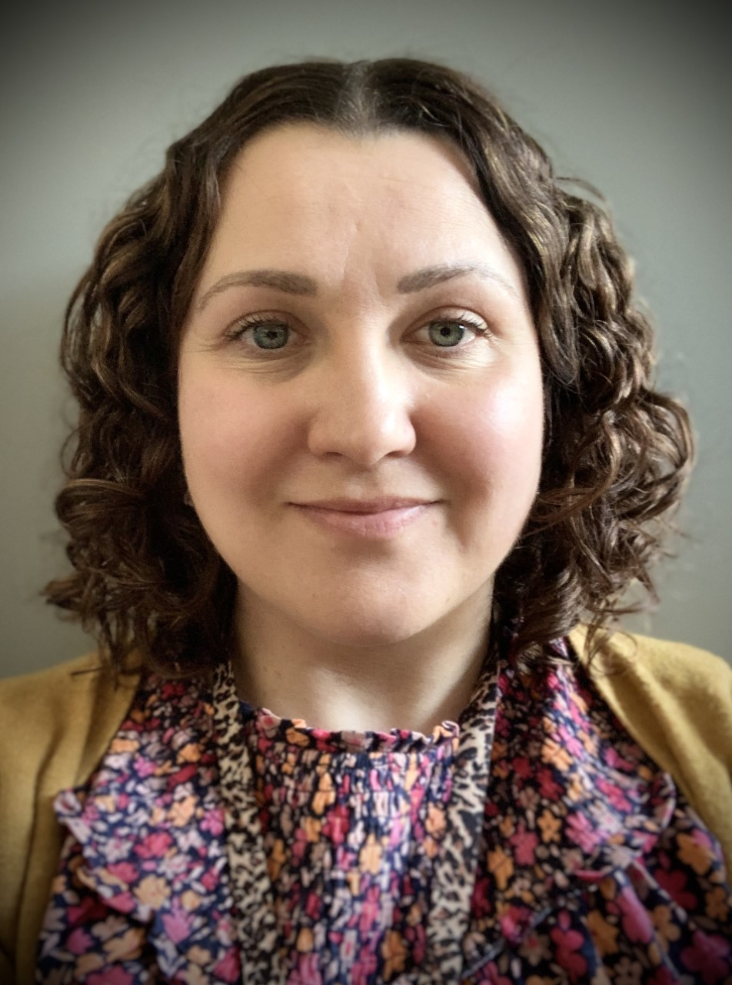
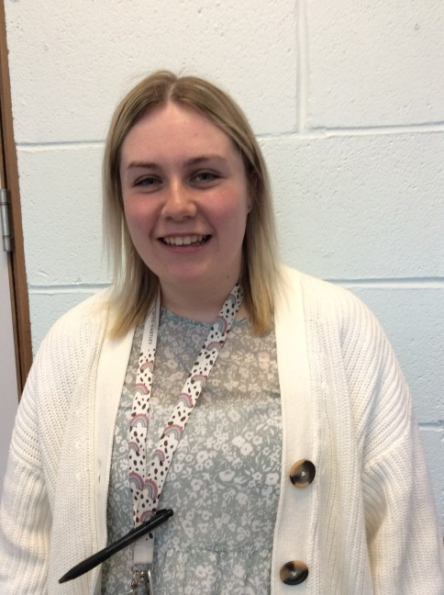
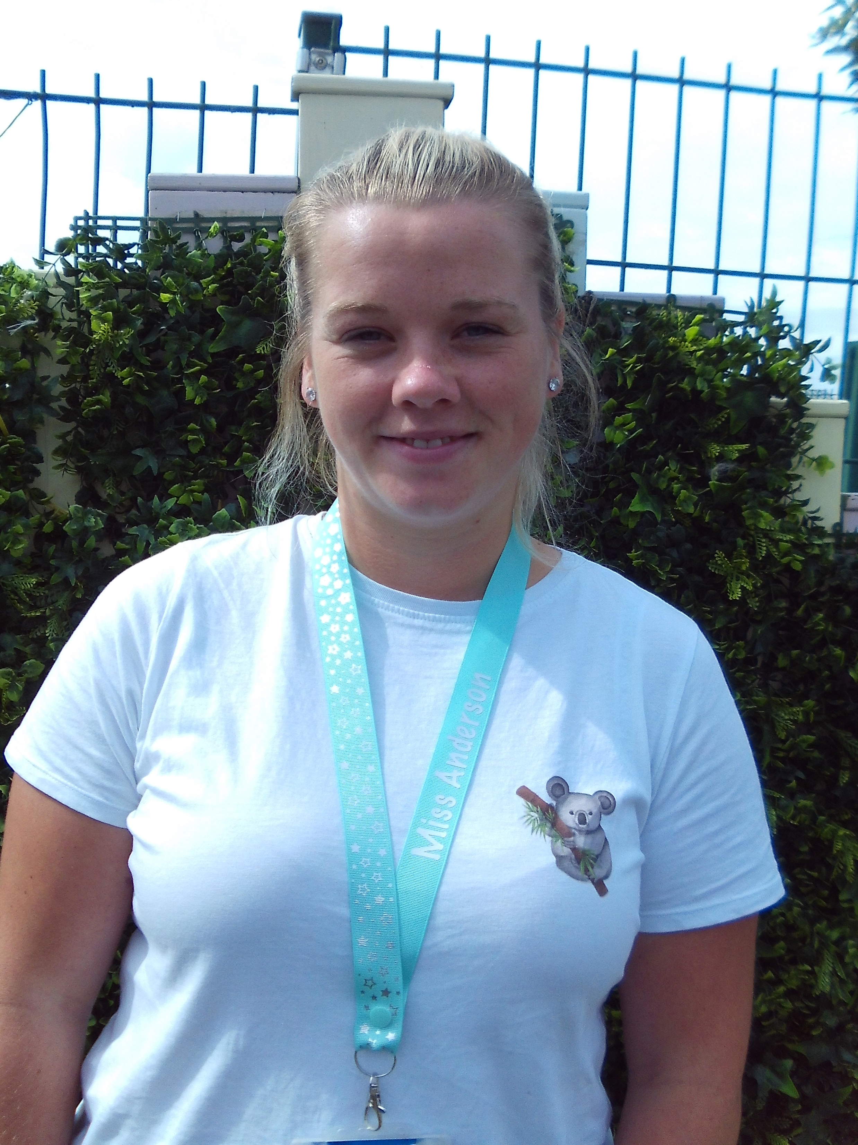
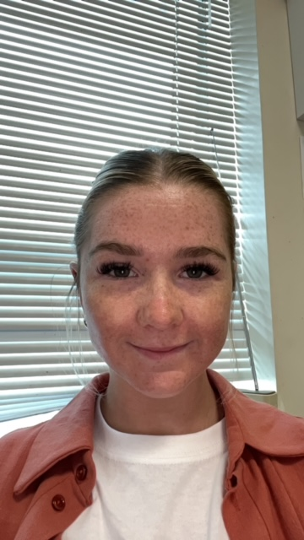
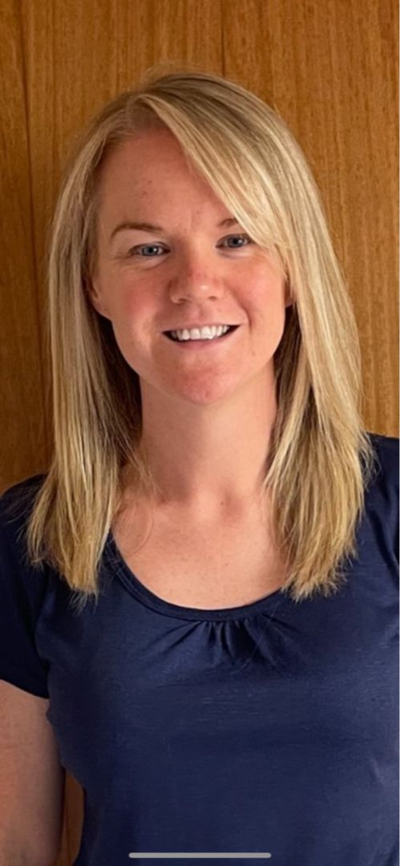
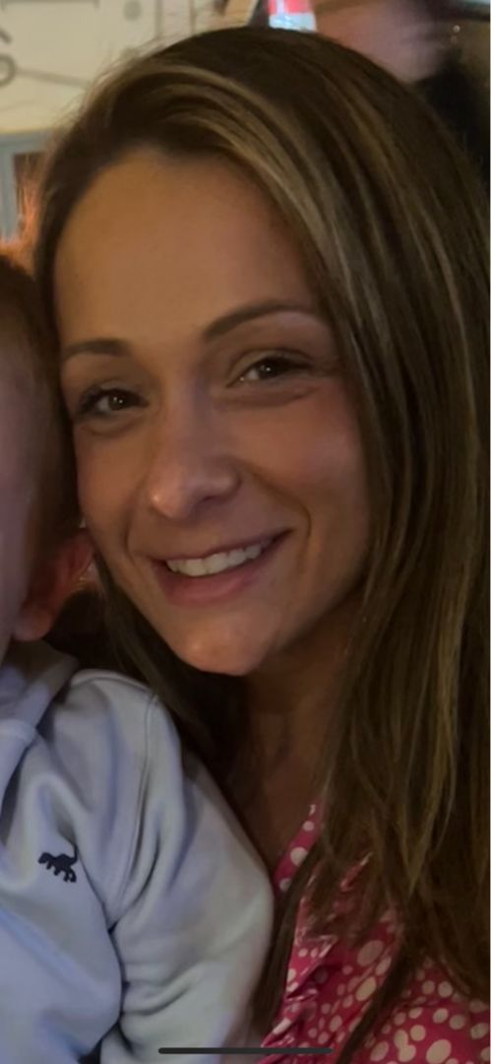
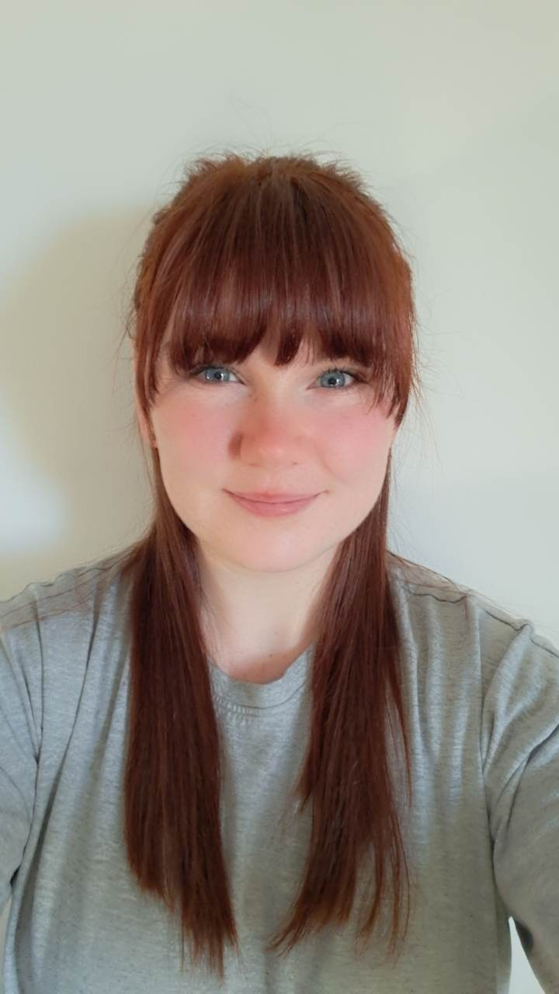
Our Early Learning Centre - Nursery
Miss Anderson
Miss Buchan
Miss Cameron
Mrs Gourley
Miss Hartley
Mrs Lowrie
Miss Partridge
Miss Scott
Mrs Smith
Mrs Strath
Miss West

Slide 5
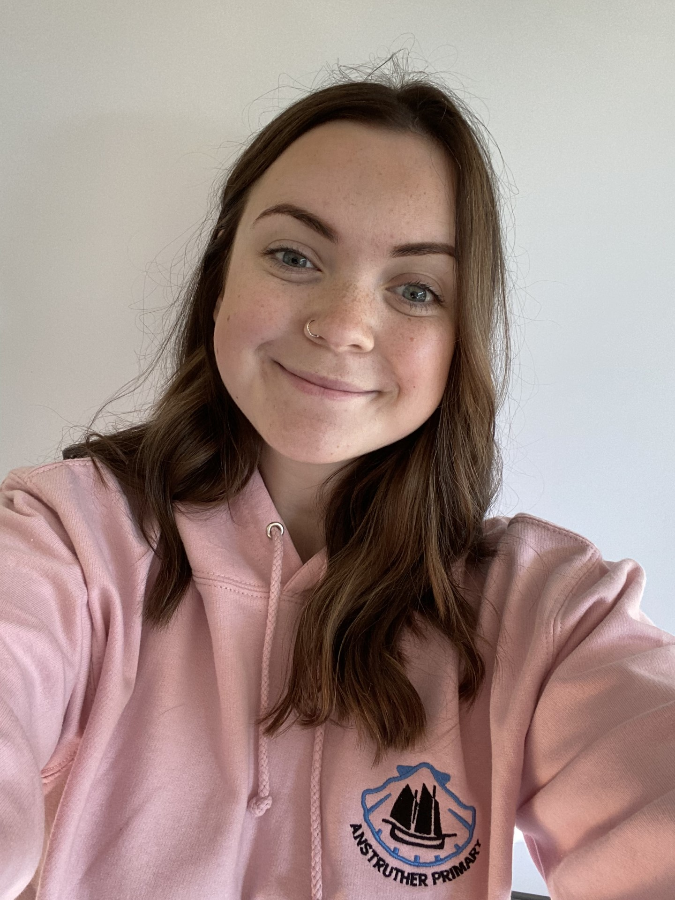
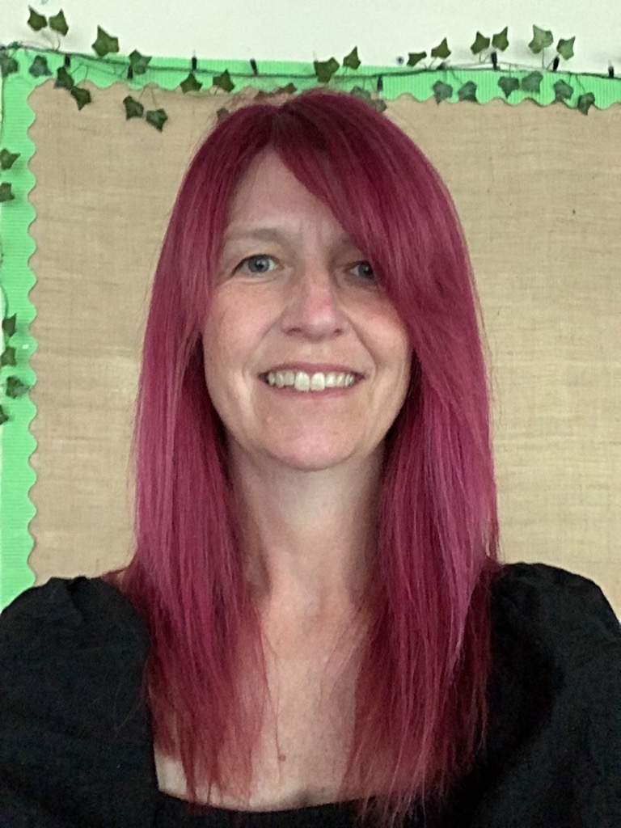
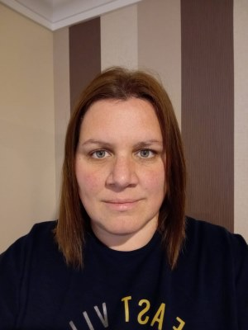
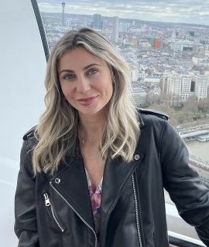
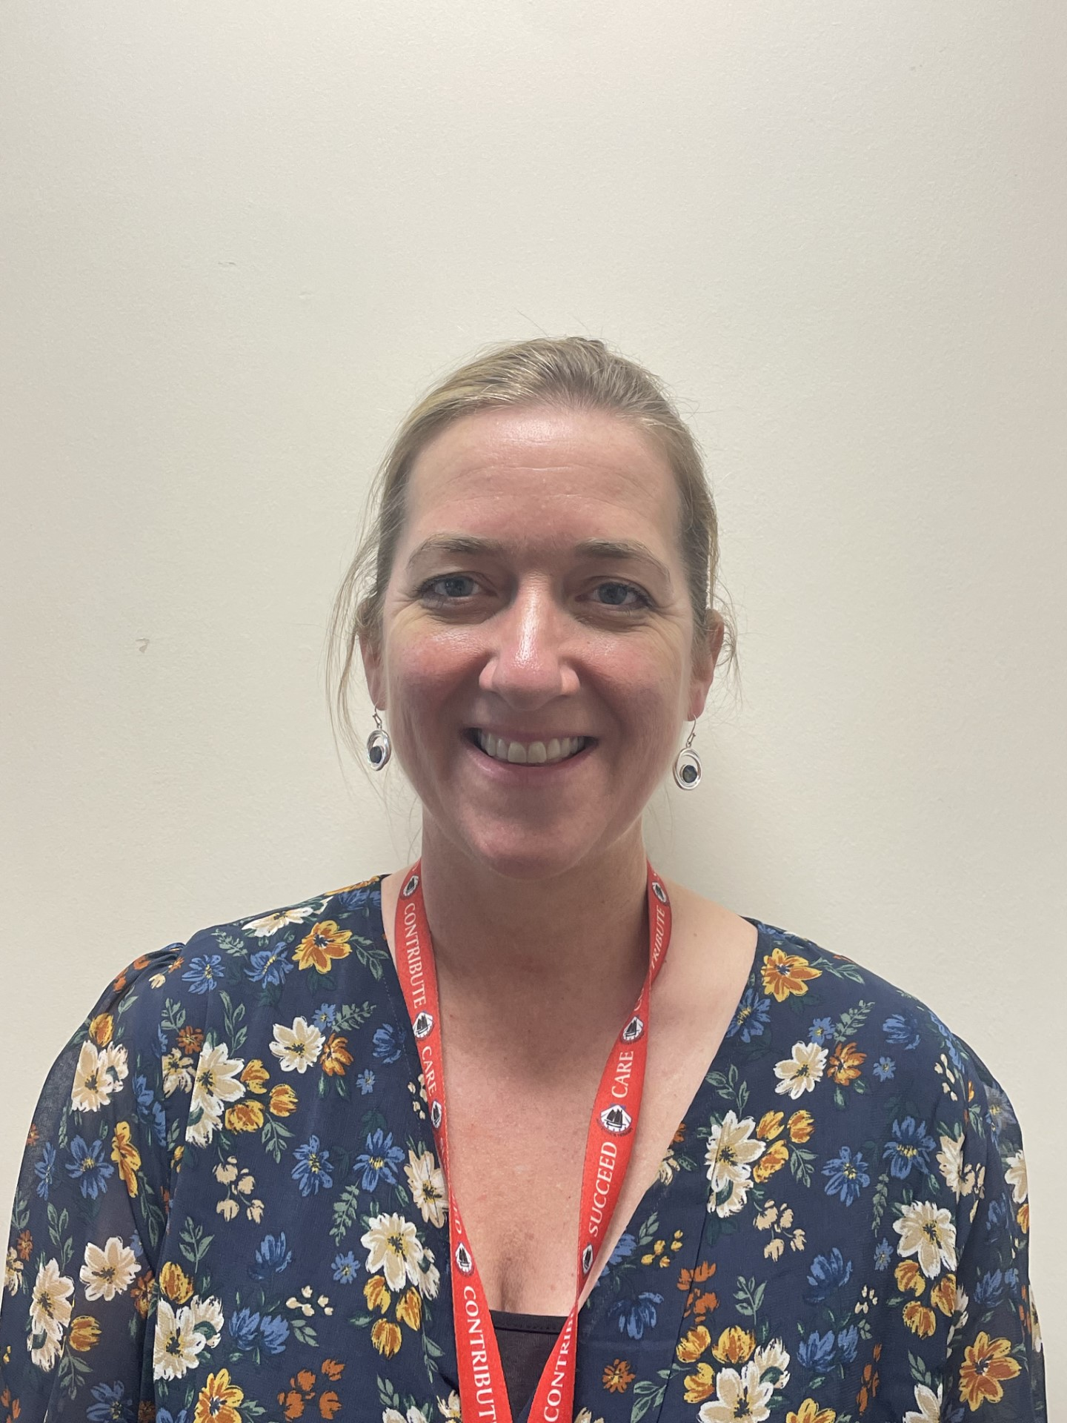
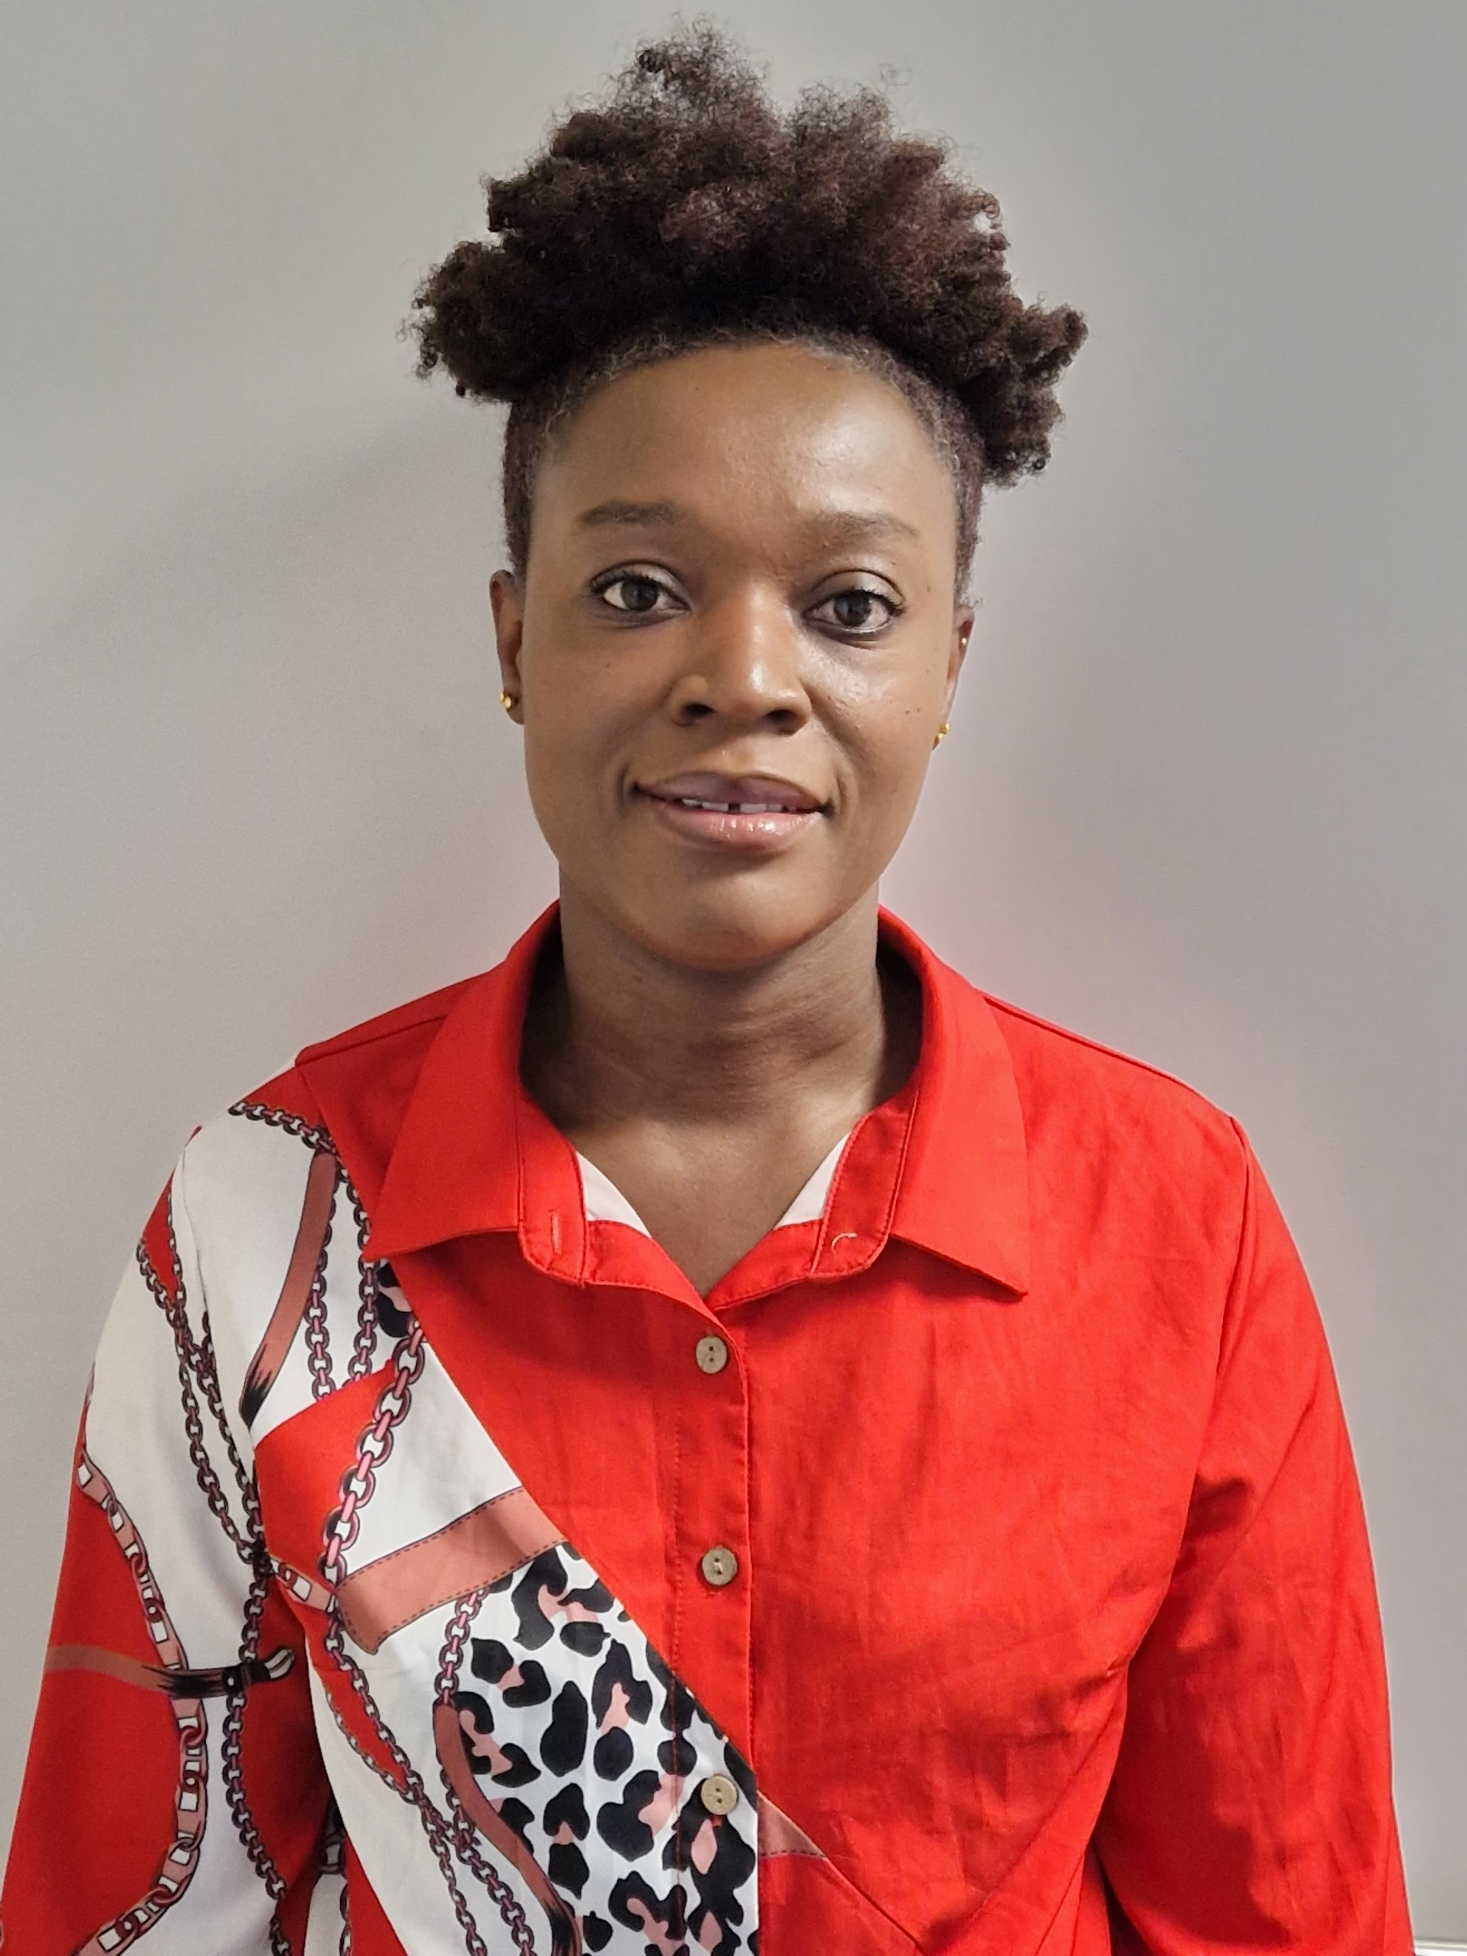
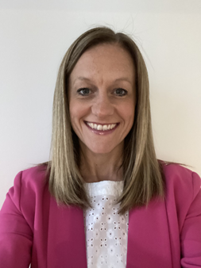
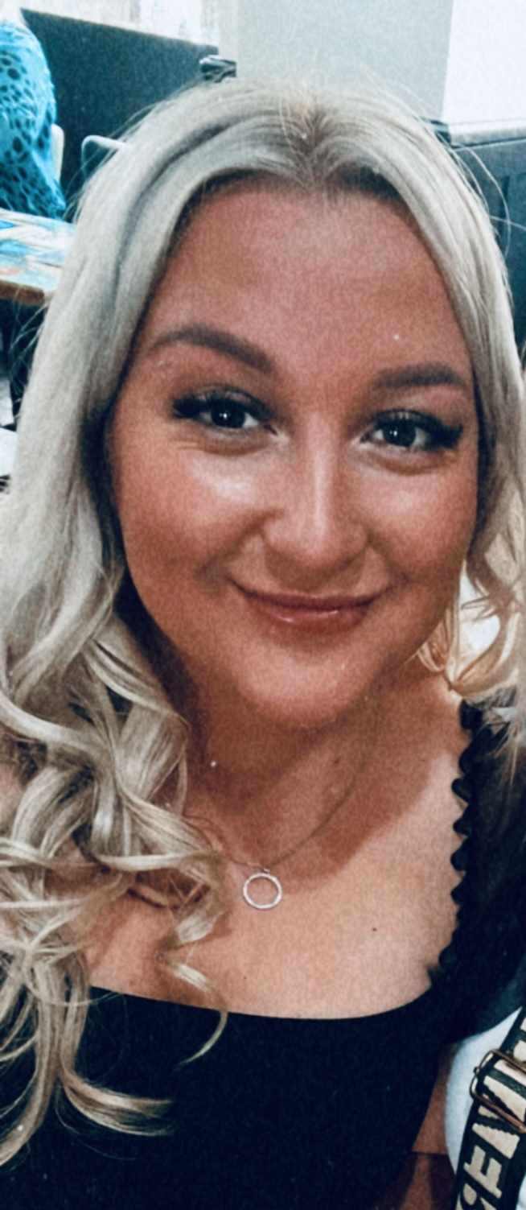
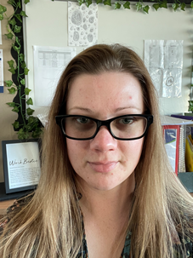
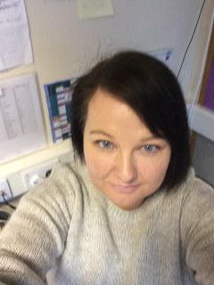
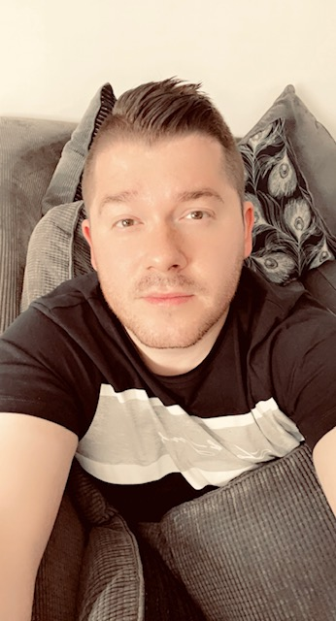
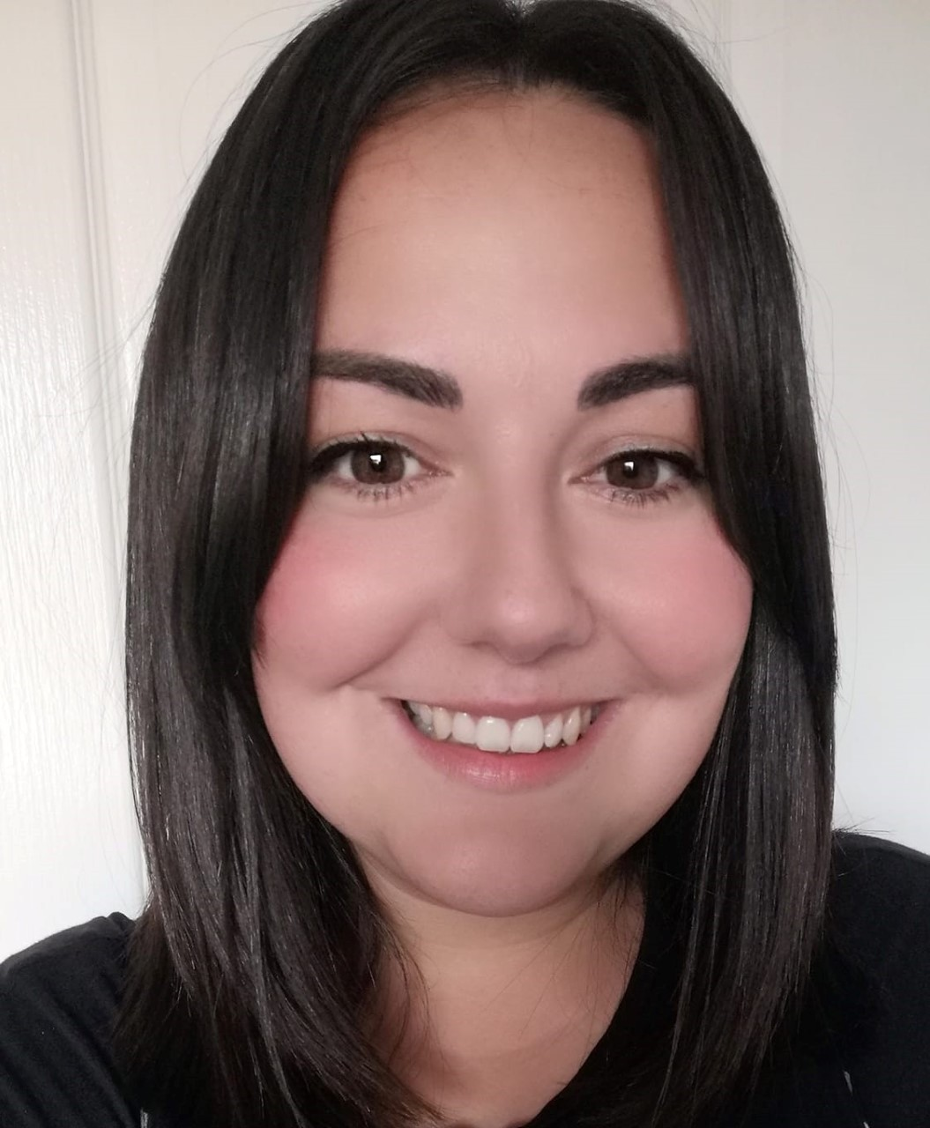
Our Primary Teachers
Miss Armour
Ms Badu
Miss Clunie
Miss Gillingham
Miss Jack
Miss King
Mrs McNeil
Miss McNeill
Miss Muldoon
Miss Murphy
Miss Niven
Miss Parker
Mr Wilson
Miss Wilson

Slide 6
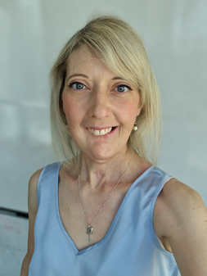
Our SFL Teachers
Mrs Morrissey
Our Non Class Contact Teachers
Mr Noble

Slide 7
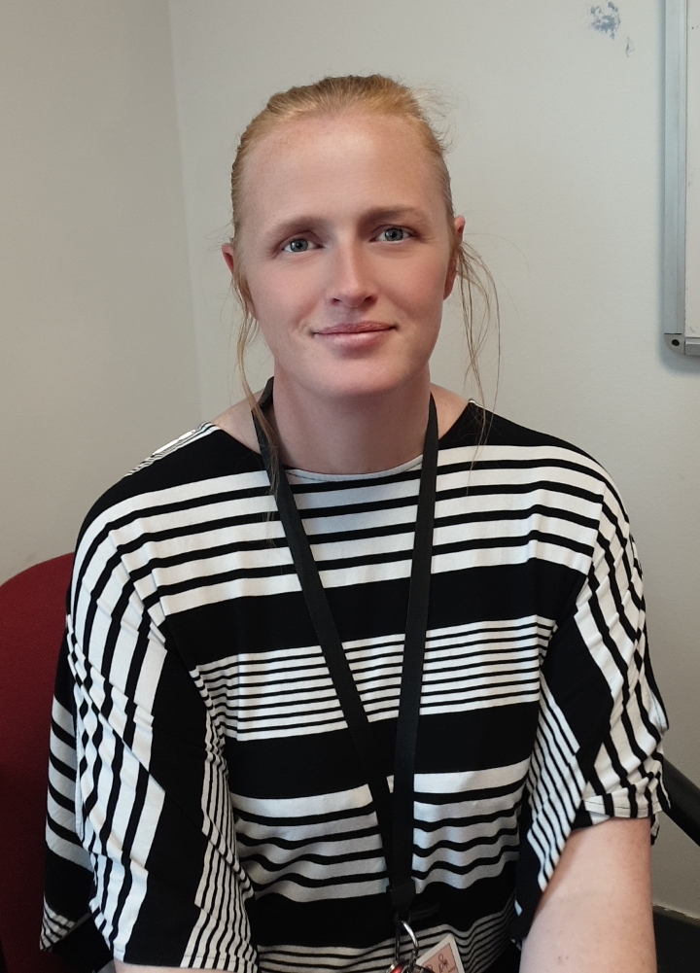
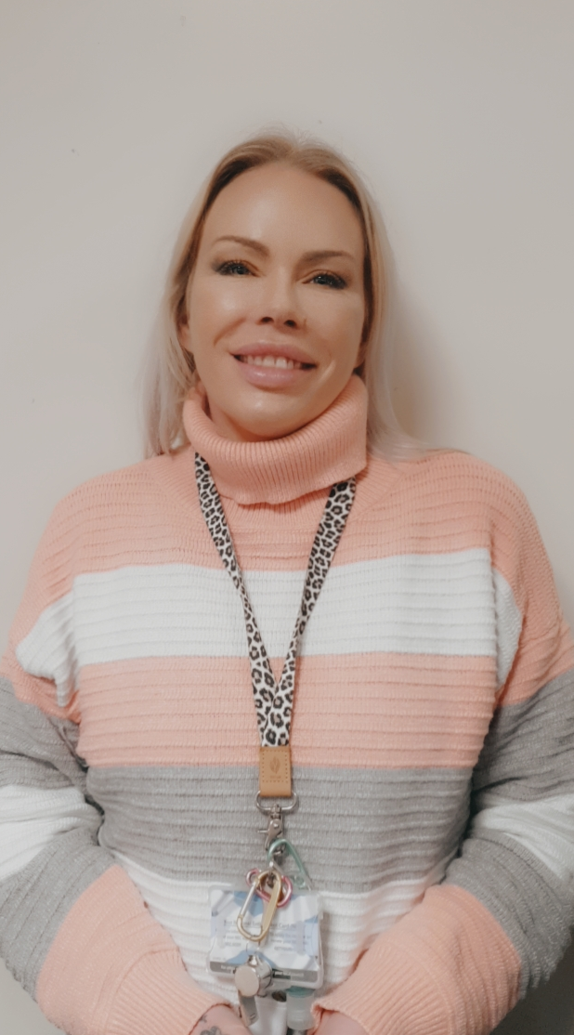
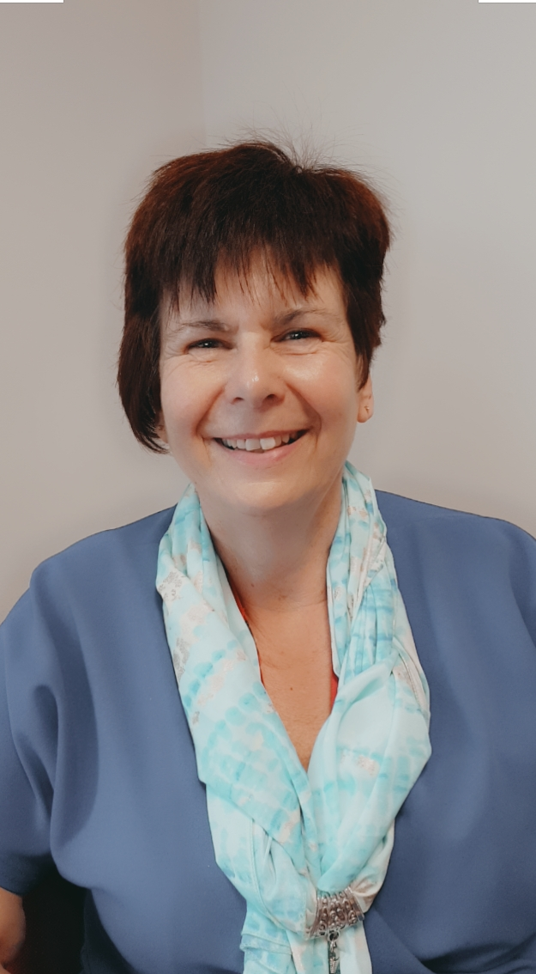
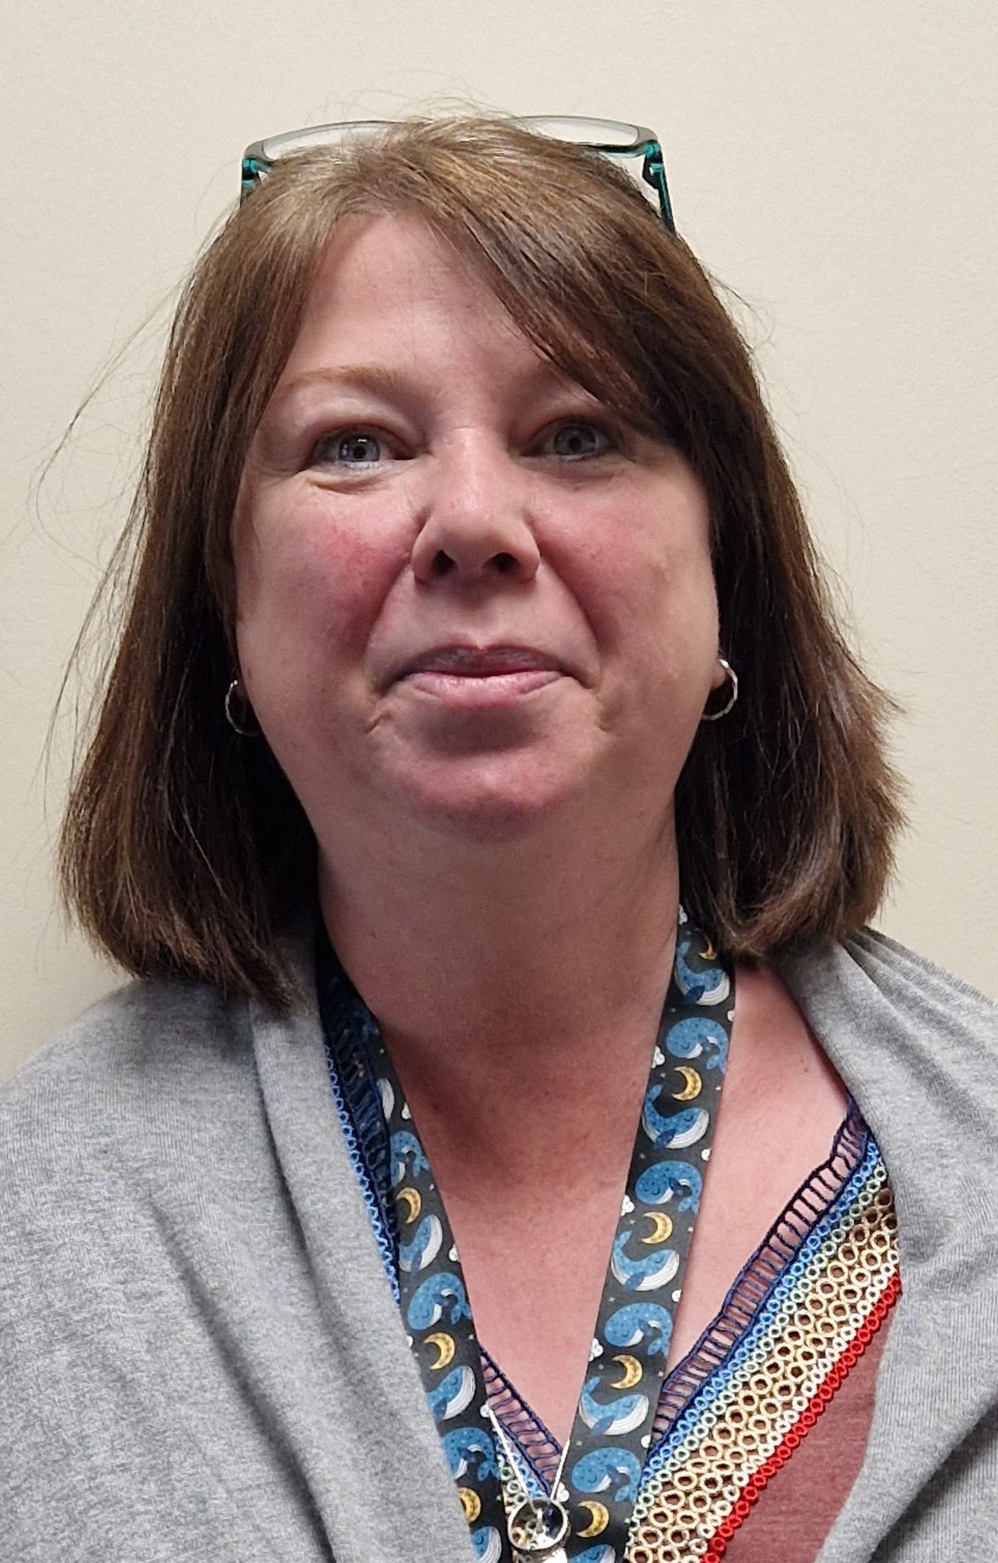
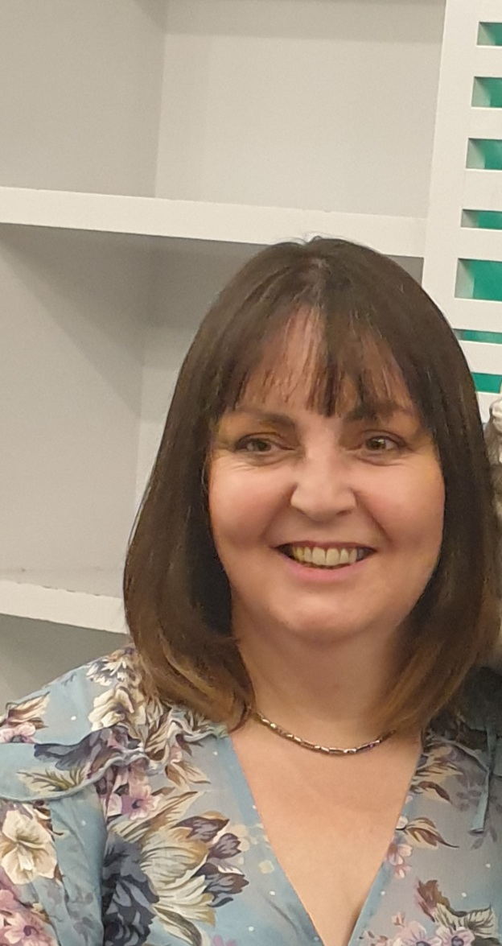
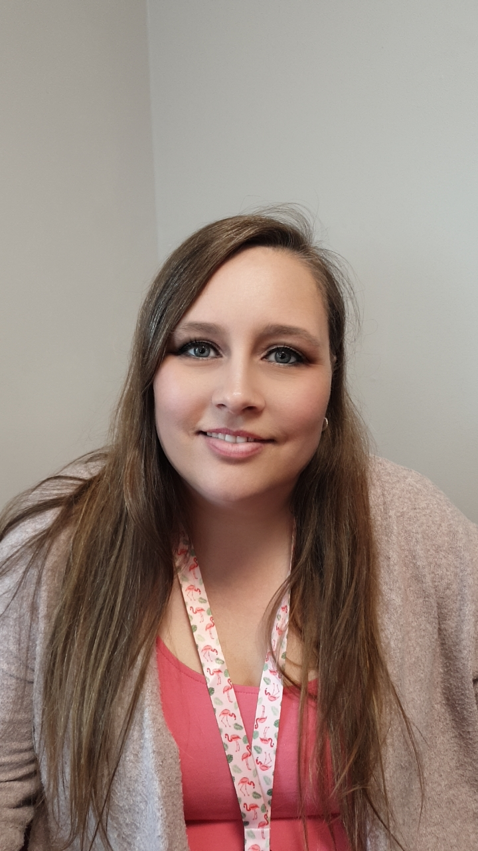
Our Pupil Support Assistants
Miss Bruce
Mrs Cowan
Mrs Horsburgh
Miss McLean
Mrs Reilly
Mrs May

Slide 8
Our Office Staff
Mrs Campbell
Miss Jackson
Miss Shaw

Slide 9
Our Catering Assistants and Janitors

Slide 10
We hope this helps you become a little more familiar with the team who work here. If you need to make contact with anyone in the team email Anstrutherps.enquiries@fife.gov.uk or telephone 01334 659447.

