Slide 1
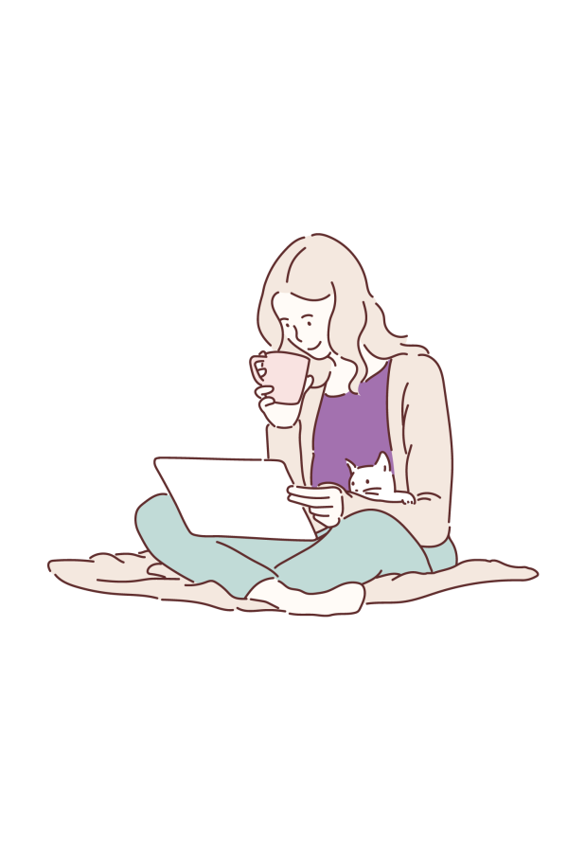
Shine
Shine is a 6 session online anxiety management group for adolescents, using a CBT approach. The course looks at helping teenagers identify anxiety when it occurs and learn strategies to tackle it effectively.
Young people are eligible for the group if they are:
Aged between 12 and 17 years
Mild to moderate anxiety, and would benefit from learning strategies for managing stress and anxiety
Do not require intensive or crisis support
The next group starts on Tuesday 7th January 2023 and runs until Tuesday 14th March 2023 from 4.15pm-5.15pm
To sign up visit: www.accesstherapiesfife.scot.nhs.uk
NHS Fife Child and Family Psychology Department

