Slide 1
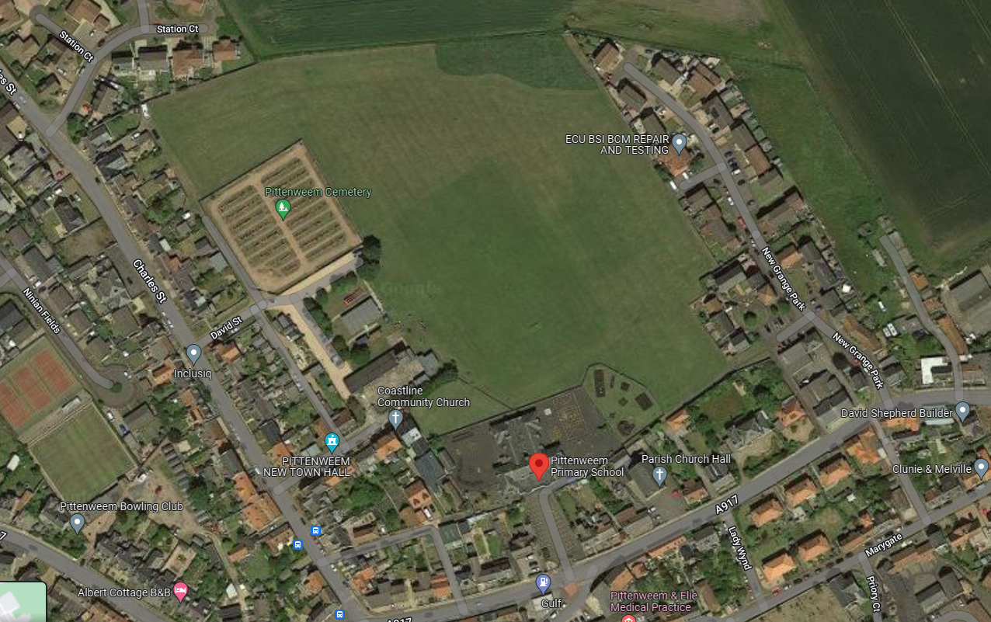
P1-2 Race Start/Finish Point
Parking
P3-4 & P5-7 Race Start/Finish Point
parent viewing areas

