Slide 1
Primary 4
P4Q- Miss McCafferty

Slide 2
The Year Ahead 2023-24
Adults in P4Q:
Class Teacher: Miss Sarah McCafferty
Music – Mrs Tracey Brockie (every second Monday)
PE – Mr Ross Manchip (Monday, Thursday with class teacher)
Support for Learning Teacher: Mrs Gillian Downie
PEF funded EYO: Miss Julie Wood
Support for Learning Assistant: Monika

Slide 3
Daily Routines
Playtime – please make sure children have suitable play pieces. Try to encourage healthy snacks. Waste free Wednesday and Fruity Friday.
Children are encouraged to bring water bottles to school which they are allowed to keep on their desk. Break: 10.00 – 10.15 Lunch: 12.15 – 1.00 (Lunches can be pre-ordered using ipay)

Slide 4
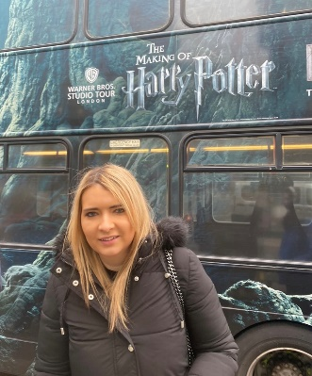
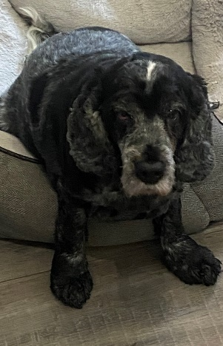
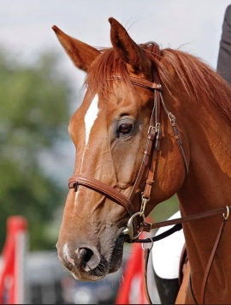
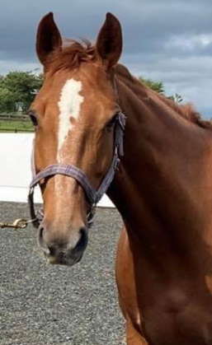
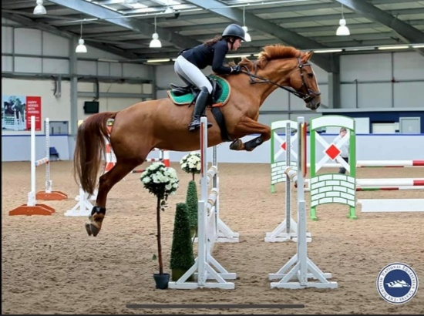
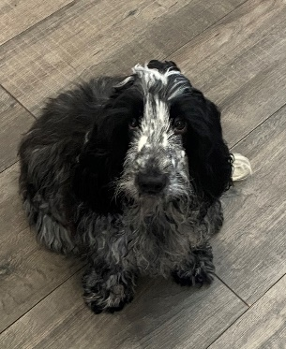
Introducing Miss McCafferty! …
Hello, my name is Miss McCafferty!
I joined Westquarter Primary in August 2016.
I have 2 dogs called Briana and Collins and 2 horses called Red and Sian.
I enjoy taking part in showjumping competitions with my horses.
I love Harry Potter!
I look forward to working with you all this year ☺

Slide 5
PE
PE days:
Thursday with Miss McCafferty
Monday with Mr Manchip
Please ensure that your child brings suitable PE kit on these days (school jumpers, polo shirt, dark coloured shorts/leggings/joggies)
Jewellery should not be worn on gym days and long hair preferably tied up. If earrings can’t be removed they must be covered with tape.

Slide 6
Class Charter
During the first few weeks of school, the pupils worked together to create our Class Charter. As a class we completed activities to decide which rights were most important to us. We choose the following articles:
Article 12 – The right to be heard
Article 19 – The right to be safe
Article 24 – The right to be healthy
Article 28 – The right to learn
Article 31 – The right to rest and play
We then discussed and voted on a theme for our charter with the most popular choice being a ‘Pokemon charter’.

Slide 7
Rights Respecting Schools Westquarter’s Rights Journey
Westquarter Primary is working on the Rights Respecting Schools Award.
We have achieved our Bronze Award and are working towards Silver.
Pupils learn about the UNCRC (United Nations Convention on the Rights of the Child) and their rights in class.
Each class will set up a Class Charter which is an agreement as a class about how the Rights of the Child will be respected.
Pupils are Rights Holders and adults in school and at home are Duty Bearers.
Children may discuss this with you at home. Please let us know if you would like any more information.
Article 42
All adults and children should know about this convention.

Slide 8
What is the UNCRC?
The United Nations Convention on the Rights of the Child is a universally agreed set of non-negotiable standards and obligations, built on varied legal systems and cultural traditions.
The Convention has a total of 54 articles.
In school we focus on Articles 1-42.
Articles 43-54 are about how adults and governments work together to make sure that all children get all their rights.

Slide 9
Ready, Respectful and safe
Reminder
“I’ve noticed that – reminder of rule.
I need you to – relate to rule.
Do you remember . . .? – relate to positive behaviour observed.
That’s who I need to see today!”
Last Chance
“This is your last chance to make the right choice.
You will have a time out.
You’ll have to speak to me at . . . – state time.”
Time out
“You need some time out.”
Warning
“I’ve explained that you’re not – reminder of rule.
You know what the consequences are.
Think carefully about your next steps.”
Repair – consequence if necessary

Slide 10
Emotion Works is a health and well-being resource used in school to develop
children’s emotional vocabulary. More information on this resource can be found on the school website ☺.

Slide 11
Absences
Although we encourage pupils to be in school every day we know absences are inevitable throughout a school year.
If your child is absent please contact the school via phone call or email to let us know why.

Slide 12
Literacy
Spelling – Set spelling words will be given each week which will also be available on Teams. Individual spelling cards also used in class.
Handwriting – Our focus will be on joining letters.
Writing – Talk for Writing. Working on a genre of writing for a specific period of time.
Reading – We will have a class novel and will have BugClub books every 1-2 weeks dependant on length. Novels for groups may begin at points throughout the year.

Slide 13
Maths
In maths we will be following the HAM resource, we are currently focusing on place value.
This year we will cover:
Place value (including comparing and ordering and rounding)
Multiplication and division
Fractions
Addition and subtraction (introducing the formal method)
Time
Money
Shape and symmetry
Position and Movement
Measure
Information handling
The children will have a variety of activities including times where they are writing and using text books, using the iPads, playing games (bought and made), and writing in formal jotters.

Slide 14
Health and Wellbeing
Living our values
Building resilience
Health and Wellbeing topics – Global Goals, harmful and safe substances and relationships.
Small Healthy Playpiece: e.g. fruit/veg, biscuit, small packet of crisps
Water Bottles: water only please - no juice allowed in class
School dinners – go over with children at home. Please send a packed lunch if they do not like anything.
2 hours of quality P.E.
Active Mile
Outdoor Learning

Slide 15
Online Learning
Log in details will be sent home for the following websites:
Active Learn Online – Children can access their Bug Club books and complete comprehension activities online.
Education City – A variety of different literacy and numeracy task will be available to access online.
Glow/Teams – Weekly spelling words, spelling activities and reading records will be available on our class Teams page.

Slide 16
IDL (Interdisciplinary Learning)
IDL is a planned approach to learning which uses links across different subjects or disciplines to enhance learning.
The children are involved in choosing what they would like to learn and how they would like to learn it.
Topics covered this year to incorporate all areas of the curriculum.
Possible topics – Global Goals, The Vikings, STEM topic. Topic subject may change according to children's interests.

Slide 17
Time | 9:00 – 10:00 |  | 10:15 – 11:15 | 11:15 – 12:15 |  | 1:00 - 2:00 |  | 2:00 - 3:00
Mon | Literacy | B R E A K 10 10:15 | Numeracy | Literacy | L U N C H 12:15 1:00 | PE Mr Manchip (NCCT) |  | Health and Wellbeing/Music (every 2nd week) 2:30 - Library
Tues | Literacy |  | Numeracy | Literacy |  | IDL | Assembly 1:20-1:45 |  | Fun 31
Wed | Numeracy |  | Literacy | Literacy |  | NCCT |  | Art
Thurs | Literacy |  | Maths | Literacy |  | PE |  | IDL
Fri | Numeracy |  | Literacy | Literacy |  | IDL |  | Fun 31

Slide 18
Our Rules
Ready
Lovely Lines
Prepared for class
Organised for school
Finish work on time
Listening to instructions
Focused
Not wasting time

Slide 19
Our Rules
Respectful
Be kind
Tell the truth
Tell people how you feel
Do your best-work hard
Keep school tidy
Good manners

Slide 20
Our Rules
Safe
Be familiar with the fire drill
Wonderful walking
Push in chairs
Keep classroom tidy
Keep safe while running in the playground
Look where you are going

Slide 21
Restorative Practises
Its about ‘justice for all’
Whole school approach by all staff and pupils
RESPECT – for everybody by listening to opinions of others
RESPONSIBILITY – for your own actions
REPAIR – identifying what went wrong and ensuring it won’t happen again
What happened?
Who has been affected?
How can we find a way forward?
How can we do things differently in the future?
Takes time but it’s worth it!

Slide 22
Communication
Please do no hesitate to call or email the school with any enquiries ☺.
Tel: 01324 503950
Email: westquarterprimaryschool@falkirk.gov.uk

Slide 23
Class Twitter
Follow our learning journey on our class Twitter!
@WPSSheltie
Our school twitter is
https://twitter.com/WestquarterPrim
@WestquarterPrim

Slide 24
Thank you for coming. I look forward to watching the children develop and grow this year.
Miss McCafferty ☺
Any questions?

