Slide 1
Meet the Teacher
Mrs Bruce & P7W

Slide 3
Primary 7 Expectations
Display a high level of resilience and independence
Show an understanding of the importance of education by being focused, hardworking and determined to achieve

Slide 4
Adults in P7W
Class Teacher - Mrs. Fiona Bruce
Music – Mrs. Tracey Brockie
PE – Mr. Ross Manchip
French – Mrs. Jennifer Downie
Support for Learning Assistant - Debbie Cochrane
Active Schools – Jen Cairns

Slide 5
Daily Routines
9:00 – 9:15 – Know and grow. All children are greeted at the door and given time to settle in with a calming morning task.
10:00 – 10:15 – Playtime
12:15 - 1:00 - Lunch

Slide 6
Daily Routines
Water – a water bottle should be brought to school each day. Please ensure these don’t contain fizzy juice, energy drinks, milkshakes etc. Children can refill their bottles in class.
Snack – children can bring a small, healthy snack for playtime. This should be something they can eat in 15 minutes. Children get house points for ‘waste free Wednesday’ and ‘fab fruit Friday’.
School lunches – can be ordered in advance on iPay.
Allergies – a reminder that food with nuts cannot be brought to school. Various breakfast bars and Nutella contain nuts, please check the packaging of snacks.

Slide 7
Weekly Routines
We cover a variety of curricular areas on our weekly timetable.
Music with Mrs Brockie – Monday
French with Mrs Downie - Monday
P.E with Mr Manchip – Tuesday
Assembly with Mrs Ramsay – Tuesday
P.E with Mrs Bruce - Friday
MUGA – Wednesday
Can you please ensure that children are wearing uniform for P.E black/grey jogging bottoms/leggings, white t-shirt & trainers. Please no football tops.

Slide 8
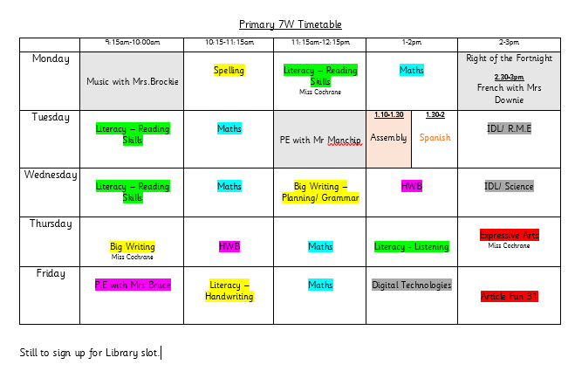

Slide 9
P7 Opportunities
House Captains – The children will have an opportunity over the next few weeks to write their speeches to present to the rest of the school.
Reading buddies – will be pairing up with P3
Information on other clubs will follow shortly.

Slide 10
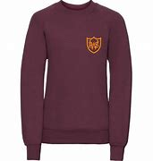
Uniform
A great start to the year! Please label all clothes and belongings, it’s much easier for them to be reunited!
School jumper or cardigan (they can take this off for the lesson)
Remove jewellery before school

Slide 11
Parent/ Teacher Communication
Working as a team is the best way to make this year a positive and successful one for your child.
If you have any queries or concerns please do not hesitate to email the school and I will get back to you as soon as possible ☺
01324 503950
westquarterprimaryschool@falkirk.gov.uk
I will be in the playground after school for any quick chats and comments.
Your child's progress will be shared via parents evenings and a end of year report.

Slide 12
If you’re on X (twitter) please follow us so we can share our learning with you all @wqps_mrsbruce
Please do not send any private messages, I cannot respond to these.
If posting pictures or replying, please do not write your child’s name, you can use their first initial if you wish, e.g P was successful at their tournament this weekend

Slide 13
Absences
If your child is unwell and cannot attend school, please contact the school in the first instance.
Please notify the office of any appointments, informing us of when your child will arrive at school/be collected/arrive back.
A reminder that children must be 48 hours clear of stomach bug symptoms and a temperature.

Slide 14
Westquarter’s Rights Journey
Westquarter Primary is working on the Rights Respecting Schools Award.
We have achieved our Bronze Award and are working towards Silver.
Pupils learn about the UNCRC (United Nations Convention on the Rights of the Child) and their rights in class.
Each class will set up a Class Charter which is an agreement as a class about how the Rights of the Child will be respected.
Pupils are Rights Holders and adults in school and at home are Duty Bearers.
Children may discuss this with you at home. Please let us know if you would like any more information.
Article 42
All adults and children should know about this convention.

Slide 15
What is the UNCRC?
The United Nations Convention on the Rights of the Child is a universally agreed set of non-negotiable standards and obligations, built on varied legal systems and cultural traditions.
The Convention has a total of 54 articles.
In school we focus on Articles 1-42.
Articles 43-54 are about how adults and governments work together to make sure that all children get all their rights.

Slide 16
Ready
Lovely Lines
Prepared for class
Organised for school
Finish work on time
Listening to instructions
Focused
Not wasting time
Safe
Be familiar with the fire drill
Wonderful walking
Push in chairs
Keep classroom tidy
Keep safe while running in the playground
Look where you are going
Respectful
Be kind
Tell the truth
Tell people how you feel
Do your best-work hard
Keep school tidy
Good manners

Slide 17
Classroom Expectations
We use a restorative approach to behaviour at Westquarter. This is a whole school approach followed by all staff and pupils.
It encourages children to take responsibility for their own actions and make any necessary repairs.
If there are any concerns around behaviour, parents and carers will be contacted by a phone call or by a quick chat in the playground. If necessary, a meeting will be organised.
As well as this, you may receive a call to advise of positive behaviours ☺

Slide 19
Restorative Practice
Whole school approach by all staff and pupils
RESPECT – for everybody by listening to opinions of others
RESPONSIBILITY – for your own actions
REPAIR – identifying what went wrong and ensuring it won’t happen again
1. What happened?
2. Who has been affected?
3. How can we find a way forward?
4. How can we do things differently in the future?

Slide 21
Our first week in P7
Building and maintaining positive friendships
Building a relationship with class teacher and support for learning
Expectations of P7
Feeling safe and happy at school
Literacy – introduction of class novel, ‘A Kind of Spark’ by Ellie Nicol’s
Numeracy – revisit some prior learning and place value
Health and Wellbeing – reintroduction of the cog model
The Rights of the Child (UNCRC) and Global Goals
Creating a classroom environment that is inclusive to all
Training the Playground buddies in P6

Slide 22
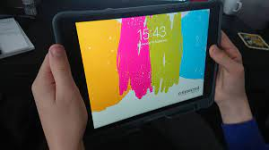
iPads
Children are expected to come to school with their iPads everyday with them fully charged
It is the children’s responsibility to look after their iPad’s
Unfortunately, it isn’t an option for children to charge their iPads in school

Slide 23
Curriculum for Excellence
We will use a variety of teaching approaches to teach the curriculum:
Active learning
Outdoor learning
Cooperative learning
Digital technologies
Self and peer assessment
Transferring learning across the curriculum
Interdisciplinary learning – child led topics

Slide 24
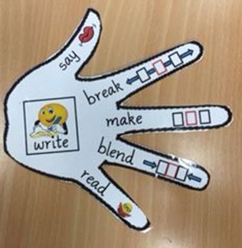
Literacy- Spelling
We are continuing to follow our Active Spelling programme. Children will be introduced to new spelling words each week. Spelling words will be uploaded onto Teams for practice at home.
Some of our strategies include:
Elkonin Boxes
Say/ Make/ Break/ Blend/ Read/ Write
Dictated Sentences
Fun Spelling
Word Aware
school
s | ch | oo | l

Slide 25
Literacy- Reading
We are currently reading our class novel just now ‘A Kind of Spark’ where we will be working on different reading strategies:
Metalinguistics (tricky & unfamiliar words)
Visualisations (using information to help create images)
Comprehension (understanding)
Inference (meaning behind)
Summarising (main events)
The children will soon be allocated their home readers on Bug Club – please encourage your children to read at home as this will be rewarded in class ☺
https://www.activelearnprimary.co.uk/login?c=0 School Code: sq6t

Slide 26
Literacy- Writing
The children will continue to use their VCOP in up-levelling their sentences and writing. The children are also going to be focusing on their grammar in writing in particular: commas, apostrophes and inverted commas.
The children will experience a variety of writing genres throughout their time in P7
Personal
Imaginative
Functional
We will also be focusing on handwriting – forming letters is important too!!

Slide 27
Maths
In our first week we have been focusing on Place Value. We have been looking at place value to tens and hundreds of thousands.
Over the year the children will cover the following areas in maths:
Whole Number
Fractions, Decimals and Percentages
Algebra
Money, Time & Measure
Shape, position & movement

Slide 28
Maths
Children will have a lot of active maths experiences as well as work on whiteboards, textbooks, iPad games etc.
Children will also have daily mental maths lessons which will consolidate and reinforce previous taught concepts as well as improving their mental agility, efficiency and flexibility.
We will also focus on various maths vocabulary.
I would please encourage you to reinforce concepts taught as children are more likely to make connections if concepts are related to real life experiences (Haylock. 2014)

Slide 29
IDL (Interdisciplinary Learning)
Child led topics that cover multiple curricular areas
The children will complete a KWL grid to help plan the topic
What I know
What I want to know
What I have learned
Our first topic is looking at our Local Area & Influential People

Slide 30
Marking
Marking is targeted and linked to the success criteria.
Self assessment
Peer assessment
Teacher assessment

Slide 31
Marking continued…
Marking is targeted and linked to the criteria that I give or the children create. Spelling is not always the focus and will often be left uncorrected as they can only concentrate on a few targets at a time.
Self assessment – Children should be encouraged to reflect on their work and how it could be improved.
Peer assessment- The children will, at times be encouraged to give positive comments on their classmates work. This helps children to spot mistakes in their own work.
Tickled Pink and Green for Growth
Verbal feedback – This will be notes in a child’s jotter if the teacher has spent a significant amount of time with them or their group.

Slide 32
Microsoft Teams
I will upload children’s spelling words onto Teams weekly. This is for the children to access and practice their words at home if they so wish. I will also upload different ways for the children to practice.
On Teams I will upload a generic home learning grid for the children to access general activities at home if they are off school or want to have some extra tasks to do at home.
Children can also access Education City & Active Learn

Slide 33
Glossary
Phonics – another name for the learning of “sounds”
Phoneme – a single unit of sound, e.g. ‘c’ in cat.
Grapheme – the written letter
Blending – stretching out each individual sound so that it almost runs into the next, e.g. c-a-t = cat.
Number bond - two numbers that go together to make another number, e.g. 70+30=10 (this is called a ‘number bond of 100’)
Learning intention – the purpose of our lessons
Success criteria – the things we need to do to meet our Learning intention
VCOP – Vocabulary, Connectives ,Openers, Punctuation
KWL- what we know, what we want to know and what we have learned.

Slide 34
Thank you.
I am very much looking forward to working with you and your children this year ☺
If you have any questions regarding any of the content in this presentation please pop an email to the school and I will answer as soon as I can.
westquarterprimaryschool@falkirk.gov.uk

