Slide 1
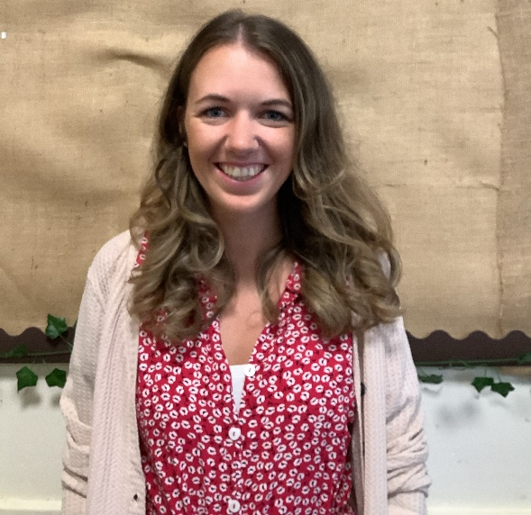
Meet the Teacher
Primary 1W
Miss MacLean
2023/2024

Slide 2
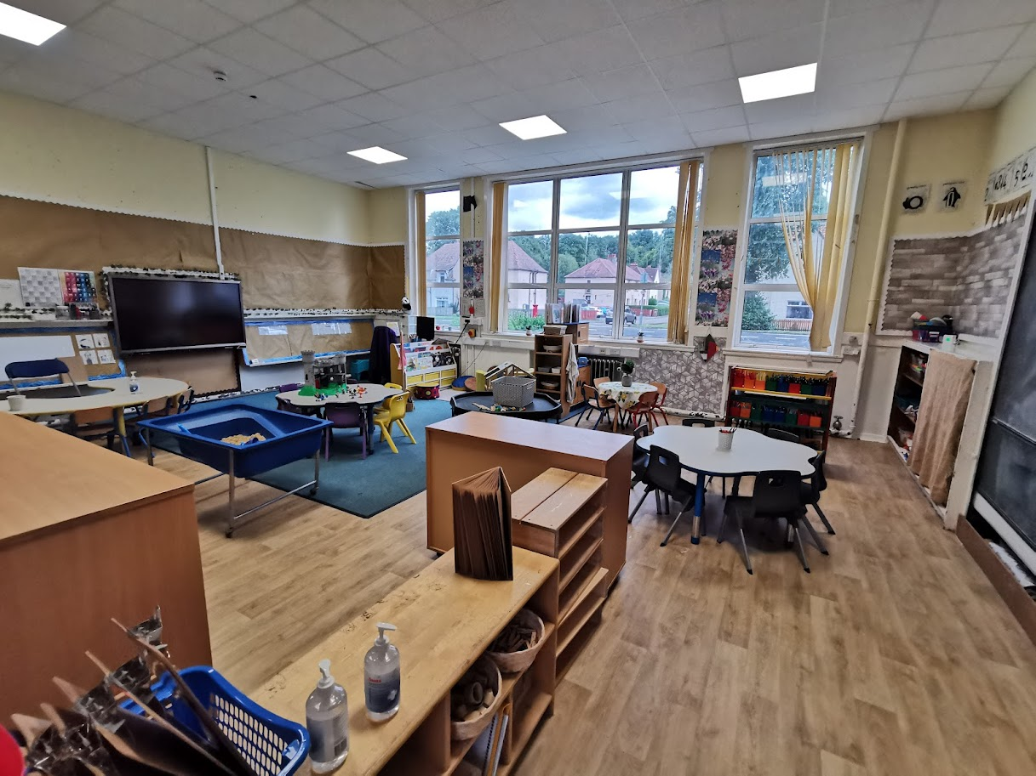
Our Classroom

Slide 3
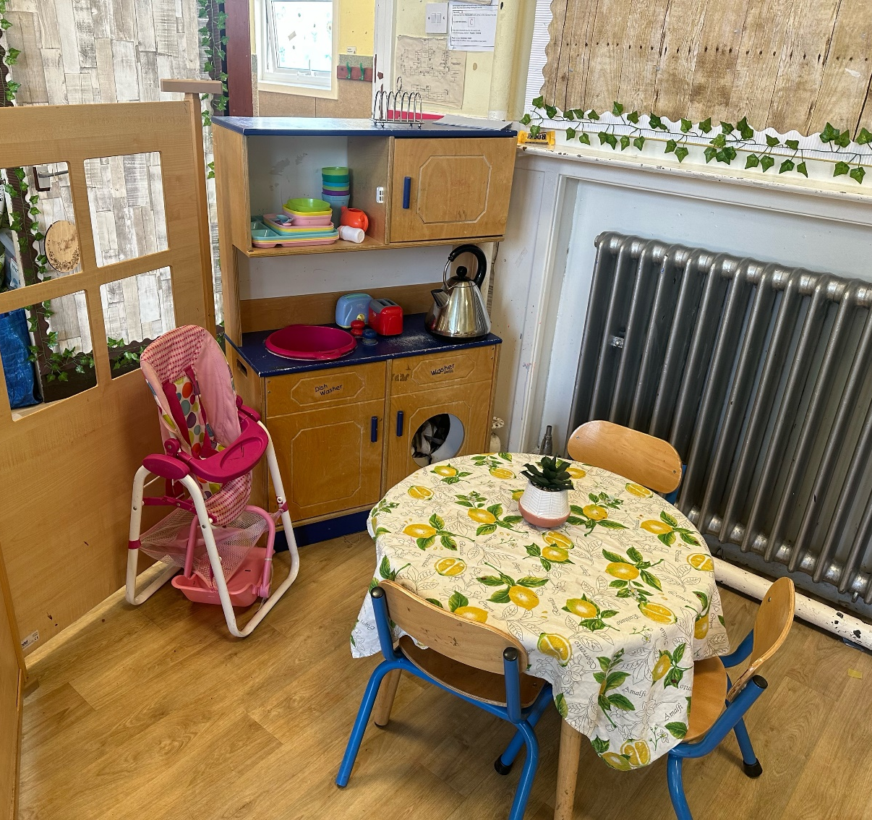
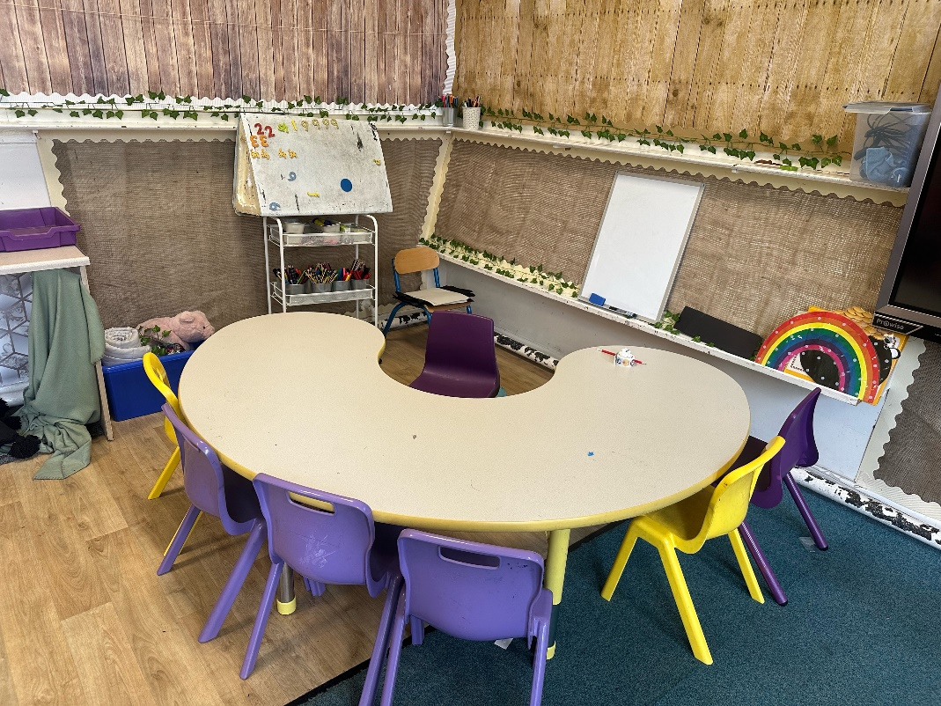
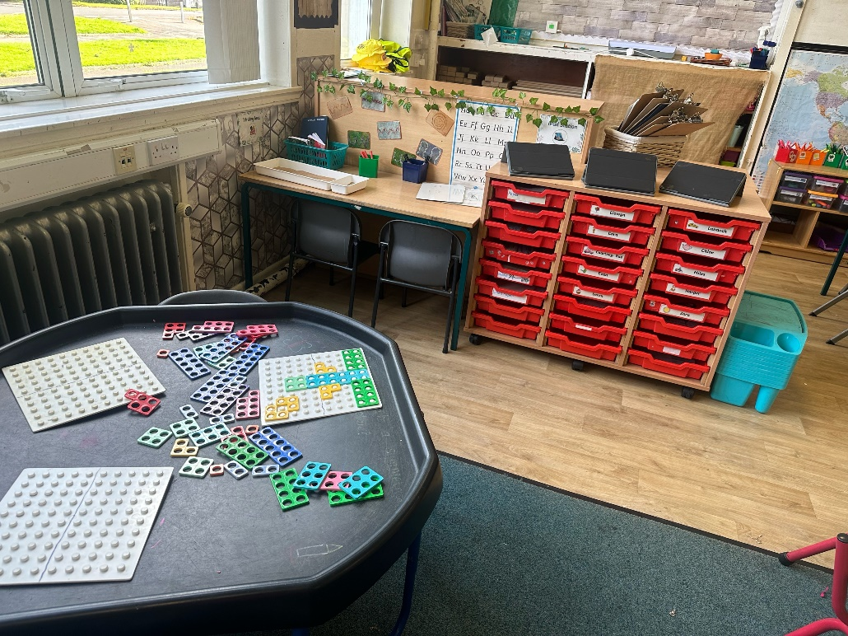
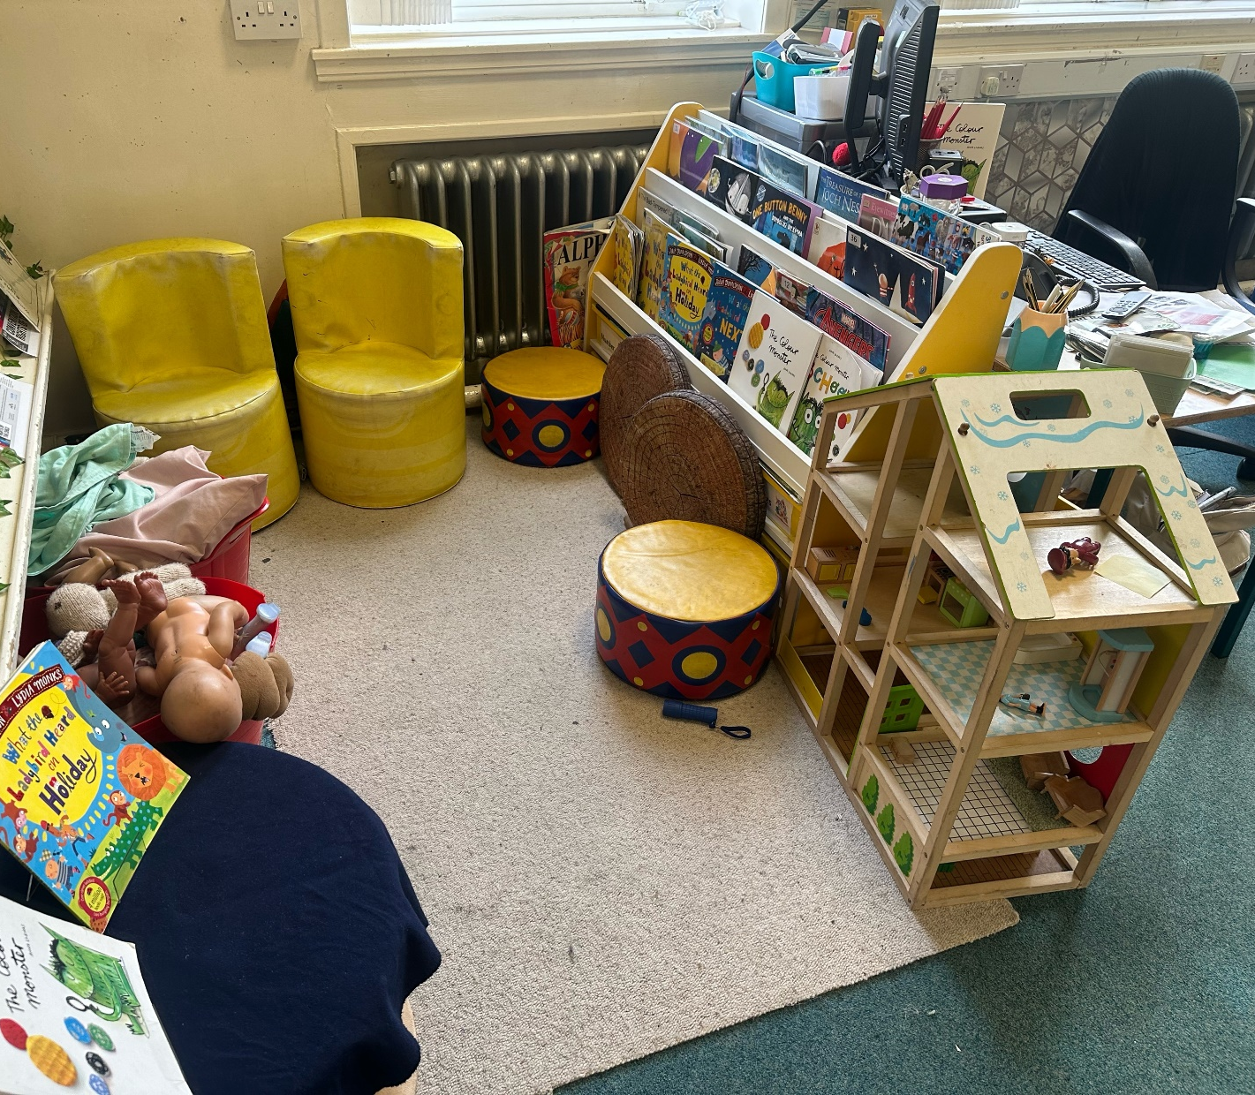
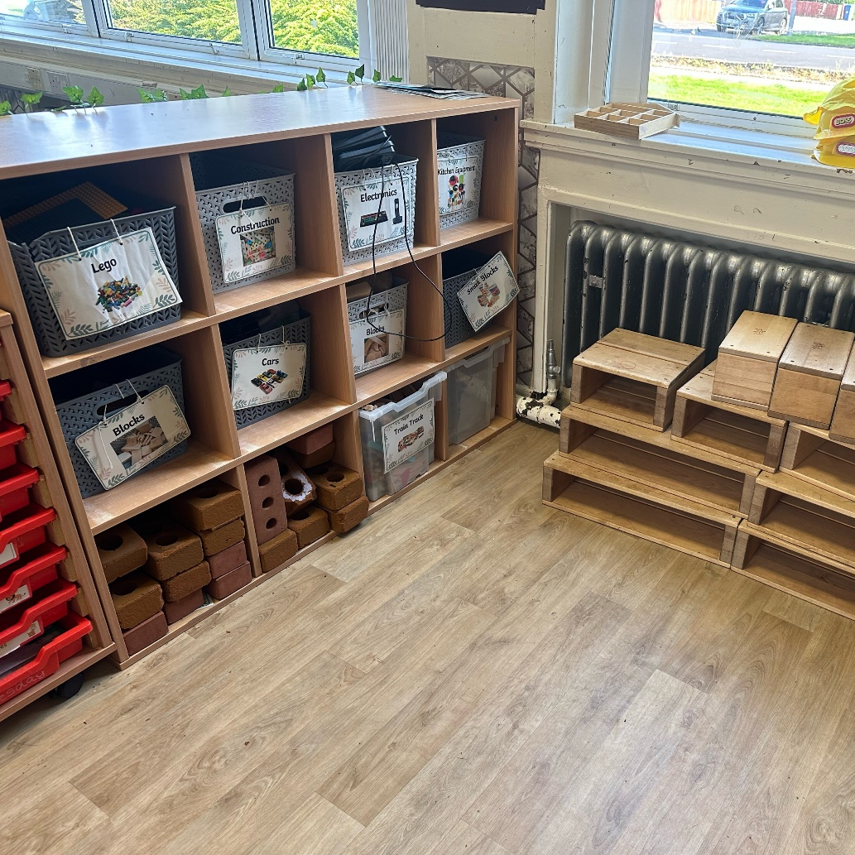
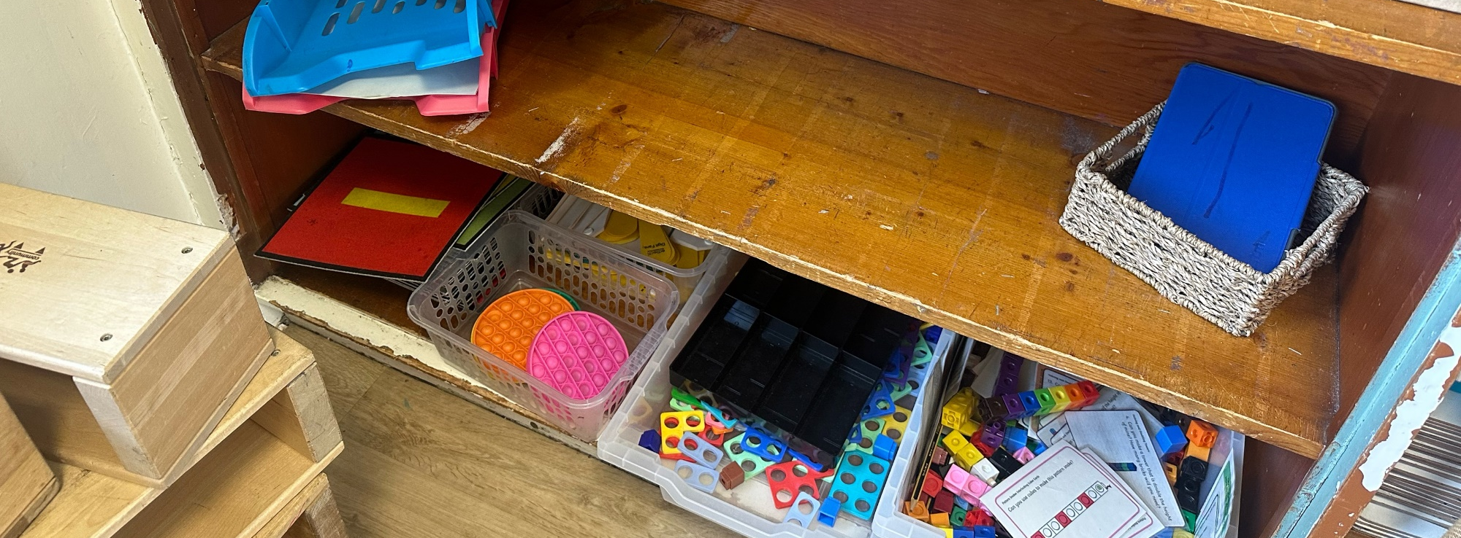

Slide 4
Other Staff
Head Teacher – Mrs Ramsay
Depute Head Teacher- Miss MacAlpine
Principal Teachers – Mrs Downie, Miss Brown
SfLA- Monika
Music – Mrs Thom
French – Mrs Downie (Monday and Friday)
PE –Mr Manchip (Tuesday)
PE – Class Teacher (Friday)

Slide 5
Settling in Routines - encouraging responsibility and independence
Morning Routine
Coats on pegs
Bags on pegs
Play pieces in trays
Water bottles in trays
Lunches: iPay Impact
Notes:
The children are being encouraged to become independent. The routines are being built on bit by bit.

Slide 6
House System
Forth Avon Carron Tay
Identity & sense of belonging (Each house has pupils from P1 – P7 with P7 House Captains.)
House points
Captains elected by pupils
Rewards – termly and end-of-year

Slide 7





Ready, Respectful and Safe
Reminder
“I’ve noticed that – reminder of rule.
I need you to – relate to rule.
Do you remember . . .? – relate to positive behaviour observed.
That’s who I need to see today!”
Last Chance
“This is your last chance to make the right choice.
You will have a time out.
You’ll have to speak to me at . . . – state time.”
Time Out
“You need some time out.”
Warning
“I’ve explained that you’re not – reminder of rule.
You know what the consequences are.
Think carefully about your next steps.”
Repair – consequence if necessary

Slide 8

Emotion Works
In school we are using emotion works in order to improve children’s emotional literacy and improve their emotional wellbeing. During circle time and health and wellbeing lessons we discuss emotional triggers, how they make us feel and behave and regulation strategies we can use to calm down.

Slide 9

Rights Respecting Schools
Westquarter’s Rights Journey
Westquarter is working on the Rights Respecting Schools Award.
We have achieved our Bronze Award and are working towards Silver.
Pupils learn about the UNCRC and their rights in class.
Each class will set up a Class Charter which is an agreement as a class about how the Rights of the Child will be respected.
Pupils are Rights Holders and adults in school and at home are Duty Bearers.
Children may discuss this with you at home. Please let us know if you would like any more information.
Article 42
All adults and children should know about this convention.

Slide 10


What is the UNCRC?
The United Nations Convention on the Rights of the Child is a universally agreed set of non-negotiable standards and obligations, built on varied legal systems and cultural traditions.
The Convention has a total of 54 articles.
In school we focus on Articles 1-42.
Articles 43-54 are about how adults and governments work together to make sure that all children get all their rights.

Slide 11
School Day
Learning through Play – a mix of adult led, adult initiated and child led
We learn in a variety of ways:
  Whole class lessons/Group Lessons
  Individual targets
  Independent literacy & numeracy target tasks (Rainbow Task)
Digital Tools most commonly used on ipads:
  Education City
  Active Learn
  Top Marks
  Scanning QR codes

Slide 12

Health and Wellbeing
Emotion Works
Building resilience
Quick Healthy Snack: fruit/veg, packet of crisps, yoghurt and water/ milk, NO fizzy juice (15 minute break)
Drinking water
School dinners – talk to your child about their lunch choice and select at home via iPay, if possible. Please send a packed lunch if they do not like anything.
Clothes- weather appropriate

Slide 13
Uniform & Kits
Our school colours are maroon and gold, usually teamed with grey or black trousers or skirts. Children wear a white polo shirt underneath and some children have shirts with the school tie.
Labelling PLEASE
PE kit – children should come dressed to school wearing their PE kit on PE days. This should be a white top and black jogging bottoms or shorts with their school jumper/cardigan. (Tuesday and Friday)
  no earrings (tape if unavoidable)

Slide 14
Parents as Partners
Supporting Children at Home
HWB - let us know if there are any changes at home
Practise sounds and words using the Skills through Play homework- this will be sent home at a later date.
Reading books – books will be sent home later in the term and allocated on Active Learn. Login details will be sent with books.
Encourage reading for enjoyment
Common Word Cards will be sent home for children to practise reading and writing independently. This will help support learning in class.

Slide 15
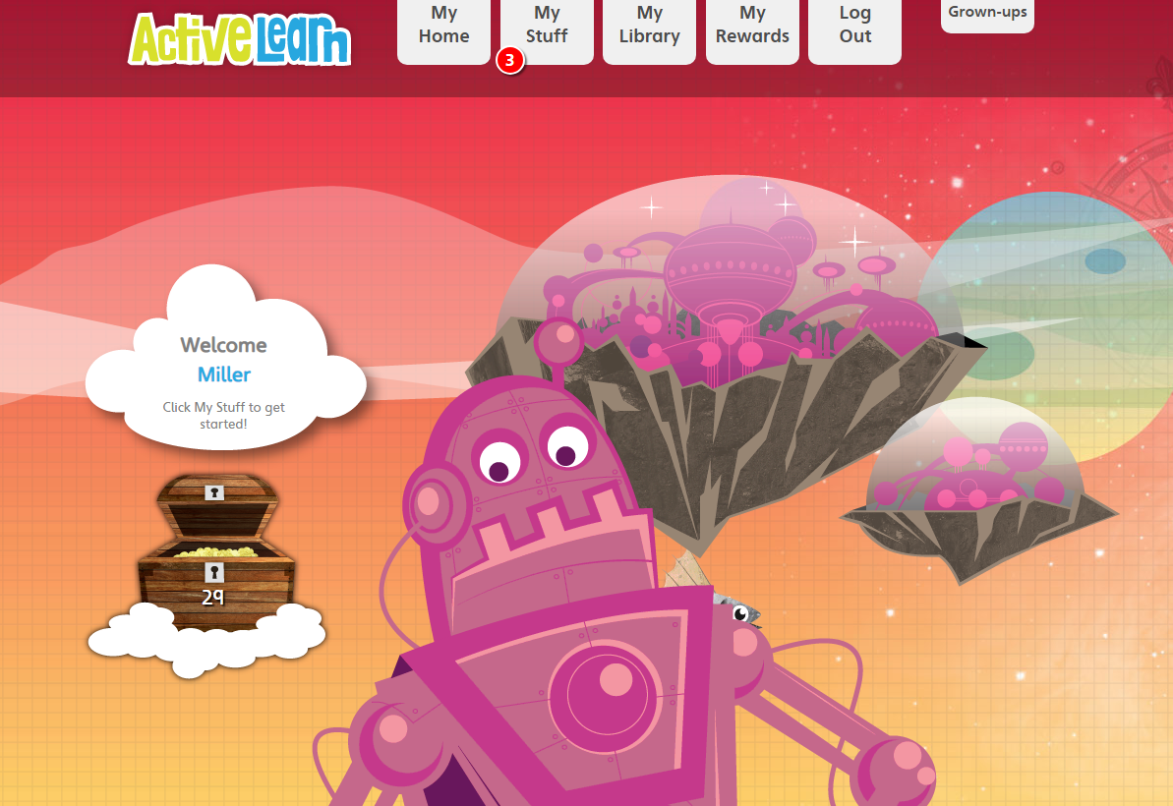
Bug Club

Slide 16

Communication
Twitter- please do not write your child’s name when posting photos or replying to a tweet.
Phone or email the school to request a meeting or phone call back if required. (please let us know what this is regarding)
Letters via school email address – westquarterprimaryschool@falkirk.gov.uk
Texts- group call
Parents’ Meetings (November and March)
Reports (June)

Slide 17
Communication
Class Twitter Name:
P1W @WestquarterP1W
School Twitter Name:
@WestquarterPrim

Slide 18

Thank you all for coming along.
Please let me know if you have any queries.

