Slide 1
A Warm Welcome to P5 from Mrs McNeill
This presentation has been devised to enable you to understand our class routines, values and focus for this year.

Slide 2
Morning Routines
The children hang their jackets and bags on pegs, place lunchboxes in the designated area and snacks in their trays.
Morning Routines:
Allows the children time to feel settled and ready to begin their school day.
Is a great opportunity for me to build relationships with the children.
Children’s lunch orders will be taken and pre-orders checked. If possible, please use the IPay Impact pre-order system.
Children are encouraged to bring water into the classroom.​ No juice please as children’s bottles are kept on their table and if juice spills on their work, it cannot be salvaged.

Slide 3
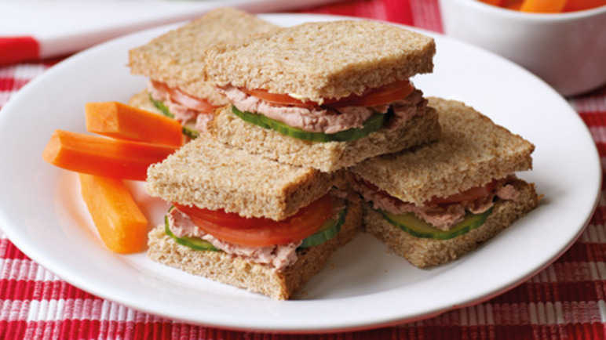
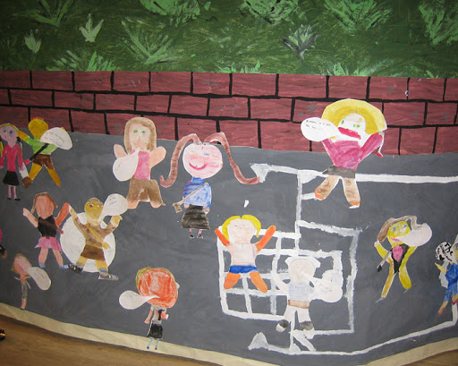
Break and lunch times
Morning break is 10:00-10:15 and lunch is 12:15-13:00.
Children should bring a healthy snack for break time to keep them from feeling hungry.
Waste Free Wednesday and Fruit Friday.
Ipay can be used to choose lunches from home. Login details have been issued to parents/carers.

Slide 4
Weekly Routines
Music - every second Monday with Mrs Brockie.​
French will be with Mrs. Downie.
PE days​
Monday day with Mr Manchip
Thursday with Mrs McNeill
Please ensure that your child brings suitable outdoor PE kit on these days (jogging bottoms/leggings, a white polo shirt or white t-shirt, school jumper and a jacket)​. Jewellery should not be worn on gym days and hair should be tied up. If earrings can’t be removed they the children must cover their ear lops with tape.​

Slide 5
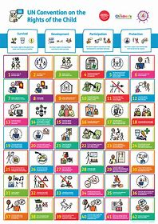
The Westquarter Way
The school rules are ‘Ready, Respectful and Safe’.
Examples:
Ready - in uniform, ready and listening to instructions, standing in line when the bell sounds.
Respectful – be kind and polite to others, treat resources with respect, look after the school.
Safe – not swinging on chairs, carrying scissors carefully, walking in the school.

Slide 6
If a child displays undesirable behaviour, the following steps will be taken:
Supportive Steps Microscript: 30 second intervention

Slide 7
Rights Respecting Schools Westquarter’s Rights Journey
Westquarter Primary is working on the Rights Respecting Schools Award.
We have achieved our Bronze Award and are working towards Silver.
Pupils learn about the UNCRC (United Nations Convention on the Rights of the Child) and their rights in class.
Each class will set up a Class Charter which is an agreement as a class about how the Rights of the Child will be respected.
Pupils are Rights Holders and adults in school and at home are Duty Bearers.
Children may discuss this with you at home. Please let us know if you would like any more information.
Article 42
All adults and children should know about this convention.

Slide 8
What is the UNCRC?
The United Nations Convention on the Rights of the Child is a universally agreed set of non-negotiable standards and obligations, built on varied legal systems and cultural traditions.
The Convention has a total of 54 articles.
In school we focus on Articles 1-42.
Articles 43-54 are about how adults and governments work together to make sure that all children get all their rights.

Slide 9
Class Charter

Slide 10
Article 13 says that every child must be free to express their thoughts and opinions and to access all kinds of information.
Pupil voice
Pupil representatives for pupil council

Slide 11
Article 16 says that every child has the right to privacy. Their private, family and home life will be protected from attacks that harm their reputation.
Respect for pupils belongings
Respect confidentiality

Slide 12
Article 17 children should be able to access information, particularly from the media. They should be able to get information from many places.
This Article applies to all kinds of media, including:
Print media― such as newspapers or magazines.
Electronic media― such as websites.
Audio visual media― such as radio and television programmes.

Slide 13
Article 23 says that all pupils a child with a disability has the right to live a full and decent life with dignity and, as far as possible, independence.
Equity for children with disabilities and additional support needs.
Enabling every child to succeed.

Slide 14
Article 28 says that all children have the right to education.
We will monitor and raise attainment of our children
Support our children and acknowledge their successes and achievements
Ensure all areas of the curriculum are taught

Slide 15
Article 31 says that children have the right to have fun in the way they want to. They have the right to rest, too.
Have playtime and lunchtimes.
Participate in meditation, art sessions and other wellbeing activities in class.

Slide 16
Implementing Our Class Charter
Created with the pupils through class discussions and voting. ​
Will be seen as our values and goals for our class community.
Will be displayed in the classroom and referred to regularly.
All children agree to the charter.​

Slide 17
Medicines
Require written permission is required from parents/carers.
**The relevant forms are stored in the folder in the medical cabinet.**
Must be handed into/collected from the front office by an adult.
**No child should have medication in their bag or about their person without prior written consent. Remove medication from children immediately and take it to the front office.**

Slide 18
Medicines
Only prescribed medicine delivered to the front office in the original, labelled packaging will be administered to pupils.
4.1.8 Educational establishment staff should only administer prescribed medication.
4.1.10 All medicine must be delivered in its original container with the original label, and must show:
name of child
name of drug
dispensary date
expiry date
dosages and frequency
normal time of administration
any precaution required regarding storage.

Slide 19
Medically Prescribed Diets
Food allergy: parent/carers must complete and return the following forms to the school:
• Medically Prescribed Diets Referral Form
• Medically Prescribed Declaration Form
A meeting is then arranged with the parents and catering before copies of the forms are sent to the centre and Catering Services.
Please ensure that no food containing nuts are brought into school.

Slide 20
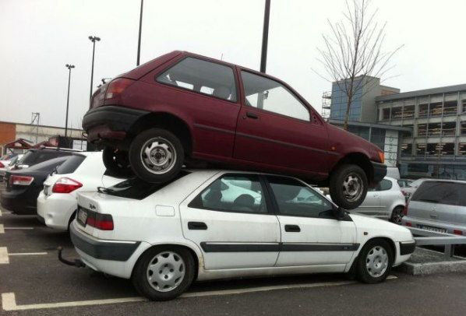
Car Parking
The front of the school should be accessible to emergency services vehicles at all times.
Please park safely e.g. no double parking.

Slide 21
Emotion Works
Health and Wellbeing will be a strong focus throughout the first term to ensure our children feel safe and secure back in their school routine.
We will use Emotion Works resources to work with the children and use this to explore thoughts and feelings.
This will also be linked the our work with the United Nations Convention on the Rights of the Child.

Slide 22
Literacy
Spelling – Children work on spelling daily.
Handwriting – Forming letters and our joined up writing.
Big Writing- We will be covering a variety of different genres of writing.
Listening and talking – This takes place throughout the day, but this will also a focus during our class assembly and presentations.
Reading – Children will be assigned a Bug Club reading book in class to work on their reading comprehension.
Active learn online- Children can read books independently and complete comprehension activities online. ​School Code: sq6t​
Term 1 big writing will cover non-fiction, for example, fact files and instructional writing.

Slide 23
Numeracy
In maths we will be focusing this term on number processes.​
The children will use Heinemann Active Maths textbooks, worksheets, games and ICT resources to enhance their learning experience.
In term 1, we will be covering place value, addition, subtraction, shape and money

Slide 24
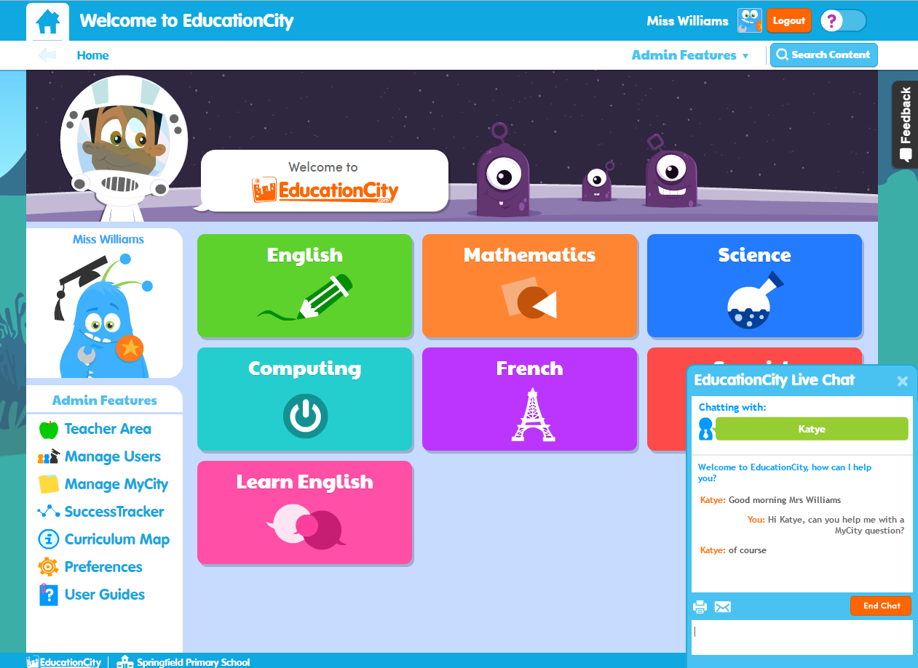
Education City
The children be given their updated logins and passwords for Education City soon. On this site, they can play games online, watch videos and access activity sheets.

Slide 25
Inter-Disciplinary Learning (IDL)
IDL is a context for learning across the curriculum. ​
The children are involved in choosing what they would like to learn and how they would like to learn it. ​
We have started the year with a novel study, we are reading ’The Sheep-Pig' as a class. This is a great way to develop literacy skills as well as many other curricular areas, particularly our work with STEM. ​
We will be looking at animal classification, food chains and life cycles.

Slide 26
Twitter
A class Twitter has been set up for each P5 class. ​You can share your children's learning and wider achievements on here. ​
Mrs McNeill @mrsmcneillwps
Our school twitter is ​ - https://twitter.com/WestquarterPrim​

