Slide 1
A Warm Welcome to P5 from Mrs Meier
This presentation has been devised to enable you to understand our class routines, values and focus for this year.

Slide 2
Morning Routines
Morning Routine
Snacks in trays, library books on table, jackets and bags on pegs. Lunchboxes are place in the designated area. Children feel settled and ready. Children’s lunch orders will be taken and pre-orders checked.
Break and lunch
Break -10:00-10:15 lunch - 12:15-13:00.
Waste Free Wednesday and Fruit Friday - Children should bring a healthy snack for break to keep them from feeling hungry.
Children are encouraged to bring water into the classroom.​ (No juice please as children’s bottles are kept on their table and if juice spills on their work, it cannot be salvaged).

Slide 3
Weekly Routines
Music - every second Monday morning with Mrs Brockie.​
French will be with Miss Thomson.
PE days​
Monday day with Mr Manchip
Wednesday with Mrs Meier
Please ensure that your child brings suitable outdoor PE kit on these days (jogging bottoms/leggings, a white polo shirt or white t-shirt, school jumper and a jacket)​. Jewellery should not be worn on gym days and hair should be tied up. If earrings can’t be removed they the children must cover their ear lops with tape.​

Slide 4
Emotion Works
Health and Wellbeing will be a strong focus throughout the first term to ensure our children feel safe and secure back in their school routine.
We will use Emotion Works resources to work with the children and use this to explore thoughts and feelings.
This will also be linked the our work with the United Nations Convention on the Rights of the Child.

Slide 5
Literacy
Spelling – Children work on spelling daily.
Handwriting – Forming letters and our joined up writing.
Big Writing- We will be covering a variety of different genres of writing.
Listening and talking – This takes place throughout the day, but this will also a focus during our class assembly and presentations.
Reading – Children will be assigned a Bug Club reading book in class to work on their reading comprehension.
Active learn online- Children can read books independently and complete comprehension activities online. ​School Code: sq6t​
Term 1 big writing will cover non-fiction, for example, fact files and instructional writing.

Slide 6
Numeracy
In maths we will be focusing this term on number processes.​
The children will use Heinemann Active Maths textbooks, worksheets, games and ICT resources to enhance their learning experience.
In term 1, we will be covering place value, addition, subtraction, shape and money

Slide 7
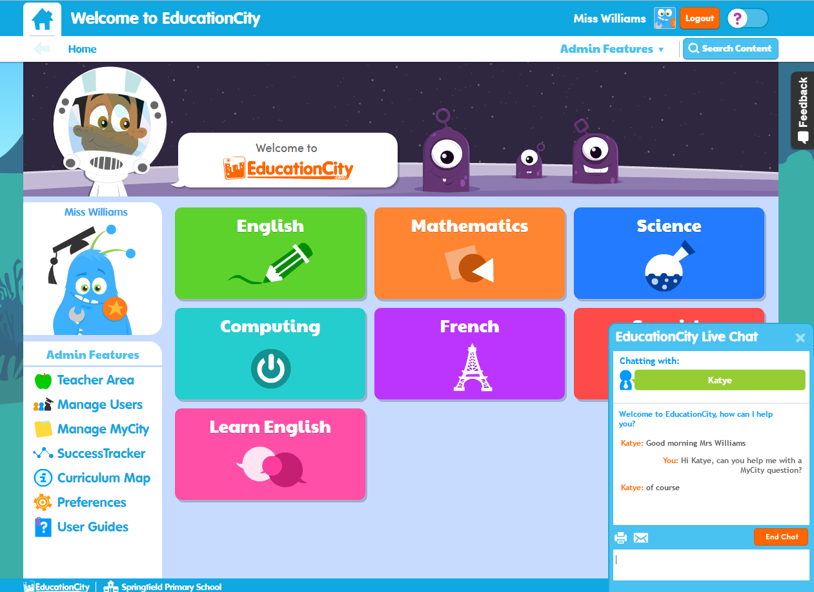
Education City
The children be given their updated logins and passwords for Education City soon. On this site, they can play games online, watch videos and access activity sheets.

Slide 8
Inter-Disciplinary Learning (IDL)
IDL is a context for learning across the curriculum. ​
The children are involved in choosing what they would like to learn and how they would like to learn it. ​
We have started the year with a novel study, we are reading ’The Sheep-Pig' as a class. This is a great way to develop literacy skills as well as many other curricular areas, particularly our work with STEM. ​
We will be looking at animal classification, food chains and life cycles.

Slide 9
The Westquarter Way
The school rules are ‘Ready, Respectful and Safe’.
Examples:
Ready - in uniform, ready and listening to instructions, standing in line when the bell sounds.
Respectful – be kind and polite to others, treat resources with respect, look after the school.
Safe – not swinging on chairs, carrying scissors carefully, walking in the school.

Slide 10
If a child displays undesirable behaviour, the following steps will be taken:
Supportive Steps Microscript: 30 second intervention

Slide 11
Rights Respecting Schools Westquarter’s Rights Journey
Westquarter Primary is working on the Rights Respecting Schools Award.
We have achieved our Bronze Award and are working towards Silver.
Pupils learn about the UNCRC (United Nations Convention on the Rights of the Child) and their rights in class.
Each class will set up a Class Charter which is an agreement as a class about how the Rights of the Child will be respected.
Pupils are Rights Holders and adults in school and at home are Duty Bearers.
Children may discuss this with you at home. Please let us know if you would like any more information.
Article 42
All adults and children should know about this convention.

Slide 12
What is the UNCRC?
The United Nations Convention on the Rights of the Child is a universally agreed set of non-negotiable standards and obligations, built on varied legal systems and cultural traditions.
The Convention has a total of 54 articles.
In school we focus on Articles 1-42.
Articles 43-54 are about how adults and governments work together to make sure that all children get all their rights.

Slide 13
Class Charter

Slide 14
Article 31 Children have the right to have fun in and have the right to rest. Have playtime and lunchtimes. Participate in meditation, art sessions and other wellbeing activities in class. | Article 17 children should be able to access information, particularly from the media. Print media― such as newspapers or magazines. Electronic media― such as websites. Audio visual media― such as radio and television programmes. | Article 24 Children should live in a safe and healthy environment and have a right to information about their health. Look at the nutritional benefits of foods. Understand the need to eat a healthy balanced diet. Become aware of important information on food labels. | Article 28 All children have the right to education. We will monitor and raise attainment of our children. Support our children and acknowledge their successes and achievements. Ensure all areas of the curriculum are taught. | Article 42 All children, and adults should know about the Convention. We will work towards our Silver Award. Learn about children’s rights in school. Promote anti-bullying, anti-discrimination campaigns and Fairtrade week. Promote children’s Rights to parents.

Slide 15
Implementing Our Class Charter
Created with the pupils through class discussions and voting. ​
Will be seen as our values and goals for our class community.
Will be displayed in the classroom and referred to regularly.
All children agree to the charter.​

Slide 16
Twitter
A class Twitter has been set up for each P5 class. ​You can share your children's learning and wider achievements on here. ​
Mrs Meier P5Q– follow @WPS_P5Q
Our school twitter is ​ - https://twitter.com/WestquarterPrim​

Slide 17
Medicines
Require written permission is required from parents/carers.
Must be handed into/collected from the front office by an adult.
Only prescribed medicine delivered to the front office in the original, labelled packaging will be administered to pupils.
All medicine must be delivered in its original container with the original label, and must show:
name of child
name of drug
dispensary date
expiry date
dosages and frequency
normal time of administration
any precaution required regarding storage.

Slide 18
Medically Prescribed Diets
Food allergy: parent/carers must complete and return the following forms to the school:
• Medically Prescribed Diets Referral Form
• Medically Prescribed Declaration Form
A meeting is then arranged with the parents and catering before copies of the forms are sent to the centre and Catering Services.
Please ensure that no food containing nuts are brought into school.

Slide 19
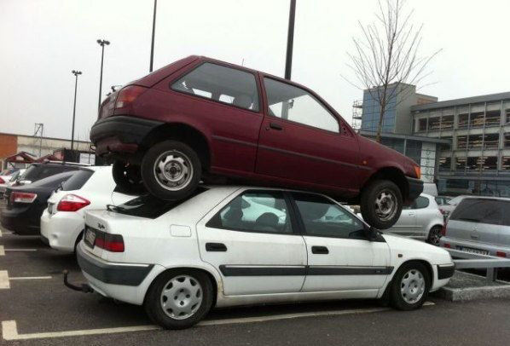
Car Parking
The front of the school should be accessible to emergency services vehicles at all times.
Please park safely e.g. no double parking.

