Slide 1
P3W
Meet the Teacher
2022-2023

Slide 2
Adults in P3W
Class Teacher: Miss Kirsten Richards
Music: Mrs Tracey Brockie
PE: Mr Ross Manchip
French: Mrs Jennifer Downie
Support for Learning: Mrs Gillian Downie and Miss Julie Wood
Support for Learning Assistant: Miss Debbie Cochrane

Slide 3
Communication
We appreciate the essential role you have in making this year a positive and successful one for your child. If you have comments or concerns please phone or email the school to arrange a meeting or a call back.
School phone number: 01324 503950
School email: westquarterprimaryschool@falkirk.gov.uk
Our learning in class will be shared on Twitter @MissRichardsWPS
Please do not send any private messages on Twitter. We cannot respond to these.
When posting pictures or replying to a tweet please do not write your child’s name. Instead you could use their initial. E.g ‘A’ is enjoying his reading book this week.’
Communication on your child’s learning will also be provided via Parent’s Evening and Reports.

Slide 4
Uniform & Kits
Please label all clothes and belongings with your child’s name and class.
On P.E. days (Tuesday and Friday) children should come to school wearing uniform that is appropriate for taking part in gym e.g.
Jogging trousers/leggings
School polo shirt/jumper
Gym shoes/trainers
Remove jewellery before school.

Slide 5
Food and Drink at School
Water in class
A water bottle can be brought to school each day. Please try to avoid filling these with juice.
Snack
Children can bring a small, healthy snack at playtime. This should be something that children will be able to eat in 15 minutes whilst they are playing.
School Lunches
School lunches are free for children in P3. You can choose these in advance by logging into iPay. Please discuss children's choices with them so that they know what to expect to have when they come to school that day.

Slide 6
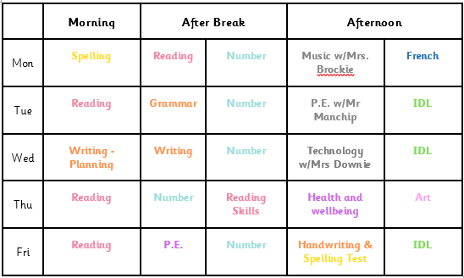
P3W’s Weekly Timetable

Slide 7
Learning in Primary 3
Children will be aiming to work within First Level of the curriculum (P2-P4)
We use a variety of teaching approaches to meet the needs of all learners.
TAG time: Tasks, activities and games. During literacy and numeracy lessons children complete independent task that help them consolidate key skills, whilst allowing the class teacher to work with small groups to introduce and reinforce new concepts.
Play-based learning: Open ended provocations and resources to allow children to explore and be creative.
Digital technologies: Developing digital skills as well as using this enhance learning by using technology to research or present information.

Slide 8
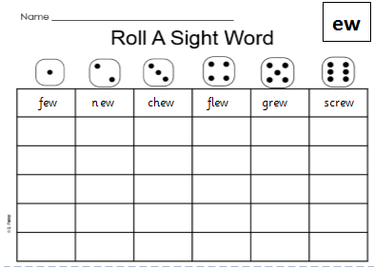
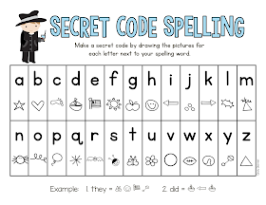
Literacy Learning - Phonics
Phonics (sounds)
Children are usually introduced to one new digraph (two letters making a sound) per week.
We practice our spelling words daily in class using magnetic boards, partner spelling and a variety of games
Spelling words for the week will be posted on teams to allow these to be practised at home.
Common Words
Children will be set individual common word targets in the coming weeks.
These will be a combination of the most common words that children encounter during reading, as well as words that children misspell when writing independently.

Slide 9
Literacy Learning - Reading
The skill of reading is made up of more than one component.
Decoding: The ability to relate written letters to the sounds that they make and blend these together. This is developed by teaching children phonics as well as a range of word attack strategies.
Comprehension: The ability to understand what we have read. We teach children a range of comprehension skills and help them develop the ability to look for evidence within the text to back up their thoughts.
Fluency: The ability to read with appropriate speed, accuracy and expression. We model this for children to allow them to become fluent readers themselves.

Slide 10
Literacy Learning -Writing
In primary 3 we aim to develop children from writing at sentence level to stories written in parts with clear Beginning, Middle and End structure. We also look at writing extended pieces of information text e.g. instructions.
Weekly writing lesson: progressing to make and use notes to plan both fiction and non fiction writing tasks.
Colourful Semantics: supports children to develop vocabulary and organise the information in their writing.
Talk for Writing: children look at a model text to learn about the key features and language to allow them to apply this to their own writing.
Independent spelling with dictionaries, word mats and word books.
VCOP is used to develop the quality of writing and success criteria is normally linked to an aspect of this.
Vocabulary (Wow words) Connectives Openers Punctuation
Handwriting: Regular lessons and activities with the expectation that all letters will be formed correctly and written appropriately on the line. Focus now on relevant sizing of letters and overall presentation. Begin joined writing later in the year

Slide 11
Numeracy
We will be looking at the following topics within maths and numeracy this year.
Place value – ability to partition and recognise the value of each digit within 3 digit numbers.
Addition and Subtraction – mental and written strategies for addition and subtraction within 100.
Multiplication and division - 2,4,5,10 times tables
Fractions - ½ ¼ 1/5 and 1/10
Money – Calculating totals, change and problems to £10
Time - ¼ to and ¼ past
Measure – Reading scales and converting between units of measure.
Patterns and symbols
2D and 3D shape
Grid references
Data analysis

Slide 12
Interdisciplinary Learning
Interdisciplinary learning is a planned approach to learning which uses links across different subjects to enhance learning.
We will be teaching the following topics this year to incorporate all areas of the curriculum:
Energy Sources and Sustainability
Movement of the sun, moon and earth
Electricity
Endangered Species
Egyptians
Materials with practical challenges and design
The Puppet Factory
These topics may change in order to align with children’s interests.

Slide 13
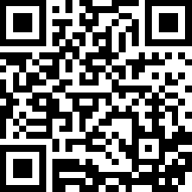
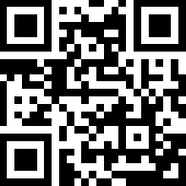
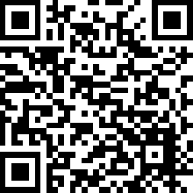
Home Learning
Children’s P3 online log in details will be sent home in the coming weeks.
Bug Club
Children will be set reading books that they can practice at home on Bug Club.
Education City
Numeracy and Literacy games will be assigned on Education City to allow children to consolidate the skills they are learning in class.
Microsoft Teams
There is a skills homework grid in the ‘Files’ section of the P3W class team. There is also a spelling menu to allow children to practice their spelling words for the week at home.

Slide 14
Our School Rules
Safe
Be familiar with the fire drill
Wonderful walking
Push in chairs
Keep classroom tidy
Keep safe while running in the playground
Look where you are going
Ready
Lovely Lines
Prepared for class
Organised for school
Finish work on time
Listening to instructions
Focused
Not wasting time
Respectful
Be kind
Tell the truth
Tell people how you feel
Do your best-work hard
Keep school tidy
Good manners

Slide 15
Rights Respecting Schools
Westquarter Primary is working on the Rights Respecting Schools Award.
We have achieved our Bronze Award and are working towards Silver.
Pupils learn about the UNCRC (United Nations Convention on the Rights of the Child) and their rights in class.
Each class will set up a Class Charter which is an agreement as a class about how the Rights of the Child will be respected.
Pupils are Rights Holders and adults in school and at home are Duty Bearers.
Children may discuss this with you at home. Please let us know if you would like any more information.
Article 42
All adults and children should know about this convention.

Slide 16
Positive Behaviour Policy
Reminder
“I’ve noticed that – reminder of rule.
I need you to – relate to rule.
Do you remember . . .? – relate to positive behaviour observed.
That’s who I need to see today!”
Last Chance
“This is your last chance to make the right choice.
You will have a time out.
You’ll have to speak to me at . . . – state time.”
Time Out
“You need some time out.”
Warning
“I’ve explained that you’re not – reminder of rule.
You know what the consequences are.
Think carefully about your next steps.”
Repair – consequence if necessary

Slide 17
Restorative Practices
Its about ‘justice for all’
Whole school approach by all staff and pupils
RESPECT – for everybody by listening to opinions of others
RESPONSIBILITY – for your own actions
REPAIR – identifying what went wrong and ensuring it won’t happen again
What happened?
Who has been affected?
How can we find a way forward?
How can we do things differently in the future?

Slide 18
Rights Respecting Schools
Westquarter Primary is working on the Rights Respecting Schools Award.
We have achieved our Bronze Award and are working towards Silver.
Pupils learn about the UNCRC (United Nations Convention on the Rights of the Child) and their rights in class.
Each class will set up a Class Charter which is an agreement as a class about how the Rights of the Child will be respected.
Pupils are Rights Holders and adults in school and at home are Duty Bearers.
Children may discuss this with you at home. Please let us know if you would like any more information.
Article 42
All adults and children should know about this convention.

Slide 19
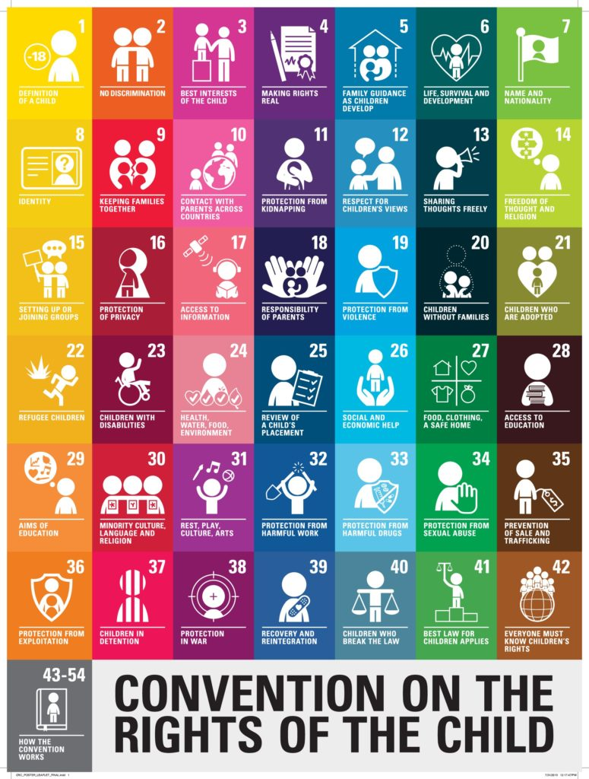
What is the UNCRC
The United Nations Convention on the Rights of the Child is a universally agreed set of non-negotiable standards and obligations, built on varied legal systems and cultural traditions.
The Convention has a total of 54 articles.
In school we focus on Articles 1-42.
Articles 43-54 are about how adults and governments work together to make sure that all children get all their rights.

Slide 20
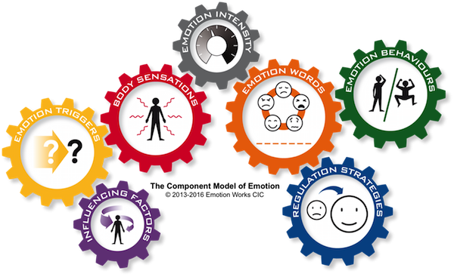
Emotion Works
5 cog model in P3 - orange, yellow, red, green and blue.
Use of stories, music, art etc to teach each of the 5 cogs.
Children complete an emotional check in each day using emotion words.
Children encouraged to use the cogs
to talk about their emotions.

Slide 21
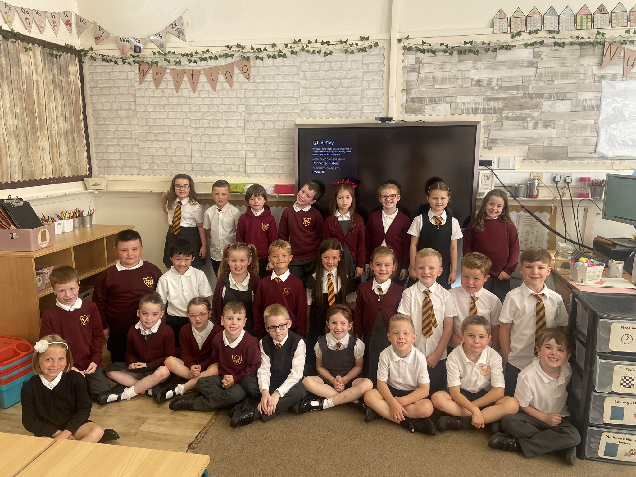
Thank you!
I look forward to working in
partnership with you this year.

