Slide 1
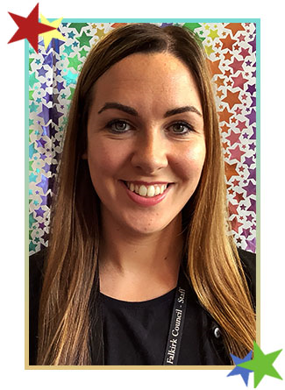
Meet the teacher
P2Q
Miss Ritchie

Slide 2
Our Morning Routine
P2Q
Meet and Greet
Jackets and bags on pegs and snack/drinks/resources in tray.
Emotional check in
Lunches/register
Calendar and positive attitude
Daily routine shared

Slide 3
Class Information
Children should come dressed in school uniform daily.
Water bottles filled each day – no juice or flavoured water please.
Please ensure your child's name is on all items that are brought into school.
Healthy and quick snacks please. Waste Free Wednesday & Fruit Fridays.
School lunches are free to all children in P2 and can be accessed through iPay impact. Please look at these in advance where possible.
If your child does not like any of the lunch options on any given day, please provide a packed lunch.
If your child requires medication during school hours, including inhalers you must fill in a form which is available at the office. Children should not bring medication to school themselves.

Slide 4
School Rules

Slide 5
Rights Respecting Schools Westquarter’s Rights Journey
Westquarter Primary is working on the Rights Respecting Schools Award.
We have achieved our Bronze Award and are working towards Silver.
Pupils learn about the UNCRC (United Nations Convention on the Rights of the Child) and their rights in class.
Each class will set up a Class Charter which is an agreement as a class about how the Rights of the Child will be respected.
Pupils are Rights Holders and adults in school and at home are Duty Bearers.
Children may discuss this with you at home. Please let us know if you would like any more information.
Article 42
All adults and children should know about this convention.

Slide 6
What is the UNCRC?
The United Nations Convention on the Rights of the Child is a universally agreed set of non-negotiable standards and obligations, built on varied legal systems and cultural traditions.
The Convention has a total of 54 articles.
In school we focus on Articles 1-42.
Articles 43-54 are about how adults and governments work together to make sure that all children get all their rights.

Slide 7
Our Learning
Teacher Led – Children work in small groups with a teacher to learn
skills that they can then transfer into their independent tasks and their play.
Independent – Children use the skills they have been taught the previous day to complete a task on their own or with a friend
Teacher Initiated – Children have the opportunity to access
activities or resources that engage them and further develop
their learning
Child Led – Play is an integral part of learning. Children have the
opportunity to lead their learning through play. Teachers observe, support and extend the play by carrying forward children’s interests and ideas.

Slide 8
What Is Play?
;

Slide 9
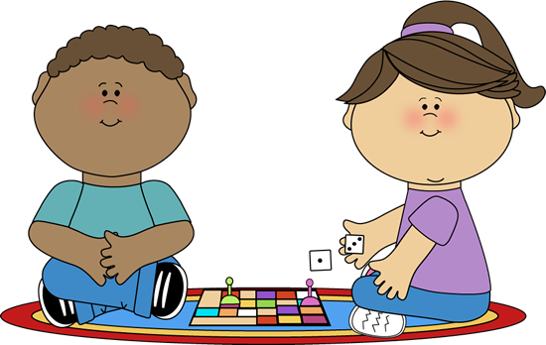
What Are the Benefits of Play in Primary 2?
Young children learn most effectively through play and Protecting children’s right to play was one of the key priorities for the Scottish Government
Through play, children can develop:
cognitive skills;
social interaction;
physical skills;
imagination;
creativity;
emotional regulation;
communication skills;
resilience;
emotional wellbeing ;
problem-solving.
These skills are developed through three main
zones in class:
Creative zone
Social zone
Discovery Zone
In each of these zones children have access
to a variety of resources.

Slide 10
Literacy - Reading
Children are encouraged to read for pleasure at school and at home.
Whilst exploring a variety of texts, children will be taught a range of reading skills.
We read a variety of texts together as a class. Children will be assigned reading books through Bug Club and will be given reading books to share with you at home. Please bring these to school daily.
Children learn common words via word walls. We encourage children to practise these at home and in school. When they have secure knowledge of reading and spelling a word wall they move on to the next set of words.
Children learn phonics. The phonemes (sounds) children learn help them become effective readers and writers. For example:
initial sounds like 'c' for cat and
diagraphs (double letter sounds) like 'ch' for chip.

Slide 11
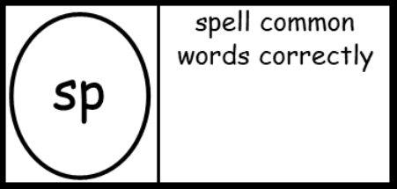
Literacy - Writing
Weekly writing lesson (Big Writing and Talk for Writing) – developing from sentence level to stories written in parts with clear structure. Extended writing also includes information writing, e.g. instructions.
VCOP is used to develop the quality of writing and success criteria is normally linked to an aspect of this.
Vocabulary (Wow words) Connectives Openers Punctuation
We are focusing on letter formation, letter size, capital letters, full stops and finger spaces.
Literacy - Listening and Talking
​
Children are encouraged to listen and talk with their peers in pairs and in groups and are regularly given the opportunity to participate in whole class discussion.
As a class we are focusing on good listening skills through a variety of activities.

Slide 12
Numeracy
Children are encouraged to explore number concepts using concrete
materials.
Children are encouraged to develop a strong sense of number through
engaging in games and activities with their peers.
Topics covered in P2
Place Value
Addition and Subtraction
Money
Time
Shape
Measurement
Fractions (halves and quarters)
Data gathering and presentation
v

Slide 13
Health and Wellbeing
P.E. Tuesday with P.E. specialist, Mr Manchip
P.E. Thursday with Miss Ritchie
Children should still wear school uniform on PE days but can wear joggers/leggings/shorts and suitable footwear. Please leave jewellery at home on these days.

Slide 14
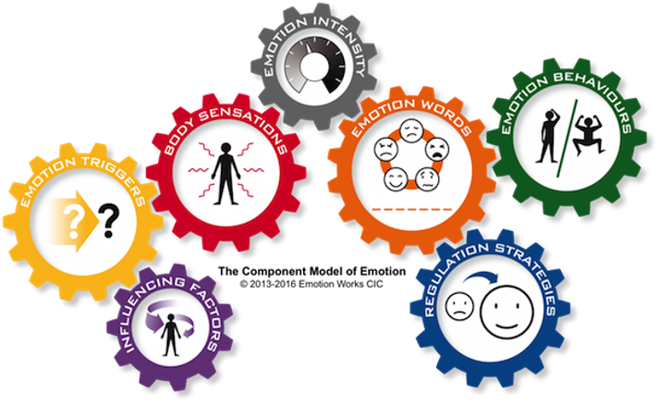
Health and Wellbeing
At Westquarter Primary we use an approach
called 'Emotion Works' to help children
develop an awareness of their emotions and
how to talk about them. Children are taught
strategies to help them recognise their own
emotional state and how to self-regulate.

Slide 15
Other Areas
Topics:
Term 1 – Woodlands
Term 2 – Eddie the Penguin (ECO)
Term 3 – Katie Morag - A comparative study: Falkirk and the Isle of Struay
Term 4 - Shops Old and New
Topics can be subject to change depending on children’s interest.
French
Expressive Arts
STEM
RME

Slide 16
How can you help your child?
Read with your child – books, magazines, road signs, menus, recipes etc..
Count with your child in 1s and 2s to 100. Count in 10s to 100. Count in 5s to 50.
Activities such as baking encourage reading as well as measuring and counting.
Involve your child in talking about money when out shopping.
It is important that children see how their learning can be applied to everyday activities.
Talk to your child about their day – what was their favourite part of the day?
Ask your child about what you have seen on Twitter posts.
Sing songs and make up fun rhymes.
During car journeys play games like 'eye spy' or e.g. count red cars.
Encourage children to follow our school rules ‘Ready, Respectful and Safe’
Talk to children about their Rights.
Reinforce that learning is fun!

Slide 17
Keep in Touch
We will try to post regularly on X to keep you up to date with what is happening in the classroom.​​
@MissRitchieWQ
Talk to your child about X posts to generate discussion about their day.​​
Please never name your child or other children on social media – please use general terms such as he, she or they as opposed to their initials.
Direct communication via email (westquarterprimaryschool@falkirk.gov.uk) or
telephone (01324 503950)

