Slide 1
Meet the Teacher
P6Q and Miss Wilson
2023-2024

Slide 2
Meet the Teacher
Welcome!
2023-2024

Slide 3
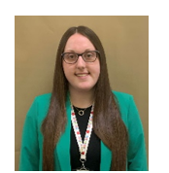
Class Teacher - Miss Hannah Wilson
Principal Teacher – Mrs Jennifer Downie
Music – Mrs Tracey Brockie
PE – Mr Ross Manchip
French - Miss Jemma Thomson
Support for Learning Assistant - Nicole Wilson
Active Schools – Jen Watson-Brown
Adults in P6Q

Slide 4
9:00 – 9:15 – Know and grow. All children are greeted at the door and given time to settle in with a calming morning task.
10:00 – 10:15 – Playtime
12:15 - 1:00 - Lunch
Daily Routines

Slide 5
Water – a water bottle should be brought to school each day. Please ensure these don’t contain fizzy juice, energy drinks, milkshakes etc. Children can refill their bottles in class.
Snack – children can bring a small, healthy snack for playtime. This should be something they can eat in 15 minutes. Children get house points for ‘waste free Wednesday’ and ‘fab fruit Friday’.
School lunches – can be ordered in advance on iPay.
Allergies – a reminder that food with nuts cannot be brought to school. Various breakfast bars and Nutella contain nuts, please check the packaging of snacks.
Daily Routines

Slide 6
Monday – alternate weeks – Music with Mrs Brockie
Wednesday – PE with Mr Manchip
Thursday – PE with Miss Wilson
Library - children will have time in the library each week
Weekly Routines

Slide 7
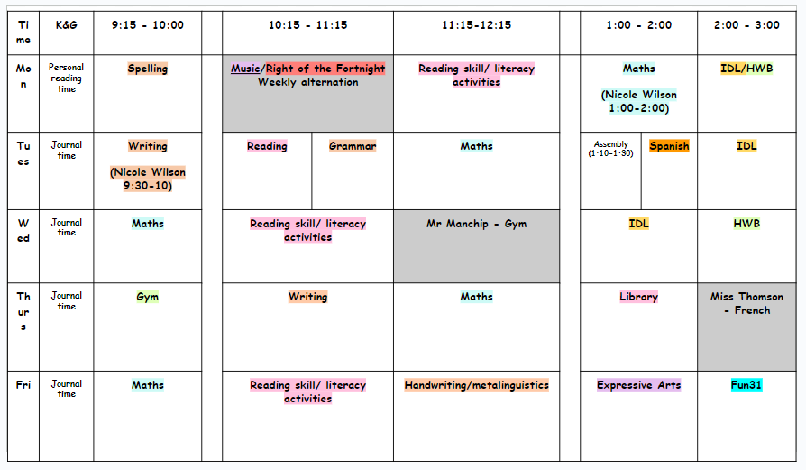

Slide 8
Young Leaders – ran by active schools with the opportunity to run a lunchtime club
Playground buddies – will write an application and be trained by P7
Reading buddies – will be pairing up with P2
Information on clubs to follow
P^6 Leadership Opportunities

Slide 9
A great start to the year! Please label all clothes and belongings, it’s much easier for them to be reunited!
Children should come to school in their kit on gym days. If they would like to get changed into fresh school uniform after this they will be given time to do so.
Black jogging trousers/leggings/short
White t-shirt/polo shirt
School jumper or cardigan (they can take this off for the lesson)
Remove jewellery before school
Uniform

Slide 10
Working as a team is the best way to make this year a positive and successful one for your child.
If you have comments or concerns, please phone or email the school to arrange a meeting or a call back.
School phone number: 01324 503950
School email: westquarterprimaryschool@falkirk.gov.uk
I will be in the playground after school for any quick chats and comments.
Your child's progress will be shared via parents evenings and a end of year report.
Mrs Jennifer Downie (Principal Teacher) is responsible for all pastoral concerns for Primary 6.
Communication

Slide 11
Communication
Our learning in class will be shared on X (formally known as Twitter) @MissWilsonWQ
Please do not send any private messages, I cannot respond to these.
If posting pictures or replying, please do not write your child’s name, you can use their first initial if you wish, e.g P was successful at their tournament this weekend.

Slide 12
If your child is unwell and cannot attend school, please contact the school in the first instance.
Please notify the office of any appointments, informing us of when your child will arrive at school/be collected/arrive back.
A reminder that children must be 48 hours clear of stomach bug symptoms and a temperature.
Absences

Slide 13
Rights Respecting Schools Westquarter’s Rights Journey
Westquarter Primary is working on the Rights Respecting Schools Award.
We have achieved our Bronze Award and are working towards Silver.
Pupils learn about the UNCRC (United Nations Convention on the Rights of the Child) and their rights in class.
Each class will set up a Class Charter which is an agreement as a class about how the Rights of the Child will be respected.
Pupils are Rights Holders and adults in school and at home are Duty Bearers.
Children may discuss this with you at home. Please let us know if you would like any more information.
Article 42
All adults and children should know about this convention.

Slide 14
What is the UNCRC?
The United Nations Convention on the Rights of the Child is a universally agreed set of non-negotiable standards and obligations, built on varied legal systems and cultural traditions.
The Convention has a total of 54 articles.
In school we focus on Articles 1-42.
Articles 43-54 are about how adults and governments work together to make sure that all children get all their rights.

Slide 15
Ready
Lovely Lines
Prepared for class
Organised for school
Finish work on time
Listening to instructions
Focused
Not wasting time
Safe
Be familiar with the fire drill
Wonderful walking
Push in chairs
Keep classroom tidy
Keep safe while running in the playground
Look where you are going
Respectful
Be kind
Tell the truth
Tell people how you feel
Do your best-work hard
Keep school tidy
Good manners

Slide 16
We use a restorative approach to behaviour at Westquarter. This is a whole school approach followed by all staff and pupils.
It encourages children to take responsibility for their own actions and make any necessary repairs.
If there are any concerns around behaviour, parents and carers will be contacted by a phone call or by a quick chat in the playground. If necessary, a meeting will be organised. I also love to have a chat about positive behaviours too! So don’t worry too much if I pop over for a chat in the playground or you see the school phoning you. ☺
Class Expectations

Slide 18
Children will be rewarded for consistently showing good behaviour and going above and beyond.
Points for lovely lines – winning class will have a treat
House points
Mrs Ramsey’s Golden Book – children can have their name added for following school rules and this will be read out at assembly.
Hot chocolate with SLT - class teachers can notify SLT of above and beyond behaviour and children will be invited for a hot chocolate with SLT.
Raffle tickets – being respectful in the playground
Rewards

Slide 19
Emotion Works

Slide 20
Building and maintaining positive friendships
Building a relationship with class teacher and support for learning
Expectations of P6
Feeling safe and happy at school
Literacy – introduction of class novel, The Explorer by Katherine Rundell
Numeracy – revisit some prior learning and place value
Health and Wellbeing – reintroduction of the cog model
The Rights of the Child (UNCRC) and Global Goals
Creating a classroom environment that is inclusive to all
Becoming familiar with the expectations of Primary 6
Playground buddies
First week in P6

Slide 21
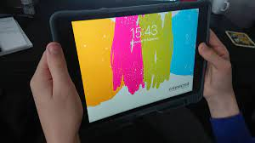
We have our iPad build on Thursday, where children will receive their one to one devices. Please remind children to come to school with their iPad fully charged and with their charger if needed.
iPads

Slide 22
We will use a variety of teaching approaches to teach the curriculum:
Active learning
Outdoor learning
Cooperative learning
Digital technologies
Self and peer assessment
Transferring learning across the curriculum
Interdisciplinary learning – child led topics
Curriculum for Excellence

Slide 23
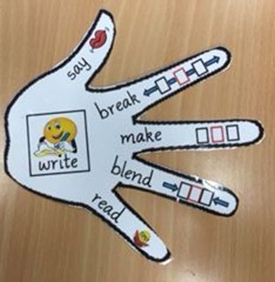
We will be following the Active Literacy spelling programme. Children will receive new spelling words each week. These will be uploaded onto Teams.
Strategies:
elkonin boxes
dictation
active spelling (play-doh, scrabble tiles etc.)
say/make/break/blend/read/write
Westquarter Phonics Chart
Literacy - Spelling
s | ch | oo | l

Slide 24
We are currently reading our class novel study – The Explorer by Katherine Rundell. We are working on different reading strategies:
Metalinguistics (tricky & unfamiliar words)
Visualisations (using information to help create images)
Comprehension (understanding)
Inference (meaning behind)
Summarising (main events)
The children will be allocated their home readers on Bug Club over the next few weeks – please encourage your children to read at home
Literacy - Reading

Slide 25
We will be following Talk for Writing to teach writing this year
This involves a 3 stage process:
Imitation – pupils learn and internalise texts to identify transferrable ideas and structures
Innovation - children use these ideas to co-construct a new version of the learned text
Invention – pupils create their own version of the text
We will cover a variety of texts throughout the year
We will use an ‘always toolkit’ a list of what children are expected to include in all pieces of writing
VCOP - is used to develop the quality of writing and success criteria is normally linked to an aspect of this.
Vocabulary (Wow words) Connectives Openers Punctuation
Literacy - Writing

Slide 26
We will be revisiting some prior learning and focusing on place value for the start of this term.
Over the year we will cover:
Whole number
Fractions, decimals and percentages
Algebra
Money, time and measure
Shape, position and movement
Maths

Slide 27
Children will have a lot of active maths experiences as well as work on whiteboards, textbooks, iPad games etc.
Children will also have daily mental maths lessons which will consolidate and reinforce previous taught concepts as well as improving their mental agility, efficiency and flexibility.
We will also focus on various maths vocabulary.
I would please encourage you to reinforce concepts taught as children are more likely to make connections if concepts are related to real life experiences (Haylock. 2014)
Maths

Slide 28
IDL – Interdisciplinary Learning
Child led topics that cover multiple curricular areas
The children will complete a KWL grid to help plan the topic
What I know
What I want to know
What I have learned
Our first topic is a comparative study of Scotland and Brazil
IDL

Slide 29
Marking is linked to our success criteria.
Learning intentions will be shared with children in each lesson, and where possible they will construct the success criteria
We will mark using self assessment, peer assessment and teacher assessment
Spelling will not always be corrected in writing if this is not the main focus
Tickled Pink and Green for Growth
Marking

Slide 30
A class teams will be set up over the next few weeks
Weekly spelling will be uploaded here
Children can practise at home if they wish to do so
Children will have access to Active Learn and Education City
Content will be uploaded throughout the year
Reading for pleasure – encourage your child to read a variety of genres and authors
Helping at Home

Slide 31
Phonics – another name for the learning of “sounds”
Phoneme – a single unit of sound, e.g. ‘c’ in cat.
Grapheme – the written letter
Blending – stretching out each individual sound so that it almost runs into the next, e.g. c-a-t = cat.
Number bond - two numbers that go together to make another number, e.g. 70+30=10 (this is called a ‘number bond of 100’)
Learning intention – the purpose of our lessons
Success criteria – the things we need to do to meet our Learning intention
VCOP – Vocabulary, Connectives ,Openers, Punctuation
KWL- what we know, what we want to know and what we have learned.
Glossary

Slide 32
Thank you so much for popping in to meet with me today.
I am really looking forward to working in partnership with you all to meet the best outcomes for your child.
All the class have settled in excellently to Primary 6 and I am looking forward to seeing them grow and progress.
Thank you

