Slide 1
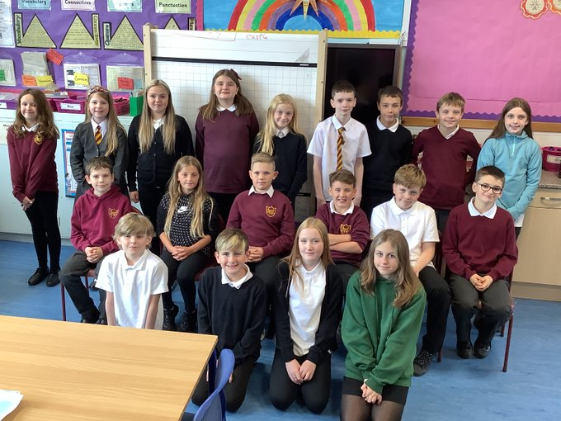
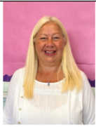
Meet the Teacher, Miss McKee ☺
Welcome to Primary 7
2022/2023

Slide 2
P.7 are encouraged to take responsibly for their own learning. ☺
If you don’t want to learn, no one can make you.
If you want to learn, no one can stop you.

Slide 3
Primary 7 Expectations:
Display a high level of resilience and independence
Show an understanding of the importance of education by being focused, hardworking and determined to achieve

Slide 4
What will be we focusing on for the first few weeks?
Settling back into school
Literacy
Numeracy
Health & Wellbeing (including Emotion Works – see next slide)
The Rights of the Child (UNCRC) – Unicef UK
Creating a supportive and fair environment in which to work
Becoming familiar with the expectations of being in Primary 7
Challenging ourselves and supporting others

Slide 5
Emotion Works
We are continuing to use the Emotion Works programme which enables children to develop their understanding of the wide range of emotions, reasons for feeling these emotions and regulation strategies to cope with the emotions. The skills learned through this programme will be life long.

Slide 6
The Rights of the Child (UNCRC) – Unicef UK
Westquarter Primary is a Rights Respecting School.
Class Charter
We have been revising the Rights of the Child and choosing which ones relate most closely to school.
From there we discussed the various Articles and voted for our top 6 which would form the basis of our class charter.
Lastly, we had to look at what children and adults would have to do to adhere to the articles.
Watch out on Twitter for our finished charter!

Slide 7
Positive Behaviour Management
Our school values ensure the best possible environment for everyone in which to learn.
Ready,
Respectful & Safe

Slide 8
Positive Behaviour Management

Slide 9
Home/School Links
Please contact the school by email or phone to:
- let us know about absences
- alert school/teacher of appointments
- inform us of issues that may impact your child’s day
- messages/questions for teacher etc.
Twitter: P7 and Miss McKee@P7Westquarter
Gym kit (Monday/Tuesday(alternate) and Friday)
Children are responsible for their own property.
Please use Ipay to order meals or to show that your child will be bringing a packed lunch from home.

Slide 10
Terms used in P.7
We use many specific words/phrases in school which your child should be able to explain to you. e.g.
phoneme – a single unit of sound, e.g. ‘ay’ in holiday.
Up-levelling – using VCOP (Vocabulary, Connective, Openers & Punctuation) to improve a piece of writing.
Metacognition – thinking about thinking, e.g. understanding how you think / learn
Visualisation – the picture that you create in your head when you read a text
Metalinguistics – focusing on words and their meanings
Mental strategies – techniques to help with completing mental calculations
Comprehension – showing understanding of a text
Inference – reading between the lines / looking for deeper meaning in a text

Slide 11
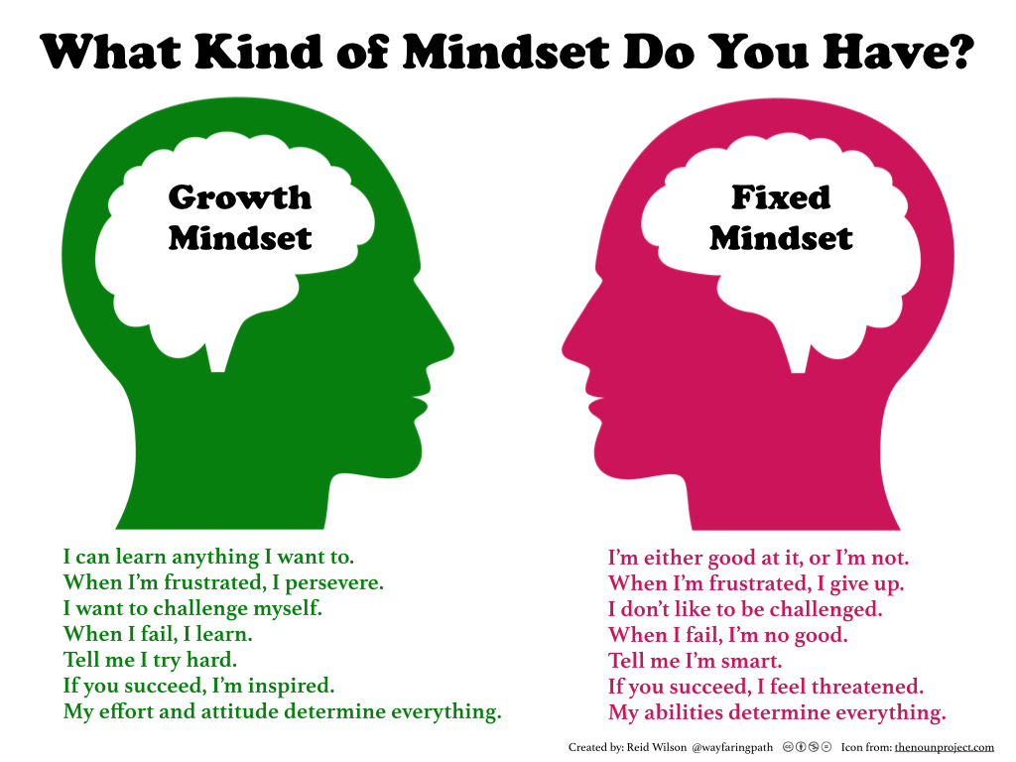
Growth Mindset

Slide 12
Covid Changes
We are in a bit of a transition period with covid restrictions. Most restrictions have been lifted, but for now, our Meet the Teacher evening will remain online. Hopefully it won’t be long before we can meet in person again. ☺

Slide 13
Some Things Never Change!
Although there are still some changes in place, our values, ethos and commitment remain the same.
It’s great to be all together, learning as a class!
Westquarter Primary School: Where People Smile ☺

Slide 14
Time to Talk
We aim to develop a wonderfully supportive ethos in our classroom, so children can feel comfortable with sharing stories or news with the teacher/class in front of others
If a quiet chat is what’s needed, children know that they can speak to me in a quieter space within the room, outside the room, or wait back at playtime and have the opportunity to speak with me more privately then.

Slide 15
High School Transition
Cluster transition activities, events and work take place throughout Primary 7. These can be in the form of visits from high school staff, sporting events, debates, producing set writing pieces, Francophonie and visits to high school at the end of the year.
Graeme High School is our cluster high school, so most of our transition work is done with them, however, we also work closely with other high schools e.g. Braes, to ensure a well organised transition for all children.
We will be working hard in class so that we will be prepared for our move to high school next summer.☺

Slide 16
Class of 2022/2023

